Slide 1
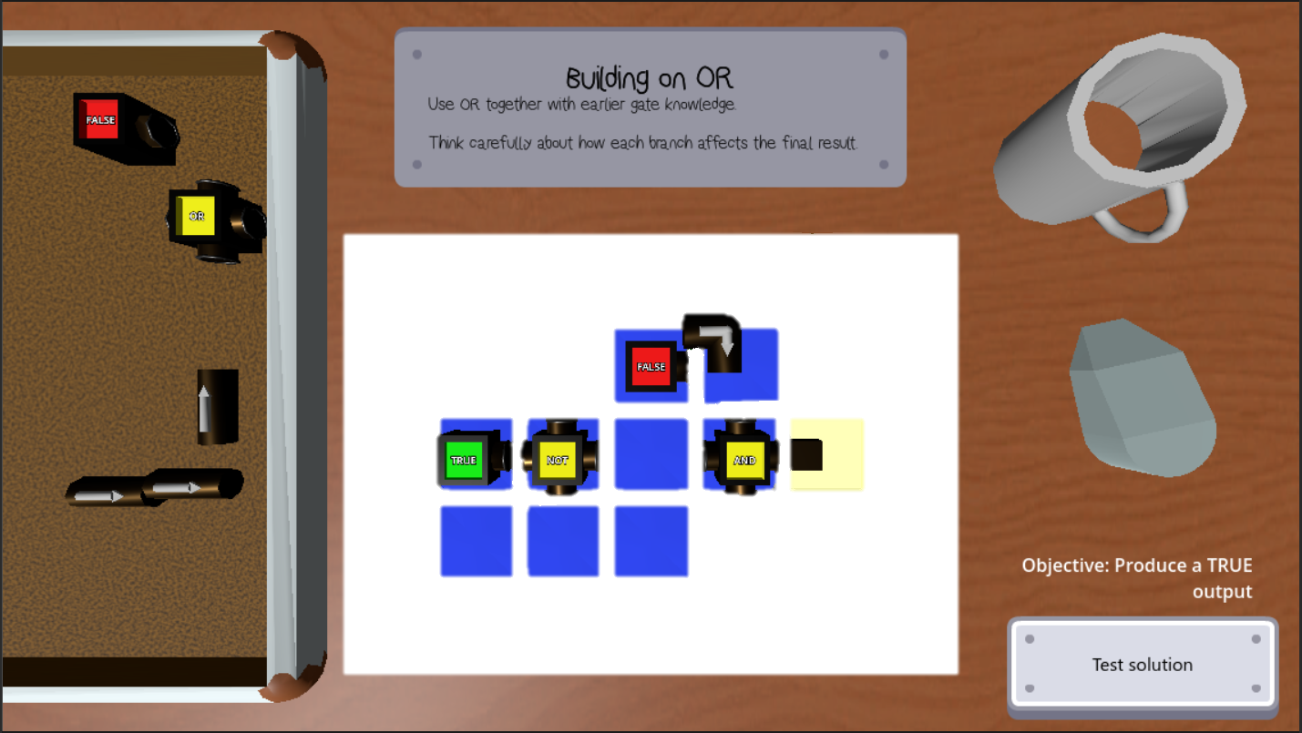

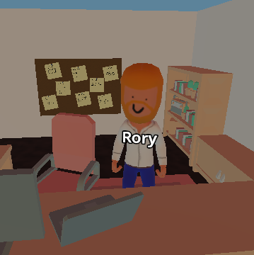
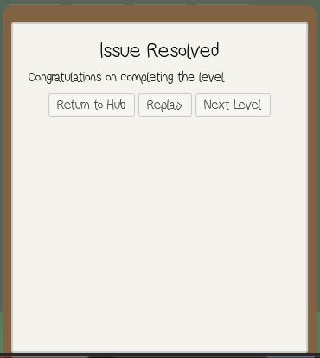




Project Mismanagement
Meet Rory, your new boss.
He’s in charge of an office full of broken systems, so naturally, it's your problem now. Your role is to use digital logic and problem-solving skills to bring order to this chaotic office.
For now…
You’ve completed the puzzle, fixed the latest office problem, you should enjoy the moment!
At least until Rory turns up with the next disaster for you to fix!
At least now you are prepared to tackle much more complex problems with your new skills.
Future development:
The current prototype focuses on introducing logic concepts through structured puzzle levels. Future development would expand on this into advanced, multi-stage circuits, larger puzzles and increasingly complex combinations of logic components.
Game concept
A 3D puzzle game where the player acts as an IT technician fixing bizarre office systems through logic-based challenges.
Main mechanic
Players build circuits on a grid using signal blocks, connectors, and logic gates to produce a target output. On testing a solution, signals propagate through the system and gates evaluate the result. Correct outputs complete the puzzle, while incorrect ones encourage iteration and experimentation.
Intended audience
Designed for beginners and students, the project aims to make digital logic more approachable through interactive play rather than static explanation.
Oliver Cole – 10859527 – oliver.cole@students.plymouth.ac.uk
BSc (Hons) Computer Science (Games Development)

