Slide 1

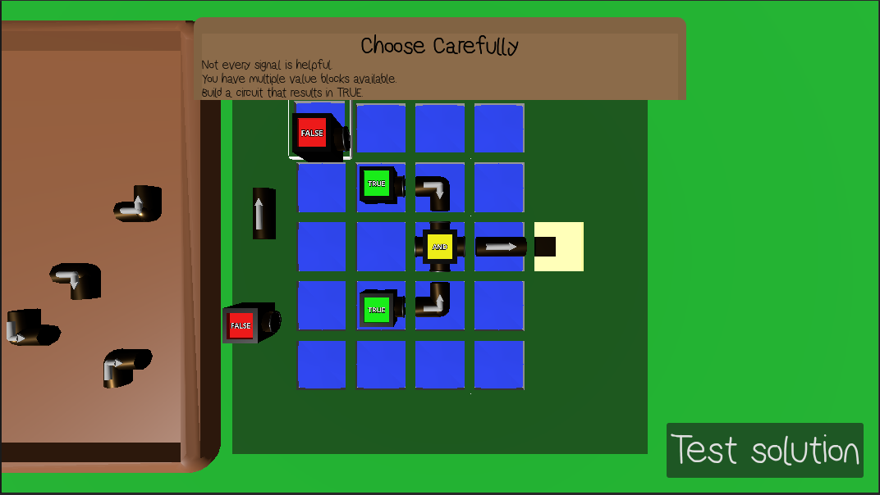
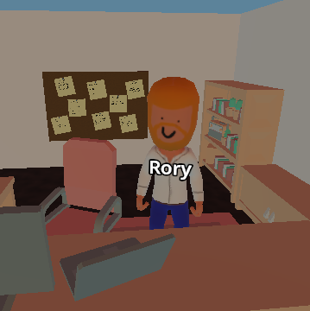
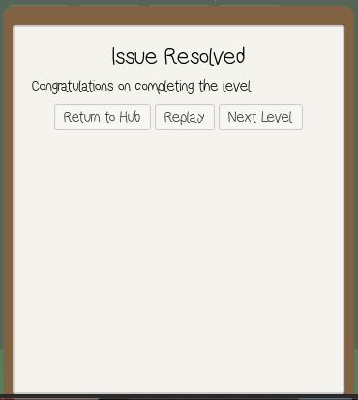


Project Mismanagement .
Meet Rory, your new boss.
He’s in charge of an office full of broken systems, so naturally, it's your problem now. Your role is to use digital logic and problem-solving skills to bring order to this chaotic office.
Workplace chaos, solved through logic (gates)
Implemented gate types:
AND
NOT
OR
NAND
NOR
XOR
XNOR
For now…
You’ve completed the puzzle, fixed the latest office problem, you should enjoy the moment!
At least until Rory turns up with the next disaster for you to fix!
At least now you are prepared to tackle much more complex problems with your new skills.
Future development:
The current prototype focuses on introducing logic concepts through structured puzzle levels. Future development would expand on this into advanced, multi-stage circuits, larger puzzles and increasingly complex combinations of logic components.
The central gameplay mechanic is a grid-based puzzle system in which the player places signal blocks, connectors and logic modules to create a functioning circuit. Each level presents a desired outcome and requires the player to arrange components so that the correct values to reach the output node. This transforms digital logic from an abstract concept into an interactive activity.
When the player selects test solution, signal propagation begins. Value blocks emit their binary signal into the circuit, while connectors carry the signal through the grid to the logic components. These evaluate the signals according to their gate type before passing the signal onwards to the output slot. If the signal matches the outputs slot’s required value, the puzzle is completed. If not, then the player gets to change their layout and try again, encouraging experimentation and puzzle-solving skills.
Oliver Cole oliver.cole@students.plymouth.ac.uk
BSc (Hons) Computer Science (Games Development)

