Slide 1
How to design for AR/VR

Slide 2
Designing for AR/VR Mentality
Break the mold
“first-person design” (non-linear, immersive)
The way things look and sound can affect how the audience feels
Something unfamiliar can throw us out of the immersion (eg. Spatial awareness)
Get a feel for what it’s like in AR/VR
Start designing in AR/VR as soon as possible

Slide 3
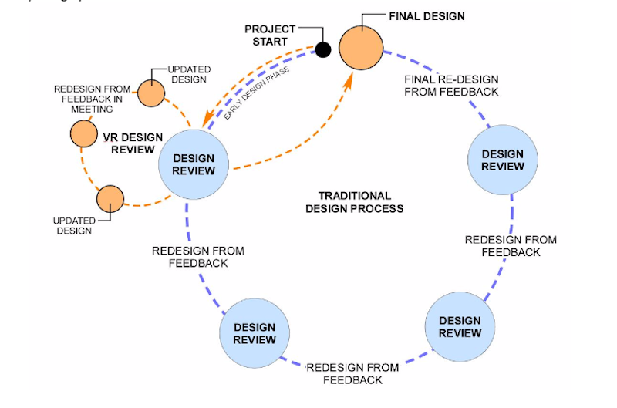
Designing for AR/VR Process
Wireframes
Visual Design
Blueprint
App design (how to navigate to the experience)
Experience design (how to navigate within the experience)

Slide 4
Designing for AR/VR Technical side
Unity
Google VR SDK
Daydream VR
Mozilla A-Frame
Canvas size is determined by device size
eg. 360 view: 3600x1800px, UI view: 1200x600px

Slide 5
Designing for AR/VR Technical side
Unity
Google VR SDK
Daydream VR
Mozilla A-Frame
Canvas size is determined by device size
eg. 360 view: 3600x1800px, UI view: 1200x600px

Slide 6
Designing for AR Marketing Push
Learn and respond to the user’s social rhythm
Compliment and enhance social rhythm without needing constant tweaks
Use opt-in instead of all in
Listen to behavioral cues to interpret interest
Flow of engagement:
Discover -> Focus -> Engage -> Experience -> Exit
2 kinds of engagement
Push notifications
Out of home marketing (built on top of physical ads)

Slide 7
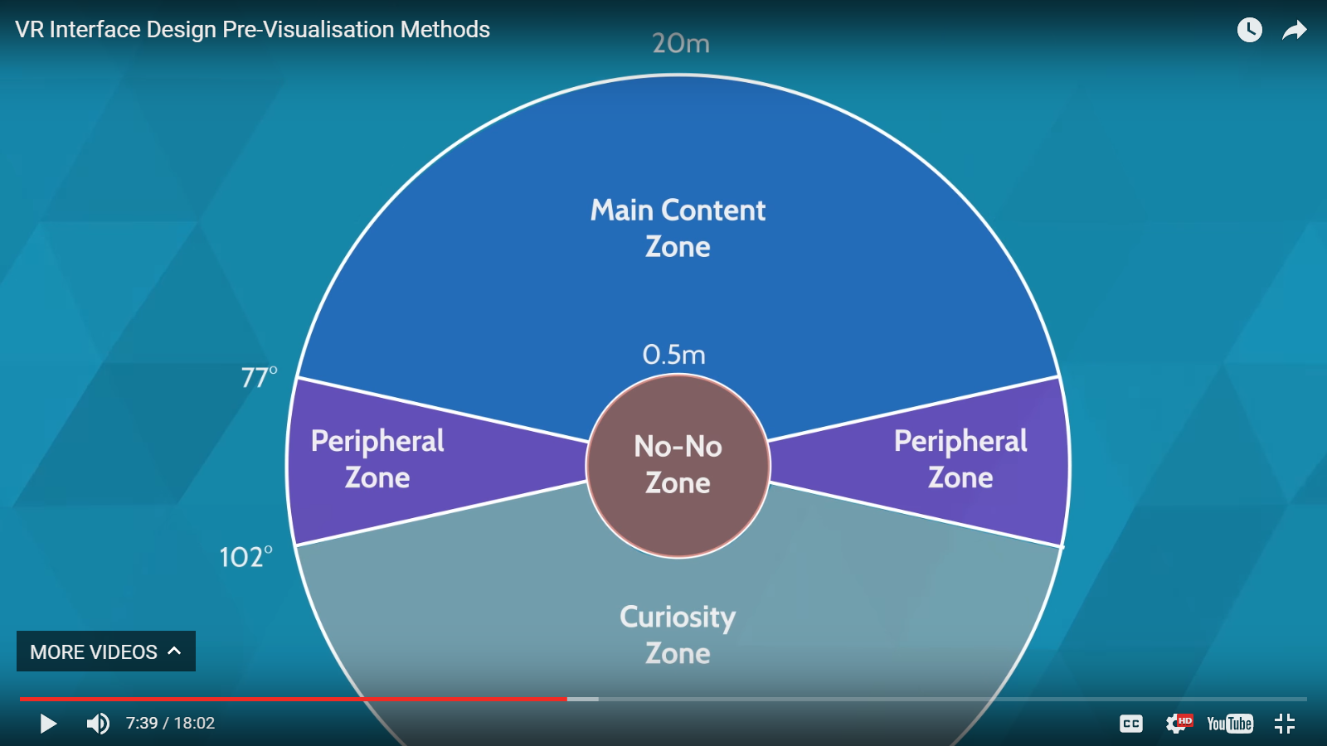
Comfortable and meaningful
Main Content and UI Zone vision zone

Slide 8
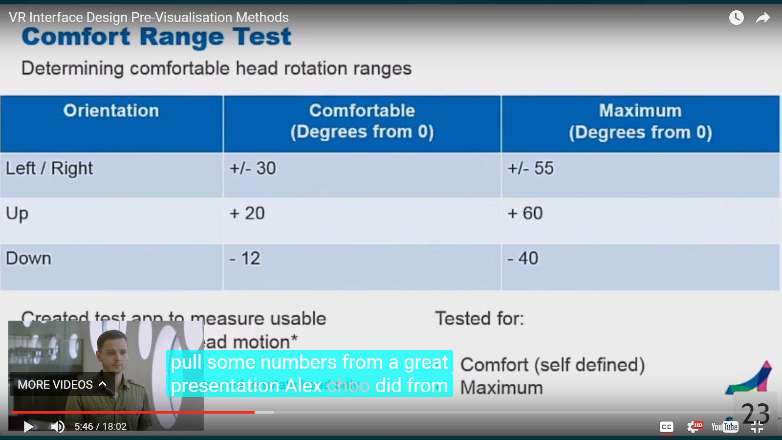
Comfortable and meaningful
Main Content and UI Zone vision zone

Slide 9
Comfortable and meaningful
How to avoid nausea
Don’t move the horizon line (in VR)
Never change the environment against the head movement (in VR)
Don’t animate movement through a space, just teleport the user.
Anchor objects as point of reference
MINIMUM 60FPS. Aim for 90FPS

Slide 10
Comfortable and meaningful
How to direct and redirect attention:
Lights
Arrows
Holophonic sound (3d sound)
Viewport (curiosity)

Slide 11
Resources
http://www.uxofvr.com/ (Super super useful)
http://realityshift.io/blog/ui-ux-design-patterns-in-virtual-reality
http://blog.proto.io/3-steps-towards-designing-arvr/
http://blog.invisionapp.com/designing-for-vr-ar/
http://blog.usabilla.com/vr-ar-mr-designing-new-reality/
https://www.bdcnetwork.com/enhancing-healthcare-facility-design-vrar
https://www.developer-tech.com/news/2017/apr/13/google-explains-how-design-optimal-vrar-experiences/
https://www.developer-tech.com/news/2017/apr/13/google-explains-how-design-optimal-vrar-experiences/

