Slide 1

Hapticus Intro June 2016
E: mailus@hapticus.com
P: +65 6635 8852
M: +65 9825 2400
Enhancing people’s lives on the move
Virtual transportation hub

Slide 2

ABOUT HAPTICUS
Proprietary and Confidential
Enhancing people’s lives on the move
An established Singapore based technology company
The Vision
provide a set of tools for smart management of transportation in megacities over web and mobile platforms, with a strong emphasize on POSITIVE SOCIAL IMPACT for sectors with special needs
The Product
a virtual transportation hub for sectors with special needs, in operation since year 2012
2
Notes:
2

Slide 3
Proprietary and Confidential
THE TEAM
Enhancing people’s lives on the move
AMIR NIVY, Founder, CEO
Technopreneur, over 15 years in the High-tech and start-up scene both in Israel and Singapore
SHAY ALMOG, Co-Founder, Strategic Business development
Seasoned executive and business development lead, Legal background (Corporate Law)
ADAM SLATER, Director
Deputy Group CEO, CWT Ltd
PROF. MICHAEL LI, Transport economist, Senior Advisor
Associate professor, Business School at NTU, Singapore.
Transport Economics, founding Director of the Nanyang Executive MBA Programme.

Slide 4






The Ecommuter- A Virtual Transportation Hub
Proprietary and Confidential
Enhancing people’s lives on the move
Ecommuter Smart Core
Demand
Commuters
Organizations
Supply
Fleets-
Admin
Drivers
Individual Drivers
a novel solution, operating in a complex environment, seamlessly bridging the supply-demand gap
4
Notes:
4

Slide 5

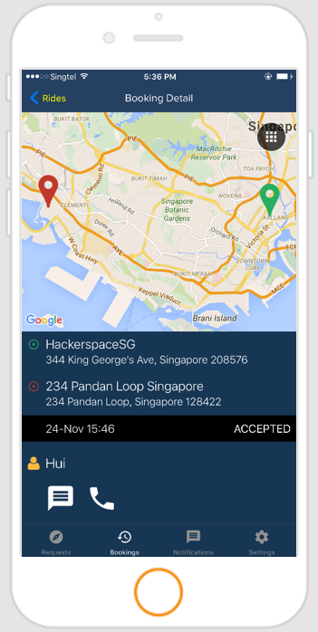

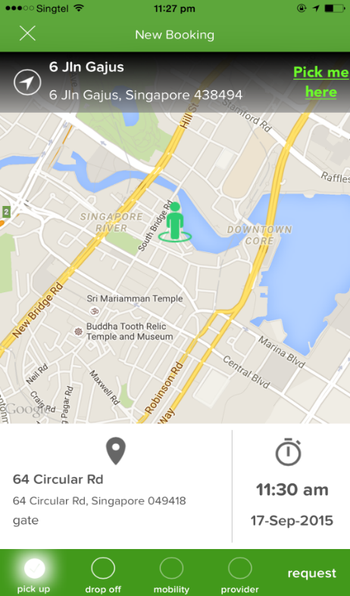
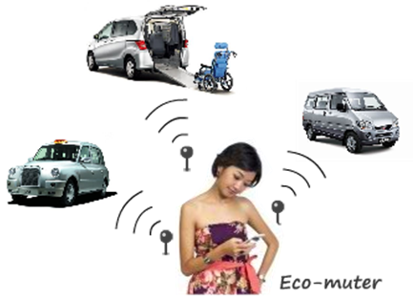
Proprietary and Confidential
The product-
Enhancing people’s lives on the move
a suite of Cloud based
Mobile and Web applications
Booking rides at a click of a button

Slide 6
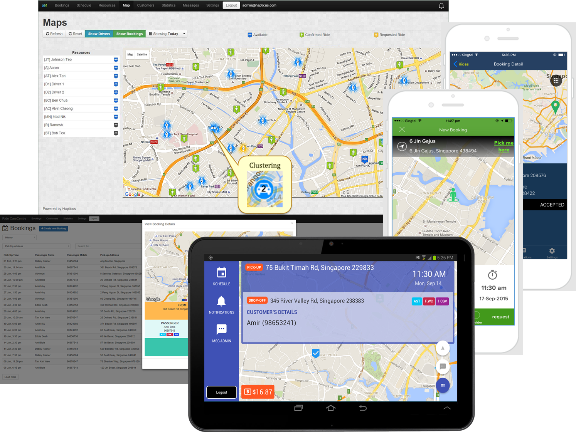
Proprietary and Confidential
The product-
Enhancing people’s lives on the move
a suite of Cloud based Mobile and Web applications

Slide 7
The product-
Proprietary and Confidential
Enhancing people’s lives on the move
A Virtual transportation hub for sectors with special and complex needs
Uniting the existing service providers under one virtual digital hub
Adding a massive fleet of individual drivers to make a difference
Providing the passengers and their supporting environment with a ride booking and management tool customized for their needs
Advanced booking in nature, providing commuters with multiple ride options, and ride management and visibility for Fleets and Drivers
7
Notes:
7

Slide 8
System capabilities & Advantages
Proprietary and Confidential
Enhancing people’s lives on the move
The Ecommuter is a complex and robust eco-system
System is in operation since 2012
Successfully passed 3rd party functional, load and Pen tests
The system is build to cater for National level scale
The system was adopted by a Major body catering for the sector of people with special needs in Singapore
8
Notes:
8

Slide 9
Proprietary and Confidential
Enhancing people’s lives on the move
THANK YOU
E: mailus@hapticus.com
P: +65 6635 8852
M: +65 9825 2400
9

