Slide 1
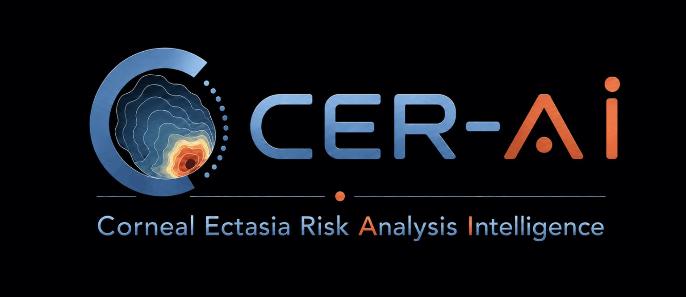
Preoperative corneal ectasia risk assessment
Program logic, canonical rules, and clinical workflow
Physician presentation | 15 September 2026
Developer and Clinical Lead: Hüseyin Cengiz, M.D.
Notes:
CER-AI kurum içi kanonik spesifikasyonu, 15 Eylül 2026. Ürün tanımı: https://cer-ai.com/

Slide 2
The clinical challenge of preoperative screening
Postoperative ectasia is uncommon, but its visual consequences can be severe
Core question
Is this cornea safe for this procedure?
No single index is sufficient
Topography, tomography, tissue load, and clinical history reveal different dimensions of risk.
Procedure eligibility can differ in the same eye
Flap, epithelium, ablation depth, and procedure-specific rules can separate the LASIK and PRK decisions.
Uncertainty is also a result
If critical data cannot be read, the system does not treat it as normal. It requests surgeon confirmation or data completion.
CER-AI | Clinical presentation for physicians
02
Notes:
Genel klinik çerçeve: Randleman JB et al. Am J Ophthalmol. 2008;145:813-818. DOI:10.1016/j.ajo.2007.12.033. Santhiago MR et al. Am J Ophthalmol. 2014;158:87-95. PMID:24727263.

Slide 3
What is CER-AI?
A clinical decision-support platform that combines Pentacam data, clinical information, and procedure planning within one controlled chain
Independent risk pathways
ERSS, Final BAD-D, NICE, and PS3 remain separate, each with its own inputs and results.
Procedure-specific safety
RSB, RST, PTA, treatment range, and predicted postoperative K form separate safety gates.
Auditable report
The source, calculation, threshold, triggered reason, and surgeon-confirmed field remain visible.
The final decision and responsibility belong to the surgeon
CER-AI | Clinical presentation for physicians
03
Notes:
Ürün çerçevesi: https://cer-ai.com/ (How CER-AI Works ve Clinical philosophy bölümleri). CER-AI kanonik spesifikasyonu, 15 Eylül 2026.

Slide 4
End-to-end assessment workflow
Each stage protects data integrity before the next stage begins
01
02
03
04
05
Clinical data
Images
Source verification
Risk analysis
Report
Age, history, manifest refraction, and intended correction
Five mandatory Pentacam images
Laterality, date, QS, and field source
ERSS, BAD-D, NICE, PS3, and tissue calculations
Reasoned result by eye and procedure
If critical data are missing or conflicting, the workflow stops and requests surgeon confirmation
CER-AI | Clinical presentation for physicians
04
Notes:
CER-AI kullanım akışı: https://cer-ai.com/ (Using CER-AI). CER-AI kanonik spesifikasyonu, 15 Eylül 2026.

Slide 5
Mandatory images and clinical inputs
Five images
Surgeon entries
OD
4-MAPS Refractive
Identity and age
Same examination and correct laterality
Patient name, patient ID, age, and assessment date.
OS
4-MAPS Refractive
Same examination and correct laterality
Refraction and intended correction
Manifest and intended values are entered separately and normalized.
OD
BAD Display
Same examination and correct laterality
Procedure plan
OS
BAD Display
PRK or LASIK, OZ, TZ, flap thickness, and actual maximum ablation when available.
Same examination and correct laterality
Both eyes
Topometric, Show 2 exams
Clinical modifiers
Stability, eye rubbing, family history, and connective tissue disease.
The treatment card is optional. Without it, the surgeon enters the manifest and intended correction.
CER-AI | Clinical presentation for physicians
05
Notes:
CER-AI kanonik görüntü seti ve zorunlu girişler, 15 Eylül 2026. Kullanım kılavuzu v1.4 yalnız iş akışı için yardımcı kaynak olarak incelendi; eşiklerde güncel kanonik spesifikasyon esas alındı.

Slide 6
Source-locked Pentacam data map
Each measurement comes from one authoritative field
Parameter | Authoritative source
K1, K2, Km | Topometric, Cornea Front table
Kmax, ARTmax | Defined Kmax and ARTmax boxes
Thinnest and pupil-center pachymetry | Thickness Map: thinnest-location circle and pupil-center + marker
HWTW | 4-MAPS Refractive, lower left
Front / back elevation | BAD Display: F.Ele.Th / B.Ele.Th only
I-S | Topometric, Show 2 exams
Axes | BAD Axis = flat axis; 4-MAPS Axis steep = steep axis
Purpose: prevent one concept from being read from different screens and producing conflicting values
CER-AI | Clinical presentation for physicians
06
Notes:
CER-AI kanonik Pentacam extraction policy, 15 Eylül 2026. Kaynak kilitleme CER-AI'ye özgü yazılım kuralıdır.

Slide 7
Data integrity and uncertainty management
Check | System behavior
QS | Non-OK quality produces a visible warning. Clinical review is required.
Unreadable value | Up to 5 rereads. The region is marked. Surgeon entry is requested.
Conflicting value | No silent preference is applied. The source and conflict are documented in the report.
Age | One field is used. Entered age overrides the derived value.
Prior PRK/LASIK/SMILE | The virgin-cornea engine is blocked.
Cylinder | Axis is required when cylinder is nonzero. Plus-cylinder entry is normalized.
Rule: unreadable or missing critical data are never treated as zero or normal
CER-AI | Clinical presentation for physicians
07
Notes:
CER-AI kanonik veri güvenliği ve retry policy, 15 Eylül 2026. Kullanıcı girişi görüntüden türetilen değeri geçersiz kılabilir; raporda kaynak görünür kalır.

Slide 8
Canonical decision engine
One authoritative chain for each concept
Source
Extraction
Calculation
Threshold
Result
Defined image region
One reading method
One formula
One versioned rule
One reported rationale
Prohibited patterns
Clinical benefit
Keeping old thresholds in parallel
Changing decisions through wrappers or monkey patches
Results that depend on import order
Multiple report fields for the same concept
The same data and version produce the same decision. The reason for the result remains traceable.
CER-AI | Clinical presentation for physicians
08
Notes:
CER-AI canonical engine policy, 15 Eylül 2026. Bu mimari CER-AI'nin kurum içi güvenlik ve tutarlılık standardıdır.

Slide 9
Independent risk channels
A normal channel does not override a stopping finding in another channel
Channel | Core question | Effect on result
ERSS | What is the classic LASIK risk profile? | Score and topography class remain visible
Final BAD-D | Is tomographic deviation present? | Independent normal, suspicious, or abnormal class
NICE | Is cumulative risk present across defined tomographic components? | Its own score and component review
PS3 | Does risk differ by procedure? | LASIK, PRK, and SMILE results may differ
Tissue safety | Does the plan leave sufficient stromal reserve? | Safety gate independent of the scores
CER-AI does not produce one opaque aggregate score
CER-AI | Clinical presentation for physicians
09
Notes:
CER-AI Evaluation Framework: https://cer-ai.com/ lines 19-59. ERSS, BAD-D, NICE, PS3 ve doku güvenliği matematiksel olarak tek skorda birleştirilmez.

Slide 10
Randleman ERSS channel
The classic LASIK risk profile remains independent within CER-AI
Component | CER-AI source / rule
Anterior topography | 4-MAPS anterior curvature or verified I-S
RSB | Thinnest CCT − flap − maximum ablation
Age | 18 = 3; 19–20 = 2; ≥21 = 0
CCT | <480 STOP; 481–509 = 2; 510–511 = 1; ≥511 = 0
Manifest MRSE | Manifest sphere + cylinder / 2
ERSS result
0–2 PASS
3 CAUTION
≥4 STOP
BAD-D or NICE does not replace the ERSS topography score
CER-AI | Clinical presentation for physicians
10
Notes:
Randleman JB, Trattler WB, Stulting RD. Validation of the Ectasia Risk Score System for Preoperative LASIK Screening. Am J Ophthalmol. 2008;145:813-818. DOI:10.1016/j.ajo.2007.12.033. CER-AI yaş ve CCT dilimleri güncel kanonik spesifikasyondur.

Slide 11
Final BAD-D and NICE channels
Final BAD-D
CER-AI adapted NICE
The authoritative value is the Final BAD-D result in the BAD Display. Subcomponents provide supporting context.
It evaluates defined inputs such as K2, pachymetry, posterior elevation, and I-S as separate components.
NORMAL
SUSPICIOUS
ABNORMAL
4 NO ADDITIONAL ESCALATION
5–8 CAUTION
≥9 STOP
The report shows the numeric value together with the application's versioned class. The deployed threshold is verified before clinical use.
NICE 4 alone does not establish surgical safety. Other channels and tissue safety remain independent.
CER-AI | Clinical presentation for physicians
11
Notes:
BAD-D genel klinik bağlamı: Bamdad S et al. Sensitivity and Specificity of Belin Ambrosio Enhanced Ectasia Display. 2020. PubMed: https://pubmed.ncbi.nlm.nih.gov/ . BAD-D sayısal eşikleri bu sunumda sabitlenmemiştir; deployed sürümün sınıflandırması doğrulanmalıdır. NICE sınıfları: CER-AI kanonik spesifikasyonu, 15 Eylül 2026.

Slide 12
PS3: procedure-sensitive risk channel
PS3 highlights findings that can produce different results for LASIK and surface ablation in the same cornea
Field | Canonical interpretation
I-S | −1.00 to −0.50 ABT; −0.50 to +0.50 normal; +1.01 to +1.39 inferior steepening; ≥+1.40 KCN suspect STOP
SRAX | Axis steep from 4-MAPS anterior curvature only; >20° skewed
Manifest axis comparison | The transposed plus-cylinder axis is used; active only when manifest astigmatism is ≥3.00 D
Surgeon modifiers | Eye rubbing and family history create CAUTION; collagen/connective tissue disease creates STOP/DEFER
One PS3 caution finding may defer LASIK while leaving PRK open to surgeon assessment
CER-AI | Clinical presentation for physicians
12
Notes:
CER-AI PS3 kanonik kuralları, 15 Eylül 2026. I-S işareti klinik olarak kritiktir: negatif değer inferior steepening olarak yorumlanmaz. SRAX kaynağı 4-MAPS Axis steep alanıdır.

Slide 13
PS3 risk level and procedure decision
Findings are converted first into a risk level, then into procedure eligibility
PS3 field | Normal | Moderate | High
Km | <48 D | 48-50 D | >50 D
Thinnest CCT | >500 µm | 470-500 µm | <470 µm
PPI Avg | ≤1.20 | >1.20 | -
Astigmatism / axis | No threshold exceeded | >1.00 D or axis difference >10° | -
SRAX | ≤20° | - | >20°
Inter-eye asymmetry | 0-3 criteria | 4 criteria | 5 criteria
Composite PS3 result
NORMAL
0 moderate, 0 high
LASIK + PRK + SMILE eligible
MODERATE
1 moderate, 0 high
LASIK DEFER
PRK + SMILE eligible
HIGH
≥2 moderate or ≥1 high
LASIK + PRK + SMILE DEFER
Regardless of the PS3 result, thinnest CCT <480 µm creates an independent hard stop
CER-AI | Clinical presentation for physicians
13
Notes:
CER-AI PS3 kanonik kriterleri: Km <48 normal, 48-50 orta, >50 yüksek; en ince CCT >500 normal, 470-500 orta, <470 yüksek; PPI Avg ≤1.20 normal, >1.20 orta; astigmatizma büyüklüğü >1.00 D veya tanımlı aks farkı >10° orta; SRAX >20° yüksek; tanımlı beş gözler arası asimetri ölçütünden 0-3 normal, 4 orta, 5 yüksek. Prosedür kuralı: 0 orta/0 yüksek tüm prosedürlere izin verir; tek orta LASIK'i erteler, PRK ve SMILE'i açık bırakır; iki orta veya tek yüksek tüm prosedürleri erteler. Global en ince CCT <480 µm hard stop kuralı PS3'ten bağımsızdır.

Slide 14
Tissue safety calculations
Calculations are performed by eye and procedure
Calculation | Formula | CER-AI limit
LASIK RSB | CCT − flap − ablation | <300 µm STOP
PRK RST | CCT − 50 µm epithelium − ablation | <310 µm STOP
LASIK PTA | (flap + ablation) / CCT × 100 | ≥40% FAIL
PRK PTA | (50 µm + ablation) / CCT × 100 | ≥40% FAIL
Postop Km | Preop Km + 0.8 × intended MRSE | 36–48 D
Estimated ablation
For the Alcon EX500, OZ values of 6.0 / 6.5 / 7.0 mm use 12 / 15 / 16.33 µm/D, respectively. When an actual laser plan is available, that value takes priority.
CER-AI | Clinical presentation for physicians
14
Notes:
PTA literatürü: Santhiago MR et al. Association Between the Percent Tissue Altered and Post-LASIK Ectasia in Eyes With Normal Preoperative Topography. Am J Ophthalmol. 2014;158:87-95. PMID:24727263. CER-AI RSB/RST/PTA ve EX500 katsayıları: kanonik spesifikasyon, 15 Eylül 2026.

Slide 15
Hard stops and procedure restrictions
Rule | Limit | Result
Thinnest CCT | <480 µm | STOP/DEFER
LASIK RSB | <300 µm | LASIK STOP
PRK RST | <310 µm | PRK STOP
PTA | ≥40% | Plan FAIL; B and C are tried, followed by STOP/DEFER if failure persists
Treatment range | Myopia >10.00 D or hyperopia >+6.00 D | STOP
Postop Km | Below 36 D or above 48 D | STOP
Prior refractive surgery | History of PRK, LASIK, or SMILE | Virgin-cornea engine blocked
Connective tissue disease | Collagen/connective tissue disease | STOP/DEFER
A threshold value differs from a value below it: CCT of 480 µm alone does not create a STOP
CER-AI | Clinical presentation for physicians
15
Notes:
CER-AI hard-stop policy, 15 Eylül 2026. Sınırlar programın sürümlü operasyonel kurallarıdır; literatürün tek ve evrensel eşikleri olarak sunulmamalıdır.

Slide 16
Safe plan search using Plans A, B, and C
Plan A
Plan B
Plan C
Requested initial plan
Selected when all safety gates pass
More conservative parameters
Tried automatically if A fails
Final safe alternative
STOP/DEFER if C also fails
ML7 hinge planning
When ΔK ≥4 D, the hinge is planned perpendicular to the flat meridian. A superior hinge is considered for a vertical flat meridian, and a temporal or nasal hinge for a horizontal flat meridian. If anatomy prevents a superior hinge, the surgeon may consider temporal/nasal placement with the +10 blade option when PTA and RSB remain acceptable.
CER-AI | Clinical presentation for physicians
16
Notes:
CER-AI Plan A/B/C ve ML7 planning policy, 15 Eylül 2026. Plan raporu flep, OZ ve TZ tanımlarını açıkça göstermelidir.

Slide 17
Final classification logic
Hard stops first, followed by the number of cautions across independent channels
Status | Rule | Report color
PASS | No caution; all mandatory safety gates passed | Green
PASS WITH CAUTION | One independent caution | Orange
CAUTION | Two or more cautions | Orange
STOP/DEFER | Any hard stop or unresolved critical safety barrier | Red
Each eye is assessed separately. The overall result is determined by the less favorable eye or a global safety gate. Values are not averaged between eyes.
CER-AI | Clinical presentation for physicians
17
Notes:
CER-AI risk aggregation policy, 15 Eylül 2026: bir caution = PASS WITH CAUTION; iki veya daha fazla caution = CAUTION; herhangi bir stop = STOP/DEFER.

Slide 18
Example: LASIK deferred; PRK eligible
One cornea, two biomechanical procedures
Input | Value
Age / thinnest CCT | 29 years / 505 µm
Maximum ablation | 60 µm
LASIK flap | 100 µm
LASIK RSB / PTA | 345 µm / 31.7%
PRK RST / PTA | 395 µm / 21.8%
Ectasia channels | BAD-D normal, NICE 4, one moderate PS3 finding
LASIK
DEFER
PS3 procedure effect
PRK
PASS WITH CAUTION
Tissue gates passed
This example is for education and does not contain real patient data
CER-AI | Clinical presentation for physicians
18
Notes:
Sentetik vaka. Hesaplar: LASIK RSB=505-100-60=345 µm; LASIK PTA=(100+60)/505=31.7%; PRK RST=505-50-60=395 µm; PRK PTA=(50+60)/505=21.8%. PS3'ün prosedür etkisi CER-AI kanonik kuralına göre gösterilmiştir.

Slide 19
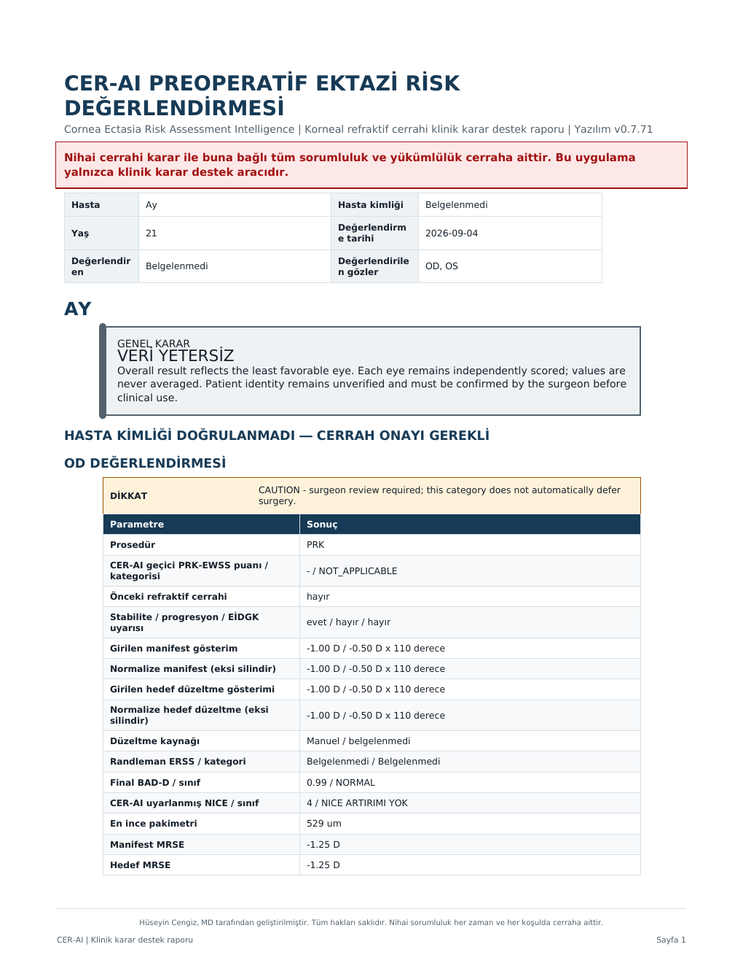
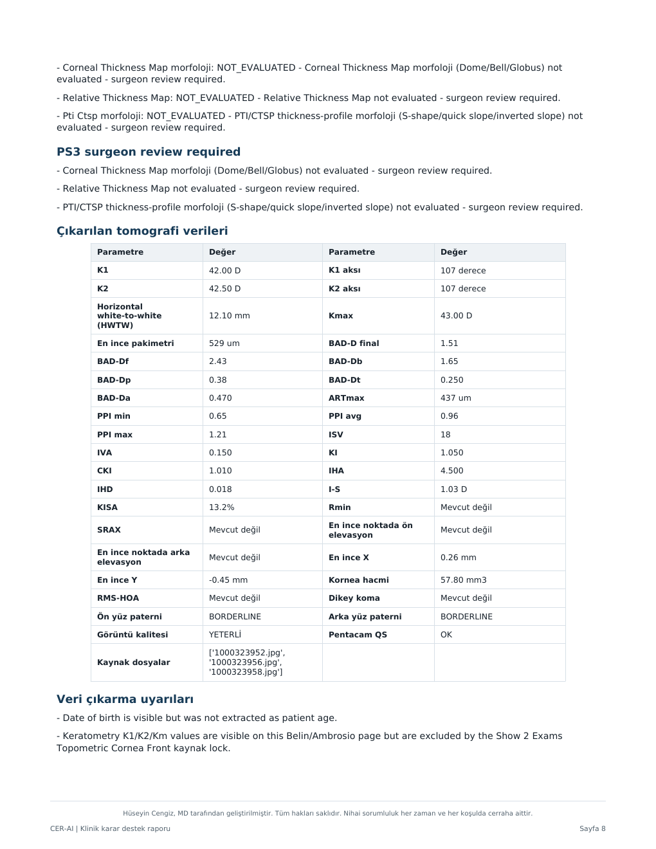
Report outputs and clinical reading order
1
Overall and eye-specific result
2
Reasons for STOP or CAUTION
3
ERSS, BAD-D, NICE, and PS3
4
RSB, RST, PTA, and plan details
5
Missing data and surgeon confirmations
CER-AI | Clinical presentation for physicians
19
Notes:
Görsel: Kullanıcı tarafından sağlanan anonimleştirilmiş CER-AI örnek raporu, 4 Eylül 2026. Klinik kullanımda hasta kimliği ve tüm değerler cerrah tarafından doğrulanmalıdır.

Slide 20
Clinical boundaries and key references
Clinical boundaries
Selected references
Decision support
Randleman JB, Trattler WB, Stulting RD. Am J Ophthalmol. 2008;145:813–818.
Santhiago MR et al. Am J Ophthalmol. 2014;158:87–95. PMID 24727263.
Santhiago MR et al. J Refract Surg. 2015;31:258–265.
Xie Y et al. JAMA Ophthalmol. 2020. Pentacam-based deep learning for refractive surgery screening.
CER-AI Evaluation Framework and current canonical specification, 15 September 2026.
CER-AI does not replace examination, image-quality review, or the surgeon's decision.
Prospective validation
Program performance requires separate evaluation in independent clinical datasets.
Versioned rules
Thresholds and report logic may change with the version. The presentation date should be reported.
Every report is completed through the surgeon's independent clinical assessment
CER-AI | Clinical presentation for physicians
20
Notes:
Kaynaklar: https://cer-ai.com/ ; Randleman DOI 10.1016/j.ajo.2007.12.033; Santhiago PubMed https://pubmed.ncbi.nlm.nih.gov/24727263/ ; Santhiago 2015 DOI 10.3928/1081597X-20150319-05; Xie Y et al. https://jamanetwork.com/journals/jamaophthalmology/fullarticle/2763363 . CER-AI'ye özgü eşikler kanonik spesifikasyondur, evrensel klinik konsensüs olarak sunulmamıştır.

