Slide 1
HTML5 Head Elements Meta. Title. Link.
Heidi Winters
CIT 230

Slide 2
Why are the head elements important?
The head elements or tags set up and start your HTML document.
They are essential if you want your code to be clean and understood.
They act as containers for other tags/elements that give your site or page depth and interest.

Slide 3
The HTML <meta> Element
The <meta> element is used to specify which character set is used, page description, keywords, author, and other metadata (data in data)
Browsers use metadata to know how to display content.
Search engines use metadata to look/use keywords.
Examples:
<meta charset="UTF-8"> (character encoding) Unicode transformation format.
<meta name = “description of webpage” content = “whatever your site is about”>
< meta name = “keywords” content = “keyword 1, kw2, kw3”

Slide 4
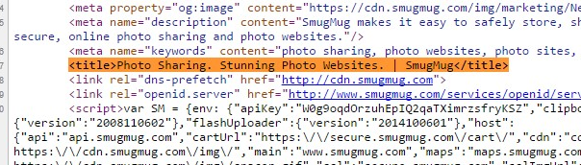

The HTML <title> Element
Defines a title in the browser tab
Provides a title for the page when it is added to favorites
Displays a title for the page in search engine results

Slide 5
Watch This
file:///C:/Users/Ginger/Documents/CIT/CIT%20230%20Web%20Front.%20Dev/tp_badexample.html

Slide 6
The HTML <link> Element
Specifies extra information about an element.
The <link> element is an empty element – it only contains attributes.
he <link> tag defines a link between a document and an external resource.
The <link> tag is used to link to external style sheets.
This element is used to link to CSS
<link rel="stylesheet" href="mystyle.css">

Slide 7
Hope you enjoyed!
The End.

