Slide 1

How to Solve a Linear System
Goran Flegar
W/: Hartwig Anzt, Yen-Chen Chen, Terry Cojean, Pratik Nayak, Enrique S. Quintana-Ortí, Mike Tsai
Scan me for slides!
github.com/gflegar/talks/tree/master/rwth_aachen_2018_09

Slide 2



Sources of linear systems
Real-world problem transformed into a linear system via:
  PDE discretizations, graph representations
  Large number of unknowns (1M+, full matrix 8TB)
  Most matrix elements are zero

Slide 3


Sources of linear systems
Real-world problem transformed into a linear system via:
  PDE discretizations, graph representations
  Large number of unknowns (1M+, full matrix 8TB)
  Most matrix elements are zero
Possible approach: iterative methods
  Krylov-subspace based linear solvers
    SpMV
    BLAS-1 operations
  Sparse matrix formats & SpMV
    accelerate each iteration of the solver
  Preconditioners
    reduce the number of iterations

Slide 4

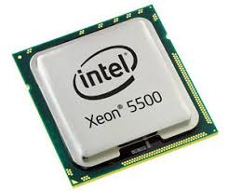
Sources of linear systems
Real-world problem transformed into a linear system via:
  PDE discretizations, graph representations
  Large number of unknowns (1M+, full matrix 8TB)
  Most matrix elements are zero
Possible approach: iterative methods
  Krylov-subspace based linear solvers
    SpMV
    BLAS-1 operations
  Sparse matrix formats & SpMV
    accelerate each iteration of the solver
  Preconditioners
    reduce the number of iterations
  Special hardware (e.g. GPUs)
  Probably not a good idea to implement everything from scratch…

Slide 5

Sources of linear systems
Real-world problem transformed into a linear system via:
  PDE discretizations, graph representations
  Large number of unknowns (1M+, full matrix 8TB)
  Most matrix elements are zero
Possible approach: iterative methods
  Krylov-subspace based linear solvers
    SpMV
    BLAS-1 operations
  Sparse matrix formats & SpMV
    accelerate each iteration of the solver
  Preconditioners
    reduce the number of iterations
  Special hardware (e.g. GPUs)
  Probably not a good idea to implement everything from scratch…
  Use a library instead:

Slide 6
Sources of linear systems
Real-world problem transformed into a linear system via:
  PDE discretizations, graph representations
  Large number of unknowns (1M+, full matrix 8TB)
  Most matrix elements are zero
Possible approach: iterative methods
  Krylov-subspace based linear solvers
    SpMV
    BLAS-1 operations
  Sparse matrix formats & SpMV
    accelerate each iteration of the solver
  Preconditioners
    reduce the number of iterations
  Special hardware (e.g. GPUs)
  Probably not a good idea to implement everything from scratch…
  Use a library instead:

Slide 7



The Ginkgo library
Linear operator algebra library
  Matrices, preconditioners, (Krylov) solvers
Joint effort: Innovative Computing Lab at University of Tennessee, Knoxvile; Karlsruhe Institute of Technology; University Jaume I

Slide 8
The Ginkgo library
Linear operator algebra library
  Matrices, preconditioners, (Krylov) solvers
Supports execution on different devices
  GPU
  Sequential reference CPU
  OpenMP under development
  Plans for multi GPU, CPU + GPU, full node
Joint effort: Innovative Computing Lab at University of Tennessee, Knoxvile; Karlsruhe Institute of Technology; University Jaume I

Slide 9
int main()
{
// Instantiate a CUDA executor
auto exec = gko::CudaExecutor::create(0, gko::OmpExecutor::create());
// Read data
auto A = gko::read<gko::matrix::Csr<>>(std::cin, exec);
auto b = gko::read<gko::matrix::Dense<>>(std::cin, exec);
auto x = gko::read<gko::matrix::Dense<>>(std::cin, exec);
// Create the solver
auto solver = gko::solver::Cg<>::Factory::create()
.with_preconditioner(
gko::preconditioner::BlockJacobiFactory<>::create(exec, 32))
.with_criterion(gko::stop::Combined::Factory::create()
.with_criteria(
gko::stop::Iteration::Factory::create()
.with_max_iters(20u)
.on_executor(exec),
gko::stop::ResidualNormReduction<>::Factory::create()
.with_reduction_factor(1e-15)
.on_executor(exec))
.on_executor(exec))
.on_executor(exec);
// Solve system
solver->generate(give(A))->apply(lend(b), lend(x));
// Write result
write(std::cout, lend(x));
}

Slide 10
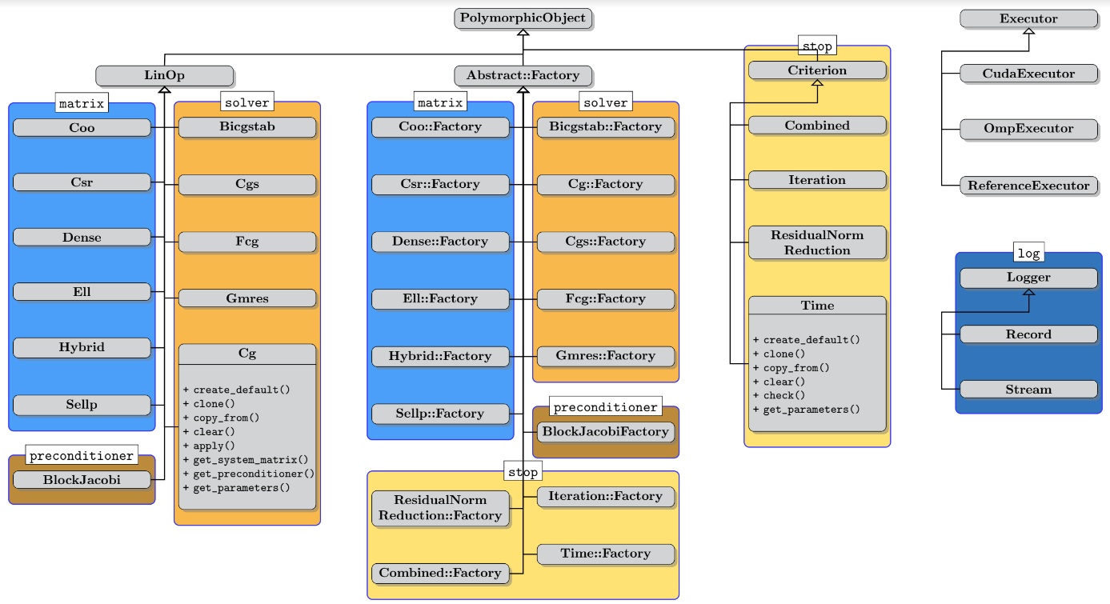
Library features

Slide 11
Library features: extensibility
users can provide new matrices, solvers, preconditioners, stopping criteria, loggers
Without recompiling the library!

Slide 12
Sources of linear systems
Real-world problem transformed into a linear system via:
  PDE discretizations, graph representations
  Large number of unknowns (1M+, full matrix 8TB)
  Most matrix elements are zero
Possible approach: iterative methods
  Krylov-subspace based linear solvers
    SpMV
    BLAS-1 operations
  Sparse matrix formats & SpMV
    accelerate each iteration of the solver
  Preconditioners
    reduce the number of iterations
  Special hardware (e.g. GPUs)
  Probably not a good idea to implement everything from scratch…
  Use a library instead:

Slide 13

Preconditioning

Slide 14

Preconditioning
Replace the original system with an equivalent preconditioned system

Slide 15


Preconditioning
Replace the original system with an equivalent preconditioned system

Slide 16

Preconditioning
Replace the original system with an equivalent preconditioned system
Do not compute the preconditioned system matrix explicitly!

Slide 17

Preconditioning
Replace the original system with an equivalent preconditioned system
Do not compute the preconditioned system matrix explicitly!

Slide 18


Preconditioning
Replace the original system with an equivalent preconditioned system
Do not compute the preconditioned system matrix explicitly!
Preconditioner application

Slide 19


Preconditioning
Replace the original system with an equivalent preconditioned system
Do not compute the preconditioned system matrix explicitly!
Generate the preconditioner matrix, and store it in a form suitable for application
Preconditioner setup
Preconditioner application

Slide 20
Preconditioning
Replace the original system with an equivalent preconditioned system
Do not compute the preconditioned system matrix explicitly!
Generate the preconditioner matrix, and store it in a form suitable for application
Generation via factory
Linear operator application
linear operator abstraction

Slide 21



Example: Block-Jacobi preconditioning
Block-Jacobi preconditioning
  Use only diagonal blocks for approximation
Anzt, Dongarra, Flegar, Quintana-Ortí, Variable-size batched Gauss–Jordan elimination for block-Jacobi preconditioning on graphics processors, ParCo

Slide 22

Benefits of block-Jacobi
56 matrices from SuiteSparse with inherent block structure
MAGMA-sparse open source library
  IDR solver
  Scalar Jacobi preconditioner
  Supervariable agglomeration
    Detects block structure of the matrix
Improves the robustness of the solver

Slide 23
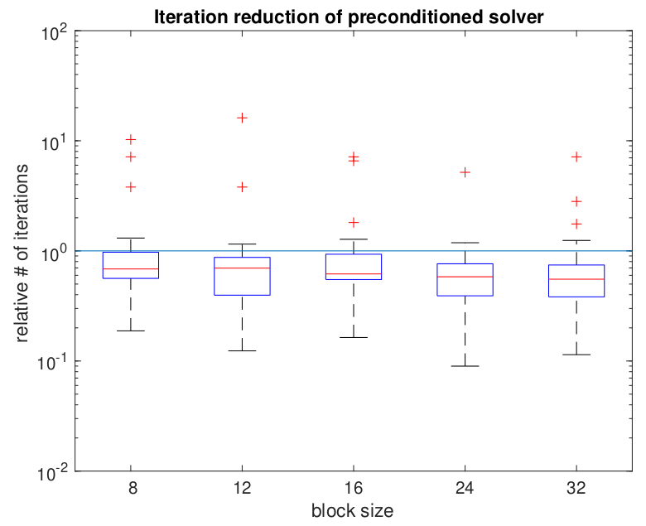
Benefits of block-Jacobi
56 matrices from SuiteSparse with inherent block structure
MAGMA-sparse open source library
  IDR solver
  Scalar Jacobi preconditioner
  Supervariable agglomeration
    Detects block structure of the matrix
Improves the robustness of the solver
Improves convergence of the solver

Slide 24






Complete solver runtime
s2rmt3m1
Chebyshev3
nd24k
G3_circuit
bcsstk38
ship_003

Slide 25

Current Research: Adaptive precision block-Jacobi
Preconditioner is an approximation of the system matrix
  Applying a preconditioner inherently carries an error
  For block-Jacobi the relative error of z is usually around 0.01 – 0.1

Slide 26
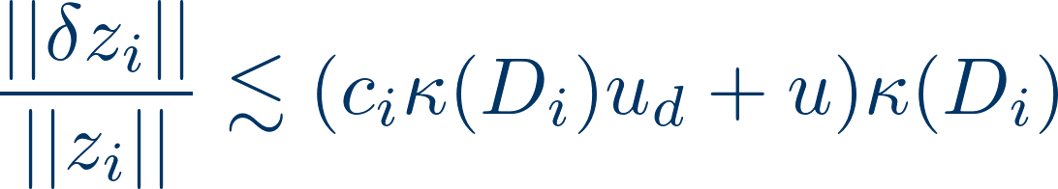
Current Research: Adaptive precision block-Jacobi
Preconditioner is an approximation of the system matrix
  Applying a preconditioner inherently carries an error
  For block-Jacobi the relative error of z is usually around 0.01 – 0.1
Preconditioner application is memory bounded
  Most of the cost comes from reading the matrix from memory
  Idea: use lower precision to store the matrix
Adaptive precision in inversion-based block-Jacobi:
  All computation is done in double precision
  Preconditioner matrix is stored in lower precision, with roundoff error “u”
  Error bound:
Anzt, Dongarra, Flegar, Higham, Quintana-Ortí, Adaptive precision in block-Jacobi preconditioning for iterative sparse linear system solvers, CCPE

Slide 27
Sources of linear systems
Real-world problem transformed into a linear system via:
  PDE discretizations, graph representations
  Large number of unknowns (1M+, full matrix 8TB)
  Most matrix elements are zero
Possible approach: iterative methods
  Krylov-subspace based linear solvers
    SpMV
    BLAS-1 operations
  Sparse matrix formats & SpMV
    accelerate each iteration of the solver
  Preconditioners
    reduce the number of iterations
  Special hardware (e.g. GPUs)
  Probably not a good idea to implement everything from scratch…
  Use a library instead:

Slide 28
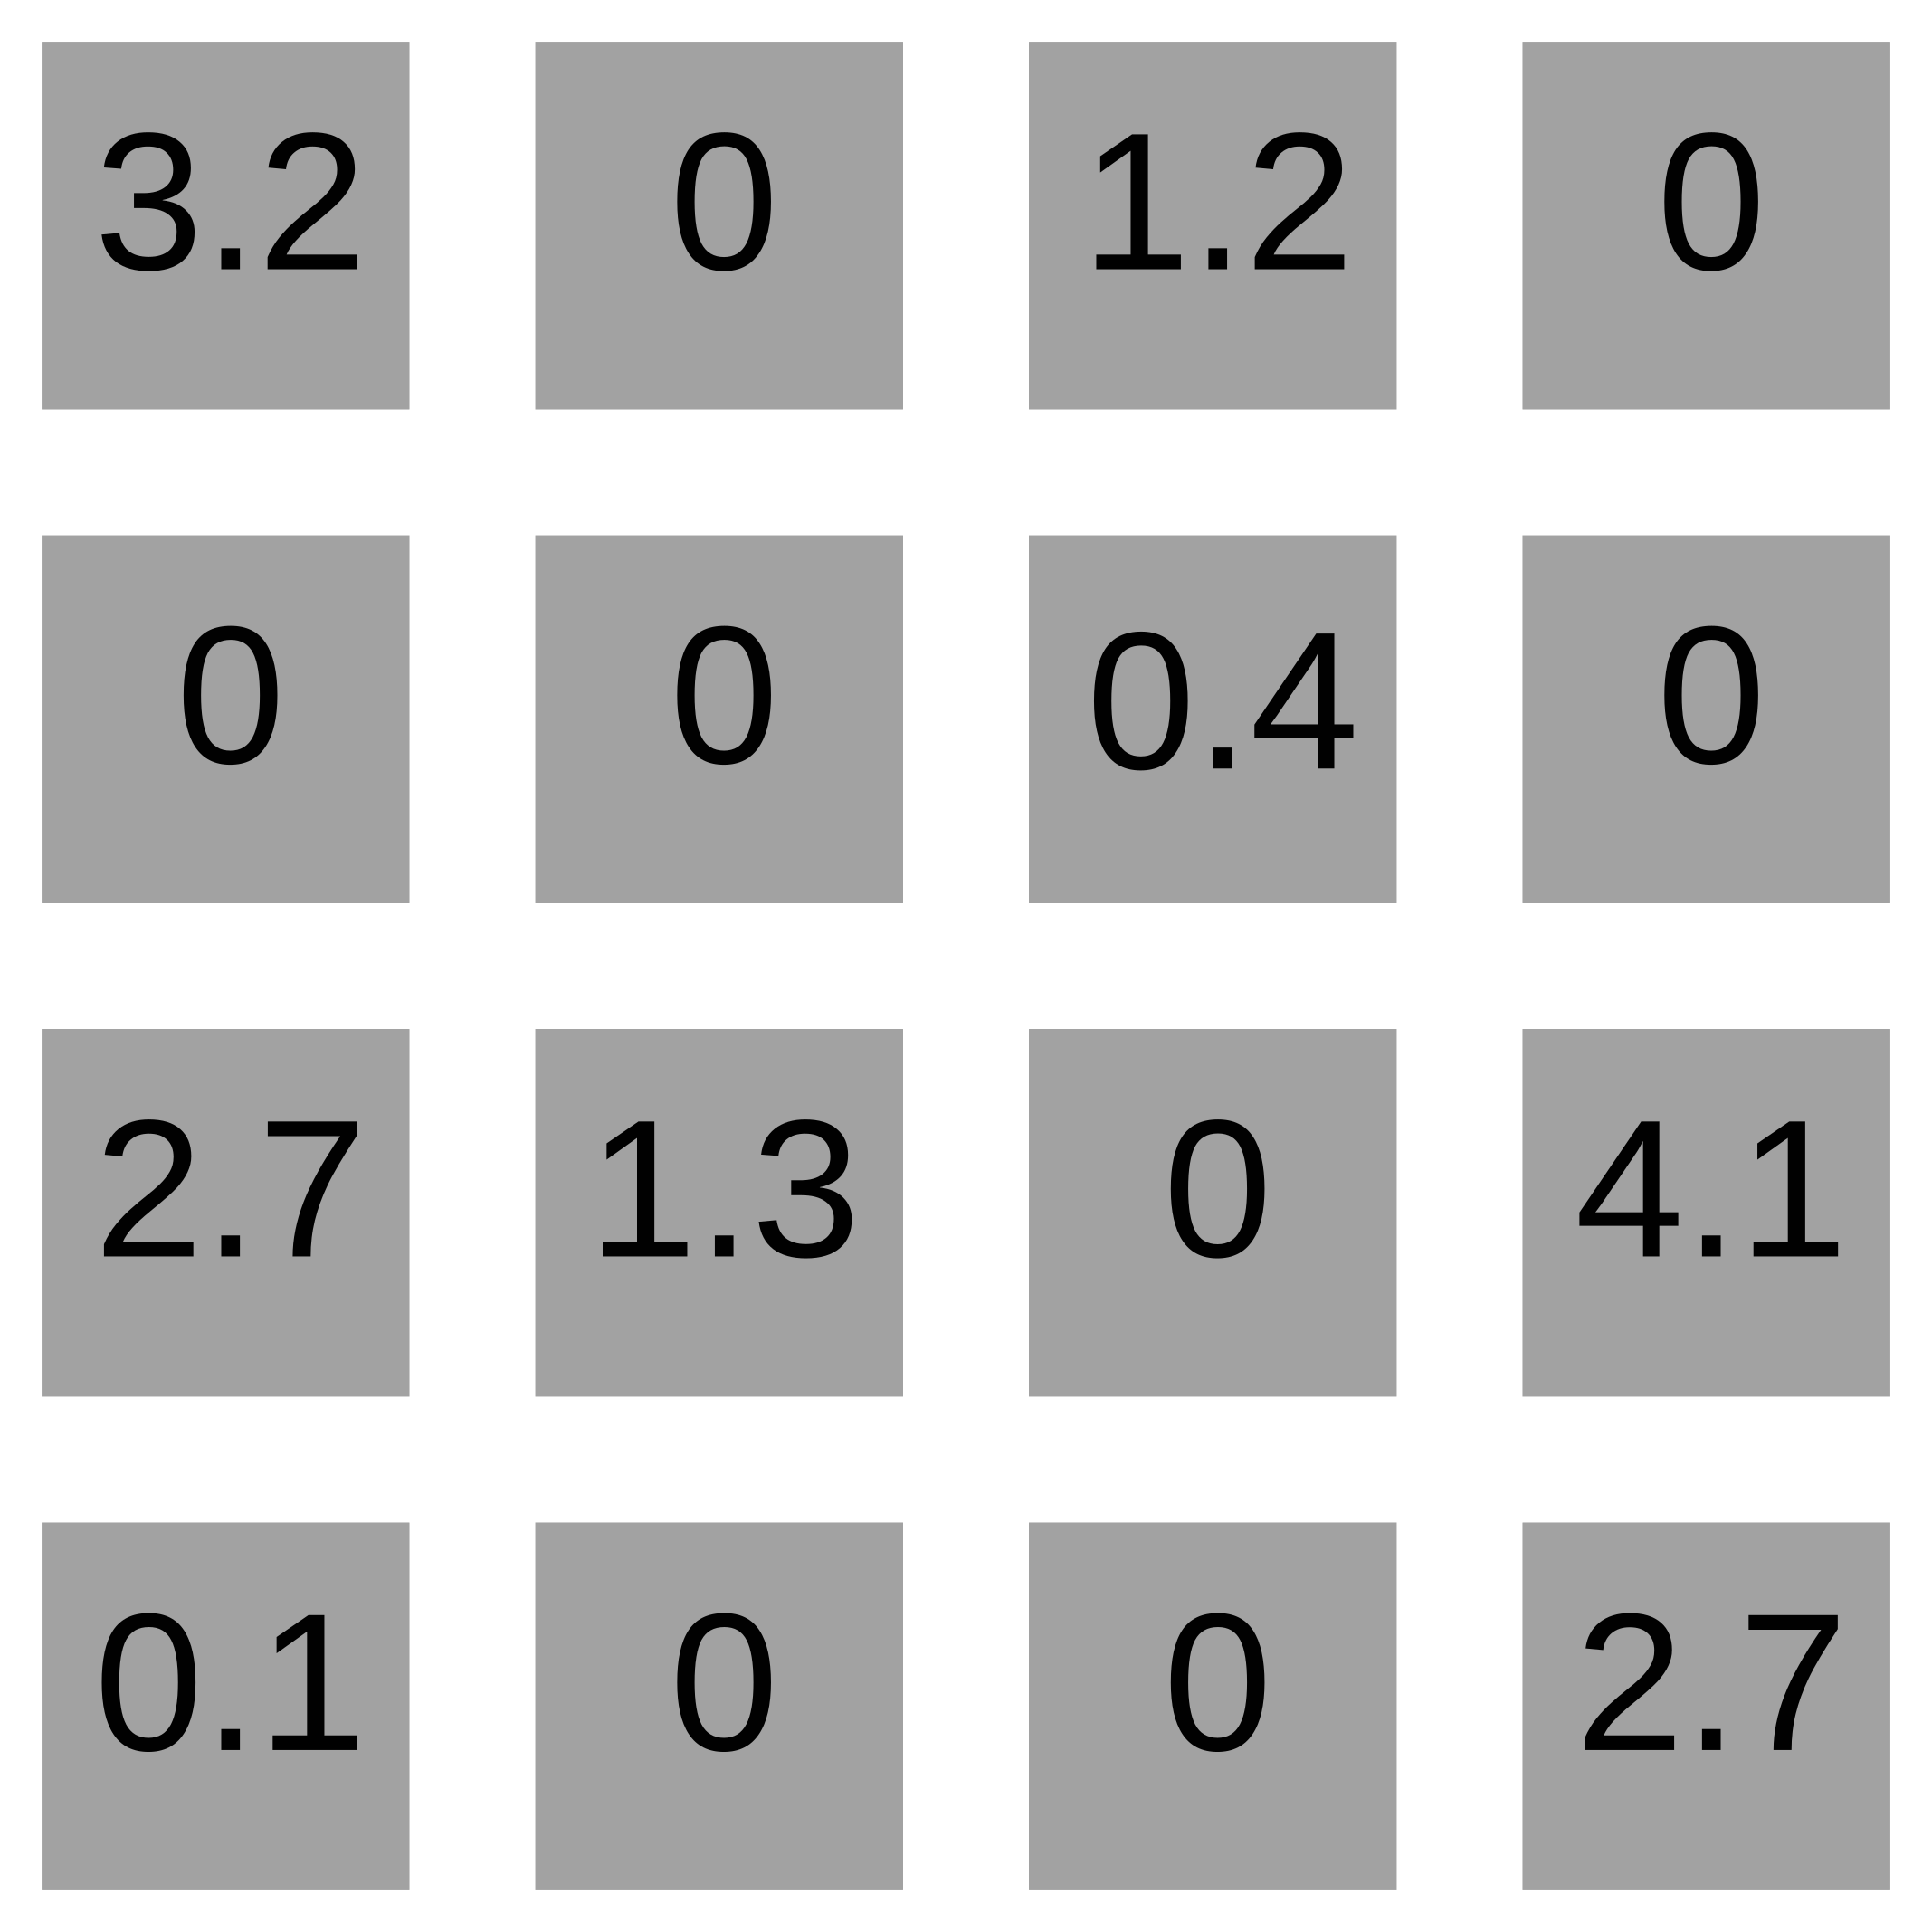
Sparse matrix formats

Slide 29
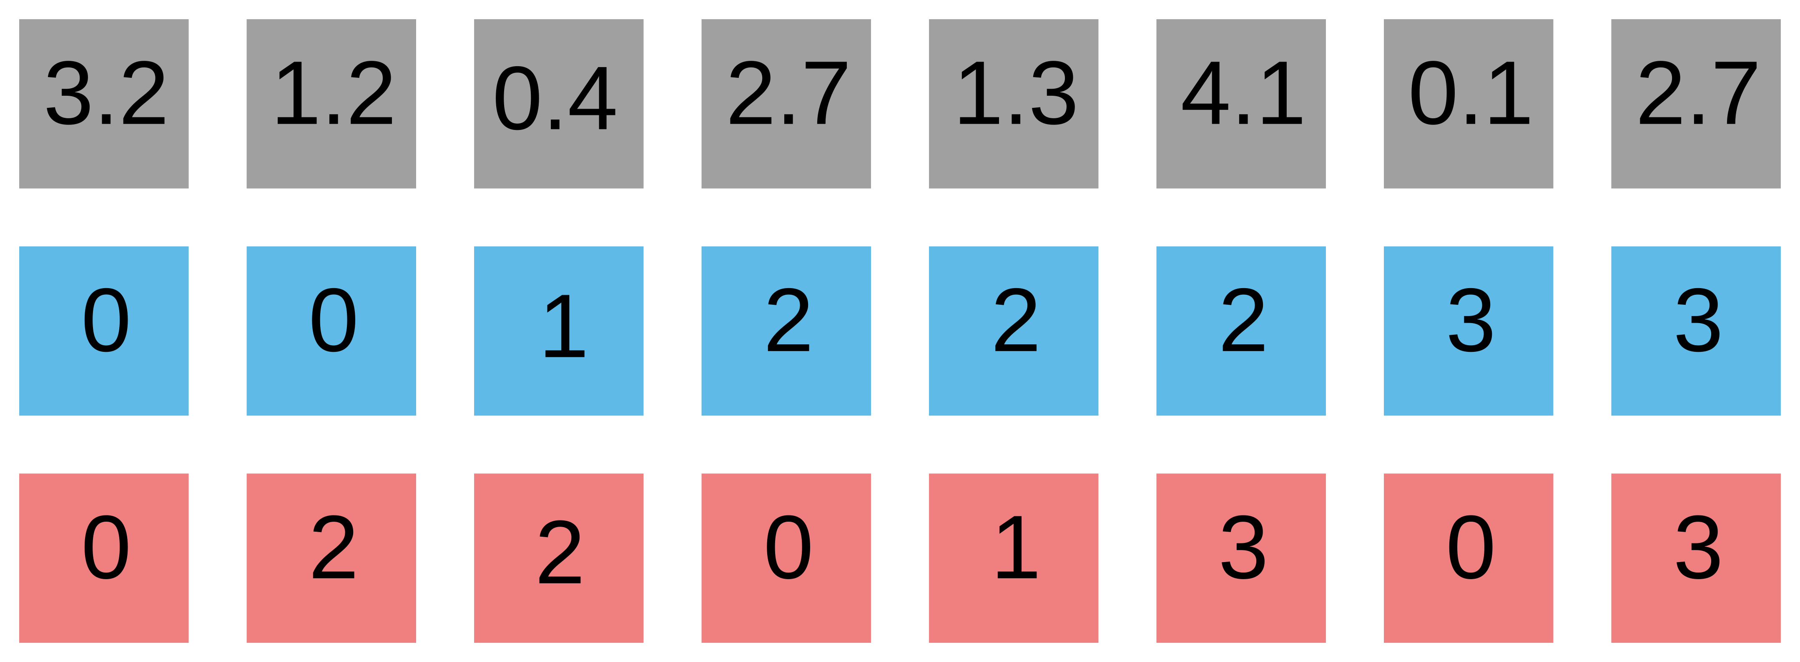
Sparse matrix formats
COO

Slide 30
Sparse matrix formats
row
column
COO

Slide 31
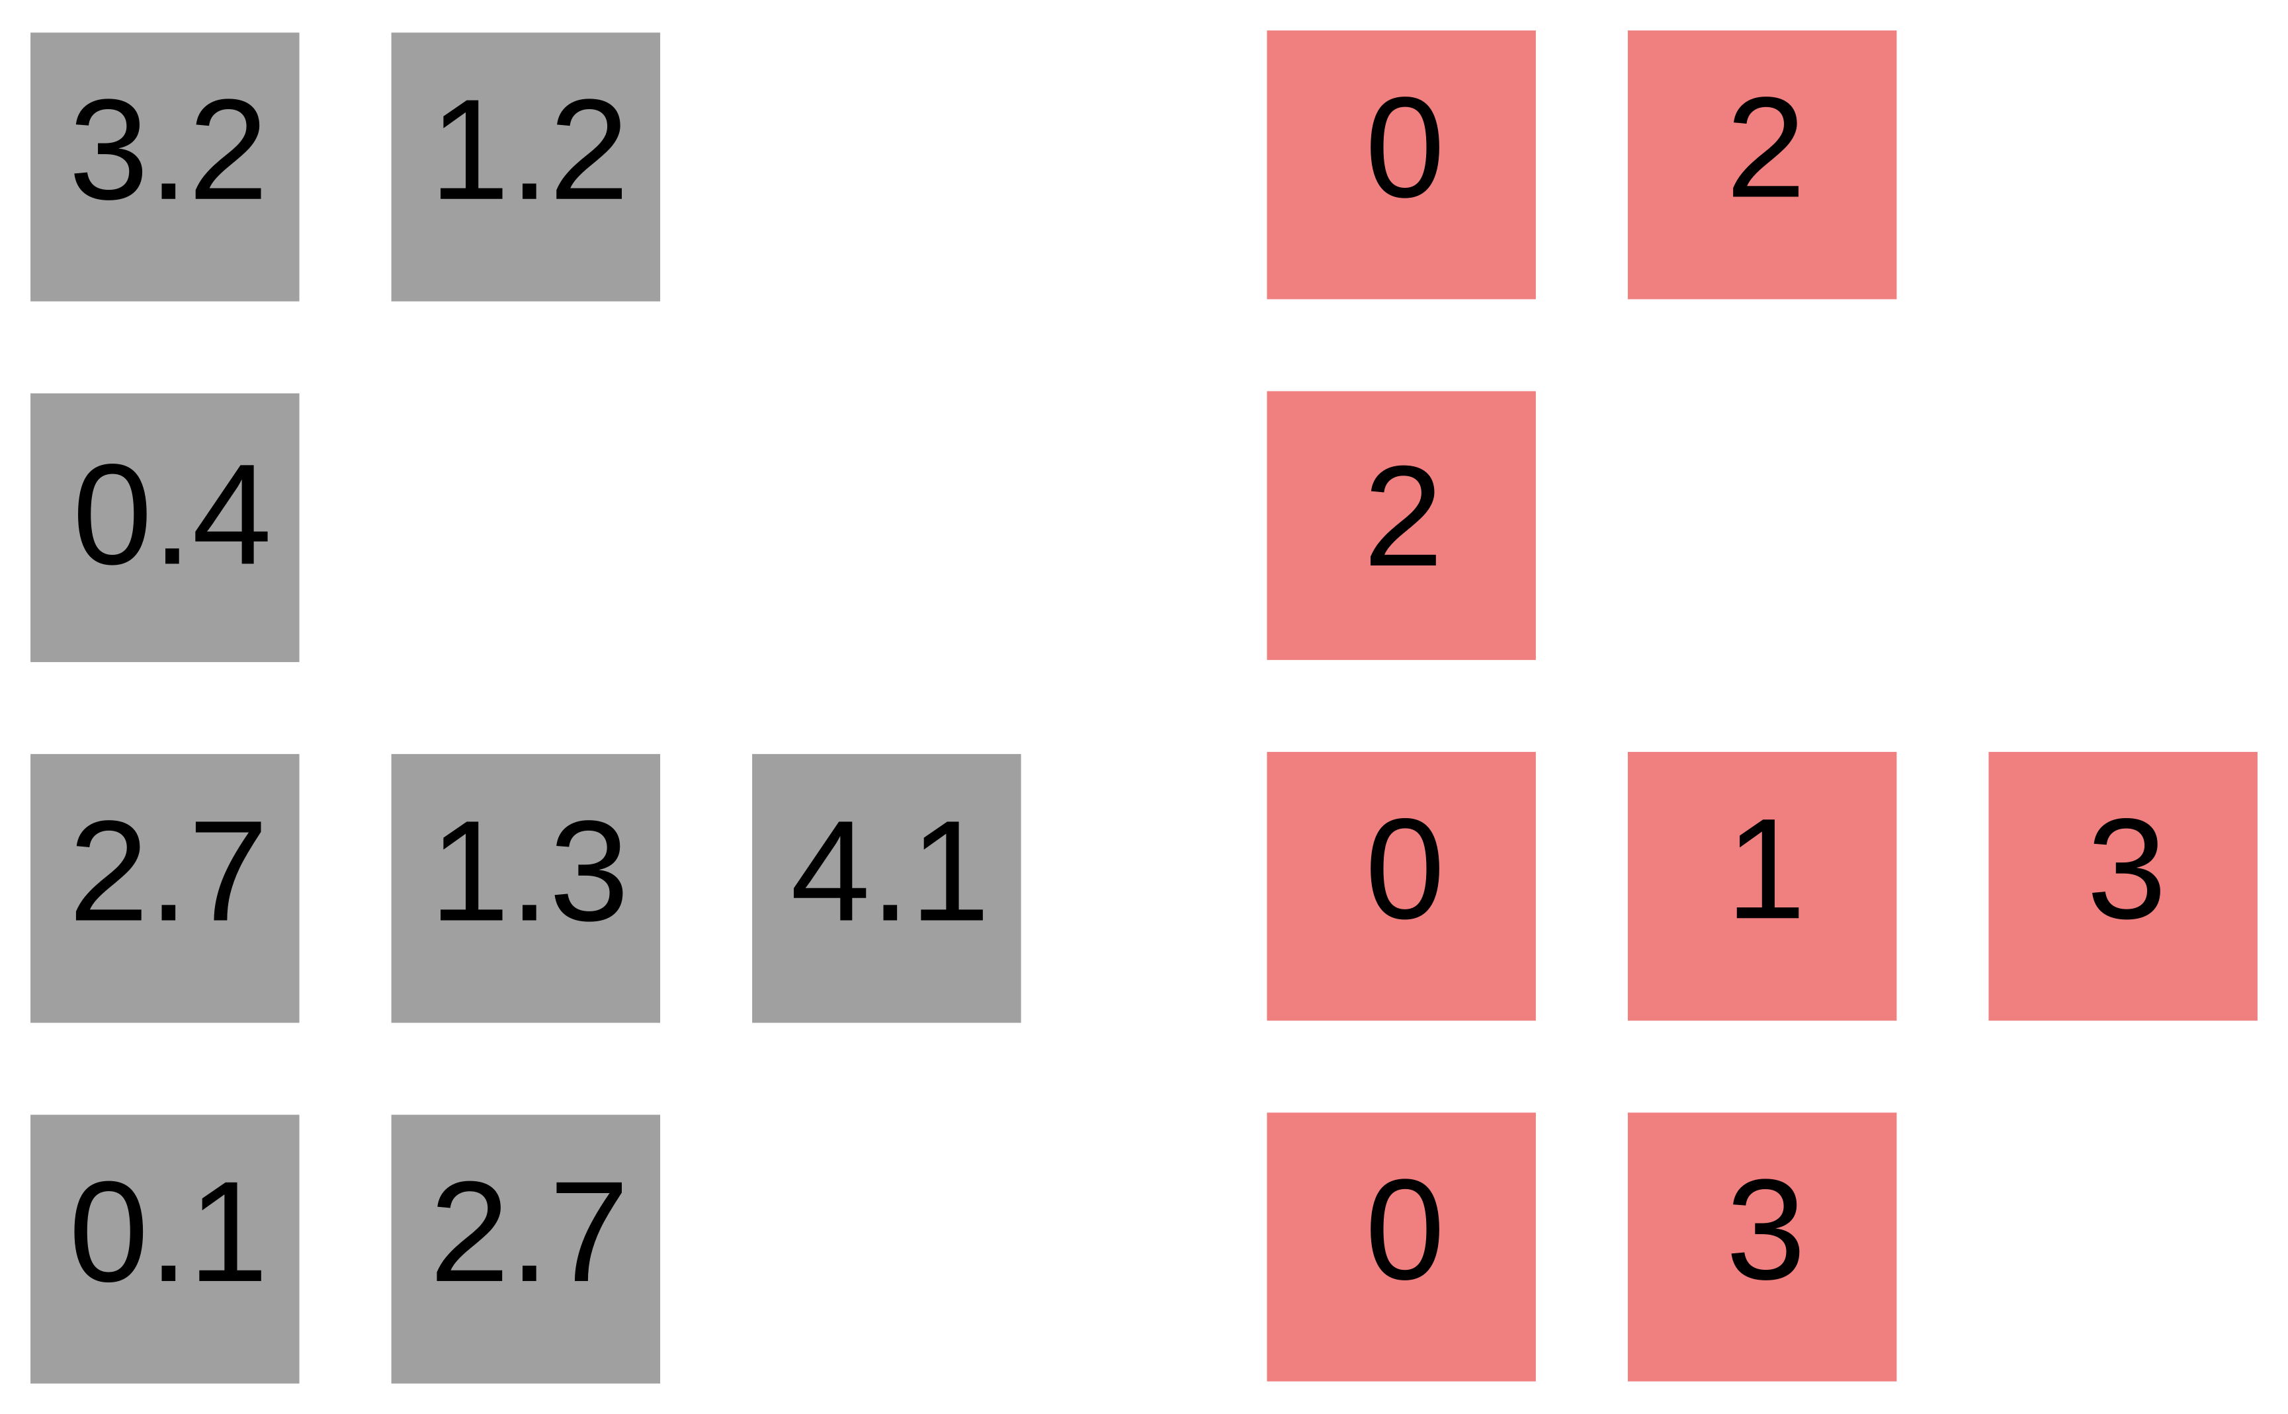
Sparse matrix formats

Slide 32
Sparse matrix formats

Slide 33
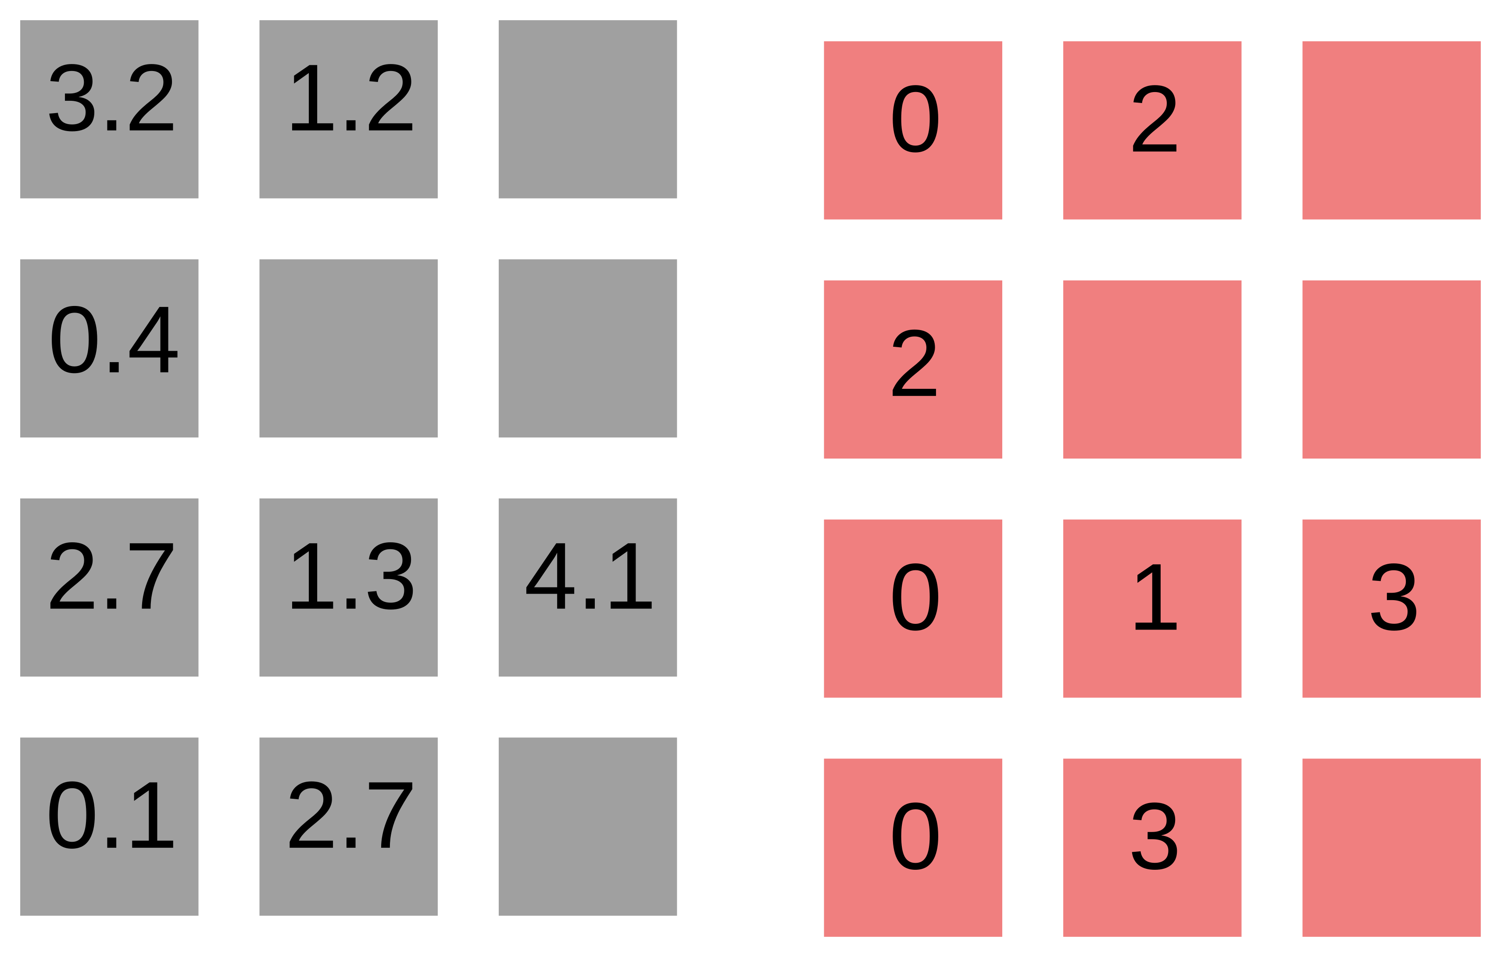
Sparse matrix formats
ELL

Slide 34
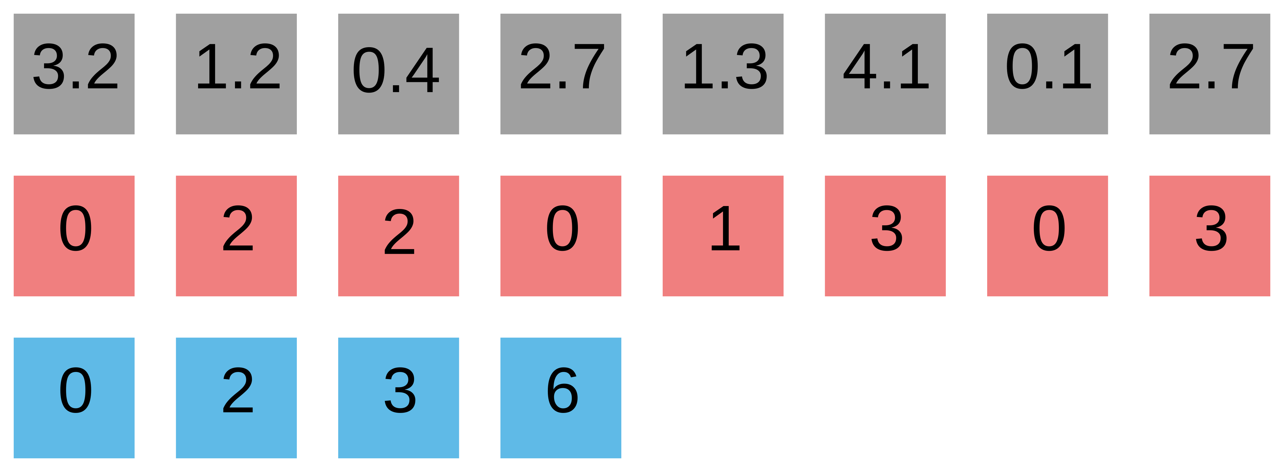
Sparse matrix formats
CSR
ELL

Slide 35
Sparse matrix formats
CSR
ELL

Slide 36
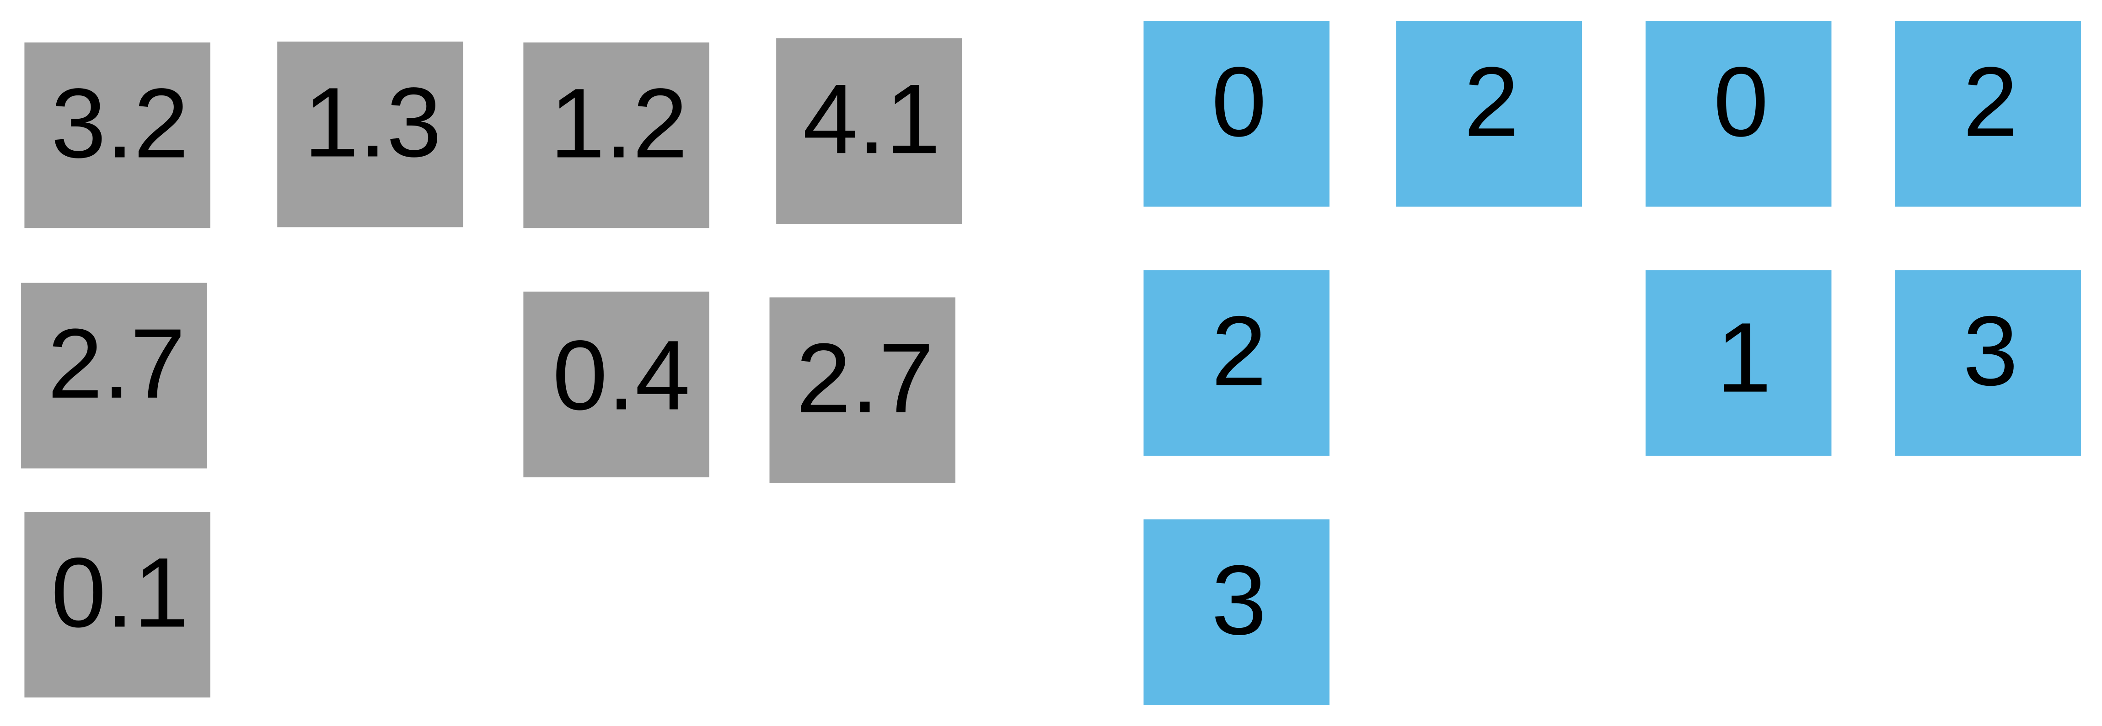
Sparse matrix formats
… leads to CSC

Slide 37
Sparse matrix formats
… leads to CSC
“Standard” approach
CSR

Slide 38
CSR SpMV
Values (val)
Column indexes (colidx)
Row pointers (rowptr)

Slide 39

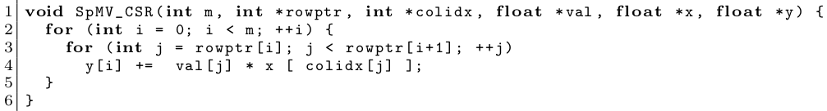
CSR SpMV
Values (val)
Column indexes (colidx)
Row pointers (rowptr)

Slide 40
CSR SpMV
Values (val)
Column indexes (colidx)
Row pointers (rowptr)
Bell & Garland ‘08
  parallelize outer loop
~ cuSPARSE SpMV

Slide 41
CSR SpMV
Values (val)
Column indexes (colidx)
Row pointers (rowptr)
Bell & Garland ‘08
  parallelize outer loop
~ cuSPARSE SpMV
Load imbalance!

Slide 42
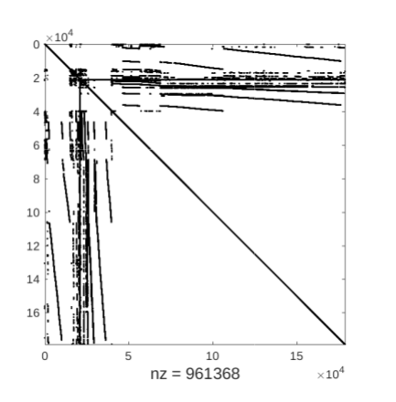
Example
Freescale/transient

Slide 43
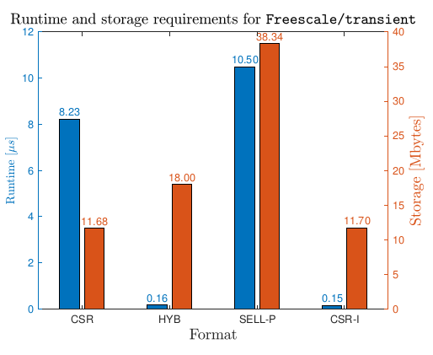
Example
* GTX 1080
Freescale/transient
Can we do better than HYB using CSR?

Slide 44
Example
* GTX 1080
Freescale/transient
Can we do better than HYB using CSR?
55x speedup
YES!
Publish a paper about it?
You can…
Flegar, Anzt, Overcoming Load Imbalance for Irregular Sparse Matrices, IA3’17
Flegar, Quintana-Ortí, Balanced CSR Sparse Matrix-Vector Product on Graphics Processors, Euro-Par’17

Slide 45
How to publish an SpMV paper
<irony>
Think of a “new” algorithm / format for sparse matrix-vector product.
  Does not have to be great, can do stuff in software that the hardware will already do automatically, or not even give correct results (no one checks).
</irony>
Copyright notice: the “<irony>” tag was shamelessly stolen from Georg Hager’s “Thirteen modern ways to fool the masses with performance results on parallel computers” talk, see https://blogs.fau.de/hager/archives/category/fooling-the-masses

Slide 46
How to publish an SpMV paper
<irony>
Think of a “new” algorithm / format for sparse matrix-vector product.
  Does not have to be great, can do stuff in software that the hardware will already do automatically, or not even give correct results (no one checks).
Find 10 - 20 matrices from the SuiteSparse collection where your algorithm is faster than any other algorithms / formats you compare.
  Not that difficult, there’s 3000 matrices with different properties, no algorithm handles all the corner cases properly.
</irony>
Copyright notice: the “<irony>” tag was shamelessly stolen from Georg Hager’s “Thirteen modern ways to fool the masses with performance results on parallel computers” talk, see https://blogs.fau.de/hager/archives/category/fooling-the-masses

Slide 47
How to publish an SpMV paper
<irony>
Think of a “new” algorithm / format for sparse matrix-vector product.
  Does not have to be great, can do stuff in software that the hardware will already do automatically, or not even give correct results (no one checks).
Find 10 - 20 matrices from the SuiteSparse collection where your algorithm is faster than any other algorithms / formats you compare.
  Not that difficult, there’s 3000 matrices with different properties, no algorithm handles all the corner cases properly.
Write a paper claiming that your algorithm is “on average 50% faster than the competitors”, on a “representative” subset.
Send it to a conference / journal and hope the reviewers do not know a lot about SpMV (most likely true).
</irony>
Copyright notice: the “<irony>” tag was shamelessly stolen from Georg Hager’s “Thirteen modern ways to fool the masses with performance results on parallel computers” talk, see https://blogs.fau.de/hager/archives/category/fooling-the-masses

Slide 48
How to publish an SpMV paper
<irony>
Think of a “new” algorithm / format for sparse matrix-vector product.
  Does not have to be great, can do stuff in software that the hardware will already do automatically, or not even give correct results (no one checks).
Find 10 - 20 matrices from the SuiteSparse collection where your algorithm is faster than any other algorithms / formats you compare.
  Not that difficult, there’s 3000 matrices with different properties, no algorithm handles all the corner cases properly.
Write a paper claiming that your algorithm is “on average 50% faster than the competitors”, on a “representative” subset.
Send it to a conference / journal and hope the reviewers do not know a lot about SpMV (most likely true).
Victory! Think of another format and repeat.
</irony>
Copyright notice: the “<irony>” tag was shamelessly stolen from Georg Hager’s “Thirteen modern ways to fool the masses with performance results on parallel computers” talk, see https://blogs.fau.de/hager/archives/category/fooling-the-masses

Slide 49
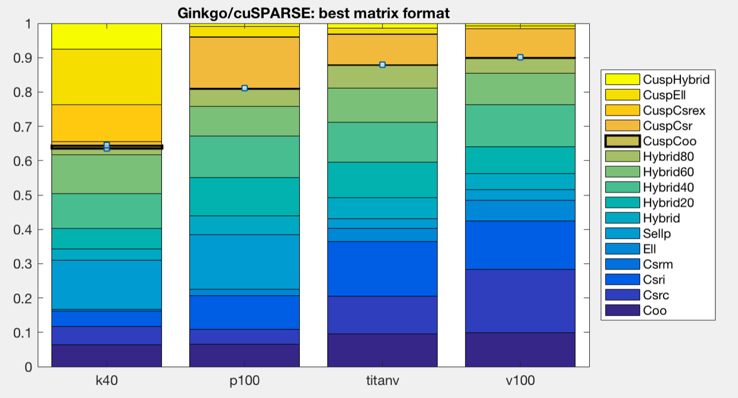
In the real world...
THERE IS NO “BEST” SPARSE MATRIX FORMAT / SpMV ALGORITHM
Can we figure out which format is going to give best performance for a given problem?
Maybe...

Slide 50
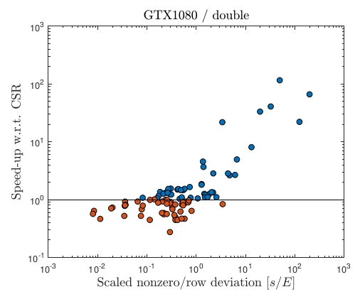
Choosing the winner a priori
CSR-I designed for irregular patterns
How to measure irregularity?
Deviation of row lengths from the mean.
Is “5” regular or irregular?
Depends on the density of the matrix (mean #rows)
Scatter plot of speedup vs normalized std. dev.

Slide 51
Choosing the winner a priori
CSR-I designed for irregular patterns
How to measure irregularity?
Deviation of row lengths from the mean.
Is “5” regular or irregular?
Depends on the density of the matrix (mean #rows)
Scatter plot of speedup vs normalized std. dev.
<0.1 use CSR
>1 use CSR-I
Benchmark both

Slide 52
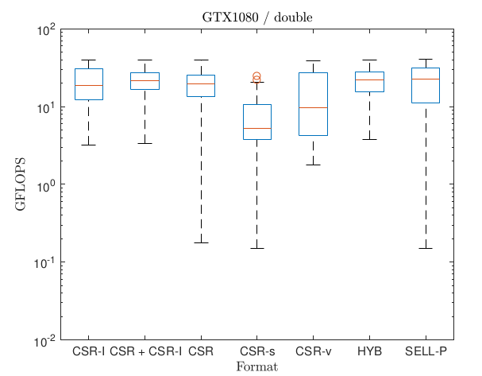
Combining both approaches

Slide 53
Outlook
Choosing the correct combination of
matrix format
solver
preconditioner
… requires expert knowledge or significant trial and error.
Design a tool that does it (semi-)automatically?

