Slide 1
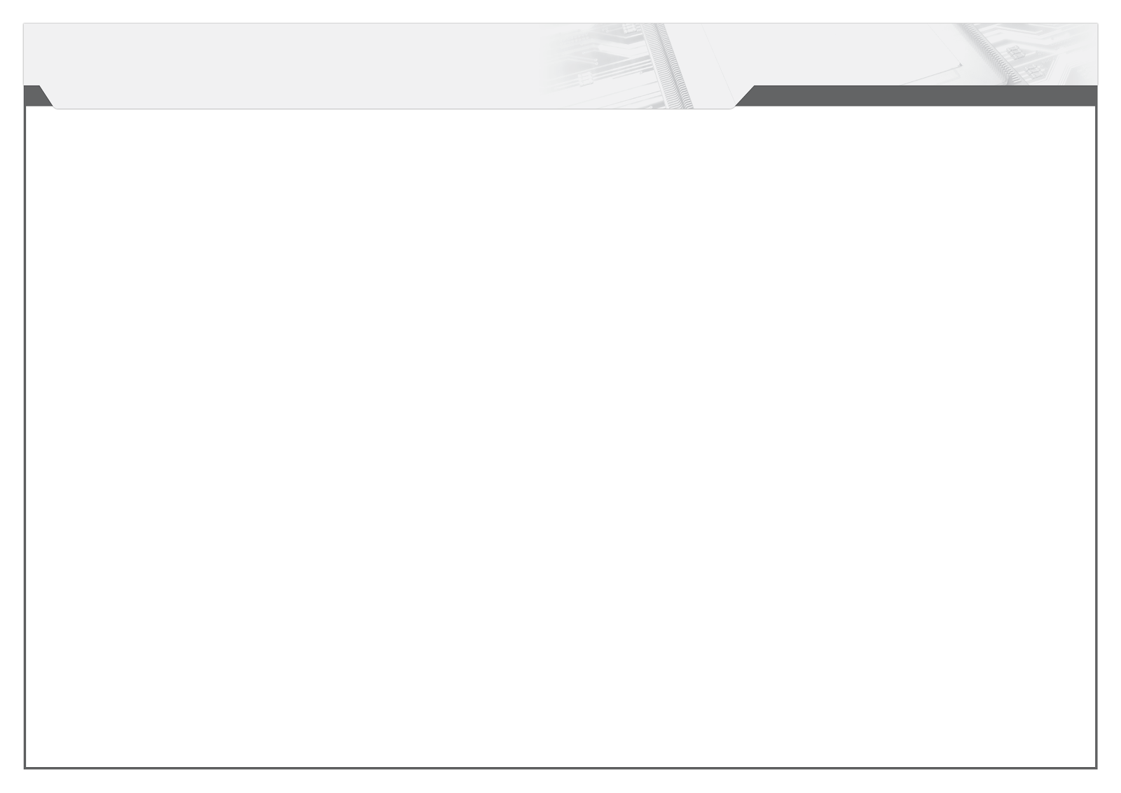





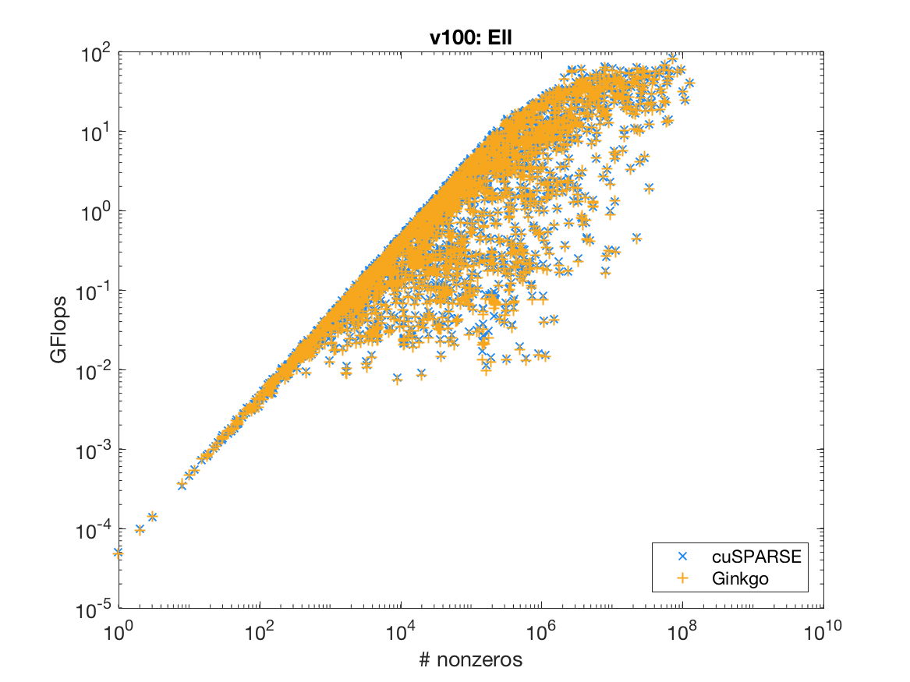
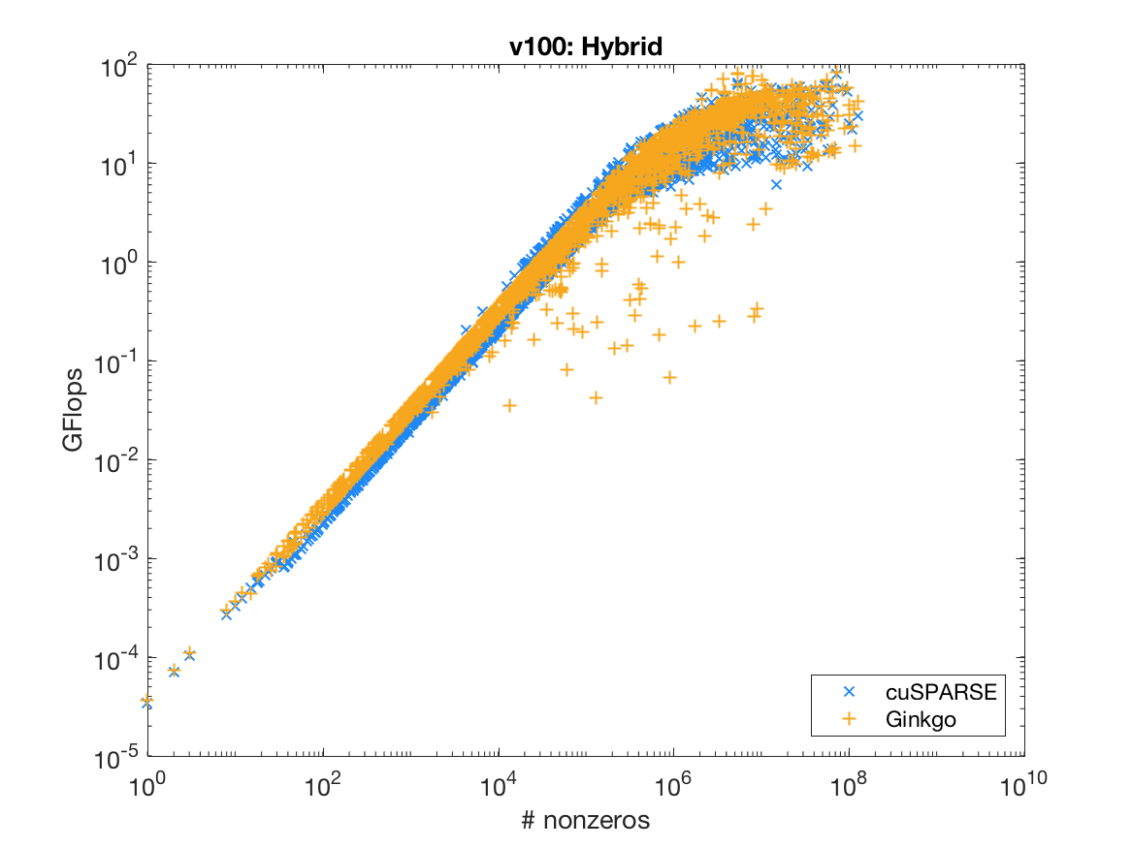




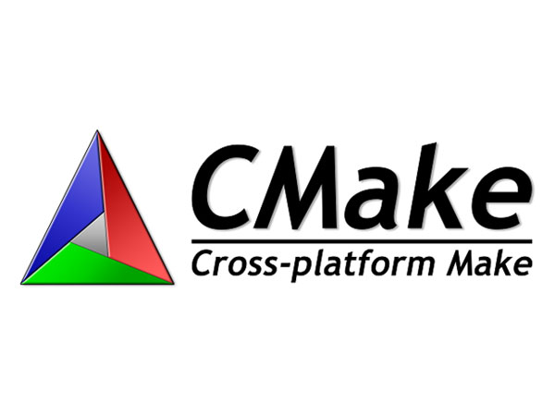
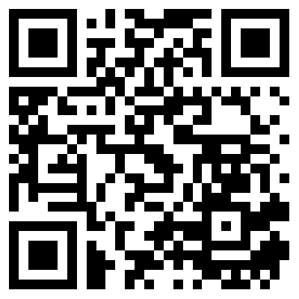

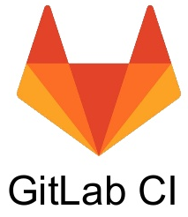
A Linear Operator Library for Sparse Problems
Hartwig Anzt, Terry Cojean, YenChen Chen, Goran Flegar, Pratik Nayak, Yuhsiang M. Tsai, Enrique S. Quintana-Orti
Open-source C++ framework for sparse linear algebra.
Sparse linear solvers, preconditioners, SpMV etc.
Generic algorithm implementation: + reference kernels for checking correctness; + architecture-specific highly optimized kernels.
Focused on GPU accelerators (i.e. NVIDIA GPUs).
Software quality and sustainability efforts guided by xSDK community policies:
Linear solver workflow
Performance evaluation on NVIDIA Volta
https://xsdk.info/
https://github.com/ginkgo-project/ginkgo

