Slide 1


On the way towards an accelerator-focused C++ sparse linear algebra library

Slide 2

Overview
Open source sparse linear algebra library
Sparse linear solvers, preconditioners
Sparse building blocks (SpMV, reductions, sparse pattern algorithms)
Generic algorithm implementation + architecture-specific highly optimized kernels
Based on C++
Focused on GPU accelerators (i.e. NVIDIA GPUs)

Slide 3

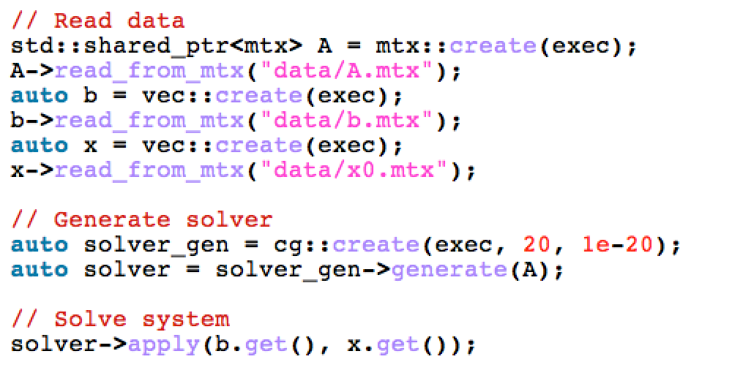
Software Design
Based on C++ (11), C bindings planned
Templated precision (ValueType, Integer)
By default, compiles Z,C,D,S
Smart pointers to avoid memory leaks (unique/shared pointers)
Runtime polymorphism
Kernels have the same signature for different architectures
Executor determines which kernel is used
LinOp class for any linear operator:
Matrices
Solvers
Preconditioners
…
Determines where Data lives
& operation is executed
generate
apply
…

Slide 4





Software Quality Efforts
Open source sparse linear algebra library
git open-source repository https://github.com/ginkgo-project/ginkgo/
Modified BSD license
Community effort
Code review process for pull requests
Copyright@ UTK, KIT, UJI
Collaborative effort: Karlsruhe Institute of Technology Universitat of Jaume University of Tennessee

Slide 5



Software Quality Efforts
Tests for all functionalities (googletest) googletest repo gets cloned in the installation step
Reference kernels for all functionality ensuring correctness (not tuned for performance)
Documentation (doxygen)
Planned integration into xSDK Compliant with the community policies https://xsdk.info
Planned Continuous Integration (CI)

Slide 6

Software Quality Efforts
CMake build system
Cross-platform compilation (Unix/Linux, MacOS, Windows)
git clone https://github.com/ginkgo-project/ginkgo/
cd ginkgo && mkdir build && cd build
cmake -DBUILD_REFERENCE=ON -DBUILD_GPU=ON ..
make
make test

Slide 7
Library Structure
├── core │ ├── base │ ├── matrix │ ├── preconditioner │ ├── solver │ └── test │ ├── base │ ├── matrix │ ├── preconditioner │ ├── solver │ └── utils ├── reference │ ├── matrix │ ├── preconditioner │ ├── solver │ └── test │ ├── base │ ├── matrix │ ├── preconditioner │ └── solver └── gpu ├── matrix ├── preconditioner ├── solver └── test ├── matrix ├── preconditioner └── solver
“Core” contains the algorithms,
like ILU, CG, GMRES etc. Anything not device-specific.
Unit tests ensure correctness.
The “reference” implementations are ensuring correctness, they are not tuned for performance.
The “gpu” folder contains the tuned numerical kernels, e.g. spmv, dot, but also algorithm-specific kernels for the solvers, preconditioners…

Slide 8
Library Structure
├── core │ ├── base │ ├── matrix │ ├── preconditioner │ ├── solver │ └── test │ ├── base │ ├── matrix │ ├── preconditioner │ ├── solver │ └── utils ├── reference │ ├── matrix │ ├── preconditioner │ ├── solver │ └── test │ ├── base │ ├── matrix │ ├── preconditioner │ └── solver └── gpu ├── matrix ├── preconditioner ├── solver └── test ├── matrix ├── preconditioner └── solver
Scenario: new ”CGS” solver
CGS class
Reference kernels for CGS
GPU kernels for CGS

Slide 9
Library Structure
├── core │ ├── base │ ├── matrix │ ├── preconditioner │ ├── solver │ └── test │ ├── base │ ├── matrix │ ├── preconditioner │ ├── solver │ └── utils ├── reference │ ├── matrix │ ├── preconditioner │ ├── solver │ └── test │ ├── base │ ├── matrix │ ├── preconditioner │ └── solver └── gpu ├── matrix ├── preconditioner ├── solver └── test ├── matrix ├── preconditioner └── solver
Scenario: new ”CGS” solver
CGS class + test for class functions
Reference kernels for CGS + test for each kernel
GPU kernels for CGS + test for each kernel (compare with reference)

Slide 10
Creating a new solver via script
cd ginkgo/dev_tools/scripts
./create_new_solver.sh <name_of_new_solver>
…

Slide 11
Creating a new solver via script
cd ginkgo/dev_tools/scripts
./create_new_solver.sh cgs
…
Summary:
Created solver file
ginkgo/core/solver/cgs.cpp
This is where the cgs algorithm needs to be implemented.
Created class header
ginkgo/core/solver/cgs.hpp
This is where the cgs class functions need to be implemented.
…
A summary of the required next steps has been written to:
todo_cgs.txt

Slide 12
How to run the example solver
cd ginkgo/build/example/simple_solver/
./simple_solver
./simple_solver gpu
Runs reference code
Runs on the GPU

Slide 13
Overhead of Runtime Polymorphism
cd ginkgo/build/example/ginkgo_overhead/
[hanzt@a05 ginkgo_overhead]$ ./ginkgo_overhead
Running 1000000 iterations of the CG solver took a total of 0.956637 seconds.
Average library overhead: 956.637 [nanoseconds / iteration]
< 1 second overhead from runtime polymorphism for 1,000,000 iterations.

Slide 14
How about distributed?
Currently not planned (even though an easy add-on: just create another executor based on MPI)
Why?
One GPU node (potentially multiple GPUs) provides enormous performance.
Maybe there is something coming from NVIDIA in the next years?
We do not necessarily want to compete with existing sparse packages based on MPI (SuperLU, PetSC, Trilinos) – but work well in cooperation.
Limited manpower: Currently 4 developers at KIT, some contributions from NTU

Slide 15


Why Ginkgo?

