Slide 1
Explainable Sentiment Analysis through Large Language Models in Ensemble Methods Joshua Gompert Johns Hopkins University Advanced Machine Learning

Slide 2
Overview
Problem Statement: How do we incorporate recent developments in large language models to increase explainability, interpretability, and trust in sentiment analysis while simultaneously enhancing performance of sentiment analysis algorithms?
Background / Context: Historical methods for sentiment analysis have struggled to provide reliable and explainable results. The recent advances in large language models such as GPT-3.5-Turbo provide a potential solution to advance the field of sentiment analysis.
Agenda
Introduction
Literature Review
Methodology: Explainable Sentiment Extreme Gradient Boosting
Results and Discussion
Conclusions
Future Works
References

Slide 3
Introduction
This research builds upon using machine learning for sentiment analysis by building upon the SentiXGBoost algorithm by integrating a large language model, GPT-3.5-Turbo, into the ensemble to enhance overall performance (precision, accuracy, and recall) and provide the user with explanations as to why the algorithm classified a text as negative or positive.
Hypothesis 1: Incorporating GPT-3.5-Turbo within the classifier ensemble will bolster the transparency and explainability of its output.
Hypothesis 2: GPT-3.5-Turbo’s accuracy in sentiment categorization will directly correlate to the robustness of the provided explanations and the resultant confidence scores.
Hypothesis 3: Integrating the eXplainability Vector (XV) as an auxiliary feature vector will significantly enhance XSXGBoost’s overall performance.

Slide 4
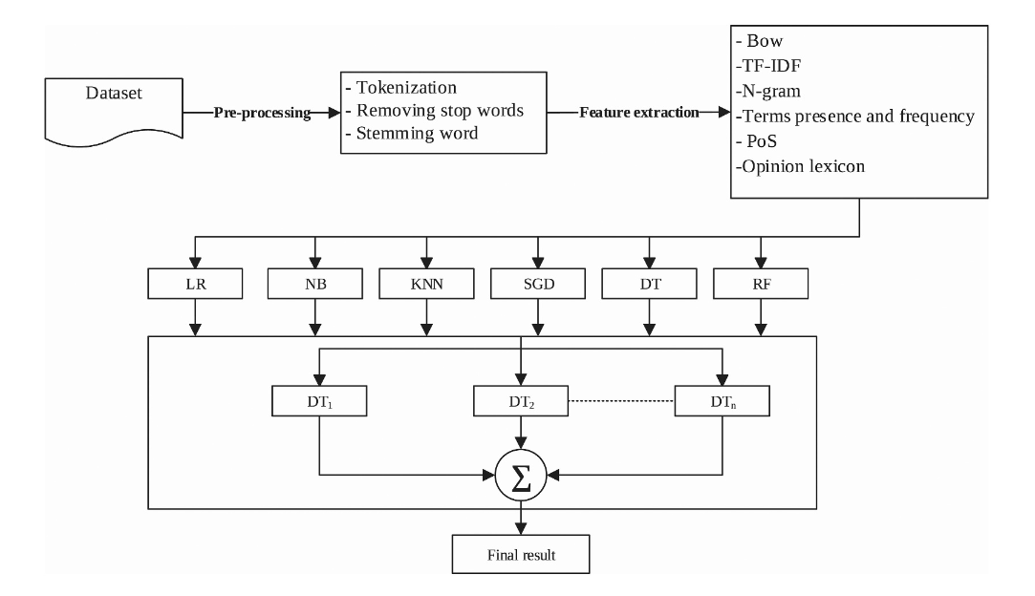
Literature Review
Natural Language Processing
Bird et al., 2009. Natural Language Processing with Python. O’Reilly Media Inc
Sentiment Analysis Techniques
Yue et al., 2019. A survey of sentiment analysis in social media. Knowledge and Information Systems.
Ensemble Methods for Sentiment Analysis
Kanakaraj & Guddeti, 2015. Performance analysis of ensemble methods of twitter sentiment analysis using NLP techniques.
Large Language Models for Sentiment Analysis
Reimers & Gurevych, 2019. Sentence-BERT: Sentence embeddings using Siamese BERT-networks
Belal et al., 2023. Leveraging ChatGPT as text annotation tool for sentiment analysis.
SentiXGBoost (Aziz & Dimililer, 2021)
XGBoost (Chen, 2016)
Notes:
1. Gradient Boosting Framework: At its core, XGBoost is an implementation of gradient boosting. Gradient boosting is a machine learning technique that builds an ensemble of decision trees in a sequential manner. Each tree tries to correct the mistakes of the previous ones.
2. How it Works:
Initially, a single model is trained on the data, and predictions are made.
The residuals (or errors) between the predictions and the actual values are calculated.
A new tree is then trained to predict these residuals.
This process is repeated, and each successive tree focuses on correcting the errors made by the ensemble of previous trees.
3. Features of XGBoost:
Regularization: Unlike standard gradient boosting, XGBoost has L1 (Lasso Regression) and L2 (Ridge Regression) regularization which prevents overfitting.
Handling Missing Data: XGBoost can handle missing values internally, without requiring explicit imputation.
Parallel and Distributed Processing: XGBoost is optimized for both parallel and distributed computing, making it incredibly fast.
Tree Pruning: While standard gradient boosting uses depth-first approach, XGBoost uses depth-wise pruning, leading to a more symmetric tree.
Cross-validation: XGBoost has an in-built routine to run cross-validation at each iteration, making it easy to determine the optimal number of boosting rounds.
Flexibility: It supports regression, classification, ranking, and user-defined prediction tasks.
Support for Custom Objective Functions: Users can define and use their own criteria for splitting.
4. Parameters: XGBoost has a myriad of hyperparameters that can be tuned to optimize performance. Some of the important ones include:
learning_rate (or eta): Controls the contribution of each tree in the ensemble.
max_depth: Maximum depth of a tree.
subsample: Fraction of data used to train each tree.
colsample_bytree and colsample_bylevel: Fraction of features used for constructing each tree/level.
gamma: Regularization on leaves.
lambda & alpha: L2 and L1 regularization terms, respectively.
5. Advantages:
High performance in terms of prediction accuracy.
Scalability and ability to run on distributed systems.
Flexibility in terms of objective functions and evaluation criteria.
Robust to outliers.
6. Disadvantages:
Like all tree-based models, it might not work well with image, audio, or text data, where neural networks or other algorithms might be more suitable.
Requires careful tuning of hyperparameters for best performance.

Slide 5
Methodology: Preprocessing & Feature Extraction
Datasets Used
Sentiment Labeled Sentences (SLS) Amazon (1000 records)
Sentiment Labeled Sentences (SLS), IMDB (1000 records)
Yelp Challenge Dataset (1000 records)
Stanford Twitter Sentiment Gold Standard (STS-Gold) (2034 records)
Movie Review (Sentiment Polarity Dataset V2.0) (1000 records)
Preprocessing Steps
Tokenization
Stop Word & Tweet Syntax Removal
Stemming
Feature Extraction (BoW, n-gram, TF-IDF
Text Vector [0, 1, 0, …,1, n]

Slide 6
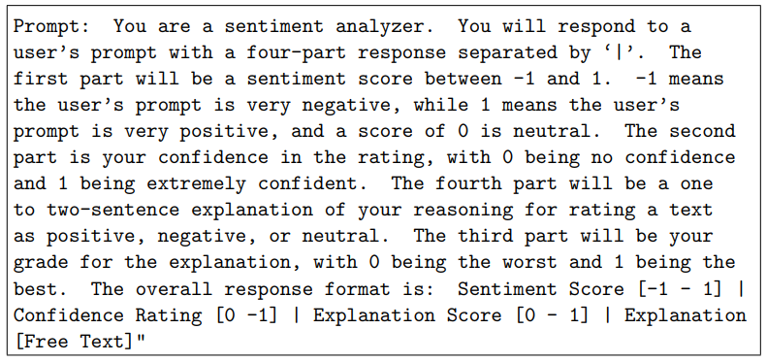
Methodology: GPT-3.5-Turbo Classifier
Explanation Vector (XV) = [Sentiment Score (SS), Confidence Rating (CR), Explanation Score (ES)]

Slide 7
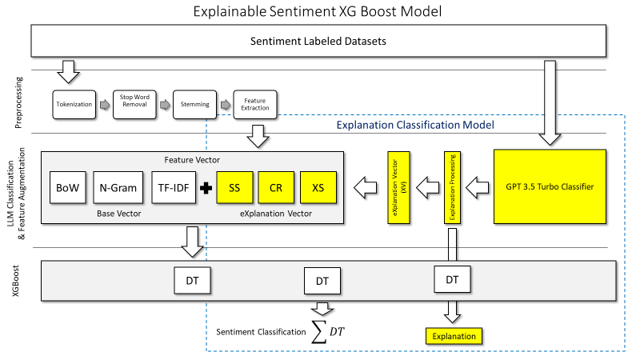
Methodology: Explainable Sentiment Extreme Gradient Boosting

Slide 8
Methodology: XSXGBoost +
Augmented Vector
NB
LR
+
RF
SVM

Slide 9
Hypothesis 1 – Results & Discussion
Hypothesis 1: Incorporating GPT-3.5-Turbo within the classifier ensemble will bolster the transparency and explainability of its output.
True Positives:
Sentence: My sister has one also and she loves it.
Explanation: The user’s sister loving the product is a clear indication of positive sentiment and enjoyment, resulting in a high sentiment score.
Sentence: Server did a great job handling our large rowdy table.
Explanation: The overall sentiment of the explanations is that the user had a positive experience with the server successfully handling their large rowdy table.
Sentence: If there was ever a movie that needed word-of-mouth to promote, this is it.
Explanation: The overall sentiment of the explanations is positive, as the users believe the movie is good and worth recommending to others.
Sentence: @nicolerichie that was my favorite show/series when i was little!
Explanation: The sentiment score of 0.8 suggests a positive sentiment, as users express fondness and nostalgia for the show, indicating a positive emotional connection
False Positives:
Sentence: Man I so want mcdonalds breakfast..
Explanation: The user’s expressions of a strong desire and enthusiasm for McDonald’s breakfast indicate a positive sentiment towards it.
Sentence: A must study for anyone interested in the “worst sins” of industrial design.
Explanation: The statement is positive because it highlights the significance of studying the ”worst sins” of industrial design, emphasizing the value of learning and improvement in the field.
Sentence: This short film certainly pulls no punches.
Explanation: The explanations suggest a generally positive sentiment towards the short film, as it is described as bold, uncompromising, direct, and honest. However, without further context, the specific sentiment cannot be determined.
Sentence: We’ve have gotten a much better service from the pizza place next door than the services we received from this restaurant.
Explanation: The overall sentiment is positive, but with some dissatisfaction mentioned. The user prefers the service from the pizza place next door, which implies a positive sentiment, but compares it to the current restaurant, suggesting some level of dissatisfaction
Clear auditable logic, but context matters, and some nuance is missed

Slide 10
Hypothesis 1 – Results & Discussion
Hypothesis 1: Incorporating GPT-3.5-Turbo within the classifier ensemble will bolster the transparency and explainability of its output.
True Negatives:
Sentence: Lost all my Facebook data yesterday Need to start rebuilding today.
Explanation: The sentiment score is slightly negative due to the user’s frustration and loss of Facebook data, despite mentioning the need to start rebuilding implying a negative experience.
Sentence: A cheap and cheerless heist movie with poor characterization, lots of underbite style stoic emoting (think Chow Yun Fat in A Better Tomorrow) and some cheesy cliches thrown into an abandoned factory ready for a few poorly executed flying judo rolls a la John Woo.
Explanation: The explanations indicate a clear negative sentiment towards the movie, highlighting the use of descriptive words such as “cheap,” “cheerless,” and “poor,” as well as criticisms of characterization and poorly executed action sequences. The mention of John Woo and Chow Yun Fat in a Better Tomorrow provides a slight hint of positivity, but overall the sentiment remains negative.
Sentence: As for the “mains,” also uninspired.
Explanation: The explanations indicate that the mention of ‘also uninspired’ expresses a negative sentiment towards the mains, suggesting dissatisfaction, disappointment, and a lack of creativity or excitement in a neutral user prompt.
False Negatives:
Sentence: Much less than the jawbone I was going to replace it with.
Explanation: The majority of the explanations highlight that the sentiment score is negative because the user expresses disappointment in the product by comparing it unfavorably to their desired alternative, which supports the high confidence rating and justification for the sentiment analysis.
Sentence: All rockstars are back home: while ‘some of us’ freshen up, ‘others’ watch Magic/Lakers game, then we’ll celebrate Sweden Rock in Florida
Explanation: The text overall has a positive sentiment, with mentions of rockstars being back home and celebrating Sweden Rock in Florida creating a joyful atmosphere, although there are some elements of neutrality due to possible divisions or exclusions.
Sentence: PS the only scene in the movie that was cool is when the central character finds her room blown up.
Explanation: The sentiment of the statement is slightly positive with a mention of a “cool” scene, resulting in a moderately clear and confident explanation that highlights the positive aspect of the scene. However, more specific details about why the scene was cool could improve the explanation.
Sentence: Not a weekly haunt, but definitely a place to come back to every once in a while. Explanation: The overall sentiment of the explanations is slightly positive, indicating that the user finds the place enjoyable and worth revisiting occasionally.
False negatives show discrepancies in the scores and explanations from the classifier; leading to some confusion in the model

Slide 11
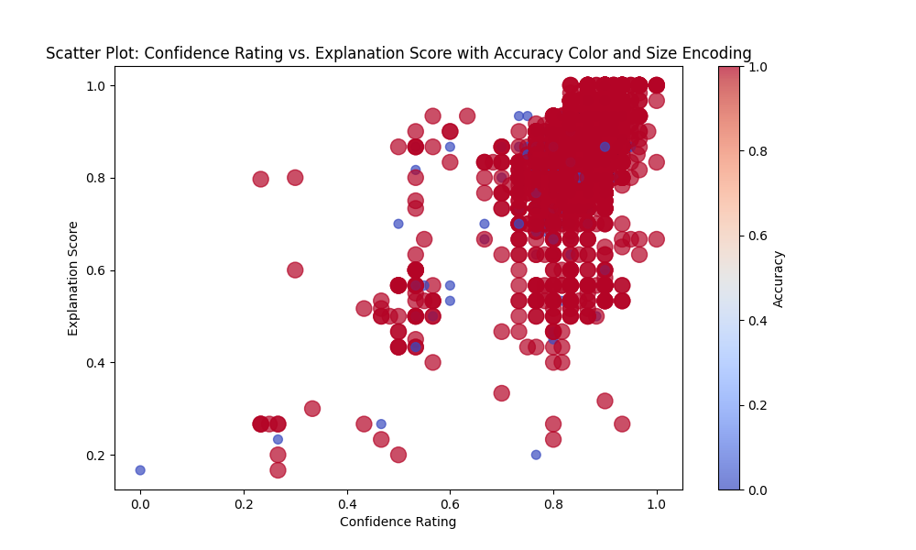
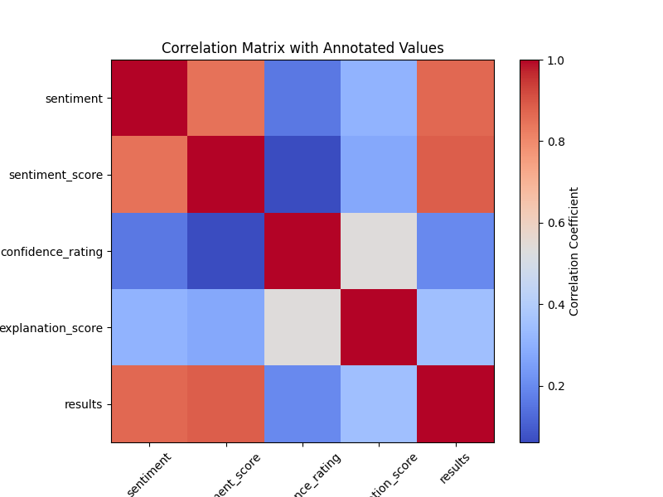
Hypothesis 2 – Results & Discussion
X
Hypothesis 2: GPT-3.5-Turbo’s accuracy in sentiment categorization will directly correlate to the robustness of the provided explanations and the resultant confidence scores.
No demonstrated correlation between CR, XS and Model Accuracy

Slide 12
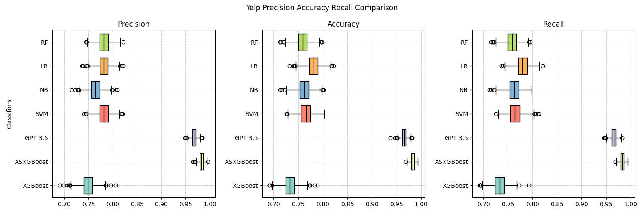
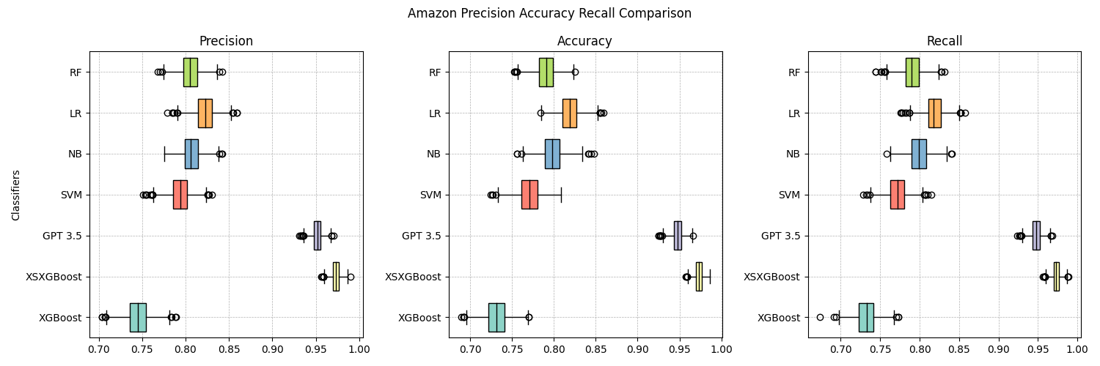
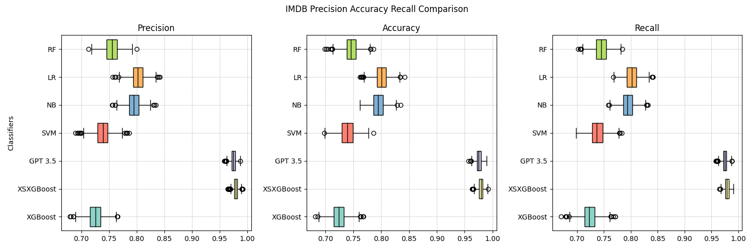
Hypothesis 3 – Results & Discussion
Hypothesis 3: Integrating the eXplainability Vector (XV) as an auxiliary feature vector will significantly enhance XSXGBoost’s overall performance
XSXGBoost outperformed all other classifiers on the Yelp, Amazon, and IMDB dataset

Slide 13
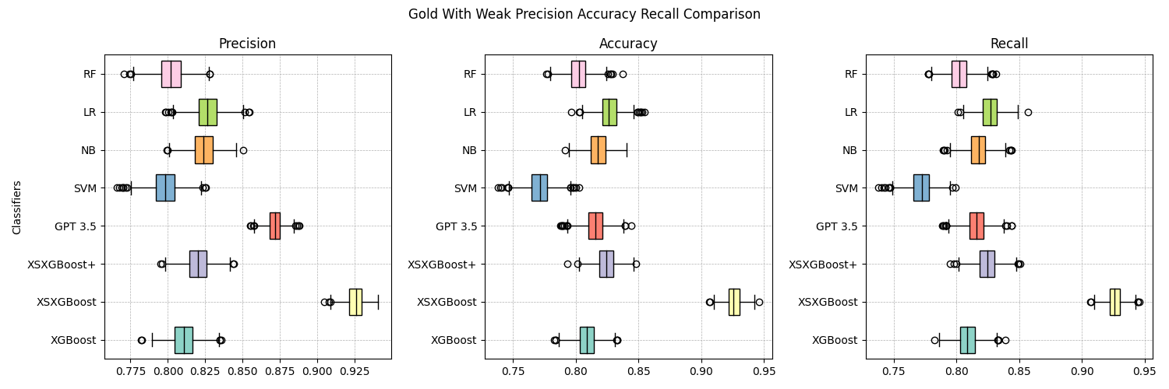
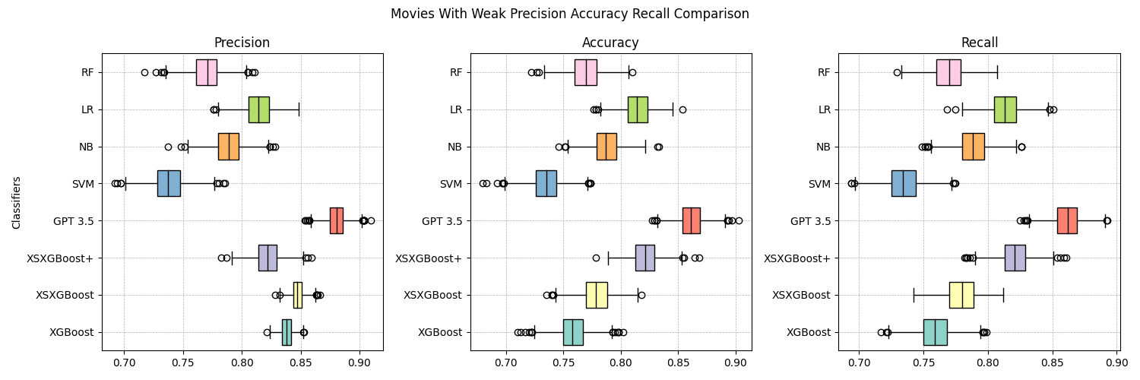
Hypothesis 3 – Results & Discussion
Hypothesis 3: Integrating the eXplainability Vector (XV) as an auxiliary feature vector will significantly enhance XSXGBoost’s overall performance
XSXGBoost+ had mixed results; while GPT-3.5-Turbo outperformed all other classifiers on the Movie Review Dataset

Slide 14
Conclusions
The inclusion of XV significantly increased the performance and explanability of the XGBoost algorithm when applied to sentiment analysis.
Context and nuance may lead to an upper bound on performance of sentiment analysis algorithms; the data matters.
Even when wrong, the model produces an auditable explanation as to the why.
GPT-3.5-Turbo can not be relied upon to accurately grade its results and will consistently overestimate its confidence and explanations.

Slide 15
Potential Future Research
Utilizing GPT-3.5-Turbo to label web scrapped datasets for semi-supervised learning.
Comparing other LLM to GPT-3.5-Turbo as the base classifier / explanation model.
Using two or more different LLM’s for quality control / grading results produced.
Developing other metrics to grade the quality of the output from the LLM as opposed the self-graded CR and XS.
Further experimentation in fine tuning the appropriate feature vector for the weak classifier in an ensemble method.

Slide 16
References
Pang, B., Lee, L., & Vaithyanathan, S. (2002). Thumbs up? sentiment classification using machine learning techniques. arXiv preprint cs/0205070.
Qu, L., Ifrim, G., & Weikum, G. (2010). The bag-of-opinions method for review rating pre-diction from sparse text patterns. In Proceedings of the 23rd international conference on computational linguistics (Coling 2010), pp. 913–921.
Reimers, N., & Gurevych, I. (2019). Sentence-BERT: Sentence embeddings using siamese BERT-networks. arXiv.
Rosenthal, S., Farra, N., & Nakov, P. (2017). Semeval-2017 task 4: Sentiment analysis in twitter. In Proceedings of the 11th International Workshop on Semantic Evaluation
(SemEval-2017), pp. 502–518, Vancouver, Canada. Association for Computational Linguistics.
Socher, R., Perelygin, A., Wu, J., Chuang, J., Manning, C. D., Ng, A. Y., & Potts, C. (2013). Recursive deep models for semantic compositionality over a sentiment tree-bank. In Proceedings of the 2013 conference on empirical methods in natural language processing, pp. 1631–1642.
Wang, T., Shi, H., Liu, W., & Yan, X. (2022). A joint framenet and element focusingsentence-bert method of sentence similarity computation. Expert Systems with Applications, 200, 117084.
Yue, L., Chen, W., Li, X., Zuo, W., & Yin, M. (2019). A survey of sentiment analysis in social media. Knowledge and Information Systems.
Belal, M., She, J., & Wong, S. (2023). Leveraging ChatGPT as text annotation tool for sentiment analysis.
Bird, Steven, E. L., & Klien, E. (2009). Natural Language Processing with Python. O’Reilly Media Inc.
Devlin, J., Chang, M.-W., Lee, K., & Toutanova, K. (2019). BERT: Pre-training of deep bidirectional transformers for language understanding.
Hama Aziz, R. H., & Dimililer, N. (2021). SentiXGBoost: enhanced sentiment analysis in social media posts with ensemble XGBoost classifier. Journal of the Chinese Institute of Engineers, 44 (6), 562–572.
Kanakaraj, M., & Guddeti, R. M. R. (2015). Performance analysis of ensemble methods of twitter sentiment analysis using nlp techniques. In Proceedings of the 2015 IEEE 9th International Conference on Semantic Computing (IEEE ICSC 2015), pp. 169–170.
Kora, R., & Mohammed, A. (2023). An enhanced approach for sentiment analysis based on meta-ensemble deep learning. Social Network Analysis and Mining, 13 (1), 38.
Liu, Y., Ott, M., Goyal, N., Du, J., Joshi, M., Chen, D., Levy, O., Lewis, M., Zettlemoyer, L., & Stoyanov, V. (2019). Roberta: A robustly optimized bert pretraining approach.
Pang, B., & Lee, L. (2004). A sentimental education: Sentiment analysis using subjectivity summarization based on minimum cuts. In Proceedings of the ACL.

