Slide 1
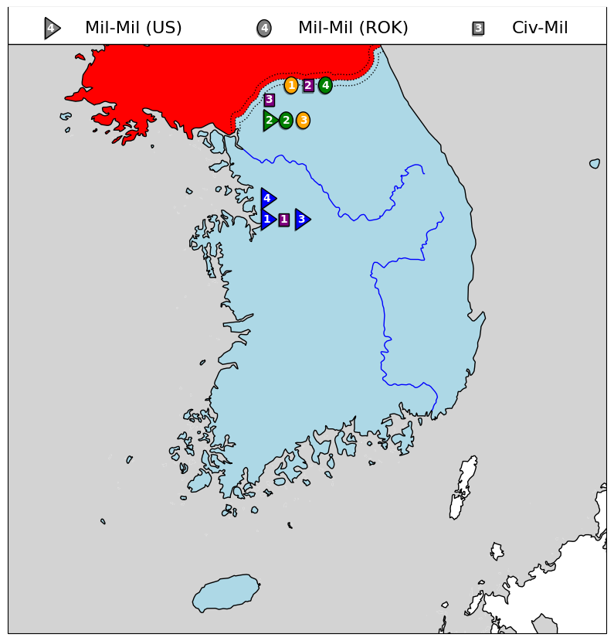
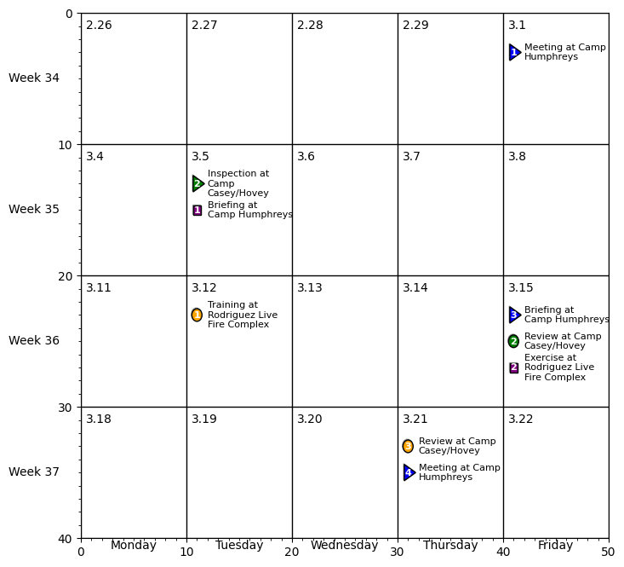
2ID/RUCD Current Engagements (Week 33 to 37)

