Slide 1
Value proposition description
Economics
Input
Run
Analyze
Engineering
Input
Run Analyze
Management
Analyze
Acceptable?
Done
No,
Repeat
Long
Cycle
Demographic
View
Engineering
View
Business
View
Shared Grid Simulation Platform: What if?...
Input
Run
Analyze
Short
Cycle

Slide 2
Simulation Steps
GUI:
Business View
On Demand Scenario Builder
Simulation
Executive
BI Analysis Tools
Command to begin a simulation
Compile scenario template together with selected CRM, GIS, EAM, and weather data
Raw simulation output
Results for
viewing

Slide 3
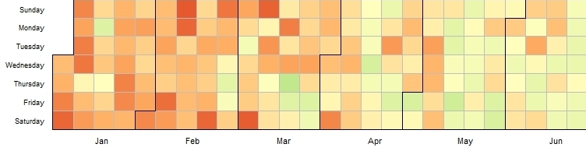

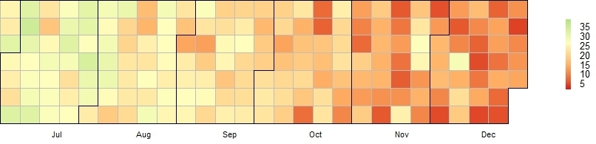
Graphic: RPS Simulation Results
Simulated Daily Renewable Generation over One Year, GWh / Day

Slide 4
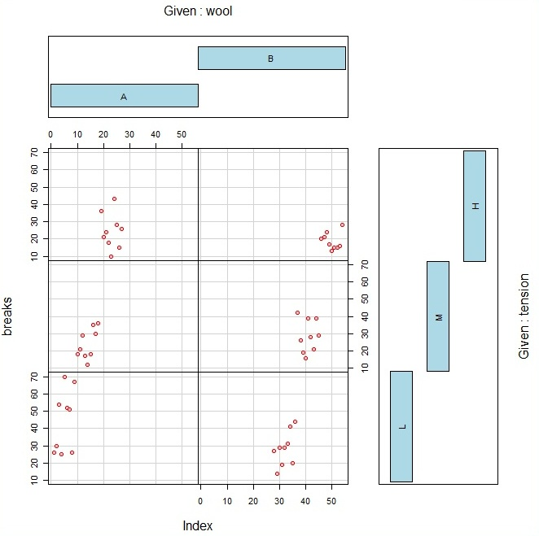
Graphic: EV Simulation Results
Given: Average penetration rate of electric vehicles
25%
50 %
4
Transformer peak sustained kVA (nameplate 30kVA)
5
Given: Number of houses on branch circuit
6
Transformer average spare capacity

