Slide 1


Dataset generator & Chatbot assistant for Instruction Manuals
Dinesh Kumar T
Adeshvar K Mullath
Abhinaya Sri Ginne

Slide 2
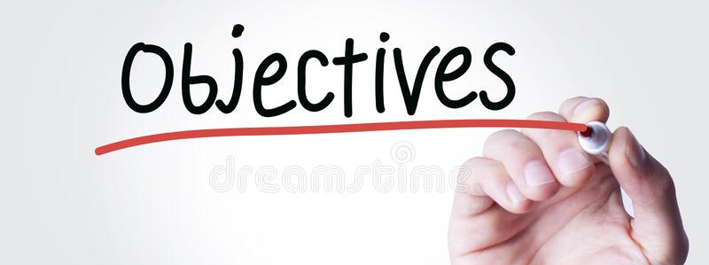
In our day to day lives, we spend a considerable amount of time on reading instruction manuals for various purposes. The main objective of this model is to reduce man hours invested on reading those instructions for instruments, appliances, automobiles etc using chatbot.

Slide 3



Bare-bones
Dataset generator
Text summarize
Chatbot
The project proceeds through three major stages -

Slide 4
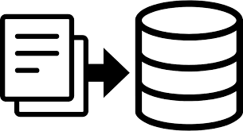
Data set Generator
The dataset generator block implements text pre-processing of the instruction manual loaded.
The major pre-processing steps done in our project are:
changing to lower case
tokenization
stemming
Lemmatization
We are utilizing snowball stemmer and spaCy library for lemmatization.

Slide 5

We are using LexRank method for text summarizing.
The scoring of sentences is done using graph method.
This graphical approach is based on Eigen Vector Centrality.
The sentences are placed at the vertexes of the graphs and the weight of the edges are calculated using cosine similarity metric.
The sentence summaries generated are later used in the chatbot for instructional queries.
Text Summarizer

Slide 6
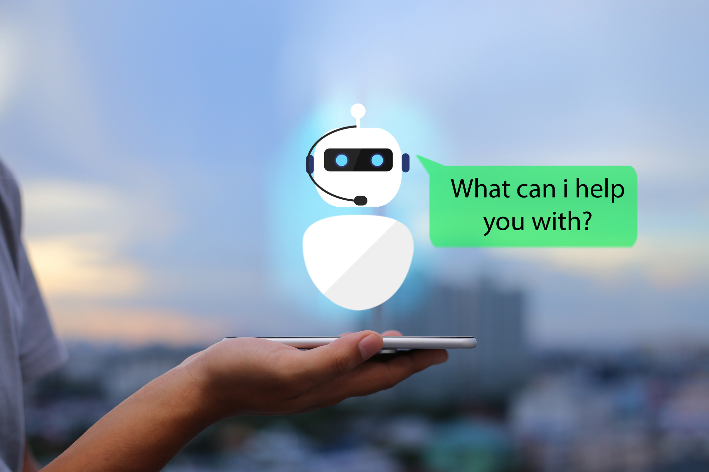
CHATBOT
This chatbot understands the context of sentence and responds accordingly.
The input dataset is given from the previous blocks (dataset generator and text summarizer).
The process goes as below -
Transforming the Conversational Intents into TensorFlow model (Neural Network using TFLEARN) using NLP and Save it as Pickle also.
Load the Same Pickle and Model to Build the Framework to Process the Responses.
At Last, We Give the Reponses.

Slide 7


IMPACTS IMPOSED
Saves a huge amount of time invested on instructions manuals.
Text summaries gives out elaborate answers for queries.
Reduces the complexity of searching for a specific instruction on a manual.

Slide 8

How we differ from the usual
Instead of single line answers, the chatbot gives elaborate summaries for long instructions.
Unlike blogs and tech forums, the user will be receiving the exact instruction from the manual and not ambiguous answers.
Our proposed project will be a native and offline version therefore eliminates the need to depend on internet connectivity.

Slide 9


