Slide 1

5th Floor, Usnaz Tower, Church Landing Rd, near Medical Trust Hospital, Pallimukku, Kochi, Kerala 682016

Slide 2
Python operators

Slide 3
Operators
Operators are special symbols in Python that carry out arithmetic or logical computation. Operators are used to perform operations on variables and values.
The value that the operator operates on is called the operand.
For example: >>> 2+3=5.
(From example ‘+’ is an Operator and ‘2’ and ‘3’ are Operands.
Python divides the operators in the following groups:
• Arithmetic operators • Assignment operators • Comparison operators • Logical operators • Identity operators • Membership operators • Bitwise operators

Slide 4
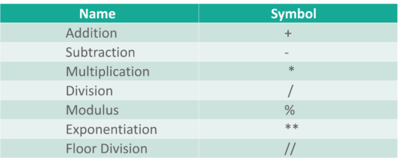
Arithmetic operators
Arithmetic operators are used to perform arithmetic calculations in python.These are the symbols that we use while doing an arithmetic operation in python.

Slide 5
Arithmetic Operators
a = 10
b = 3
print("a + b =", a + b)
print("a - b =", a - b)
print("a * b =", a * b)
print("a / b =", a / b)
print("a % b =", a % b)
print("a ** b =", a ** b)
print("a // b =", a // b)

Slide 6
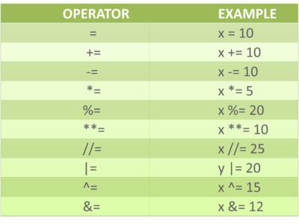
Assignment operators
Assignment operators are used to assign values to the variables or any other object in python. Following are the assignment operators that we have in python

Slide 7
Assignment Operators
r = 7
r += 3
print("r after r += 3:", r)
r -= 2
print("r after r -= 2:", r)
r *= 5
print("r after r *= 5:", r)
r /= 2
print("r after r /= 2:", r)
r %= 3
print("r after r %= 3:", r)
r //= 2
print("r after r //= 2:", r)
r **= 4
print("r after r **= 4:", r)

Slide 8
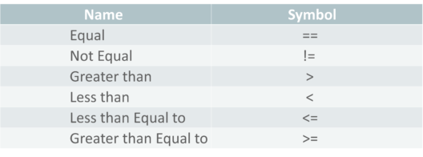
Comparison operators
Comparison operators are used to compare two values. Following are the comparison operators that we have in python.

Slide 9
Comparison Operators
x = 5
y = 8
print("x == y:", x == y)
print("x != y:", x != y)
print("x < y:", x < y)
print("x > y:", x > y)
print("x <= y:", x <= y)
print("x >= y:", x >= y)

Slide 10
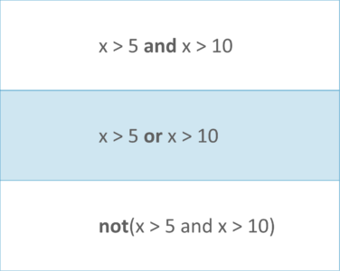
Logical operators
Logical operators are used to compare two conditional statements. Following are the logical operators that we have in python.

Slide 11
Logical Operators
p = True
q = False
print("p and q:", p and q)
print("p or q:", p or q)
print("not p:", not p)

Slide 12
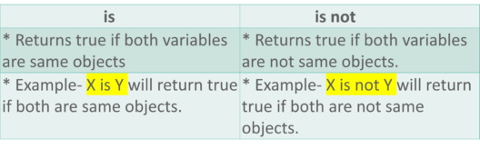
Identity operators
Identity operators compare two objects. Following are the identity operators that we have in python.

Slide 13
Identity Operators
s = "hello"
t = "world"
u = "hello"
print("s is t:", s is t)
print("s is u:", s is u)
print("s is not u:", s is not u)
print("s is not t:", s is not t)

Slide 14
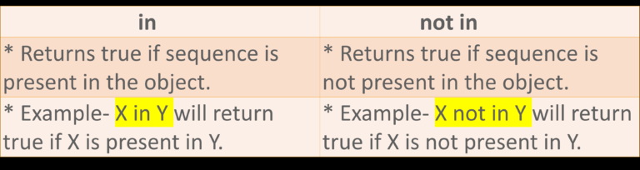
Membership operators
Membership operators are used to check if a sequence is present in an object. Following are the membership operators that we have in python.

Slide 15
Membership Operators
v = [1, 2, 3, 4, 5]
print("2 in v:", 2 in v)
print("6 in v:", 6 in v)
print("2 not in v:", 2 not in v)
print("6 not in v:", 6 not in v)

Slide 16
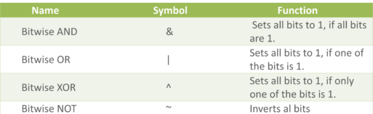
Bitwise operators
Bitwise operators compare the binary values. Following are the bitwise operators that we have in python

