Slide 1

5th Floor, Usnaz Tower, Church Landing Rd, near Medical Trust Hospital, Pallimukku, Kochi, Kerala 682016

Slide 2
Modules

Slide 3
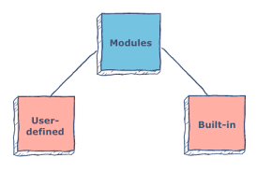
A module is a file containing Python code, definitions of functions, statements, or classes. An example_module.py file is a module we will create and whose name is example_module. We employ modules to divide complicated programs into smaller, more understandable pieces. Modules also allow for the reuse of code.
1. Built in
2. User-defined.

Slide 4
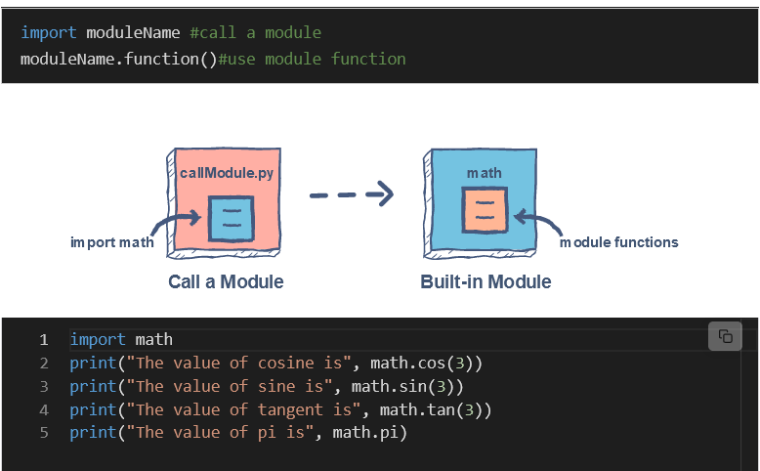
Built-in modules
Built-in modules come with default Python installation. One of Python’s most significant advantages is its rich library support that contains lots of built-in modules. Hence, it provides a lot of reusable code. Some commonly used Python built-in modules are datetime, os, math, json, random etc

Slide 5
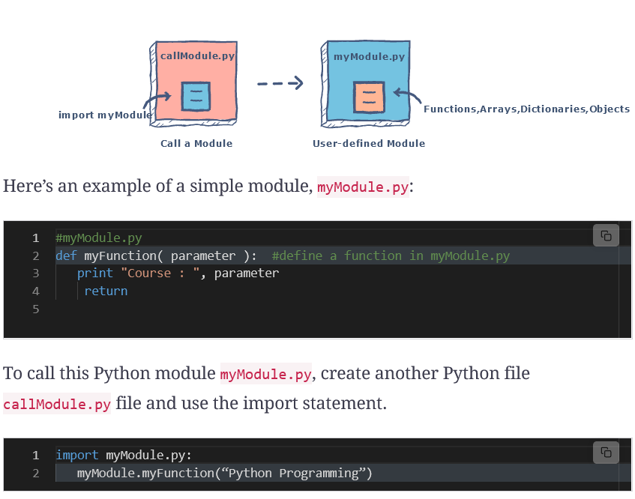
User-defined modules
The modules which the user defines or create are called a user-defined module.
We can create our own module, which contains classes, functions,variables, etc., as per our requirements.

Slide 6
Benefits of modules in Python
There are a couple of key benefits of creating and using a module in Python:
Structured Code
Code is logically organized by being grouped into one Python file which makes development easier and less error-prone.
Code is easier to understand and use.
Reusability
Functionality defined in a single module can be easily reused by other parts of the application. This eliminates the need to recreate duplicate code.

