Slide 1

5th Floor, Usnaz Tower, Church Landing Rd, near Medical Trust Hospital, Pallimukku, Kochi, Kerala 682016

Slide 2
Functions

Slide 3
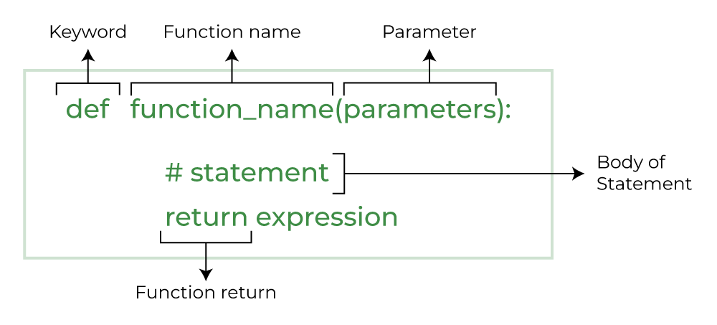
Introduction to Python Functions
Python functions are a powerful tool for creating custom code. They are defined blocks of code that can be executed with a single call. Functions can be used to simplify code and make it easier to read and maintain.
Python functions are defined using the 'def' keyword, followed by the function name and a set of parentheses. The parentheses may contain parameters that are passed to the function when it is called.

Slide 4
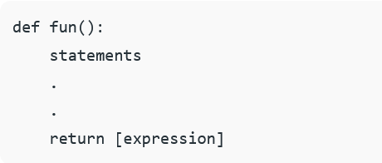
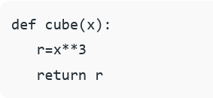
Return Values
Python functions can return values. When a function returns a value, the code inside of the function is executed and the value is returned to the calling code. The value that is returned can be used in the calling code.
It is important to note that if a function does not explicitly return a value, then the function will return the special value 'None'. This is a special value that indicates that no value was returned from the function.

Slide 5
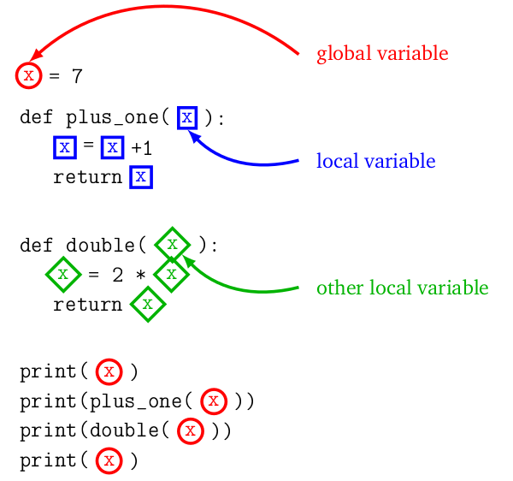
Variable Scope
Python functions have a concept of variable scope. Variables that are defined inside of a function are only visible inside of that function and are not visible outside of the function. This is referred to as a local variable.
Variables that are defined outside of a function are referred to as global variables and are visible inside of the function. It is important to note that if a variable is defined inside of a function and is given the same name as a global variable, the local variable will take precedence.

Slide 6
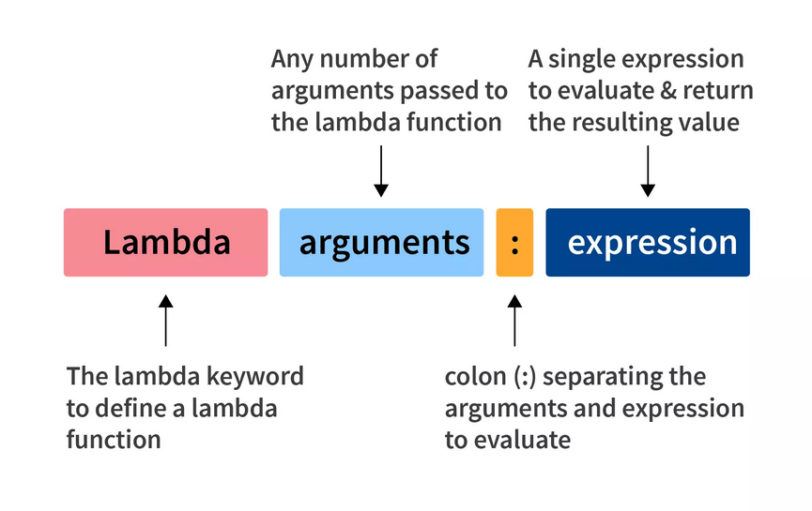

Lambda Functions
Python also supports the concept of lambda functions. Lambda functions are anonymous functions that are defined using the 'lambda' keyword. They are typically used when a function is only needed for a short period of time and does not need to be reused.
Lambda functions are defined using the 'lambda' keyword followed by a set of parameters, a colon, and the expression that will be evaluated. Lambda functions are typically used in conjunction with other built-in functions such as 'map' and 'filter' to create custom code.

Slide 7
Python functions are a powerful tool for creating custom code. They are defined blocks of code that can be executed with a single call. Functions can be used to simplify code and make it easier to read and maintain.
Python functions can return values, have variable scope, and can be called from other functions. Python also supports the concept of lambda functions, which are anonymous functions that are defined using the 'lambda' keyword.

