Slide 1

5th Floor, Usnaz Tower, Church Landing Rd, near Medical Trust Hospital, Pallimukku, Kochi, Kerala 682016

Slide 2
Object-oriented programming (OOP)

Slide 3
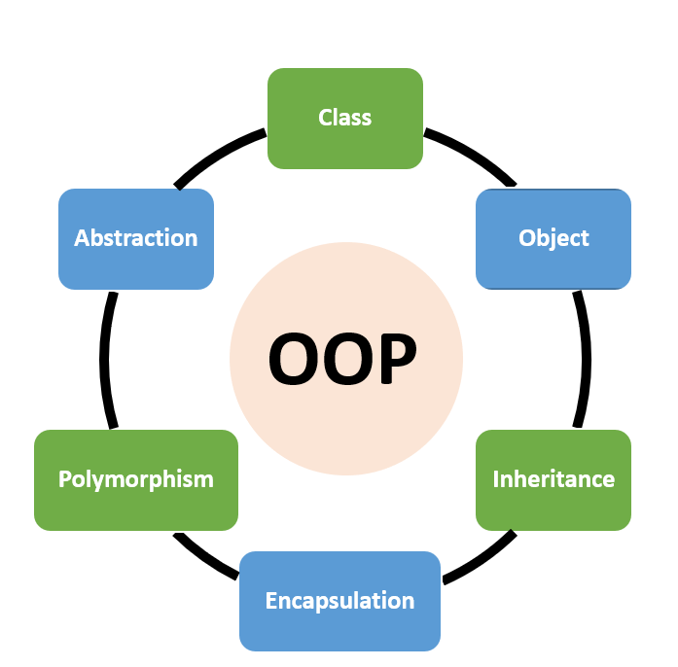
What is an OOPs in Python?
Object-Oriented Programming (OOPs) is a programming paradigm based on the concept of objects. It is a way of organizing and structuring code that allows for code reuse and efficient problem solving. In Python, OOPs is used to create classes and objects that can be used to store and manipulate data.
Python is an object-oriented language, meaning it allows users to create and use objects. Objects are defined by their attributes and behaviors, and can interact with other objects. This makes it easier to develop complex applications with fewer lines of code.

Slide 4
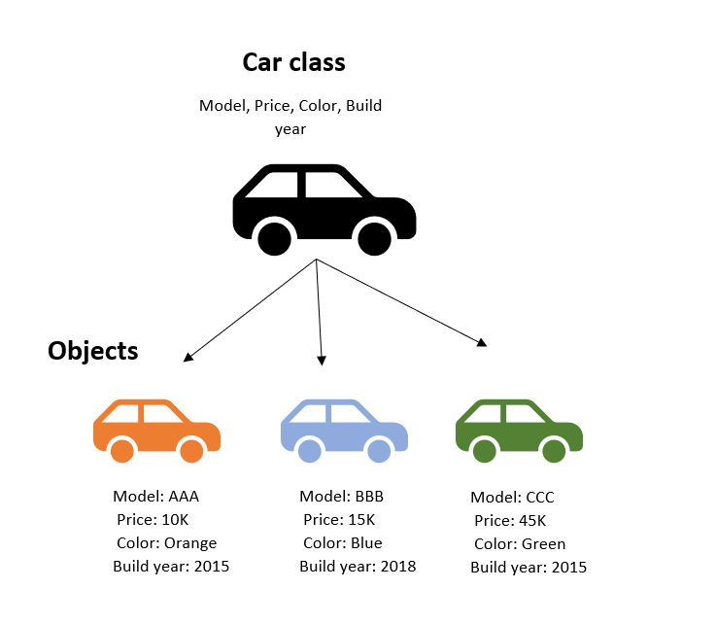
Examples of OOPs in Python
One example of OOPs in Python is creating classes and objects. A class is a template for creating objects, and objects are instances of a class. Objects can contain data, such as attributes, and methods, which are functions that can be used to manipulate the data.
Another example of OOPs in Python is creating inheritance. Inheritance allows one class to inherit the attributes and methods of another class, which makes it easier to create complex applications with fewer lines of code.

Slide 5
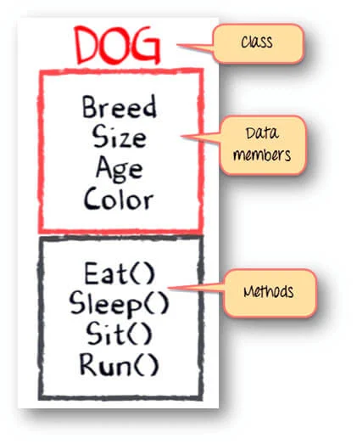
Class
A class is a collection of objects. A class contains the blueprints or the prototype from which the objects are being created. It is a logical entity that contains some attributes and methods.
To understand the need for creating a class let’s consider an example, let’s say you wanted to track the number of dogs that may have different attributes like breed, age. If a list is used, the first element could be the dog’s breed while the second element could represent its age. Let’s suppose there are 100 different dogs, then how would you know which element is supposed to be which? What if you wanted to add other properties to these dogs? This lacks organization and it’s the exact need for classes.

Slide 6
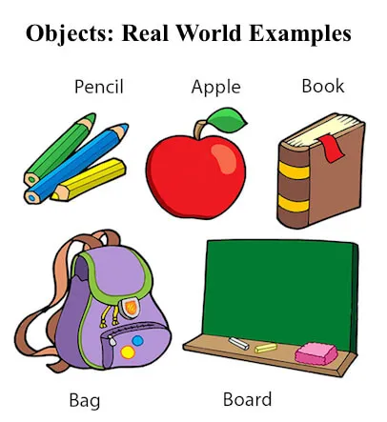
Objects
The object is an entity that has a state and behavior associated with it. It may be any real-world object like a mouse, keyboard, chair, table, pen, etc. Integers, strings, floating-point numbers, even arrays, and dictionaries, are all objects. More specifically, any single integer or any single string is an object. The number 12 is an object, the string “Hello, world” is an object, a list is an object that can hold other objects, and so on.

Slide 7
class employee:
name="rahul"
designation="SE"
salary=30000
def fun1(self):
print("Employee Name: ",self.name)
print("Designation: ",self.designation)
print("Salary: ",self.salary)
obj=employee()
obj.fun1()
class animal:
attr1="cat"
attr2="dog"
def fun(self):
print("first animal is",self.attr1)
print("second animal is",self.attr2)
obj=animal()
print(obj.attr1)
print(obj.attr2)
obj.fun()

Slide 8
Polymorphism in Python
Polymorphism is a concept in OOPs that allows objects to have different behaviors depending on the context. In Python, polymorphism is used to create objects that can be used in different ways. For example, a function can be written to take any object as an argument and do something with it.
Polymorphism is a powerful concept that allows for the creation of code that is more flexible and easier to maintain. It also allows for code reuse, as objects can be used in different ways without having to rewrite the code.

Slide 9
Encapsulation in Python
Encapsulation is a concept in OOPs that allows for the hiding of data. In Python, encapsulation is used to create classes and objects that can be used to store and manipulate data. Encapsulation allows for code that is more secure and easier to maintain, as data can be hidden from outside code.
Encapsulation also allows for code reuse, as data can be reused without having to rewrite code. It also makes it easier to debug and test code, as objects can be tested individually.

Slide 10
Benefits of OOPs in Python
OOPs in Python allows for code reuse, which can save time and effort. It also makes it easier to maintain code, as objects can be modified without having to rewrite the entire program. OOPs also makes it easier to debug and test code, as objects can be tested individually.
OOPs also allows for abstraction, which is the process of hiding the details of an object's implementation. This makes it easier to understand code and makes it easier to modify code in the future.

