Slide 1
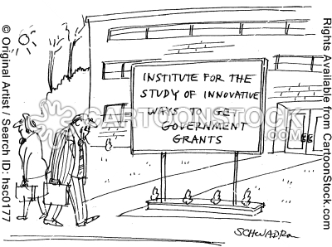
Writing Proposals and Getting Funded
Tessa Hill, UC Davis Sarah Penniston-Dorland, U Maryland
tmhill@ucdavis.edu sarahpd@umd.edu

Slide 2
Outline of topics
Interacting with your Program Officer
Sources for finding funding opportunities
Elements of successful proposals
Common pitfalls
Resubmissions
Myths debunked
Strategies for proposal writing

Slide 3
Your Program Officer…
Is a scholar in your field (usually) who knows what everybody is doing & is formative in directing the scholarship of your field; Can be permanent or temporary
Coordinates & runs the review process
Executes or makes funding decisions, depending upon agency policies
Advocates for your field in competition with other research areas and budget priorities.
Continues to work with you throughout your grant and is interested in your success

Slide 4
Ask your Program Officer…
(After doing your homework)
Does your program fund this type of research?
What is the average program budget and success rate; how many proposals in a competition?
What is the typical size of a successful “new investigator” project in this program?
What is the review and decision-making process in this program?
Are there special programs for which I qualify and how can I be considered for them?
Are you aware of other agencies or organizations that fund this kind of project?

Slide 5
Get funding calls for proposals to come to you
Your Sponsored Projects Office
Meet your SPO contact, make him/her familiar with your work
Individual Agency email lists
E.g. NSF (http://nsf.gov/funding/)
Community of Scholars – Pivot
http://pivot.cos.com (Free 30-day trial)
Discipline-specific listservs
Acknowledgements sections at conference presentations
Meeting with your program officers

Slide 6
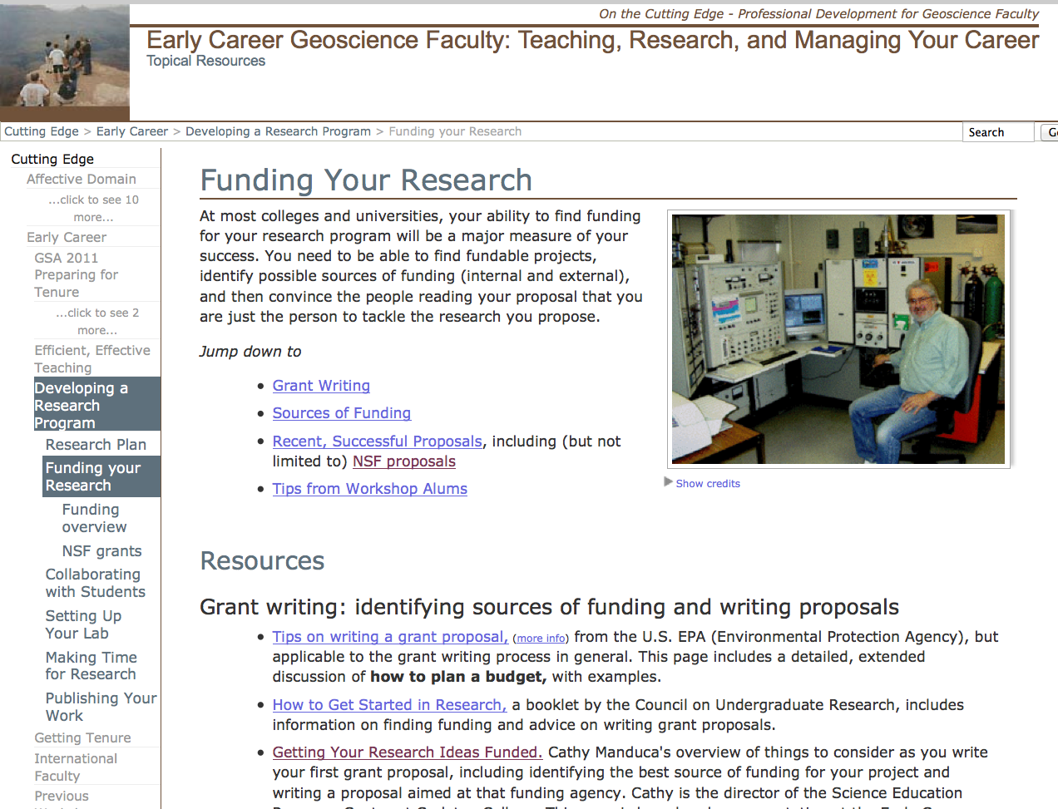
A good source for information about Grant Writing:
http://serc.carleton.edu/NAGTWorkshops/earlycareer/research/funding.html

Slide 7
Take advantage of special opportunities
Packard Fellowship http://www.packard.org/what-we-fund/conservation-and-science/packard-fellowships-for-science-and-engineering/
NSF CAREER/PECASE http://www.nsf.gov/funding/pgm_summ.jsp?pims_id=503214
DOE Early Career Awards http://science.energy.gov/early-career/
HHMI Professorships (for undergrad research) http://www.hhmi.org/programs/society-of-hhmi-professors
Opportunities at your institution for early career faculty

Slide 8
Proposal strategic planning – Research significance
Pick a research topic you are considering writing a proposal to fund.
Why is this topic important?
What is unique/transformative about the research?
What are the benefits of this research?
How does this research fit with your overall career plan?

Slide 9
Elements of Successful Proposals: Big Picture and Hypotheses
The relevance and importance of the proposed work should be clearly stated. Connect it to the ‘big picture.’
Proposals should be hypothesis or question driven… objectives/hypotheses/questions appear on the first 1-2 pages
Hypotheses should relatable to big picture questions
Outline tests of hypotheses and expected outcomes
Outline possible alternatives

Slide 10
Elements of Successful Proposals: Formatting and Writing Style
Use images – a picture is worth a thousand words.
Well organized, with underlining, differences in type, spacing, TITLES, to call attention to main points and structure
Written in appropriate size font. Smaller is not better!
Use active writing style rather than passive. This is not a research paper. [examples]
Describe new and exciting aspects of proposed research. Do not cast it as an extension of previous research.

Slide 11
Elements of Successful Proposals: Leave No Unanswered Questions!
Don’t leave any questions in the reader’s mind.
Explain concepts clearly using concise language.
Don’t use overly specialized terminology.
Provide preliminary data
Demonstrates ability to conduct proposed research
Makes expected outcomes clear.
Demonstrate access to resources required for research (letters of support)
Demonstrate expertise
Use appropriate references (old and new)
Refer to your published work on similar topics

Slide 12
Common pitfalls
Too ambitious - for proposed budget, for personnel, for time
Results too specific and not generalizable
Importance of proposed work not fully explained

Slide 13
Resubmissions
Specifically and directly addresses each review critique
Has substantially revised, rewritten, or removed sections that were critiqued in earlier reviews.
Updates preliminary/pilot data and interpretations.
Incorporates new references that may have appeared since the previous submission (or were missed in the prior proposal).
Has a refined/revised list of potential reviewers based on reviews (some reading between the lines required).
Appears noticeably stronger that the prior version.

Slide 14
Complete your strategic plan worksheet
What resources do you need to be successful?
What are some potential funding sources for this research?
What strategies will you apply to develop your proposal?
If funded, what is the timeline for this research?
Notes:
We might want to revisit this slide to target it more directly to what we discuss in the session. No great ideas at this time.

Slide 15
Proposal-writing strategies
Ask colleagues in the same field as you about expectations for proposals in your field
Ask trusted colleagues to read through proposals

