Slide 1
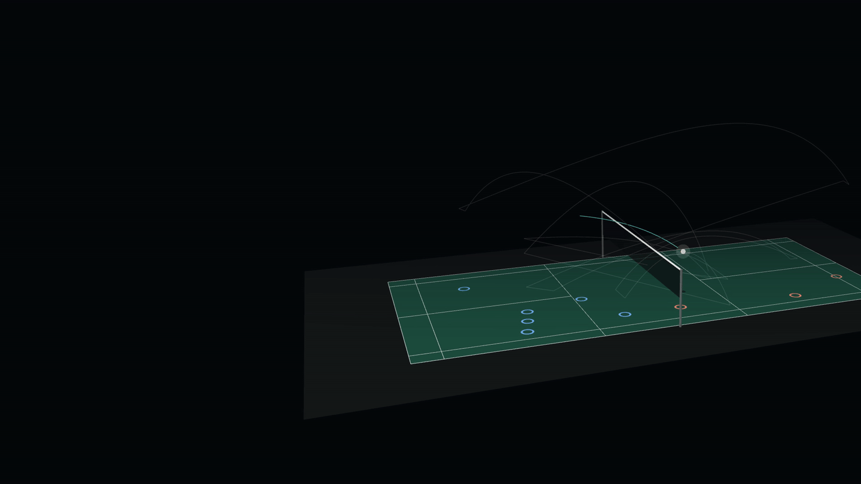
BATTLEFIELD THUNDERSTORM · INTEL ARC PRO B70 32GB · EVERYDAY AI
PRIVATE BADMINTON INTELLIGENCE
SHUTTLE
COACH
A private, on-device multi-agent badminton analyst
[Team name] · [Members] · github.com/gino6178/ASUS_hackathon
Notes:
The cover is the live product: the 3D rally behind the title is reconstructed from a single broadcast camera.

Slide 2
Pros get data-driven coaching. Everyone else guesses.
1 · CONTEXT AND PROBLEM DEFINITION
1
2
3
4
5
Hire an analyst
Cloud analysis app
ShuttleCoach
Match video leaves the court
Shared with a person
Uploaded to a server
Never: 0 bytes leave
Time to a report
Days
Upload, then queue
≤ match length
Cost model
Salary or per-match fee
Monthly, per player
One station + yearly update
Works with no internet
Yes
No
Yes
3D flight and shot speed
Rarely
2D stats
Every shot, metric 3D
Plan adapted to the player
If there is time
Generic tips
A coaching staff that debates and learns
Pro insight, priced for a club, and the footage never leaves the building.

Slide 3



Match video is personal data, so the analysis stays local
1 · CONTEXT AND PROBLEM DEFINITION
1
2
3
4
5
Biometric data
Faces, body shape and movement signatures, often of minors in school and junior programmes.
DESIGN RULE
Zero bytes of video or pose data leave the machine.
Tactical secrets
A team's footage is its game plan. Coaches will not upload it to a third-party cloud.
Every model, from shuttle tracking to the coaching agents, runs on one Intel Arc Pro B70.
Courts are offline
Offline by default · no account · Telegram is opt-in and carries text only · one-step deletion · reports never share frames.
Gyms and community halls have weak or no internet.

Slide 4
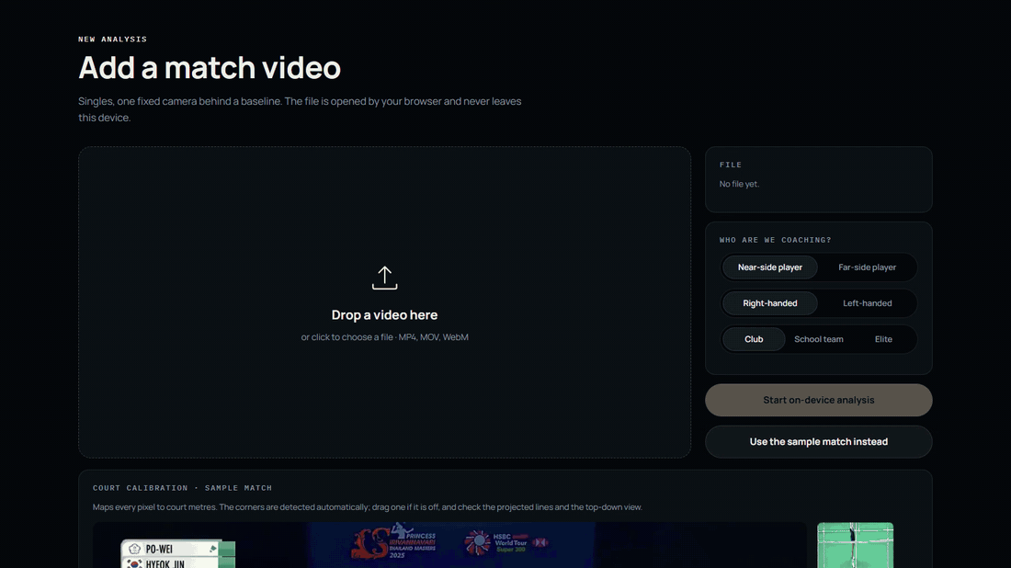




One camera in. A coaching staff out.
2 · SOLUTION: TOOLS, TECHNOLOGIES AND METHODOLOGY
1
2
3
4
5
Record
Any fixed camera behind the court
Reconstruct
Shuttle flight in metric 3D, hits, player positions
Reason
Four coach agents analyse, remember and simulate
Act
Personified coaches flash zones, muscles and flights
Recorded from the prototype: the video is opened by the browser and never uploaded.

Slide 5
Solution: tools, technologies and methodology
2 · SOLUTION: TOOLS, TECHNOLOGIES AND METHODOLOGY
1
2
3
4
5
Perception
TrackNetV5 · 2D shuttle
Monocular scene reconstruction
METHODOLOGY
video → tracks
Intent detection
hit detection
YOLO11-pose / MediaPipe
1
Facts before language
Deterministic code computes every number; the LLM only explains it.
Analytics
match database
speed · apex · landing
stroke type
rally outcome
tracks → facts
2
100% traceable
A verifier recomputes every figure an agent says and links it to a rally, shot and video time.
Agents
Tactics
Technique
Fitness
Data
Memory
facts → advice
RAG: player memory · papers
Head coach · round table
LLM 4–14B INT4
3
Simulate before advising
OpenVINO
verifier
research agent
Simulator
Positioning changes must cut simulated losses first.
what-if before advice
Interface
React + Three.js
Telegram bot
Whisper voice (offline)
4
Measure against ground truth
advice → player
court calibration
highlight MP4
live brief
CSV / JSON
3D checked against a multi-camera capture; outcomes against labelled rallies.
Dashed chips: in-house closed blocks. Everything runs on one local GPU.

Slide 6
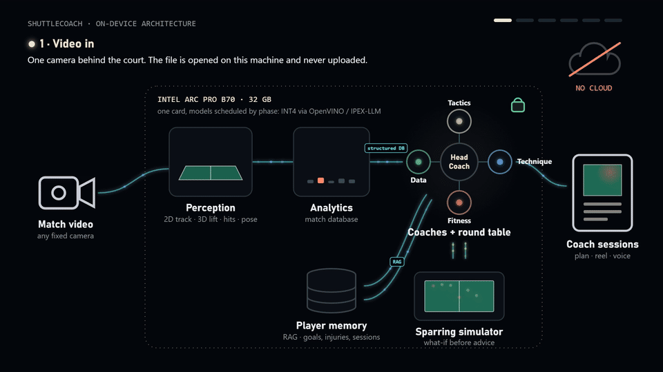
How the system works, end to end
2 · SOLUTION: TOOLS, TECHNOLOGIES AND METHODOLOGY
1
2
3
4
5

Slide 7
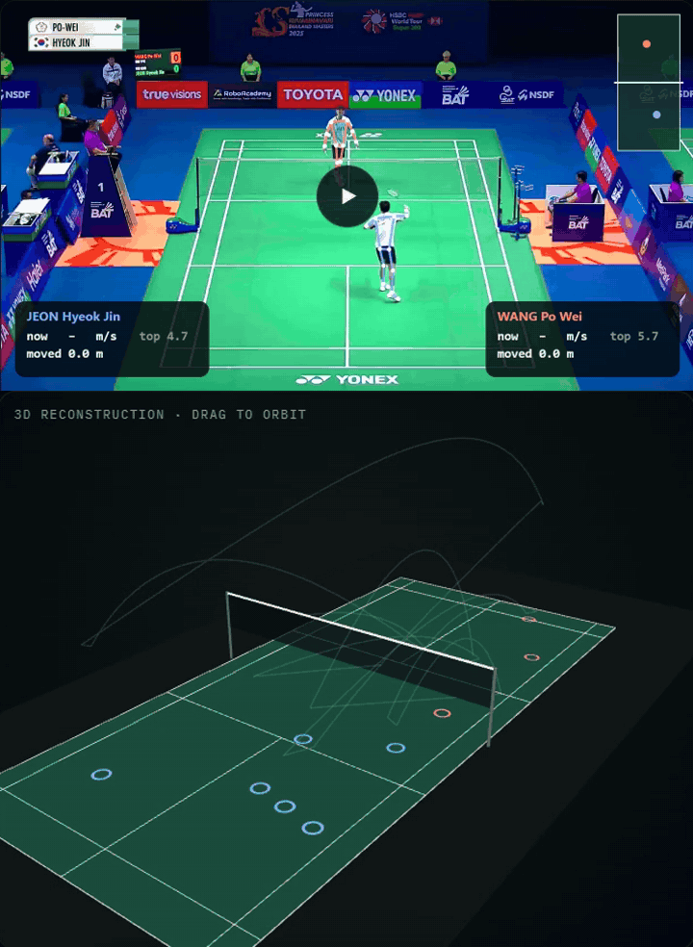
Built on our own perception research
2 · SOLUTION: TOOLS, TECHNOLOGIES AND METHODOLOGY
1
2
3
4
5
TrackNetV5
2D shuttle tracking
Finds the shuttle in every broadcast frame, using motion cues across neighbouring frames. Used as a frozen backbone.
F1 98.1%
Public code
Frozen backbone
In ShuttleCoach
Monocular scene reconstruction
IN broadcast video → OUT 3D shuttle flight (m)
0.42 m median error
Single camera
In ShuttleCoach
Intent detection
IN live 3D rally → OUT opponent's next stroke
400 ms before contact
Real-time
The two in-house blocks are shown by what goes in and what comes out, with their headline results; the details stay closed.

Slide 8
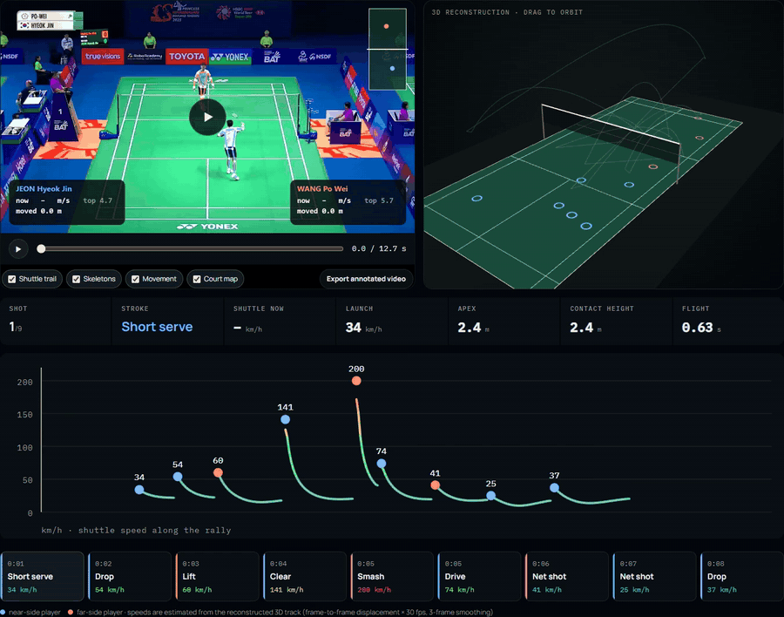
Every shot measured: 3D flight, speed, apex, contact height
2 · SOLUTION: TOOLS, TECHNOLOGIES AND METHODOLOGY
1
2
3
4
5
1
2
2D TO 3D IN 3 STEPS
1 2D track. TrackNetV5 finds the shuttle in every broadcast frame.
2 Camera, 3D and pose. Monocular scene reconstruction turns the 2D track into the flight in metres; pose gives both skeletons, speed and distance.
3 Speed curve. Each hit's launch speed, apex and contact height, clickable back to the frame.
3
200 km/h
far player's smash, measured from the 3D track

Slide 9
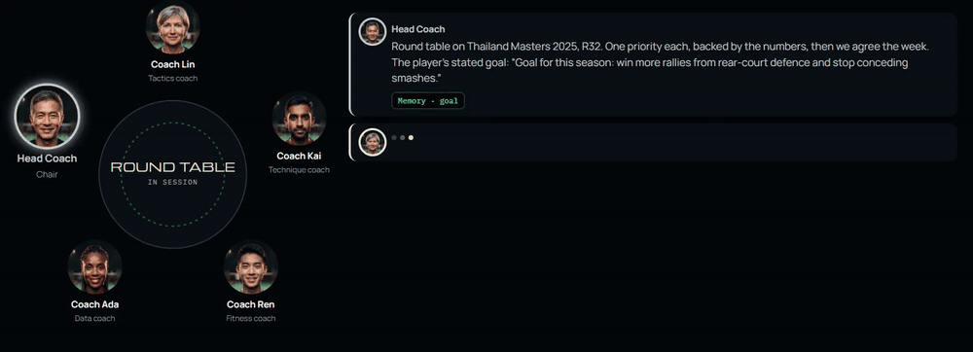
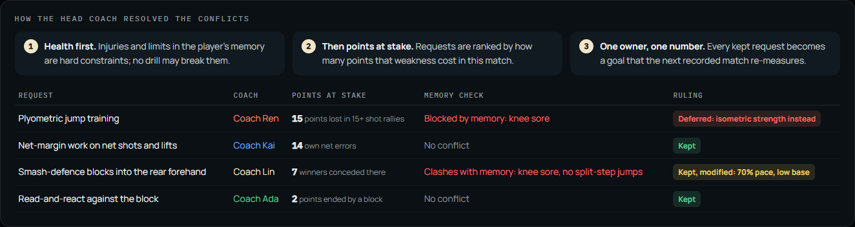
Round table: coaches who argue, then agree the week
2 · SOLUTION: TOOLS, TECHNOLOGIES AND METHODOLOGY
1
2
3
4
5
Conflict, then resolution
Ren challenges Lin: smash-defence blocks mean jumps, and memory says “right knee sore”. The table shows the clash, then the head coach rules: health first, then points at stake.
No invented numbers
8 of 8 figures in the meeting re-computed from the raw labels; 23 evidence chips open the exact rally and shot.
Output
Four measurable goals and a 7-day schedule, written back to memory and sent to each player on Telegram.

Slide 10
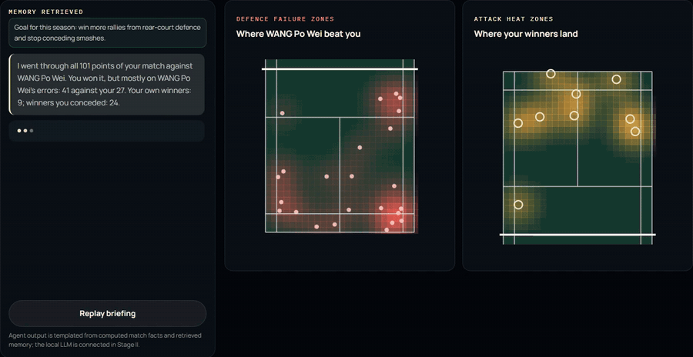
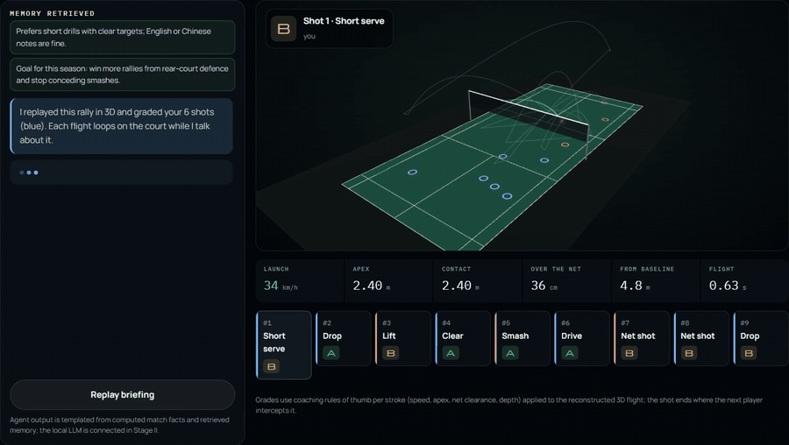
Tactics and technique coaches: the zones and the flights
2 · SOLUTION: TOOLS, TECHNOLOGIES AND METHODOLOGY
1
2
3
4
5
Every shot graded A / B / C from its 3D flight
Rear forehand: 29% of points lost (7/24)
COACH LIN · TACTICS
COACH KAI · TECHNIQUE
Reads every point. 101 points: 9 winners hit vs 24 conceded; the match was won on 41 opponent errors.
Flashes the leak. Rear forehand: 7 of 24 points lost, blinking on the defence map.
Game plan. Recover toward the forehand after clears; lift deep to the backhand corner.
Every flight in 3D. Launch speed, apex, contact height, net clearance and depth per shot.
Shot quality grades. A deep 141 km/h clear earns an A; a net shot 40 cm over the tape a B.
What to fix. The weakest stroke goes first on next session's list.

Slide 11
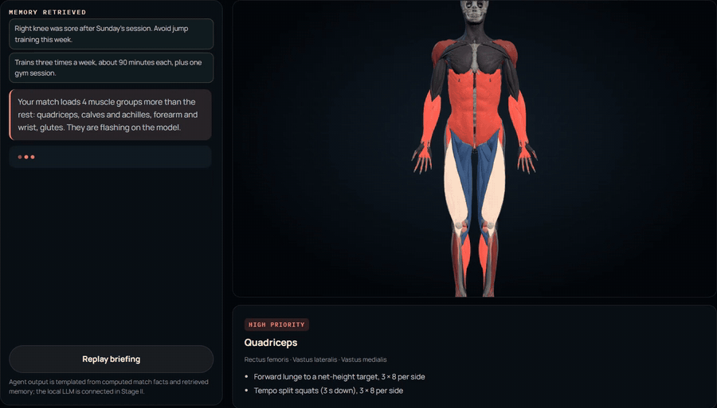
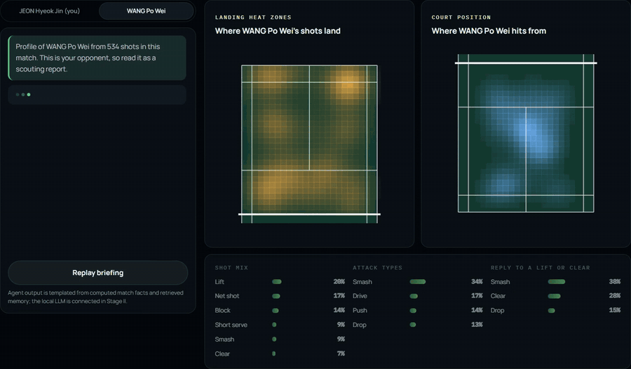
Fitness and data coaches: the body and the habits
2 · SOLUTION: TOOLS, TECHNOLOGIES AND METHODOLOGY
1
2
3
4
5
Right knee sore: no jump drills this week
After a lift, WANG smashes 38% of the time
COACH REN · FITNESS
COACH ADA · DATA
Muscles that flash. Quadriceps, calves, forearm and glutes pulse on a 402-muscle 3D model.
Why each one. Tied to findings: 60% of smashes into your half go to the mid forehand.
Adapts to memory. “Right knee sore”: jump drills become tempo split squats and isometric holds.
Player profile. Shot mix, attack types and winners for either player, from every labelled shot.
Heat zones that blink. Favourite landing targets and hitting positions.
Habits under pressure. Facing a lift, the opponent smashes 38% of the time.

Slide 12


Self-evolving coaches: they read, reflect and improve
2 · SOLUTION: TOOLS, TECHNOLOGIES AND METHODOLOGY
1
2
3
4
5
EVERY NIGHT, ON THE STATION
EXTENSION · 24-HOUR COACH
1
2
3
4
5
ShuttleCoach staff bot
Food at home
Research agent
Knowledge base
Grounded reply
Feedback
Reflection
I bought chicken breast and broccoli today
meals timed to training
Turns the player's weak points into paper searches; keeps a finding only if its numbers are in the abstract.
Findings embedded on the station (RAG); each coach cites the closest studies as [E#].
Match numbers only from facts [F#], study numbers only from [E#]; the verifier checks each one.
Helpful / not helpful from players, plus every draft the verifier rejected.
Each coach proposes at most two changes to its own playbook of rules.
Added to your kitchen: chicken breast, broccoli. …
I have club training on Wednesday from 19:00 to 21:00
Schedule
In your calendar: Wed 2026-10-28 19:00-21:00 club training (training). I'll message you an hour before, with what to eat.
reminder 1 h before; plans around exams
/meal
playbook v+1, used from the next reply
Coach Mei: Eat a meal of rice (1 cup) and stir-fried broccoli with tofu (1 fist) about 2 hours before your next session. …
Training log
GATES, LIKE A HEAD COACH SIGNING OFF
evening check-in; weekly totals
First reflection run
A coach proposed lunges for knee pain, citing a real study. The gates held it for a human coach instead of adopting it.
Did 45 minutes of footwork and net drills today, knee felt fine
Cites a study, in the coach's own area
Logged for 2026-10-26: footwork and net drills, 45 min.
Passes the safety check; locked rules stay
21 / 21
How did today's session go? Tell me what you did, roughly how long, and any pain.
No regression on its test questions
end-to-end checks passed
43
0.8 s
Message
Health changes need a human coach; any version rolls back
findings from 16 papers
median reply, local 4B
Bot output from its end-to-end test
Notes:
Real coaches keep reading and learn from their players; so do these. Each night a research agent reads new papers into a local knowledge base, and each coach reflects on player feedback, rejected drafts and new findings to change its own playbook, behind gates a head coach would apply: a cited study, a safety check, no regression, and a human sign-off for anything about health. The same staff extends to Telegram as a 24-hour coach: food at home, schedule and training log, with reminders before each session and an evening check-in. Only text passes through Telegram.

Slide 13
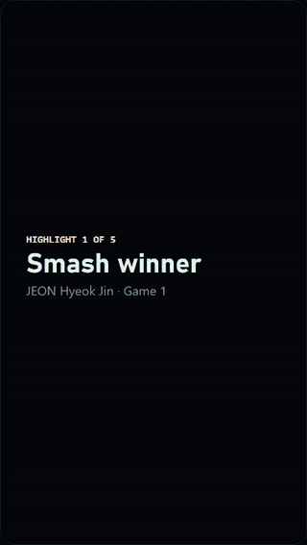
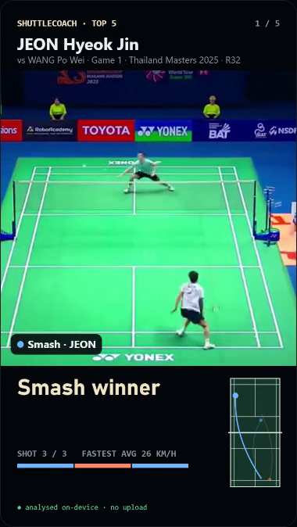
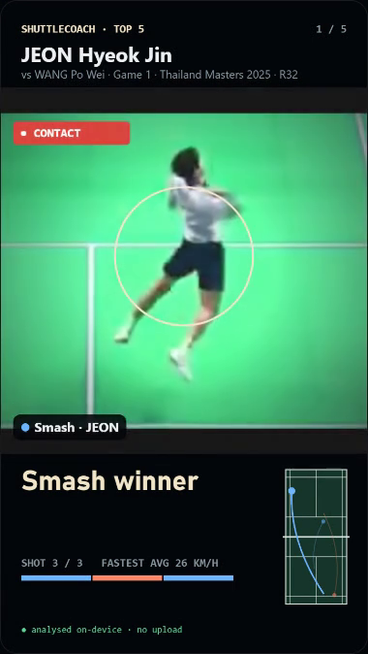
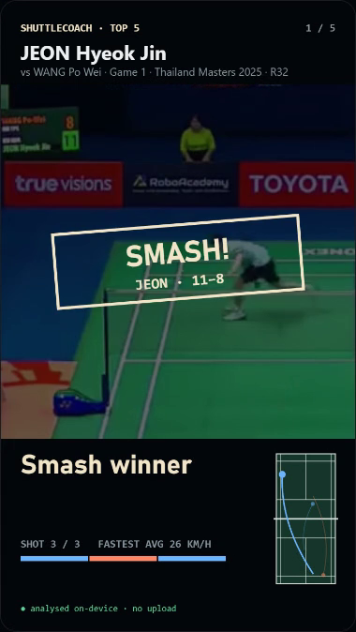
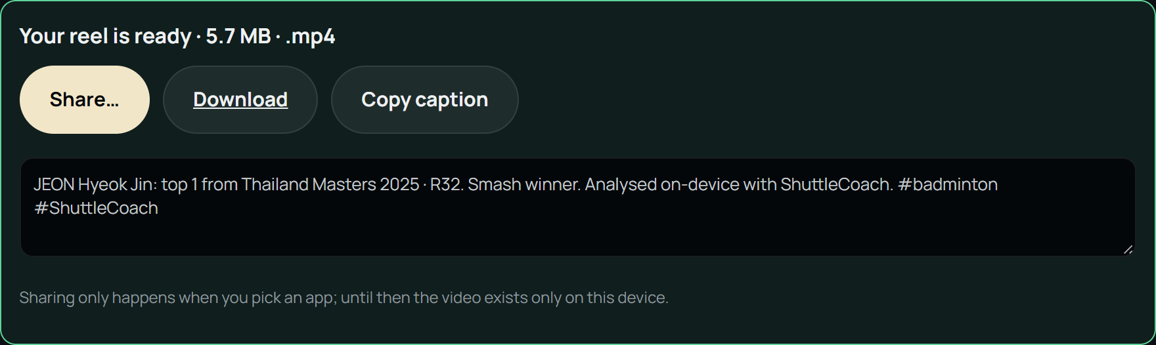
Auto highlights: picked, filmed and shared on the device
2 · SOLUTION: TOOLS, TECHNOLOGIES AND METHODOLOGY
1
2
3
4
5
Picked automatically
Outright winners, rally length, smash finishes and pressure points (18+) rank every rally; untick one and the next best fills in.
Ready to post
MP4 in 9:16 (Reels, TikTok, Shorts) or 16:9; one-tap Share, Download, and a written caption with hashtags.
Why it sells
Players post their best rallies with the club's name on them: free marketing for the venue, and a reason to keep the subscription.
1 Follow-cam
2 Slow-mo push-in
3 Winner freeze
tracks the shuttle between hitter and receiver
speed ramps down, camera closes on the hitter, holds on contact
stamp, score and the winning shot
9:16, ready for Reels · TikTok · Shorts

Slide 14
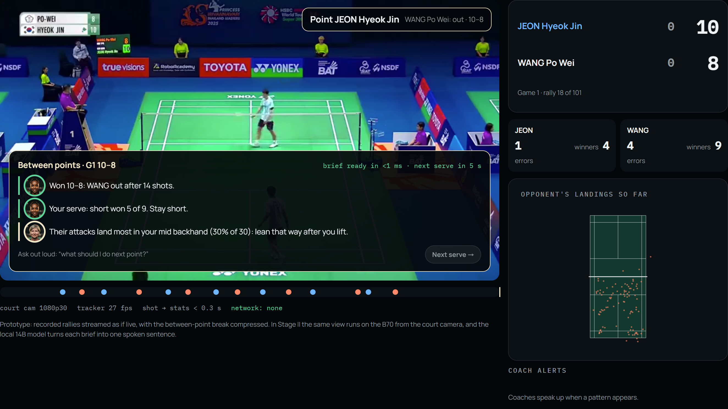
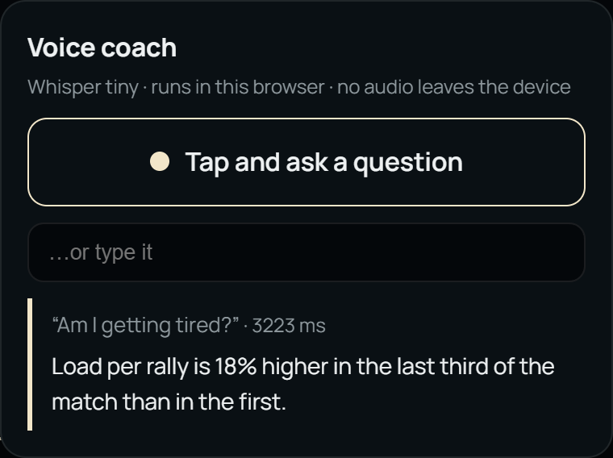

Live and hands-free: a brief in every break, answers by voice
2 · SOLUTION: TOOLS, TECHNOLOGIES AND METHODOLOGY
1
2
3
4
5
Speech stays on this device. Whisper runs locally in the browser: no audio and no court conversation is recorded or sent anywhere.
Between points (~20 s)
Hands-free voice
On the B70 in Stage II
Last point, next serve, the opponent's hot zone and an error warning; longer briefs at 11 points and between games. Computed in under 1 ms.
Tap Ask and speak: “What should I do next point?”. Whisper tiny runs in the browser, so no audio leaves the court.
Pose and tracking live from the court camera; a 4B model turns each brief into one spoken sentence in under a second; Whisper on OpenVINO.

Slide 15
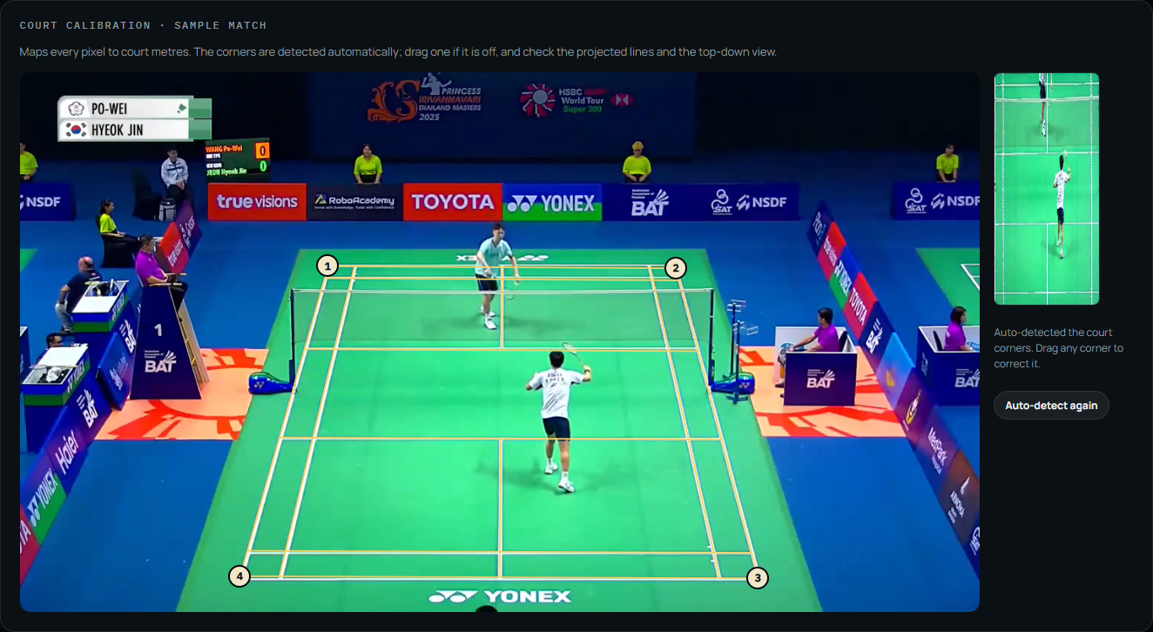
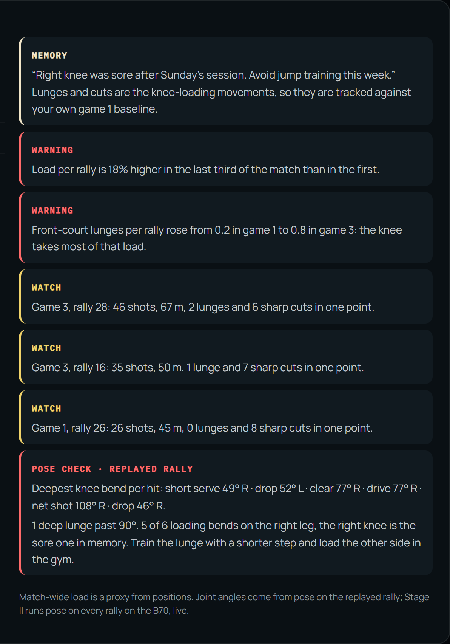
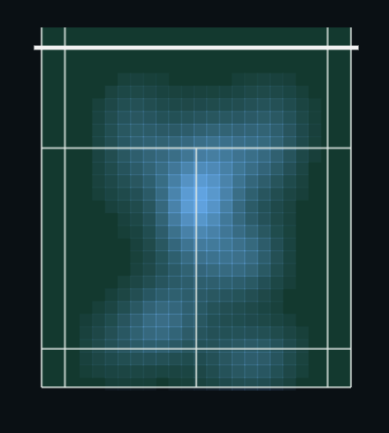
Analyst toolkit: court calibration, injury watch, position maps
2 · SOLUTION: TOOLS, TECHNOLOGIES AND METHODOLOGY
1
2
3
4
5
Deep knee bend 108° on the sore right knee (over 90°)
Court calibration
Load and injury watch
Maps, scouting, export
Corners found automatically from the court lines, draggable to correct; the court model is drawn back and a top-down view checks the fit.
Lunges and sharp cuts per rally from positions; pose skeletons give knee bend at every hit: 5 of 6 deep bends on the sore right knee.
Where each player hits from (heat map or scatter); one-page scouting PDF; every shot as CSV or JSON.

Slide 16
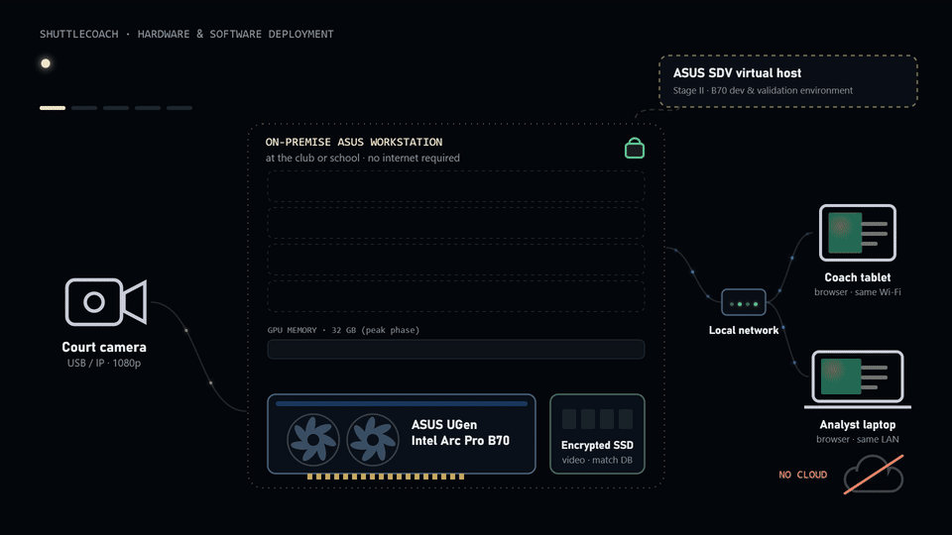
Deployment on ASUS UGen Intel Arc Pro B70
3 · HARDWARE AND SOFTWARE ARCHITECTURE, SYSTEM PLANNING
1
2
3
4
5

Slide 17
One GPU, scheduled by phase: what runs when
3 · HARDWARE AND SOFTWARE ARCHITECTURE, SYSTEM PLANNING
1
2
3
4
5
GPU TIME BY PHASE · BAR = SHARE OF THE CARD
Rally (live)
Between points
After the match
Coaching
33 ms a frame
brief < 3 s
batch, minutes
answers < 10 s
2D tracking + pose
3D reconstruction
Intent detection
4B assistant · voice
14B coach agents
Clip reviewer 7B
Simulator
Highlight render
Dynamic scheduler
A priority queue on one card: live perception keeps its 33 ms deadline, the between-point brief preempts batch work, and post-match jobs fill idle time; nightly research and reflection run when the court is closed. The 14B coaches load only after the match: peak 29 of 32 GB.
4B model for the fast path
Qwen3-4B, Phi-4-mini or Gemma-3-4B on OpenVINO, INT4 ≈ 2.5 GB; at 608 GB/s the decode ceiling is about 240 tokens/s. Running today on our test GPU: Qwen3-4B (4-bit) answers the coach chat in 0.8 s median at about 160 tokens/s. B70 figures in Stage II.

Slide 18
Expected benefits and outcomes
4 · EXPECTED BENEFITS AND OUTCOMES
1
2
3
4
5
Players
Coaches
Clubs and schools
Other sports
Where points are won and lost, by zone and stroke
A weekly plan tied to their own footage
Measurable progress per session
Hours of video review cut to minutes
Advice backed by cited shots
Test tactics in simulation first
Analytics on every court, minors' video stays local
One station, no per-upload fees
A differentiated coaching service
Same pipeline: ball tracking, court calibration, 3D reconstruction, agents
Tennis, table tennis, pickleball, volleyball
New sport = new tracker + court model
STAGE II DELIVERABLES
Working system
Open repository
Performance report
Demo video
Upload a match video on the B70 and get the full report, end to end, offline
Code, system architecture diagram, README, model information and performance data
Speed, accuracy and latency measured on the B70; 3D error against reference data
Real operation on the provided environment, 10 minutes, in English

Slide 19



Who pays, what it costs, and when it pays back
4 · EXPECTED BENEFITS AND OUTCOMES
1
2
3
4
5
TAM
people play badminton weekly worldwide (BWF, 2024); sports analytics US$2.3 B in 2025
SAM
players in Taiwan: 9.4% of residents 13+ (Ministry of Sports, 2025); 113 commercial venues (MOF, May 2024), +16.5% a year
SOM
year-3 target in Taiwan venues and school teams, about 1,800 subscribing players
384 M
≈ 2 M
30 Stations
B2B: club and venue
One Station shared by every member. 60 members on a NT$300/month “Pro analysis” add-on bring NT$18k a month against NT$7.5k a month of Station cost: hardware paid back in about 12 months, and a reason to join the club.
B2B2C: player subscription
NT$199/month through the club's Station: highlight reels, round-table plans, season tracking. Revenue split 70% club, 30% ShuttleCoach.
Schools and university teams
1.5 years
2.7 years
~12 months
Same Station, no minors' video in the cloud; pilot with a university team and a local academy.
payback against a part-time analyst
break-even against per-player cloud apps, with the video kept local
club payback with 60 members on the NT$300 add-on
Illustrative assumptions: analyst 8 h/week at NT$400/h, 48 weeks; cloud NT$400/player/month; Station NT$180k + NT$30k/year (NT$7.5k/month over 3 years). Replace with quotes.

Slide 20
References and source code
5 · REFERENCES AND GITHUB SOURCE CODE
1
2
3
4
5
SOURCE CODE
https://github.com/gino6178/ASUS_hackathon
TrackNetV3: shuttlecock tracking with augmentations and trajectory rectification. ACM MMAsia 2023. Code: MIT licence.
TrackNetV5: robust shuttlecock tracking via motion prompts and spatiotemporal attentive fusion (backbone used frozen). Code: github.com/gino6178/TrackNetV5
ShuttleSet: a human-annotated stroke-level singles dataset for badminton tactical analysis. KDD 2023.
Monocular scene reconstruction and intent detection: in-house blocks, shown closed.
3D anatomy: BodyParts3D 4.0, © The Database Center for Life Science, CC BY 4.0; adapted via Human Atlas (MIT).
Sample match: Thailand Masters 2025 R32 broadcast footage and lab annotations, used for a research prototype only.
Libraries: Whisper tiny.en (MIT) via Transformers.js (Apache-2.0); MediaPipe Pose Landmarker (Apache-2.0). Feature ideas from Good-Badminton (yo-WASSUP): annotated video, court calibration, position maps.
Agents: Qwen3-4B (Apache-2.0) served locally; OpenVINO GenAI path for the B70; Qwen3-Embedding for the knowledge base. Papers found through the OpenAlex, arXiv and Semantic Scholar APIs; messaging via the Telegram Bot API.
Prototype status: coach agents answer on a local 4B model from computed match facts, every figure verified; tested on an RTX 3090 server, moving to the B70 in Stage II. Coach portraits are AI-generated, fictional people.
Team: [names] · Contact: [email]

