Slide 1
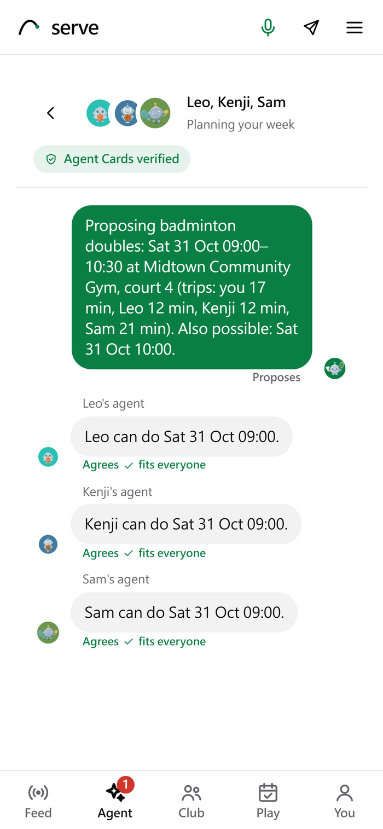
Serve: Play more.
Manage less.
Technical report · Meta Global AI Developer Hackathon 2026 · Indie Developer track
play.theminimallab.com · github.com/gino6178/serve-meta-hackathon
Notes:
Serve is a platform where people and agents make games together. This deck follows the technical report: impact, technical depth, Meta models, and what is not done yet.

Slide 2
People stop playing because organising is hard
What stops adults playing regularly (Sport New Zealand, Active NZ 2023). Serve's three helpers answer them in turn.
64.2%
21.3%
10.2%
times hard to fit together around other commitments
no way to keep the habit going
no regular people to play with
Talk fits the time
Match keeps the habit
The agents find the people
40% of 18 to 21 year olds played a sport, but only 26% of 26 to 49 year olds (NPR, RWJF and Harvard Chan, 2015). Serve's core value: hours of back-and-forth in a chat app become one yes from each person.
Notes:
Most people who stop playing have not lost interest; they are worn down by organising a game. The three barriers map to Serve's three helpers: Talk, Match, and the agents.

Slide 3
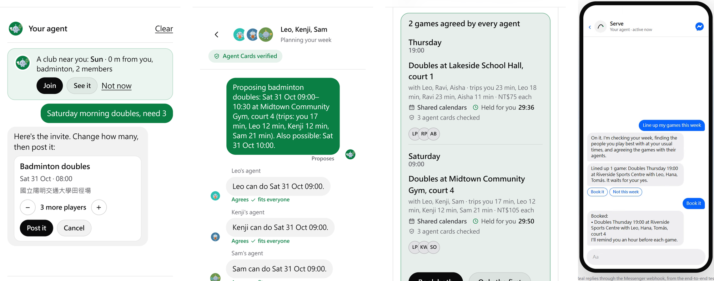
A first real club: 3 invites, 2 games played in three days
More than 10 people
of a real badminton club used Serve during the hackathon; of the 3 game invites sent through it, 2 became games that were played.
“It's actually really handy. You just talk to the agent.”
“The way it suggests games first can make people more motivated to play.”
Players A and B, translated from Chinese
Notes:
On the web a sentence becomes an invite, the players' agents agree the time, one tap books it; in Messenger the same booking, with the agent's real replies from the Messenger end-to-end test.

Slide 4
Validated in nine days by 153 independent AI agents
25
153
rounds of agent testing
agents, each a new model with only a persona and the address
16,713
0
logged requests on fresh copies of the live code
faults in a core flow from the last round's six agents
Fixed between rounds: what each round found was fixed before the next.
An agent with only the address: the best of three was doing useful work by its third API request, and found its person a Sunday 09:00 tennis game, free, 2.6 km away.
Honest scope: the testers were AI models, not people; beyond one real club the evidence is simulated.
Notes:
A long trial with real players is not possible in a nine-day build, so Serve was also checked by agents: six a round, five to ten in the first five rounds.

Slide 5
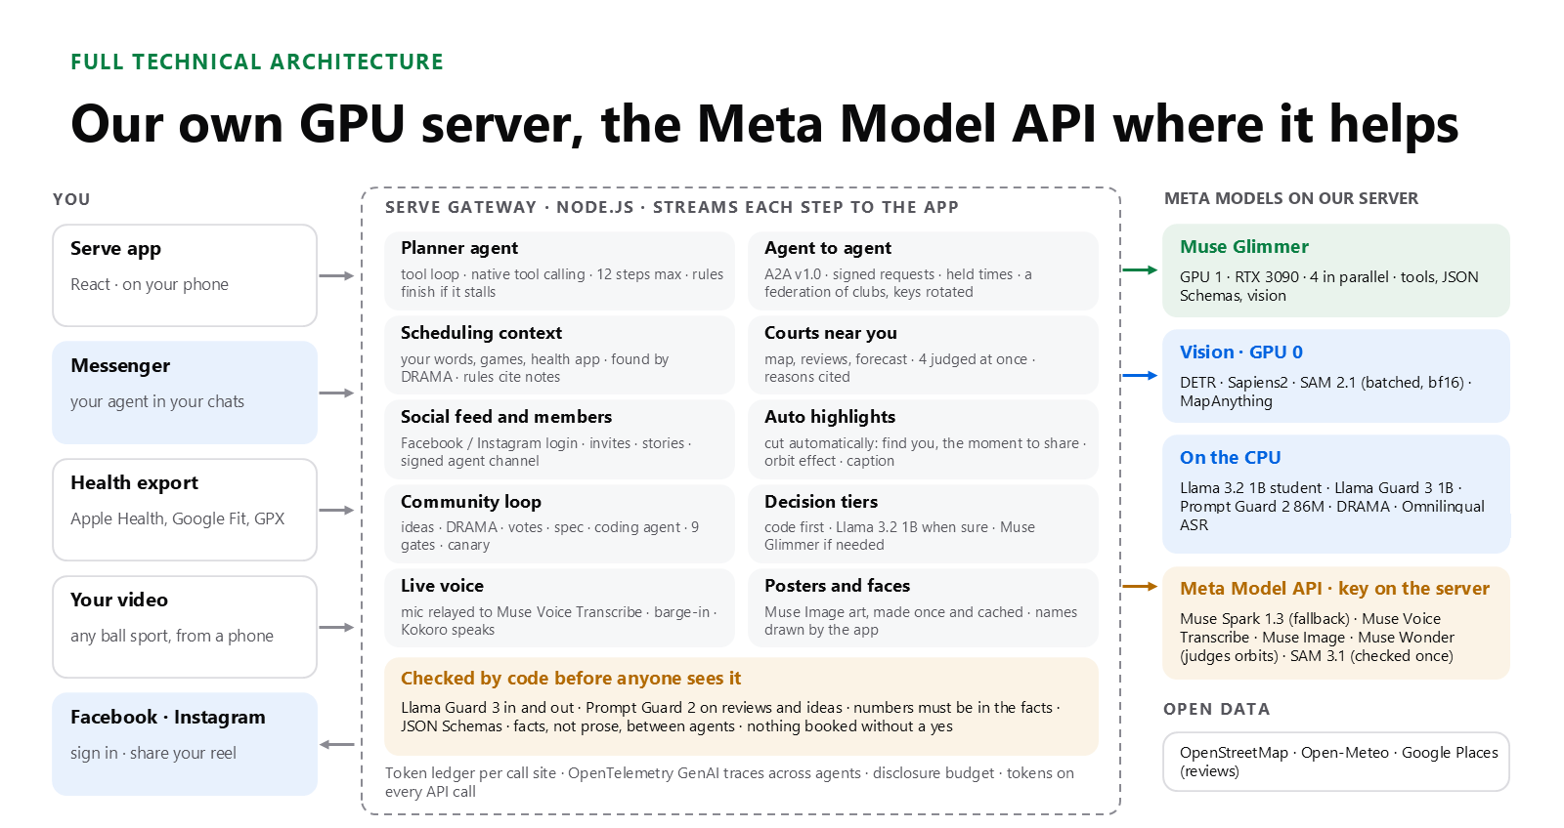
Code computes the facts; models choose among preferences
That keeps a model's mistake from turning into a wrong booking or a clash. Four pieces of engineering underneath: a standard A2A protocol with a negotiation engine, active querying by the value of information, a community that evolves the platform with rollback, and 3D reconstruction from a phone video.
Notes:
The one rule throughout: code computes the facts and keeps the hard rules; the models choose only among the real preferences left.

Slide 6
A2A v1.0: facts only, settled in one round by intersection
Facts only. A proposal carries each time as {id, date, start, venue, court, trip}; sentences between agents are templates filled by code, so no agent's model reads another side's words.
One round, by intersection. The host lists up to 12 times that fit every calendar; each agent marks the ones that work, and that is binding. Contract Net with a one-shot intersection.
Durable and signed. Saved before every round, answered once, idempotent booking; Agent Cards signed (Ed25519 JWS over canonical JSON).
To the standard. jku on cards, the proposal and hold extensions declared and required, the protocol's own error codes.
0 of 12
20 / 20
double bookings with holds (11 of 12 without)
recovery checks, gateway killed at 5 points
22 / 22
185 ms
checks across two machines, 12 talks at once
added per request by the cross-machine hop
The fairest venue. Code picks the venue whose longest trip is shortest. Fairness score 0.73, against 0.59 (shortest total trip) and 0.58 (Nash), at 2.3 more minutes per game.
Notes:
Holds are leases with resource ordering: all or nothing, 30 minutes, asked in a fixed order.

Slide 7
Times ranked by the chance everyone says yes
The product of each player's chance of a yes, with a least-misery floor: a time where anyone's chance is under 0.15 goes to the back.
Why it matters: with shared calendars, the first time proposed decides whether each agent can say yes by code or must ask a model.
3,000 simulated requests of each kind; with private calendars it found no more games.
0.261 → 0.109
model choices per doubles request, so most doubles talks need no model at all
Notes:
Before, times were ordered by how many players had them free. Now they are ordered by the chance that every player accepts.

Slide 8
When talks fail, ask the one question worth most
A belief per player and hour, a Beta posterior over what the agent has seen of that player's agent, never their calendar.
One answer teaches about similar hours (after Pep and VPL): Brier 0.223 → 0.200; first talk lands 68.9% → 73.7%, or 75.1% → 79.2% with one question first.
Private by budget: every free-or-busy question is charged to the disclosure budget; an agent that keeps asking learns at most 24 of 112 weekly hours in 28 days.
At most 3 asks a week, and an .ics calendar can be imported (busy times only).
Each rate is good to about 0.7 points either way.
Notes:
The agent neither gives up nor asks the player again: it asks the single yes-or-no question whose answer most raises the expected chance of a game.

Slide 9
A community that evolves the platform, and rolls itself back
Unmet request
One sentence, shared only with a yes
Screened
Idea and quadratic vote
Spec and class
Nine gates
Canary of members
Kept, or rolled back
Code makes every decision; models only write short sentences that code checks. The class comes from what a change does, never from the draft.
Nine gates: policy, a code scan, unit tests, the crash matrix, the red team, Messenger end to end, the planner test, the spec's oracle and a privacy canary.
Anything bigger goes to a person: the builder agent writes it on a branch with read-only tests and no network.
0.6%
22%
harmless changes rolled back (anytime-valid test)
with a z-test checked at every look
In 20,000 simulated 7-day canaries of 5 members, looked at every 5 minutes. The price is caution: a bad change (thumbs down 25% → 60%) was caught in 61% of canaries.
Notes:
It draws on the Darwin Godel Machine (tests read-only), AlphaEvolve (keep a change only when evaluators pass it), Clio (minimum cluster sizes) and CaMeL.

Slide 10
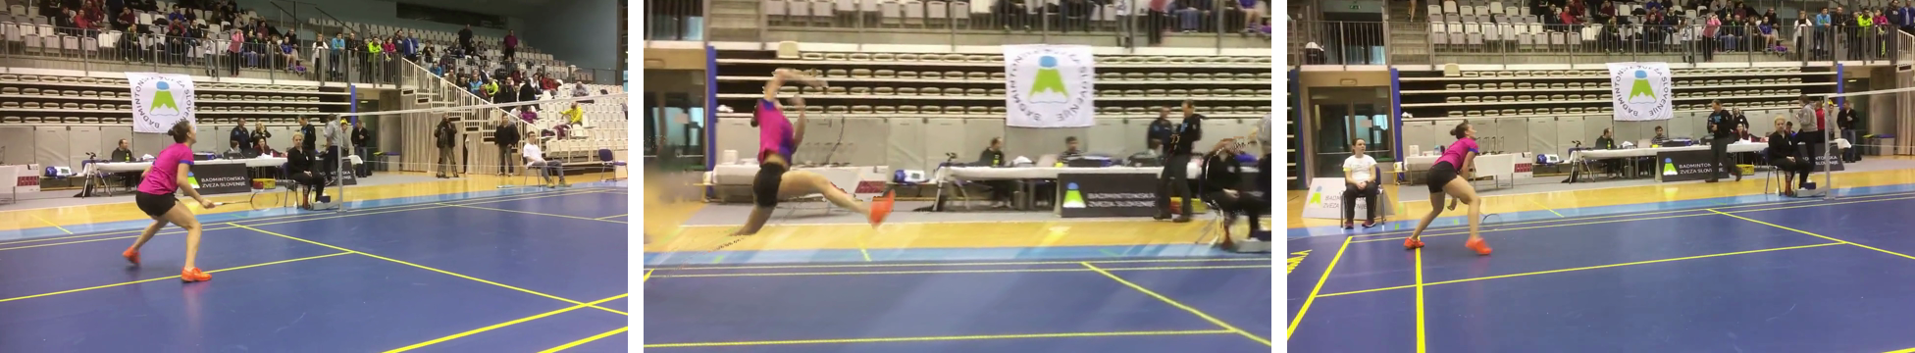
3D replays and automatic highlights from one phone video
An automatic highlight as the pipeline cut it (clip: Badminton klub Ljubljana, CC BY 3.0)
1.00 / 0.79
87%
19.9 s
MapAnything reads depth and the camera; SAM 2.1 cuts the player out.
RT-DETR follows the right player on all three test clips, about 2× faster than DETR.
precision / recall of the learned arc threshold (first rule: 0.45 / 0.64)
Muse Wonder agreed with the labels, and says why
a moment on the RTX 3090, models loaded
Notes:
Arcs of about 6 to 12 degrees look like a real camera move; a learned threshold on the share of invented pixels picks the widest arc that still looks right, or falls back to a zoom.

Slide 11
A tiered decision engine: each layer takes what is left
Code
milliseconds
Free times, clashes, trips, every hard rule; the game's card in 7 ms (median)
Our 1B student
about 0.9 s, CPU
Answers when at least 0.6 sure: 96.0% of ordinary choices, 73.0% of the hardest
Two cheap reads that agree
0.53 s
The one-token decider and the student on the same time: settled without Glimmer 72.1% → 79.0%
Muse Glimmer, stopped early
20 to 40 s
Early exit after DEER: 596 → 420 tokens an answer, no later (22.3 s → 21.3 s)
Following FrugalGPT. Before any of them, Match works ahead of time, so the agents have often agreed a game before anyone waits at all.
Notes:
Every wait the person starts shows a moving bar and a status line within 250 ms.

Slide 12
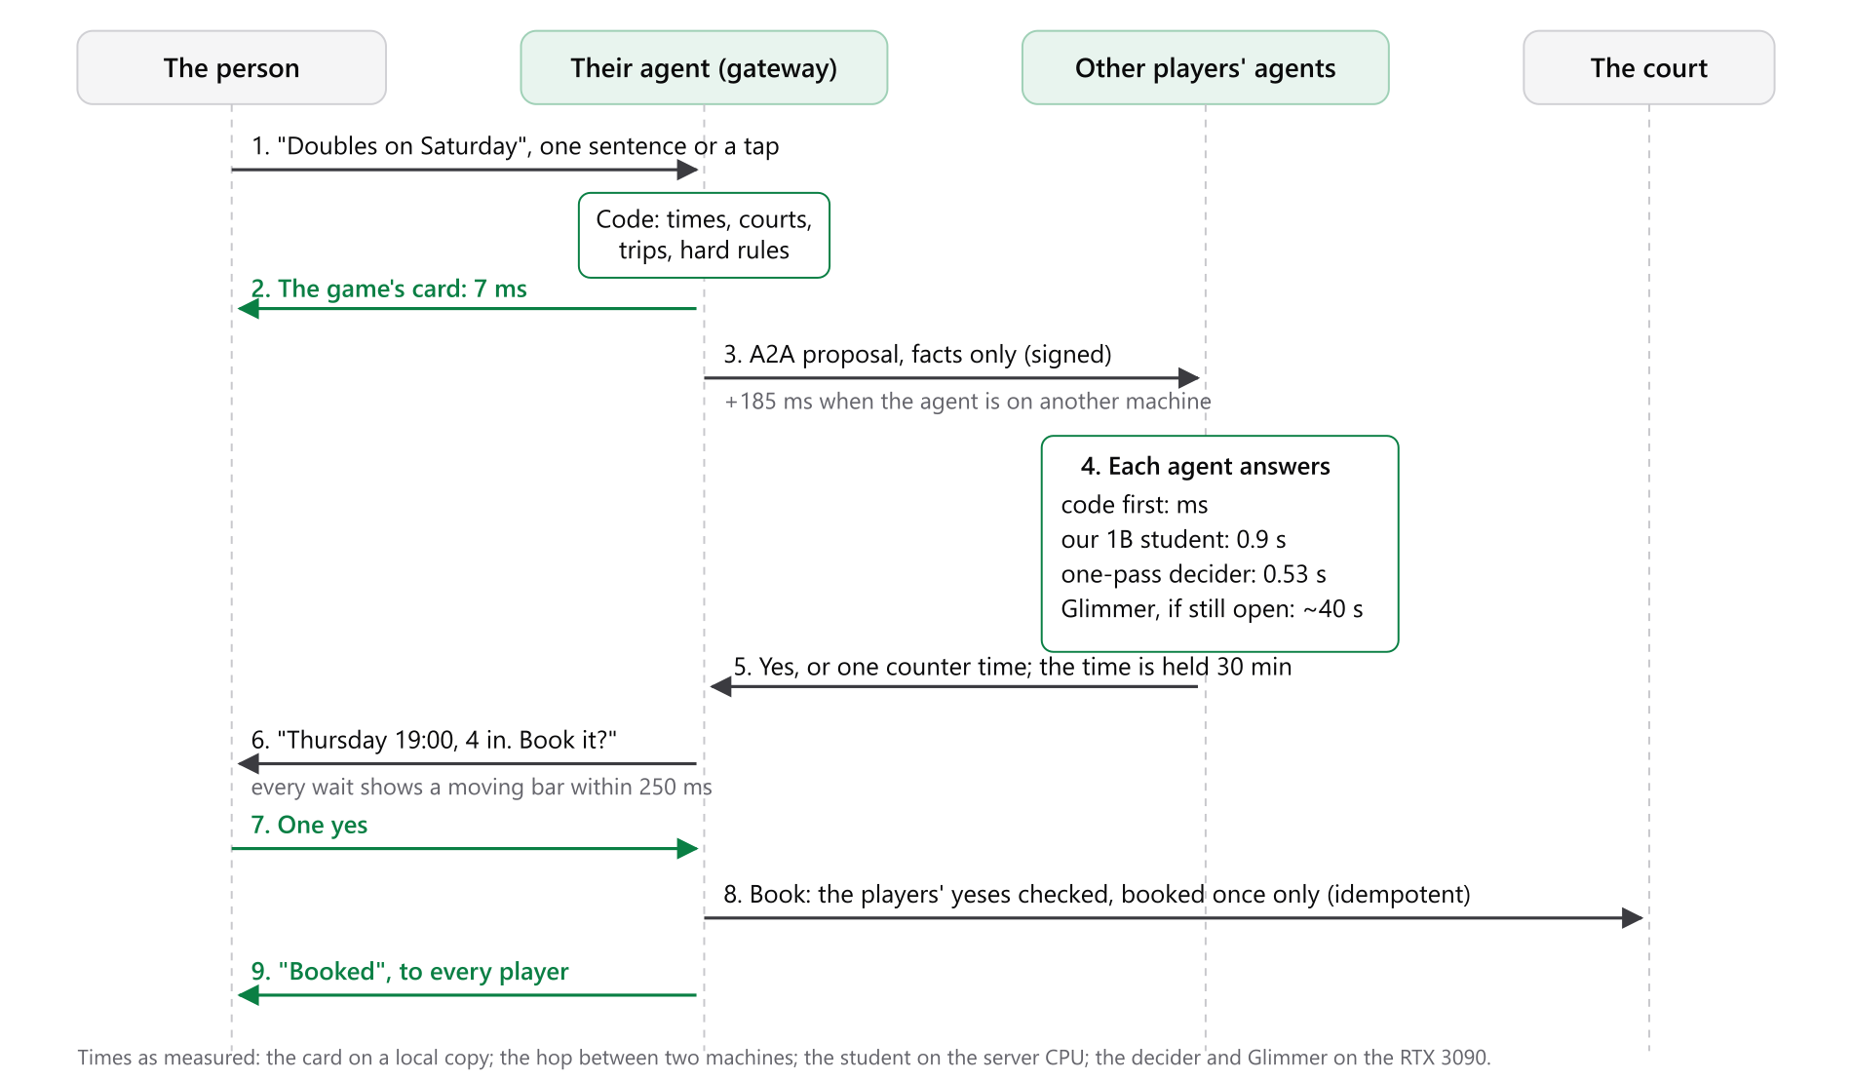
A booking, step by step, with its measured times
Notes:
Times as measured: the card on a local copy; the hop between two machines; the student on the server CPU; the decider and Glimmer on the RTX 3090.

Slide 13
Our own model: a Llama 3.2 1B distilled from Muse Glimmer
89.5%
0.9 s
0.052
4,868
agreement with Glimmer on 500 held-out cases (Glimmer with itself: 88.8%)
a choice on the CPU, about 44× faster than Glimmer's ~40 s
expected calibration error: its confidence can be trusted
of Glimmer's choices distilled
A decision model, like TypeSafe's Jev: options declared in advance and scored together in one read; it never writes text that could break a rule.
Served at 0.6 sure: answers 96.0% of 500 and 73.0% of the 196 hardest; agreement 89.9% and 68.4% (Glimmer again: 73.5%).
0.5 was tried and not kept: 96.9% of the hardest answered, but agreement there fell to 61.2%.
In talks with the simulated club: Glimmer's member answers cut by 67% (54% with private calendars), no rule broken.
Notes:
Why distil when the decider takes 0.53 s? The decider is still Glimmer and needs the GPU; the student runs on the CPU and leaves the GPU free for work only Glimmer can do.

Slide 14
What surprised us, running Meta's models in a product
Glimmer reasons even when told not to
84% of the tokens it wrote over 2,755 calls were reasoning; 9% of calls came back empty. Every call now asks for think "low" with 900 tokens of room.
A 1B agrees with Glimmer as often as Glimmer agrees with itself
89.5% against 88.8% on 500 held-out cases, in 0.9 s instead of about 40 s.
Glimmer can decide in one token
Read with no chat template, its next token gives a probability for each option: 0.53 s, no reasoning. It mostly reads the order, though: 99.5% of picks were the first time listed.
Llama Guard 3 reads sports injuries as medical advice
Its S6 category flagged 6 to 8 of 15 ordinary injury-care answers; S6 now blocks only when code also finds a dose, a medicine or a condition.
Notes:
Four findings, each measured. The order finding was measured after the report: on 196 hard cases the one-token decider picked the first listed time 99.5% of the time.

Slide 15
Security, and a failure the agents found
Prompt Guard 2 first: every post and comment, before Llama Guard 3 and code.
A signed record of every yes: each entry signed and chained to the one before, so a yes cannot be changed or removed unseen.
No-shows, with no money: show-up fades with a 60-day half-life and is shown as a range in words; a short game is called off 3 hours before; a freed spot goes to the waitlist with 12 hours to confirm.
The Agents Rule of Two: no agent holds untrusted input, private data and the power to act at once.
93 / 93
attack cases stopped, named by OWASP LLM Top 10 risk
A failure, and the fix. A tester working as a host could work out how many people nearby were open to being asked, first from a count, then from the talk. Now nearby people appear only once they can actually play, and everyone else sees only published badge words; later rounds re-checked it and found nothing.
Notes:
93 attack cases all stopped; crash and recovery checks are on the A2A slide.

Slide 16
Meta models, and which one answers: by length
Model | Runs on | Its job in Serve
Muse Glimmer (30B) | RTX 3090 | Every agent's reasoning; a JSON Schema on every call
Our Llama 3.2 1B | Server CPU, int4 | Choices between times; short text at five checked sites
Muse Spark 1.3 | Meta Model API | Calls of 12,000+ tokens, and the fallback
Muse Voice Transcribe | Meta Model API | Live voice, full duplex
Muse Image · Muse Wonder · SAM 3.1 | Meta Model API | Agent faces and posters · orbit judge (87%) · outline cross-check (0.974 IoU)
Llama Guard 3 · Prompt Guard 2 | Server CPU | Safety on Messenger, wishes, posts and reviews
DRAMA · Omnilingual ASR | Server CPU | Memory by meaning, game-request router · voice notes
SAM 2.1 · Sapiens2 · MapAnything | RTX 3090 | Highlights and 3D replays
Routing by length
Short (≤ ~700 tokens) at a checked site → our 1B
Longer, or anywhere else → Muse Glimmer
12,000+ tokens → Muse Spark
Every short site was tried on the 1B first: 9 end-to-end checks failed, 2 of 6 hostile comments got through, 4 of 10 injected reviews were obeyed. So only five checked sites, and the red team stays 93 of 93.
Notes:
Open weights run on our own GPU server so players' data stays there; the Meta Model API handles live voice, long calls, images and checks.

Slide 17
Measured since the report: seven more agent upgrades
Send gate
When not to ask: opt-outs 37.7% → 26.2%, games from asks 3.97 → 4.39 (simulated)
Harder simulated users
With 25% difficult people pass^1 0.69 → 0.38; six flow bugs found and being fixed
Preference records
Newest word wins: stale-preference decisions 95% → 17% once the player says it (simulated)
Order of the options
Glimmer changed 24 of 60 answers when only the order changed; kept as is
Tool-call checks
Silent failures passed as success 53 of 53 → 0 of 56 (fault injection)
Stretch round
Games found +0.3 (singles) and +1.3 points (doubles): small, reported as such
Courts judged ahead
Wait after moving the time 49.0 s → 25.7 s, at twice the judgings (RTX 3090)
Each from a 2024–2026 paper, built and measured against what ran before; most numbers are simulated and say so (README, submission/results/).
Notes:
After the report: send gate (Oralytics, EOPA), preference records (PersonaMem, Mem0), tool checks (JSONSchemaBench, ToolMaze), judging ahead (Speculative Actions), pass^k (tau-bench, Sim2Real), order (Magentic Marketplace), stretch round (CalBench).

Slide 18
What is not done yet
1
Most validation is simulated
Beyond one real club and two games, the evidence comes from AI agents, simulated members and local copies.
2
The slow path still exists
When the small models are unsure, Glimmer takes about 20 to 40 s; the steps stream in, but it is still a wait.
3
Venues are samples
No venue has joined yet, so quiet-hour prices are sample prices.
4
The community loop has not run on real members
An idea shows only once 5 different members ask for it.
5
Orbit replays are short
Only arcs of about ±6 to 12° look right; otherwise a zoom.
Notes:
Said plainly: this is a nine-day build, validated mostly by agents and simulation.

Slide 19
One yes from each person
Live: play.theminimallab.com · Code: github.com/gino6178/serve-meta-hackathon · Every number from submission/results/
Notes:
Serve turns hours of back-and-forth into one tap from each person.

