Slide 1
Custom Website Design
A website as unique as your business. Designed with your business in mind.

Slide 2
Agenda
1
2
3
4
Importance Of Custom website design
Custom Website Design
Features & Benefits Overview
Addressing Common Concerns

Slide 3

Tailored for your business
A custom website is built and tailored specifically for your business. It’s unique just like your business.
One of the reasons a custom website design may be right for you is because you completely own the design. This give you freedom to do what you want with the site. It’s a great way to stand out from the competition. We provide optimal hosting for WordPress sites giving your site the best platform to let it stand out.
As per local Cision
94%
Of first impressions relate to the site’s web design
Notes:
Statistics on how many consumers read online reviews before making a purchase and how positive reviews can lead to increased customer trust, loyalty, and sales.

Slide 4
Cost of not having a custom website design
Cookie cutter site
A generic or outdated website design can create a poor first impression and doesn’t help stand out.
Lack of optimization
Custom websites can be optimized from the ground up, incorporating SEO best practices and ensuring proper indexing and ranking in search engine results.
Lack of scalability
Neglecting a custom website may result in scalability limitations, making it challenging to handle growth effectively and resulting in potential disruptions, performance issues, or the need for costly redevelopment in the future.
Increased reliance on third-party platforms
Businesses may be forced to rely heavily on third-party platforms (e.g., social media, online marketplaces) to establish an online presence. This dependence can limit control over branding, customer data, and overall business strategy.

Slide 5
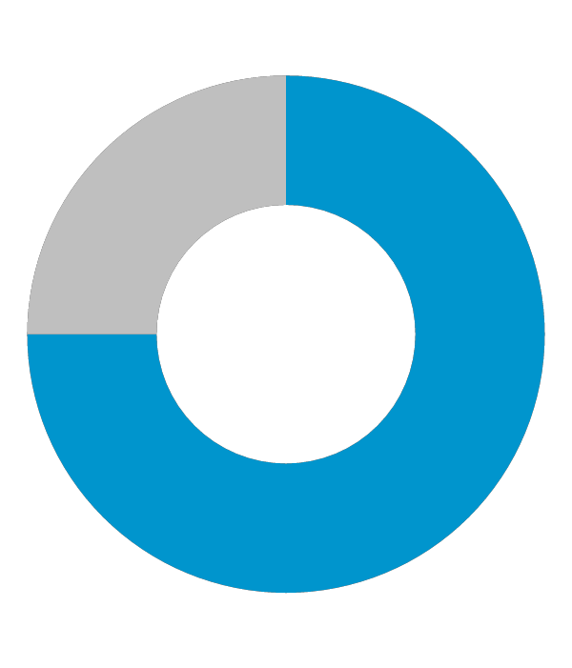
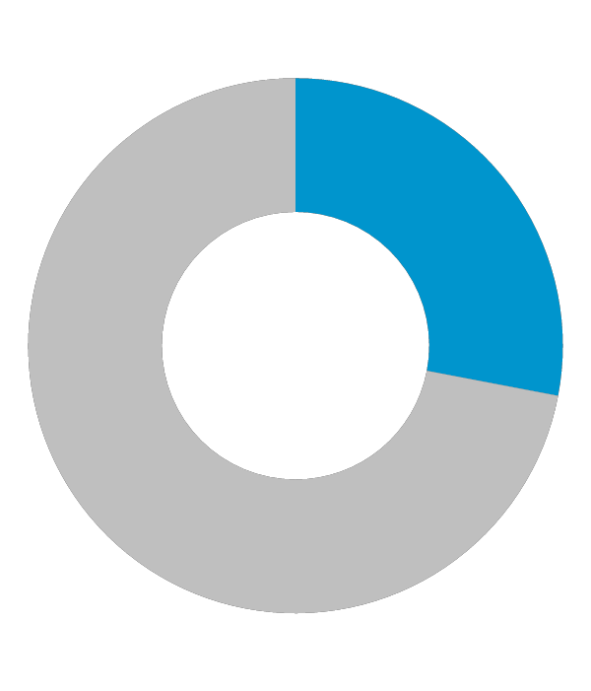
Impact of not having a website
90%
81%
72%
of shoppers have visited a store because of a positive online experience
Mention.com
Of consumers who search on a computer/tablet go to a store within 5 miles of their location.
SMA Marketing, 2022
Of internet users research products online before they make a purchase.
GE Capital Retail Bank

Slide 6
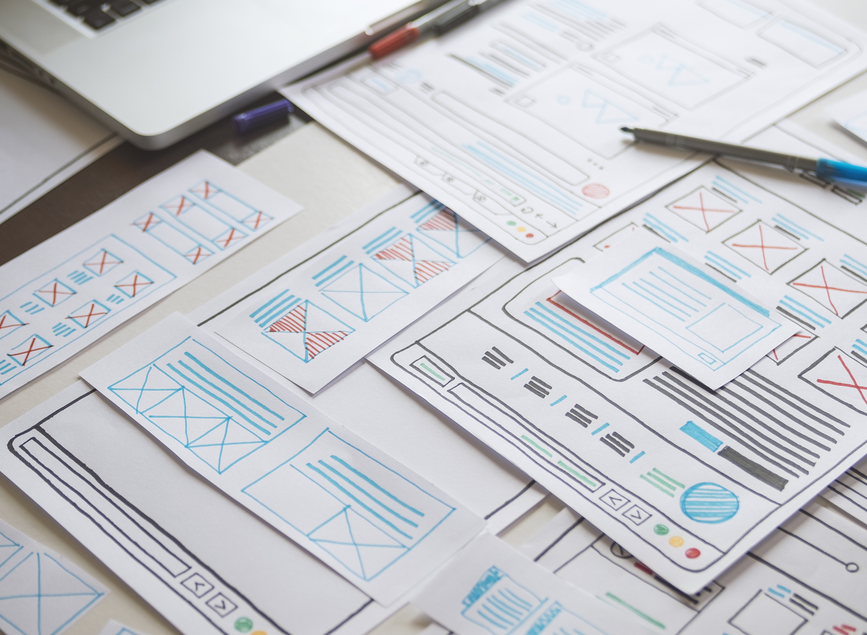
Custom Website Design
Built for your business
One of a kind
Design ownership
Hosting

Slide 7

Collaborate with experienced designers
Our website professionals will work with the customer to understand their business needs and uncover how their website can help them gain and retain customers.
Our team knows the right layout, typography, imagery, and color schemes to make the design pop.

Slide 8
Features
Multiple revisions
Multiple revisions can be made on the website build based on scope of work.
WordPress
WordPress is used to build 43% of all websites on the internet. (colorlib, 2023) It’s popular and it works.
Optimized website
The site is built using basic SEO best practices and provides the search engines the ability to crawl the website. It is also mobile friendly so it will look great on tablets and smartphones too.
No hidden fees
The customer receives a quote with the price breakdown including add-ons like maintenance and hosting.

Slide 9
How it works

Slide 10
Fill out a questionnaire with the sales team
The customer will fill out a questionnaire with a member of the sales team.
Once all the criteria has been reviewed by the custom website team, they will put together a comprehensive proposal.
The payment is divided into two 50% payments. One collected at the time of purchase, the other when the site is ready to go live.
The custom website process can range from 4-8 weeks depending on customer responsiveness and overall complexity of the site build/design.

Slide 11
Benefits
Built for your business
The design is based on your conversations with our developers and the information in the questionnaire. Tailored and built specifically for you.
One of kind
Built from scratch and made to attract your target audience and drive results.
Design Ownership
You own the design and content
Hosting
We provide optimal hosting for WordPress sites.

Slide 12
Q & A / Next steps

Slide 13
Frequently Asked Questions

Slide 14
What is the cost of a custom website design?
The cost of a custom website design varies depending on your website needs. They typically start at about $3,500 and go up from there depending on functionality.
2. How long until I receive my proposal?
You will receive the proposal within 2-3 business days. You will have time to go over it before you decide to move forward.
3. What is the difference between a custom website design and a templated website?
A custom website is built for your business, and everything is designed with your goals, brand and needs in mind. Think of buying a suit. You have two options; you can buy one off the rack or have one custom made. The one off the rack will fit anyone with your measurements, you can make minor changes to make it fit better however anyone can have one just like it. A custom tailor-made suit is made with your specific measurements, it’s made to fit your body.
4. Do I own my website? What if I want to move it to another provider?
Yes, you completely own the website! If you choose to move it to another provider you can move it, as long as they support WordPress sites.

Slide 15
Probing Questions

Slide 16
Are there any specific features/ advanced functionality you’re looking to get from your website?
With a custom website design, you are not constrained by the limits of a template. Anything is possible. If you want to embed 3rd party software or have a database within the site, a custom website will fit the needs of your business.
Do you want a unique design/brand?
A custom website is a great way to have a unique website that represents your brand. With the freedom to create your vision and think outside of the box your website will be unique just like your business. Stand out from the competition with a site unlike any other.
I noticed your website has not been updated in a long time. Why not?
Stale content can have a negative impact on the search results. Google’s algorithm takes how often your site is updated into account when deciding on ranking, so to stay up to date with your competitors, customers and Google you’ll want to maintain fresh and updated content, pages and more.
Do you want to own your website design?
Custom websites are built on WordPress and you are given full ownership to the site. This allows you to choose what happens to your site. You can change hosting providers as long as they support WordPress sites. You can also make your own changes.

Slide 17
Objection Handlers

Slide 18
It’s too expensive.
What are you comparing it to? I understand this may seem expensive, but this is an investment in your business. All businesses need a website, it shows your customer who you are and what you are capable of, a custom website is unique to your business and shows off your style to your customer.
I’m not interested.
Why not? First impressions matter and without a fresh updated design potential customers may go with your competition. A custom website allows you to customize the site to fit your business needs. Get the right design for your business. 94% of people say web design is the reason they mistrust a website (DatAchieve Digital, 2022)
I already have a website.
Is your website working for you and your business? Is it driving traffic to your business and attracting new customers? Do you update it frequently and is it SEO friendly and mobile responsive? I realize you already have a website but to remain competitive in today’s market you need a website that is designed to work on multiple devices, updated frequently with fresh content and images. Let me run a website assessment on your current site to see how you measure up to your competition.
I can build it myself.
Are you familiar with website standards? Do you have the time to devote to building a site? Custom sites have a whole team that is dedicated to building your site and they can maintain it for you so you can focus on your business.

Slide 19
Test Your Knowledge

Slide 20
1. What percentage of first impressions relate to a website design?
A) 88%
B) 94%
C) 65%
D) 80%
2. How long does it take to get a website proposal?
A) 1 business day
B) 4-5 business days
C) 2-3 business days
D) 7-10 business days
3. True or False: Customers own their website design
A) True
B) False
4. What are benefits of custom website design?
A) Built for your business
B) One of a kind
C) Design ownership
D) All of the above
5. What platform is the website built on?
A) WordPress
B) Online Presence Builder
C) Wix
D) None of the above
6. What is the starting cost of a custom website design?
A) $2,000
B) $5,000
C) $3,500
D) $8,000
7. True or False: The custom website is paid in one lump-sum
A) True
B) False
8. How long will it take to design the website?
A) 30 days
B) 4-8 weeks
C) 3 months
D) 2 weeks
9. Which are key features of custom website design?
A) Collaborate with experienced designers
B) Multiple revisions
C) Built on WordPress
D) All of the above
10. True or False: A custom website is built with your business in mind.
True
False

Slide 21
Correct Answers
B) 94%
C) 2-3 business days
A) True
D) All of the above
A) WordPress
C) $3,500
B) False
B) 4-8 weeks
D) All of the Above
A) True

