Slide 1
Professional Website Design
A professionally designed website to help your business stand-out.

Slide 2
Agenda
1
2
3
4
Importance of a professional website
DIFM Website
Features & Benefits
Addressing common concerns

Slide 3

Customers are searching online
Did you know that a staggering 63% of customer now make their purchases online?
A professional website is crucial for small businesses as it serves as a digital storefront and a key marketing tool.
A well-designed website plays a vital role in building brand awareness, trust, and customer engagement, ultimately contributing to growth and success.
As per BrightLocal Survey 2023.
98%
of consumers used the internet to find information about local businesses in 2022.

Slide 4
Cost of neglecting a professional website
Damage to Brand Reputation
Website is often the first point of contact for potential customers. Neglecting it can harm brand's reputation, making it challenging to attract and retain customers in the long run.
Poor User Experience
Users may struggle to navigate the site, find information, or complete desired actions, resulting in frustration and a higher bounce rate.
Competitive Disadvantage
Neglecting your website puts a business at a significant disadvantage compared to competitors who invest in their online presence, potentially losing customers to them.
Negative impact on SEO
Search engines prioritize websites with good design, user experience, and relevant content.
Limited Access to Analytics
Neglecting the website may result in not having access to valuable analytics and data.
Security Risks
Outdated website software or plugins can pose security vulnerabilities, making the website more susceptible to hacking or malware attacks.

Slide 5
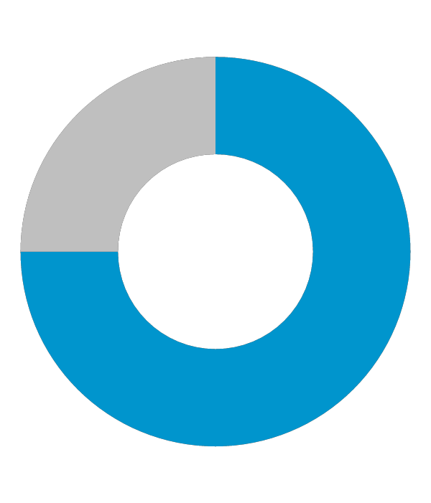
Professional website increase visibility and accessibility
94%
74%
73%
of first impressions of a website are design-related.
Newswire
of online users will return to a website that is mobile-friendly.
Forbes
of businesses invest in unique design.
Forbes

Slide 6
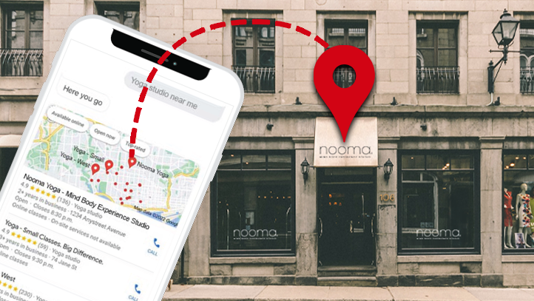
Website Design
Modern designs tailored to your industry.
Mobile responsive and search friendly.
Personalized consultation with an expert.
Flexible add on features such as lead forms, interactive photo gallery, appointment scheduler, coupons and more.
Have a designer create an Online Store for your business, and set up your products, tax, shipping and more.
Annual maintenance to ensure your website remains up-to-date.

Slide 7
How it works

Slide 8
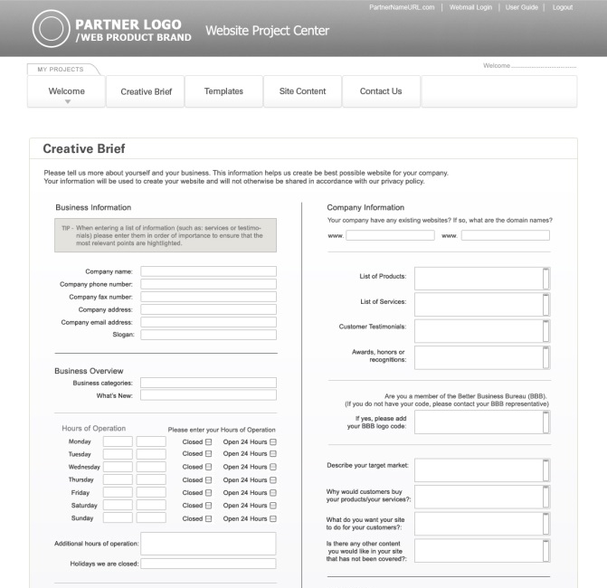
First step is to connect with our website coordinator
Within 2 business days, a website Coordinator will call you to book your 1-on-1 consultation to discuss your business needs and help determine your website goals. Your website coordinator will manage the design of your website with a team to build, design, and write professional copy.
Submit any images or content to be included on your website directly to your dedicated website coordinator.

Slide 9
Benefits
Work with experts
With the help of an expert, get a website that works for your business, so you can focus on your day-to-day.
Automatically optimizes your website across devices, including desktops, tablets, and smartphones.
Be mobile ready
24/7 Access
Anytime, anywhere access. Manage your website from anywhere that has an Internet connection.
Monthly maintenance time with our website packages means you can call or email to request edits and updates to keep your website up-to-date and stay credible, with no extra work or investment.
Ongoing updates

Slide 10
Q & A / Next steps

Slide 11
Frequently Asked Questions

Slide 12
What is included in a professional website design package?
Included in your package, you will have access to all the tools you need to manage and market an effective online presence. Most of our plans include a domain, business email and a website customized to your business and marketed by our team of experts.
Your subscription will give you access to a website Coordinator, who will liaise with a designer, copywriter and quality assurance team on the delivery of your website.
2. Does the plan include hosting?
Yes, all professional website design packages include hosting, as well as access to an account management dashboard to manage your domain, website and additional online marketing tools.
Your package also includes business-class email. You can create and manage email accounts in your dashboard and use Webmail to access your email anywhere.
3. What is the design process?
After your purchase, you will receive a Welcome email with login credentials to a Project Center so you can review your website’s design.
Your design process starts with a creative brief, where you provide your website Coordinator with details about your business and branding, including your logo, colors, font preferences and more. You will also discuss your website requirements and design preferences in your 1-on-1 phone consultation with your website Coordinator. Your website Coordinator will manage the design of your website with a professional designer, copywriter and quality assurance team.
Throughout the process, you will get emails prompting you to log in to the Project Center and review drafts of your website. You will also have the chance to review your finished website before it is published online.
4. How much input will I have into the design of my website?
Your design process starts with a modern, professionally designed template selection. You can provide your website Coordinator details about your business and branding, including your logo, colors, font preferences and more through a creative brief. You will also discuss your website requirements and design preferences in your 1-on-1 phone consultation with your website Coordinator.
You will also have the chance to review your finished website before it is published online.
5. Do I own my website?
While you are subscribed to your plan, you have access to your website, but you do not own the website in its entirety.
You will retain ownership of any images or content that you provide. Any assets provided by your designer including templates, images and content will remain under our ownership.

Slide 13
Probing Questions

Slide 14
What would happen if I Googled what your business offers, in your city? Would your business show up?
Do you know that 9 out of 10 purchases start online? You need to get found online, and have your professional website come up when customers are searching.
We have an option where we can build a professional website that gets your business online. Plus, features that drive your visitors to action.
I can have a website Coordinator call you to get started tomorrow. What do you think?
Do you have a website?
• Yes?
How could your website be improved: design, mobile-friendly, selling online, attract new customers?
• No?
Great, don’t lose any more time waiting! It’s important to have a professional online presence, so customers can trust your business’ credibility.
I have a solution that won’t take up your time or cost you an arm and a leg. We offer Professional Design website packages, where you work with a website coordinator to build your business a website that will work for you.
Is your website mobile responsive? Are you aware that Google will only show mobile-friendly websites to users searching on their smartphones?
72% of consumers who search on a computer/tablet go to a store within 5 miles of their location. (SMA Marketing, 2022)
88% of consumers visit a store within a day after conducting a local search on their smartphone. (Finances Online, 2023)
Your professionally designed website will perform perfectly across devices.

Slide 15
Objection Handlers

Slide 16
I already have a website / happy with my current provider.
Is your design modern? Is your website up to date? Is it mobile-friendly?
First impressions are extremely important. It takes no more than a split second (50 to 500 milliseconds) for users to form an opinion about your website (CXL, 2022).
First impressions are 94% design-related. (DatAchieve Digital, 2022)
Your new website will be modern, professionally designed, and will be built responsive, so it looks great on every device.
If someone else makes changes for you, do they charge and are they able to make changes quickly?
Can you easily make changes to your website yourself?
Our plans include ongoing monthly maintenance, so you can call in to make updates whenever you need to keep your website fresh and credible with your customers, at no extra cost.
You can also make changes to your website yourself, through our easy-to-use editor, Online Presence Builder, so you can make quick, easy edits or updates on the fly, anytime 24/7.
Does your website get found by customers searching online? Does it have an impact on your business and help drive sales and prospects? Does it include marketing tools to help promote your business?
Our plans include a full offering of marketing support and tools such as:
Optimizing your web pages for SEO and submitting your website to search listings.
Leveraging email marketing to promote your products or services and driving traffic to your new website.
Social media tools make it easy to post one time with one login, to Twitter, Facebook and LinkedIn.
Website analytics to measure visitors and what pages are most popular.
Your website should do more than be there for existing business, it should help your business get found by new customers.
It’s too expensive.
How many new customers a month would it take to handle the cost?
Our Professional plans are much more affordable than hiring a designer or boutique agency, which can cost you thousands of dollars up front. We finance the design of your website and have developed a process to keep our costs low.
A website is an investment – drive new business and stay competitive.
Our plans include more than a website – you’ll get free professional email addresses using your domain; email marketing tools to market and communicate to customers; social media tools, and more.
How much do you spend on print advertising?
Customers are turning to the Internet to search for businesses – especially local services. To compete, you need to consider how you’re being found.
I don’t have/need a website.
Customers are searching online for local businesses, at home and on their mobile devices. A website will help you reach new customers and grow your sales.
Having a professional, modern, up-to-date website builds your credibility and professionalism. Customers will trust your brand.
A good website will lighten your load – providing company information including your hours, contact information, products and services, and where to find you. Reduce repeat calls on general inquiries about your business.
If you’re not online, your customers could be finding your competition instead.

