Slide 1
Email Marketing/ Announcer Pro
Engage with existing customers, promote products and drive traffic.

Slide 2
Agenda
1
2
3
4
Importance of Announcer Pro
Announcer Pro
Features & Benefits Overview
Addressing Common Concerns

Slide 3

Keep businesses top of mind
By reaching out to customers on a regular basis with offers, coupons and updates it helps keep businesses top of mind. This ensures that when customers are ready to make a purchase they think of a specific small business and their products and services.
Creating multiple campaigns allows small business owners to target the right customer at the right time with the right offer. Reaching out to customers helps to increase sales and brand loyalty.
As per local Salescycle, 2022
50%
Of people buy from marketing emails at least once per month

Slide 4
Cost of not connecting with customers
Lack of customer engagement
Businesses miss out on opportunities to build relationships with customers and foster loyalty.
Lack of insights
Email communication with customers can facilitate in-person sales, enabling businesses to provide recommendations for complementary products alongside the initial purchase.
Missed sales opportunities
Businesses may lose out on revenue from new customers by not providing them with the right offer at the right time.
Not staying top of mind
By emailing customers on a consistent basis businesses stay top of mind and existing customers will recommend the business to new customers.

Slide 5
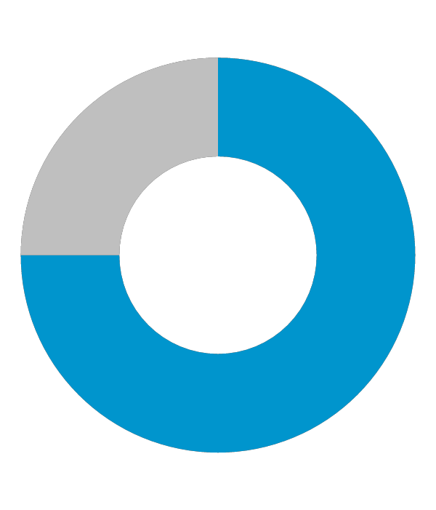

Impact of email marketing on businesses
50%
59%
81%
of customers are more likely to open an email if it includes a personalized subject line
Zero Bounce
of respondents say that marketing emails have influenced their purchase
Salecycle
of SMB’s still rely on email as their primary customer acquisition channel
Oberlo

Slide 6

Announcer Pro
Look Professional
Ease of use
Stay connected
Improve Marketing

Slide 7

Professionally Designed Newsletter Templates
A wide variety of templates. Choose from over 300 pre-built newsletter templates that include suggested text and titles.
A layout for different newsletter types. Traditional newsletter style, coupon/special offer and special announcement.
Business owners can easily add their own content using drag and drop functionality. Upload their logo, add text, links and social media.
Simple drag and drop editing.

Slide 8
Features
Professionally designed Newsletter templates
A wide variety of templates. Choose from over 300 pre-built newsletter templates that include suggested text and titles.
Schedule Multiple Campaigns
Easily manage multiple campaigns. Pre-schedule specific dates and times to send individual newsletters. Unlimited number of newsletters.
Contact Management
Easily build a contact list. Create individual contacts or upload existing contacts in excel. Import contacts from Outlook, Yahoo! Mail or Gmail, LinkedIn or contacts from computer files.
Organize the contact list. Add, edit or delete individual contacts with easy-to-use management tools.
Campaign Reporting
Measure the effectiveness of a campaign. View detailed reporting. View email performance as list, percentages, and visual breakdowns. Compare the performance of sent campaigns.

Slide 9
How it works

Slide 10
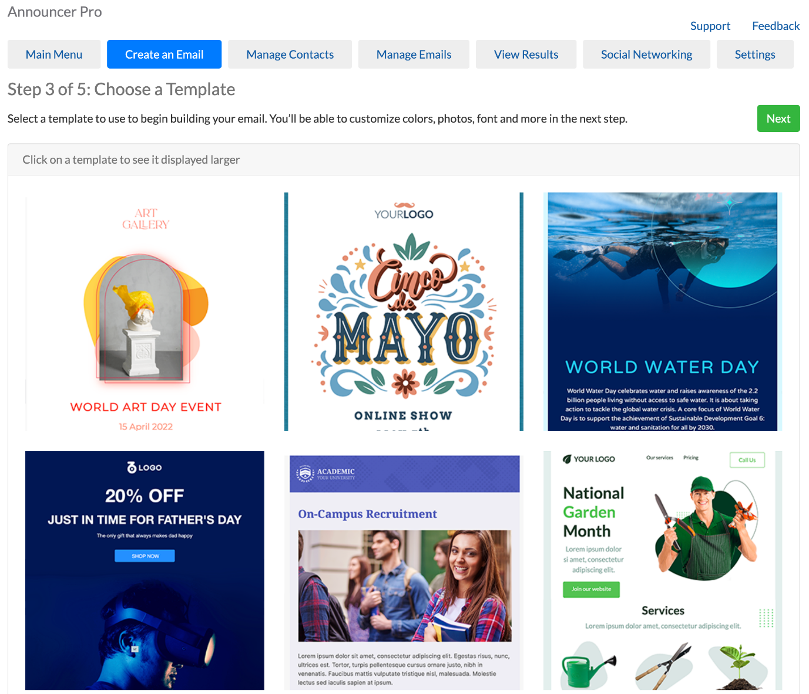
Login to your portal and access Announcer Pro
Start by creating a new email.
Choose contacts, add new or existing
Choose a template. Templates allow customers to select the overall layout and theme of the newsletter.
Edit the template
Preview the email and send a test before sending or scheduling.

Slide 11
Benefits
Easily manage multiple campaigns.
Businesses can pre-schedule specific dates and times to send emails whether they are in or out of the office.
Create auto-response emails for customers who subscribe.
Stay top of mind
Cost effective
Announcer Pro is a cost effective and easy to use solution that allows customers to create email campaigns without extra features they don’t need.
Easily create and send professional email newsletters to customers. Choose from hundreds of email templates that include suggested text and titles.
Look Professional
Measure and improve email marketing campaign performance with detailed reporting, including open and click rates and social media activity so that the right customers are targeted with the right message at the right time.
Improve Marketing

Slide 12
Q & A / Next steps

Slide 13
Frequently Asked Questions

Slide 14
What is Announcer Pro?
Announcer Pro is an email marketing tool which allows anyone to create and send graphic-rich emails in just a few short steps. Announcer Pro combines professional-looking templates with campaign management tools providing users with an enhanced email marketing tool to communicate with customers.
2. Why choose Announcer Pro over other email marketing solutions?
Users who have no HTML experience or email marketing campaign experience will find Announcer Pro easy to use. Included you will find the email Wizard which will be your guide to walk you through the account setup, creating campaigns, managing contact lists and publishing emails. Announcer Pro is a cost-effective solution that allows customers to create email campaigns without the features they don’t need.
3. What is a campaign?
A campaign is a newsletter sent to one or multiple contacts at a time.
4. What is the maximum number of recipients I can have for an email campaign?
Currently the limit is 10,000 for a single campaign. There are some conditions that address the use of Announcer Pro for the purposes of spam and other types of inappropriate email marketing activities.

Slide 15
Probing Questions

Slide 16
How are you advertising your business?
Email marketing is one of the most effective, cost-efficient ways for small businesses to advertise and stay top of mind with customers. Stats show that email marketing was ranked as the best channel in terms of return on investment for digital marketing.
What’s your budget?
What’s your typical return on investment?
How do you keep your current customer informed of new and exciting things that your company may be doing?
It is important to keep existing customers engaged and for your business to stay top of mind so that they keep coming back to you instead of your competition.
It is always easier to grow revenues by servicing existing repeat customers that to find new customers. Your existing customers do business with you because they like your products and services, they like you’re pricing, or they like you as a business. Nurture this relationship by keeping them informed of new offers, pricing, sales, product launches and more.
Do you get a lot of repeat customers?
Yes? Did you know most customers prefer to be contacted by businesses via email.
No? Email is a fantastic marketing medium for attracting repeat business, not only because it allows you to share promotional information, but because it lets you develop a more personal relationship with your customers. And it keeps your business on their mind, so that when they’re ready to make their next purchase, they’re already thinking about you.
Are you currently using email marketing?
Yes? That’s great. What provider are you using? Is it simple to use? Have you seen a lot of success? Did you know that email marketing is included in our website plans?
No? Establishing consumer trust and loyalty in a brand takes time. Email marketing allows you to build relationships with prospects, leads, and past and current customers by directly speaking to them about your brand via their inbox. It’s such a fast, easy way to reach out to customers. It enables you to provide customers with immediate information and allows instant access to their replies and queries.

Slide 17
Objection Handlers

Slide 18
I don’t have time or resources to use email marketing.
Email marketing is an incredibly important and easy way to stay in front of customers. New customers will always increase revenue and brand awareness for the company, but attracting a new audience can cost up to ten times as much as committing to growing your relationship with existing customers. Not to mention, repeat clients tend to spend a whole lot more on your services and products than new ones.
You can start by sending one email a month, which can take as little as 20 minutes, and you’ll be capitalizing on one of the easiest channels with the highest rate of return.
The tool is super easy to use, you only have to double click to add in any images you want and edit the text. I guarantee once you start seeing the impact it can have, you’ll be using it more often!
I don’t have an email list to send to.
Everyone has to start somewhere! Our Email Marketing tool can help with the task of collecting emails to start building a list.
First, you can import your contacts from Yahoo, Gmail or Outlook, or add contacts individually. Second, you can add a Subscriber form to your website for visitors to sign up—sweeten the deal by noting that you’ll send out special offers and promotions through your email. Third, you can start building a list by having a sign up in store; once you start collecting emails, it will be incredibly easy to stay top-of-mind so that you can keep driving customers back through your door!
I’m not very technical.
Our email marketing was built so that anyone can use it. It’s perfectly tailored for small business users to help you get in front of customers without much effort.
It takes just a few steps to set up an email: confirm your business details, choose a template, input your own text, select a list to send to and hit send!
You can use your contacts from Gmail or other email accounts to start and add a Subscriber form on your website to grow the list.

Slide 19
Test Your Knowledge

Slide 20
1. What percentage of customers buy from marketing emails at least once a month?
A) 50%
B) 41%
C) 36%
D) 62%
2. How many newsletter templates are there?
A) Over 200
B) 100
C) Over 300
D) Over 600
3. True or False: You can measure the effectiveness of each campaign.
A) True
B) False
4. What are benefits of using Announcer Pro?
A) Stay top of mind
B) Cost effective
C) Look professional
D) All of the above
5. What is included in campaign reporting?
A) Measures the effectiveness of a campaign
B) View Email performance
C) Compare the performance of sent campaigns
D) All of the above
6. Why should SMB’s use email marketing?
A) It gets you new customers
B) There is a coordinator who will create the newsletter for the business, so its easy and it gives business owners free time to focus on other areas of the business
C) It’s one of the most effective, cost-efficient ways for small businesses to advertise and stay top of mind with customers.
D) They shouldn’t.
7. True or False: You need to be technical to use Announcer Pro.
A) True
B) False
8. How many newsletters can you have?
A) 50
B) Unlimited
C) 100
D) 10
9. Which are key features of Announcer Pro?
A) Professionally designed newsletter templates
B) Schedule multiple campaigns
C) Contact management
D) All of the above
10. True or False: Email marketing has the highest return on investment.
True
False

Slide 21
Correct Answers
A) 50%
C) Over 300
A) True
D) All of the above
D) All of the above
C) It’s one of the most effective, cost-efficient ways for small businesses to advertise and stay top of mind with customers.
B) False
B) Unlimited
D) All of the above
A) True

