Slide 1
Reviews Promoter
Build online trust. Spread the word through customer reviews and social media.

Slide 2
Agenda
1
2
3
4
Importance Of Online Reviews
Reviews Promoter
Features & Benefits Overview
Addressing Common Concerns

Slide 3

Customers are talking online
When it comes to making a purchase decision, customers today heavily rely on online reviews to help guide their choices.
Positive reviews can also have a significant impact on a business's bottom line, as they can lead to increased customer trust, loyalty, and ultimately, sales.
As per local Consumer Review Survey 2023
98%
Of customers read online reviews for local businesses
Notes:
Statistics on how many consumers read online reviews before making a purchase and how positive reviews can lead to increased customer trust, loyalty, and sales.

Slide 4
Cost of neglecting online reputation
Lower Search Engine Rankings
Businesses with more positive reviews are more likely to rank higher in search engine results pages
Lack of Social Proof
Without reviews, businesses may be perceived as less trustworthy or less credible
Lack of Customer Engagement
Businesses may miss out on opportunities to build relationships with customers and foster loyalty
Missed Opportunities for Improvement
Reviews provide valuable feedback and can help businesses identify areas for improvement
Missed Sales Opportunities
Without reviews, businesses may miss out on potential sales and revenue
Increased Risk of Negative Publicity
Businesses may be more susceptible to negative publicity and damage to their reputation.

Slide 5
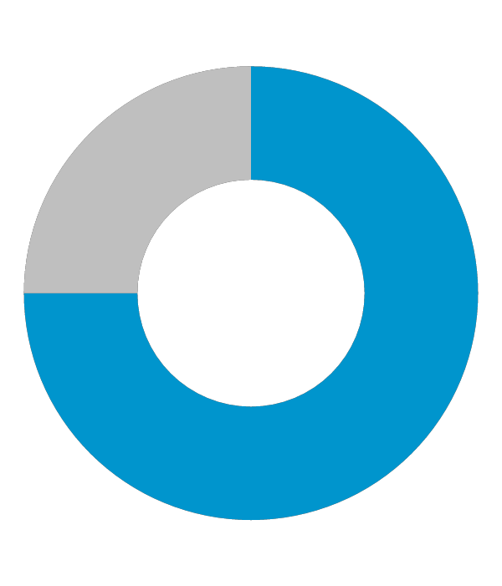
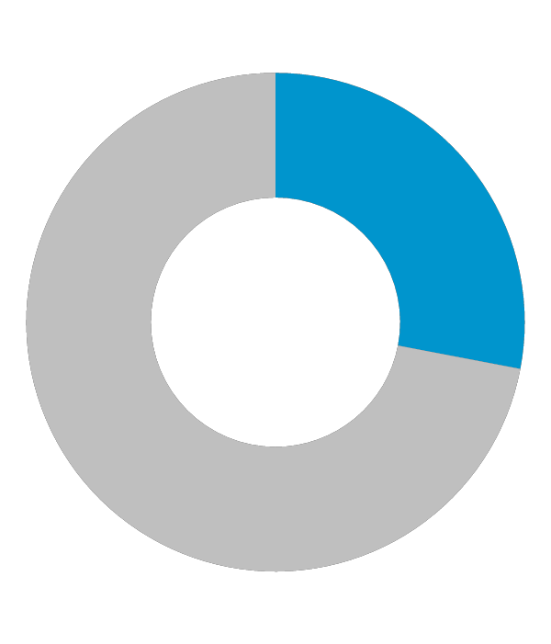
Online reviews impact reputation and bottom line
94%
9%
92%
of customer saying an online review has convinced them to avoid a business
Qualtrics
of businesses with a 4-star rating or higher see an average increase of 9% in revenue
Bright Local
of consumers hesitate to buy from a business with no reviews
Bright Local

Slide 6

Reviews Promoter
Review collection, review response, social media engagement, social media content, and competitor intelligence.
Simple solution to improve local online marketing
Collect 5-star reviews
Improve online credibility and trust
Monitor your competitors
Easily share testimonials online
Automate social posting

Slide 7
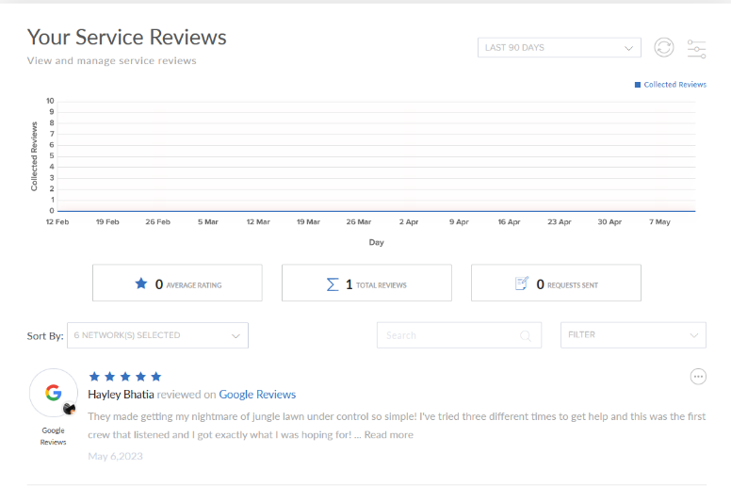
Get 5-Star Reviews
Send SMS texts and/or emails to customers asking them to review your company/product/service
Send review requests in bulk by uploading a customer list
Set up automated texts and/or emails to be sent out upon successful payment if the payment system is integrated with Zapier
Set up automatic sharing of a single review to multiple social platforms based on rules
Easy-to-use visual customizer for SMS text and email
Easily view your published reviews within the service reviews section of your dashboard
Simple and intuitive user interface

Slide 8
Reputation Manager
Consolidated view of all reviews and social media posts from multiple networks
Easily respond to reviews and posts
Sentiment analysis on a “Happiness Meter” provides an overall score across all networks for customer satisfaction
Filter views based on sentiment analysis and/or social networks
Automated notifications for new reviews and posts.

Slide 9

Social Calendar
Easily create and schedule custom content such as promotions, discounts, reminders, events, etc.​
1
Post to Facebook, Instagram, Twitter, Tumblr and LinkedIn
2
Artificial Intelligence Engine (AIE) will select and schedule engaging content that will be posted to multiple social media networks
3
Configure when posts are scheduled
4
Access a library of free stock photos for social content
5
See all the postings that will take place on the calendar, along with the amount of time saved by using the “Social 365” tool
6
View Social Analytics to track reactions, comments, shares and total engagement across platforms. Set up email notifications on social performance, post schedules and more
7

Slide 10
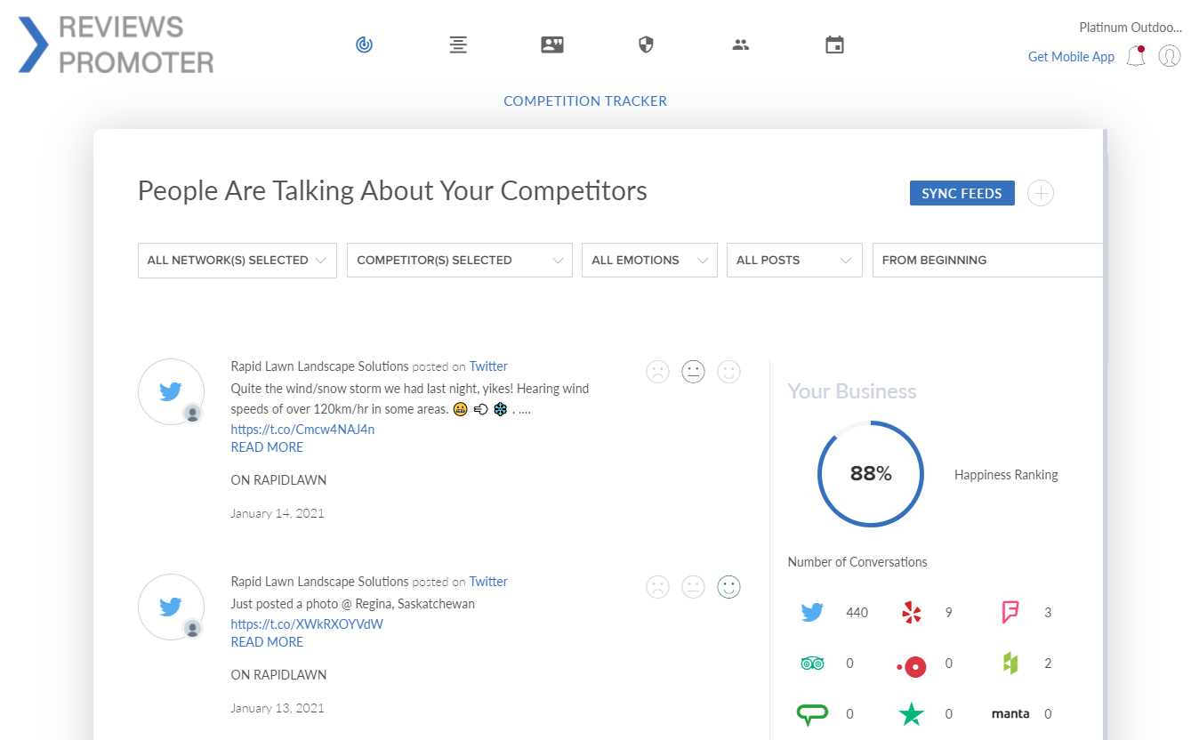
Competition Tracker
Monitor and track what customers are saying about competitors online.
Gather intelligence to help build competitive offerings and promotions.
Sentiment analysis of a “Happiness Meter” provides an overall score across all networks for each competitor.
Filter views based on sentiment analysis, selected competitors, and/or social networks.

Slide 11
Supported Channels
- Facebook Reviews - Google Reviews - Foursquare Reviews - Yelp - Instagram - Angie’s List - TripAdvisor - Trustpilot - Open Table - Houzz - Manta - Wedding Wire - Rate MDs - Realtor.com - Cylex - The Knot - Yellow Pages - Consumer Affairs - ZocDoc – Zillow – Trulia
Disclaimer: The supported channels may change at anytime and without prior notice.

Slide 12
How it works

Slide 13
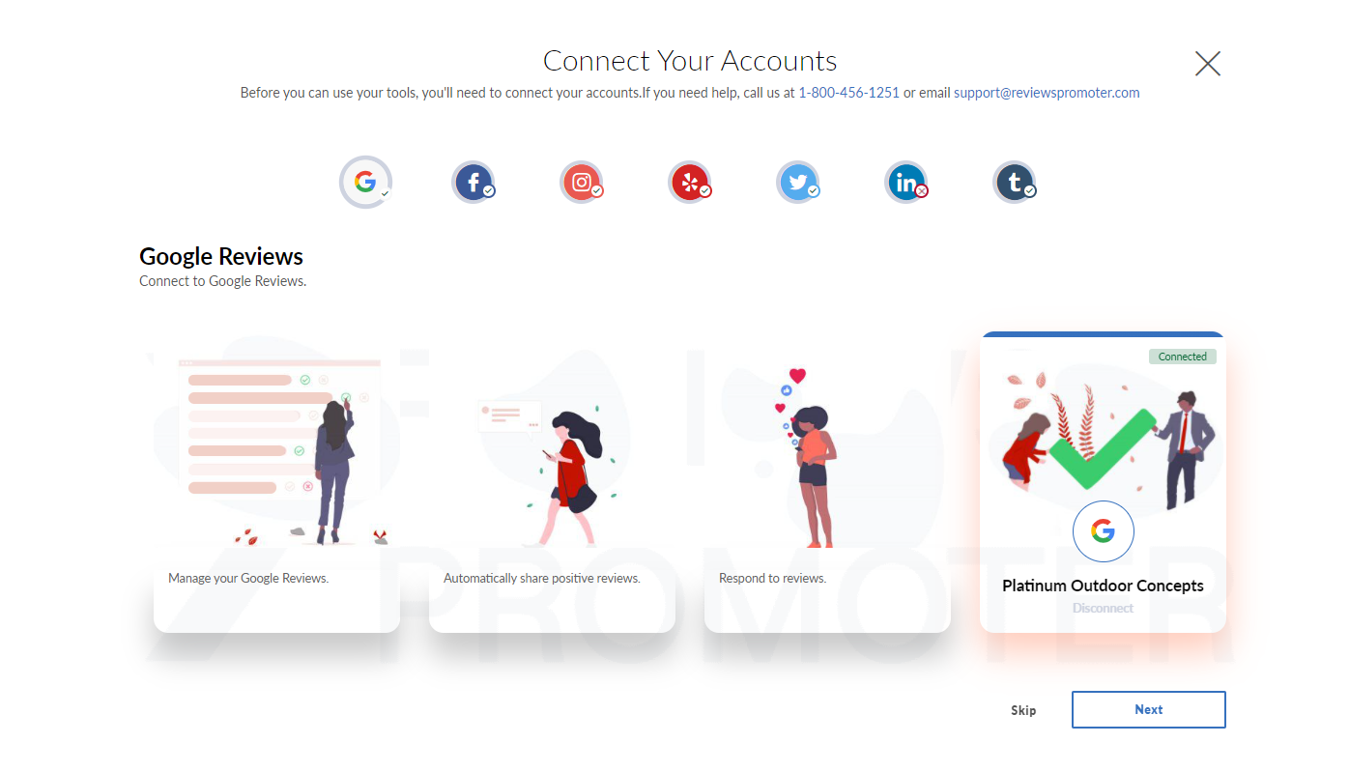
First step is to connect social and review accounts
Connecting accounts will allow customers to request reviews, get review and post notifications, respond to reviews and post to social accounts all through the Reviews Promoter dashboard. Connect all relevant accounts to maximize impact.

Slide 14
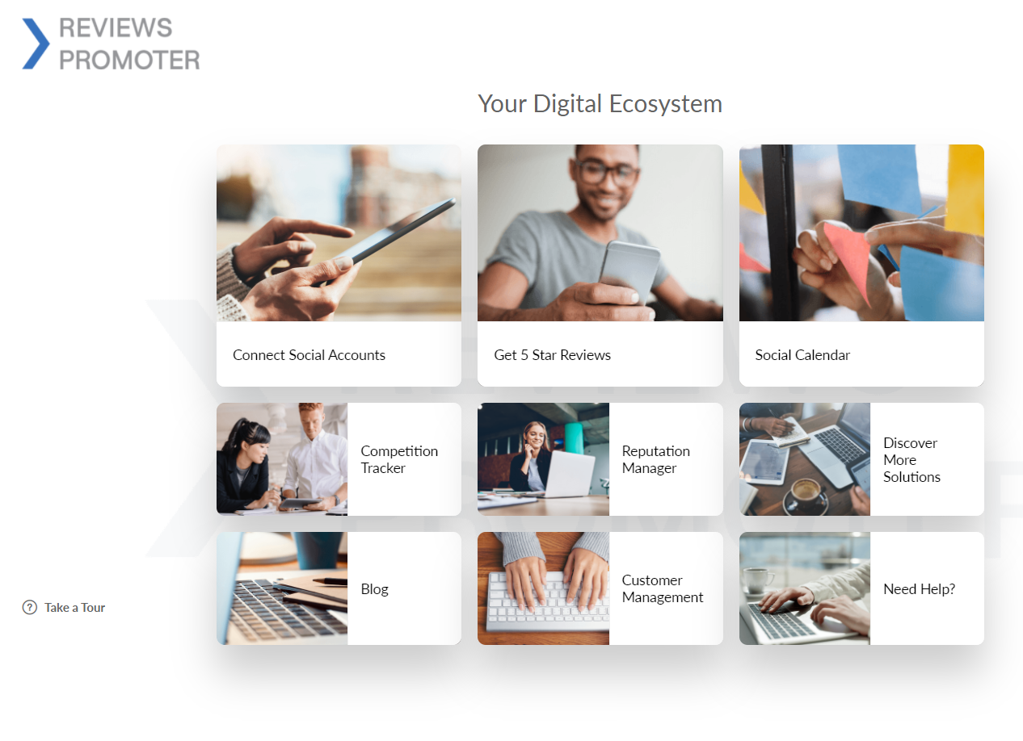
Dashboard that puts everything you need right at your fingertips
Customers can effortlessly access all of the features to enhance their online reputation and drive business growth. Say goodbye to the hassle of navigating multiple tools and platforms

Slide 15
Benefits
Increase the number of online reviews by sending requests to your customers by SMS texts and emails.
Customer reviews go a long way toward encouraging new prospects to try your business, plus they provide online content that helps your search engine ranking.
Easily embed real-time reviews on your company’s website.
Monitor social activity and reviews across the web.
Through a single platform, you can solicit reviews from multiple customers and have those reviews auto-published on your website and various social media channels.
Schedule hundreds of social media posts across multiple connected platforms based on selected interests and desired posting frequency.
Receive automated notifications for new reviews and posts. (not available for indirect channel)
Respond directly to reviews, posts, and comments from multiple connected platforms and sources.
Track your reputation through the “Happiness Meter”.
An active social media presence can help your business stay credible to prospective customers and can help improve your search engine ranking.
Schedule automated posts with relevant content using A.I. and/or schedule custom posts to keep accounts active.
Gather competitor intelligence by monitoring what customers say about competitors online.
Access all your Reviews Promoter features through a simple mobile app while on-the-go.
Turn customers into promoters
Save time with an all-in-one engagement platform
Manage your online reputation
Stay active on social media
Gain competitive insight
Easy mobile app

Slide 16
Q & A / Next steps

Slide 17
Frequently Asked Questions

Slide 18
Is sending a SMS text or email survey better to get reviews?
Sending both will increase your chances of getting a review, however text messages are more likely to get you new reviews more quickly. Customers are more likely to click on the link in an SMS text than in an email. An SMS text has an average open rate of 98% while email has an average open rate of 15-25%.
If you do not have a cell phone number and email address of customers, then you can still send a review request to the contact information they have provided.
How often should I send a text and/or email to ask for a review?
You should send a text and/or email to ask for a review to a happy customer after each completed purchase. Then send a follow-up text and/or email a few days later.
The dashboard has settings the customer can use to have the system automatically resend a text/email if the customer hasn't responded in X amount of days.
3. Can I remove negative reviews?
There is not currently a method to remove negative reviews from Google, Facebook, Yelp, Foursquare, etc however you can request to remove a negative review but only based on certain criteria. These top review/social sites base their credibility on untainted, authentic reviews. Some of these sites will even blacklist businesses that are identified for writing false reviews and/or boosting reviews unfairly.
Negative reviews can be just as powerful as positive reviews if you manage them by responding quickly. When businesses don’t respond to negative reviews at all, it gives the impression that the business does not care.

Slide 19
Probing Questions

Slide 20
How many online reviews does your business have on Google?
31% of consumers read more than 10 reviews before they trust a business (Statista 2023).
Reviews are critical for your business in a few ways:
Potential customers want to read testimonials to trust your business. The number of reviews, average star rating and how recent these reviews are, are all important. You should also be responding to reviews across platforms, it shows you are credible, engaged and care about your customers’ experience.
Search engines like Google use online reviews as a ranking factor in determining how your business ranks in search results. Online reviews are now an important part of local SEO.
We have a very simple solution called Reviews Promoter that makes it easy to collect customer reviews, respond to reviews posted on different platforms, and allows you to embed positive reviews onto your website.
What online marketing is your business doing today?
Online reviews have become one of the most important elements in your online presence. Did you know 98% of consumers read online reviews for local businesses (BrightLocal, 2023)?
Having more reviews leads to higher potential online conversion and helps to improve local SEO.
It can be challenging to collect reviews, stay on top of managing your online reputation and respond to customer reviews online. We have a very simple solution called Reviews Promoter.
It’s an all-in-one online engagement platform that helps you grow your business through four main features:
1. Gather Reviews
2. Social Content & Engagement
3. Reputation Management
4. Competition Tracker
Are you currently asking customers for reviews and testimonials?
What tools are you using today? Is it easy to share reviews across platforms and embed on your website?
We have a fantastic online engagement tool called Reviews Promoter that allows you to:
View and respond to reviews from over 15 review sources in a single dashboard.
Set up sharing of a single review to multiple social platforms.
Embed a live feed of reviews on your website based on rules.
Plus, the tool also includes an amazing social calendar feature that will automatically generate social content for your business.
Are negative reviews hurting your business?
Remember that not everyone will have a positive experience with your business, but that doesn’t mean you have to let it damage your online reputation. The more reviews you gather, the less prominent the negative reviews will be. A negative review also gives you the opportunity to quickly respond and make things right with a customer which is just as powerful as a 5-star review. With Reviews Promoter, we give you the tools to easily gather more 5-star reviews by sending out surveys via text or email and respond to your reviews all in one place.
How many social review channels are you listed in?
When it comes to researching a business, customers have different preferences on the platforms they use. In order for customers to find more information on your business, it’s important to have a profile on as many platforms as possible and to ensure that your business information is consistent. With Reputation Manager, you will see comments across Google Reviews, Yelp, Facebook, Twitter, Foursquare, Trustpilot, OpenTable, TripAdvisor, and more.

Slide 21
Objection Handlers

Slide 22
I am not interested.
[Check the business’ Google Business Profile account and note the number of reviews and whether the owner responds to reviews.]
I notice that your business today has X reviews on Google OR How many online reviews does your business have today?
I’m asking because Reviews have become an important factor in SEO; search engines like Google reward businesses that have more reviews and are engaging with reviews and social media. Plus, consumers themselves are checking your reviews when deciding to do business, and the number of reviews, the rating, and how recent they are all matter as part of that decision-making process. This is something I can highly recommend that can have an impact on your business this year.
I don’t really have the money for it right now.
How much is a new customer worth to you? I understand every investment in your business has to be carefully considered. Are you investing in other digital or traditional marketing today? With so much of our time spent online, Google is the first-place potential customers are going to measure your business. Growing and managing your reviews has become one of the top ROI marketing activities you can do.
Why do I need to be on a contract?
Being on a contract secures that we provide you with services that I mentioned to you for your business, and it secures the monthly payment that I committed to you. With access to Reviews Promoter there is no need to navigate multiple sites gathering reviews, posting content, responding to comments and checking on competitors. One dashboard gets it all done!
We are too busy right now due to [X reason].
I completely understand how busy you must be. That’s one of the great benefits of Reviews Promoter.
Once it’s set up, it can save you tons of time. Our AI engine can automatically create and schedule social posts. Plus, you can increase the number of reviews by sending your customers texts and emails inviting them to join the reviews conversation. Most of our review competitors such as Podium and Trustpilot only allow customers to leave a Google and/or Facebook review.
We are waiting for [X person] to start before we start using your service.
I understand wanting to wait; but the best time to start was yesterday! This type of activity can take a bit of time to ramp up and collect reviews, and it takes time for Google and other search engines to re-rank your business. The sooner you start optimizing your online presence, the sooner you’ll see results.
I am already using [insert competitor] so I’m not interested.
It’s great that you’re already working with [insert competitor]. It shows that you see the value of increasing the number of reviews for your business and managing your social presence.
May I ask how much you are spending? How many new reviews you have received in the past month?
With Reviews Promoter, in addition to managing reviews and social presence all in one dashboard, we can help you increase the number of reviews displayed on your website, and your customers will also have the option to leave reviews on other platforms such as Google, Facebook, Yelp, Foursquare, and more. We have helped our customers substantially increase reviews.

Slide 23
Test Your Knowledge

Slide 24
1. What are some of the key features of Reviews Promoter?
A) Reputation Manager
B) Social Calendar
C) Automate social posting
D) All of the above
2. What is the benefit of online reputation management?
A) Improve a business's image
B) Increase sales
C) Decrease customer satisfaction
D) Decrease customer engagement
3. What are the consequences of negative online reviews?
A) Decreased customer trust
B) Decreased sales
C) All of the above
D) None of the above
4. How can online reputation management help small businesses?
A) By monitoring online reviews
B) By responding to negative reviews
C) By generating positive reviews
D) All of the above
5. How can small businesses monitor their online reputation?
A) By checking online review sites
B) By using an online reputation management tool
C) Both A and B
D) By asking customers for feedback via email
6. How can small businesses respond to negative reviews?
A) By ignoring them
B) By apologizing and offering a solution
C) By arguing with the reviewer
D) By deleting the review
7. What is the benefit of generating positive reviews?
A) Increase in customer trust
B) Increase in sales
C) Both A and B
D) Decrease in customer loyalty
8. How can small businesses generate positive reviews?
A) By asking satisfied customers to leave a review
B) By incentivizing customers to leave a review
C) Both A and B
D) By paying for positive reviews
9. How long does it take to see the effects of online reputation management?
A) Immediately
B) A few days
C) A few weeks
D) A few months
10. How can small businesses choose an online reputation management tool?
A) By comparing features and pricing
B) By reading reviews from other businesses
C) By choosing the first tool they find
D) By choosing the most expensive tool available

Slide 25
Correct Answers
D) All of the above
B) Increase sales
C) All of the above
D) All of the above
C) Both A and B
B) By apologizing and offering a solution
C) Both A and B
C) Both A and B
C) A few weeks
A) By comparing features and pricing

