Slide 1
CloudTrainVZ – Group Session #1
10/02/2017

Slide 2
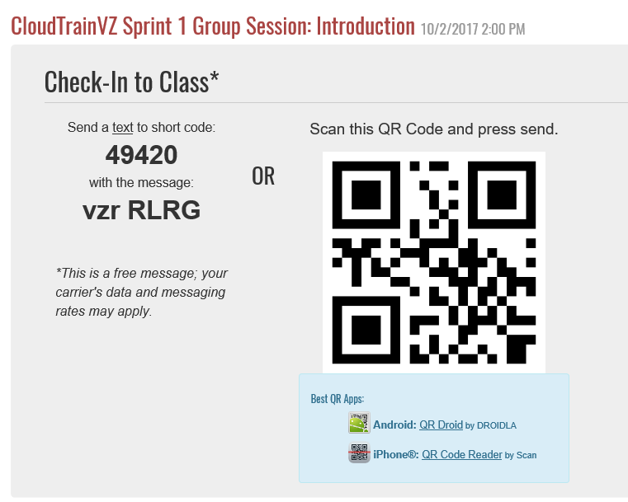

Slide 3
Agenda
Introduction CloudTrainVZ
AWS Overview
IAM Model
Verizon’s AWS Services
Verizon’s AWS Account Model
Verizon’s Access Roles
How-to Request Console Access
How-to Login to AWS Console
AWS Console Demo

Slide 4
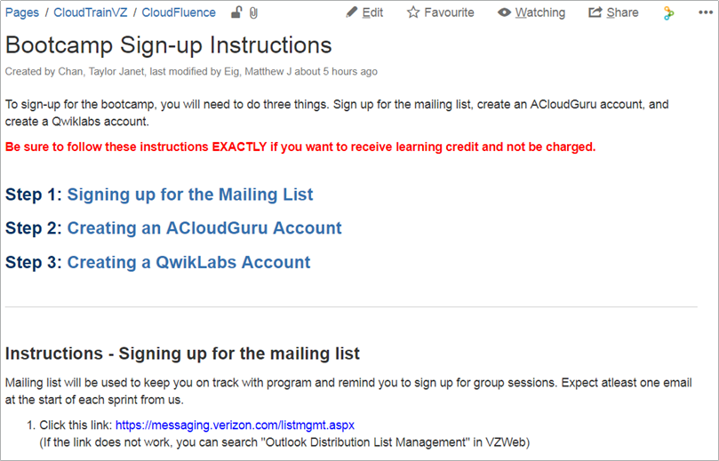
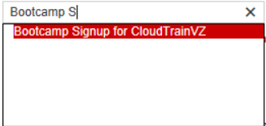
Signing Up
https://oneconfluence.verizon.com/display/CloudTrainVZ/Bootcamp+Sign-up+Instructions
Notes:
Please confirm that everyone has followed the steps detailed on the CloudTrain site

Slide 5
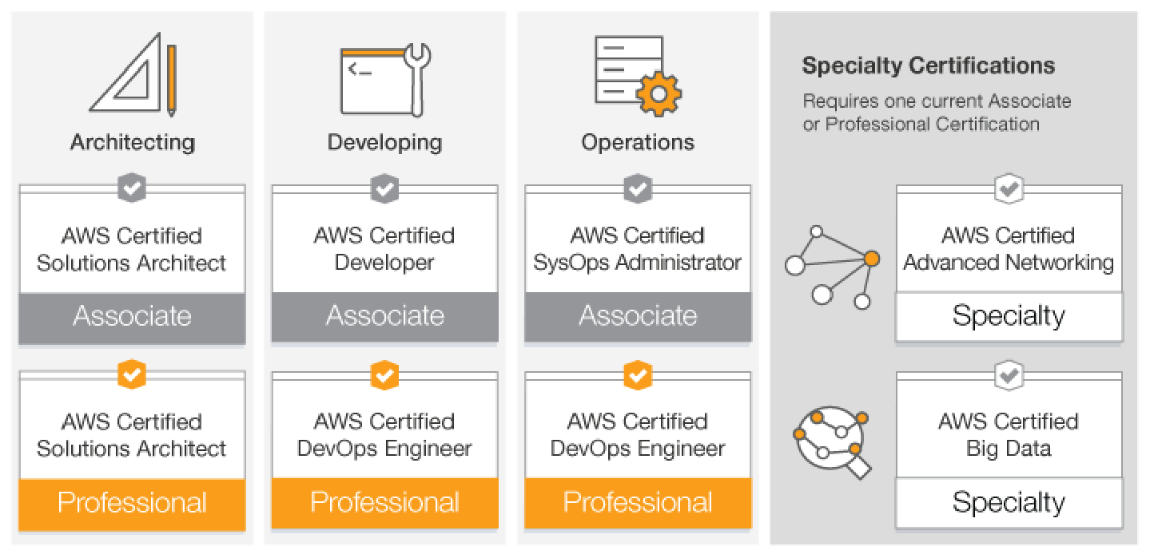
Exam Voucher for AWS Certification Track
Test Voucher will cover Certified Solutions Architect Associate Exam (CSAA $150 ea.)
Note: Certified Solutions Architect Certifications are sponsored by Verizon. All others are optional.

Slide 6
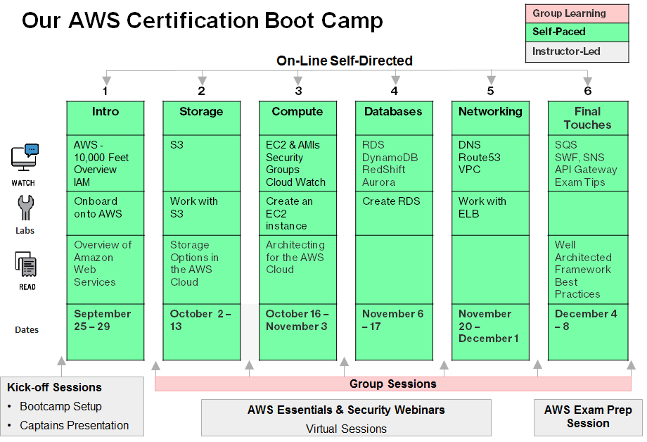
Our AWS Certification Bootcamp

Slide 7
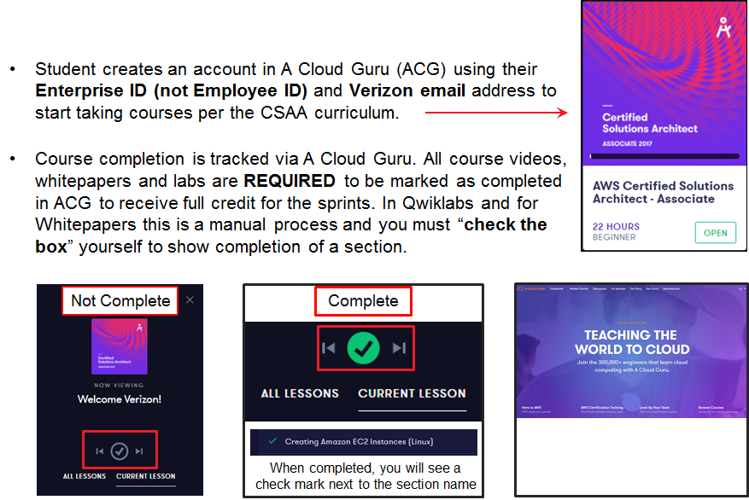
A Cloud Guru

Slide 8
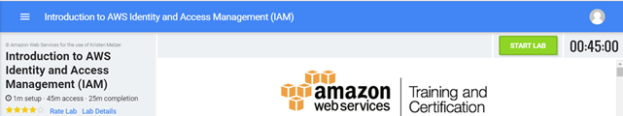
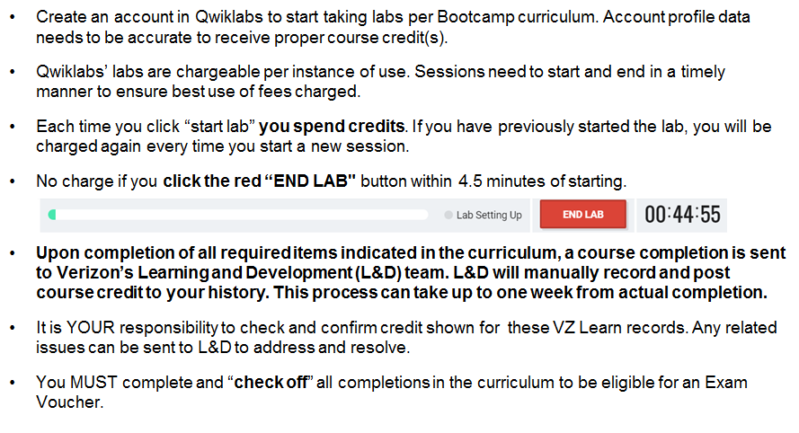
Qwiklabs

Slide 9
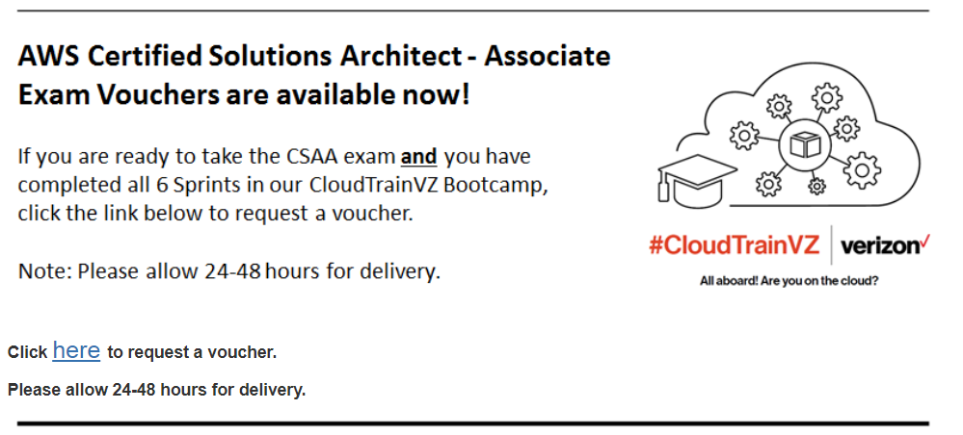
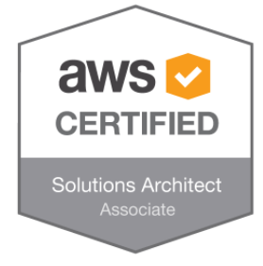
Exam Voucher Request Process
Be sure to complete all 6 Sprints and take sample exam and secure a good passing rate (>60%) prior to requesting Exam Voucher
Submit request for voucher via online form (see CloudTrainVZ site)
Voucher code provided
Register for Exam and provide Voucher ID as payment
Reply to matthew.eig@verizon.com with exam date and your results
Post your badge to About You

Slide 10
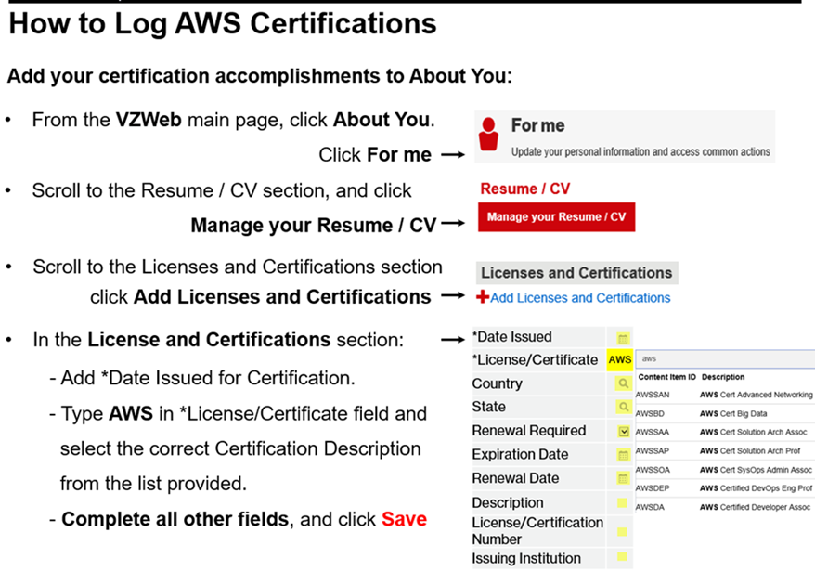

Slide 11

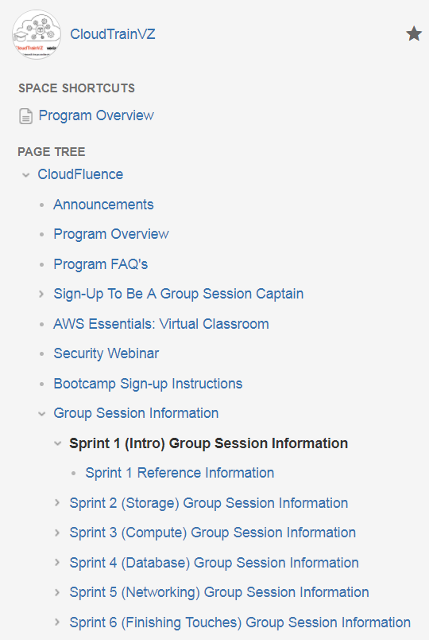
Captains Panels
Before your group session students should:
Review the content of the Sprint
Including: A Cloud Guru, Qwiklabs, Whitepapers and verify that there were no problems encountered.
During the group session:
Do not just lecture. Ask questions about that sprint’s content
Help students and encourage participation.
Highlight the “Verizon way” for the content.
Leverage the knowledge of your students.
Use the content for each sprint that’s on CloudTrainVZ
For example:
Talk through the high level of what each part of the sprint entailed.
Open the floor to discussion about issues.
Have the group work together to solve the issues of their peers
If the group can't or is wrong, step in to help solve the issue.
Discuss how they can use this new skill in their work life.

Slide 12
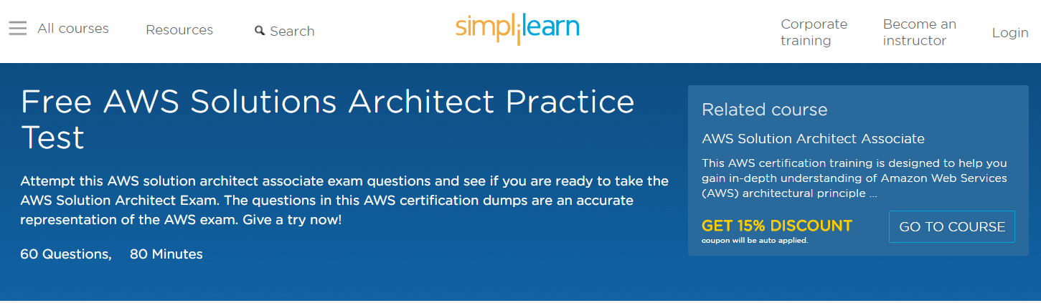
AWS Test Material Details
For new topics be sure to check FAQs in A Cloud Guru.
Dynamo DB - need to know what this is and when to use it (think push-button scalability). There will be far more questions about RDS and maybe some specific questions regarding Aurora.
ECS, EC2, Lambda – new topics to be aware of, but only study if you have time
API Gateway and more
Must Dos:
A Cloud Guru quizzes, especially the Mega Quiz. Take at least twice if possible.
Take the free practice exam at https://www.simplilearn.com/aws-solutions-architect-exam-free-practice-test

Slide 13
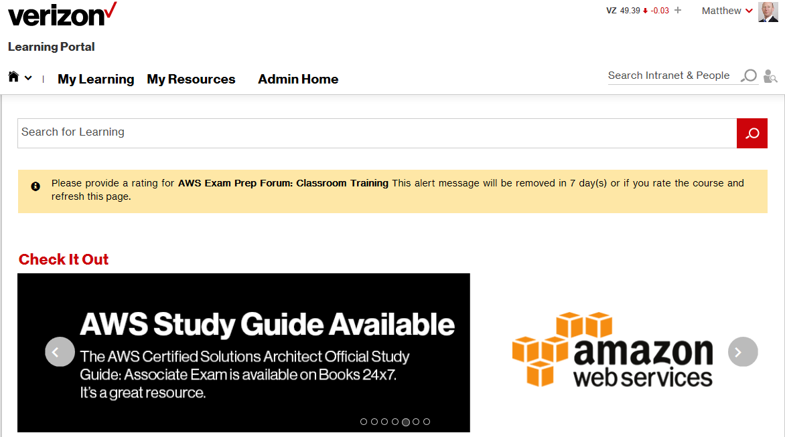
AWS Test Material Details
Good References:
AWS Official Study Guide – good overview of services and practice questions
Whizlab mock exams – very helpful for practice – cost is $14
Amazon AWS Practice Exam – cost is $20 (20 questions)
Download apps from the app store. “AWS Certified Solutions Architect Associate” by Magic Bytes Soft (free on Google App Store)
Suggestions for best practice Whitepaper to review:
https://aws.amazon.com/whitepapers/aws-security-best-practices
https://d0.awsstatic.com/whitepapers/aws-storage-options.pdf
From VZ Web Learning Portal you can access Skillport Books24x7 which includes AWS Certified Solutions Architect Official Study Guide: Associate Exam:
https://learn.lms.verizon.com/psp/vzlmpra/EMPLOYEE/ELM/h/?tab=LEEP_DASHBOARD&pslnkid=LEEP_DASHBOARD_LINK

Slide 14

AWS Testing Methodology Highlights
Test difficulty level is increasing over time as technology changes.
Study in two phases. Phase 1 is Acloudguru. Acloudguru will help with 50-60% of studying necessary. Use it as a base. Acloudguru is good for basics and an overview.
Supplement Acloudguru with other sources such as “AWS Certified Solutions Architect Official Study Guide: Associate Exam” on Skillport Books24x7), YouTube videos, AWS FAQs, personal AWS accounts, Captains, etc.
Ensure you understand how services differ in terms of key concepts like Availability Zones, Regions, etc. What is provided at an AZ level, what is needed or affected at the Region level. Think of subnets, DynamoDB, S3 cross-region replication vs default same region redundancy, etc.
Most basic questions will be re-worded to ensure you have a deep level of understanding. Unlikely you will see simple questions like S3 is object level, while EBS is block level storage. But you will need to apply your knowledge of these concepts.
New materials may get more focus on tests (ie more questions on the topic, so be sure to read prep reviews, FAQs, etc.).

Slide 15

FAQ’s
Q: I already have ACloudGuru and Qwiklabs accounts from the first sprint offered earlier this year. Due to my job responsibilities and work hours I was not able to finish that sprint. I should have more time this go around. Does that mean I am already registered for this new sprint or do I have to do something else special to get registered to this new sprint?
A: You are all set. Please add your name to our new mailing list called “Bootcamp Sign Up for CloudTrainVZ” so we can keep you in the loop about upcoming sessions and more.
Q: I followed the steps on the CloudTrainVZ site, now My manager is asking me to register for the program course on VZLearn. How do I do that?
A: You don’t. When you complete the sections in A Cloud Guru, Qwiklabs and the Whitepapers (AND CHECK THE BOXES), you will be credited for each Sprint as a separate class in VZLearn.
Q: Can I use the exam voucher for the Developer or other AWS certification exam?
A: We are only sponsoring the CSAA exam.

Slide 16
AWS Rapid Pace of Innovation
722
New Features/Services Launched
159
82
48
2009
2011
2013
2015

Slide 17
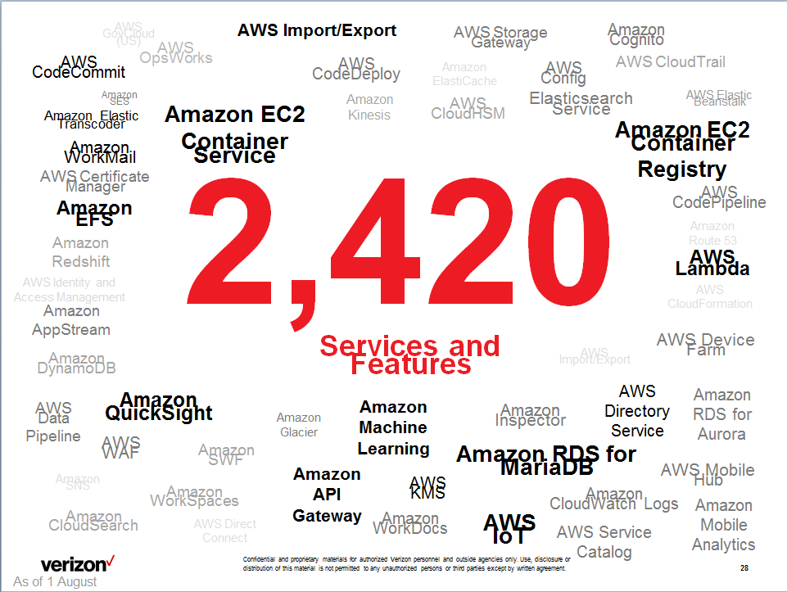

Slide 18
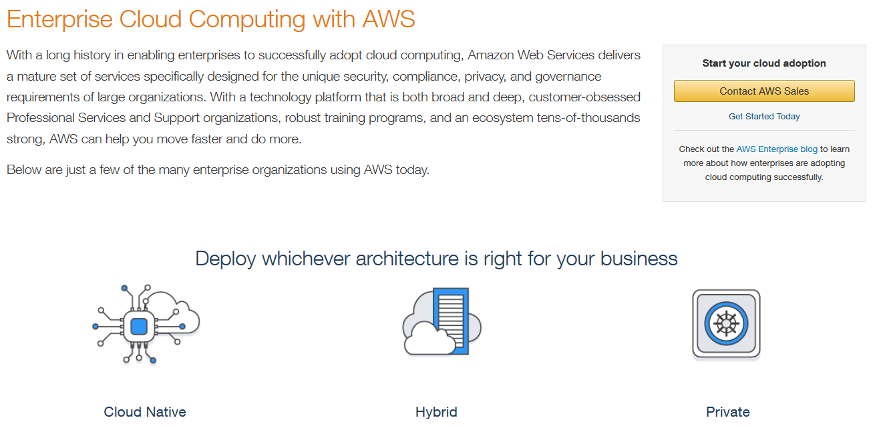
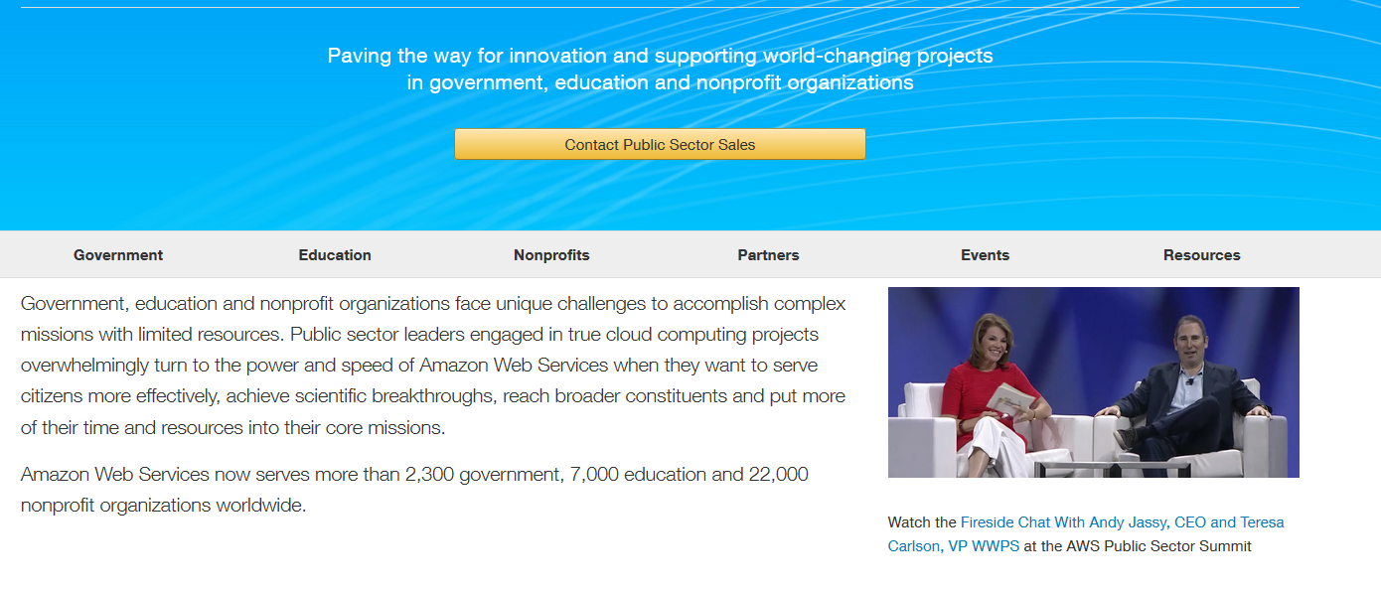
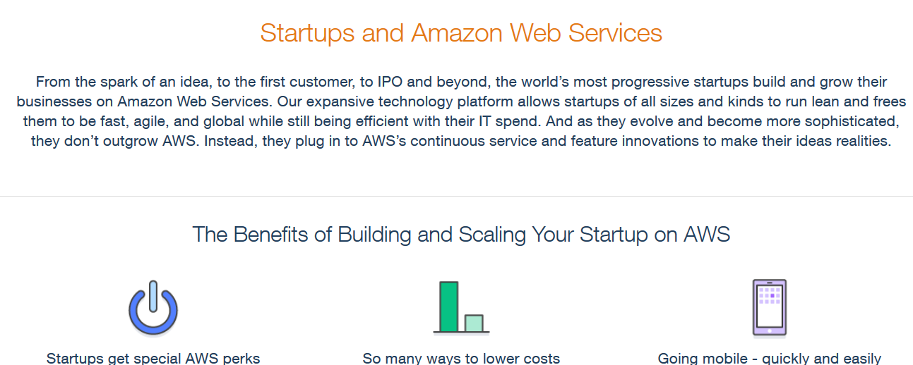
AWS Customers
Enterprise Customers
Public Sector Customers
Startup Customers
18

Slide 19
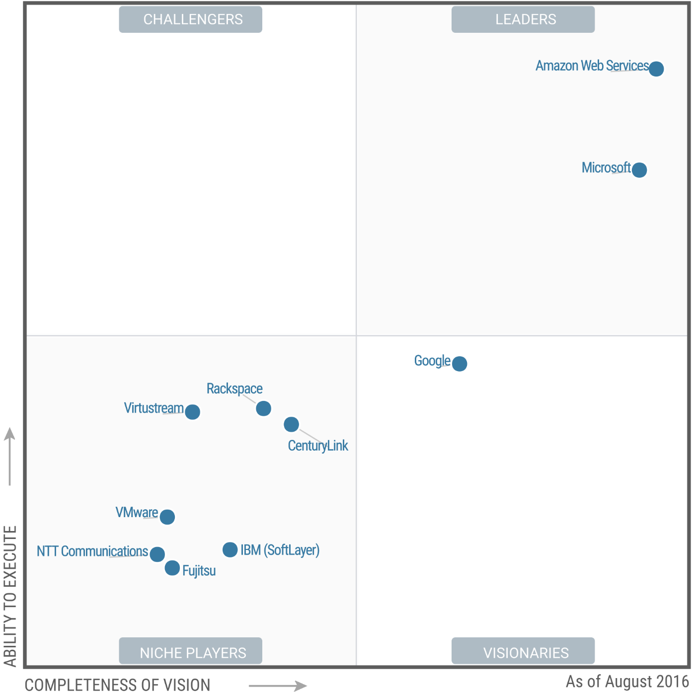
Gartner Magic Quadrant for Cloud Infrastructure as a Service, Worldwide
Gartner “Magic Quadrant for Cloud Infrastructure as a Service, Worldwide,” Lydia Leong, Gregor Petri, Bob Gill, Mike Dorosh, 03 August 2016. This Magic Quadrant graphic was published by Gartner, Inc. as part of a larger research note and should be evaluated in the context of the entire report. The Gartner report is available at https://aws.amazon.com/resources/analyst-reports/ . Gartner does not endorse any vendor, product or service depicted in its research publications, and does not advise technology users to select only those vendors with the highest ratings or other designation. Gartner research publications consist of the opinions of Gartner's research organization and should not be construed as statements of fact. Gartner disclaims all warranties, expressed or implied, with respect to this research, including any warranties of merchantability or fitness for a particular purpose.
19

Slide 20
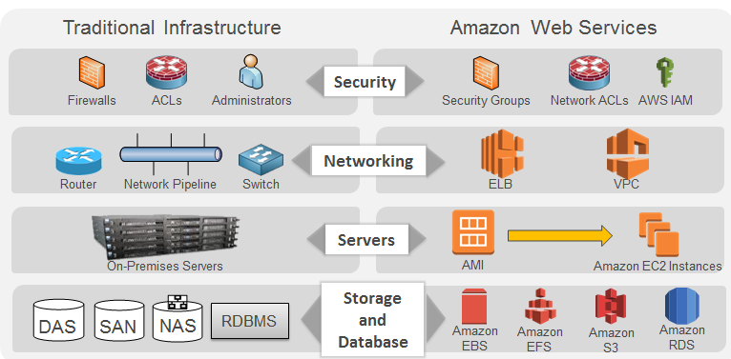
AWS Core Infrastructure and Services

Slide 21
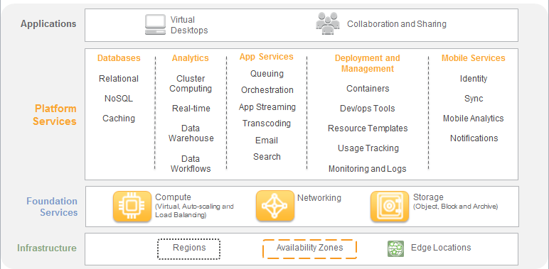
AWS Cloud Computing
21

Slide 22
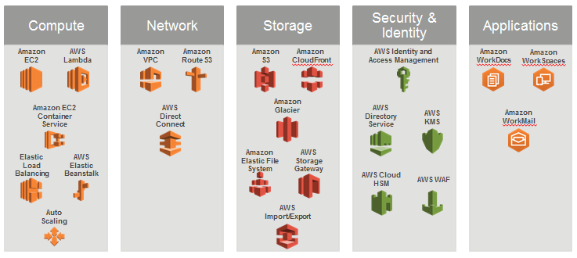
AWS Foundation Services
22

Slide 23
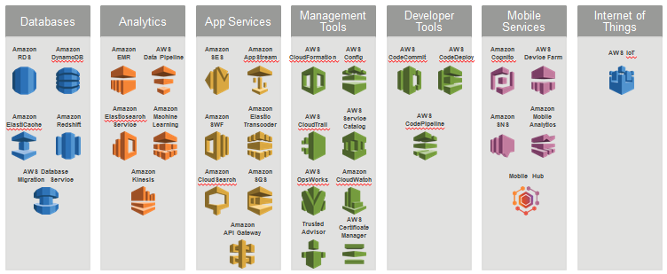
AWS Platform Services

Slide 24
AWS Global Infrastructure
Regions
Geographic locations
Consist of at least two Availability Zones
Availability Zones
Clusters of data centers
Isolated from failures in other Availability Zones

Slide 25
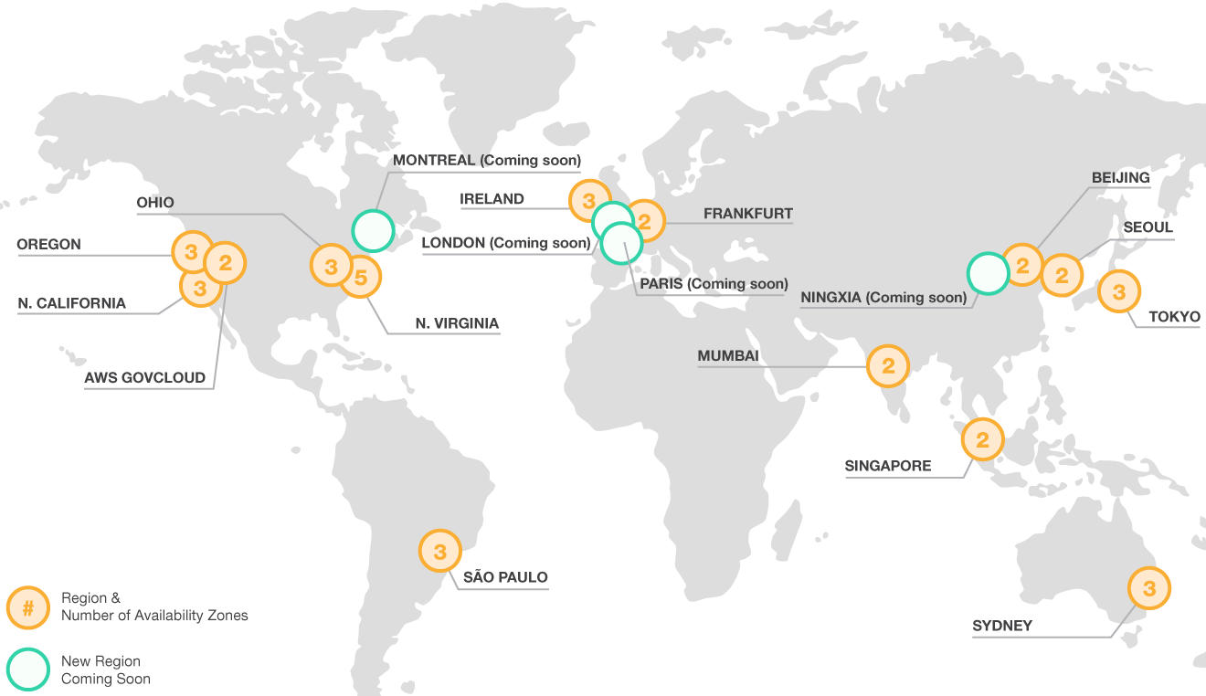
AWS Global Infrastructure

Slide 26
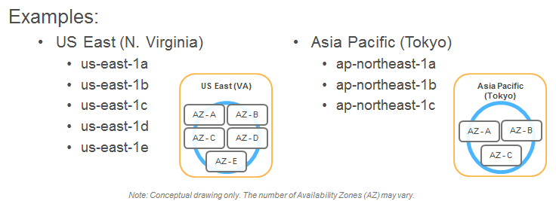
AWS Global Infrastructure
At least 2 Availability Zones per region.
Note: Conceptual drawing only. The number of Availability Zones (AZ) may vary.

Slide 27

High Availability Using Multi-AZ Deployments
Region
Availability Zone - A
Availability Zone - B
Availability Zone - C

Slide 28


AWS Global Infrastructure
50+ AWS Edge locations - local points of presence commonly supporting AWS services such as:
Amazon Route 53
Amazon CloudFront

Slide 29
A Memory Jogger
IAM stands for?
Incident Assignment Management
Identity Access Management
Idiomatic And Mysterious
Improvised Application Management
None of the above
Notes:
Start out with something fun! Obviously, the correct answer is “B”. But, sometimes it can feel like “C”.
For newcomers, understanding IAM is one of the most challenging aspects of AWS. So, let people know that it is okay to feel a bit overwhelmed at first.

Slide 30
IAM
Highlights
Centralized control of your AWS account
Shared Access to your AWS Account
Granular Permissions
Identity Federation (we use SAML with AD)
Multifactor Authentication
Provide temporary access for users/devices and services where necessary
Allows you to setup your own password rotation policy
Integrates with many different AWS services
Supports PCI DSS compliance

Slide 31
IAM
Critical Terms
Users – Think real people
Groups – A collection of users under one set of permissions
Roles – You create Roles and can then assign them to AWS resources. Users can also assume a Role
Policies – A document that contains 1:M permissions

Slide 32
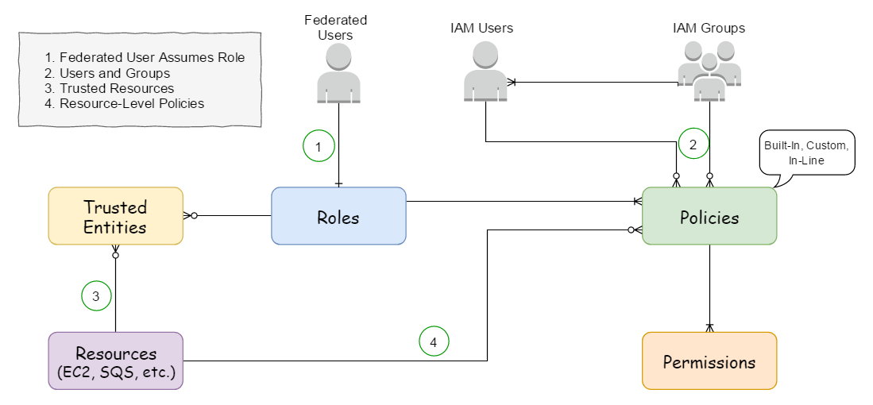
IAM Model
Notes:
Explain how the model works for the 4 use cases (i.e., Federated Users, User and Groups, Trusted Resources and Resource-level policies.) And in the AWS Console, show a example of each use case.
Also, show/discuss the Policy Generator (https://awspolicygen.s3.amazonaws.com/policygen.html) and the Policy Simulator (https://policysim.aws.amazon.com/home/index.jsp?#)

Slide 33











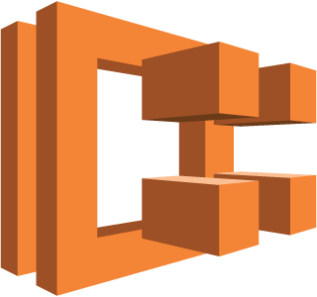











Verizon’s AWS Services
SNS
EC2
Elastic Load Balancing
Lambda
API Gateway
S3
EBS
Available
Data Pipeline
RDS
Redshift
ElastiCache
ECS
CloudWatch
CloudFormation
SQS
Kinesis
EMR
CloudTrail
Unavailable???
Its Complicated….
Check Confluence….
Beanstalk
Route 53
CloudFront
DynamoDB
SWF
Notes:
Let students know that they don’t need to understand the details of how all the AWS services work. For example, for their CSAA, they will focus mainly on EC2, ELB, EBS, S3, RDS, CloudWatch and CloudFormation. They will need a general understanding of the other services (even the services which are “unavailable” at Verizon.)

Slide 34
Verizon’s AWS Services
More Information:
https://oneconfluence.verizon.com/display/CLOUD/AWS+Services+Usage+Policy
Notes:
Talk thru the process for requesting Console Access.

Slide 35
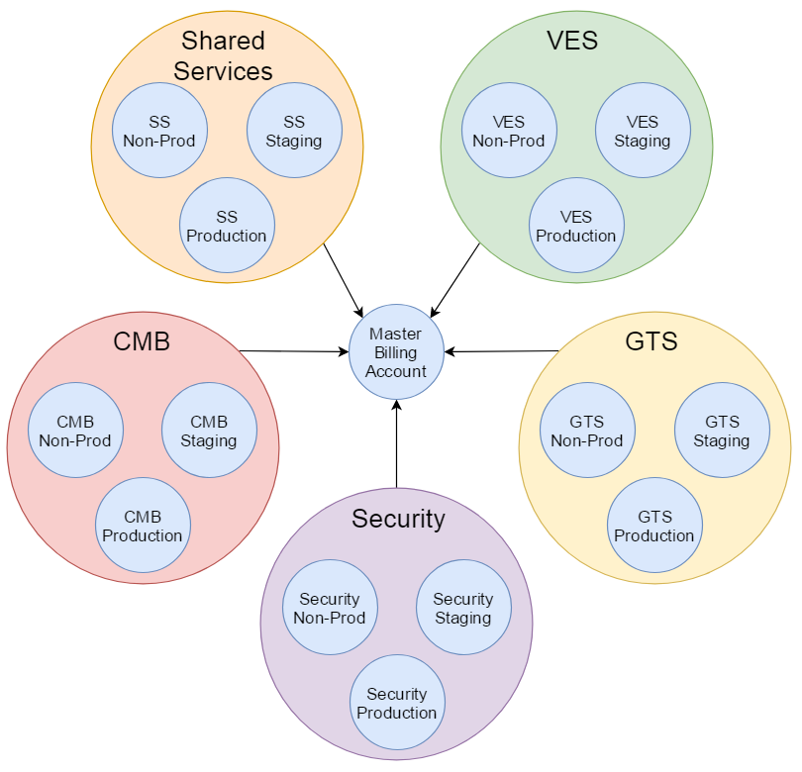
Verizon’s AWS Account Model
Notes:
Verizon’s AWS Account Model is based upon line-of-business portfolios. Each portfolio has a set of pre-configured accounts (i.e., Non-Prod, Staging and Production.) Each portfolio’s applications run in one of these pre-configured accounts.
At the center, the Master Billing Account is used for Consolidated Billing.

Slide 36
Verizon’s AWS Account Model
More information:
https://oneconfluence.verizon.com/display/CLOUD/AWS+Account+Listings
https://oneconfluence.verizon.com/display/CLOUD/AWS+Account+Segmentation+Strategy

Slide 37
Verizon’s Access Roles:
Onshore
Select this role if you are a US-based Onshore Developer
Offshore
Select this role if you are an Offshore Developer
Billing
Select this role if you are in Finance
Read Only
Select this role if you need read-only access
Notes:
Describe the various Access Roles

Slide 38
How-to Request Console Access
https://oneconfluence.verizon.com/display/CLOUD/1.1+-+How+to+request+AWS+Console+Access
Notes:
Talk thru the process for requesting Console Access.

Slide 39
How-to Login to AWS Console
The AWS Console is a web application used for managing AWS resources.
For example, you can use the Console to:
Manage files in an S3 bucket
Start and Stop EC2 instances
View CloudWatch logs
URL for Onshore Users:
https://federation.verizon.com/aws/console.jsp
URL for VDSI Users:
https://federationfdc.verizon.com/affwebservices/public/saml2sso?SPID=urn:amazon:webservices
More information:
https://oneconfluence.verizon.com/display/CLOUD/1.0+-+AWS+Console+Overview

Slide 40
CLI Access
Accessing The AWS Command Line From A Desktop
https://oneconfluence.verizon.com/display/CLOUD/Accessing+The+AWS+Command+Line+From+A+Desktop?src=contextnavpagetreemode
Enable AWS CLI in EC2 Instances with IAM Roles
https://oneconfluence.verizon.com/display/CLOUD/Enable+AWS+CLI+in+EC2+Instances+with+IAM+Roles?src=contextnavpagetreemode
Installing AWS CLI via Python in Windows Local Machine
https://oneconfluence.verizon.com/display/CLOUD/Installing+AWS+CLI+via+Python+in+Windows+Local+Machine?src=contextnavpagetreemode
Installing AWS CLI via Python on EC2 RHL Instance
https://oneconfluence.verizon.com/display/CLOUD/Installing+AWS+CLI+via+Python+on+EC2+RHL+Instance?src=contextnavpagetreemode
Notes:
Talk thru the process for requesting Console Access.

Slide 41
AWS Console Demo
Notes:
Show a quick demo of the AWS Console. Show how to search for services, show how to edit the services bar, and discuss the rationale for using Resource Groups.

Slide 42
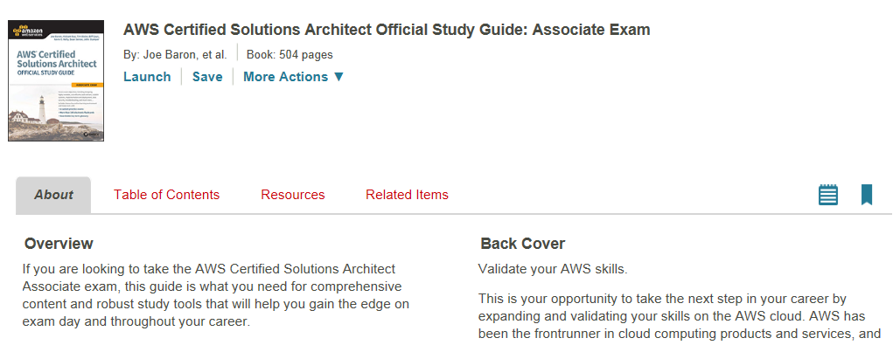
AWS CSAA Study Guide
The AWS CSAA Official Study Guide is available on books24x7:
https://verizon.skillport.com/skillportfe/main.action?assetid=120248&rowid=2

Slide 43
Questions?

