Slide 1
IT Brown Bag: Cloud Foundry
An introduction to Cloud Foundry, its use and Verizon’s strategy
Josh Stone – June 15, 2016

Slide 2
Today’s Talk
What is Cloud Foundry?
How does it work?
How do I leverage Cloud Foundry?
What is Verizon’s Strategy for Cloud Foundry?

Slide 3
What is Cloud Foundry?

Slide 4
First, some definitions
Infrastructure as a Service: IaaS
Platform as a Service: PaaS
On demand delivery of bare infrastructure compute, storage, networking and OS
You still have to install some software/configure the environment to run your application
On demand delivery of complete runtime/middleware
Abstracts away all hardware/infrastructure considerations from the application
AWS EC2, Openstack, Azure, etc.
Google App Engine, Openshift. AWS Elastic Beanstack, Cloud Foundry
Notes:
What is Cloud Foundry (CF)?
Pivotal CF is a next-gen middleware/PaaS that delivers:
We provision operating systems and middleware.
We deliver workload density without compromising application performance.
We ensure that applications have appropriate network security safe guards to prevent security threats.
We support application connections to external sources including databases and legacy middleware.
We provide 4 levels of HA, with built in load balancing for scale in/out
We support multi-tenant environments so that each line of business can operate with a discrete quota and isolated system access.
We provision next generation data services including NOSQL databases, traditional databases and hadoop clusters.
We provide horizontal and vertical scaling for the underlying IaaS so that you can scale your infrastructure in lock step with your Business.
We provide a built-in log aggregation service, built-in APM metrics and utilization based auto-scaling so that you can monitor the health of your applications and scale out without human or 3rd party tool intervention.

Slide 5
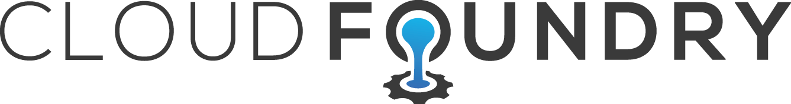
Let’s Start Simple
What is Cloud Foundry (CF)?
A next-gen, multi-cloud, multi-vendor Platform as a Service (PaaS) for apps
Takes care of provisioning, packaging, hosting, scaling, routing, health management, security, service management, log aggregation, metrics, …
What can you (a developer) do with CF?
Develop with your favorite cloud-native application framework, then just ‘cf push’.
Build, test, deploy, update and scale faster
Add services to your applications (e.g. messaging, caching, etc.)
Cool, how do you access it?
CF Apps Manager GUI
CF Command Line Interface (CF CLI)
Full API provides interface in DevOps Toolchain

Slide 6



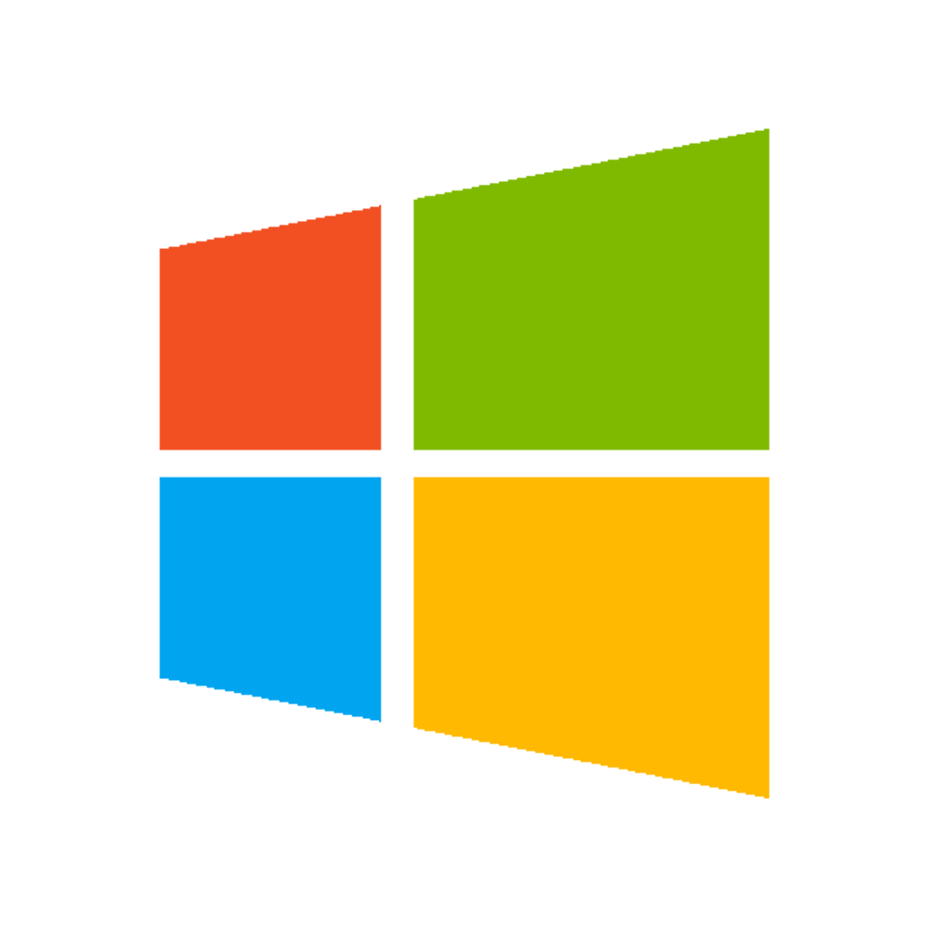
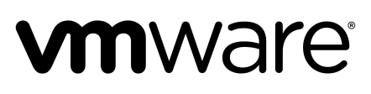

CF: Bird’s Eye View
Dynamic
Router
Elastic
Container
Runtime
Agile Microservices
Bindable Services
Health
Monitor
User
& Role
Mgmt
DataStax
Cassandra
Rabbit MQ
SSO
etc.
Azure

Slide 7
Quick Note: Multi-Tenancy
Organizations (Orgs)
Logical division within CF, each with its own users and assigned quota
User permissions / roles are specified per space within an organization
Sub-divided into Spaces
Spaces
Logical sub-division within an org
Users authorized at an organization level can have different roles per space
Users authorized at an organization level can have different roles per space
Same Service can have different meanings per space

Slide 8
How Does it Work?

Slide 9
How Cloud Foundry Works
App Code
Buildpack
Droplet

Slide 10
How Cloud Foundry Works
Diego CELL

Slide 11
How Cloud Foundry Works
Router

Slide 12
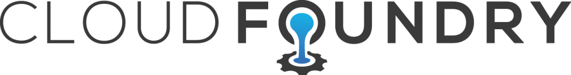
Deploying my Application
Blobstore
CC Database
~>
Cloud Controller
push app
Stage
Deploy
+ app MD
Router
cf push
+
=
BBS / etcd
✓
Upload App
Create Record and Route
Stage application
Deploy application
myapp.cf.verizon.com
CELL
Brain
DEA
✓
DEA
Auctioneer
Task
✓
LRP
✓
Notes:
This slide is animated. – View in Presentation Mode

Slide 13
Demo: “CF Push”

Slide 14
Success in Cloud Foundry.

Slide 15
What does a successful CF app look like?
Successful applications in Cloud Foundry are Stateless Microservices that adhere to 12 Factor.
Microservice
Broken up into small functional bits, loosely coupled via RESTful API
Each microservice performs 1 function
Independently updateable, deployable, scalable.
Stateless
Doe not track state internally, state is managed via sessionids
Stores nothing internally, no logging to local file system, no storing data in memory for a later use
12 Factor
Methodology (broken into 12 sections) to build a cloud-native application.
Includes Dependencies, Config, Backing Services, Disposibility, Logging, etc.
Full detail at 12factor.net

Slide 16
Our Strategy.

Slide 17
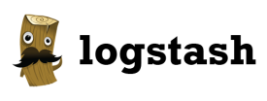

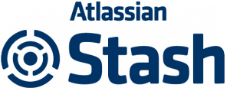
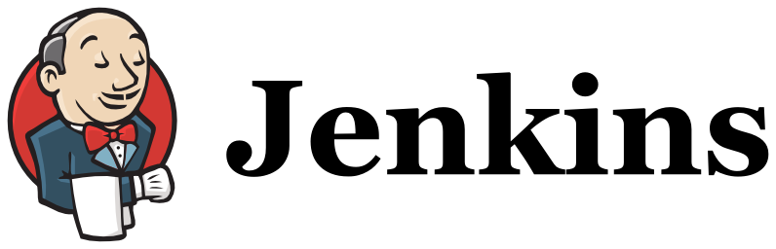

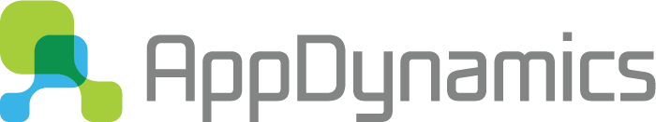
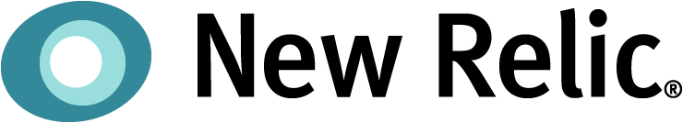
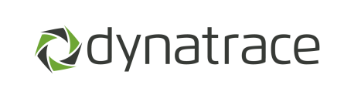
Integrating into CI/CD Pipeline
Logging
vElite
Available to all teams
Monitoring
Bring-your-own-monitoring

Slide 18
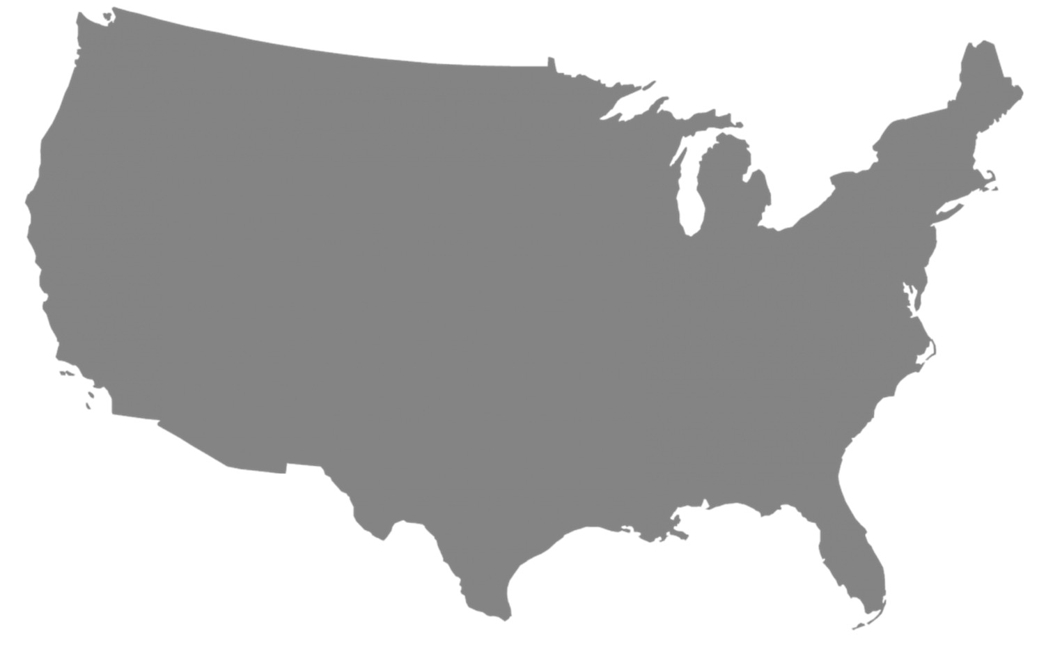


Summer 2016: Twelve Geographically Dispersed Deployments
Production environments in Fairland*, Omaha*, Sacramento(2), Tampa(2), and Twinsburg*
Non-Production environments in Tampa(3), Twinsburg, and AWS*
*by Aug. 2016

Slide 19
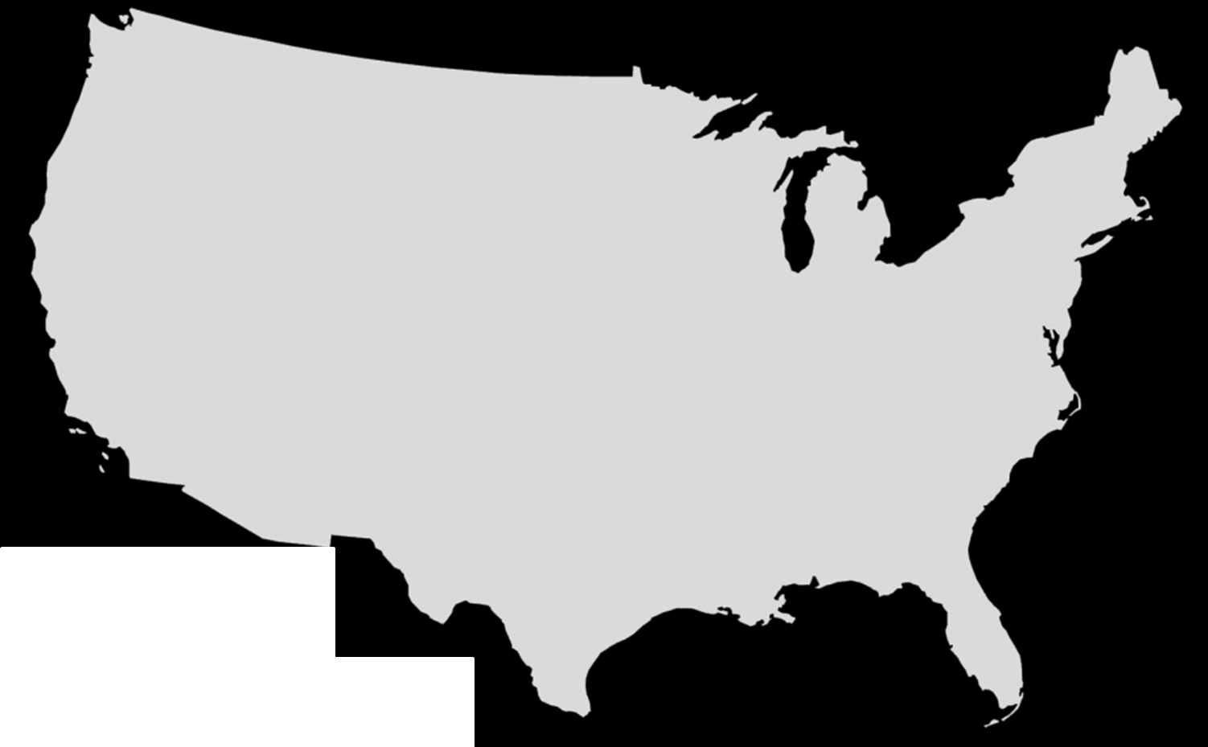

Application high-availability via GSLB


GSLB
GSLB
Loadbalancer
Loadbalancer
Router
Router
Router
Router

Slide 20
Available Buildpacks
Language-based
Special Use
Verizon Custom *
Java
Ruby
Node.js
Go
Python
PHP
Binary
Static File
Java – Dynatrace
Java – CA Wily
All buildpacks are on Github and can be customized by application teams
* Note that buildpack customizations do not fall under Pivotal support

Slide 21
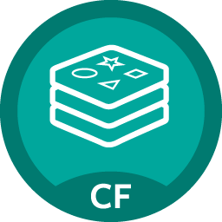
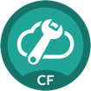
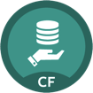
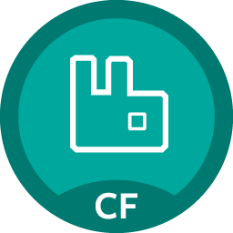
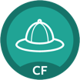
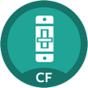

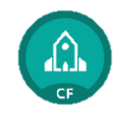
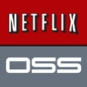
Marketplace of available, bindable services
Data
Cloud Native
Redis
Config Server
MySQL*
RabbitMQ
Service Directory
Application
Circuit Breaker
SSO
Autoscale
Powered by

Slide 22
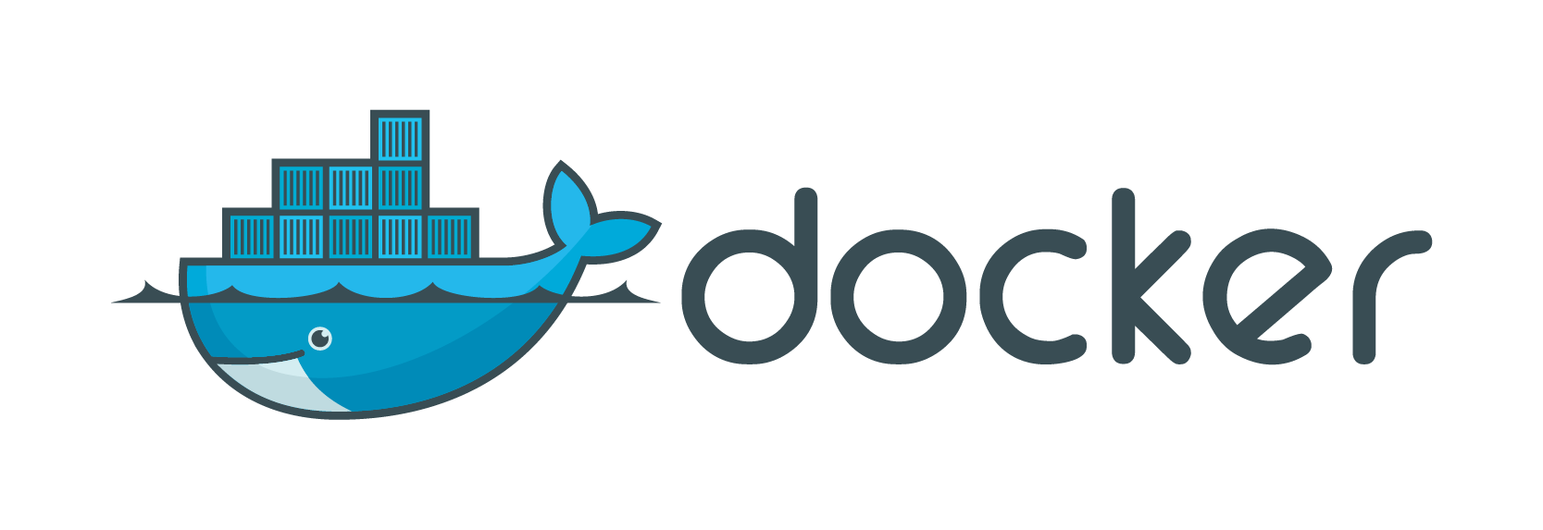
Docker
Cloud Foundry supports running Docker containers
Docker Images are stored in an existing public or private* Docker Registry
On a cf push referencing that Docker image Cloud Foundry decomposes the image and converts it to a Droplet
*by Aug. 2016

Slide 23
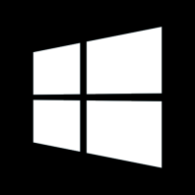
.NET/Windows
Cloud Foundry now supports using Windows Diego Cells to run .NET applications.
Must still adhere to microservice/12 Factor architecture to be successful.
Must compile externally on a Windows OS and use a simple “binary” buildpack as a wrapper to deploy.
Sample applications on GitHub
Still early on in implementing, look for more on this later in the summer.

Slide 24
Today we covered:
What is Cloud Foundry?
Cloud Foundry Overview
CF: Bird’s Eye View
How does it work?
Droplets and Buildpacks
Deploying an Application
Demo: “CF Push”
How do I leverage Cloud Foundry?
Microservices / 12 Factor
What is Verizon’s Strategy for Cloud Foundry?
Integration with CI/CD, Logging and Monitoring
CF Environments
Available Services/Buildpacks
Docker/.NET

Slide 25
Where to Next?
Cloud Foundry Sandbox
https://devops.verizon.com/Helpdesk/CFSandbox.aspx
Cloud PMO Website
http://myvzcloud.verizon.com/pmo
Onboarding by App Portfolio
DPE.AppServices@verizon.com
Crowdaround
https://crowdaround.verizon.com/groups/cloud-foundry-user-group
DevOps Portal
https://devops.verizon.com/

