Slide 1
Advanced Mobile Application Code Review Techniques
Prashant Verma
Dinesh Shetty
Prashant.verma@paladion.net
Dinesh.shetty@paladion.net
April 13, 2012

Slide 2
Agenda
Introduction
Mobile Threats
Mobile Code Reviews & its benefits
Android Insecurities –from code base
iOS Insecurities –from code base
Advanced Technique –Mobile Code Reviews
Checklist –Android &iOS applications

Slide 3
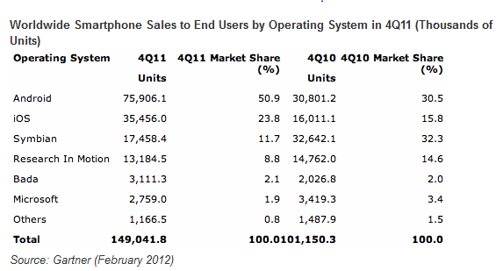
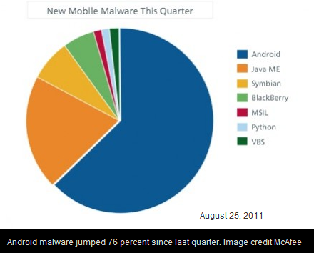
Mobile Market Trends
Notes:
Android is the most popular, followed by iOS. Diff In the mkt share in last one year, tells the popularity for android &iOS.
Malwaretargetting Android the most, increased usage may be the motivation.

Slide 4
Mobile Operating Systems
Android
Highest market share, open source & the target of malwares
iOS
Most user friendly, proprietary
Blackberry
Enterprises preferred it for a long time
Windows Mobile
Still developing, seems secure
Notes:
Windows- less friendly, more secure

Slide 5
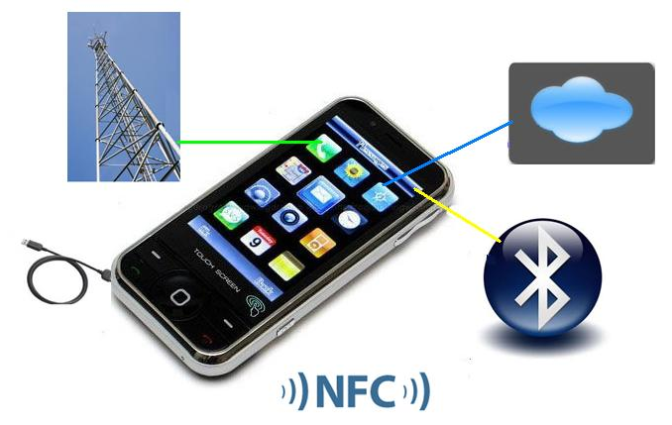
Mobile Threat Model
Notes:
This ppt focuses only HTTP channel

Slide 6
Mobile Security
Understand the threats
Address at the designing phase
Code Review Flaws
Conduct security code reviews during development stages
Application Flaws
Conduct Grey Box assessments on UAT
Periodic assessments at appropriate intervals

Slide 7
Challenges in Mobile Security
On account of the variety in the mobile space, each OS is an altogether different thing in itself.
Certain Basic Security concepts & test cases remain the same.
Some do change as every platform may have its own specific issues
Guideline standardization is difficult
Notes:
Same- storage, hardcoded
Diff- malwares, url schemes, backgrounding

Slide 8
Mobile Security- Grey Box
Reading Stored Data
Capturing Requests
Proxying the phones
Proxying the emulators/simulators
Reversing the Application Package
Platform Specific Issues

Slide 9
Mobile Application Code Review
Review the source code of the mobile application to discover the flaws
Originate because of the bad app coding
App = client side app
Review Android app (.apk), iOS application & other mobile apps

Slide 10
Benefits of Mobile Application Code Reviews
Detect injection flaws
Detect backdoors or suspicious code
Detect hardcoded passwords and secret keys
Detect weak algorithm usage and hardcoded keys
Detect the data storage definitions
Detect certain platform specific issues
Notes:
//backdoor?

Slide 11
Android Insecurities
April 12, 2012

Slide 12
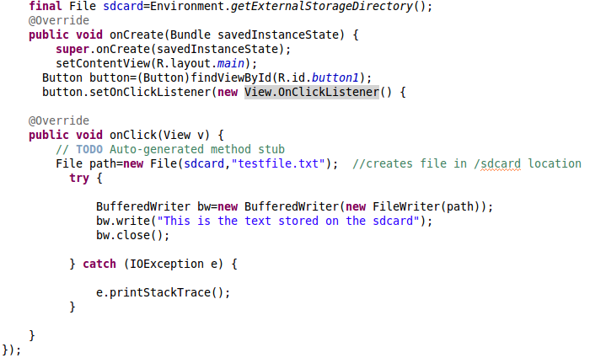
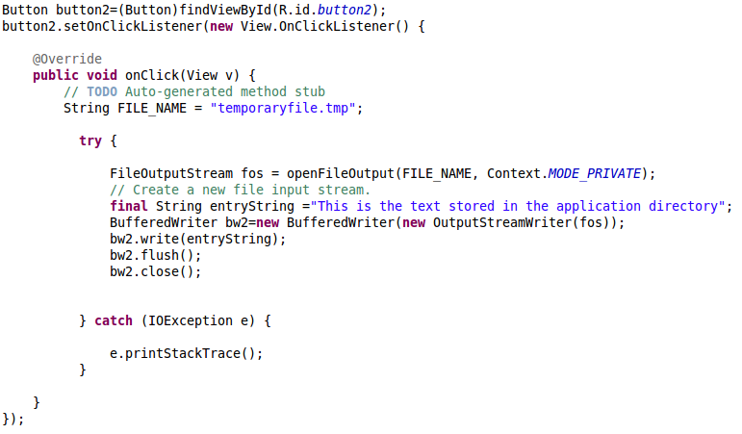
1. Local Data storage flaws

Slide 13
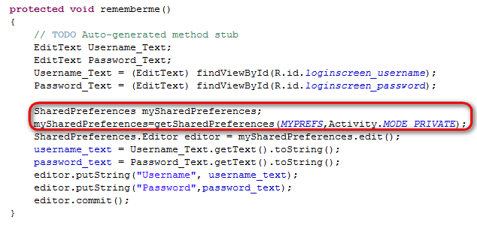
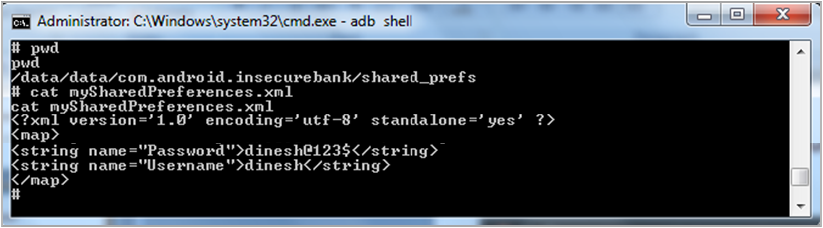
Local Data storage flaws
SQLite DB screenshot??????

Slide 14
2. Malwares
Malwares present in the application, sends unauthorized SMS or makes unauthorized call
ZITMO
public class SmsReceiver extends BroadcastReceiver
{
public static final String KEY_SMS_ARRAY = "pdus";
public static final String TAG = "SmsReceiver";
public void onReceive(ContextparamContext, Intent paramIntent)
{
Bundle localBundle = paramIntent.getExtras();
if ((localBundle != null) && (localBundle.containsKey("pdus")))
{
abortBroadcast();
paramContext.startService(newIntent(paramContext, MainService.class).putExtra("pdus", localBundle));
}
}
}
Notes:
Broadcast Receiver

Slide 15
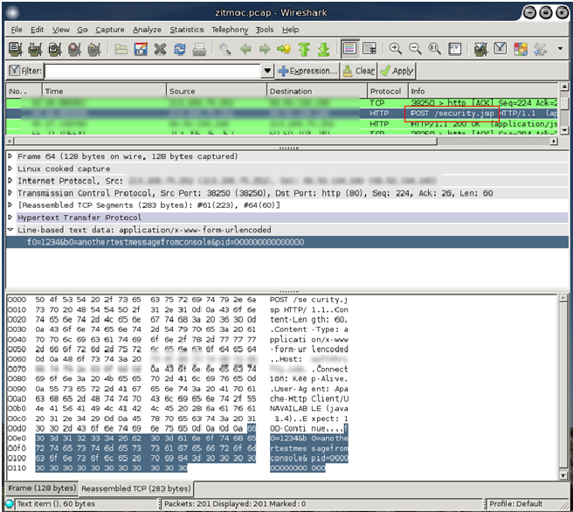
Malwares
HttpPostlocalHttpPost = new HttpPost(str);
localHttpPost.setEntity(paramUrlEncodedFormEntity);
BasicResponseHandlerlocalBasicResponseHandler = new BasicResponseHandler();
JSONObjectlocalJSONObject = (JSONObject)newJSONTokener((String)newDefaultHttpClient().execute(localHttpPost, localBasicResponseHandler)).nextValue();
localObject = localJSONObject;
Image Credit: Fortinet

Slide 16
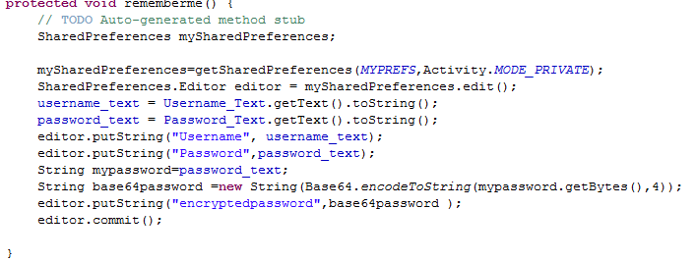
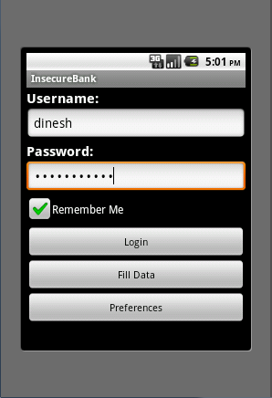
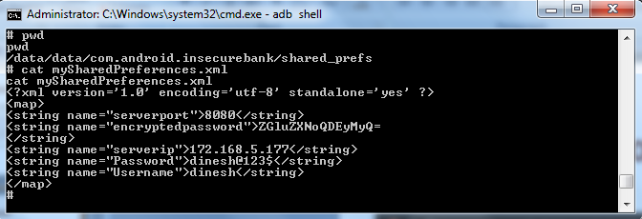
3. Weak encoding/encryption

Slide 17
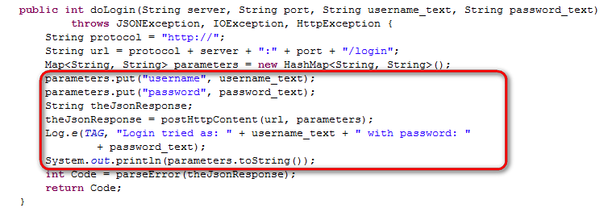
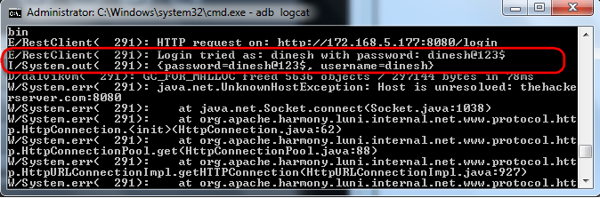
4. Insecure Logging

Slide 18
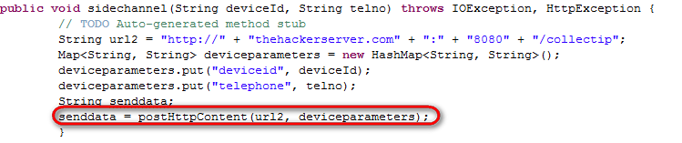
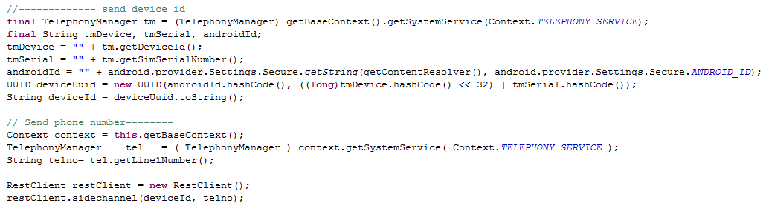
5. Identity Decloaking

Slide 19
6. Tapjacking
Like clickjacking
Click on play game..
..you just spent $1000 buying a gift
Android 2.3 and above
<Button android:text="Button"
android:id="@+id/button1"
android:layout_width="wrap_content"
android:layout_height="wrap_content"
android:filterTouchesWhenObscured="true">
</Button>
Notes:
Even though your Activity may be at the top of the stack, if there is anything obscuring it from view Android will disallow interaction with it. For most applications, this should not be an issue.
Android 2.3 and above

Slide 20
iOS Insecurities
April 12, 2012

Slide 21
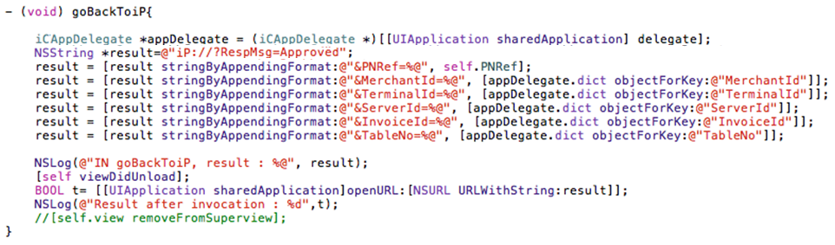
1. Insecure URLScheme
An application can call other applications by accessing a URL scheme
“iP://RespMsg=Approved” – Doesn’t this look fishy?
Notes:
iP
Here, this app calls opens the iP app with parameter RespMsg=Approved value.
Do you see any problem here? The iP app on receiving the parameter RespMsg=Approved, processes the transaction and generates the receipt.
What if a malicious app calls this URL with help of same code? Or even an easier way, what if you just call this URL ‘iP://RespMsg=Approved’ through Mobile Safari?
Ans – It will simply get executed and the iP app will open and do the perform the mentioned action.
Solution – We don’t have a perfect solution yet. Accept parameters through such URL schemes only if it MUST. May be we can have a some kind of encryption to send this data to other apps.
Validate before allowing access to the URLSchemes.
http://iphonedevelopertips.com/cocoa/launching-your-own-application-via-a-custom-url-scheme.html

Slide 22
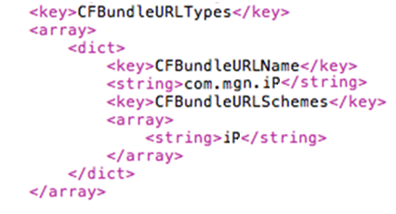
Discovering exposed URLSchemes
URLSchemes related information is stored in the plist file
For example,
Plist file can be easily extracted from the app file if the phone is jailbroken
Notes:
Code fromiP-Info.plist file
property list files are used to store a user's settings.
http://software-security.sans.org/blog/2010/11/08/insecure-handling-url-schemes-apples-ios/
Visit www.HandleOpenUrl.com
http://www.handleopenurl.com/scheme/facebook
http://www.handleopenurl.com/scheme/twitter

Slide 23
2. Insecure UIWebView Implementation
UIWebView is used to embed the web content in the application.
Web page can be loaded inside the application by simply passing the URL to the UIWebView class object.
This object renders the HTML as the iOS Safari browser (webkit) would render it.
HTML Injection possible
It can also execute JavaScript.
Cross-site Scripting (XSS) possible

Slide 24
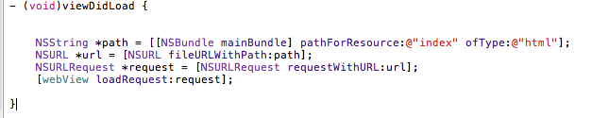
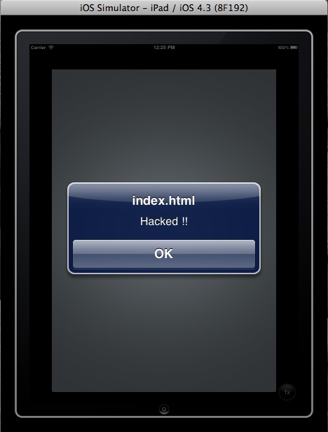
Insecure UIWebView Implementation

Slide 25
3. iOSBackgrounding
In order optimize the UI performance, the iOS takes screenshot of the application screen before moving it to background.
When the application is re-launched, as the actual UI is loading in the background, it displays the screenshot in the foreground.
Screenshot may contain sensitive data like credit card number, profile info etc.
Screenshot path
/private/var/mobile/Applications/ApplicationID/

Slide 26
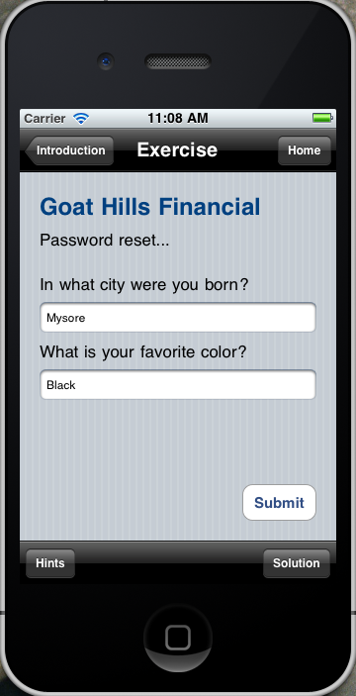
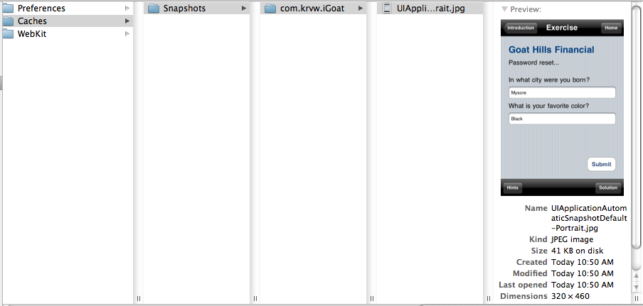
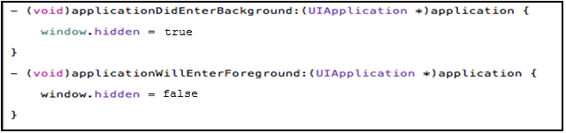
iOS Backgrounding
OWASP iGoat Project

Slide 27
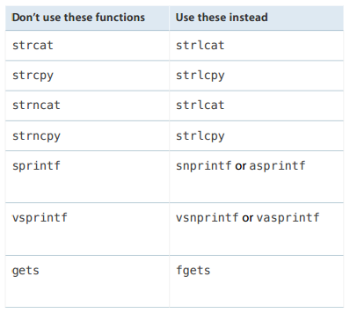
4. Buffer Overflows
When the input data is longer than the buffer size, if it is accepted, it will overwrite other data in memory.
No protection by default in C, Objective-C, and C++
Apple Recommends
Notes:
https://developer.apple.com/library/mac/documentation/security/conceptual/SecureCodingGuide/SecureCodingGuide.pdf
//inbuilt protection techniques by apple?

Slide 28
5. Insecure Network Connections
Protect the data while in transit
Most commonly used protocol is HTTP or HTTPS – means using NSURL or NSURLConnection class
HTTPS should be used
Never use setAllowsAnyHTTPSCertificate:forHost:
Fail safe on SSL error - Implement the connection:didFailWithError: delegate
Not to redirect to http

Slide 29
Advanced Mobile Code Reviews
April 12, 2012

Slide 30
Android Testing – The Logic
S. No. | Checks | Analysis Logic
1 | Does the application leak sensitive information via Property Files? | Check for presence of putString, MODE_PRIVATE, MODE_WORLD_READABLE, MODE_WORLD_WRITEABLE, addPreferencesFromResource in Source Code
2 | Does the application leak sensitive information via SD Card storage? | Check for presence of WRITE_EXTERNAL_STORAGE in Android Manifest File and getExternalStorageDirectory(), sdcard in Source code
3 | Is the application vulnerable to TapJacking attack? | Check for presence of <Button> tag not containing filterTouchesWhenObscured="true" in Layout file
4 | CanMalicious Activity be performed due to insecure WebView implementation? | Check for presence of addJavascriptInterface(), setJavaScriptEnabled(true) in Source code

Slide 31
Android Testing – The Logic
S. No. | To Check | Analysis Logic
5 | Does the application leak sensitive information via hardcoded secrets? | Check for presence of // and /* */ in Source code
6 | Can sensitive information be enumerated due to the enabled Autocomplete feature? | Check for presence of <Input> tag not containing textNoSuggestions in Layout file
7 | Does the application leak sensitive information viaSQLite db? | Check for presence of db, sqlite, database, insert, delete, select, table, cursor, rawQueryin Source code
8 | Does the application leak sensitive information due to insecure Logging mechanism? | Check for presence of Log. In Source code
9 | Is critical data of the application encrypted using proper control? | Check for presence of MD5, base64, des in Source code

Slide 32
S. No. | To Check | Analysis Logic
10 | Does the application implement a insecure transport mechanism? | Check for presence of http://, HttpURLConnection,URLConnection, URL, TrustAllSSLSocket-Factory, AllTrustSSLSocketFactory, NonValidatingSSLSocketFactory in Source code
11 | Does the application leak sensitive system level information via Toast messages? | Check for presence of sensitive information in Toast.makeText
12 | Does the application have debugging enabled? | Check for presence of android:debuggable set to true in Android Manifest File
13 | Does the application misuse or leaksensitive information like device identifiers or via a side channel? | Check for the presence of uid, user-id, imei, deviceId, deviceSerialNumber, devicePrint, X-DSN, phone, mdn, did, IMSI, uuid in Source code
14 | Is the application vulnerable to Intent Injection? | Check for the presence of Action.getIntent() in the Source code
15 | Does the application misuse or leaksensitive information like Location Info or via a side channel? | Check for the presence of getLastKnownLocation(), requestLocationUpdates(), getLatitude(), getLongitude(), LOCATION in Source code

Slide 33
Handy tricks for Mobile Code Reviews
Use the analysis logic give in the previous slides to create custom script for a quick static analysis.
Use the custom script for a quick static analysis
Lets see how..

Slide 34
Results: Insecure Banking Application
S. No. | Vulnerabilities Found
1 | Information Sniffing due to Unencrypted Transport medium
2 | Sensitive information disclosure via Property Files
3 | Sensitive information disclosure via SD card storage
4 | Sensitive information disclosure via SQLite DB
5 | Sensitive information disclosure via Device and Application Logs
6 | Sensitive information disclosure via Side Channel Leakage

Slide 35
Results: Insecure Banking Application
S. No. | Vulnerabilities Found
7 | Malicious Activity via Clientside XSS
8 | Malicious Activity due to insecure WebView implementation
9 | Sensitive information leakage due to hardcoded secrets
10 | Sensitive information leakage due to weak encryption algorithm
11 | Malicious Activity via Backdoor
12 | Malicious Activity via Reverse Engineering

Slide 36
iOS Testing – The Logic
S. No. | Checks | Analysis Logic
1 | Does the application leak sensitive information via device memory? | Check for presence ofNSFile, writeToFile in Source Code
2 | Can the application leak sensitive information due to iOS default Screencapture feature? | Check for the presence of window.hidden in applicationWillEnterBackground and applicationWillTerminate functions in Source code.
3 | Does the application leak sensitive information via hardcoded secrets? | Check for presence of // and /* */ in Source code
4 | Is the application vulnerable to buffer overflow attack? | Check for the presence of strcat, strcpy, strncat, strncpy, sprintf, vsprintf, gets in the Source code

Slide 37
iOS Testing – The Logic
S. No. | Checks | Analysis Logic
5 | Can malicious activties be performed due to insecure implementation of URL Schemes? | Check for the presence of presence of Authorisation in functions having openUrl, handleOpenURL.
6 | Does the application leak sensitive information viaSQLite db? | Check for presence of db, sqlite, database, insert, delete, select, table, cursor, sqlite3_prepare in Source code
7 | Does the application leak sensitive information due to insecure Logging mechanism? | Check for presence of NSLog in Source code
8 | Is critical data of the application encrypted using proper control? | Check for presence of MD5, base64, des in Source code

Slide 38
iOS Testing – The Logic
S. No. | Checks | Analysis Logic
9 | Does the application implement a insecure transport mechanism? | Check for presence of http://, URL, setAllowsAnyHTTPSCertificate, NSURL,writeToUrl, NSURLConnection, CFStream, NSStreamin Source code. Also check for presence of redirection to http in via didFailWithError in the Source code.
10 | Does the application misuse or leaksensitive information like device identifiers or via a side channel? | Check for the presence of uid, user-id, imei, deviceId, deviceSerialNumber, devicePrint, X-DSN, phone, mdn, did, IMSI, uuid in Source code
11 | Does the application misuse or leaksensitive information like Location Info or via a side channel? | Check for the presence of CLLocationManager, startUpdatingLocation, locationManager, didUpdateToLocation, CLLocationDegrees, CLLocation, CLLocationDistance, startMonitoringSignificantLocationChanges, LOCATION in Source code

Slide 39
Thank You
PrashantVerma
Prashant.verma@paladion.net
Twitter: @prashantverma21
DineshShetty
Dinesh.shetty@paladion.net
Linkedin id: 91288384
April 13, 2012

