Slide 1
Mir_Met papier genomique
Dendrogram figure

Slide 2
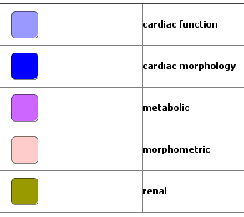
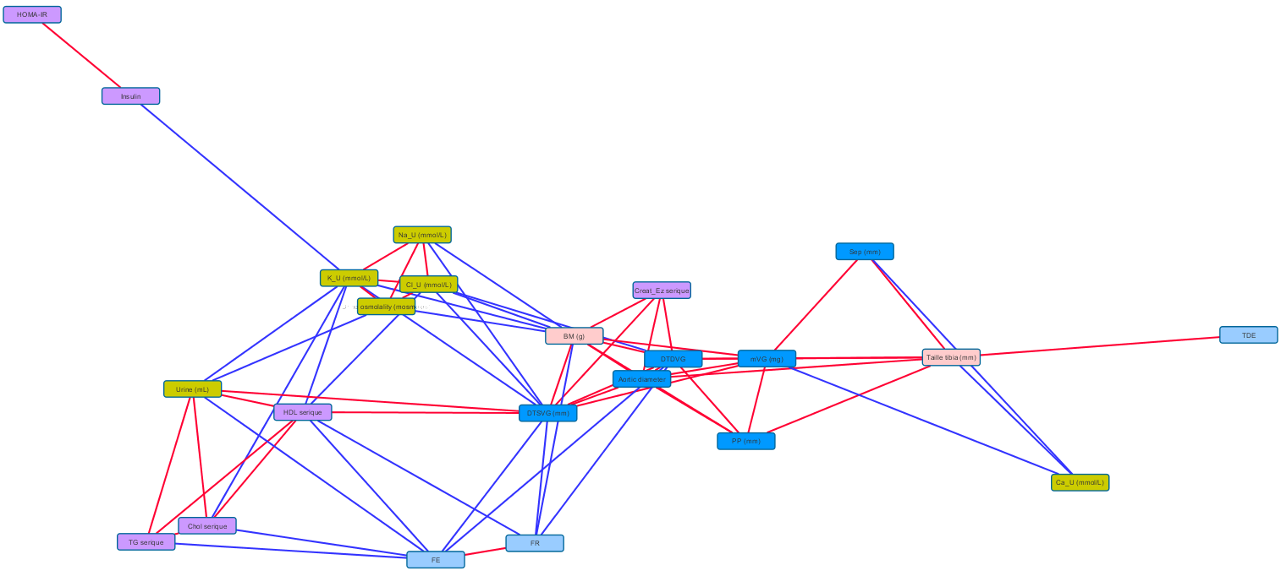
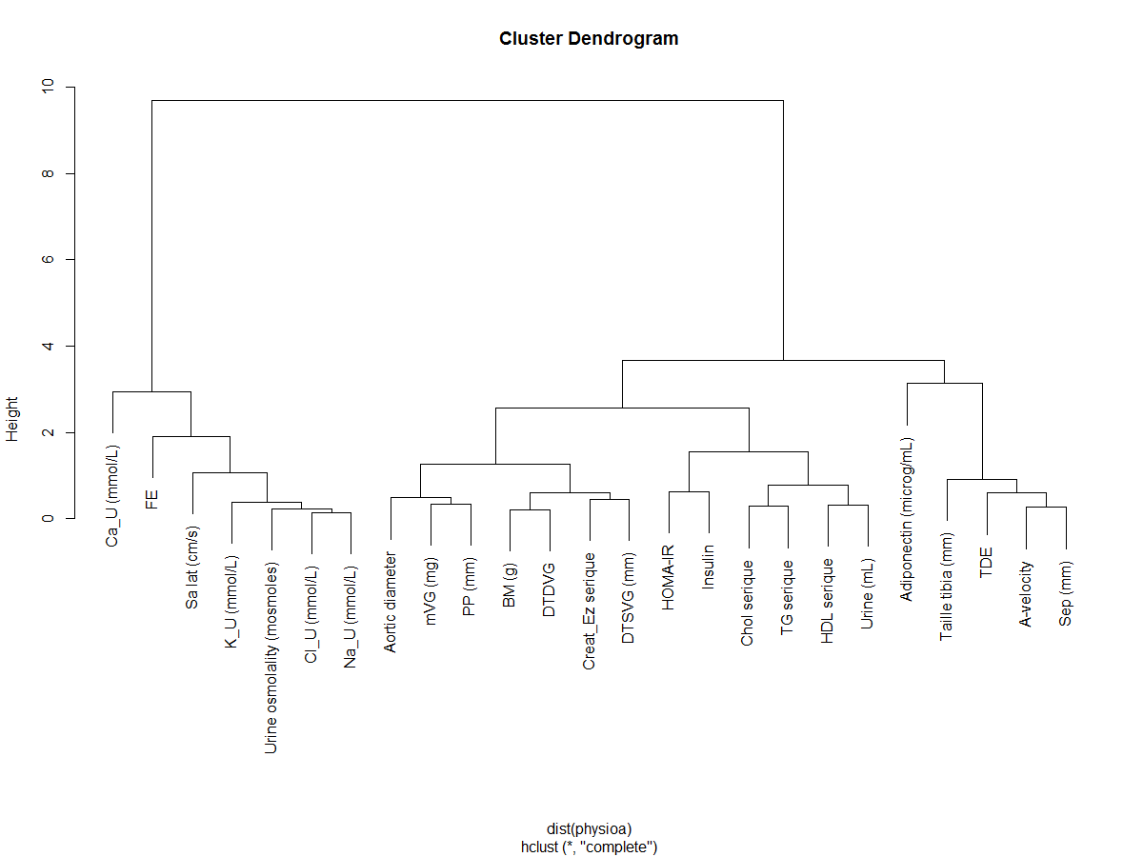
Input data
From the following figure:
To a dendrogram:

Slide 3
Input data - network
The network has been generated with correlation between the physiological parameters data.
The length of the edges is inverse proportional with the level of correletion.
Positive correlation is shown in blue, negative in red.
Only (abs) correlation > 0.8 are shown.
The output/interpretation is that some physiological parameters of the same group cluster together(ie: yellow and light blue nodes).
Sample of data used for the network generation:

Slide 4
Input data - dendrogram
From all correlations values (from -1 to +1),
transform into correlation matrix,
calculated hierachical clustering,
plot.
Note:
some correlations are <0, does that affect hclust?
difficulties in having label leaves in ggdendrogram
may need to show a hline or vline (revealing group consistency)
may need to color labels into groups (+legend?)
FR is not shown!
may have to manually remove some leaves
may have to add a « size » to the leaves

Slide 5

Result
Actual stage:
: orphans in the network view are not shown
Threshold
Dendrogram fits with the network representation.
A threshold can be defined in order to cluster the groups

Slide 6
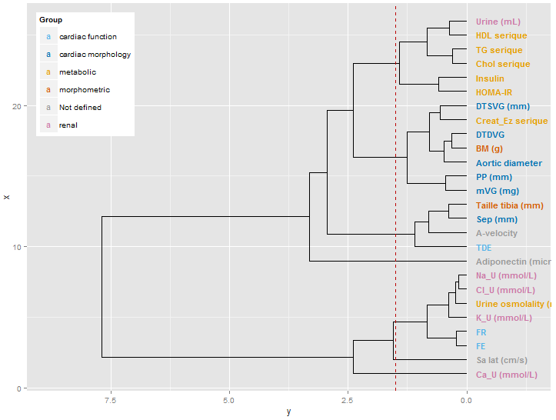
Result
In the previous dendro, an issue has been noticed with the absence of the FR parameter.
Situation is now solved, the new dendro keeps it’s global structure.
Mainly Metabolic
Mainly Cardiac Morpho
Mainly Renal
Dendrogram fits with the network representation.
A threshold can be defined in order to cluster the groups (4 groups + 3 orphans)
: orphan not shown in the network

