Slide 1
Procedures

Slide 2
What are Procedures?
Blocks of codes that perform a specific task
In Assembly Language, we use the PROC, ENDP, CALL and RET instructions in using procedures.
PROC marks the beginning of the procedure
<name> PROC
ENDP marks the end of the procedure
<name> ENDP
CALL – calls a procedure
CALL <name of procedure>
RET – returns program flow to the calling procedure.
RET

Slide 3
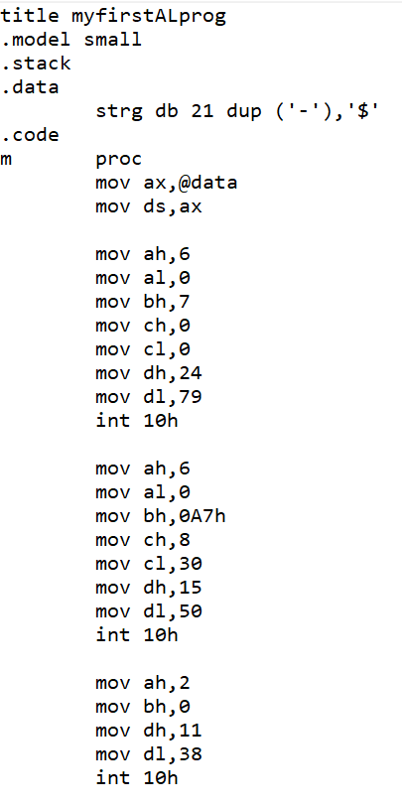
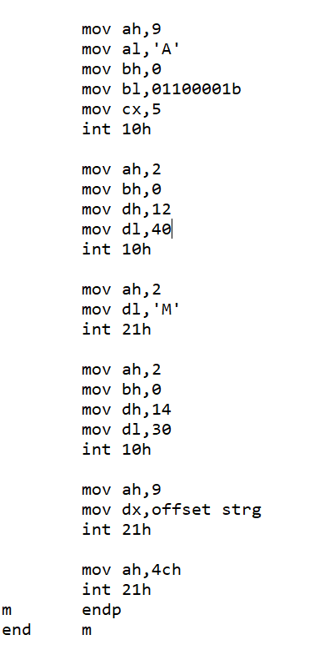
Example
Notice the functions that are repeating in this example.
We can rewrite the program to eliminate these repeating instructions using procedures.

Slide 4
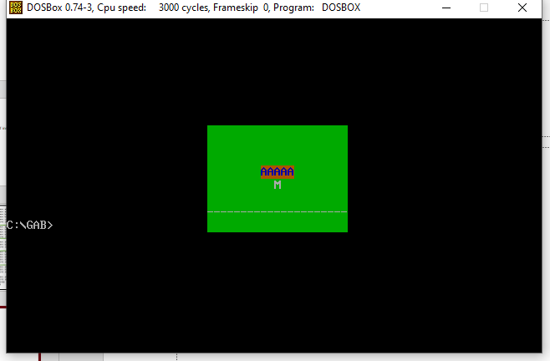
Output

Slide 5
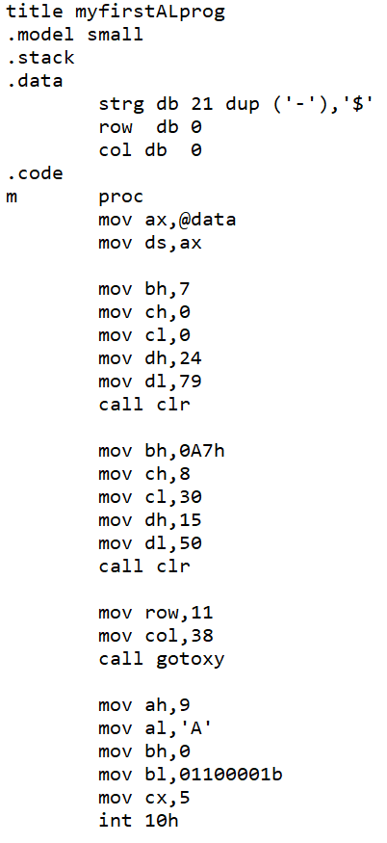
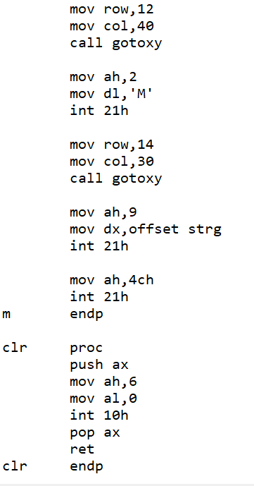
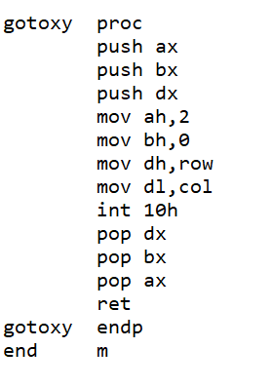
Put all instructions that are the same in the procedure. Leave the instructions that may have varying values.
This is the same as setting the parameters before calling the procedure
Instructions that are the same are in the procedure.
Store all values of the registers that are used in the procedure using “push” and restore the values using “pop” before returning to the calling procedure.

Slide 6
Output

Slide 7
Storing values using push and pop makes sure that the values of the registers before the procedure call are restored after executing the procedure. If a register, before the procedure call, is also being used inside the procedure, then it’s value will be overwritten inside the procedure if not saved.

