Slide 1

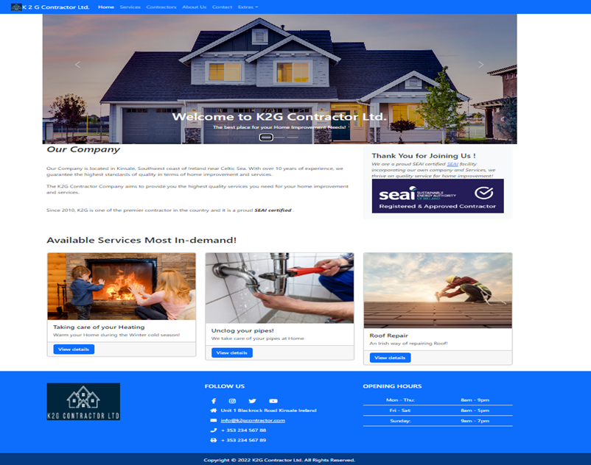
Contractors Web Application
Broker of Home Improvement
By
Gino Ruperez

Slide 2
Overview
Contractors Web Application is an online service application that provides selections of contractors for home improvement. The primary target audience are the households in Ireland that requires home services or improvement. It aims to provide an immediate list of contractors for home service needs online. The application provided a search facilities to find the appropriate contractors based on customer requirements.
List of services available
Electrical
Roofing
Plumbing
Carpets
Drywall
Heating
Airconditioning
Glass
Washing Machine
The application consists of Frontend application and Backend application

Slide 3
Features & Benefits
Contractors Listing and Searching – this feature provides a dynamic page and intuitive presentation of all available contractors. It has filter option to narrow down a specific contractors and data can be exported to .csv file for analysis and comparisons.
Request for Quotation via Contact Us – this feature provided the customer to send request , feedbacks and comments to CSR (Customer Sales Representative)
CRUD functionality for both Services and Contractors data are provided for admin users
Customers Registration is provided by application on FrontEnd
Customers profile update – provides ability to change password
Other information about the application is augmented by other static pages such as About us, FAQ, Testimonials and highlighted featured services such as Heating, Plumbing and Roofing.

Slide 4





Web Application Architecture
Access
Data via
HTTP
URL
Users
Frontend
Users see and interact with ReactJS, Javascript, HTML, CSS, Bootstrap and MaterialUI
Request
Backend
Runs on Web Server
Contains application logic using Java and Springboot framework
Response
Display
Results
File System
HTML and JSP
Database
MySQL/MariaDB

Slide 5


Backend Application Architecture
View (jsp, html)
Controller (Java)
Spring boot Framework
Model
Rest API (Java)
Spring boot Framework
MySQL Database

Slide 6
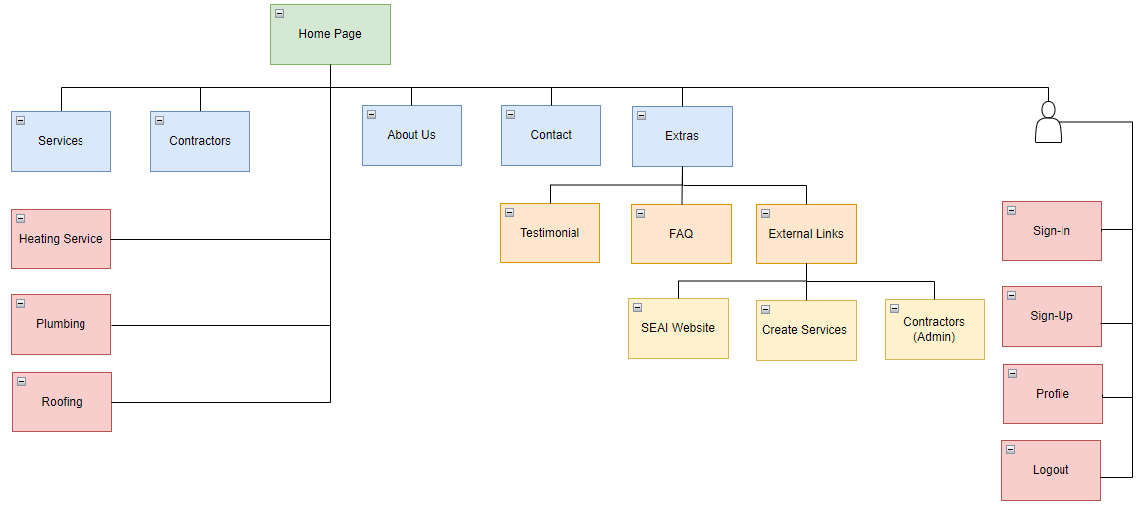
Frontend Hierarchy Diagram

Slide 7
Impact in General
Encourages small player contracting companies to join and register and include them in the application database.
Encourages skilled individuals to join and advertise their services in the application database.
The services offered by application can be extended to many type of services such as Personal Care services like Nail art for women, Physiotherapy, Financial services, etc.
Application can be used as a base template for future project for my daughters’ website as a Nail Art Technician.

