Slide 1


Online Retail II:
Sales Analysis & Customer Segmentation
A SQL and Python project analyzing e-commerce sales, customer behavior, and segmentation strategies
Ironhack Data Science and Machine Learning Bootcamp
Author: Ginosca Alejandro Dávila
Date: December 20, 2024
Project 2
LOGO HERE
Notes:
Hello everyone, and thank you for being here.
This presentation is part of my second project for the Ironhack Data Science and Machine Learning Bootcamp, and on sales analysis and customer segmentation using the Online Retail II dataset.
My name is Ginosca Alejandro Dávila, and I’m excited to walk you through the insights and learnings I’ve uncovered during this analysis. Let’s begin.

Slide 2
Project Overview
Project Goals:
Analyze sales trends, customer behavior, and product performance using real-world e-commerce data from a UK-based online retailer
Build a clean, relational database and use SQL to answer business questions
Segment customers using RFM metrics for marketing strategy
Project Scope:
Data cleaning and transformation
Exploratory data analysis (EDA)
SQL-based business insights
Customer segmentation
Tools & Technologies:
Python (Pandas, Matplotlib, Seaborn, SQLite, dotenv)
SQL (MySQL)
Tableau
Google Colab
Jupyter
Anaconda Prompt
Github
Notes:
This project is centered on analyzing transactional data from a UK-based online retailer.
My goal was to understand sales trends, customer behavior, and product performance, and to segment customers using RFM metrics for marketing purposes.
I began by cleaning the raw data using Python, then performed exploratory data analysis (EDA) to uncover patterns and answer key business questions.
These questions were first answered in Python using visual analysis and SQLite queries, and then replicated in MySQL to validate insights in a real SQL environment.
I also automated the schema setup and data loading process into MySQL using Python scripts, which included credential handling and referential integrity checks.
While I created Tableau dashboards as an optional extension of the project, the core analysis and insights were generated using Python and SQL.

Slide 3
Dataset Summary
🧾 Dataset
📁 Source File:
🔑 Key Variables
online_retail_II.xlsx
Sheets used:
Year 2009-2010
Year 2010-2011
Date range: 2009-12-01 to 2011-12-09
InvoiceNo: Transaction ID (prefix ‘C’ = cancellation)
StockCode: Product ID
Description: Product name
Quantity: Number of items purchased per transaction
InvoiceDate: Date and time of the transaction
UnitPrice: Price per unit (GBP)
CustomerID: Unique customer identifier
Country: Country where the transaction occurred
Online Retail II - UCI Machine Learning Repository
Over 1 million e-commerce transactions from UK-based online retailer
Notes:
The dataset used for this project is the Online Retail II dataset from the UCI Machine Learning Repository.
It contains over one million transactions from a UK-based online retailer, spanning from December 2009 to December 2011.
The source file includes two sheets, one for each year. I combined and cleaned both sheets to prepare a unified dataset.
The variables include invoice numbers, product codes, descriptions, purchase dates and quantities, unit prices, customer IDs, and their countries.
This transactional data served as the foundation for building a relational database and performing all subsequent analysis.

Slide 4
Data Quality Assessment
Initial Issues Identified:
❌ Missing values in CustomerID and Description
⛔ Canceled invoice (prefix “C” in InvoiceNo)
⚠️ Negative or zero values in Quantity and UnitPrice
🔁 Fully duplicated rows in raw dataset
❗ Non-product StockCode (e.g., POST, DOT, BANK CHARGES)
🔄 StockCode-Description inconsistencies
Conflicting CustomerID-Country and InvoiceNo-InvoiceDate mappings
Duplicate line items within invoices (same InvoiceNo and StockCode)
Assessment Approach:
🧪 Validated foreign key candidates
📆 Checked data range consistency (2009-2011)
🔍 Verified identifiers and invoice integrity
🧹 Used Python (pandas) in 1_data_cleaning_online_retail_ii.ipynb to inspect , validate, and understand data issues
Notes:
In the raw dataset, I identified several quality issues, including missing values in customer and product description, negative or zero quantities and prices, and canceled invoices.
Some records were fully duplicated, and there were inconsistencies in product codes and their descriptions, as well as mismatches between customer IDs and countries.
I also detected non-product stock codes like "POST" or "DOT". Additionally, I found multiple invoice line items with the same product listed more than once — often with split quantities — and duplicate invoice metadata where a single invoice number had slightly different timestamps.
Using Python and pandas, I systematically inspected and validated the data, checked foreign key relationships and date ranges, and ensured invoice integrity.
This helped me fully understand the dataset’s structure and clean it confidently.

Slide 5
Data Cleaning Summary
Cleaning Steps Performed:
🔤 Standardized column names (snake_case) and categorical values
➖ Removed rows with negative or zero values in quantity and unit_price
⛔ Dropped canceled invoices (invoice_no starting with “C”)
🧹 Removed rows with missing customer_id and description
🆔 Cast identifiers like invoice_no and stock_code to strings
🔁 Removed fully duplicates rows
💷 Created line_revenue as quantity×unit_price
🧾 Removed non-product stock_code values
🧼 Cleaned and resolved stock_code-description conflicts
🌍 Standardized customer_id-country mappings
📦 Cleaned invoice metadata: enforced one-to-one mapping between invoice_no, customer_id, and invoice_date
📊 Aggregated repeated invoice items (same invoice_no and stock_code)
🧱 Normalized into 4 relational tables: customers.csv, products.csv, invoices.csv, invoice_items.csv
🔗 Resolved ID conflicts and ensured referential integrity
Output Files:
✅ cleaned_online_retail_II.csv (flat file)
✅ 4 normalized relational tables (for MySQL): customers.csv, products.csv, invoices.csv and invoice_tems.csv
Notes:
To ensure a reliable foundation for analysis, I applied extensive cleaning to the raw transaction data.
First, I standardized all column names and categorical values to improve consistency. I removed rows with invalid values, such as negative or zero quantities or unit prices, and filtered out canceled invoices — which are flagged with an "invoice_no" starting with the letter “C.”
Missing or incomplete records, especially those without customer IDs or product descriptions, were dropped to avoid skewing the results. I also cast all identifiers like invoice_no and stock_code to strings and removed duplicate rows.
Then, I created a new metric — line_revenue, calculated as quantity times unit price. Non-product stock_code values were removed, and I cleaned up product descriptions that had inconsistencies across the same code.
For customer and invoice integrity, I ensured standardized country mappings and enforced a strict one-to-one relationship between invoice number, customer ID, and invoice date. I also aggregated invoice items to handle duplicate product entries within the same invoice.
Finally, I normalized the cleaned data into four relational tables — customers, products, invoices, and invoice_items — and ensured full referential integrity across them.
The result was a clean flat file for exploratory analysis and four structured tables ready for SQL-based analysis in MySQL.

Slide 6
SQL Project Structure
Business Questions (12 total): Grouped into 4 sections based on analytical focus:
🛒 Sales Performance
🌍 Country and Regional Insights
👥 Customer Insights
📊 RFM Analysis
Q1. Monthly Revenue Trend
Q2. Top 10 Products by Revenue
Q3. Top 10 Invoices by Transaction Value
Q4a. Revenue by Country (incl. UK)
Q4b. Revenue by Country (excl. UK)
Q5. Customer Behavior by Country
Q6. One-Time vs. Repeat Customers
Q7. Top 10 Customers by Avg. Order Value
Q8. Top 10 Customers by Total Spend
Q9. Recency (Days Since Last Purchase)
Q10. Frequency (Number of Purchases)
Q11. Monetary(Total Spend)
Q12. RFM-Based Customer Segmentation
Notes:
This project addresses twelve business questions designed to uncover key sales, product, and customer insights.
To organize the analysis, I grouped the questions into four thematic areas. First, Sales Performance, where I analyzed revenue trends, product sales, and high-value invoices.
Then, Country & Regional Insights, where I examined revenue distribution and customer behavior across different markets — both including and excluding the UK, which dominates the dataset.
In Customer Insights, I looked at purchase behavior — distinguishing between one-time and repeat buyers, and identifying top customers by average order value and total spend.
Finally, in the RFM Analysis section, I calculated recency, frequency, and monetary metrics to prepare for customer segmentation. These metrics form the basis for data-driven marketing strategies.

Slide 7
Project Workflow
📊 EDA Phase: Python + Pandas on the flat cleaned dataset in 2_eda_online_retail_ii.ipynb
🧱 SQL Queries in SQLite: SQL executed via Python in 3_sql_analysis_sales_performance_online_retail_ii.ipynb on normalized tables
🛠️ MySQL Validation & Final SQL Execution: Real SQL environment for final results in 1_validate_online_retail_ii.sql and 2_business_questions_online_retail_ii.sql
Notes:
To ensure both analytical depth and technical robustness, I answered each business question through three stages. First, I used Python and Pandas for EDA on the flat dataset. Next, I built and queried normalized relational tables using SQL in SQLite via Python. Finally, I replicated and validated all queries in a real MySQL environment to simulate a production-ready database workflow. This three-layer approach helped cross-validate results and demonstrate tool versatility.

Slide 8
MySQL Environment Setup & Validation
🛠️ Notebook: 4_mysql_real_env_setup_online_retail_ii.ipynb
🗃️ Created retail_sales schema (4 relational tables: customers, products, invoices, and invoice_items)
📥 Loaded cleaned CSVs into MySQL from cleaned relational tables using Python
🔐 Secure credentials handled via .env + dotenv
🧪 Initial Validation in Python:
✅ Row counts checks after insertion
✅ Foreign key relationship tests
✅ Checked for:
Orphan invoice items
Invoice with no customer
Invoice with no items
Products never sold
Notes:
This notebook automated the setup of a real MySQL environment. It created the full schema with four relational tables and loaded the cleaned CSVs using Python.
I also used secure credential handling with a .env file and the dotenv package.
After loading the data, I ran initial validation checks in Python — confirming row counts, enforcing foreign key constraints, and verifying that there were no orphan invoice items, empty invoices, or unused products.

Slide 9
Final SQL Validation & Business Questions Execution in MySQL
📄 SQL Scripts:
🧪 1_validate_online_retail_ii.sql
✅ Confirmed shema structure (4 tables: customers, products, invoices, and invoice_items)
✅ Verified row counts, primary keys, and foreign keys
✅ Verified invoice date ranges and data consistency
✅ Ran sanity checks on quantities, unit prices, and line revenue
✅ Invoice date within expected range (2009-2011)
📊 2_business_questions_online_retail_ii.sql
✅ Answered all 12 business questions using MySQL queries
✅ Results matched EDA and SQLite outputs
✅ Simulated real SQL production environment
Notes:
After setting up the MySQL environment, I ran a full validation SQL script to confirm that all tables, keys, and values matched expectations. I verified schema structure, row counts, foreign key relationships, and general data integrity — ensuring there were no orphaned rows or inconsistencies.
Then, I answered all twelve business questions in the MySQL environment using real SQL queries. This final analysis replicated the results I had previously generated using Python and SQLite, helping me confirm consistency and reliability across different tools.
While I later explored optional visualizations in Tableau, my main reporting and analysis was performed using Python and SQL outputs.

Slide 10
Business Insights - Sales Performance
📈 Monthly Revenue Trend
🏆 Top Products by Revenue
💰 Highest Revenue Invoices
Revenue peaked in November of both 2010 (£1.16M) and 2011 (£1.14M) reflecting strong pre-holiday shopping activity.
A consistent post-holiday dip is visible in January and February, aligning with typical retail seasonality.
The Q4 surge followed by Q1 slowdown highlights clear annual seasonality in consumer behavior.
The top product, regency cakestand 3 tier, generated £277,656.25 in revenue from 24,124 units, with an average unit price of £12.46.
In second place, white hanging heart t-light holder earned £247,048.01 from 91,757 units - a low-cost, high-revenue product that sold exceptionally well.
Other high-revenue products were affordable, decorative items such as: paper craft, little birdie; assorted colour bird ornament and; jumbo bag red retrospot.
Invoice 581483 generated £168,469.60 from a single item - an extreme outlier likely a bulk order or possible data anomaly
Top 10 invoices range from £22,206.00 to £168,469.60 in total revenue. Most fall between £22k and £77k.
Item counts vary widely - some invoices contain over 130 items, while others list only 1-2 items.
Customers 18102 and 17450 appear multiple times, suggesting loyal, high value clients with repeated large purchases.
Notes:
This first insight section focuses on overall sales performance. Monthly revenue trends showed clear seasonal peaks — especially in November, which coincides with pre-holiday shopping. The drop in January and February reflects typical post-holiday slowdowns, showing strong retail seasonality.
When looking at top products by revenue, we can see that affordable but appealing decorative items drove a significant share of income — with one standout being a tiered cakestand, and another a popular heart-shaped light holder. These items sold in large volumes, which helped them top the revenue charts.
As for invoices, I found extreme outliers like one invoice worth over £168K, which likely represents a bulk commercial purchase or a possible data anomaly. I also identified repeat high-value customers, suggesting there may be room for targeted retention strategies or loyalty programs.

Slide 11
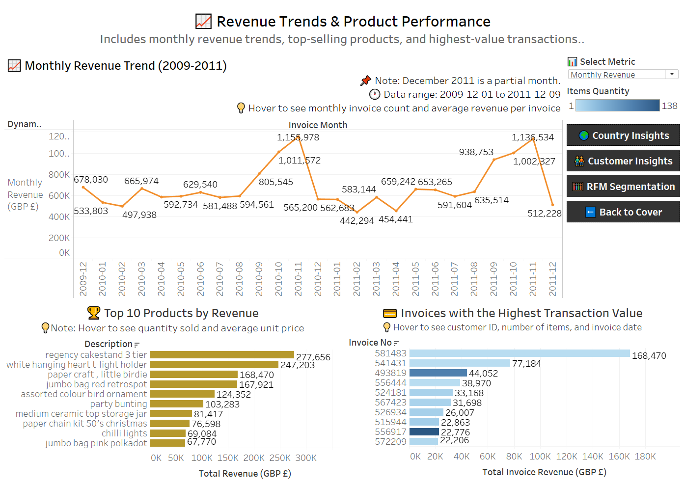
Dashboard - Sales Performance
Notes:
To complement the SQL and Python analysis, I created a Tableau dashboard to visually explore the sales performance findings.
At the top, you can see a line chart of monthly revenue, which clearly highlights the seasonal peaks we discussed — particularly the strong surges in November of both years.
The bar chart on the left shows the top revenue-generating products, where we can spot items like the Regency Cakestand and T-Light Holder dominating. These products combined affordability with high volume to drive substantial sales.
On the right, the top invoices visualization identifies standout transactions, including the extreme outlier invoice of over £168,000, which visually confirms the anomaly we saw earlier.
This dashboard format allows for quick pattern recognition and makes it easy to share insights with non-technical stakeholders. It also supports interactivity, allowing filtering by product, country, or time frame for deeper exploration.

Slide 12
Business Insights - Country & Regional Insights
🌍 Revenue by Country
👥 Customer Behavior by Country
The UK has 5,334 customers with an average of 6.26 invoices and £2,679 revenue per customer - our largest and most balanced group.
With only 3 customers, Ireland shows exceptionally high values (~£195 revenue and 176 invoices per customer) - likely due to atypical client behavior such as bulk purchasing client, internal use account, or testing/demo user.
Netherlands has strong potential market with £24.9K per customer and ~10 invoices/customer - indicating high engagement and value.
France and Germany show a balance customer base and solid per-customer revenue (~£3.3K-£3.6K)
Sweden, Switzerland, Denmark, and Australia show low-frequency but high value purchasing behavior - ideal for premium offerings or B2B targeting.
UK generated £14.29M across 33,374 invoices - accounting for ~91% of all revenue.
Ireland (Eire) leads among non-UK countries, with approximately £586k in revenue and a high average invoice value of ~£1,111.
The Netherlands tops in average invoice value at ~£2,545, despite a moderate volume of 216 invoices.
Countries like Australia, Switzerland, and Denmark generate significant revenue from fewer than 100 invoices each.
Germany and France show a healthy balance of volume and value, indicating mature and stable market performance.
Markets such as Netherlands, Australia, and Denmark are strong candidates for B2B or premium expansion due to high-value, low-frequency trends.
Notes:
This slide highlights sales and customer behavior trends across countries.
Starting with revenue by country, the UK dominates overall revenue with over £14 million across more than 33,000 invoices — that’s about 91% of total revenue. But looking outside the UK, Ireland, the Netherlands and Germany stand out.
Ireland shows high total revenue and invoice count despite having only 3 customers — suggesting an atypical client, possibly a bulk buyer or an internal/testing account.
The Netherlands has the highest average invoice value at over £2,500 and strong revenue per customer — making it a high-potential market for premium or B2B strategies.
We also see France and Germany with more balanced metrics — healthy customer bases and solid per-customer revenue — indicating mature markets with steady performance.
In the customer behavior section, the UK has the largest and most stable customer group, averaging around 6 invoices and £2.6K revenue per customer.
Other countries like Sweden, Switzerland, Denmark, and Australia have fewer purchases but higher revenue per transaction, again pointing to B2B or high-end retail potential.
These patterns help identify not only which countries are profitable, but also which customer segments within them offer the greatest strategic opportunity.

Slide 13
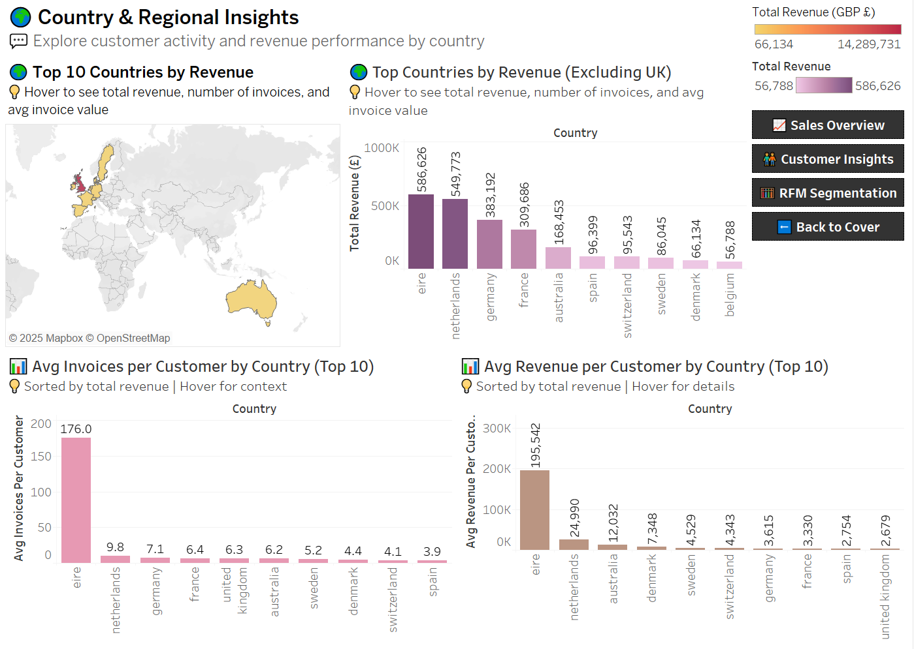
Dashboard - Country & Regional Insights
Notes:
This interactive dashboard highlights key geographic insights.
The top revenue map and bar chart confirm that the UK is the dominant market, but also highlight strong performers like Ireland, the Netherlands, and Germany.
To avoid skewing, I also visualized non-UK countries separately, helping reveal high-value markets like France, Australia, and Switzerland.
On the bottom left, we see average invoices per customer — Ireland stands out with an extreme value, hinting at a possible bulk buyer or demo/test account. The Netherlands and Germany follow with steady engagement levels.
Lastly, the average revenue per customer chart shows the Netherlands, Australia, and Sweden as standout markets — lower volume but high per-customer value, making them great candidates for B2B or premium targeting.
This dashboard helped guide expansion and marketing strategies by visualizing regional patterns of both purchase frequency and customer value.

Slide 14
Business Insights - Customer Behavior
🔁 One-Time vs Repeat
👥 Top Customers by AOV
💰 Top Customers by Total Spend
Nearly 3 out of 4 customers made multiple purchases, suggesting decent customer retention.
Around 28% of users only purchased once, which presents an opportunity for re-engagement campaigns.
Customer 16446 stands out with an average order value of £84,236.25, placing just two orders - a clear outlier likely reflecting bulk or business purchases..
Other high-ranking customers, such as 15098 and 15749, average between £13.3K and £14.8K per order.
While these values are impressive, 99.8% of customers have an AOV under £5,600, showing a strongly right-skewed distribution with a few extreme cases.
Customer 18102 tops the list with £580,987 across 145 orders.
Several others (e.g. 14646, 14156) show high revenue from consistent repeat ordering.
Customer 16446 stands out with just 2 orders but £168K total spend - likely a bulk B2B transaction or anomaly.
These customers warrant special attention for retention, loyalty programs or custom offers.
Notes:
I explored customer-level behavior, focusing on repeat activity, order value, and total spending.
Starting with purchase frequency, we see that nearly 72% of customers made multiple purchases, suggesting reasonable customer retention. The remaining 28% only purchased once, which represents a good opportunity for re-engagement strategies like email campaigns or targeted discounts.
Next, I looked at average order value per customer. One clear outlier is customer 16446, who placed just 2 orders but averaged over £84K per purchase — likely a B2B bulk transaction or a special event. Other top AOV customers also had very high per-order spending, but most customers actually fell well below £5,600, showing a strong right skew in the distribution.
Finally, when looking at total customer spend, customer 18102 emerged as the top spender with £580K across 145 orders, indicating strong loyalty and consistent engagement. Other customers like 14646 and 14156 also generated high revenue through repeat purchases, reinforcing their value.
These insights can guide strategies like customer segmentation, loyalty rewards, or priority support for top-tier clients.

Slide 15
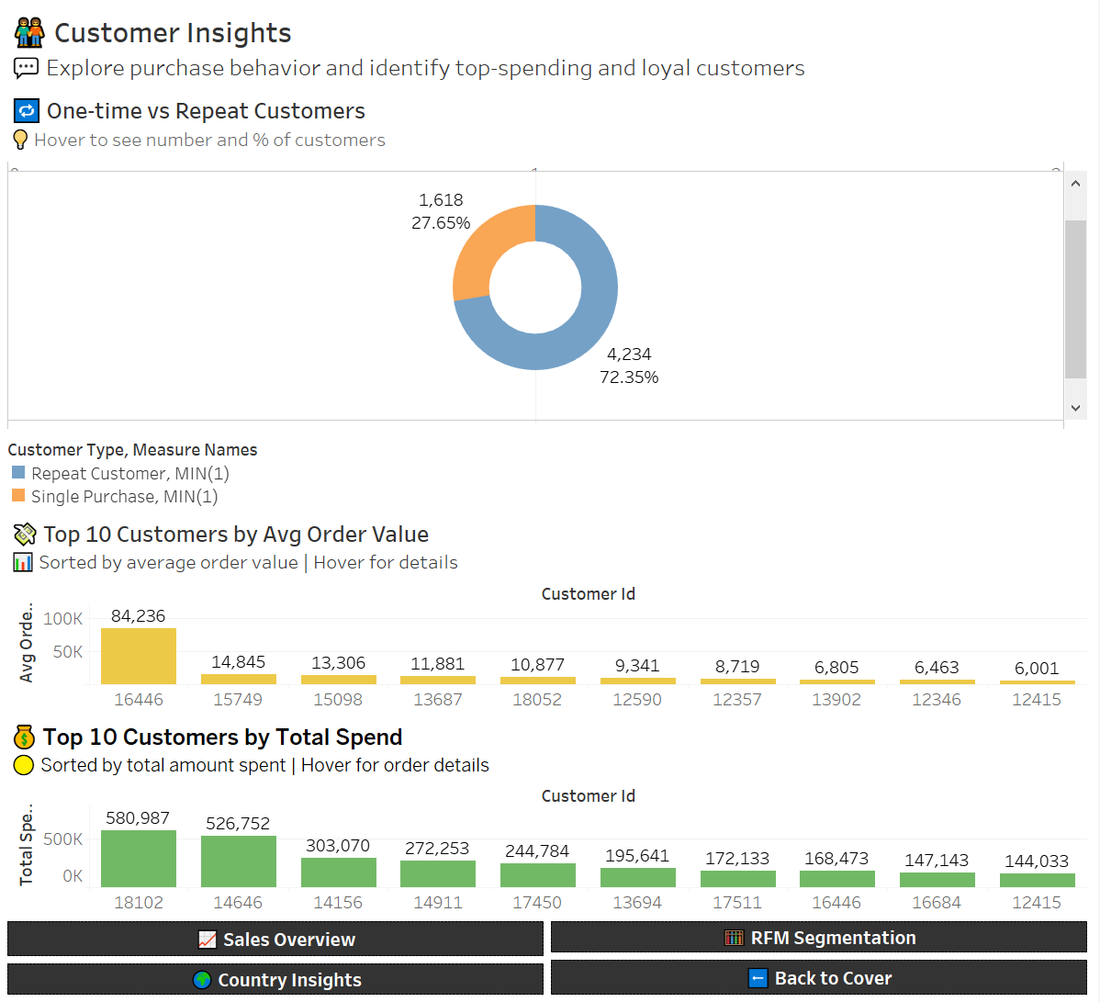
Dashboard - Customer Behavior
Notes:
This dashboard provides a deeper look at customer behavior patterns using visualizations from Tableau.
Starting at the top, we see a donut chart showing that 72.35% of customers made more than one purchase, while around 27.65% only purchased once — confirming a good level of customer retention, with room for reactivation strategies for one-time buyers.
In the middle, we have the Top 10 customers by average order value. The outlier is Customer 16446, who averaged over £84K per order with just two purchases. The rest of the top customers placed high-value orders ranging from £6K to £15K, suggesting they may be wholesale or special event buyers. It’s important to note that over 99% of customers had an AOV below £5,600, highlighting how a small segment drives much of the revenue.
In green, the Top 10 customers by total spend reveals that Customer 18102 spent nearly £581K across 145 orders, reflecting both loyalty and volume. Interestingly, Customer 16446 reappears here with £168K from just 2 orders, reinforcing their impact despite low frequency.
These findings help identify loyal and high-value customers, as well as one-time buyers worth re-engaging, and outliers that may merit personalized attention, retention programs, or even special B2B strategies.

Slide 16
Business Insights - RFM Metrics
📅 Recency (R)
🔁 Frequency (F)
💰 Monetary (M)
Measures days since a customer’s last purchase (relative to 2011-12-09)
Most customers made their most recent purchase within the first 100 days
Recency spans from 0 to 738 days.
Some customers haven’t purchased in over 2 years - indicating churn risk
Distribution is right-skewed, with many recent buyers and a few long-inactive users.
Number of unique purchases per customer (invoice count).
Most users placed 1 to 8 orders, with some outliers exceeding 100+ orders.
The spread reveals a core of casual shoppers and a small group of highly engaged customers.
Total revenue generated per customer.
Over 99% of customers spent less than £20K.
A few outliers - including one at £580K - generate a large share of total revenue.
Distribution is highly right-skewed, emphasizing top-value clients.
Notes:
In this slide, I break down the three core metrics of RFM analysis — Recency, Frequency, and Monetary value — which help us understand customer engagement and value patterns.
We’ll start with Recency, which measures how many days have passed since a customer’s last purchase, relative to our dataset’s end date of December 9, 2011. Most customers made their last purchase within the first 100 days, but the range extends all the way up to 738 days. That means some customers haven’t bought anything in over two years, which strongly indicates churn risk. The distribution is right-skewed, showing that while many customers are recently active, there’s a noticeable tail of long-inactive users.
Next is Frequency, which reflects how many unique purchases each customer made — specifically the number of distinct invoices. Most customers placed between 1 and 8 orders, but there are a few highly engaged outliers who made over 100 purchases. This helps us separate casual shoppers from a small group of power users who are consistently active.
Lastly, we have Monetary, which represents the total amount spent by each customer. The vast majority — over 99% of customers — spent less than £20,000 in total. But we do see a few extreme cases, including one customer who spent over £580,000. This metric is also heavily right-skewed, meaning a small number of customers drive a large portion of revenue — which makes them ideal candidates for loyalty or VIP programs.
Overall, these RFM metrics form the foundation for segmentation, allowing us to target active, loyal, or high-value customers, and flag inactive or one-time buyers for re-engagement.

Slide 17
Business Insights - RFM Segmentation
📊 RFM Metrics
🧩 Segment Breakdown
📌Key Insights
Each customer was scored from 1 (low) to 4 (high) on:
Recency → Days since last purchase (as of 2011-12-09)
Frequency → Number of unique purchases
Monetary → Total spending
Customers were grouped into key behavioral segments:
🟡 High Value → Big Spenders with frequent orders
🟢 Loyal → Recent and frequent buyers
🔴 At risk → Long inactive but previously valuable
🔵 One-Time → Single-purchase, low-engagement users
⚪ Other → Doesn’t meet specific criteria for grouping
High-Value segment is largest - major revenue driver.
Other and At-Risk segments are the next largest groups.
Loyal and One-Time customers form smaller but strategically important segments.
This distribution reveals a diverse customer base with distinct behavioral patterns.
Notes:
To better understand our customers, we used RFM segmentation — scoring each customer on:
- **Recency**: Days since their last purchase (relative to our latest invoice date).
- **Frequency**: Number of unique purchase transactions.
- **Monetary**: Total spend across all purchases.
We assigned quartile-based scores from 1 to 4 for each metric, where 4 is best. These were summed into a total RFM score from 3 to 12.
Based on these scores and behavioral patterns, we grouped customers into five segments:
🟡 **High-Value** – Top scorers with frequent, high-spending behavior.
🟢 **Loyal** – Recently active and frequent buyers, even if not the biggest spenders.
🔴 **At-Risk** – Previously valuable customers who haven’t purchased in a long time.
🔵 **One-Time** – Single low-spend transactions — great re-engagement potential.
⚪ **Other** – Mixed patterns that don’t fit neatly into the above.
The **High-Value** group was the largest — a strong driver of revenue.
**Other** and **At-Risk** segments are sizable and worth exploring for churn or growth.
**Loyal** and **One-Time** customers, while smaller, offer strategic opportunities.
This segmentation enables smarter targeting, tailored messaging, and better allocation of marketing resources.

Slide 18
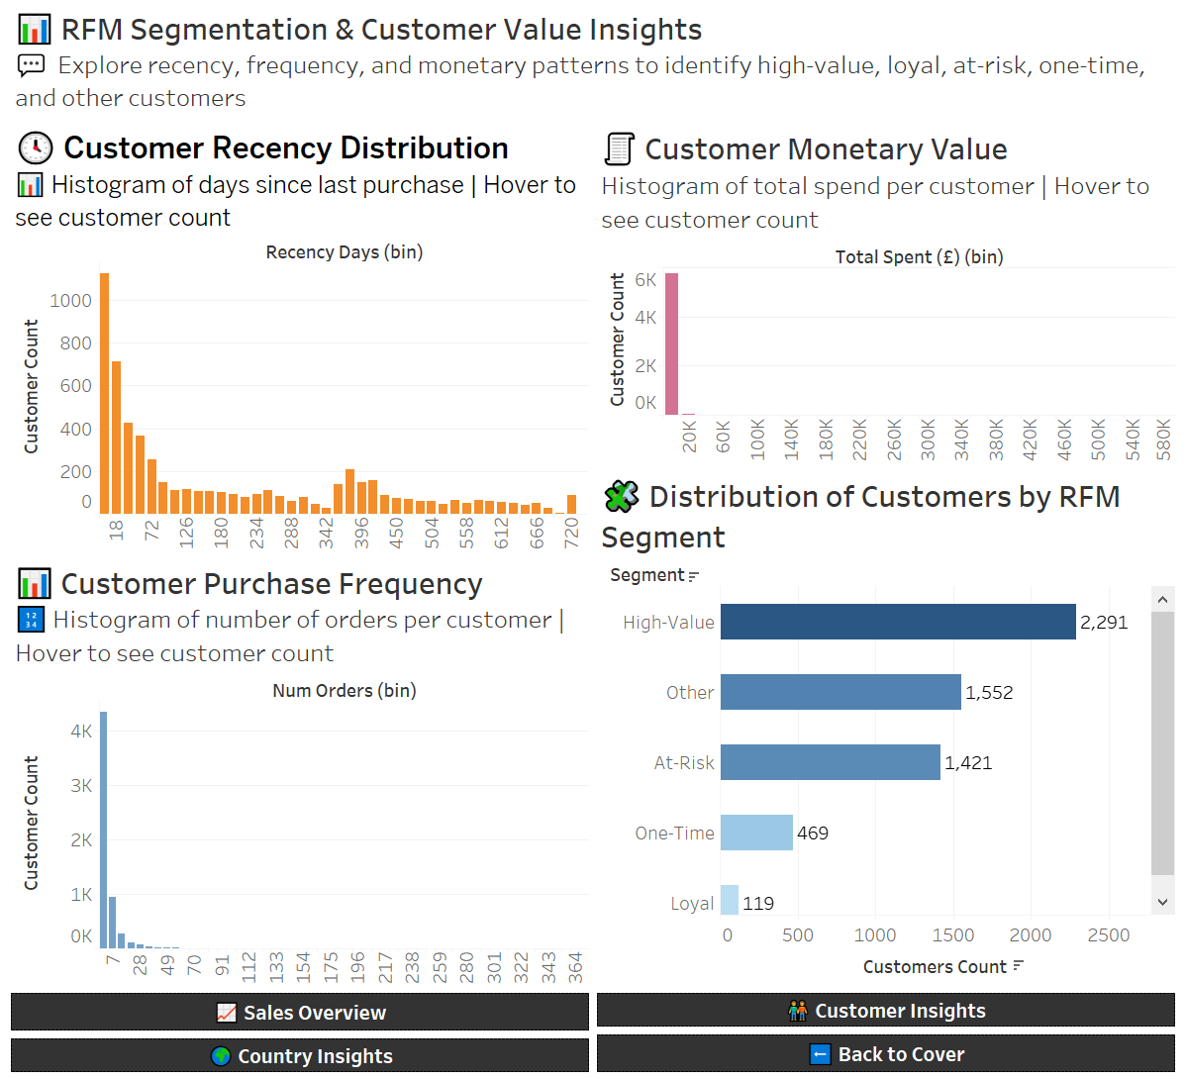
Dashboard - RFM Analysis
Notes:
This dashboard summarizes our RFM segmentation and customer value insights.
In the top left, we see the Recency distribution. Most customers made their last purchase within the first 100 days, but there's a long tail of inactivity — with some users not returning for over two years.
Bottom left shows Purchase Frequency. The majority placed only one to eight orders, with a sharp drop-off afterward. Still, a few highly engaged customers made over 100 purchases.
Top right, we have the Monetary Value chart. Most customers spent less than £20,000, but a small group of outliers contributes disproportionately to total revenue — highlighting how skewed spending patterns are.
Finally, bottom right, the RFM Segment bar chart shows our segmentation results:
The High-Value segment is the largest group, with 2,291 customers.
Other and At-Risk segments follow in size and represent meaningful opportunities — either for churn prevention or more personalized engagement.
Loyal and One-Time customers are smaller in number but strategically important.
These combined views help us understand not just who our best customers are, but also how to prioritize marketing, retention, and growth strategies based on behavior.

Slide 19
Business Recommendations
📌 Key actions based on Python and SQL analysis:
Prioritize High-Value Customers
Reward top spenders with VIP perks, early access, or loyalty programs to boost retention.
Retain Loyal & Re-Engage At-Risk Buyers
Use targeted email campaigns, offers, and incentives to keep loyal users engaged and bring back long-inactive customers.
Convert One-Time Buyers
Design onboarding flows and personalized discounts to turn first-time shoppers into repeat customers.
Capitalize on Seasonal Peaks
Strengthen marketing and inventory strategies ahead of Q4, especially October-November, to maximize holiday revenue.
Grow in High-Value Markets
Expand marketing in Ireland, Netherlands, Germany, and explore premium strategies for Switzerland and Australia
Optimize Product Strategy
Double down on bestsellers and seasonal items. Test bundling and complementary offers to increase average order value.
Notes:
To conclude our analysis, we’ve outlined key actions that align with the data. First, high-value customers generate the majority of revenue — they should be nurtured through VIP programs or exclusive offers.
Next, we have a solid base of loyal users and a significant at-risk group — these should be the focus of retention and win-back strategies.
Since over 25% of customers buy only once, we see strong potential in converting them with onboarding emails and follow-up promotions.
Seasonal spikes in Q4 — especially October and November — are a clear pattern, so planning campaigns and stock for that period is essential.
International growth opportunities exist beyond the UK. Ireland, Netherlands, and Germany show strong revenue, while Switzerland and Australia present high-spend segments.
Finally, the product data suggests an opportunity to fine-tune the catalog — highlighting top sellers, bundling items, and using insights to guide future offerings.

Slide 20
Future Steps
🧭 Strategic Next Steps
Customer Lifetime Value (CLV) Modeling
Predict long-term value per segment to guide budget allocation and retention strategies.
Cohort & Churn Analysis
Track behavior of customer groups over time and identify early signs of churn for proactive.
A/B Testing & Campaign Tracking
Run experiments on emails, offers, and loyalty perks to optimize conversions and ROI.
Product Affinity & Bundling
Analyze purchase patterns to identify frequently bundled items and improve cross-selling opportunities
Personalized Marketing
Use RFM segments and buying behavior to tailor messaging, promotions, and product recommendations.
Notes:
To build on this analysis, several data-driven initiatives can take our customer strategy even further.
First, Customer Lifetime Value modeling would help us estimate the long-term profitability of different customer segments. This allows us to make smarter decisions around marketing spend and retention priorities.
Next, cohort and churn analysis can help track how different customer groups behave over time — especially identifying early warning signs of drop-off or disengagement. This enables us to take proactive action before we lose them.
We also recommend implementing A/B testing and campaign tracking. For example, testing subject lines, discount offers, or loyalty perks to see which approaches actually drive conversions.
Another opportunity lies in product affinity analysis, where we can identify items frequently purchased together. This can support bundling strategies and personalized cross-sell offers that increase basket size.
Finally, all of this feeds into personalized marketing. By using RFM segments and past purchase behavior, we can craft messages and offers that feel more relevant to each customer — which improves both engagement and retention.
Together, these next steps can help us evolve from reactive reporting to predictive, personalized strategies that drive long-term growth.

Slide 21
Limitations
Data is Historical (2011)
The dataset ends in December 2011, so customer behavior trends may not reflect current realities.
Lack of Demographic Information
No age, gender, or region data - limiting personalization and advanced customer segmentation.
Unclear Customer Type (B2B vs B2C)
The dataset does not distinguish between business and individual buyers, which could affect segmentation logic.
Limited Product Classification
No structured product categories - insights are based on item descriptions and stock codes only
RFM Threshold Assumptions
Segment labels are based on quartile logic, which may not fully capture business-specific nuances.
Notes:
While our findings are valuable, it’s important to recognize the key limitations that affect how we interpret the results.
First, the dataset ends in December 2011 — that’s over a decade ago. Current customer behavior and e-commerce patterns may differ significantly, especially post-pandemic.
We also lacked demographic data, such as age, gender, or location, which would have allowed us to perform more personalized segmentation and customer profiling.
Additionally, the dataset does not indicate whether customers are business (B2B) or individual (B2C) — and this can significantly impact purchasing behavior, order size, and how we interpret engagement.
There’s also a lack of formal product categorization. We analyzed performance based on stock codes and descriptions, but richer product grouping would have enhanced inventory and trend analysis.
Lastly, our RFM segmentation used quartile-based thresholds. While practical for exploration, real-world businesses may need more customized or dynamic scoring systems for accurate targeting.
Understanding these limitations helps us avoid overgeneralizing and positions us better for refining future analyses.

Slide 22
Thank You!
Questions?
Contact:
👩‍💻Ginosca Alejandro Dávila
📍 Data Analyst & Educator
🔗 linkedin.com/in/g-alejandro
Notes:
Thank you for your time and attention. I'm happy to answer any questions or discuss parts of the project in more detail. If you'd like to connect afterward, feel free to reach out via LinkedIn.

