Slide 1
A Low-Voltage CMOS Rail-to-Rail Operational Amplifier Using Double P-Channel Differential Input Pairs
彰師大 積體電路設計研究所
指導教授：林志明 老師
研 究 生：賴信吉
MAIL ：s94662005@mail.ncue.edu.tw

Slide 2
Provenance
Chun-Jen Huang and Hong-Yi Huang, “A Low-Voltage CMOS Rail-to-Rail Operational Amplifier Using Double P-Channel Differential Input Pairs,’ IEEE International Symposium on Circuits and Systems, pp. I.636-I.637, 2004.

Slide 3
Online
Introduction.
Limitation low voltage.
Typical input stage
Improve input stage.
Result and comparisons.
Simulation by DIY

Slide 4
Introduction
The OPA is the basic building cell in analog and mixed-signal circuits.
Reducing the power dissipation and operating at low supply voltages are the trends.
This work：
0.35µm 2p4m CMOS process ;
1V supply voltage ;
76 dB dc gain ;
5.27 MHz unit-gain bandwidth ;
288µW power dissipation ;
84º phase margin at 15 pF output load.

Slide 5
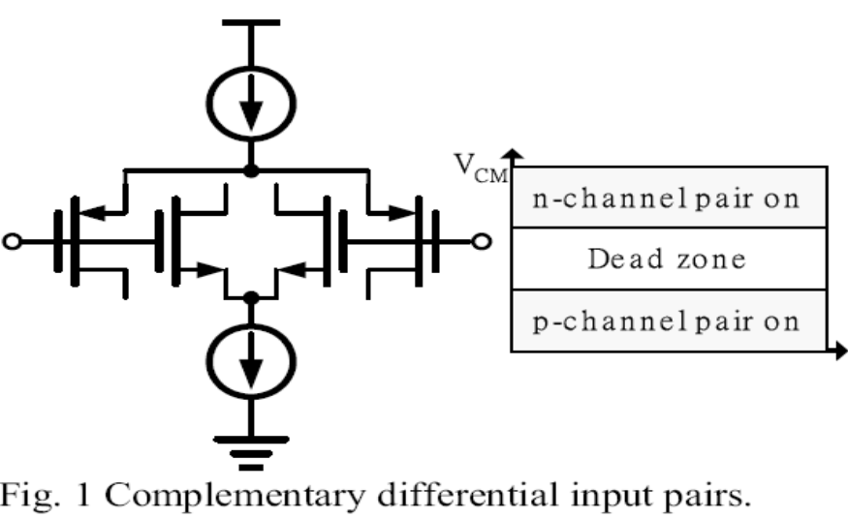
Limitation low voltage
Supply voltage is below Vt,NMOS+|Vt,PMOS|+VDS,NMOS+|VDS,PMOS|, there is a dead zone in the middle of supply voltage.

Slide 6
Low voltage
Eliminate body effect.
Large aspect ratio (W/L).
Virtual transistor.
This work.

Slide 7
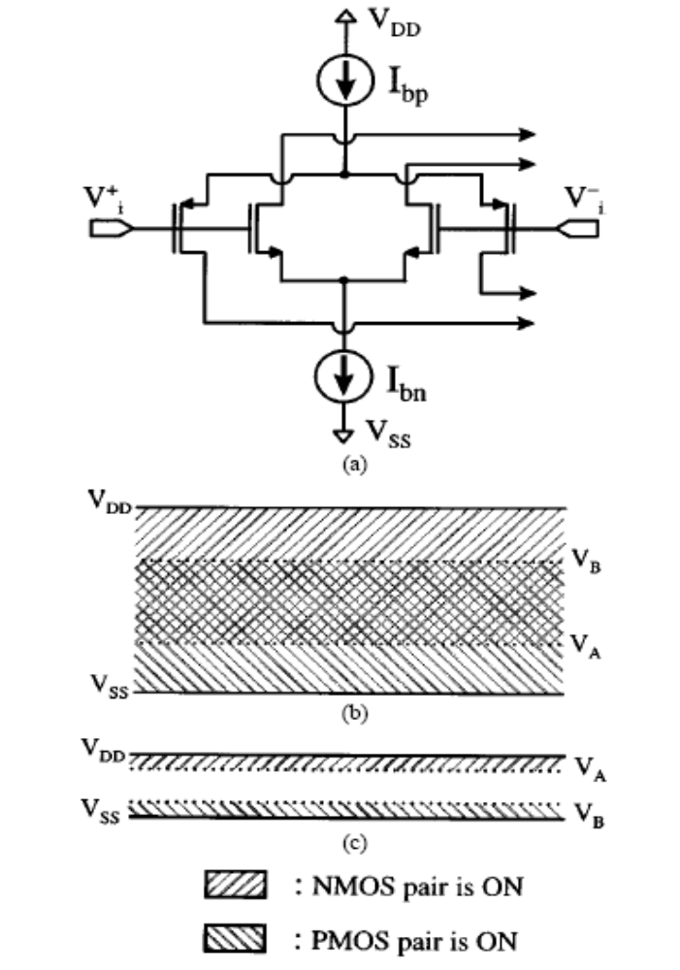
Typical input stage
(a) Typical input stage for rail-to-rail amplifiers, (b) different operation zones for low supply voltage operation, and (c) different operation zones for extremely low supply voltage operation.
VA =Vss+2* VDSat+ VT,NMOS ; VB=VDD- 2*│VDSat│-│VT,PMOS│

Slide 8
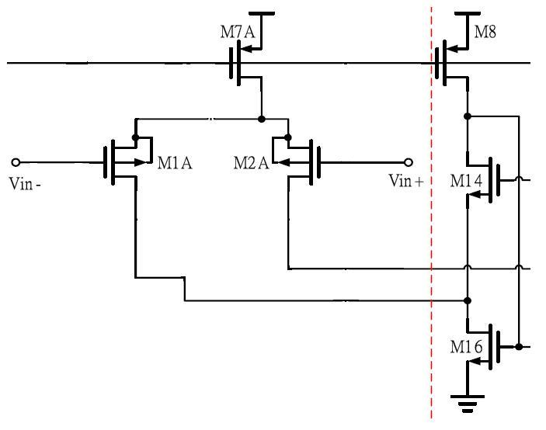
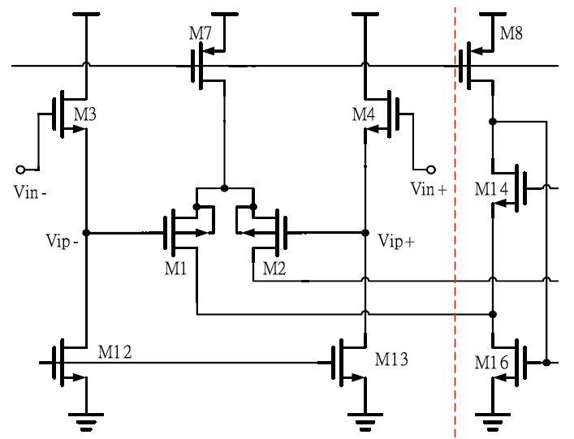
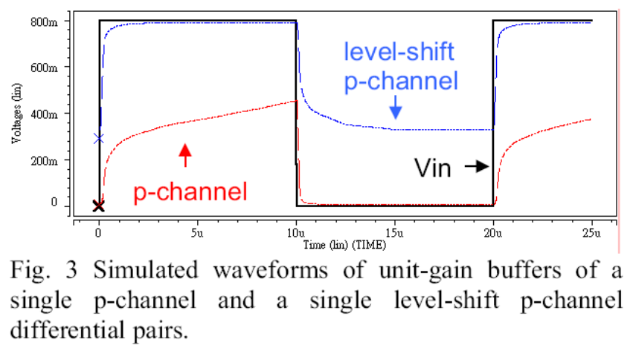
Improve input stage.
0~0.4v
0.4~0.8v
P-channel different pair
Level-shift
P-channel

Slide 9
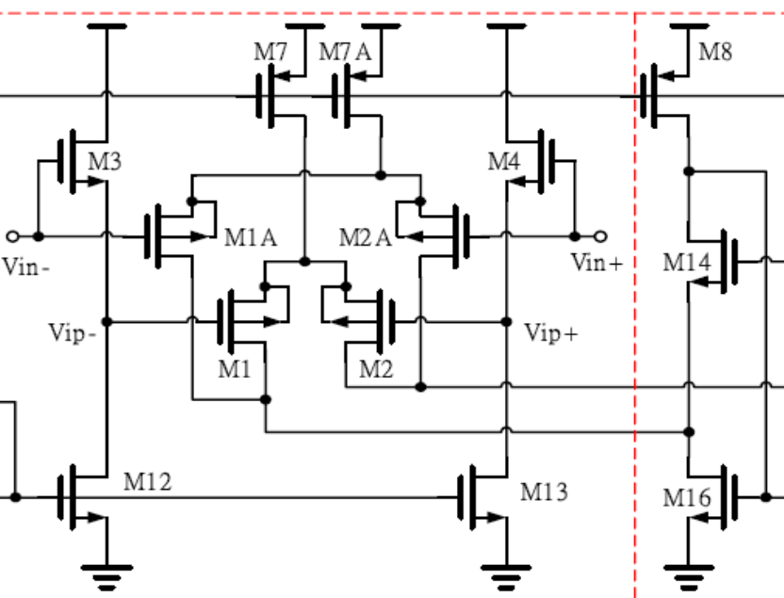
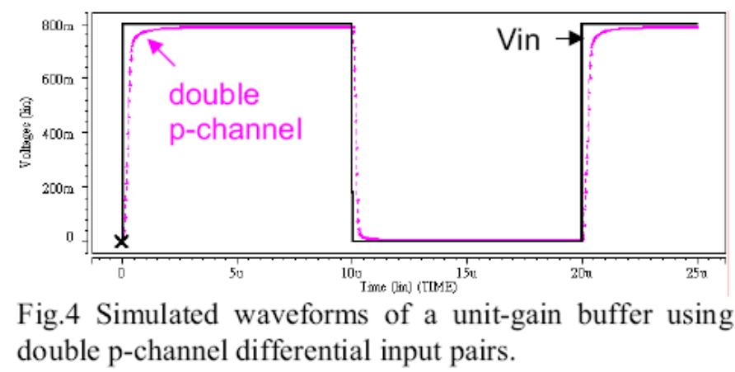

Slide 10
VCM , VDD formula
P-channel different pair

Slide 11
Level-shift
P-channel

Slide 12
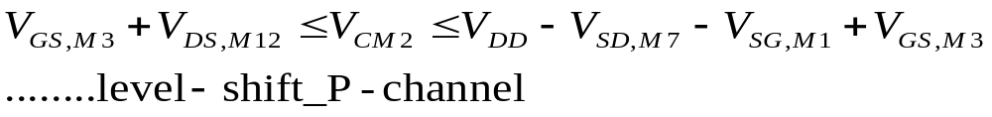
To achieve a rail-to-rail signaling at the inputs, the
following conditions have to be satisfied. The W/L ratios of M1~M4 must be large enough to sustain
VGS=Vtn+Veff

Slide 13
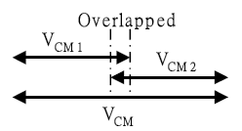

The upper limit of VCM1 has to be larger than the
lower limit of VCM2. → No dead zone.

Slide 14
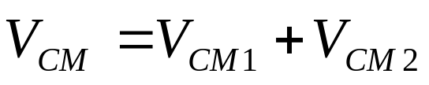

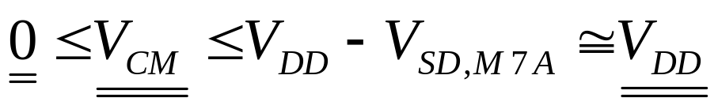

Slide 15
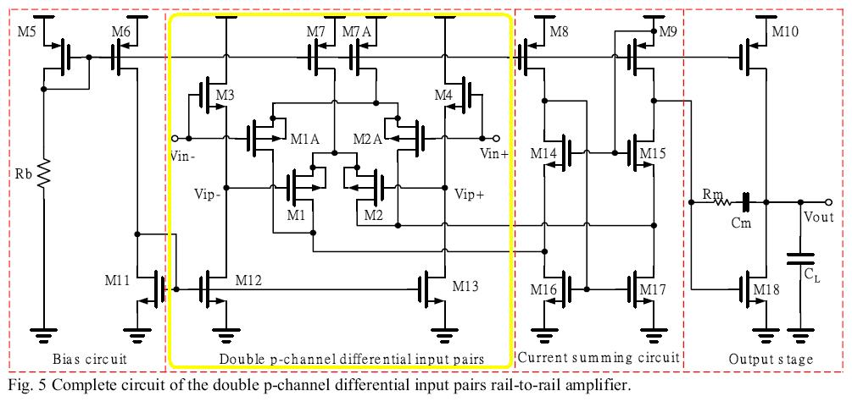
Complete circuit

Slide 16

Result and comparisons
The typical threshold voltages of the n-channel and p-channel devicesare 0.52V and –0.74V, respectively.
At 1 voltage, we obtainVSG,M1A=0.4V, VGS,M3=0.562V, VSD, M7A 0V and VDS,M12=0.096V from the simulation.
The results satisfy

Slide 17
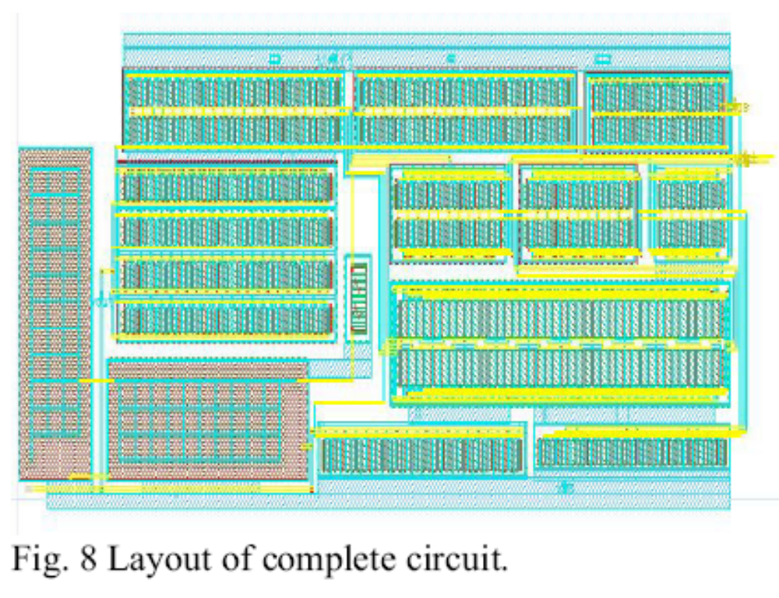
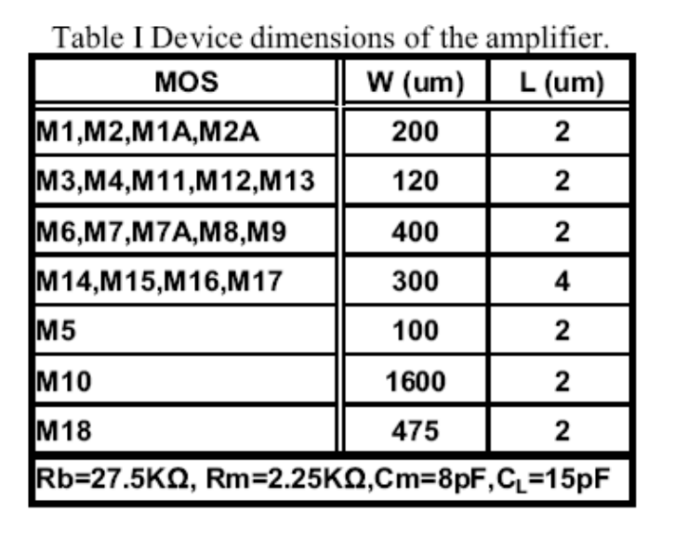

Slide 18
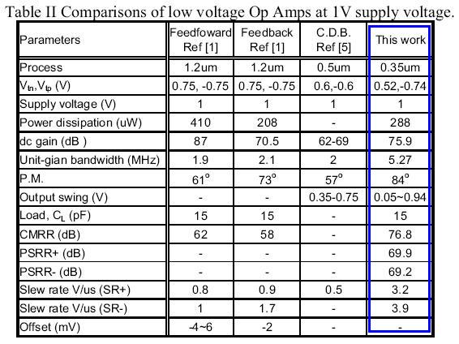
Comparisons

Slide 19
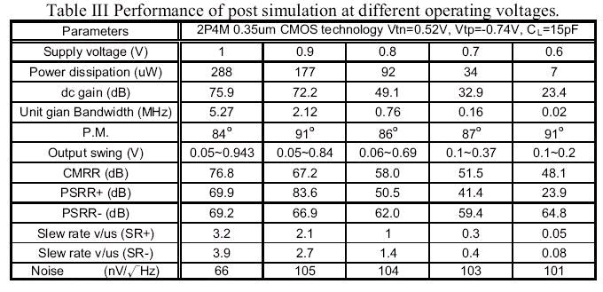

Slide 20
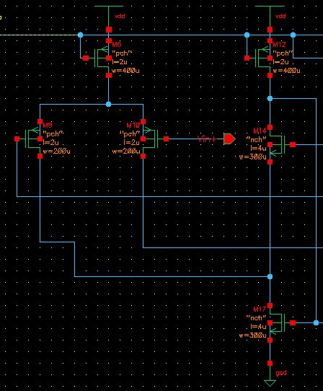
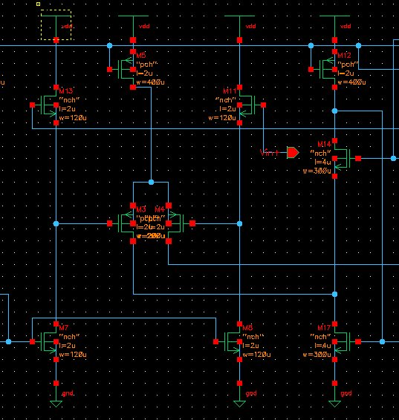
Simulation by DIY
P-channel different pair
Level-shift
P-channel

Slide 21
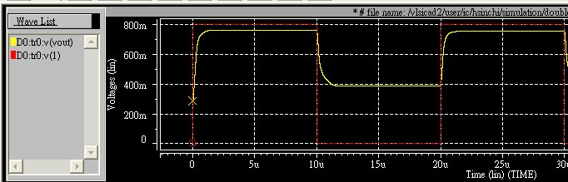
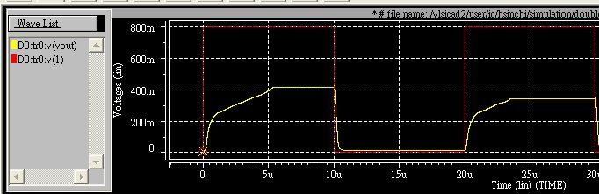
Level-shift
P-channel
P-channel different pair

Slide 22
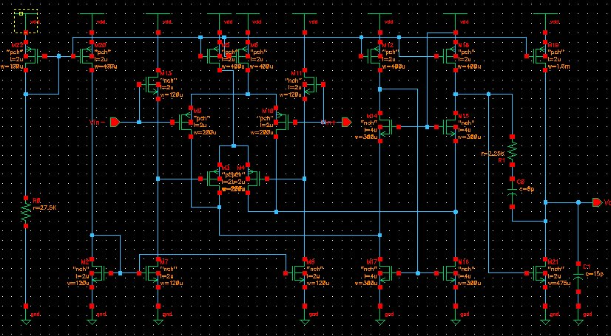
Complete circuit of the double p-channel differential input pairs rail-to-rail amplifier

Slide 23
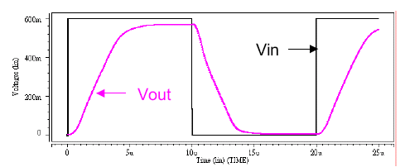
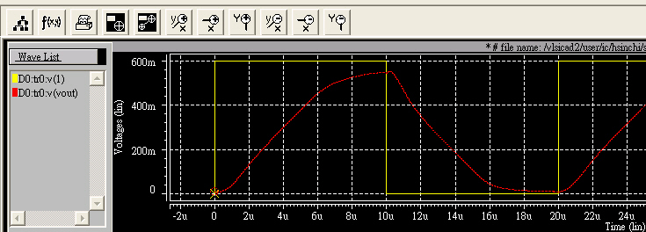
Simulation waveforms of an unit-gain buffer at 0.6V supply voltage.
0.6V

Slide 24
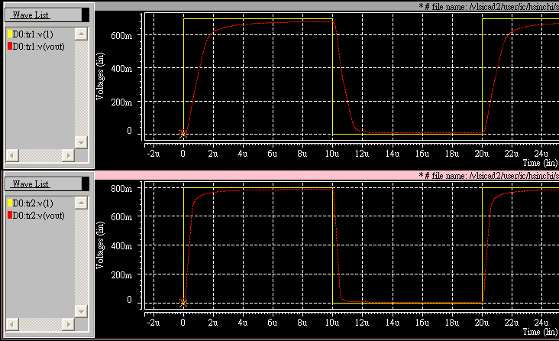
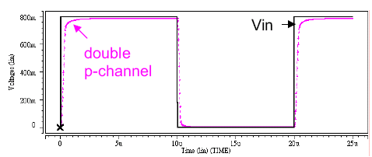
0.7v
0.8v

Slide 25
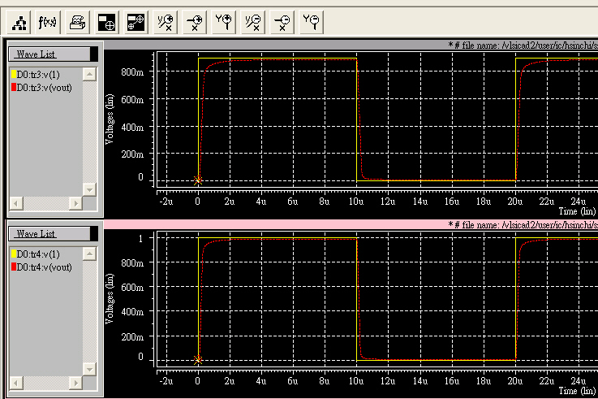
0.9v
1.0v

Slide 26
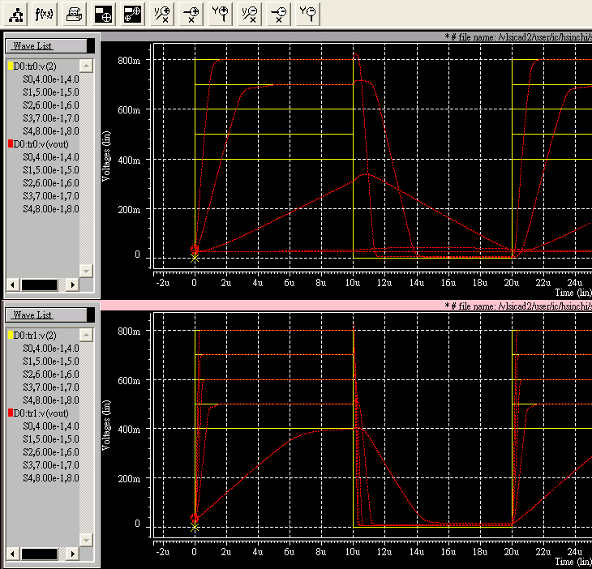
0.7V
W(µm) | L (µm)
20 | 0.35
12 | 0.35
40 | 0.35
30 | 0.7
10 | 0.35
100 | 0.35
47.5 | 0.35
0.35
0.5V
0.18

