Slide 1

Introduction to
Analog-VLSI Design
Hirokazu Ikeda
ikeda@post.kek.jp
IPNS,
High Energy Accelerator Research Organization
July 28, 2003 @Riken
1

Slide 2

Contents for talk
Title: Introduction to analog-VLSI design
What is CMOS?
Design flow (with examples)
Multi-chip project provided by VDEC
Recent progress: IP and Pixel
2

Slide 3
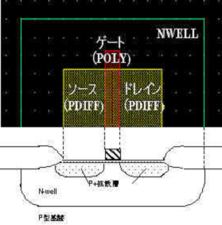
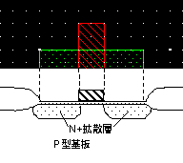
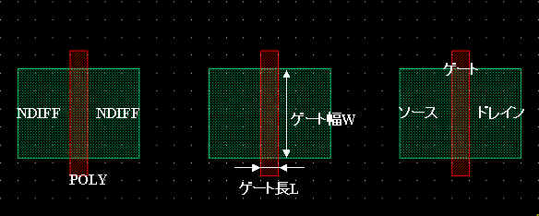
What is CMOS?(1)
CMOS is a silicon-based integrated circuit fabrication technology with complementary FETs
PMOS Transistor
ＮＭＯＳ Transistor
Field Oxide
3

Slide 4
What is CMOS?(2)
General:
1)Conformance with very high integration with very low power consumption.
2) Complicated analog-digital circuits are allowed to be mixed together
3) Fabrication process is well matured.
4) Easy to be destructed by static discharge
5) Difficult to implement large capacitors and high resistors.
6) Allowable power-rail voltage is relatively low.
7)Absolute value for elements is very poor, while matching is excellent.
8) Radiation tolerance is being improved.
Specific parameters for 0.35um CMOS from RHOM
Gate oxide：7.2 nm
Gate length：0.4 μm
Metal width：0.6 μm
Metal spacing：1 μm
Resistor：2.35 kΩ/□
Capacitor：1.8 fF/μm²
Power rail：2.7-3.6 V
4

Slide 5

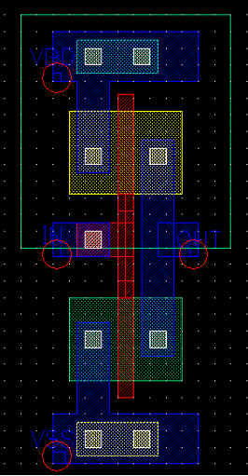
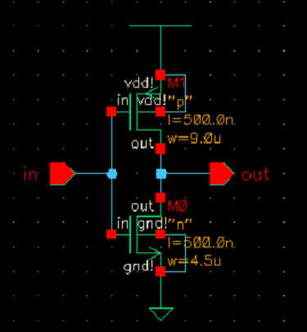


Design Flow
1)Making-up Spec’s
2)Functional description
3)Transistor-based description+verification
4)Layout design +verification
5)Silicon Process ( front-end, back-end)
6)Delivery to designers
5

Slide 6
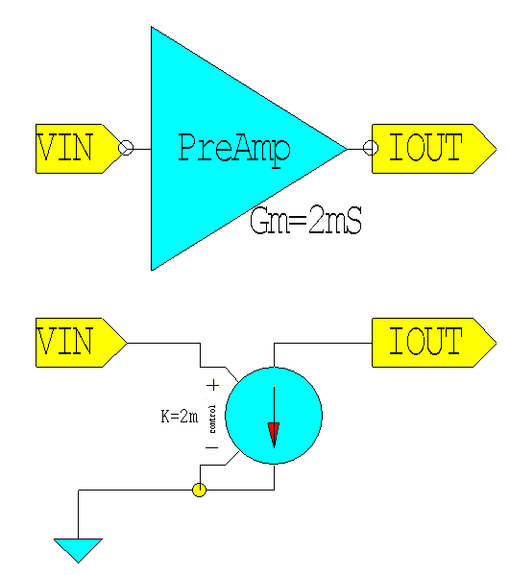
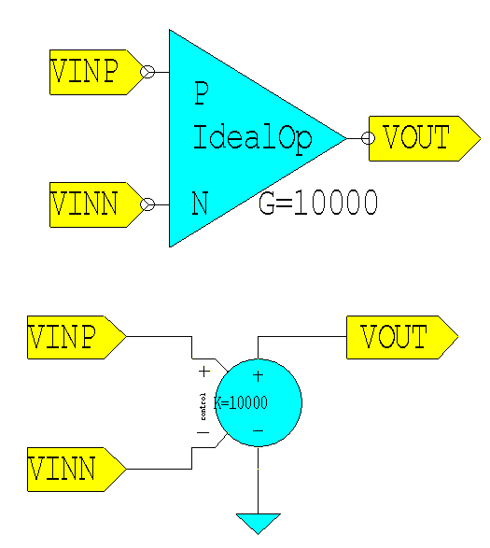
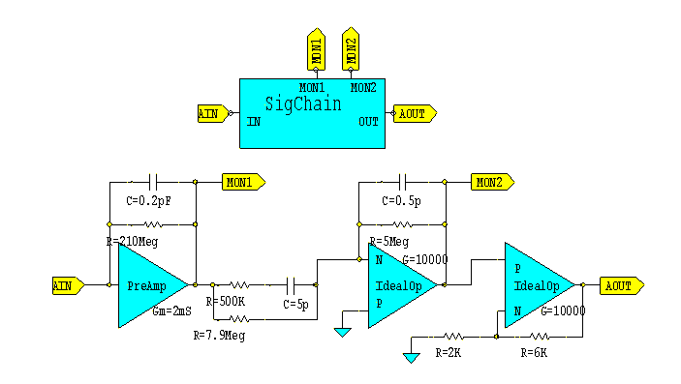
Functional Description(1)
The first step of circuit design is to construct a signal chain
with ideal elements such as VCCS’s, VCVS’s, resistors, and capacitors.
VCVS
前置増幅器
整形増幅器
Integrator and Amplifier
非反転増幅器
ポール・ゼロ補償
Pole/zero canceller
6
Preamplifier

Slide 7
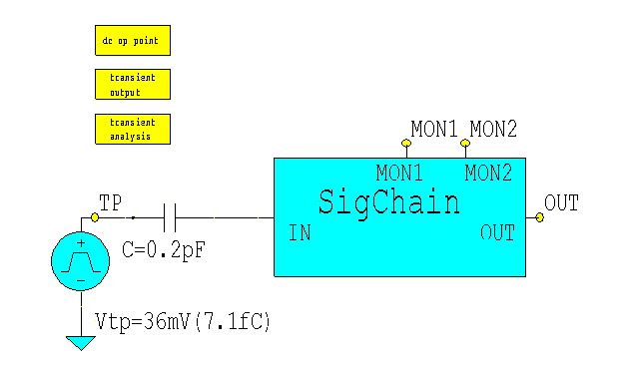
Functional Description(2)
Generation of SPICE-netlist
* SPICE netlist written by S-Edit Win32 7.03
.SUBCKT IdealOp VINN VINP VOUT Gnd
e1 VOUT Gnd VINP VINN 10000
.ENDS
.SUBCKT PreAmp IOUT VIN Gnd
g1 IOUT Gnd VIN Gnd 2m
.ENDS
.SUBCKT SigChain AIN AOUT MON1 MON2 Gnd
X1 MON1 AIN Gnd PreAmp
X2 N3 Gnd MON2 Gnd IdealOp
X3 N1 MON2 AOUT Gnd IdealOp
C1 AIN MON1 0.2pF
C2 N2 N3 5p
C3 N3 MON2 0.5p
R4 AIN MON1 210Meg TC=0.0, 0.0
R5 N3 MON2 5Meg TC=0.0, 0.0
R6 N1 AOUT 6K TC=0.0, 0.0
R7 Gnd N1 2K TC=0.0, 0.0
RP MON1 N2 500K TC=0.0, 0.0
RZ MON1 N3 7.9Meg TC=0.0, 0.0
.ENDS
Simulation Program,
Integrated Circuit Emphasis
* Main circuit: T000
X1 N1 OUT MON1 MON2 Gnd SigChain
C1 TP N1 0.2pF
.op
v2 TP Gnd pulse(0.0 36m 100n 10n 10n 100u 200u)
.tran 10n 50u
.print tran v(VTP) v(MON1) v(MON2) v(OUT)
* End of main circuit: T000
7

Slide 8
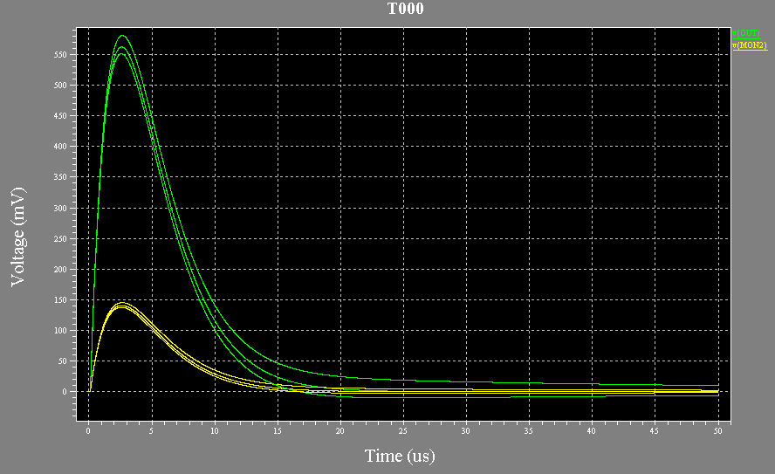
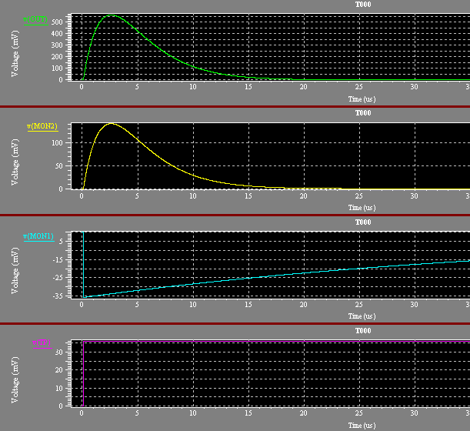
Functional Description(3)
Execution of SPICE with functional description; confirming
whether the description is exactly what you want to do.
V(OUT)
Example of the pole/zero
adjustment
V(MON2)
V(MON1)
V(TP)

Slide 9
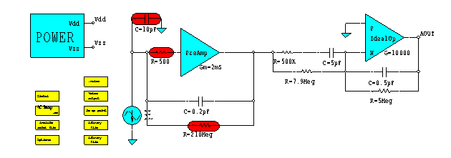
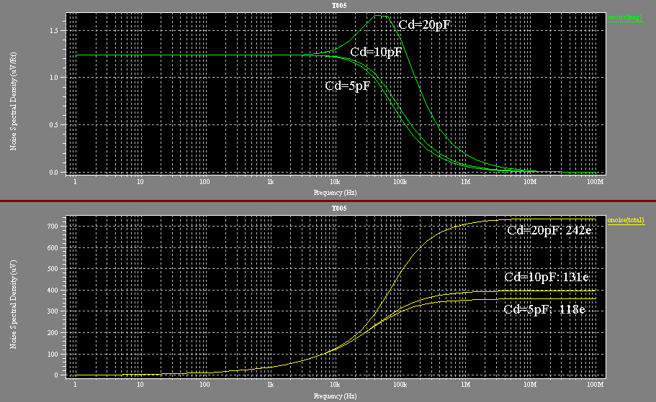
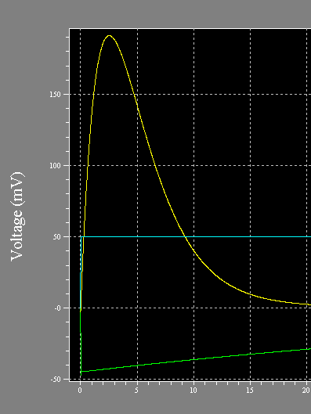
Functional description(4)
Electronic noise is inherent to electronic devices and is enhanced by detector capacitance and leakage current.
Calibration
Pulse for normalization
Noise spectrum
Integrated noise
9

Slide 10
Transistor-based circuit design
The step is to assemble MOSFET’s to implement required functions as specified or implied
1) W/O large capacitors, and high resistors
2) DC, AC, Transient, & Noise analysis
for circuit blocks, signal chains, and finally entire chip.
2) Analysis with SKEW(FAST, TYPICAL, SLOW) parameter is a mandatory part .
3) Monte-Carlo analysis is available if required.
4) Temperature dependence, power-rail dependence, and/or
bias current sensitivities should be checked out as a part of final
confirmation.
10

Slide 11
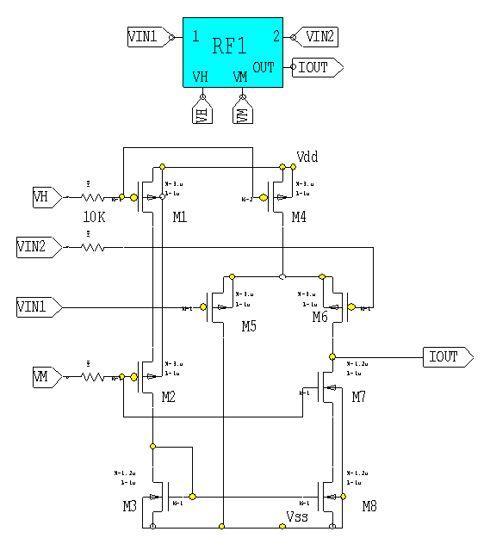

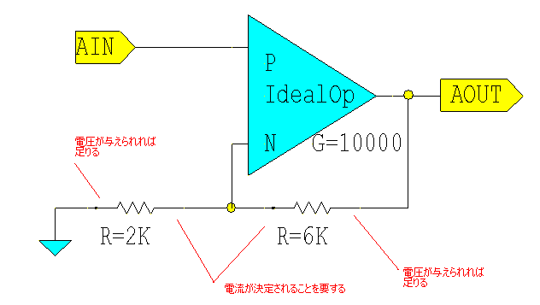
Resistance Circuit(1)
The resistance circuit exhibits a resistor-like behavior for its one terminal while the other terminal is kept as high impedance.
In general the current generated
by a resistor is utilized only one
terminal of the resistance device; on the other terminal the current is no more than an annoyance.
The resistance circuit can be controlled to exhibit resistance of 10kΩ to 500MΩ.
Our concern is just the KCL
On this node.
11

Slide 12
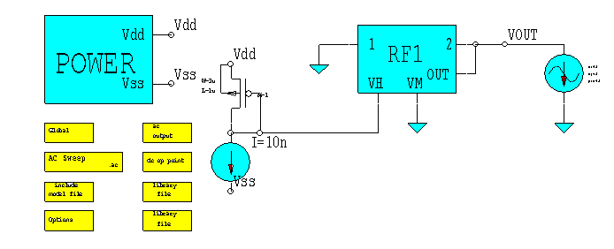
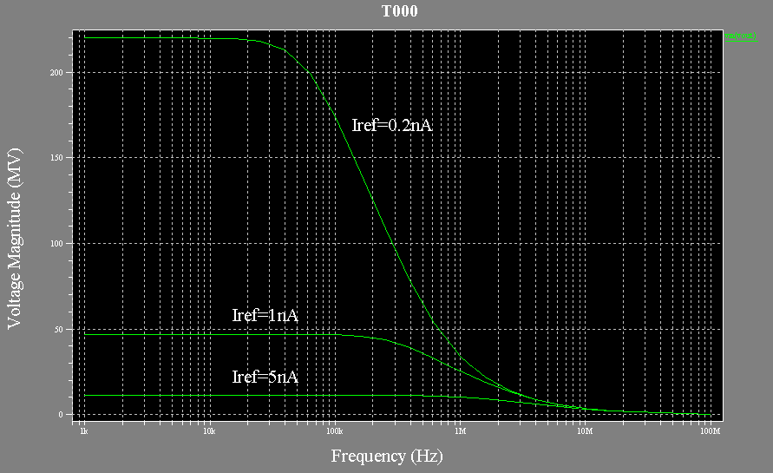
Resistance circuit（2）
AC analysis

Slide 13
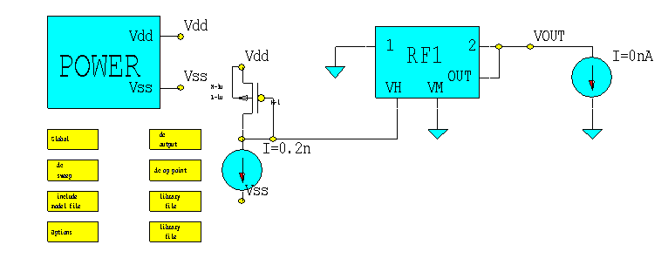
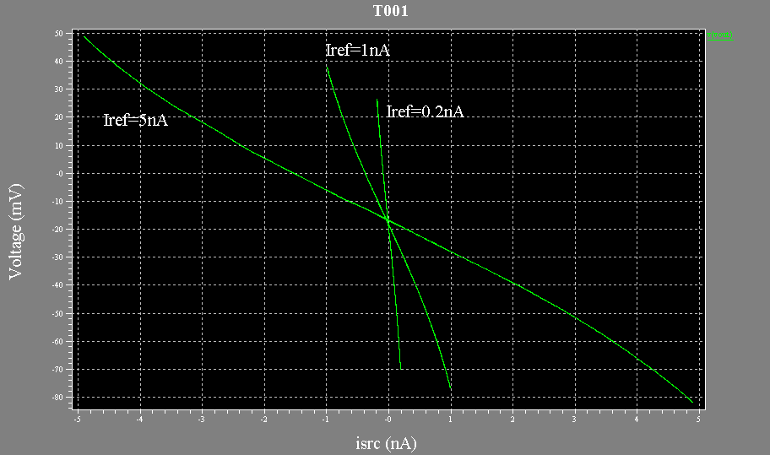
Resistance Circuit （3）
DC analysis

Slide 14
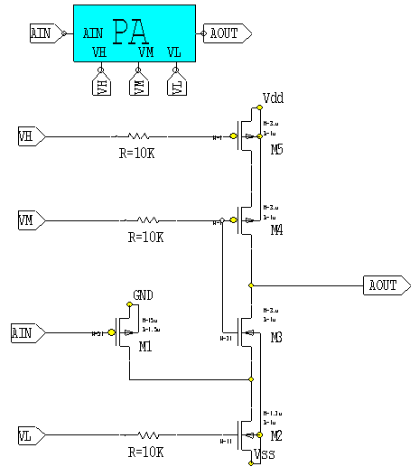
Preamplifier(1)
Preamplifier is an integrator circuit to gather charges generated in a detector medium with very low electronic noise.
1) The input transistor employed is
a pMOS with W=15um, L=0.5um,
and M=50.
2)The amplifier takes a folded-cascode
configuration.
3)The large input transistor suppresses
electronic noise associated
with the detector capacitance.
4) PMOS is known to exhibit
lower 1/f noise than NMOS
with less influence due to radiation.
Constant current
with cascode
Input transistor
Cascode
transistor
Constant current
14

Slide 15
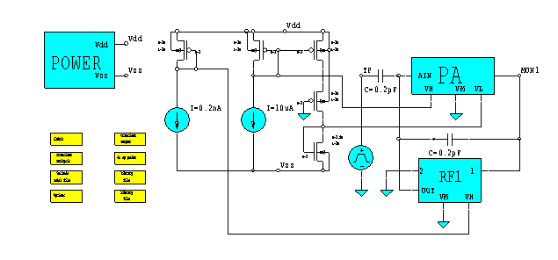
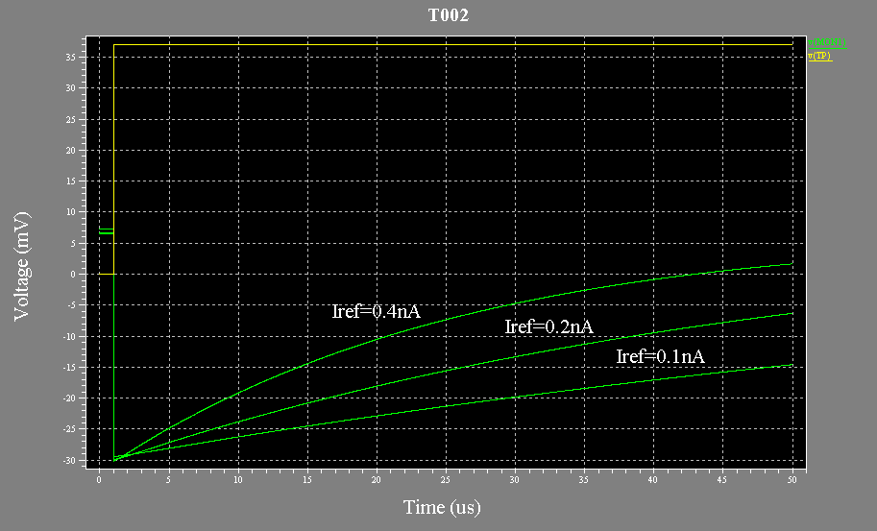
Preamplifier(2)
Adding a resistance circuit as well as a feed-back capacitance.
Reference circuit
Transient Analysis
Test Pulse
Test Pulse
Feed-back
capacitance
15

Slide 16

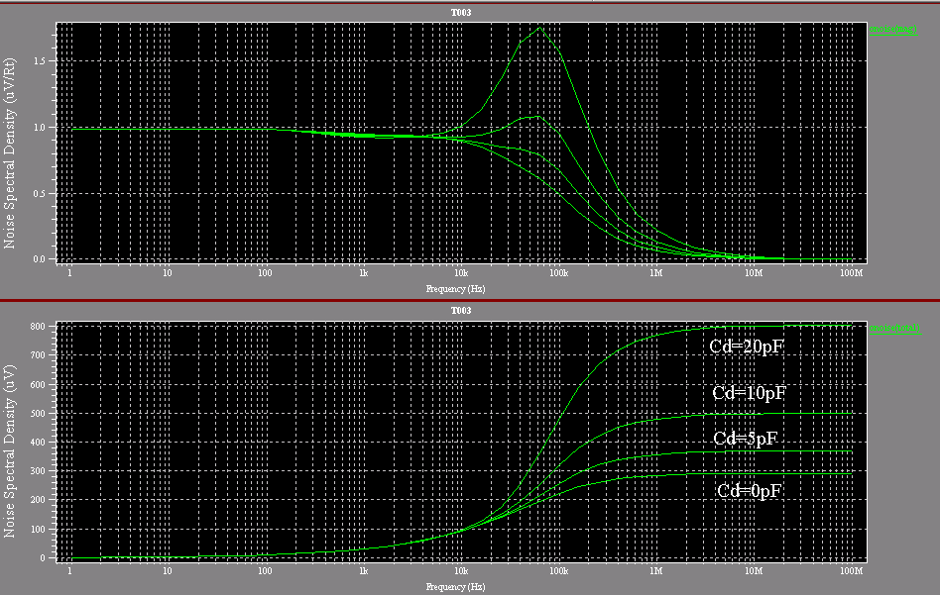
Preamplifier(3)
Additional noise sources contribute to the total noise in one way or another.
Noise Analysis
AGAIN!
Noise estimated preliminarily
Noise after assembled
16
Notes:
.alter
C4 N13 Gnd 5pF
i13 N2 Vss 40uA
i14 N3 Vss 0.02nA
R12 N8 N1 83.5Meg TC=0.0, 0.0
.alter
C4 N13 Gnd 0pF
.alter
C4 N13 Gnd 10pF
.alter
C4 N13 Gnd 20pF
* End of main circuit: T003

Slide 17

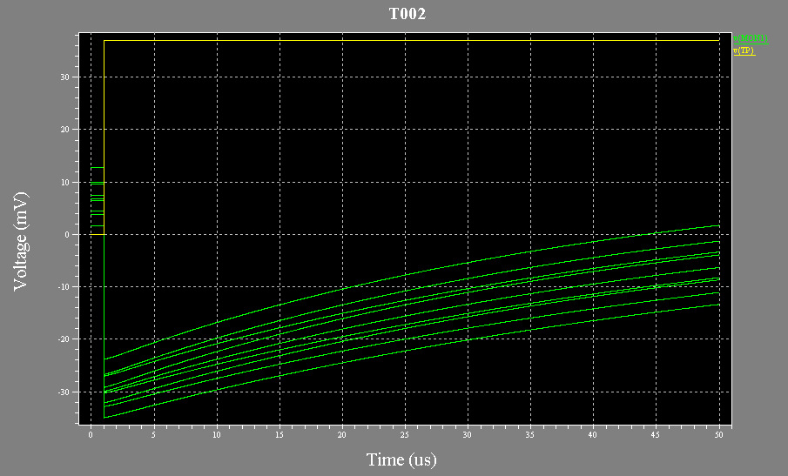
Preamplifier(4)
The SKEW parameters provide modified SPICE parameters corresponding to the deviation of the silicon process
SKEW Simulation
W/ Temperature dependence
W/ Radiation damage
As for the 3 by 3 combinations for the SKEW parameters, the offset is severely affected to request
a provision of an offset compensation, while the time
constant is affected slightly.
17

Slide 18
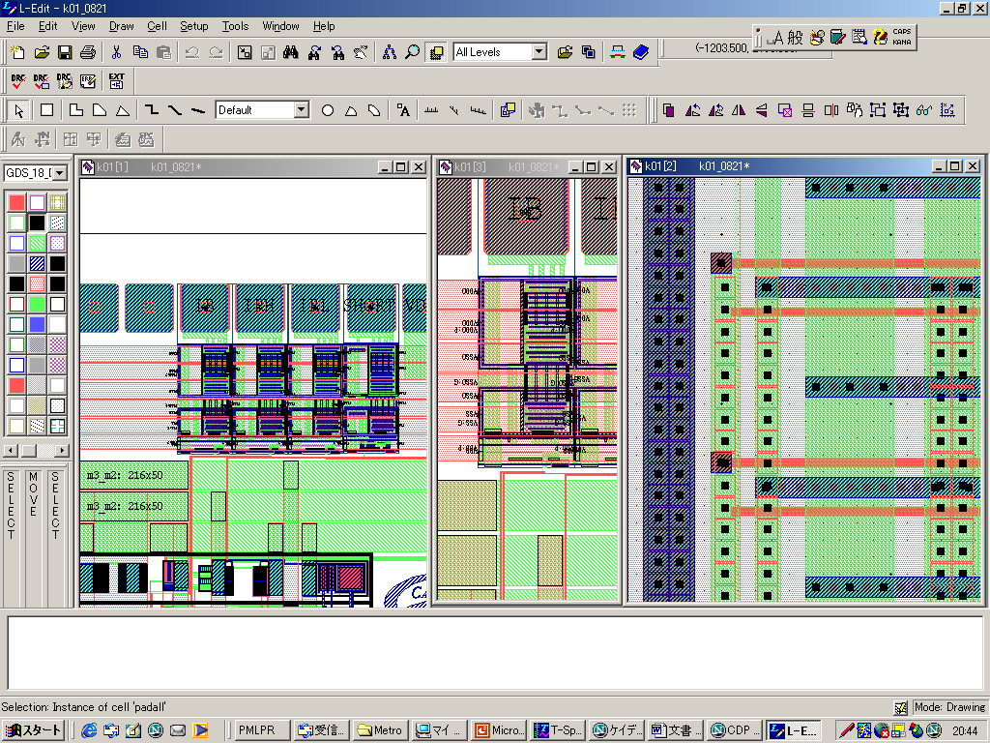
LAYOUT Design
LAYOUT design is a step to draw mask geometries for a photo-lithography
It happens the case that the layout design is asked to be
finished by an out-side expert; the circuit design should be
well documented prior to initiating the layout design.
1) Examples (Preamplifier, Resistance circuit, and etc)
2) DRC
3) LVS
18

Slide 19
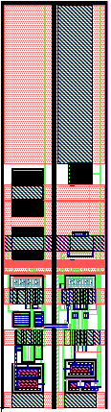
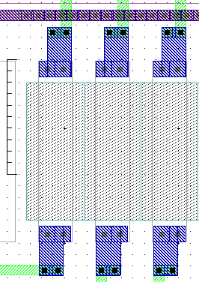
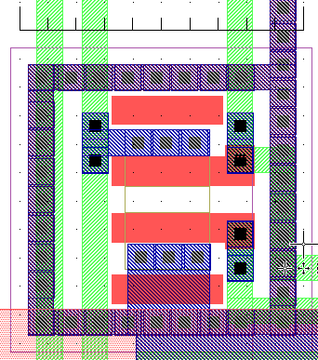
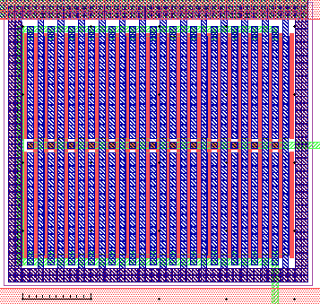
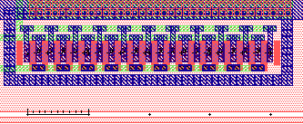
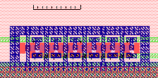
LAYOUT for Preamplifier
Dummy
19

Slide 20
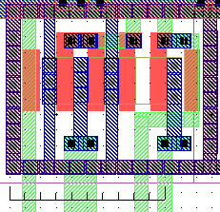
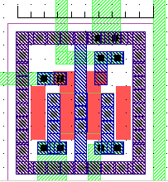
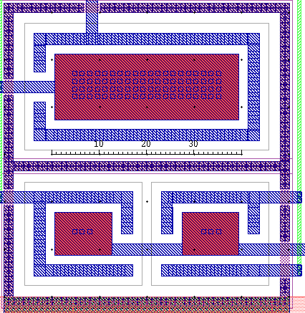
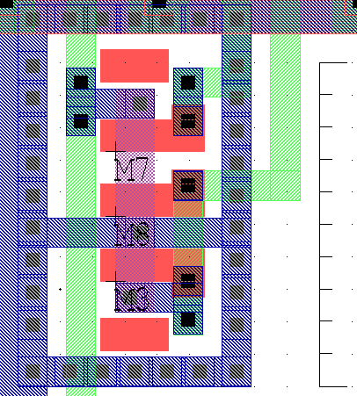
LAYOUT for Resistance Circuit
20

Slide 21
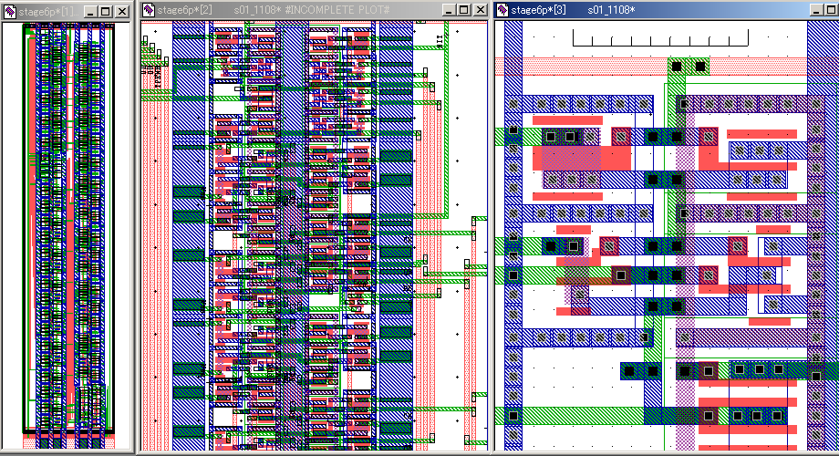
LAYOUT for Digital Circuits
Layout for digital circuits is denser than that for analog circuits
21

Slide 22
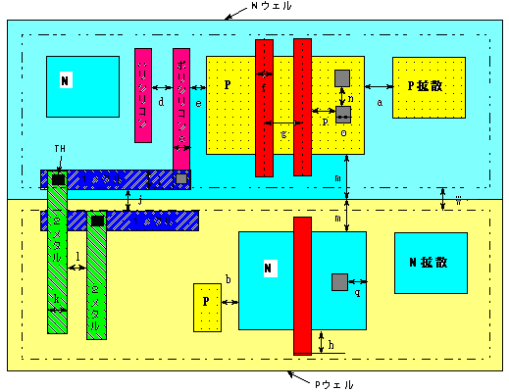
DRC
DRC is a step to eliminate violations against the design-rule.
22

Slide 23
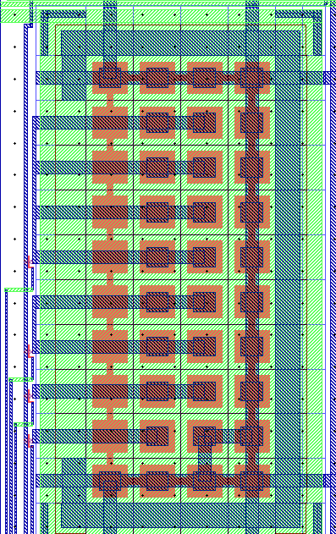
LVS
LVS is a step to verify conformance between the layout design and the SPICE netlist.
Extracted netlist
SPICE netlist
C79 VSS 16 1.99800E-13
C80 VSS 16 1.99800E-13
C81 VSS 16 1.99800E-13
C82 VSS 16 1.99800E-13
C83 VSS 17 1.99800E-13
C84 VSS 17 1.99800E-13
C85 VSS 18 1.99800E-13
C86 VSS 19 1.99800E-13
C87 VSS 16 1.99800E-13
C88 VSS 16 1.99800E-13
C89 VSS 16 1.99800E-13
C90 VSS 16 1.99800E-13
C91 VSS 17 1.99800E-13
C92 VSS 17 1.99800E-13
C93 VSS 18 1.99800E-13
CC1 RLO VM 2.69280E-16
CC2 RLO VDD 3.93420E-15
CC3 RLO AIN 7.99200E-16
CC4 RLO VSS 1.28943E-14
CC5 VM VDD 5.61180E-15
CC6 VM AIN 7.99200E-16
CC7 VM VSS 1.26425E-14
CC8 AIN VDD 4.84440E-15
CC9 AIN VSS 5.41248E-15
CC10 AIN 15 2.46144E-15
CC11 AIN 24 2.87500E-16
CC12 AOUT VDD 1.59840E-15
CC13 AOUT VSS 4.07737E-14
CC14 AOUT C0 2.36160E-16
CC15 AOUT C1 5.71680E-16
CC16 AOUT C2 5.71680E-16
CC17 AOUT C3 5.71680E-16
CC18 AOUT 13 1.20960E-15
CC19 AOUT 15 3.10768E-15
CC20 C0 VDD 6.27600E-16
CC21 C0 VSS 1.65874E-14
CC22 C0 C1 1.52280E-16
CC23 C0 C2 1.52280E-16
CC24 C0 C3 1.52280E-16
CC25 C1 VDD 6.27600E-16
CC26 C1 VSS 1.94140E-14
CC27 C1 C2 1.52280E-16
CC28 C1 C3 1.52280E-16
CC29 C2 VDD 6.27600E-16
CC30 C2 VSS 2.16160E-14
CC31 C2 C3 1.52280E-16
CC32 C3 VDD 6.27600E-16
CC33 C3 VSS 2.59496E-14
CC34 11 VDD 3.97345E-14
CC35 11 VSS 3.34900E-15
CC36 11 13 9.07200E-16
CC37 11 15 2.41920E-15
CC38 12 VDD 2.01848E-15
CC39 12 VSS 4.18735E-14
CC40 12 13 1.22085E-15
CC41 12 20 1.20960E-15
CC42 12 21 9.07200E-16
CC43 12 29 2.87500E-16
CC44 12 30 2.87500E-16
CC45 13 VDD 7.01411E-15
CC46 13 VSS 2.07688E-14
CC47 13 22 3.02400E-16
CC48 14 VDD 5.71456E-15
CC49 14 22 3.02400E-16
CC50 15 VDD 2.87840E-15
CC51 15 VSS 7.73580E-15
CC52 15 24 1.21120E-15
CC53 15 25 1.21120E-15
CC54 16 VDD 1.33974E-13
CC55 16 VSS 2.25064E-14
CC56 17 VDD 6.69872E-14
CC57 17 VSS 1.05768E-14
CC58 18 VDD 3.34936E-14
CC59 18 VSS 4.61200E-15
CC60 19 VDD 2.31392E-14
CC61 19 VSS 4.61200E-15
CC62 20 VSS 6.26770E-15
CC63 21 VSS 4.70260E-15
CC64 22 VDD 2.40430E-15
CC65 23 VDD 1.19240E-15
CC66 26 VSS 8.91600E-16
CC67 27 VSS 8.54000E-16
CC68 28 VSS 8.91600E-16
CC69 29 VSS 8.91600E-16
CC70 30 VSS 8.91600E-16
C0 N1 Vss 0.2pF
C1 N5 Vss 0.4pF
C2 N4 Vss 0.8pF
C3 N3 Vss 1.6pF
STRAY CAPACITANCE
If everything is OK, the sing-off condition is met.
23

Slide 24
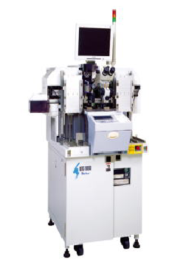
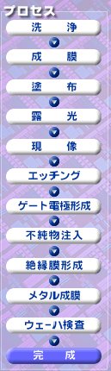

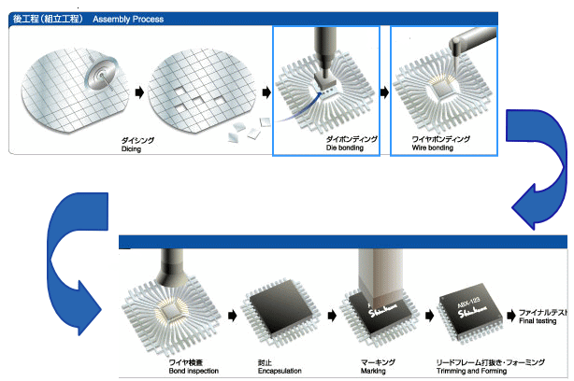
Silicon Process and Assembly
24

Slide 25

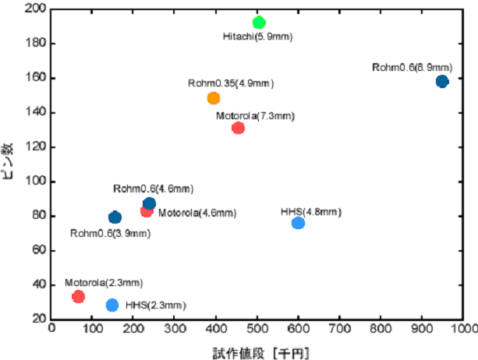
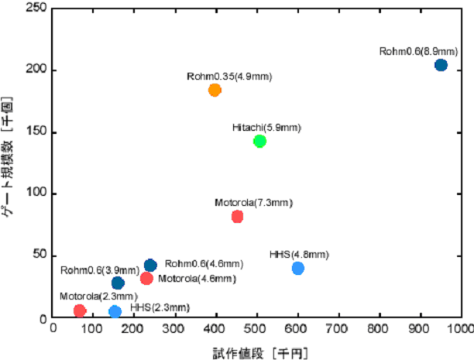


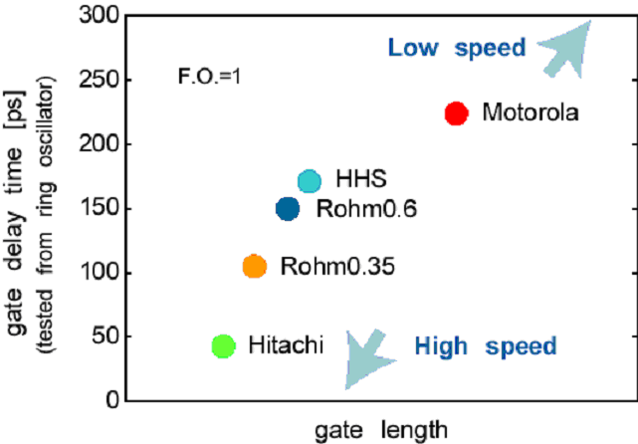
東京大学大規模集積システム設計教育研究センター
1.2um
25

Slide 26


Development of front-end IP
Front-end is a circuit directly connected to a radiation detector.
IP stands for Intellectual Properties; specifically reusable sub-circuit designs organized to be ready for migrated use.
From ASIC’s designed for special purpose
Multi-channel signal processing circuit for CdTe X-ray detector.
Timing/amplitude readout circuit for 3D pixel detector.
3) Digital readout circuit for HPD array device.
Reusable circuit blocks such as
1) Amplification elements
2) Reference circuits
3) Logic gates
4) I/O pads, and etc
are extracted for later use
The labor loads save in this approach are deployed for still unexplored circuit elements, which are applied for new circuit design.
26

Slide 27
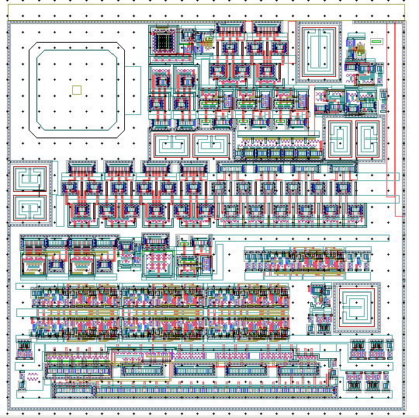
Pixel readout design in progress
In place of
Conclusion/summary
260μm by 260μm
Preamplifier
Shaping amplifier
CR-RC³
Peak-hold circuit
Comparator
Analog multiplexer
Trim-DAC/registers
27/E

Slide 28
以上
以下付録が２枚あります。

Slide 29
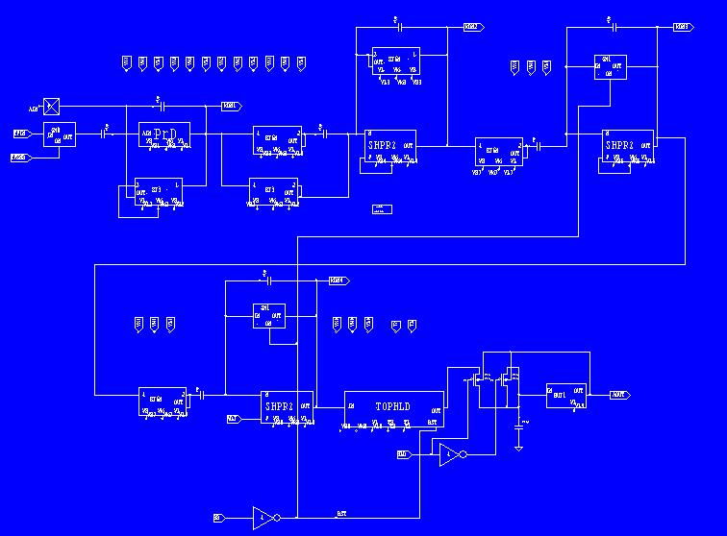
Preamplifier
Pole/zero
canceller
1st integrator
2nd integrator
3rd integrator
Peak-hold circuit

Slide 30
