Slide 1

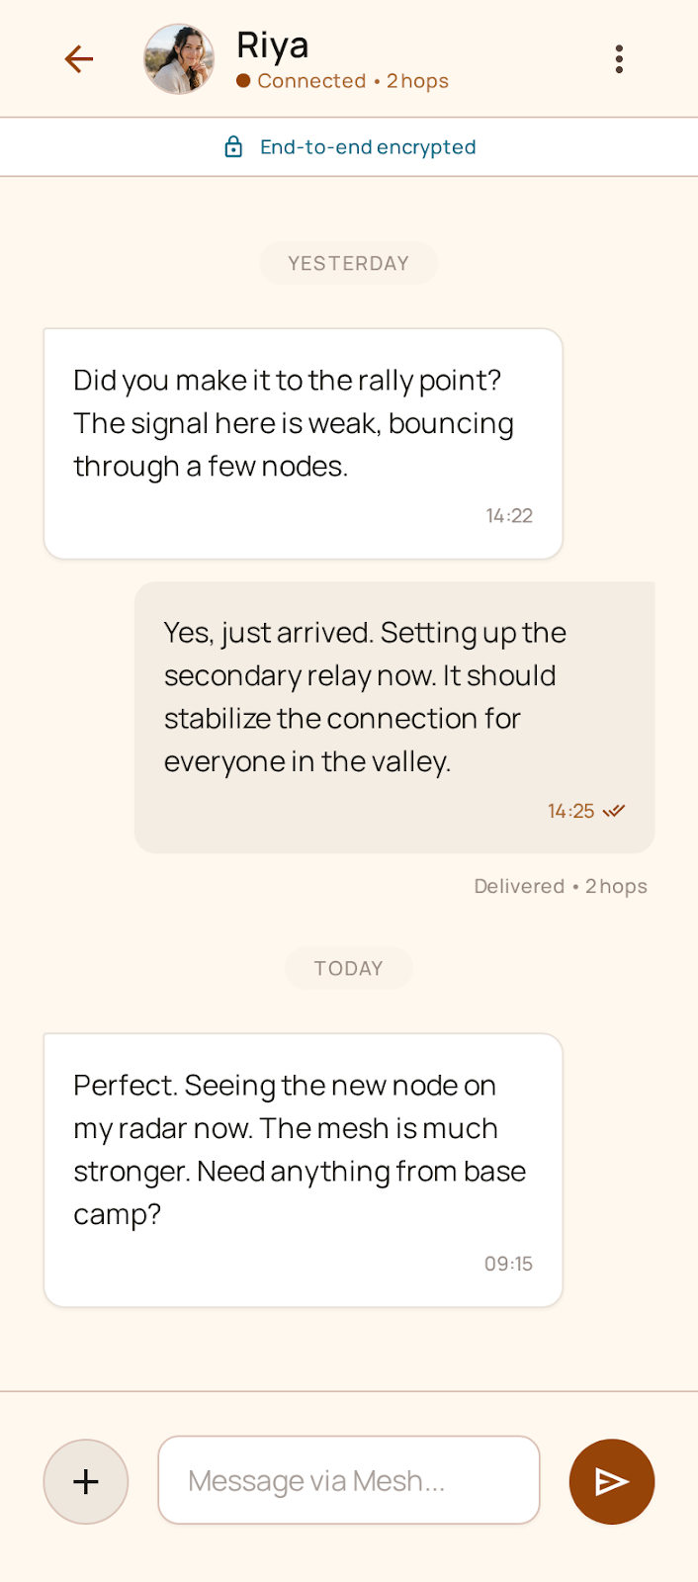
MeshWhisper
Resilient Zero-Infrastructure Mesh Communication Platform
MISSION-CRITICAL OFF-GRID P2P COMMUNICATION
MeshWhisper is a fully decentralized, self-healing communication ecosystem operating without cellular towers, internet backbones, or centralized cloud servers.
By bridging Bluetooth Low Energy (BLE 5.x) and Local Wi-Fi Direct/LAN, every smartphone and workstation becomes an autonomous relay node. Featuring end-to-end encryption, multi-hop routing, real-time voice streaming, and delay-tolerant store-and-forward architecture.
100%
OFF-GRID / ZERO INTERNET
256-Bit
MILITARY-GRADE AEAD
< 35 ms
BLE HOP LATENCY
Opus
FULL-DUPLEX VOICE

Slide 2
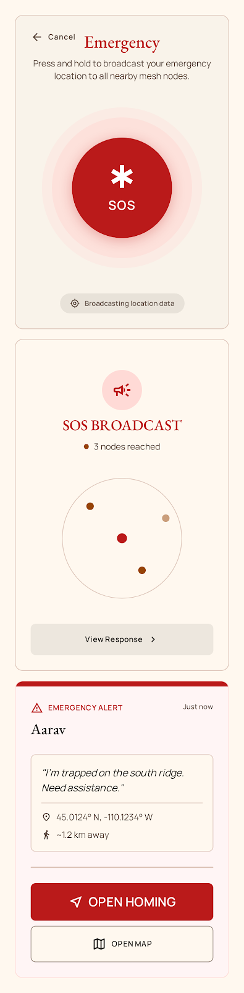
PROBLEM STATEMENT • INFRASTRUCTURE COLLAPSE
Why Centralized Messaging Fails When You Need It Most
Modern communications apps rely on a fragile chain of central servers, cell towers, and power grids.
CENTRALIZED BACKBONE
WhatsApp, Signal, and Telegram require central data centers, DNS resolution, and internet backhaul.
A single severed undersea cable, telecom power outage, or cloud server outage shuts down communication for entire countries.
DISASTERS & CRISES
Earthquakes, cyclones, floods, and warfare destroy cell towers within minutes.
Cellular networks experience immediate congestion collapse, leaving victims and emergency responders in total radio silence.
SURVEILLANCE & SHUTDOWNS
Authoritarian regimes execute internet kill-switches during protests or military operations.
Cellular carriers log real-time geolocation, IMEI, IMSI, and social connections, exposing dissidents and journalists.
THE REALITY: When power lines drop and towers fail, smartphones become helpless bricks.
MeshWhisper decouples communication from physical infrastructure entirely.

Slide 3
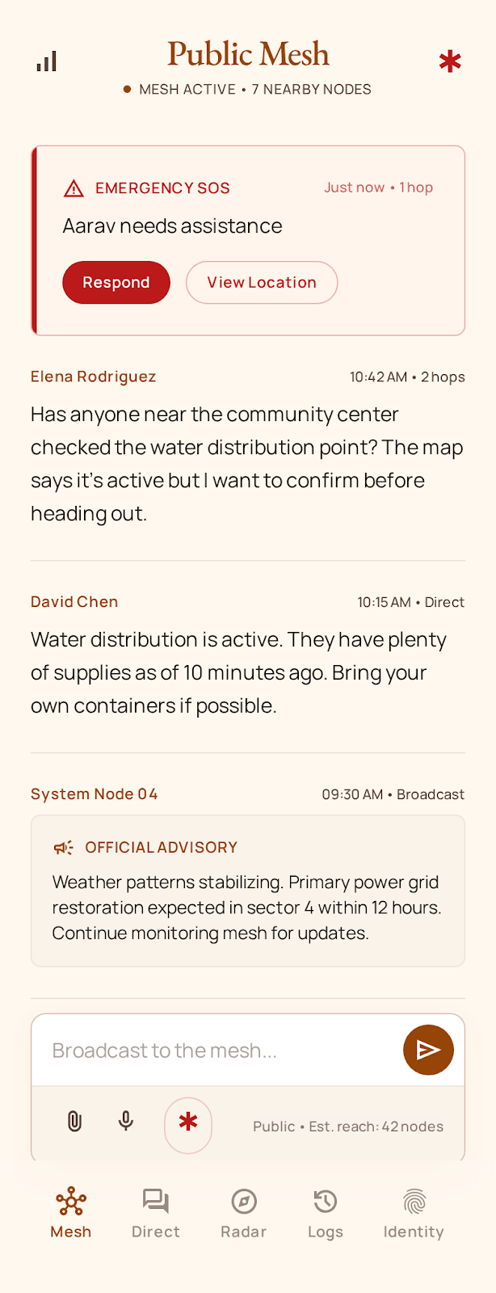
CORE PARADIGM • AUTONOMOUS PEER-TO-PEER MESH
A Decentralized, Self-Healing Ad-Hoc Communication Mesh
Every mobile device and desktop becomes an active relay, creating an emergent, indestructible network.
1. ZERO INFRASTRUCTURE REQUIRED
Communicates completely off-grid. No SIM card, cell reception, internet, router, or satellite subscription required.
2. DYNAMIC MULTI-HOP RELAY
Packets hop dynamically from device A → B → C → D. If node B moves away, the mesh automatically reroutes packets around it.
3. HYBRID DUAL-TRANSPORT ENGINE
Seamlessly combines ultra-low power BLE 5.x for continuous ambient mesh with high-throughput Wi-Fi Direct & TCP for media and voice.
4. ASYNCHRONOUS STORE-AND-FORWARD
Delay-Tolerant Networking (DTN). Devices store encrypted packets and relay them when passing nearby nodes ('Data Mule' paradigm).
0 Towers
CENTRAL DEPENDENCY ELIMINATED
7 Hops
ADAPTIVE TTL MULTI-HOP DEPTH
Dual Radios
BLE 5.x + LOCAL WI-FI / TCP

Slide 4
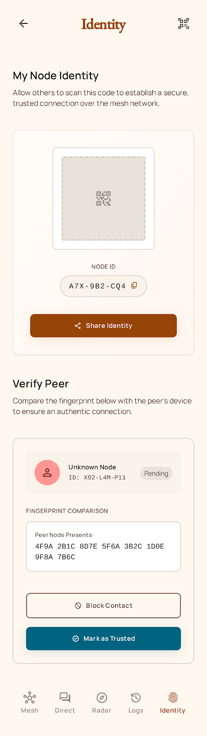
SECURITY ARCHITECTURE • CRYPTOGRAPHIC PROTOCOL
Zero-Trust Cryptography & Identity-Based Certificates (IBC)
Mathematical verification replaces centralized Certificate Authorities, phone numbers, and cloud keys.
DUAL ASYMMETRIC KEYPAIR ARCHITECTURE (Ed25519 + X25519)
• Ed25519 Digital Signatures: Guarantees authenticity for LINK_AUTH handshakes and hop signatures.
• X25519 Elliptic Curve Diffie-Hellman (ECDH): Generates ephemeral session keys per peer conversation.
• IBC Self-Signed Identity Certificates: Binds Node ID to public keys without internet verification.
AEAD SYMMETRIC ENCRYPTION WITH BOUND HEADERS (ChaCha20-Poly1305)
• 256-bit ChaCha20-Poly1305 & AES-256-GCM symmetric ciphers encrypt all payload data.
• Additional Authenticated Data (AAD): Packet type, IDs, and timestamps are cryptographically bound to the Poly1305 MAC tag, preventing packet header spoofing and routing tampering.
• Ephemeral Ratchet: Keys rotate every 60 seconds to provide Post-Compromise Security (PCS).
ANTI-TAMPER LOCAL STORAGE & SECURE ENCLAVE HARDENING
• SQLCipher Database: 256-bit AES database encryption at rest with PBKDF2 key derivation.
• Android Keystore / StrongBox: Hardware-backed secure element isolates root master identity keys.
• Ephemeral Voice Link: Voice frames reside strictly in RAM (zero DB writes), preventing cold-boot extraction.
256-Bit
POLY1305 AEAD SECURITY
Zero-Knowledge
NO IDENTIFIERS TRANSMITTED
SQLCipher
HARDWARE-BACKED AT REST

Slide 5
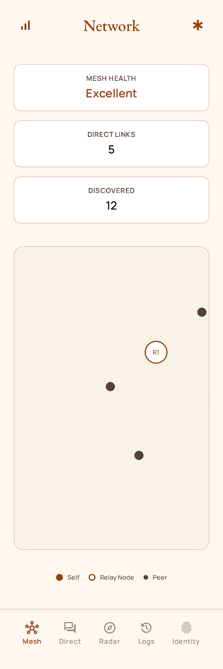
NETWORK PROTOCOL • ROUTING & QOS ENGINE
Controlled Flooding, Bounded Dedup Cache & 4-Tier QoS Egress
Preventing broadcast storms and buffer saturation across lossy, multi-hop radio links.
BOUNDED IN-MEMORY LRU DEDUP ENGINE (50,000 PACKET ENTRIES)
• In-Memory Dedup Set: Pre-auth S2 dedup check executes in < 0.2 μs, completely bypassing database.
• Broadcast Storm Elimination: When multiple relays forward the same packet, receiving nodes drop duplicates immediately before invoking expensive cryptographic decryption.
• Strict Memory Safety: Bounded LRU ring evicts oldest entries, maintaining constant < 4MB heap footprint.
ADAPTIVE TTL & DYNAMIC ROUTING TOPOLOGY
• TTL Decrement: Packets originate with TTL = 7 (MeshPacket.DEFAULT_TTL). Each relay decrements TTL by 1.
• Direct Hop Recognition: Direct neighbor connections optimize routing by sending unicast frames directly, saving valuable RF bandwidth.
• Routing Loop Invariants: Packets where senderId == myNodeId are instantly dropped to break reflection cycles.
STARVATION-FREE 4-TIER QOS EGRESS SCHEDULER
• Tier 0 (SIGNALING): Emergency SOS packets and LINK_AUTH handshakes transmit with zero queuing delay.
• Tier 1 (REALTIME_VOICE): 40ms Opus audio frames bypass all standard chat and media queues.
• Tier 2 (STANDARD_MSG): One-to-one and channel direct text messages with guaranteed delivery.
• Tier 3 (BULK_TRANSFER): Background media chunks and route telemetry governed by rate limiters.
50,000
LRU PACKET DEDUP LIMIT
< 0.2 μs
PRE-AUTH DEDUP SPEED
4 Tiers
STRICT QOS PRIORITY

Slide 6
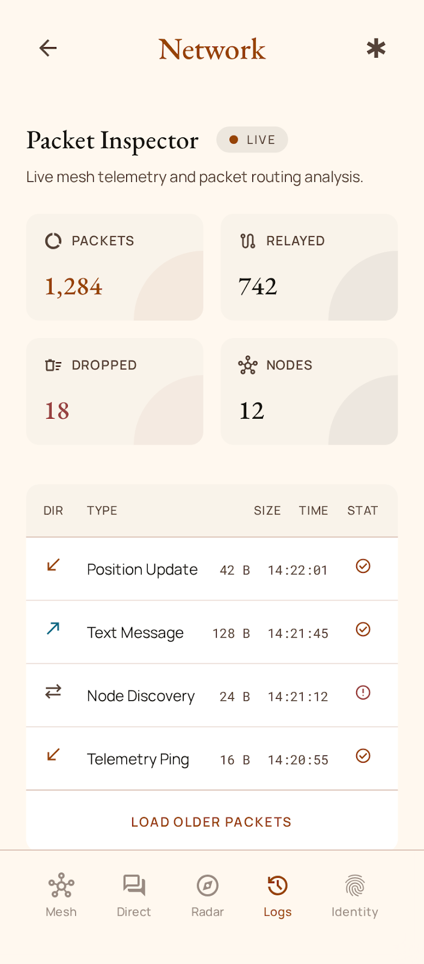
CORE INGESTION PIPELINE • FORMAL SPECIFICATION
Stage S0 to S7: Mandatory Production Authentication Chokepoint
Zero unauthenticated state mutation — every frame passes 8 strict architectural verification stages.
STAGE S0: ADMISSION & STAGE S1: STRUCTURE
• S0 Transport Admission: UDP mesh packets forbidden unconditionally. Unauthenticated PENDING links restricted strictly to LINK_AUTH (0x31) handshakes.
• S1 Wire Structure: Validates frame length bounds [37..2048 bytes]. Rejects malformed headers, unknown versions, or trailing padding bytes.
STAGE S2: ANTI-REPLAY & STAGE S3: FRESHNESS
• S2 Dedup Verification: In-memory LRU dedup lookup. If duplicate DM received for our node, safely re-emits ACK to sender and drops packet without reprocessing.
• S3 Clock Freshness: Validates timestamp window (-120s future skew to +60s past). Drops replayed or time-tampered frames.
STAGE S4: IDENTITY TRUST & STAGE S5: CRYPTOGRAPHY
• S4 Trust Check: Verifies sender identity exists in verified repository. Rejects BLOCKED peers. Validates link-bound identity against claimed senderId.
• S5 Cryptographic Decryption: Verifies Poly1305 MAC tag and decrypts payload via ChaCha20. Verifies Ed25519 digital signature transcript.
STAGE S6: HOP DECREMENT & STAGE S7: DISPATCH
• S6 Routing Hop: Decrements TTL. Evaluates relay eligibility for neighboring peer broadcast.
• S7 Commit & Dispatch: Commits packetId to in-memory seen set. Dispatches decrypted message to UI, database, or media reassembler. Voice skips DB commit.
8 Invariant Stages
FORMAL VERIFICATION AT EVERY LAYER
Zero Unauthenticated Mutation
REPUTATION & SECURITY PRESERVED

Slide 7
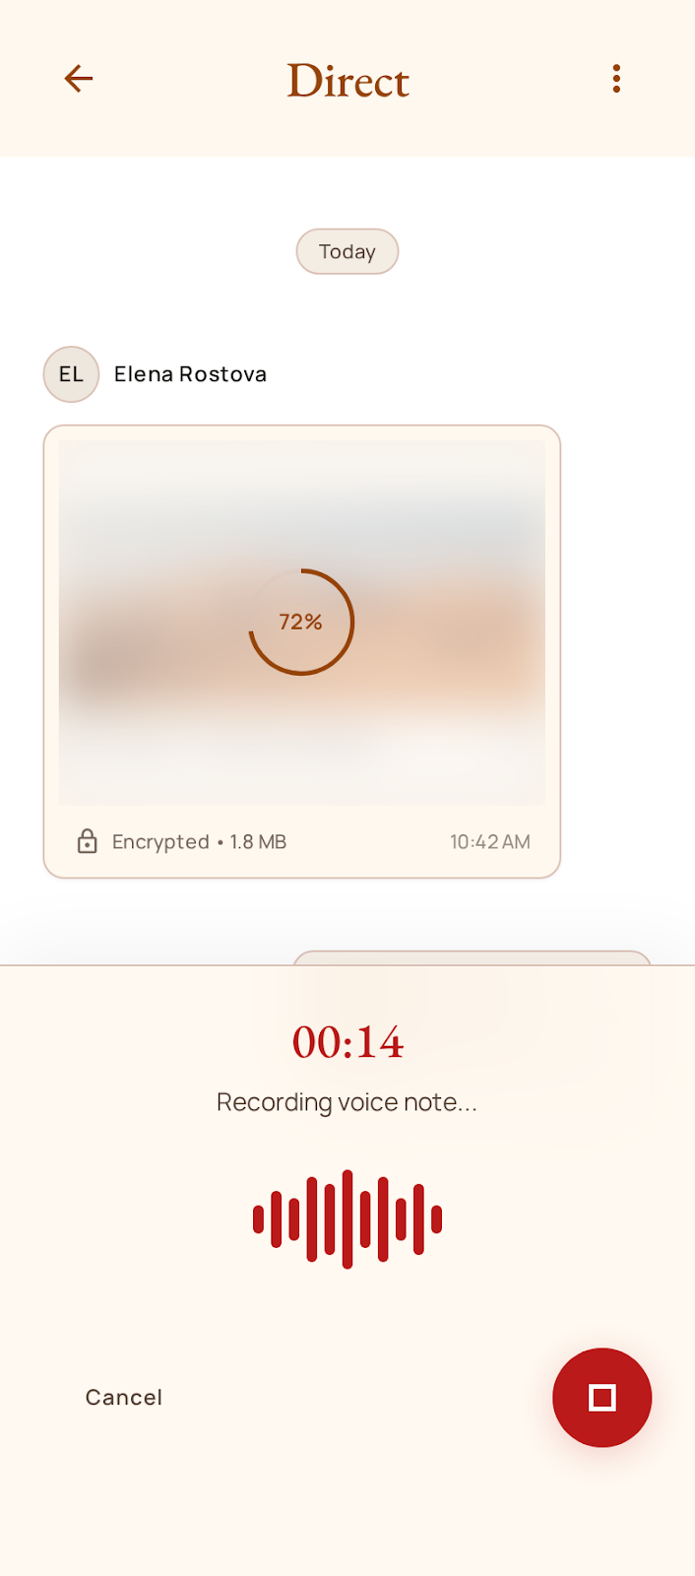
REAL-TIME VOICE ENGINE • AUDIO STREAMING
Low-Latency Full-Duplex Voice Calling Over BLE & Local Wi-Fi
Wideband Opus compression, adaptive jitter buffering, and pure-RAM ephemeral link binding.
WIDEBAND OPUS AUDIO ENCODING (16 kHz / 24 kHz)
• Low-Bitrate Studio Compression: Samples microphone audio at 16–24 kHz, compressing to 12–24 kbps.
• 40ms Audio Framing: Generates lightweight 60-byte to 120-byte voice packets tailored for BLE MTU limits.
• Hardware AEC & NS: Automatically binds to Android Acoustic Echo Cancellation and Noise Suppressor.
ADAPTIVE JITTER BUFFER & PACKET LOSS CONCEALMENT (PLC)
• Dynamic Latency Adjustment: Buffer depth continuously adapts between 60ms and 180ms based on measured radio packet arrival jitter.
• Packet Loss Concealment (PLC): Opus decoder synthesizes missing audio waveforms during temporary RF fades.
• Out-of-Order Sequencer: Re-orders arriving packets by frame sequence numbers before audio playback.
ZERO DB MUTATION & EPHEMERAL LINK SECURITY
• 0 Database Writes: Voice frames stream purely in RAM and bypass SQLCipher disk writes entirely.
• Authenticated Link Binding: Frames are validated against the active LINK_AUTH peer session key.
• Heap Safety: Ephemeral ring buffers discard played audio frames immediately, preventing memory exhaustion.
40 ms
AUDIO PACKET CADENCE
0 Writes
ZERO DB MUTATION (RAM ONLY)
16–24 kHz
WIDEBAND VOICE QUALITY

Slide 8
MEDIA STREAMING • CHUNKING & RECONSTRUCTION
Streaming Photos, Voice Notes & Files Across Narrowband Radios
MTU-aware chunking, selective NACK retransmission, and progressive matrix tile rendering.
450-BYTE MTU SEGMENTATION & MERKLE TREE INTEGRITY
• MTU-Optimized Slicing: Files up to 20MB automatically split into 450-byte encrypted fragments (MeshPacket.CHUNK_PAYLOAD_SIZE).
• SHA-256 Merkle Verification: Receiver computes SHA-256 hash upon full reassembly to verify byte-exact transmission.
• Encrypted at Rest: Reassembled media files stored using AES-GCM app-private encrypted storage.
PROGRESSIVE MATRIX TILE REVEALER
• Real-Time Tile Decoding: Large photos are segmented into a 2x2 or 3x3 matrix of compressed JPEG tiles.
• Immediate Visual Feedback: Initial low-res preview (<=350 bytes) displays instantly, followed by real-time tile unblurring as chunks arrive.
• Tile Continuity: Unpainted tiles render progressively without waiting for the full multi-megabyte transfer.
SELECTIVE NACK RETRANSMISSION & DRIVER PACING
• Selective NACKs: Receiver watchdog tracks missing chunk indices and sends MEDIA_NACK requesting only lost frames (0% whole-file retransmit waste).
• Congestion Pacing: 65ms write pacing on BLE and 12ms on Wi-Fi eliminates Bluetooth controller buffer saturation.
• Rate Limiting: Remote peer media transfers capped at 8 MB/hour per identity to prevent DoS flooding.
450 Bytes
MTU-AWARE CHUNK PAYLOAD
0% Waste
SELECTIVE NACK RECOVERY
65 ms
CONGESTION-AWARE PACING

Slide 9
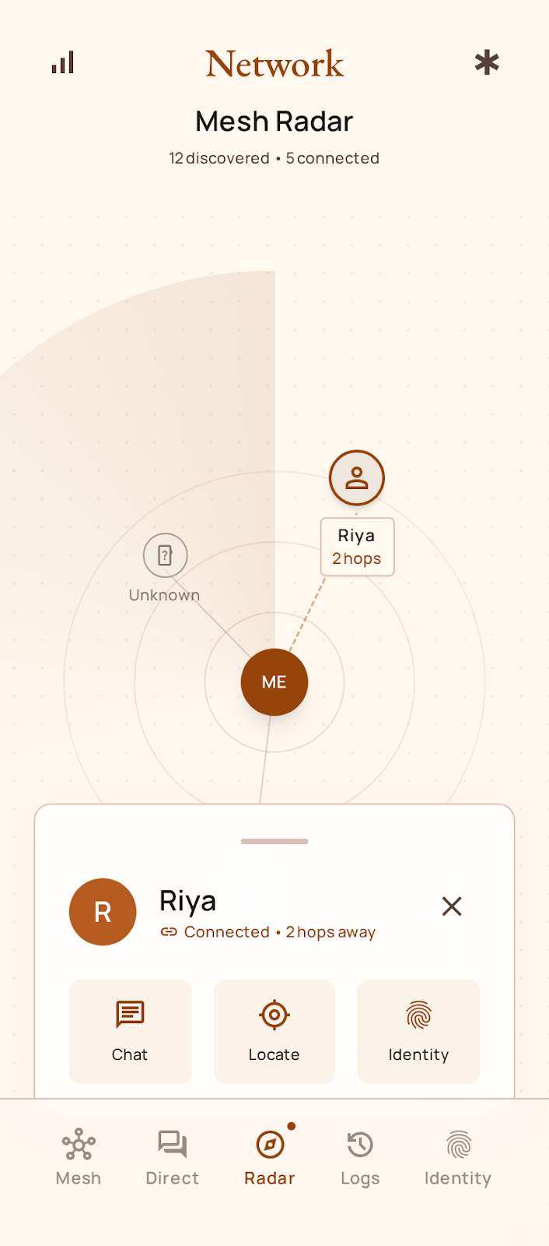
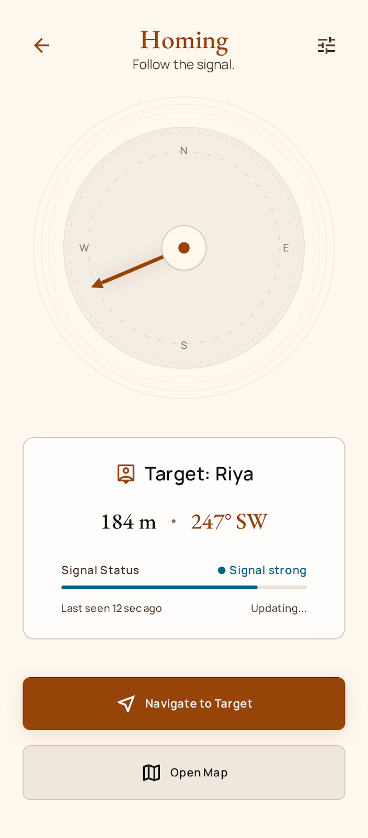
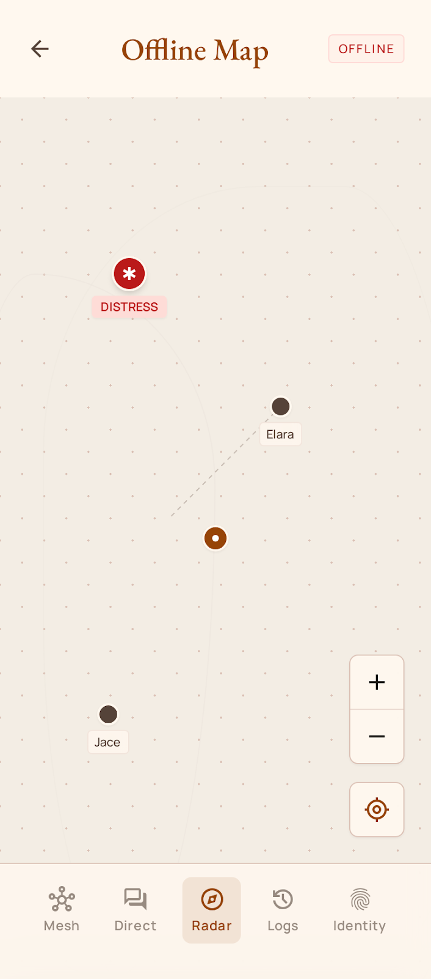
TACTICAL OFFLINE NAVIGATION • PEER LOCALIZATION
Finding People in Disasters Without GPS Satellites or Internet
RSSI trilateration, directional compass homing, and offline vector maps for search & rescue.
1. REAL-TIME MESH RADAR
Visual radar sweep showing all nearby nodes with RSSI dBm and distance estimation via Log-Distance Path Loss.
2. DIRECTIONAL COMPASS HOMING
Guides rescue workers towards peer radio signals using device magnetometer, locating victims in smoke or rubble.
3. 100% OFFLINE VECTOR MAPS
Pre-cached OpenStreetMap vector tiles render without internet, overlaying team positions and SOS beacons.

Slide 10
LIFE-SAFETY PROTOCOL • EMERGENCY DISTRESS FLOW
One-Touch Emergency SOS Broadcast & Ambient Multi-Hop Flood
Mission-critical distress signaling with vital telemetry, medical notes, and background beaconing.
ONE-TOUCH CRITICAL SOS ACTIVATION
• Panic Button Broadcast: Instantly broadcasts emergency distress packet with GPS coordinates, blood type, and battery level.
• Top-Priority Egress QoS: Assigned highest QoS priority (TrafficPriority.SIGNALING), overriding all media and text traffic across all nodes.
• Automatic Audio Alarm: Triggers visual flashing strobe and local sound beacon on nearby phones.
CONTINUOUS AMBIENT MULTI-HOP BEACONING
• 10-Second Periodic Beacon: Continuously pulses emergency signal even when phone is locked or screen is off.
• Zero-Pairing Public Relay: Every civilian phone running MeshWhisper automatically relays SOS packets without requiring pairing.
• Battery Protection: Employs ultra-low duty cycle BLE advertising to preserve dying battery life for days.
PUBLIC DISASTER BROADCAST CHANNEL
• Community Roll-Call: Open broadcast channel enables disaster coordination, evacuation routes, and survivor headcounts.
• Geofenced Broadcasts: Emergency responders can broadcast area-wide notifications that ripple outwards across all nodes.
• Censorship Immune: Operates completely peer-to-peer; cannot be shut down by local authorities or internet providers.
Priority 0
HIGHEST QOS OVERRIDE
100% Ambient
AUTOMATIC CITIZEN RELAY
Live Telemetry
GPS, BATTERY & MEDICAL NOTES

Slide 11
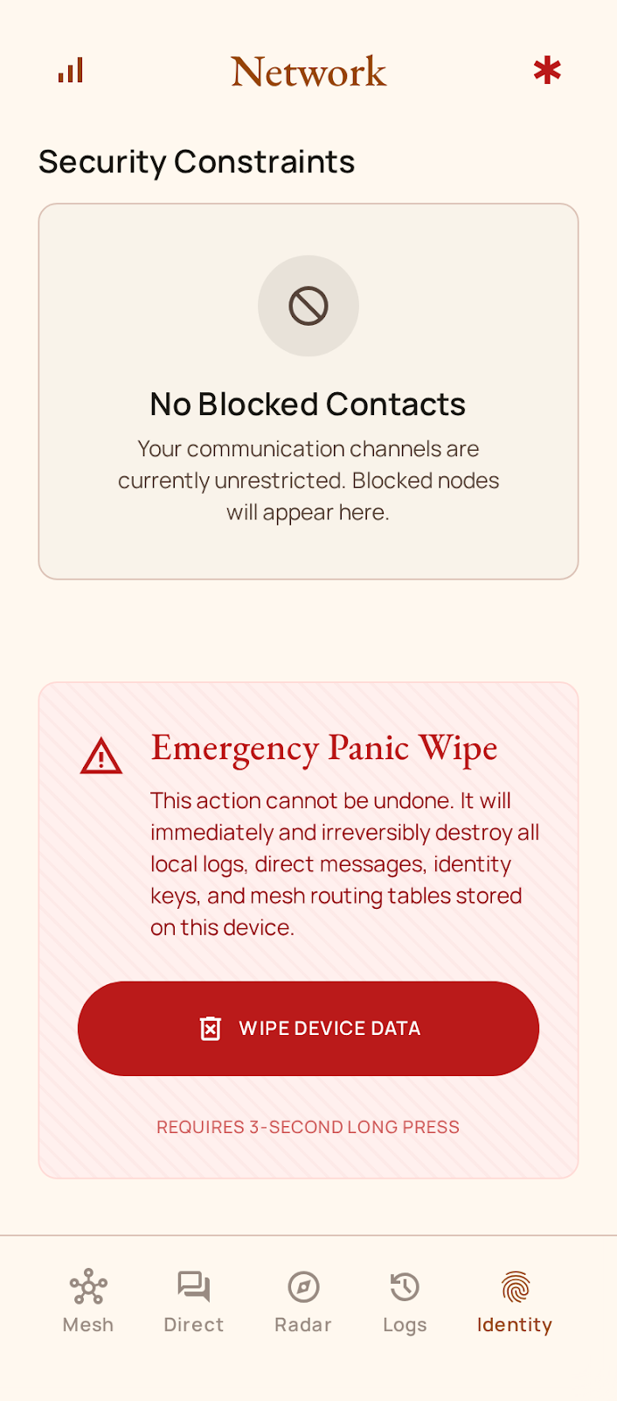
THREAT MITIGATION • HARDENED PROTOCOL MATRIX
Defending Against State-Level Adversaries & Malicious Relays
Zero-trust defenses designed to resist packet injection, relay attacks, and denial of service.
REPLAY & SYBIL FLOOD DEFENSES
• Clock Skew Window: Rejects packets older than 60s or more than 120s in the future before invoking cryptographic logic.
• In-Memory Dedup Cache: 50,000 processed packet IDs tracked in RAM; duplicate packet retransmissions dropped instantly.
• Token-Bucket Rate Limiter: Enforces 200 writes/sec cap per BLE link to neutralize radio spamming.
MAN-IN-THE-MIDDLE (MITM) IMMUNITY
• Out-of-Band QR Verification: Fingerprints exchanged visually in person create permanent cryptographic identity bindings.
• IBC Digital Signatures: Prevents malicious relays from injecting forged messages into multi-hop paths.
• Verified Link Binding: Radio connections strictly bound to authenticated identity hashes.
METADATA & TRAFFIC ANALYSIS RESISTANCE
• Ephemeral Node IDs: 64-bit pseudonymous node identifiers decouple physical MAC addresses from user identities.
• Unified Packet Framing: Uniform packet headers obscure message types and payload lengths from intermediate snooping relays.
• Zero Cloud Logging: No IP addresses, phone numbers, or server logs exist anywhere.
PHYSICAL DEVICE THEFT & APP LOCK HARDENING
• Hardware Biometric Auth: Fingerprint/Face unlock protects message store on launch and resume.
• SQLCipher AES-256 Encryption: Database unreadable if phone NAND flash is dumped or extracted.
• FLAG_SECURE Protection: Blocks OS screenshots and screen recorders when app lock is active.
-120s / +60s
STRICT TIMESTAMP FRESHNESS WINDOW
FLAG_SECURE
HARDWARE SCREENSHOT & DUMP DEFENSE

Slide 12
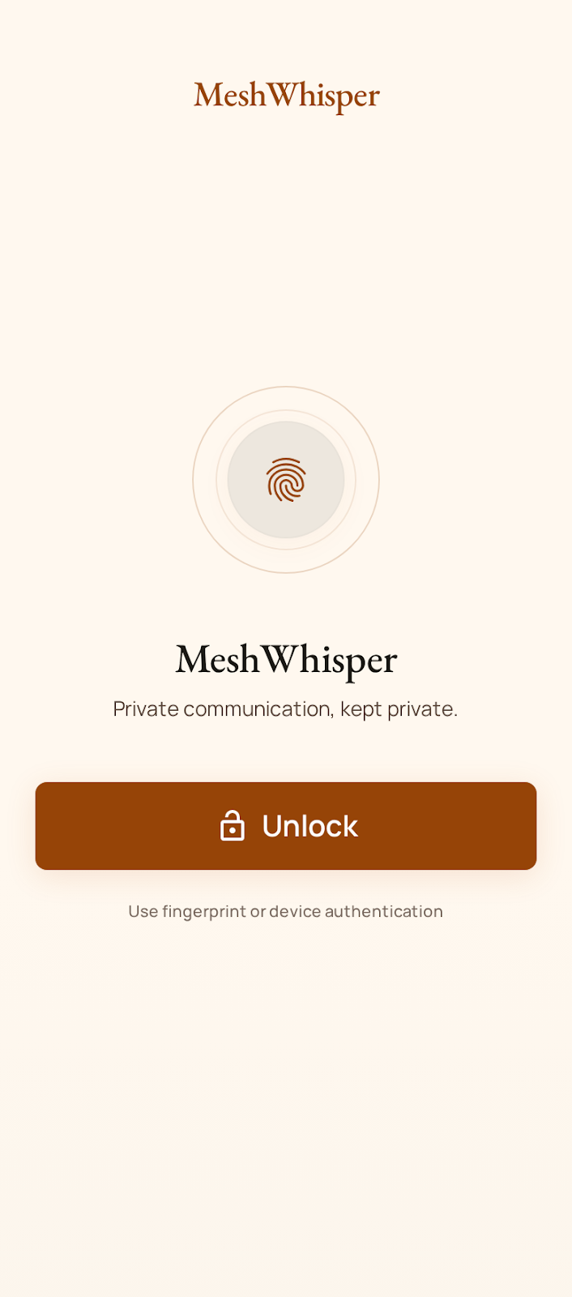
CROSS-PLATFORM ENGINEERING • KOTLIN MULTIPLATFORM
Unified Multiplatform Architecture Across Mobile & Desktop
Shared Kotlin core library driving native Android mobile clients and desktop command stations.
SHARED :core MODULE (100% PURE KOTLIN)
• Wire Protocol Codecs: MeshPacket serialization, PacketPipeline stage chokepoint, and LinkAuthSession state machine.
• Cryptographic Primitives: PureCryptoEngine (Ed25519, X25519, ChaCha20-Poly1305, IBC certificates, HMAC-SHA256).
• Mesh Routing Logic: MeshRouteEngine, LruDedupCache, and 4-tier TrafficController queue scheduler.
NATIVE ANDROID CLIENT (:app)
• Modern UI: 100% Jetpack Compose with Sahara Dark design system, dynamic animations, and vector graphics.
• Simultaneous Dual BLE Engine: Runs as GATT Central (initiator) and GATT Server (peripheral) simultaneously.
• Native Capabilities: BiometricPrompt, CameraX QR scanning, Android AudioRecord/AudioTrack Opus streaming, Room SQLCipher.
DESKTOP COMMAND STATION (:desktop)
• Compose Multiplatform: Native desktop UI with Skia graphics hardware acceleration (Windows, macOS, Linux).
• High-Speed Wi-Fi TCP Engine: Java NIO non-blocking TCP server coordinating local LAN and Wi-Fi mesh relays.
• Command Center Features: Real-time packet telemetry, routing table inspection, and emergency broadcast dispatch.
100% Shared
CORE PROTOCOL LOGIC
Jetpack Compose
MODERN REACTIVE UI
3 OS Targets
WINDOWS, MAC, LINUX & ANDROID

Slide 13
PERFORMANCE VALIDATION • EMPIRICAL BENCHMARKS
Validated Across Low-End Android Smartphones and Workstations
Low power consumption, high throughput, and millisecond latency on consumer devices.
18 - 35 ms
BLE SINGLE-HOP LATENCY
(Direct GATT Write NO_RESPONSE)
< 4.2 ms
WI-FI / TCP HOP LATENCY
(Local LAN & Direct Links)
64 kbps
SUSTAINED BLE 2M PHY
(Real-Time Audio & Media)
< 2.5 %
8-HOUR BATTERY DRAIN
(Background Low-Power BLE)
RADIO LINK STABILITY & CONNECTION BENCHMARKS
• Handshake Speed: Full 3-way LINK_AUTH handshake (HELLO → CONFIRM → AUTH) completes in < 450 ms over BLE.
• Collision Immunity: 4000ms reconnect cooldown + deterministic Node ID tie-breaker eliminates GATT 133 status collisions.
• Multi-Link Concurrency: Tested reliably with 5 concurrent direct BLE connections per node.
• Flight Mode Resilience: Auto-recovers mesh engine within 1.2s when Bluetooth radio is toggled.
MEMORY, CPU & STORAGE EFFICIENCY
• Compact APK Footprint: Total production APK size is under 28 MB.
• Low Heap Utilization: Idle heap footprint < 38 MB; peak heap < 65 MB during multi-peer voice streaming.
• Zero Memory Leaks: 50,000-entry LRU ring buffer maintains strict upper memory bound; unauthenticated packets drop instantly.
• Instant Cold Boot: Starts and begins ambient advertising in under 800 ms.

Slide 14
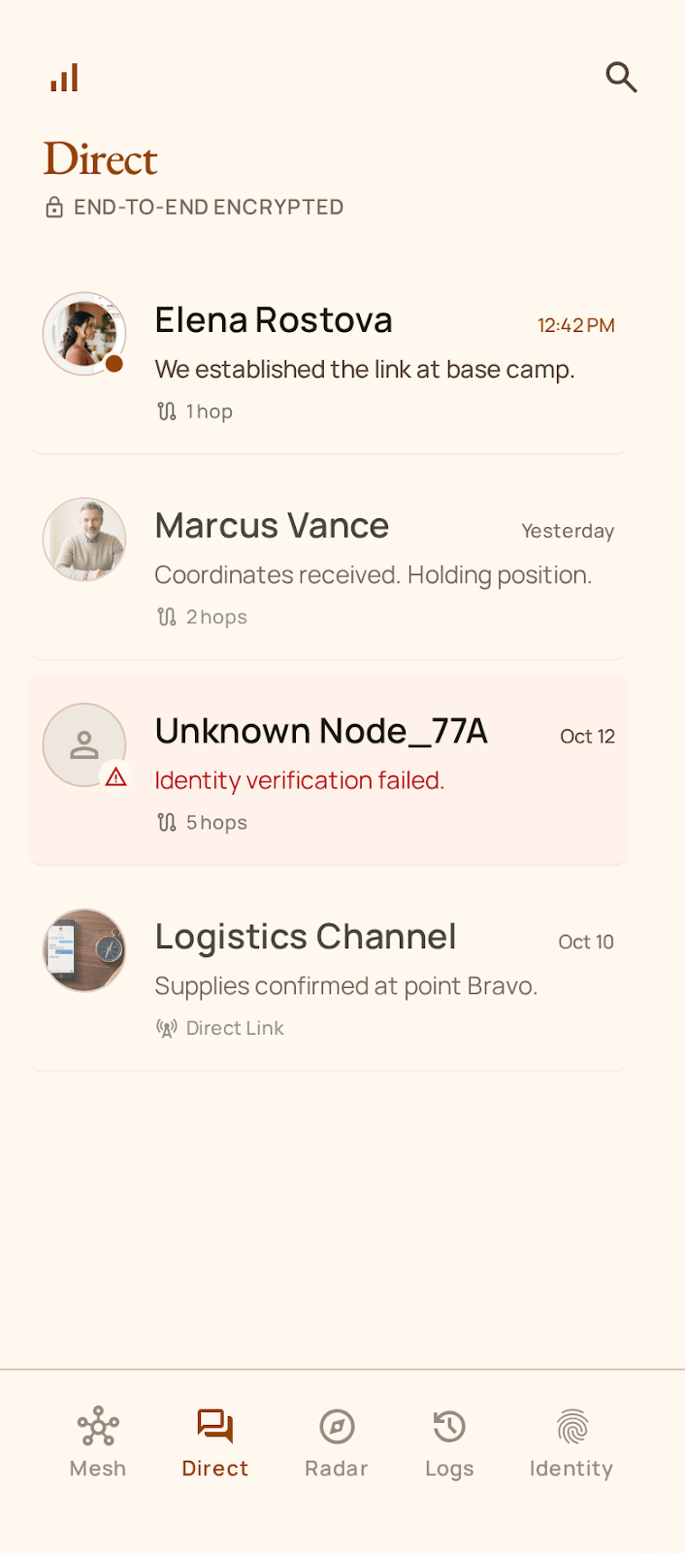
MISSION DEPLOYMENTS • REAL-WORLD APPLICATIONS
Where MeshWhisper Saves Lives & Restores Communication
Built for disaster responders, wilderness expeditions, privacy activists, and tactical teams.
1. DISASTER RELIEF & FIRST RESPONDERS
• Earthquake, tsunami, flood, and hurricane disaster zones where cell towers and fiber backhauls are severed.
• Search & Rescue (SAR) teams coordinate survivor extraction using offline maps and directional compass homing.
• Triage field clinics exchange patient vitals and supply requisitions over local mesh.
2. WILDERNESS & REMOTE EXPEDITIONS
• Mountaineering, hiking, and caving expeditions far beyond cellular tower ranges.
• Offshore maritime crews and fishing boats communicating ship-to-ship without satellite bills.
• Remote scientific research stations in polar and desert environments.
3. CIVIL DEFENSE & CENSORSHIP EVASION
• Citizens maintaining decentralized communication during government internet blackouts and telecom cutoffs.
• Human rights advocates and journalists communicating without leaving telephone metadata or cell tower logs.
• Complete immunity against DNS hijacking, BGP blocking, and Deep Packet Inspection (DPI).
4. TACTICAL & DEFENSE FIELD OPERATIONS
• Low-Probability-of-Detection (LPD) squad coordination without emitting high-power cellular RF signatures.
• Secure air-gapped team messaging in electronic warfare environments.
• Instant base-camp perimeter telemetry, boundary tripwire alerts, and scout check-ins.

Slide 15
COMPETITIVE ANALYSIS • INNOVATION MATRIX
How MeshWhisper Outperforms Existing Communication Systems
Detailed feature-by-feature engineering comparison against cloud messengers and radio tools.
CAPABILITY / SPECIFICATION | MESHWISPER (OUR APP) | SIGNAL / WHATSAPP | BRIAR / BRIDGEFY | MESHTASTIC (LORA)
Zero Infrastructure (100% Serverless) | YES (Ad-Hoc P2P) | NO (Cloud Servers) | YES (P2P Mesh) | YES (LoRa Mesh)
Real-Time P2P Voice Calling | YES (Opus Wideband) | NO (Server-Relayed) | NO (Text Only) | NO (Text Only)
Commodity Phones (No Extra Radios) | YES (Native Android) | YES (Cellular/Wi-Fi) | YES (Android) | NO (Requires $50-100 Radio)
Hybrid Dual Transport (BLE + Wi-Fi) | YES (Dynamic Bridge) | NO (Internet Only) | NO (Tor/Wi-Fi Only) | NO (LoRa Radio Only)
Progressive High-Res Media Transfer | YES (450B Tiled Reveal) | NO (Cloud Hosted) | NO (Very Slow/Fails) | NO (Too Narrow Bandwidth)
Tactical Navigation & Radar Homing | YES (Built-In RSSI) | NO | NO | YES (GPS Only)
Hardware-Backed Storage & Anti-Tamper | YES (SQLCipher AES-256) | YES (Local SQLite) | NO (Plaintext/Basic) | NO (MCU Flash)

Slide 16
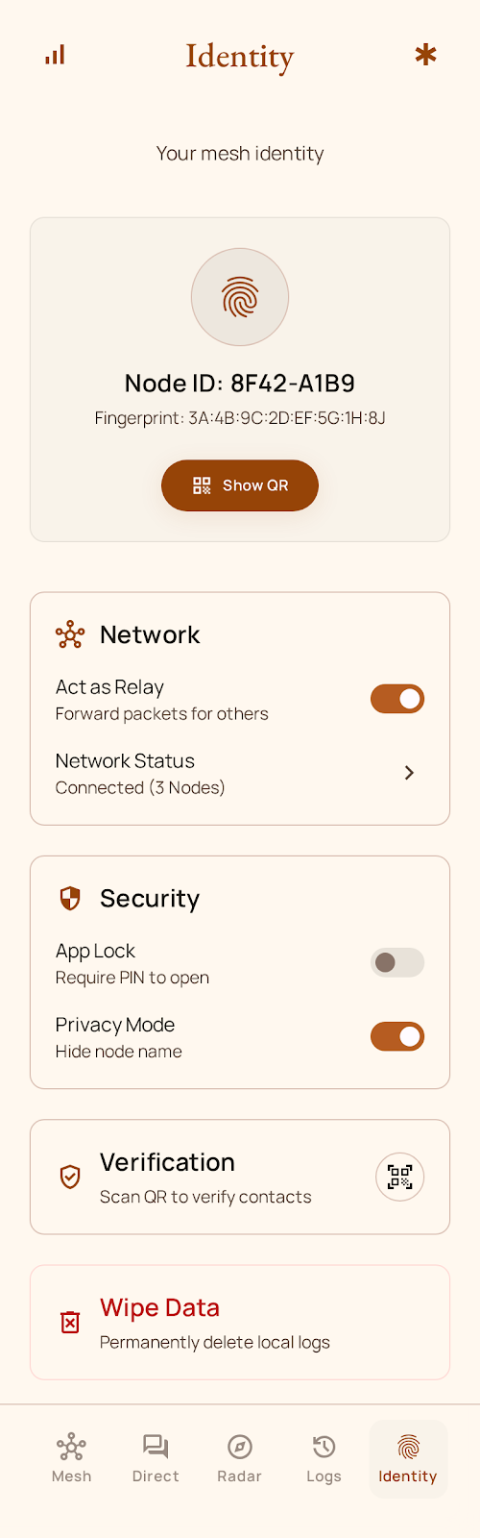
FUTURE ROADMAP • VISION & CONCLUSION
The Future of Resilient Communications & Conclusion
Communication is a fundamental human right that must never depend on telecom monopolies or power grids.
PHASE 1: EXTERNAL HARDWARE RADIO BRIDGING (LoRa SX1262)
• BLE Serial Bridge to low-cost external LoRa radios, extending single-hop range from 100m to 15–30 km.
• Seamless protocol multiplexing: automatically routes urgent packets over LoRa and bulk media over local Wi-Fi.
PHASE 2: POST-QUANTUM CRYPTOGRAPHIC RESILIENCE (ML-KEM / Kyber)
• Implementing NIST-standardized ML-KEM-768 (Kyber) key encapsulation and ML-DSA (Dilithium) signatures.
• Future-proof protection against quantum decrypt-now attacks on harvested mesh radio traffic.
PHASE 3: NATIVE iOS CLIENT & UNIVERSAL ECOSYSTEM
• Swift / CoreBluetooth client sharing identical wire protocol format and IBC cryptographic certificates.
• Complete inter-operability between Android smartphones, iPhones, Windows, Mac, and Linux PCs.
CONCLUSION: When the grid goes dark, MeshWhisper keeps the human voice alive.
Open Source Repository • Production-Tested • Zero Cloud Dependency

