Slide 1
Model building and exploration of Cerebral Vasoregulation in Elderly with Stroke (cves) dataset
Gintare Bucaite gintare.bucaite@kcl.ac.uk
April 2019

Slide 2
Background
Ischaemic strokes are caused by blockages which cut off the blood supply to parts of the brain.
There are more than 100,000 strokes in the UK each year.
Stroke is the fourth biggest killer in the UK.
Risk factors include: hypertension (high blood pressure), high blood cholesterol, diabetes (type 2), being overweight, smoking, alcohol consumption, drug use and lack of physical exercise.

Slide 3
CVES study
Dataset containing multimodal data from a large study investigating the effects of ischemic stroke on cerebral vasoregulation.
60 subjects who suffered strokes and 60 control subjects.
Here, the dataset was used to train a linear regression model to predict whether patient has suffered stroke

Slide 4
Visual exploratory data analysis
Visualise some of high risk factors (hypertension and high cholesterol) recorded in the dataset and associated with stroke.

Slide 5
Data preprocessing for model building
Missing values were filled with the mean of the column df.apply(lambda x: x.fillna(x.mean()),axis=0)
Highly correlated features were removed by filtering df.corr().abs() with a set threshold (0.7).
Categorical features were encoded pd.get_dummies(df)

Slide 6
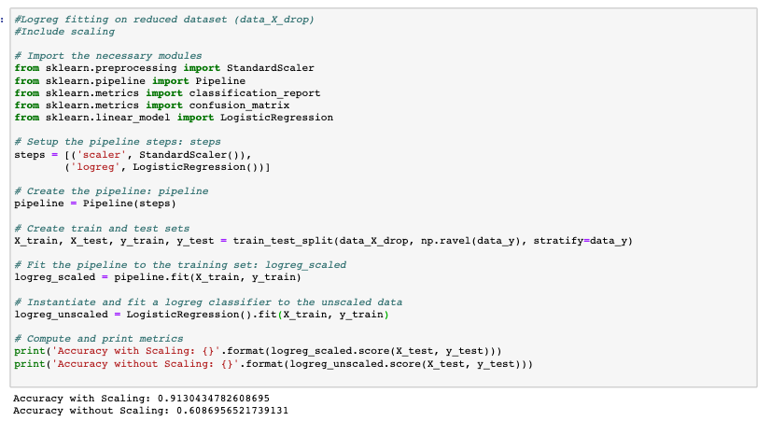
LinearRegression() model performance

