Slide 1
Enhancing Security in RESTful APIs through Modern Tools and Techniques
Ginu George Karippaparambil
22563889

Slide 2
Agenda
INTRODUCTION
LITERATURE REVIEW
PROBLEM
PROPOSED METHODOLOGY
RESULTS
COMPARISON
CONCLUSION

Slide 3
INTRODUCTION
RESTful APIs are fundamental to modern application architecture.
APIs (Application Programming Interfaces), particularly RESTful APIs, are vital to modern software systems,
enabling seamless communication and data exchange between applications, devices, and services.
However, the growing reliance on APIs also introduces significant security risks, making it essential to implement proactive measures to protect sensitive data and ensure system integrity.
APIs expose security vulnerabilities that need to be addressed.
This dissertation explores contemporary methods and tools to enhance API security.
The extensive use of APIs exposes digital systems to serious security threats, which must be addressed to protect sensitive data and ensure reliable services. Key challenges include:
Unauthorized Access: Exploiting API vulnerabilities to access sensitive data without permission.
Injection Attacks: Using methods like SQL injection and XSS to run malicious code and cause data breaches.
Data Leakage: Weak security measures can lead to accidental exposure of confidential information.
Denial-of-Service (DoS) Attacks: Overloading systems to disrupt services and damage user trust.
These challenges highlight the urgent need for robust API security measures to safeguard digital infrastructure.

Slide 4
INTRODUCTION KEY INSIGHT CONTINUES…….
This dissertation explores a comprehensive strategy to improve RESTful API security through modern tools, techniques, and best practices:
1. Authentication and Authorization:
Analyzes secure access controls using API keys, OAuth, and JWTs to prevent unauthorized access.
2. Encryption Practices:
Focuses on using Transport Layer Security (TLS) to protect data during transmission and compares encryption methods to identify the most effective strategies.
3. API Gateway Solutions:
Assesses tools like Kong, Apigee, and AWS API Gateway for features such as rate limiting and authentication, which help secure API operations.
4. Web Application Firewalls (WAFs):
Provides a defensive layer against attacks and utilizes real-time monitoring tools like Prometheus and Grafana for proactive threat detection and alerting.
5. DevSecOps Integration:
Embeds security into the development process from the start, promoting continuous assessment and improvement.
6. Documentation and Versioning:
Stresses the importance of clear and current API documentation to prevent security lapses and keep developers informed of changes and vulnerabilities.

Slide 5
Literature Review
API Security Challenges:
Unauthorized access
Data breaches
Injection attacks (e.g., SQLi, XSS)
Denial of Service (DoS) attacks
Common Best Practices:
Strong authentication and authorization (OAuth, JWT)
Encryption and data integrity (TLS)

Slide 6
Literature Review
Security Technologies:
API Gateways (e.g., Kong, AWS API Gateway)
Web Application Firewalls (WAFs)
Monitoring tools (Prometheus, Grafana)
DevSecOps practices for automated security testing

Slide 7
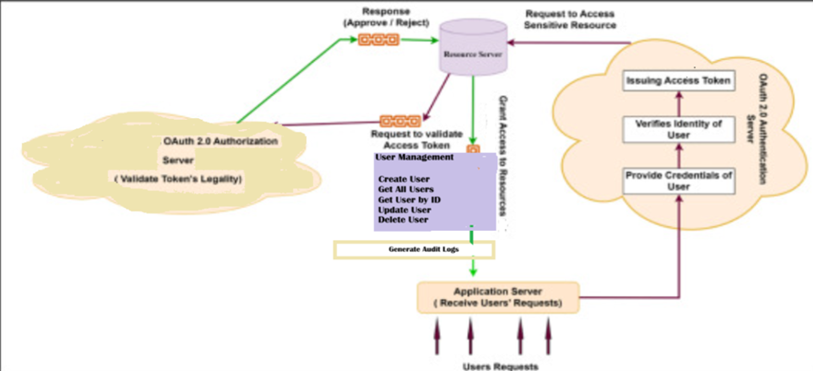
Existing ImplemenTATION -User Management

Slide 8
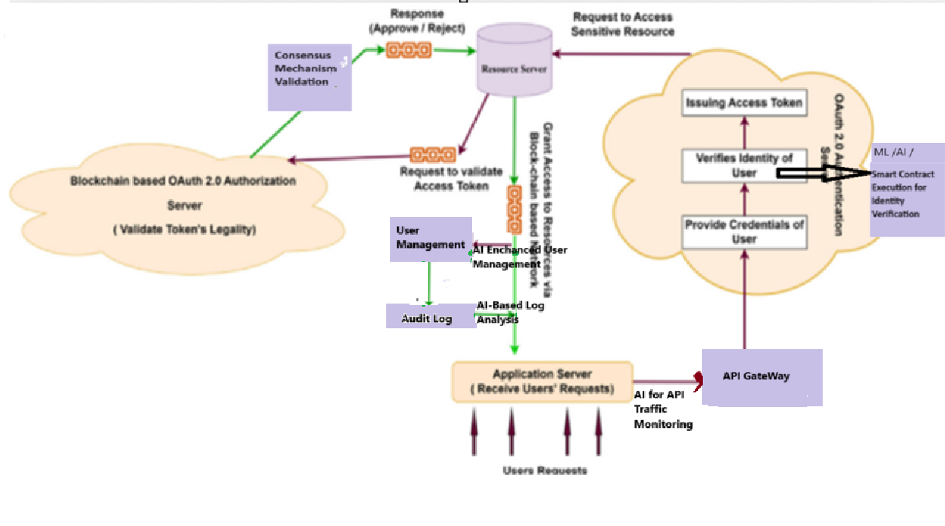
Proposed Methodology

Slide 9
ACCESS CONTROL
Access Control mechanisms
Role-Based Access Control (RBAC) assigns access based on roles, like "Admin" or "User." Each role has specific permissions, ensuring users only access what they need, which simplifies management and reduces security risks.
Attribute-Based Access Control (ABAC) uses attributes like user role, location, or time to control access dynamically. This approach allows more flexible and detailed permissions, adapting to different contexts.
RBAC is great for simple, structured setups, while ABAC offers more control in complex environments. Both help secure APIs by managing who can do what, protecting data, and preventing unauthorized access.

Slide 10
Modern Security Tools
API Gateways:
Web Application Firewalls (WAFs):
DevSecOps:

Slide 11
API Gateways
Aspect | Kong | Apigee | AWS API Gateway
Introduction | Open-source, highly flexible, supports plugins for customization. | Enterprise-grade, robust management platform from Google Cloud. | Fully managed, integrated with AWS ecosystem.
Features | Authentication, rate limiting, caching, custom plugins. | Advanced analytics, authentication, rate limiting, monetization options. | Authentication, rate limiting, caching, AWS integration.
Strengths | Great for microservices, supports Kubernetes, high scalability. | Ideal for large enterprises needing deep insights and control. | Best for AWS-centric applications, seamless AWS service integration.
Use Cases | Microservices, cloud-native apps, flexible deployments. | Large organizations, complex API management, compliance-focused. | Scalable cloud apps, AWS infrastructure-heavy environments
Benefits | Centralized API management, enhanced security, performance optimization. | Centralized control, detailed analytics, security enforcement. | Centralized API control, robust scaling, security through AWS tools.
Threat Mitigation | Mitigates DoS via rate limiting; prevents unauthorized access with plugins. | Blocks unauthorized access, mitigates DoS with throttling, monitors threats. | Manages DoS with rate limiting, throttles traffic, secures APIs with AWS WAF.

Slide 12
Web Application Firewalls (WAFs)
How WAFs Protect APIs from Common Web Attacks
SQL Injection (SQLi):
WAFs detect and block malicious SQL queries embedded in API requests by
analyzing patterns and looking for
SQL keywords that indicate an injection attempt. This prevents unauthorized
database access and manipulation.
Cross-Site Scripting (XSS):
WAFs scan API traffic for harmful scripts that could be injected into responses
and block them before they reach the user, safeguarding against the execution of malicious
code.

Slide 13
Types of WAFs
Rule-Based WAFs:
These operate on predefined rules and signatures to identify and block known attack patterns.
They are reliable in detecting attacks with low false positive rates but require regular updates to stay effective against emerging threats.
Machine Learning-Based WAFs:
These WAFs adapt to new threats by learning from traffic patterns and detecting anomalies.
They offer better protection against zero-day attacks but are more complex to maintain and can generate higher false positives if not properly tuned.

Slide 14
Integration with API Gateways
WAFs can be deployed alongside API gateways to enhance security.
While the gateway manages traffic and applies rate limits, the WAF filters incoming requests for malicious content.
This combination provides comprehensive protection by addressing both traffic management and deep packet inspection.

Slide 15
Examples of WAFs in Action
ModSecurity:
Often used with API gateways like Nginx, ModSecurity effectively blocks SQLi and XSS attacks by filtering and monitoring HTTP requests.
Cloudflare WAF:
Integrated with Cloudflare’s CDN, this WAF has mitigated numerous large-scale DDoS attacks, protecting APIs from overwhelming traffic and malicious requests by using both rule-based and machine learning techniques

Slide 16
DevSecOps Practices
DevSecOps integrates security into every stage of the development process,
shifting security considerations to the left from the design phase through deployment.
This approach embeds security checks and assessments throughout the CI/CD pipeline,
reducing vulnerabilities early on and fostering a culture of continuous security
improvement within development teams .
Automated Security Testing
Automated security testing includes tools like Static Application Security Testing (SAST) and
Dynamic Application Security Testing (DAST).
SAST analyzes code for vulnerabilities before it’s run, while DAST tests the application during execution to find runtime flaws.
These tools help identify security issues early in the development lifecycle, allowing teams to address vulnerabilities before they reach production .

Slide 17
Continuous Monitoring
Continuous monitoring involves real-time tracking of API behavior to detect and respond to security threats as they arise. Tools like Prometheus, Grafana, and ELK Stack enable developers to visualize and analyze API performance, detect anomalies, and respond to incidents swiftly, ensuring the continuous security and availability of services .
Details: Case Studies of DevSecOps in Action
One case study highlights the implementation of DevSecOps in a RESTful User Management API, utilizing tools like JWT-based authentication, RBAC for authorization, audit logging, and TLS encryption.
This approach ensured secure user management, minimized vulnerabilities, and provided a robust framework for API security .
These practices illustrate the effectiveness of integrating security into development, using automated tools, and maintaining vigilance through continuous monitoring to enhance API security.

Slide 18
Case Study 1: Implementing API Security
Below the endpoints created for the web service implementation with CRUD operations,
RBAC, JWT authentication, and audit logging:
Web Service Functionality
Create User (POST /users): Admins can add new users.
Update User (PUT /users/{id}): Admins can modify existing users.
Delete User (DELETE /users/{id}): Admins can remove users.
Fetch All Users (GET /users): Admins and regular users can view all users.
Fetch User by ID (GET /users/{id}): Admins and regular users can view details of a specific user.

Slide 19
Implementing API Security CONTINUES…..
Security Features
JWT-Based Authentication:
Users authenticate with their credentials and receive a JWT token.
The JWT token is sent with each request to verify user identity and role.
Role-Based Access Control (RBAC):
ADMIN_ROLE: Can perform all operations (create, update, delete, and view users).
USER_ROLE: Can only view users and their details.
TLS Encryption:
All communication between the client and server is encrypted using TLS, ensuring data security during transmission.

Slide 20
Implementing API Security CONTINUES…..
Audit and Error Logging
Audit Logs:
Each action (create, update, delete, fetch) performed by a user is logged in the database.
Logs include user ID, action type, timestamp, and the resource affected, providing traceability for accountability and security analysis.
Error Logging:
A separate log file captures all operational errors and exceptions.
This helps in diagnosing issues and maintaining a record of application behavior for future reference.

Slide 21
How the System Works
User Login: User logs in, and the server issues a JWT token.
Request Handling: Each request to an endpoint includes the JWT token for authentication.
Role Verification: The server checks the token to determine the user’s role and grants or denies access to the requested operation based on RBAC.
Operation Execution: If authorized, the requested operation (create, update, delete, fetch) is executed.
Logging: Every action is logged in the audit logs (database) and error log file (if applicable).

Slide 22
Key Benefits
Security: TLS and JWT provide strong security measures for data transmission and access control.
Control: RBAC ensures users can only perform actions allowed by their roles, protecting sensitive operations.
Accountability: Audit logs provide a detailed record of user activities, enhancing monitoring and compliance.
This setup provides a robust, secure, and well-monitored user management system suitable for maintaining high standards of security and operational efficiency. Let me know if you need further details or a visual representation!

Slide 23
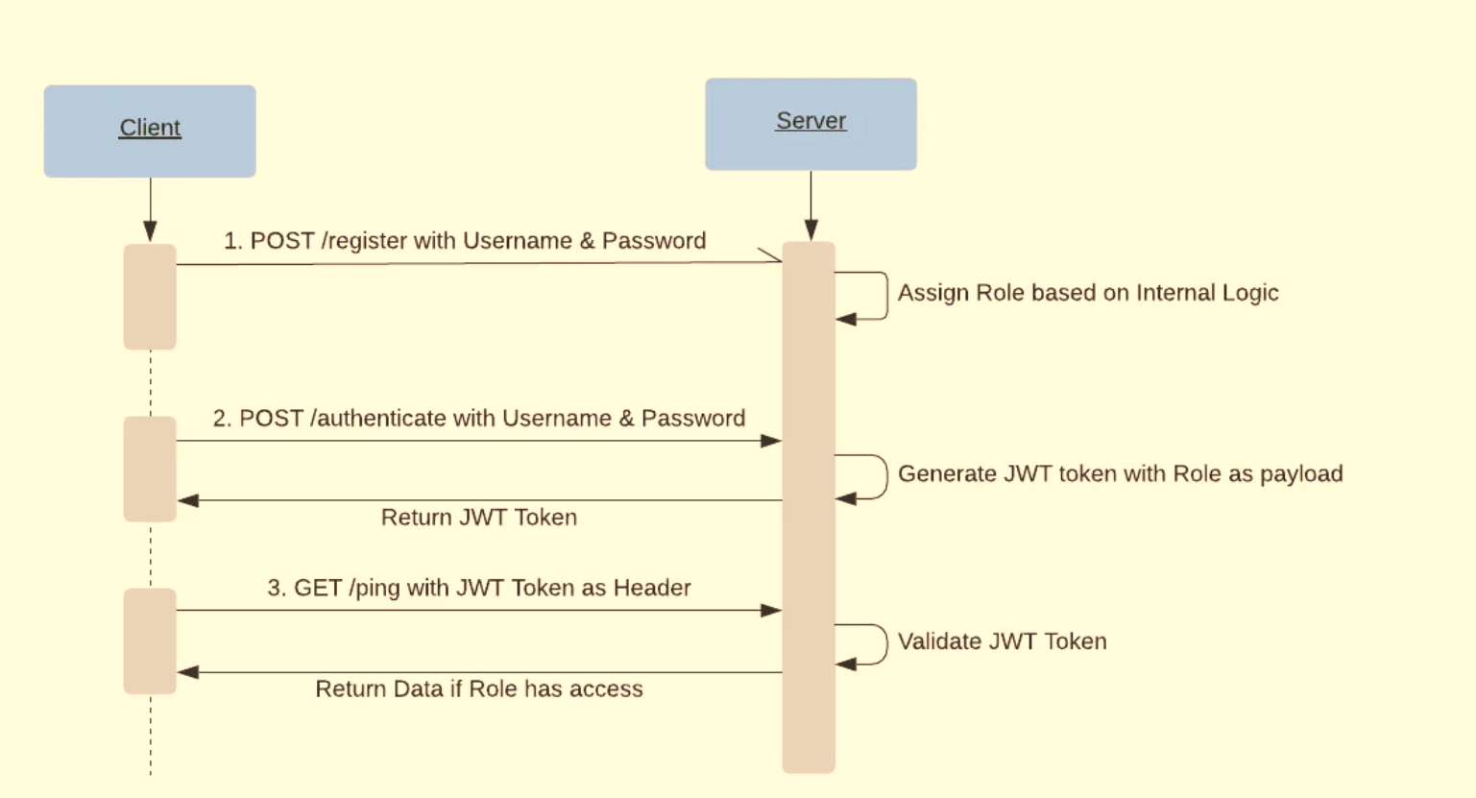

Slide 24
Case Study 2: API Gateway Evaluation
Feature/Criteria | Kong | Apigee | AWS API Gateway
Performance | High throughput, low latency using NGINX; great for real-time microservices. | Enterprise-level performance with rich features; some latency in complex scenarios. | Optimized within AWS, fast processing, excellent scalability; costs can increase with high traffic.
Security Features | Flexible security with OAuth2, JWT, IP filtering, and customizable plugins. | Comprehensive security (OAuth2, SAML, threat detection); ideal for compliance-heavy environments. | Integrated with AWS IAM, OAuth2, API keys; strong native security controls within AWS.
Scalability | Scales horizontally across on-premises, cloud, and Kubernetes environments. | Highly scalable; designed for large volumes, cloud, and hybrid deployments. | Virtually limitless scalability within AWS; handles millions of requests per second.
Ease of Integration | Highly customizable; supports various plugins; great for microservices. | Seamless integration with enterprise tools; best for complex API management needs. | Best for AWS users; tight integration with AWS services like Lambda, DynamoDB; easy to manage.
Cost | Open-source version free; paid for enterprise features. | Subscription-based; pricing depends on usage and features. | Pay-as-you-go; costs depend on requests and data transfer.
Recommendation | Best for flexibility, customization, and performance in varied environments. | Ideal for enterprises needing advanced security, management, and compliance. | Optimal for AWS users with seamless integration, scalability, and robust AWS-native security.

Slide 25
Recommendations
1. Use API Gateways:
Recommendation:
Centralize and enforce API security through gateways.
Action Steps:
Select an API Gateway: Choose based on your environment (e.g., Kong for flexibility, AWS API Gateway for AWS integration).
Centralize Security: Enforce authentication, rate limiting, and TLS encryption centrally.
Monitor Traffic: Enable logging and analytics to detect threats and optimize performance.
2. Implement DevSecOps:
Recommendation:
Integrate security into the development lifecycle.
Action Steps:
Shift Left: Incorporate security testing early in the CI/CD pipeline using tools like SAST and DAST.
Automate Security Checks: Use automated scans for code and dependencies to catch vulnerabilities early.
Foster Collaboration: Encourage teamwork among developers, security, and operations for shared security responsibility.

Slide 26
Recommendations CONTINUES….
3. Regular Updates
Recommendation:
Keep security practices up to date to counter new threats.
Action Steps:
Patch Regularly: Automate updates for software and libraries to fix vulnerabilities quickly.
Stay Informed: Follow security news, bulletins, and participate in security workshops.
Conduct Security Audits: Regularly assess and improve your security posture with audits and vulnerability assessments.
Implementation Overview
Deploy API Gateways: Set up your API gateway with the right security configurations.
Adopt DevSecOps: Embed security tools into your development processes.
Routine Updates: Use automated tools for consistent updates and threat management.
These steps will strengthen your organization’s security posture, making it resilient against evolving cyber threats

Slide 27
Future Research Directions
AI and ML in API Security:
Explore the potential for using artificial intelligence and machine learning to predict and
respond to API security threats.
Blockchain for API Security:
Discuss how blockchain technology could be used to create tamper-proof transaction logs
and enforce smart contracts in API ecosystems.
Standardized Frameworks:
Advocate for the development of standardized security protocols for APIs to ensure consistency
and interoperability across platforms.
Details:
Highlight areas where further research is needed, such as the scalability of AI-based security tools or
the integration of blockchain with existing API infrastructures.

Slide 28
Conclusion
Summary:
Recap the key points discussed, emphasizing the importance of
API security in protecting modern digital ecosystems.
Call to Action:
Encourage the audience to adopt the recommended tools and
practices to enhance the security of their APIs.
Details:
End with a strong closing statement that reinforces the significance of proactive
API security in today's interconnected world.

Slide 29
Thank You
Closing:
Thank the audience for their time and attention,
offering your contact information for further inquiries.
Details:
Include a brief summary of the presentation or a memorable closing statement to
leave a lasting impression.

