Slide 1
Enhancing Security in RESTful APIs through Modern Tools and Techniques
Ginu George Karippaparambil
22563889

Slide 2
Agenda
Introduction
Objectives
API Security Challenges
Modern Security Tools
API Gateways
Web Application Firewalls (WAFs)
DevSecOps Practices
Case Study 1: Implementing API Security
Case Study 2: API Gateway Evaluation
Recommendations
Future Research Directions
Conclusion
Q&A
Thank You

Slide 3
INTRODUCTION
APIs (Application Programming Interfaces), particularly RESTful APIs, are vital to modern software systems, enabling seamless communication and data exchange between applications, devices, and services.
They are foundational to mobile apps, cloud services, IoT devices, and microservices, driving integration, operational efficiency, and innovation.
However, the growing reliance on APIs also introduces significant security risks, making it essential to implement proactive measures to protect sensitive data and ensure system integrity.

Slide 4
INTRODUCTION CONTINUES…..
Problem Statement
The extensive use of APIs exposes digital systems to serious security threats, which must be addressed to protect sensitive data and ensure reliable services. Key challenges include:
Unauthorized Access: Exploiting API vulnerabilities to access sensitive data without permission.
Injection Attacks: Using methods like SQL injection and XSS to run malicious code and cause data breaches.
Data Leakage: Weak security measures can lead to accidental exposure of confidential information.
Denial-of-Service (DoS) Attacks: Overloading systems to disrupt services and damage user trust.
These challenges highlight the urgent need for robust API security measures to safeguard digital infrastructure.

Slide 5
INTRODUCTION KEY INSIGHT CONTINUES…….
This dissertation explores a comprehensive strategy to improve RESTful API security through modern tools, techniques, and best practices:
1.Authentication and Authorization:
Analyzes secure access controls using API keys, OAuth, and JWTs to prevent unauthorized access.
2. Encryption Practices:
Focuses on using Transport Layer Security (TLS) to protect data during transmission and compares encryption methods to identify the most effective strategies.
3. API Gateway Solutions:
Assesses tools like Kong, Apigee, and AWS API Gateway for features such as rate limiting and authentication, which help secure API operations.
4.Web Application Firewalls (WAFs):
Provides a defensive layer against attacks and utilizes real-time monitoring tools like Prometheus and Grafana for proactive threat detection and alerting.

Slide 6
INTRODUCTION CONTINUES…..
5.DevSecOps Integration:
Embeds security into the development process from the start, promoting continuous assessment and improvement.
6. Documentation and Versioning:
Stresses the importance of clear and current API documentation to prevent security lapses and keep developers informed of changes and vulnerabilities.

Slide 7
INTRODUCTION CONTINUES…..
By leveraging advanced security tools, best practices, and a proactive approach, this dissertation offers actionable insights to enhance RESTful API security. Addressing these challenges is crucial to protecting data integrity, safeguarding user privacy, and ensuring the reliability of digital services in today’s interconnected world.

Slide 8
Objectives
Goal And Sub-Goals
To analyze and address the security challenges associated with RESTful APIs.
Assess the security threats facing RESTful APIs.
Explore the effectiveness of modern security tools and techniques.
Propose a robust framework for API security.

Slide 9
Achieving the objectives outlined in your dissertation enhances API security in real-world scenarios by identifying vulnerabilities, developing robust security frameworks, and leveraging machine learning for threat detection.
These measures help organizations proactively defend their APIs by spotting and responding to threats in real-time.
Evaluating the effectiveness of these security protocols ensures they are practical, scalable, and fit for real-world applications, such as in finance and healthcare, where API security is critical.
By implementing best practice recommendations, businesses can safeguard their APIs against unauthorized access, data breaches, and other security threats, ultimately protecting sensitive data and maintaining system integrity.

Slide 10
API Security Challenges
Unauthorized Access
Injection Attacks
Data Leakage
Denial-of-Service (DoS) Attacks

Slide 11
API Security Challenges Continues….
UNAUTHORIZED ACCESS
APIs exposed to unauthorized users can lead to serious risks like data leaks,
allowing sensitive information to be accessed and stolen.
Attackers can misuse API functions to alter or manipulate data, disrupt services,
or perform unauthorized actions.
This exposure increases the chances of attacks like data tampering, unauthorized access to backend systems, and overall loss of data integrity, making robust security measures essential to prevent such breaches.

Slide 12
INJECTION ATTACKS
Injection attacks occur when attackers insert malicious code into input fields, exploiting weak input validation to manipulate databases or system commands.
A common type is SQL injection, where attackers inject harmful SQL code to gain unauthorized access, alter data, or compromise the entire system.
These attacks can lead to data breaches, loss, and corruption, posing significant risks to data integrity and security.
Mitigation strategies include validating inputs, using parameterized queries, prepared statements, and implementing security tools like web application firewalls (WAFs) to detect and prevent such vulnerabilities.

Slide 13
DATA LEAKAGE
Data leakage occurs when APIs inadvertently expose sensitive information due to inadequate security measures.
This can happen through insecure endpoints, insufficient access controls, or improper data handling practices.
Data leakage risks include exposing personal information, financial data, or proprietary business information, leading to privacy breaches, financial losses, and reputational damage.
Mitigating these risks involves implementing strong authentication and authorization, encrypting data in transit, and conducting regular security audits and monitoring to detect and prevent unauthorized access or data exposure

Slide 14
DENIAL-OF-SERVICE (DOS)
DOS attacks aim to overwhelm an API or web service with excessive traffic, rendering it unavailable to legitimate users.
These attacks disrupt service availability, degrade performance, and can cause significant financial and reputational damage.
The dissertation highlights that DoS attacks target the availability of APIs by flooding them with requests,
often exploiting specific vulnerabilities like inadequate rate limiting or poorly configured APIs.

Slide 15
Mitigation Strategies:
Rate Limiting and Throttling: These mechanisms restrict the number of requests a user can make within a specified timeframe, helping to manage traffic and prevent overloads.
Web Application Firewalls (WAFs): WAFs filter and monitor API traffic, blocking malicious requests and mitigating the impact of DoS attacks by using behavioural analysis to differentiate between legitimate and harmful traffic.
Continuous Monitoring: Real-time monitoring and anomaly detection help identify unusual spikes in traffic, allowing for rapid response to potential DoS threats​.
These strategies are crucial for maintaining the stability and availability of APIs in the face of DoS attacks.

Slide 16
API Security Best Practices
Authentication & Authorization:
Encryption:
Access Control

Slide 17
API Security Best Practices……
1. Authentication & Authorization
There are various methods for securing APIs, with a focus on authentication and authorization techniques like OAuth 2.0, JSON Web Tokens (JWTs), and API keys. Here's a brief explanation of how each method works:
OAuth 2.0: OAuth 2.0 is a widely used protocol that enables secure, delegated access to resources without sharing user credentials directly. It issues tokens after successful authentication, allowing third-party applications to interact with APIs securely. This is particularly useful in scenarios where users need to grant access to their data on different platforms without exposing their credentials.
JSON Web Tokens (JWTs): JWTs are self-contained tokens used for stateless authentication and authorization. They carry encoded user information, which can be verified by the server without needing to store session data. JWTs are commonly used in modern web applications to ensure secure communication between clients and APIs.
API Keys: API keys are simple tokens that grant access to an API. While easy to implement, they are less secure because they grant full access to the API if exposed. API keys are suitable for basic scenarios but require careful management to avoid unauthorized use.
These methods help manage and verify access to APIs, ensuring that only authorized users can interact with the system, thus protecting sensitive data from unauthorized access

Slide 18
ENCRYPTION
TLS is a cryptographic protocol essential for securing data transmissions between clients and servers by encrypting the data in transit. This encryption ensures that sensitive information, such as personal data or authentication credentials, remains confidential and protected from eavesdropping, interception, and tampering by unauthorized users.
Data Integrity and Confidentiality: TLS prevents data from being altered or accessed during transmission, ensuring that the information remains accurate and secure.
Server and Client Authentication: TLS can authenticate both the server and the client, verifying their identities and establishing trust before data exchange occurs.
Protection Against Man-in-the-Middle (MitM) Attacks: By encrypting the communication channel, TLS protects against MitM attacks, where attackers attempt to intercept and manipulate the data between the client and server.
Real-World Application: TLS is widely used in APIs to secure connections in financial services, healthcare, and other industries that handle sensitive data. By implementing TLS, organizations can safeguard their API communications, reducing the risk of data breaches and enhancing overall security​

Slide 19
ACCESS CONTROL
Access Control mechanisms
Role-Based Access Control (RBAC) assigns access based on roles, like "Admin" or "User." Each role has specific permissions, ensuring users only access what they need, which simplifies management and reduces security risks.
Attribute-Based Access Control (ABAC) uses attributes like user role, location, or time to control access dynamically. This approach allows more flexible and detailed permissions, adapting to different contexts.
RBAC is great for simple, structured setups, while ABAC offers more control in complex environments. Both help secure APIs by managing who can do what, protecting data, and preventing unauthorized access.

Slide 20
Modern Security Tools
API Gateways:
Web Application Firewalls (WAFs):
DevSecOps:

Slide 21
API Gateways
Aspect | Kong | Apigee | AWS API Gateway
Introduction | Open-source, highly flexible, supports plugins for customization. | Enterprise-grade, robust management platform from Google Cloud. | Fully managed, integrated with AWS ecosystem.
Features | Authentication, rate limiting, caching, custom plugins. | Advanced analytics, authentication, rate limiting, monetization options. | Authentication, rate limiting, caching, AWS integration.
Strengths | Great for microservices, supports Kubernetes, high scalability. | Ideal for large enterprises needing deep insights and control. | Best for AWS-centric applications, seamless AWS service integration.
Use Cases | Microservices, cloud-native apps, flexible deployments. | Large organizations, complex API management, compliance-focused. | Scalable cloud apps, AWS infrastructure-heavy environments
Benefits | Centralized API management, enhanced security, performance optimization. | Centralized control, detailed analytics, security enforcement. | Centralized API control, robust scaling, security through AWS tools.
Threat Mitigation | Mitigates DoS via rate limiting; prevents unauthorized access with plugins. | Blocks unauthorized access, mitigates DoS with throttling, monitors threats. | Manages DoS with rate limiting, throttles traffic, secures APIs with AWS WAF.

Slide 22
Web Application Firewalls (WAFs)
How WAFs Protect APIs from Common Web Attacks
SQL Injection (SQLi):
WAFs detect and block malicious SQL queries embedded in API requests by
analyzing patterns and looking for
SQL keywords that indicate an injection attempt. This prevents unauthorized
database access and manipulation.
Cross-Site Scripting (XSS):
WAFs scan API traffic for harmful scripts that could be injected into responses
and block them before they reach the user, safeguarding against the execution of malicious
code.

Slide 23
Types of WAFs
Rule-Based WAFs:
These operate on predefined rules and signatures to identify and block known attack patterns.
They are reliable in detecting attacks with low false positive rates but require regular updates to stay effective against emerging threats.
Machine Learning-Based WAFs:
These WAFs adapt to new threats by learning from traffic patterns and detecting anomalies.
They offer better protection against zero-day attacks but are more complex to maintain and can generate higher false positives if not properly tuned.

Slide 24
Integration with API Gateways
WAFs can be deployed alongside API gateways to enhance security.
While the gateway manages traffic and applies rate limits, the WAF filters incoming requests for malicious content.
This combination provides comprehensive protection by addressing both traffic management and deep packet inspection.

Slide 25
Examples of WAFs in Action
ModSecurity:
Often used with API gateways like Nginx, ModSecurity effectively blocks SQLi and XSS attacks by filtering and monitoring HTTP requests.
Cloudflare WAF:
Integrated with Cloudflare’s CDN, this WAF has mitigated numerous large-scale DDoS attacks, protecting APIs from overwhelming traffic and malicious requests by using both rule-based and machine learning techniques

Slide 26
DevSecOps Practices
DevSecOps integrates security into every stage of the development process,
shifting security considerations to the left from the design phase through deployment.
This approach embeds security checks and assessments throughout the CI/CD pipeline,
reducing vulnerabilities early on and fostering a culture of continuous security
improvement within development teams .
Automated Security Testing
Automated security testing includes tools like Static Application Security Testing (SAST) and
Dynamic Application Security Testing (DAST).
SAST analyzes code for vulnerabilities before it’s run, while DAST tests the application during execution to find runtime flaws.
These tools help identify security issues early in the development lifecycle, allowing teams to address vulnerabilities before they reach production .

Slide 27
Continuous Monitoring
Continuous monitoring involves real-time tracking of API behavior to detect and respond to security threats as they arise. Tools like Prometheus, Grafana, and ELK Stack enable developers to visualize and analyze API performance, detect anomalies, and respond to incidents swiftly, ensuring the continuous security and availability of services .
Details: Case Studies of DevSecOps in Action
One case study highlights the implementation of DevSecOps in a RESTful User Management API, utilizing tools like JWT-based authentication, RBAC for authorization, audit logging, and TLS encryption.
This approach ensured secure user management, minimized vulnerabilities, and provided a robust framework for API security .
These practices illustrate the effectiveness of integrating security into development, using automated tools, and maintaining vigilance through continuous monitoring to enhance API security.

Slide 28
Case Study 1: Implementing API Security
Scenario:
Describe a case study where a RESTful User Management API was secured using
JWT-based authentication and TLS encryption.
Challenges:
Discuss issues like managing token expiry and configuring access controls.
Solutions:
Explain the implementation of RBAC and audit logging to address these challenges.
Details:
Use visuals like diagrams or flowcharts to illustrate the security
measures implemented in this case study.

Slide 29
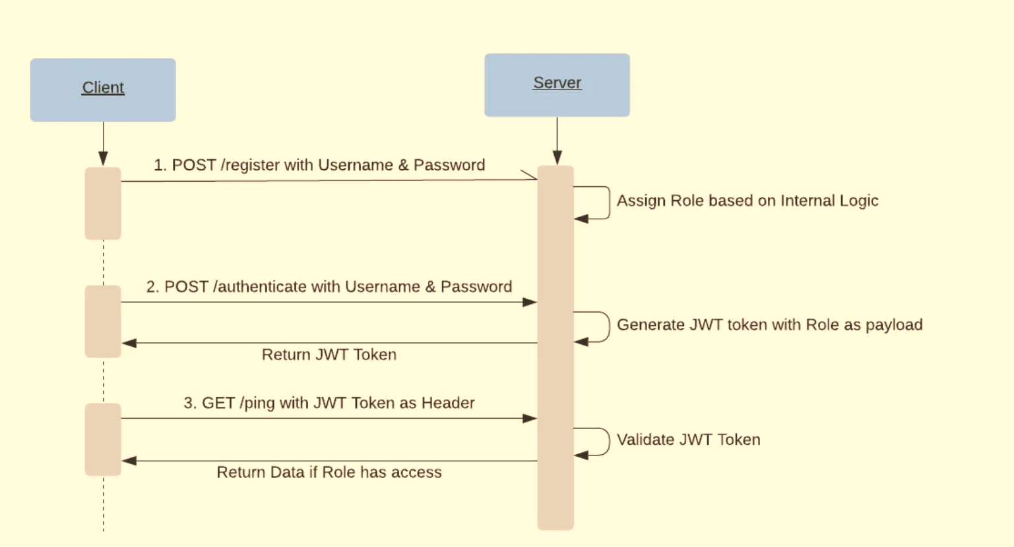

Slide 30
Case Study 2: API Gateway Evaluation
Tools Compared:
Detail the evaluation of API gateways like Kong, Apigee, and AWS API Gateway based on performance, security features, and scalability.
Criteria:
Discuss the key factors considered in the evaluation, such as integration capabilities and ease of use.
Recommendation:
Provide a recommendation based on the specific needs of the organization, such as choosing Kong for flexibility or AWS API Gateway for seamless AWS integration.
Details:
Include data or metrics from the evaluation to support the recommendation.

Slide 31
Recommendations
Use API Gateways:
Recommend the implementation of API gateways to centralize and enforce API security.
Implement DevSecOps:
Encourage the adoption of DevSecOps practices to integrate security into the development lifecycle.
Regular Updates:
Stress the importance of keeping security practices up to date to address new and emerging threats.
Details:
Provide actionable steps for organizations to implement these recommendations in their own environments.

Slide 32
Future Research Directions
AI and ML in API Security:
Explore the potential for using artificial intelligence and machine learning to predict and
respond to API security threats.
Blockchain for API Security:
Discuss how blockchain technology could be used to create tamper-proof transaction logs
and enforce smart contracts in API ecosystems.
Standardized Frameworks:
Advocate for the development of standardized security protocols for APIs to ensure consistency
and interoperability across platforms.
Details:
Highlight areas where further research is needed, such as the scalability of AI-based security tools or
the integration of blockchain with existing API infrastructures.

Slide 33
Conclusion
Summary:
Recap the key points discussed, emphasizing the importance of
API security in protecting modern digital ecosystems.
Call to Action:
Encourage the audience to adopt the recommended tools and
practices to enhance the security of their APIs.
Details:
End with a strong closing statement that reinforces the significance of proactive
API security in today's interconnected world.

Slide 34
Thank You
Closing:
Thank the audience for their time and attention,
offering your contact information for further inquiries.
Details:
Include a brief summary of the presentation or a memorable closing statement to
leave a lasting impression.

