Slide 1
Qcow2 layout

Slide 2
Header
first cluster
common header
header extension 1(optional)
backing file name(optional)
...
additional header(version 3 or higher only)
header extension n(optional)
unused

Slide 3
Host cluster management
refcount table
refcount block
data cluster
physical view
......
......
......
......
......
......
refcount table entry
......
refcount table
logical view
refcount block entry
refcount block
...
...
...
...
...
...
data cluster
......

Slide 4
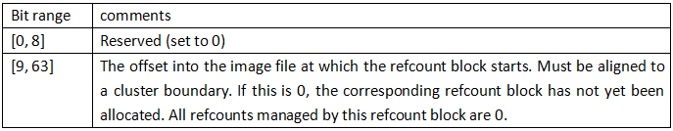
Host cluster management(2)
refcount table entry
refcount block entry

Slide 5
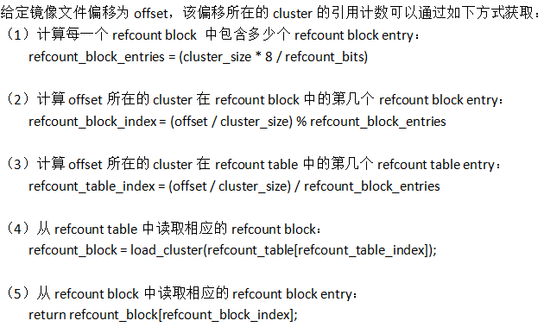
Host cluster management(3)
refcount retrieve

Slide 6
Guest to host cluster mapping
guest offset
virtual disk
......
......
L1 table entry
......
L1 table
L2 table entry
L2 table
...
...
...
...
...
...
image file
......
......
host offset

Slide 7
Guest to host cluster mapping(2)
L1 table entry
L2 table entry
standard cluster descriptor
Bit range | comments
[0, 8] | Reserved (set to 0)
[9, 55] | The offset into the image file at which the L2 table starts. Must be aligned to a cluster boundary. If the offset is 0, the L2 table and all clusters described by this L2 table are unallocated.
[56, 62] | Reserved (set to 0)
[63] | 0 for an L2 table that is unused or requires COW, 1 if its refcount is exactly one.
Bit range | comments
[0, 61] | Cluster descriptor
[62] | 0 for standard clusters1 for compressed clusters
[63] | 0 for a cluster that is unused or requires COW, 1 if its refcount is exactly one.
Bit range | comments
[0] | If set to 1, the cluster reads as all zeros. The host cluster offset can be used to describe a preallocation, but it won't be used for reading data from this cluster, nor is data read from the backing file if the cluster is unallocated. With version 2, this is always 0.
[1, 8] | Reserved (set to 0)
[9, 55] | Host cluster offset. Must be aligned to a cluster boundary. If the offset is 0, the cluster is unallocated.
[56, 61] | Reserved (set to 0)

Slide 8
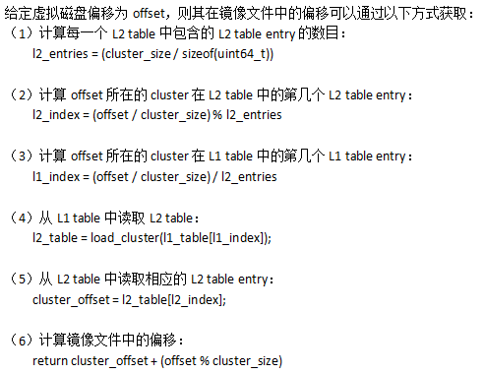
Guest to host cluster mapping(3)
Guest offset to host offset mapping

Slide 9
Bitmap
bitmap directory entry
......
bitmap directory
bitmap table entry
bitmap table
...
...
...
...
...
...
bitmap data
......
......
......
cluster
bits
0
1
0
1
1
0
1
1
1
0
1
......
1
1
0
1
0
0
1
1
0
0
1
one bit corresponding to one bitmap granularity

Slide 10
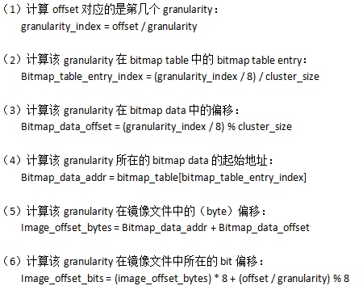
Bitmap(2)
guest (byte) offset to host bit offset mapping

