Slide 1


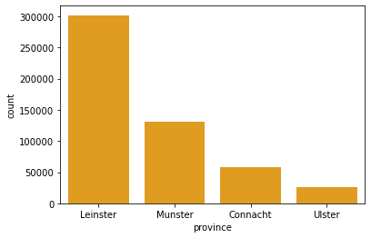
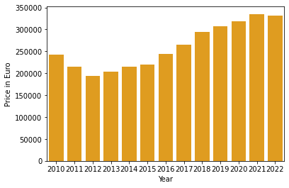
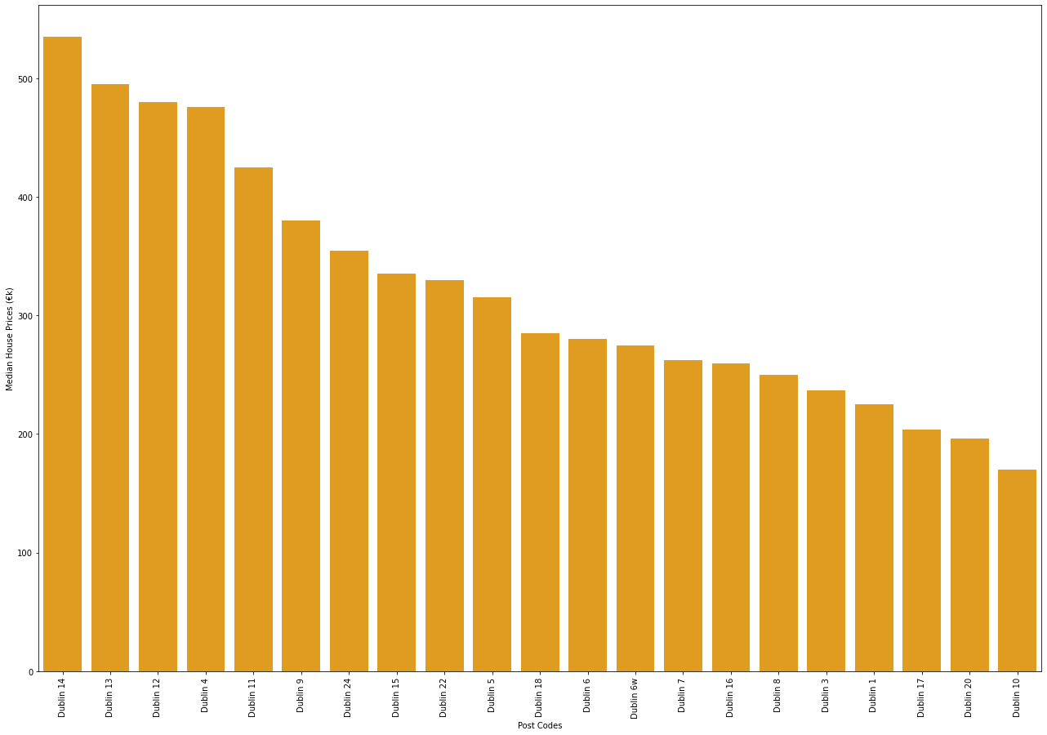
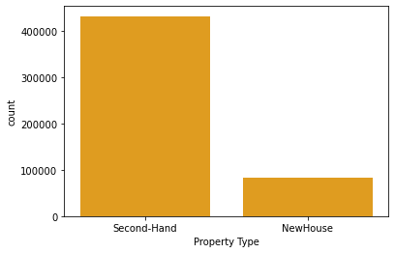
Analysis of Property Prices in Ireland
Ginu Varghese
Department of Computing Science And Mathematics
D00251842@student.dkit.ie
Introduction
The property prices are increasing every year and it is demanding the analysis and prediction of property prices. An accurate house price prediction is important for prospective homeowners, real estate developers, investors, banks, governments, tax assessors, insurers, and mortgage lenders. The main objective of this study is to analyze the property prices of Ireland from 2010 to 2022 collected from the PSRA website. Factors influencing the house prices county, year, province, location of property, property size and type are considered for analysis.
Methods And Results
The entire project is based on CRISP-DM methodology. Statistical analyses such as ANOVA and MLR and various plots using seaborn and matplotlib were generated for the initial analysis of the property prices.
Conclusion and Future work
The results from the ANOVA and MLR implies that the attributes ‘year’, ‘province’, ‘property_description’ and ‘location’ has significant effect on the property prices. From different visualizations generated, it is evident that prices are increasing every year and higher number of houses are sold in Leinster province and the most sold houses are secondhand. It is also revealed that the Post codes in Dublin are also having an impact on the house prices. For future research, I will be using Hedonic regression, Random Forest, SVM and Linear Regression Machine learning techniques to analyze and predict the house prices.
Figure 2. Another example poster with caption at 36 points [2].
Figure 1. Property Price Vs Year.
Figure 2. Another example poster with caption at 36 points [2].
Research Questions
Has the property prices increased over the years?
Which county has the highest prices for properties?
Does the property price depend on which county the house is in? Is there any relationship between the counties and the prices?
Is there any relationship between the size of the properties, type of properties (like new or second hand) and the property prices?
Acknowledgments
The Data used for this research was taken from the Residential Property Price Register page of PSRA website, https://propertypriceregister.ie.
References (Calibri, 32 points)
Phan, T.D. (2019). Housing price prediction using machine learning algorithms: the case of Melbourne city, Australia. Proceedings - International Conference on Machine Learning and Data Engineering.
Thamarai, M. and Malarvizhi, S.P. (2020). Information Engineering and Electronic Business. Information Engineering and Electronic Business.
Jeffrey W. Kaeli, Hanumant Singh, and Roy Armstrong, "Morphological Image Recognition of Deep-Water Reef Corals" (Blacksburg, VA: Virginia Tech, October 2005).
Figure 2. Another example poster with caption at 36 points [2].

Slide 2
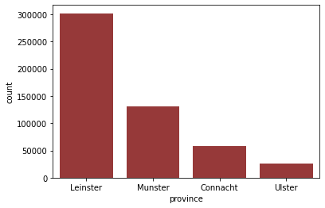
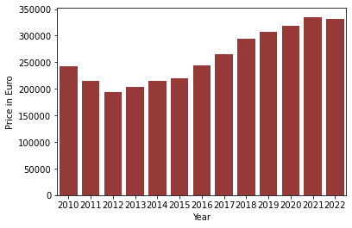
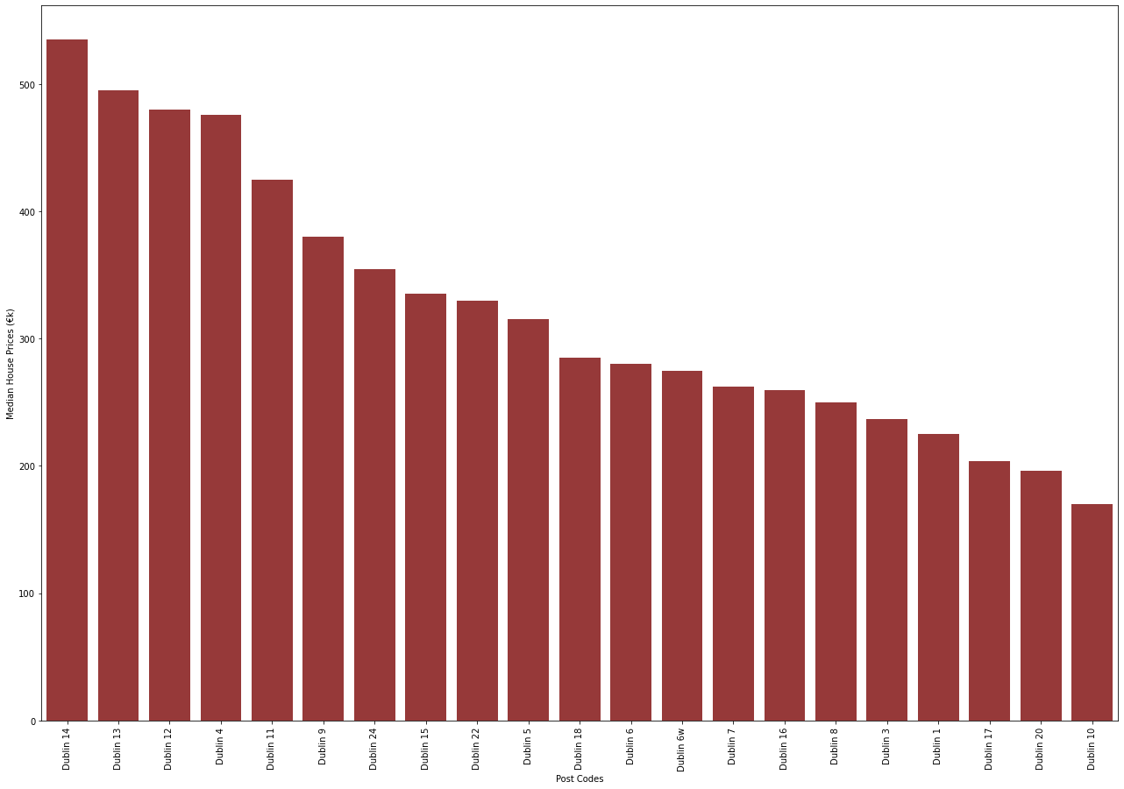
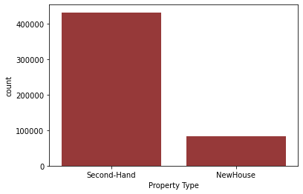
Analysis of Property Prices in Ireland
Ginu Varghese
Department of Computing Science And Mathematics
D00251842@student.dkit.ie
Introduction
The property prices are increasing every year and it is demanding the analysis and prediction of property prices. An accurate house price prediction is important for prospective homeowners, real estate developers, investors, banks, governments, tax assessors, insurers, and mortgage lenders. The main objective of this study is to analyze the property prices of Ireland from 2010 to 2022 collected from the PSRA website. Factors influencing the house prices county, year, province, location of property, property size and type are considered for analysis.
Methods And Results
The entire project is based on CRISP-DM methodology. Statistical analyses such as ANOVA and MLR and various plots using seaborn and matplotlib were generated for the initial analysis of the property prices.
Conclusion and Future work
The results from the ANOVA and MLR implies that the attributes ‘year’, ‘province’, ‘property_description’ and ‘location’ has significant effect on the property prices. From different visualizations generated, it is evident that prices are increasing every year and higher number of houses are sold in Leinster province and the most sold houses are secondhand. It is also revealed that the Post codes in Dublin are also having an impact on the house prices. For future research, I will be using Hedonic regression, Random Forest, SVM and Linear Regression Machine learning techniques to analyze and predict the house prices.
Figure 2. Another example poster with caption at 36 points [2].
Figure 1. Property Price Vs Year.
Figure 2. Another example poster with caption at 36 points [2].
Research Questions
Has the property prices increased over the years?
Which county has the highest prices for properties?
Does the property price depend on which county the house is in? Is there any relationship between the counties and the prices?
Is there any relationship between the size of the properties, type of properties (like new or second hand) and the property prices?
Acknowledgments
The Data used for this research was taken from the Residential Property Price Register page of PSRA website, https://propertypriceregister.ie.
References (Calibri, 32 points)
Phan, T.D. (2019). Housing price prediction using machine learning algorithms: the case of Melbourne city, Australia. Proceedings - International Conference on Machine Learning and Data Engineering.
Thamarai, M. and Malarvizhi, S.P. (2020). Information Engineering and Electronic Business. Information Engineering and Electronic Business.
Jeffrey W. Kaeli, Hanumant Singh, and Roy Armstrong, "Morphological Image Recognition of Deep-Water Reef Corals" (Blacksburg, VA: Virginia Tech, October 2005).
Figure 2. Another example poster with caption at 36 points [2].

Slide 3
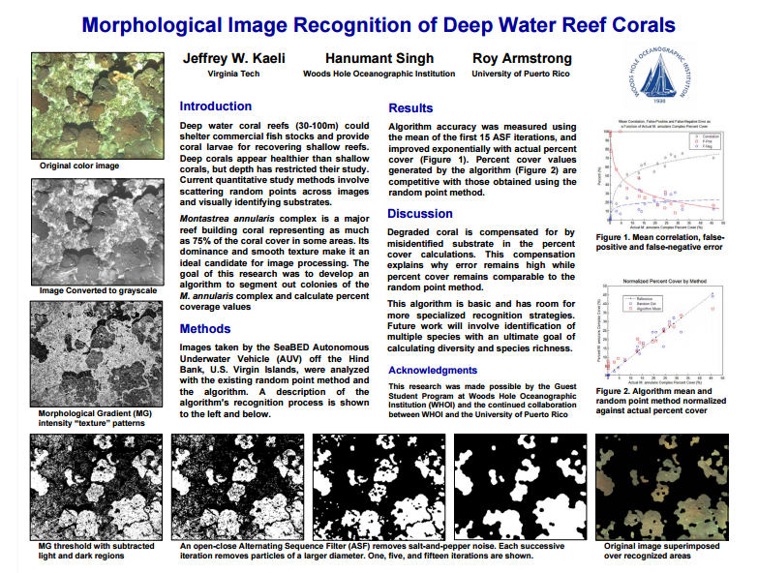
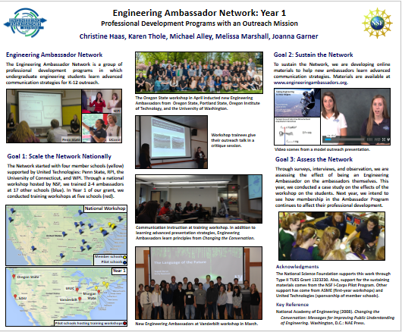
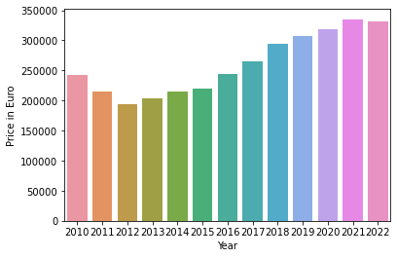
Analysis of Property Prices in Ireland
Ginu Varghese
Department of Computing Science And Mathematics
D00251842@student.dkit.ie
Introduction
The property prices are increasing every year and it is demanding the analysis and prediction of property prices. An accurate house price prediction is important for prospective homeowners, real estate developers, investors, banks, governments, tax assessors, insurers, and mortgage lenders. The main objective of this study is to analyze the property prices of Ireland from 2010 to 2022 collected from the PSRA website. Factors influencing the house prices county, year, province, location of property, property size and type are considered for analysis.
Methods
At least one section of the poster should present results. An important point with posters is to rely on visuals rather than longs blocks of text to communicate. Figure 3 shows another possible layout for posters. This section was set in Calibri, boldface, 36 points.
Figure 3. Another example poster with caption at 36 points [3].
Conclusion
The final section of the poster generally provides conclusions and recommendations. This section was set in Calibri, boldface, 36 points. As with the first section, this section is read by most passers-by.
Figure 1. Property Price Vs Year.
Acknowledgments (Calibri, 32 points)
In this template, acknowledgments are set in Calibri, 28 points. Try to keep the acknowledgments to one or two lines.
Research Questions
The second section of the poster might serve a number of purposes: background, methods, or system design. An important point with posters is to rely on visuals rather than longs blocks of text to communicate. Figure 2 shows another possible layout for a poster. Notice how the middle column is used for illustrations. Also, note how the top illustrations serve to orient the reader to the title. This section was set in Calibri, boldface, 40 points.
Figure 2. Another example poster with caption at 36 points [2].
Results
At least one section of the poster should present results. An important point with posters is to rely on visuals rather than longs blocks of text to communicate. Figure 3 shows another possible layout for posters. This section was set in Calibri, boldface, 36 points.
References (Calibri, 32 points)
Couch, Eric, Jesse Christophel, Eric Hohlfeld, and Karen Thole, "Cooling Effects of Dirst Purge Holes on the Tips of Gas Turbine Blades" (Blacksburg, VA: Virginia Tech, April 2003).
Christine Haas, “Engineering Ambassador Network: Year 1,” 2015 ASEE Conference (Seattle, WA: ASEE).
3. Jeffrey W. Kaeli, Hanumant Singh, and Roy Armstrong, "Morphological Image Recognition of Deep Water Reef Corals" (Blacksburg, VA: Virginia Tech, October 2005).

