Slide 1
Analysis of Property Prices in Ireland
Ginu Varghese
D00251842
Dundalk Institute of Technology

Slide 2
Contents
Introduction
Research Questions
Methods
Results
Conclusion
References

Slide 3
Introduction
The house prices are increasing every year and it is demanding the analysis and prediction of property prices.
The main objective of this study is to conduct both statistical and machine learning analysis on the property prices of Ireland from 2010 to 2022 collected from the PSRA website.
Factors influencing the house prices county, year, province, location of property, property size and type are considered for analysis.

Slide 4
Research Questions
1. What is the trend in the property prices over the years?
2. Which County has the highest demand for properties?
3. Does the property price depend on which county the house is in? Is there any relationship between the counties and the prices?
4. Is there any relationship between the size of the properties, type of properties (like new or second hand) and the property prices?
5. What are the factors contributing to the price of the properties?
6. Is the post codes are impacting the house prices?
7.How does the latitude and longitude effect the property prices?

Slide 5
Methods
Implementation Methods
Statistical methods
ANOVA Test
MLR
SLR
ML Models
Linear Regression
Decision Tree
Support Vector Machine
Random Forest
XG-Boost
NN

Slide 6
Methods…
Evaluation Methods
RMSE
MAE
R Squared

Slide 7
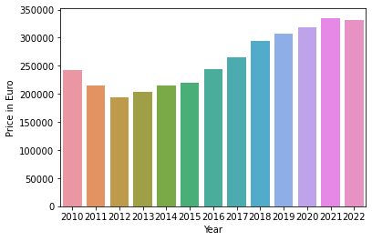
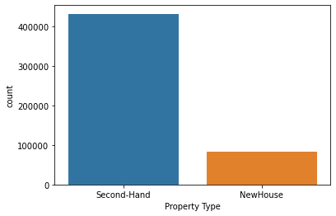
Results

Slide 8
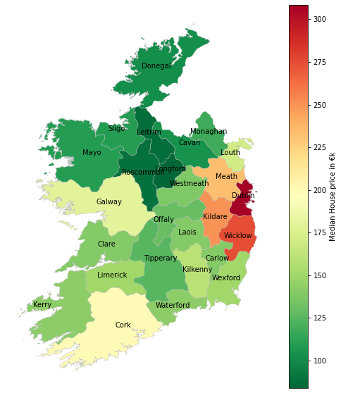
Results…

Slide 9
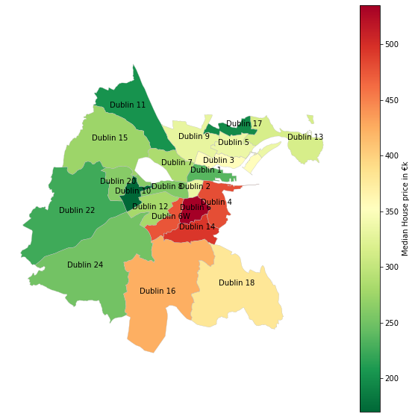
Results…

Slide 10
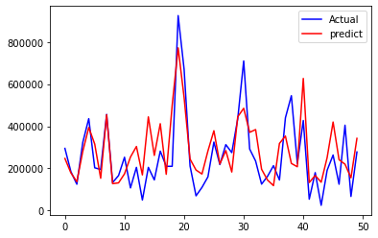
Results…
XG-Boost was found to be the better predicting model.
The performance metrics values were found to be better for XG-Boost compared to the other models.
NN and SVM is also having comparatively good RMSE and MAE values.

Slide 11
Conclusion
Statistical analysis revealed that, location, County, the type of property, size of property are having significant impact on the property prices.
In Dublin, the post codes are highly effecting the property prices.
The best algorithm to predict property prices was found to be the XG-Boost followed by NN and SVM.
In future, if the data regarding the unemployment rate, geographical data such as flood rate of the area, population of the area in each year, and safety index of the area is available, the prediction could be done based on that data which makes the prediction more valuable and helpful to the customers.
In addition to this the proposed model has high scalability which can be used to analyse the house prices of other countries with similar population and landscapes and properties.

Slide 12
References
Abdulai, R. and Owusu-Ansah, A. (2011). (PDF) Hedonic regression analysis of house price determinants in Liverpool, England [online]. , pp.6–31. Available from: https://www.researchgate.net/publication/286675668_Hedonic_regression_analysis_of_house_price_determinants_in_Liverpool_England [accessed 1 June 2022].
Advantages of Support Vector Machines (SVM). Available from: https://iq.opengenus.org/advantages-of-svm/ [accessed 2 June 2022].
Ajay Ohri. (2022). 10 Popular Regression Algorithms In Machine Learning Of 2022 [online]. Available from: https://www.jigsawacademy.com/popular-regression-algorithms-ml/ [accessed 22 August 2022].
Alfiyatin, A.N., Febrita, R.E., Taufiq, H. and Mahmudy, W.F. (2017). Modeling House Price Prediction using Regression Analysis and Particle Swarm Optimization Case Study : Malang, East Java, Indonesia. International Journal of Advanced Computer Science and Applications [online], 8(10). Available from: www.ijacsa.thesai.org [accessed 1 June 2022].
Amrutha. (2022). Decision Tree Machine Learning Algorithm - Analytics Vidhya [online]. https://www.analyticsvidhya.com/ [online]. Available from: https://www.analyticsvidhya.com/blog/2022/01/decision-tree-machine-learning-algorithm/ [accessed 5 June 2022].

Slide 13
Thank You

