Slide 1
RS232
Characteristics of a low level bus.
Richard Miikael Jaks, Fadir Kyrychenko, Jian Zhang

Slide 2
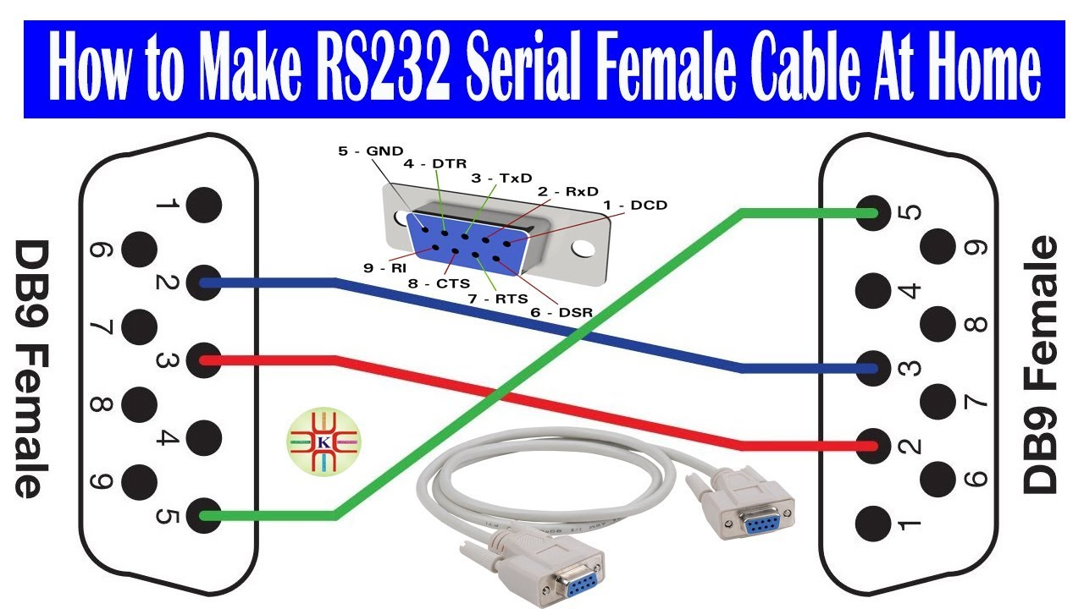
Useless piece on antique history
Small file transfer
Unidirectional file transfer
Used in most commonly used in printers
Also used in old modems, routers, barcode scanners, automotive parts (diagnostic tools, onboard computers) and medical devices
First one created for public use
Pictures of wiring or example pictures

Slide 3
Properties
Wires (Number and function): 9 wires
Speed: 115 kb/s
Max lengths: 15m
Special properties: unidirectional transfer, no electromagnetic shielding

