Slide 1
Performance of a Video production company
Tools used:
Matlab (traces fitting)
JMT (model definition and analysis)
Excel (data visualization of the simulation results)

Slide 2
Project Structure
This PDF containing a resume of the work
open.jsimg: contains the model used for the project
closed.jsimg: contains a closed model version of the project, not considered here
result.xls: contains the result of the simulation of the Open Model with confidence interval and some graphs
fitting.m: the matlab code used to fit the trace on several distributions

Slide 3
Goal of Performance Evaluation Project
Performance evaluation in computer systems aims to measure and optimize system behavior to achieve optimal functionality and user satisfaction.
KPI (Key Performance Index):
Throughput
Number of episodes produced in a given time
The Series Producer wants to maximize it
Response Time
Time taken for the system to respond to a request
Users want it to be as little as possible

Slide 4
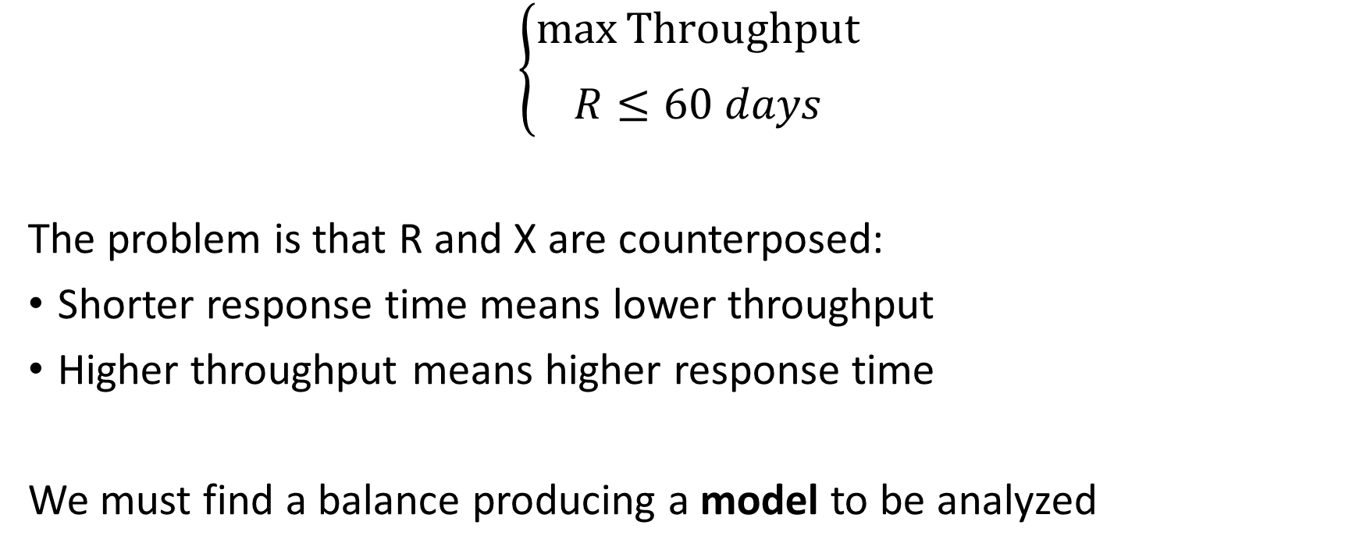
An optimization problem
$$\left\{\begin{aligned}\max_{}{\text{Throughput}} \\ R≤60 days\end{aligned}\right.$$
The problem is that R and X are counterposed:
Shorter response time means lower throughput
Higher throughput means higher response time
We must find a balance producing a model to be analyzed

Slide 5
Fitting
Fitting is done against:
Uniform Distribution
Exponential Distribution
Erlang Distribution
Weibull Distribution
Pareto Distribution
Hyper-Exponential Distribution
Hypo-Exponential Distribution

Slide 6
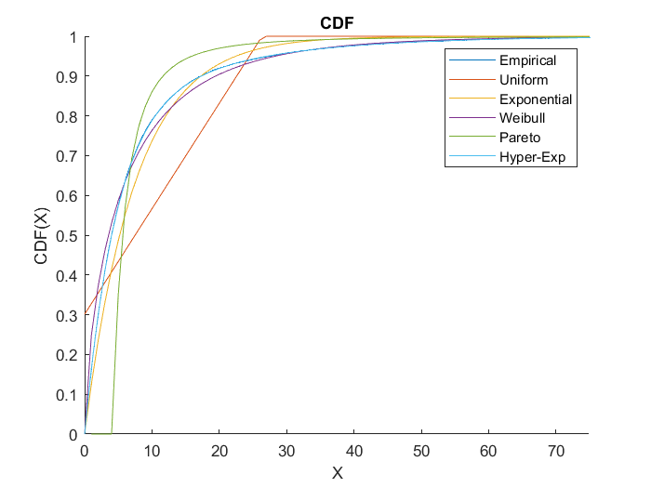
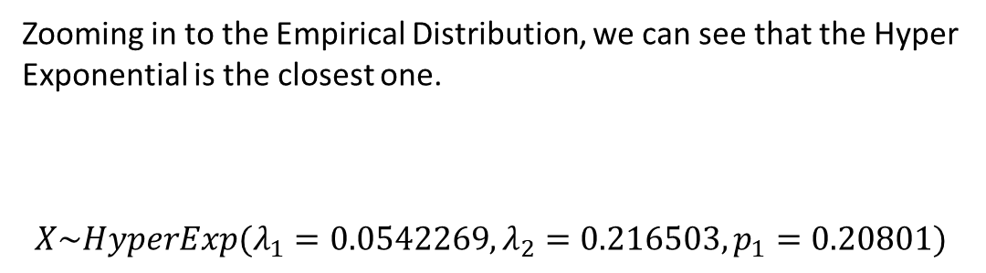
Fitting Result – Audio Editing
Zooming in to the Empirical Distribution, we can see that the Hyper Exponential is the closest one.
$$X\sim HyperExp(λ_{1}=0.0542269, λ_{2}=0.216503, p_{1}=0.20801)$$

Slide 7
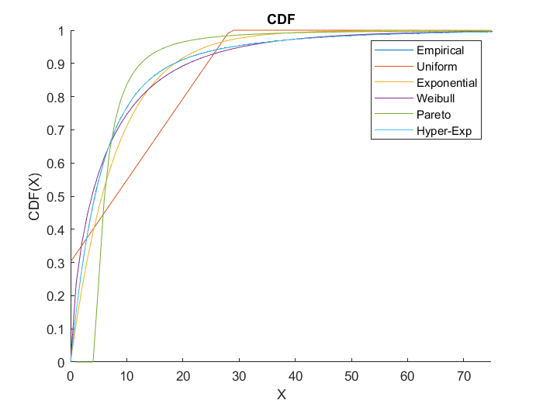
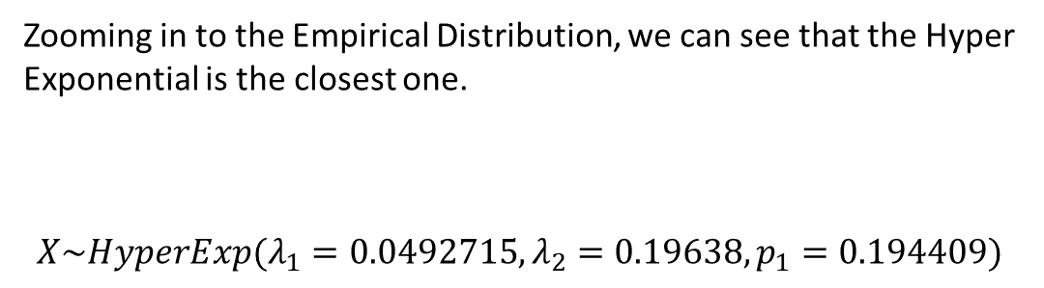
Fitting Result – Video Editing
Zooming in to the Empirical Distribution, we can see that the Hyper Exponential is the closest one.
$$X\sim HyperExp(λ_{1}=0.0492715, λ_{2}=0.19638, p_{1}=0.194409)$$

Slide 8
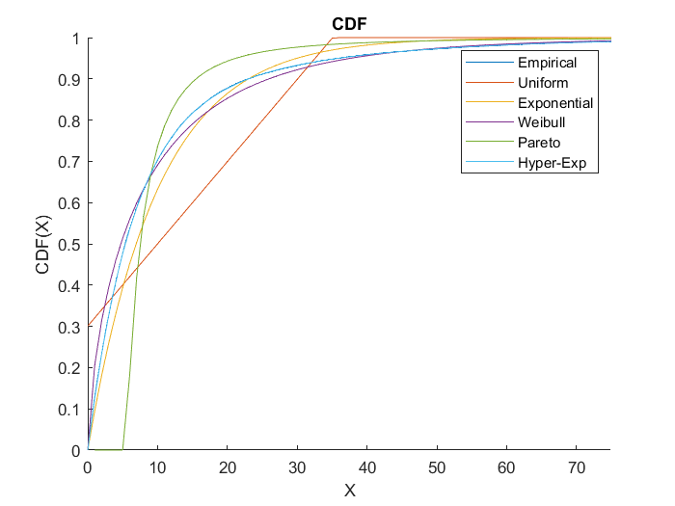
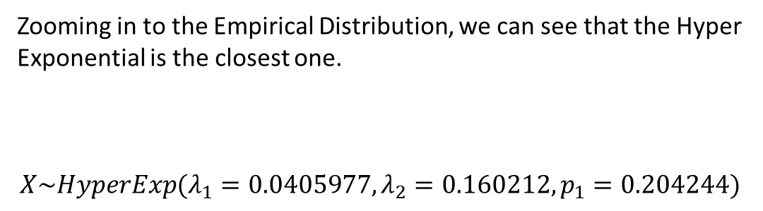
Fitting Result – VFX
Zooming in to the Empirical Distribution, we can see that the Hyper Exponential is the closest one.
$$X\sim HyperExp(λ_{1}=0.0405977, λ_{2}=0.160212, p_{1}=0.204244)$$

Slide 9
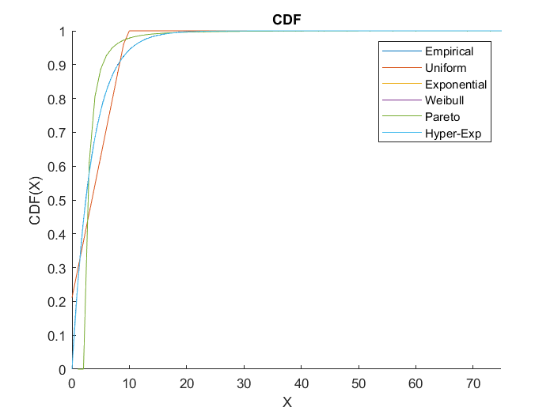
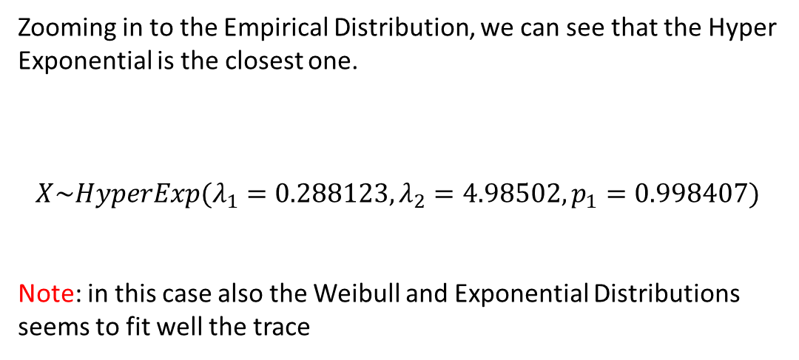
Fitting Result – Compositing
Zooming in to the Empirical Distribution, we can see that the Hyper Exponential is the closest one.
$$X\sim HyperExp(λ_{1}=0.288123, λ_{2}=4.98502, p_{1}=0.998407)$$
Note: in this case also the Weibull and Exponential Distributions seems to fit well the trace

Slide 10
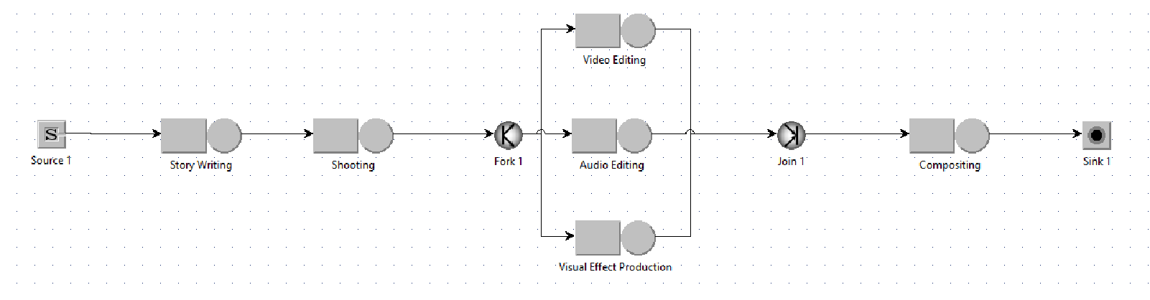
The (open) Model
Arrival Rate = Target Throughput

Slide 11
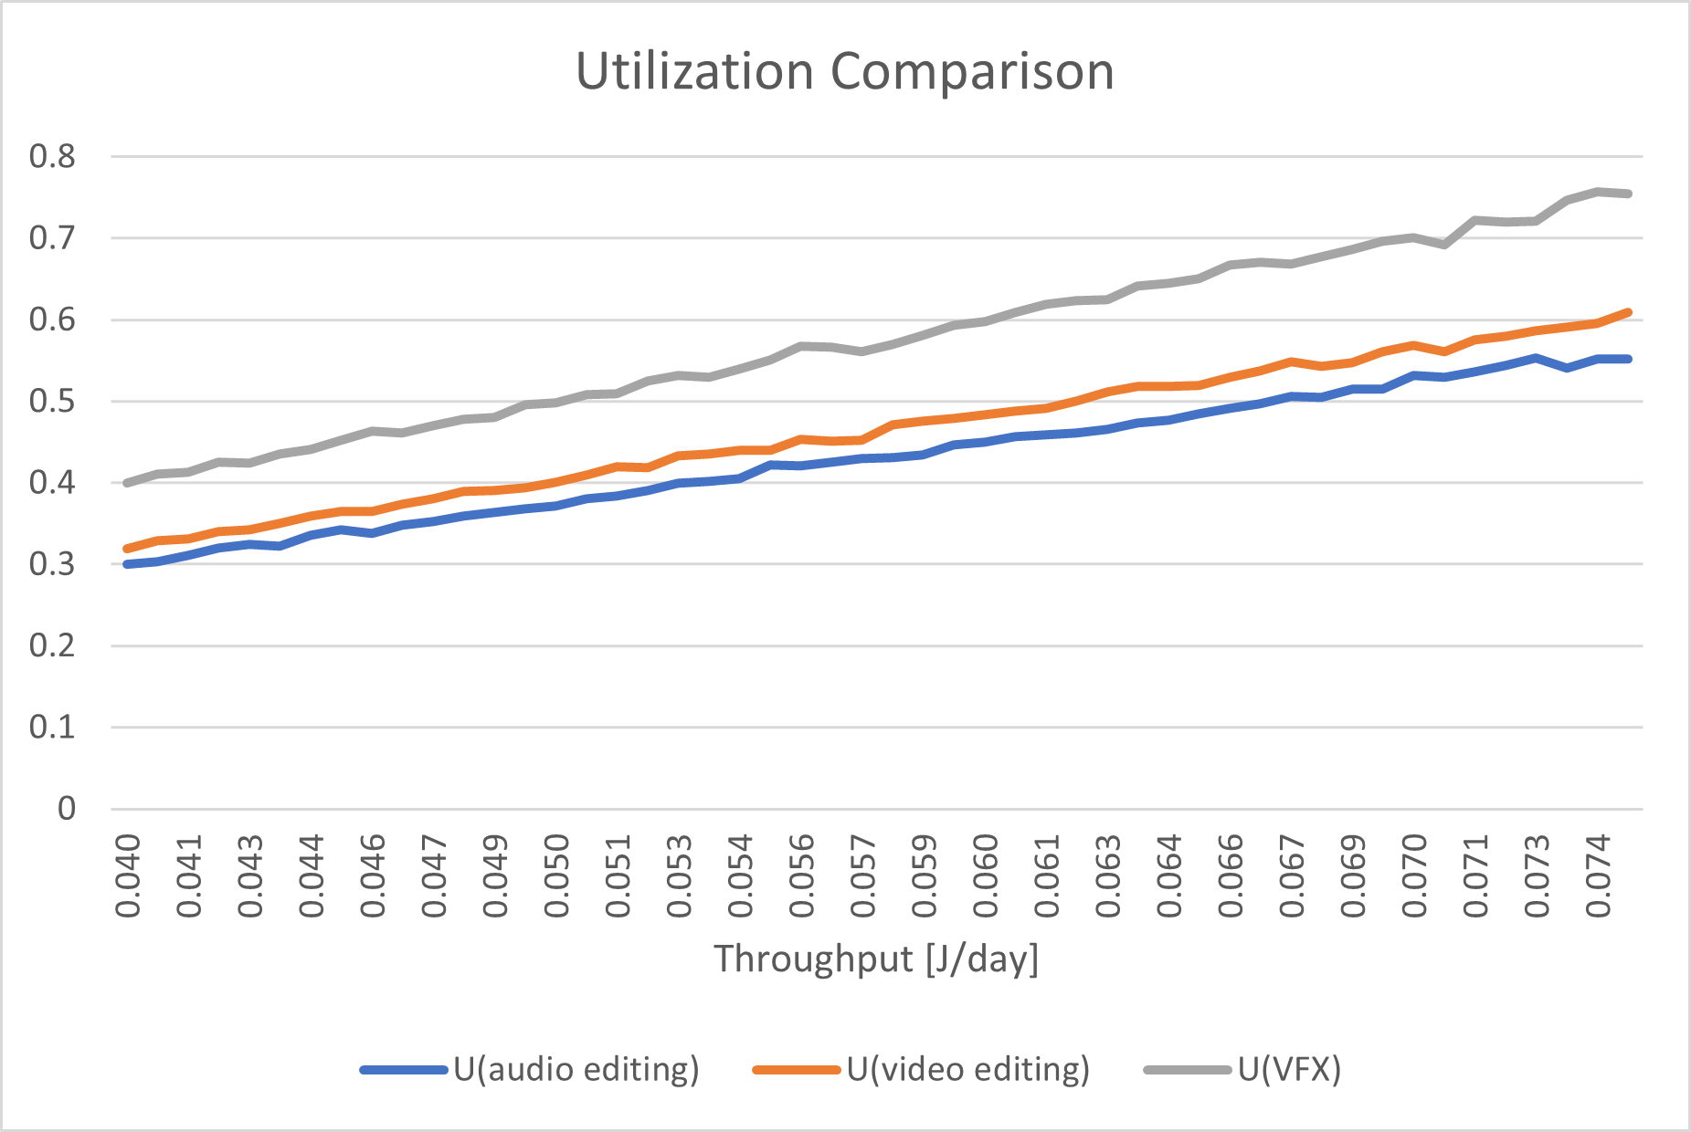
Find the bottleneck(s)
Run a What-If analysis to identify what is the bottleneck (highest utilization in the parallel section)
As we can see the VFX utilization clearly dominates the other ones, then we can add another VFX by putting `2` into Number of Servers in JMT upon double clicking on the VFX queue (service section)

Slide 12
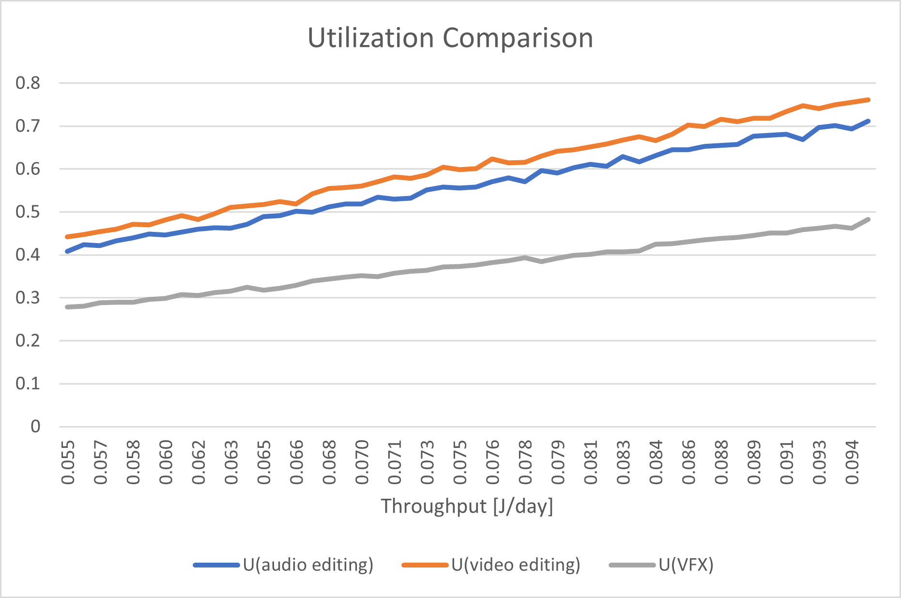
Find the bottleneck with an extra VFX
Run a What-If analysis to identify what is the bottleneck (highest utilization in the parallel section)
In this case the bottleneck is the Video Editing, we add another one

Slide 13
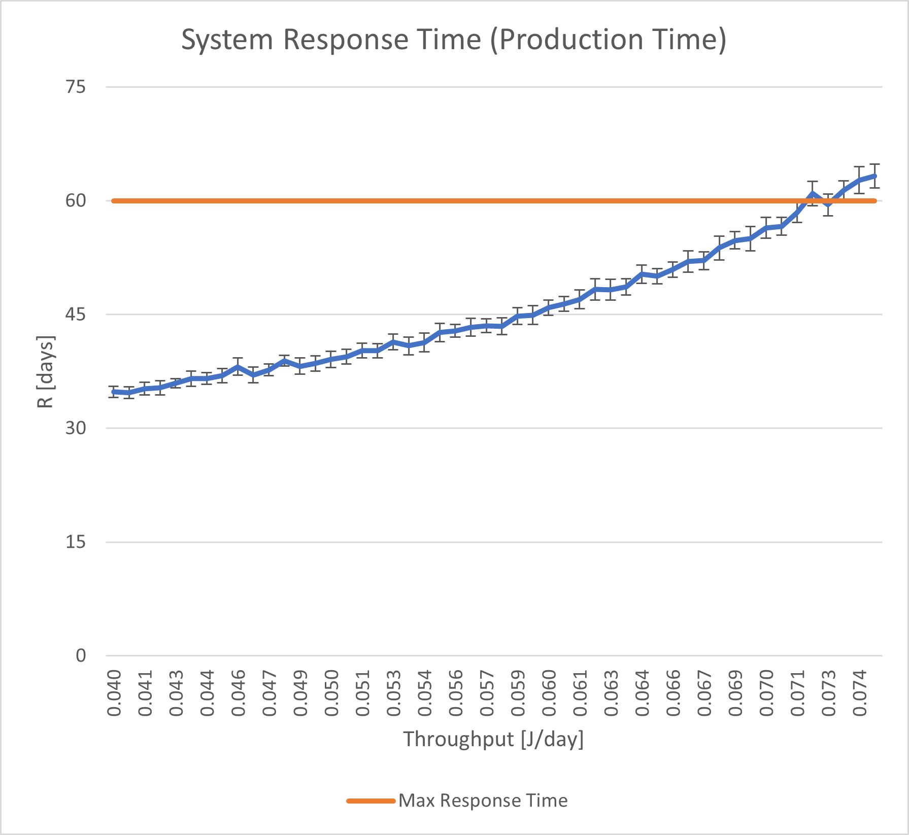
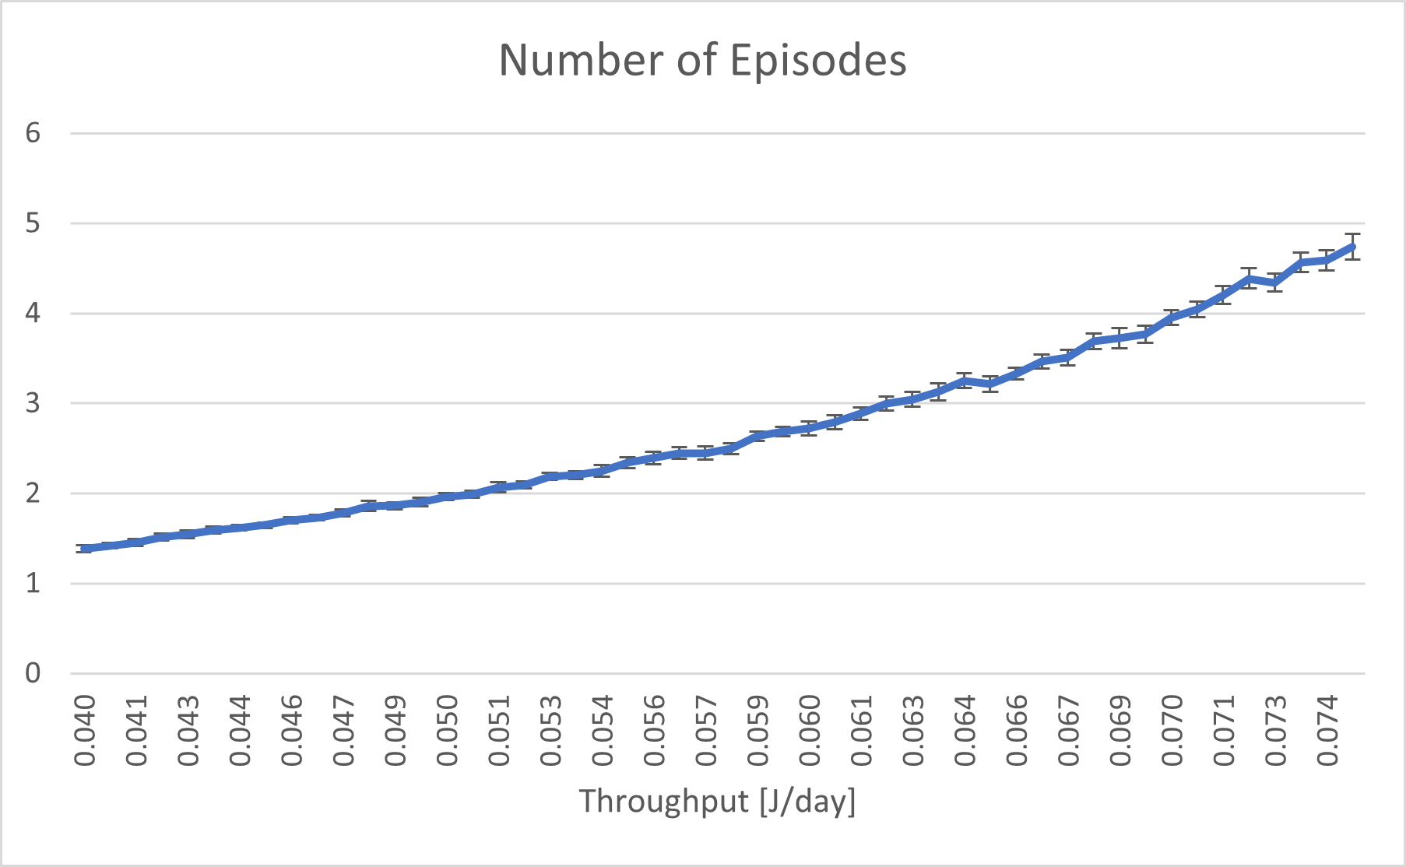
How to find the optimum? (Case w. no extra unit)
Run a What-If analysis to identify what is the maximum throughput possible in this scenario
X ≈ 0.073214 j/day or 1 episode every 13.65 days
This corresponds to N ≈ 4.4 jobs in the system

Slide 14
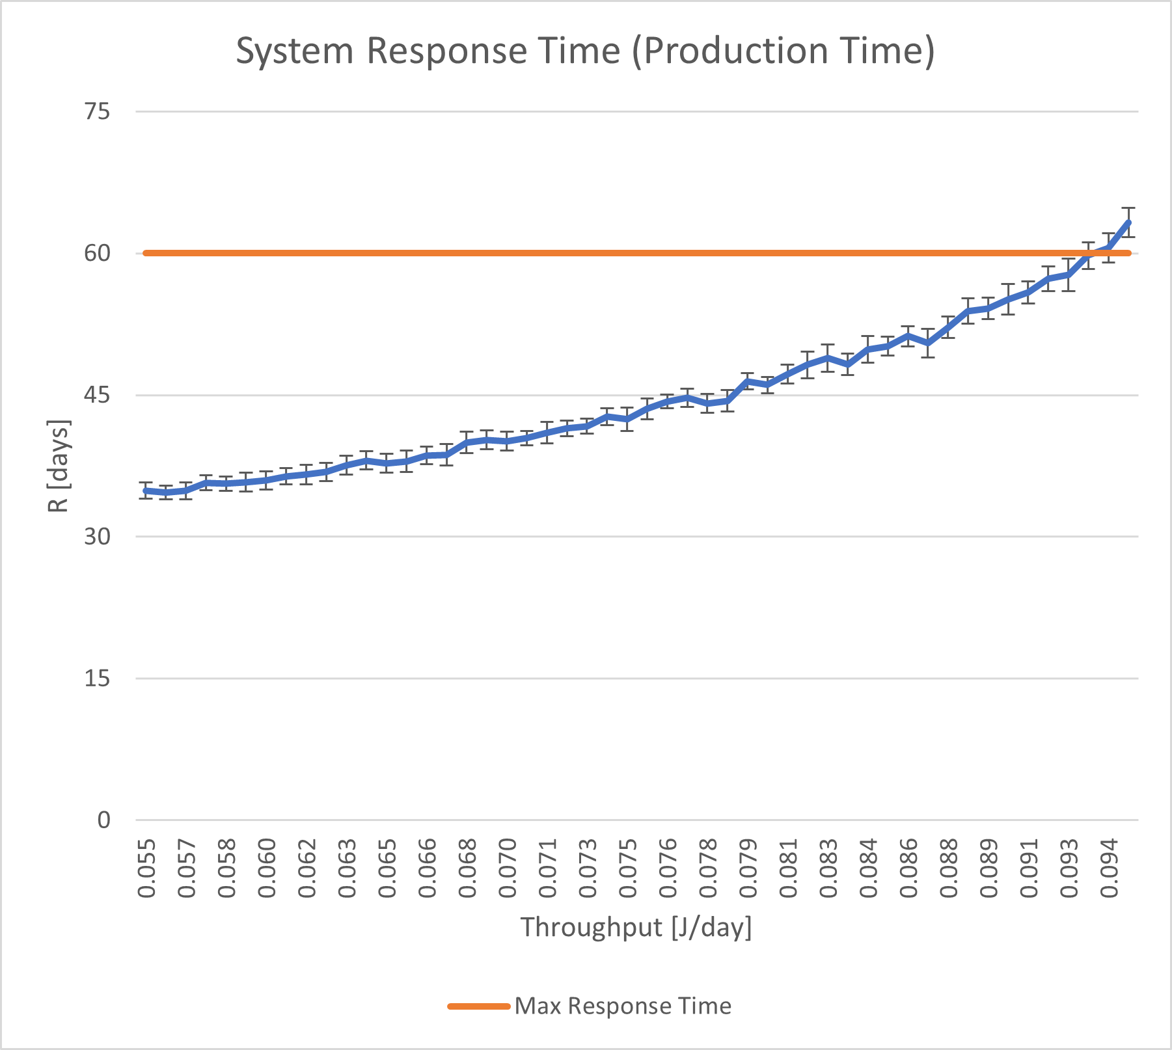
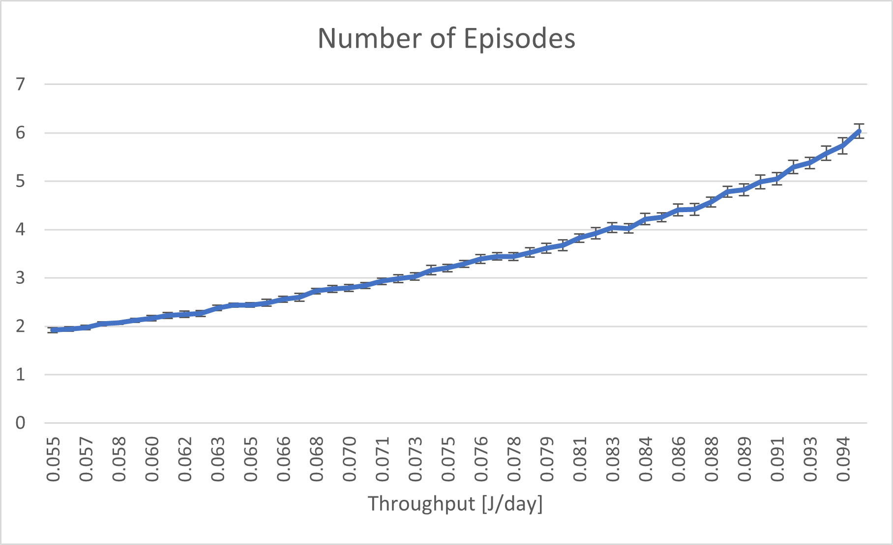
How to find the optimum? (Case w. 1 extra VFX)
Run a What-If analysis to identify what is the maximum throughput possible in this scenario
X ≈ 0.093776 j/day or 1 episode every 10.66 days
This corresponds to N ≈ 5.6 jobs in the system

Slide 15
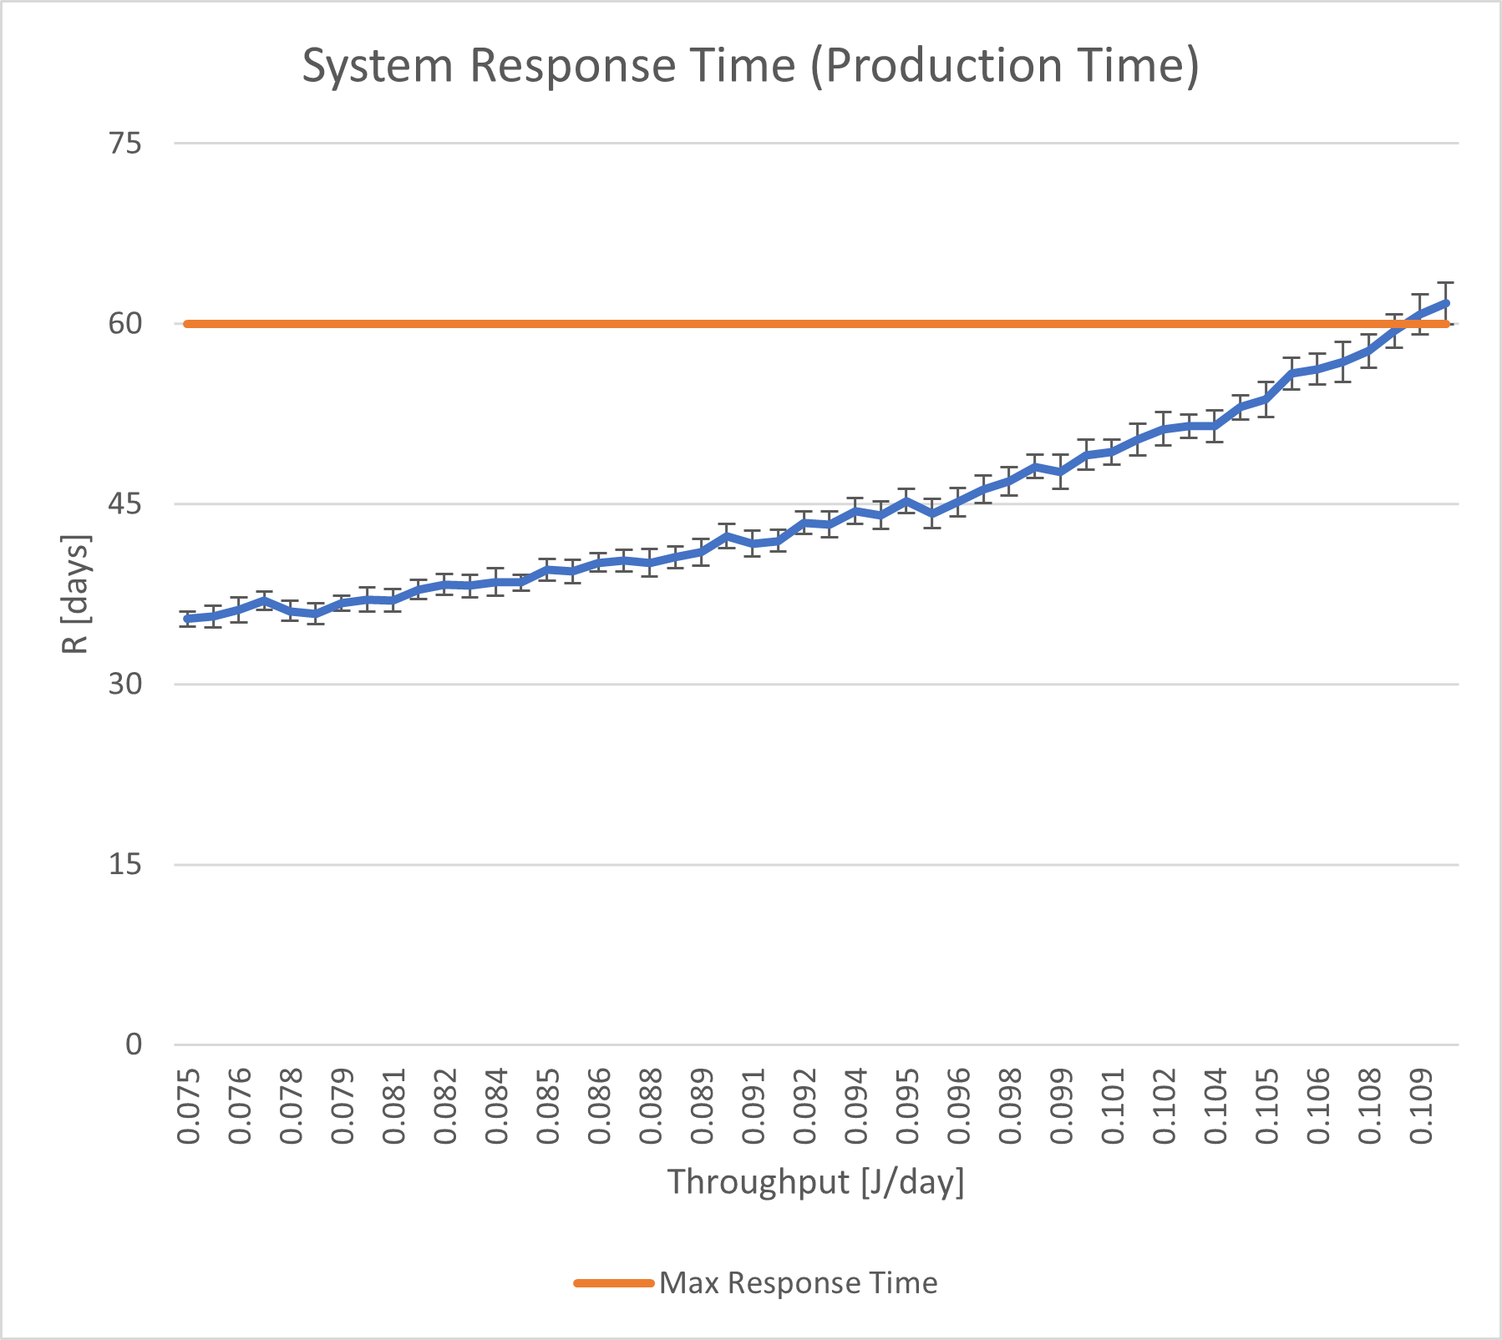
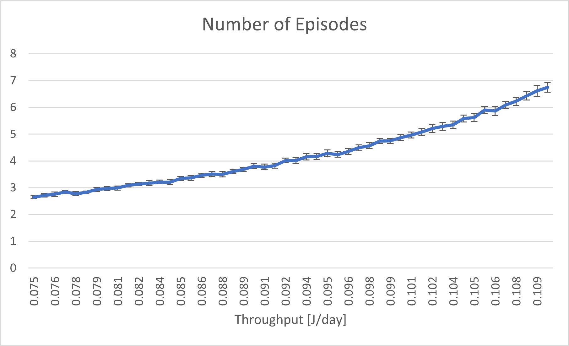
How to find the optimum? (Case w. VFX + V_Edit)
Run a What-If analysis to identify what is the maximum throughput possible in this scenario
X ≈ 0.108929 j/day or 1 episode every 9.18 days
This corresponds to N ≈ 6.42 jobs in the system

Slide 16
Final Remarks
To ensure accurate fitting, it was necessary to eliminate data entries containing 0 from the traces, resolving issues with MATLAB.
I opted to present and utilize the open model as I believe that the creation of new episodes should not be constrained by the completion of older episodes. However, I acknowledge that a closed model also holds merit since the total number of episodes to produce (N) is, at the end, an integer.

