Slide 1
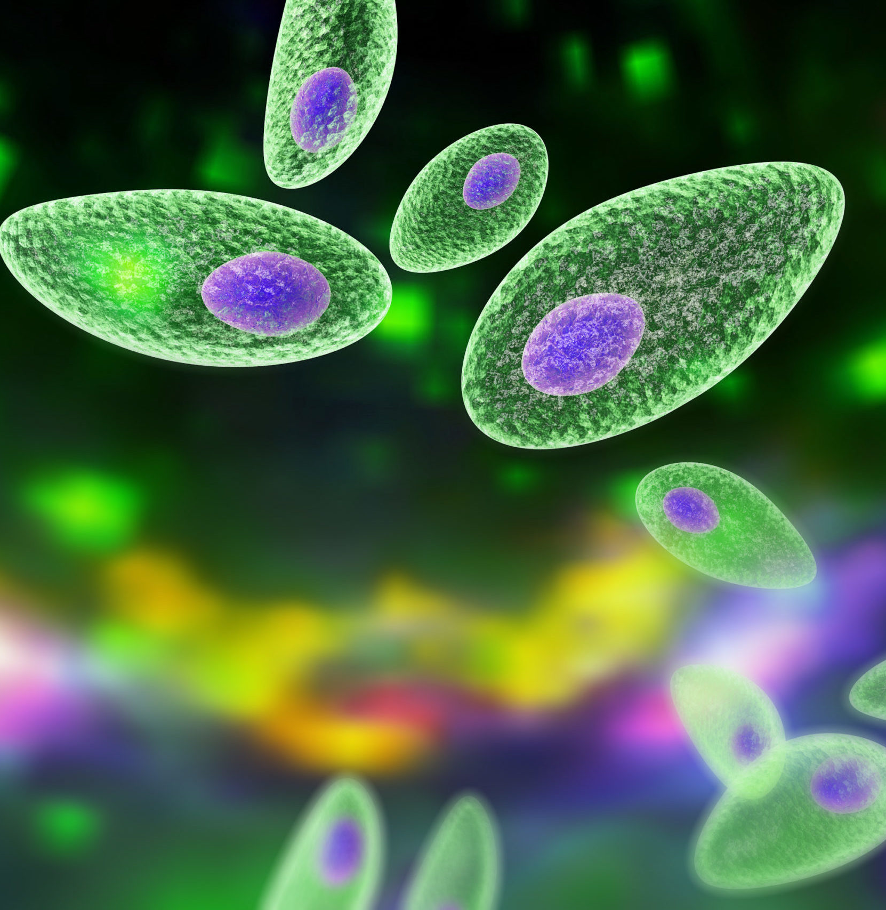

University of Milano-Bicocca
Master's Degree in Data Science
Data Science Lab in Biosciences
Academic Year 2022-2023
TOXOPLASMA GONDII:
TAXONOMY & PUBLICATION ANALYSIS
Authors:
Giorgio CARBONE matr. n° 811974
Emilio LINGENTHAL matr. n° 889111
Lorenzo LONGO matr. n° 846738

Slide 2
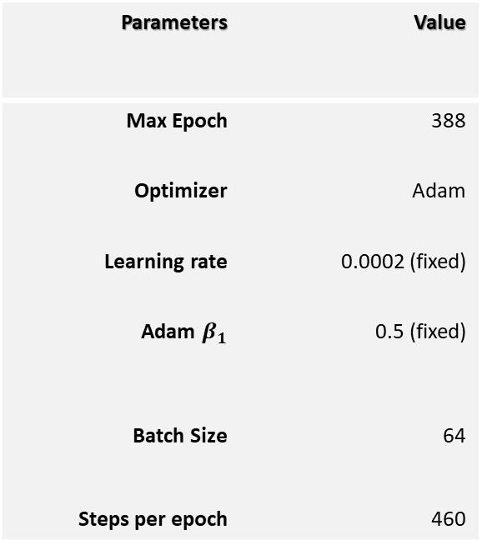
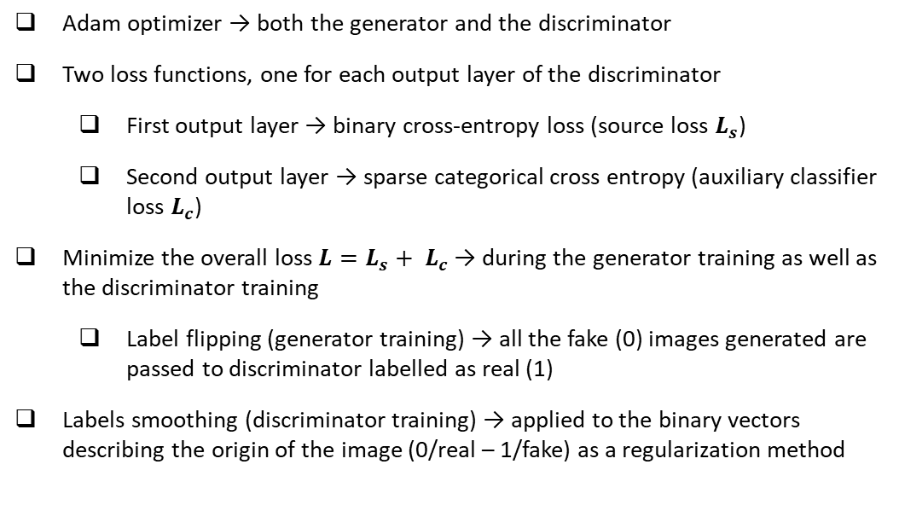
Training and regularization
Adam optimizer → both the generator and the discriminator
Two loss functions, one for each output layer of the discriminator
First output layer → binary cross-entropy loss (source loss $L_{s}$)
Second output layer → sparse categorical cross entropy (auxiliary classifier loss $L_{c}$)
Minimize the overall loss ${L=L_{s}+ L}_{c}$→ during the generator training as well as the discriminator training
Label flipping (generator training) → all the fake (0) images generated are passed to discriminator labelled as real (1)
Labels smoothing (discriminator training) → applied to the binary vectors describing the origin of the image (0/real – 1/fake) as a regularization method
Parameters | Value
Max Epoch | 388
Optimizer | Adam
Learning rate | 0.0002 (fixed)
Adam $β_{1}$ | 0.5 (fixed)
Batch Size | 64
Steps per epoch | 460

Slide 3
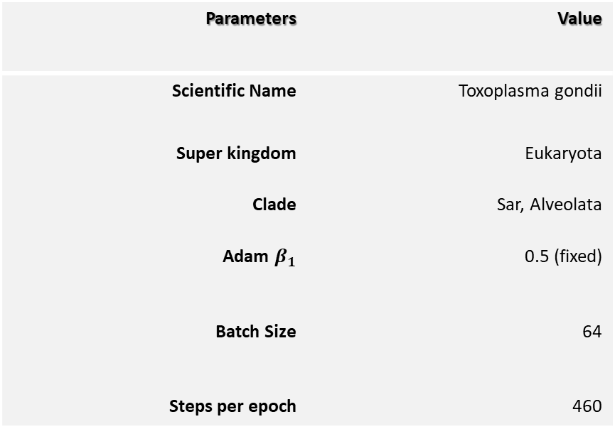
Taxonomy
Parameters | Value
Scientific Name | Toxoplasma gondii
Super kingdom | Eukaryota
Clade | Sar, Alveolata
Adam $β_{1}$ | 0.5 (fixed)
Batch Size | 64
Steps per epoch | 460
Action: waving

Slide 4
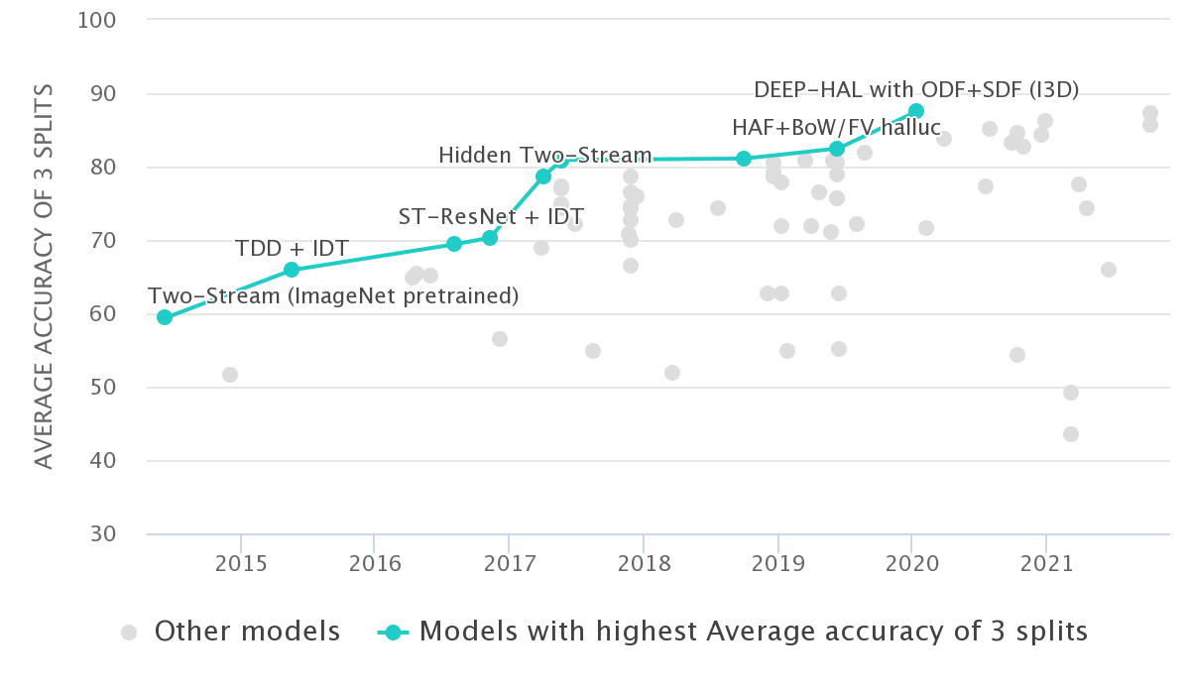
Simple Action Recognition: Video Classification Methods
Hand-crafted Features
Single Stream Networks
Single-Frame CNN (2D CNN’s)
Late Fusion / Early Fusion / Slow Fusion (2D CNN’s)
3D ConvNet (C3D)
CNN with LSTM’s
Pose Detection and LSTM
Two Stream Networks
Optical Flow and CNN’s
SlowFast Networks
Action Recognition on HMDB-51: State-of-the-Art:
DEEP-HAL with ODF+SDF (I3D) 2020 -> 87.56%

Slide 5
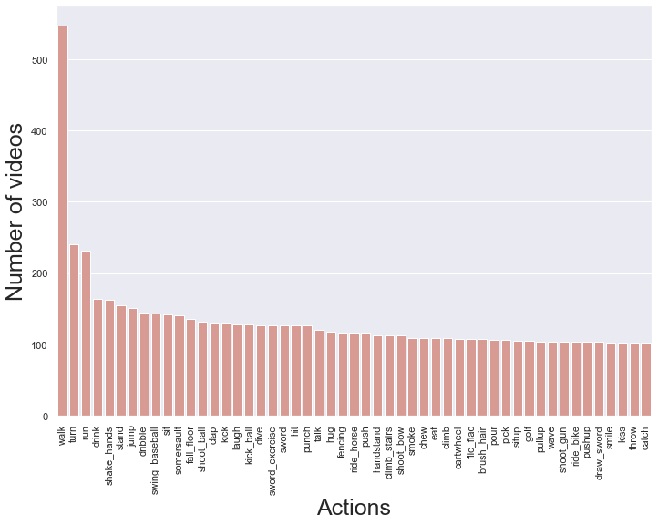
HMDB51: A Large Video Database for Human Motion Recognition
6766 annotated clips
Different sources: Youtube, Google videos, movies.
51 categories with a minimum of 101 clips per action
Categories grouped in five types:
General facial actions
Facial actions with object manipulation
General body movements
Body movements with object interaction
Body movements for human interaction

Slide 6
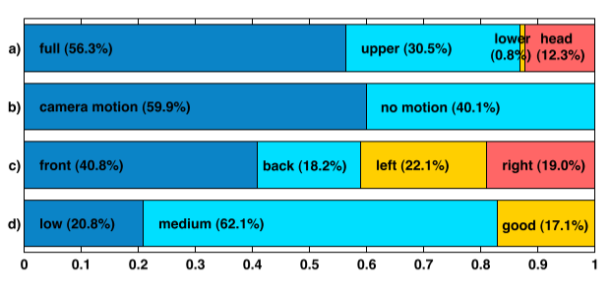
HMDB51: Data Exploration
Additional meta information:
Visible body parts / occlusions: full, upper, lower, head
Camera motion: motion or static
Camera viewpoint: front, back, left, right
Video quality: good, medium or bad
Number of people involved
Video normalization:
Height of all the frames is scaled to 240 pixels
Width is scaled to maintain aspect ratio
Frame rate of 30 fps

Slide 7
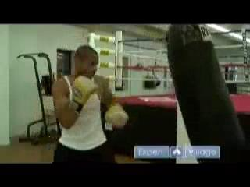
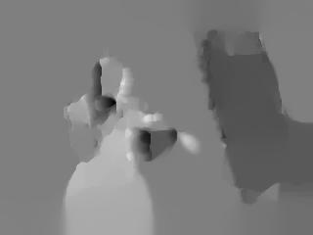
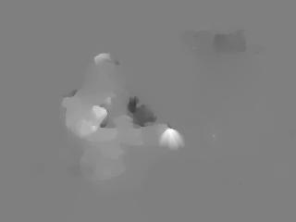
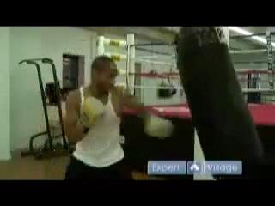
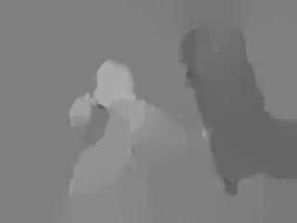
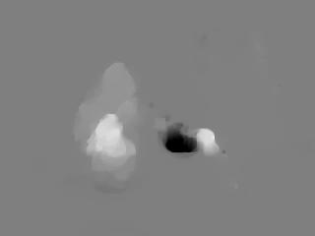
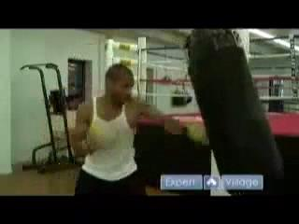
Data Preparation
Training (70 clip/class) and test (30 clip/class) split
Frame extraction (625775 total frames)
Dense Optical Flow extraction
2 consecutive frames
Dual TV-L1 Optical Flow
Sampling
Data augmentation on frames & optical flows:
Random Horizontal flip (50% probability)
Random Crop (224x224)
Random Rotation (0.15)
Centering, scaling and Resizing (224x224)
X flow
Y flow

Slide 8
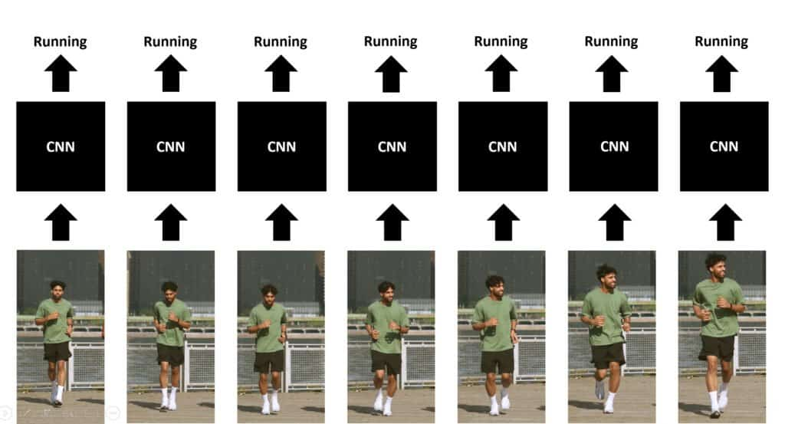
First approach: CNN single frame classification
Architecture
Convolutional Neural Network
17 frames per video
Layers:
Preprocessing (224 x 224 x 3)
Convolutional2D (activation: Relu)
Zero padding
Batch normalization
MaxPooling (pool size: 3x3, stride: 2)
Dense (dropout: 0.5, activation: ReLu, Softmax)

Slide 9
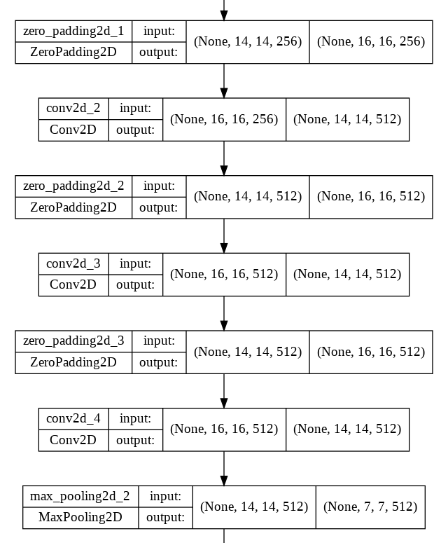
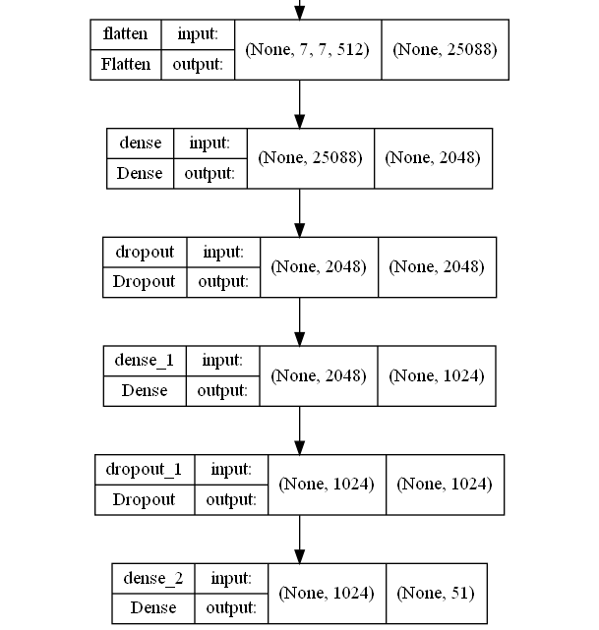
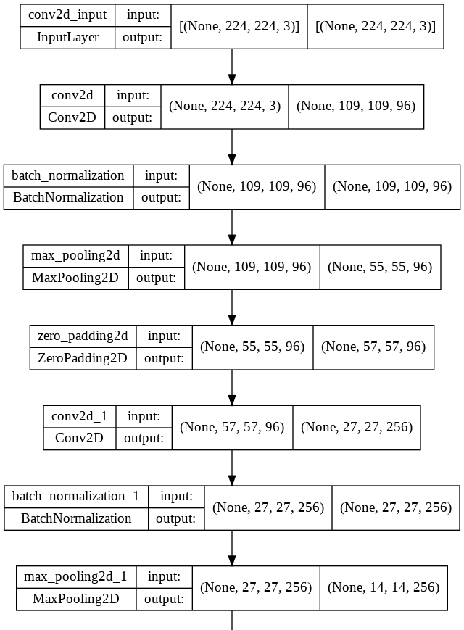
First approach: CNN single frame classification

Slide 10
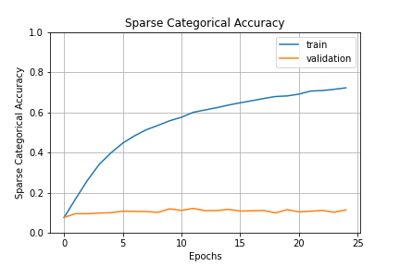
First approach: CNN single frame classification
First train:
Validation loss: 13.73
Top 1 accuracy: 6.6%
Best train:
Validation loss: 4.74
Top 1 accuracy: 12.1%
Top 5 accuracy: 34.4%
 | Optimizer | Epochs | L.R. | Batch | Train. P. | Data Aug. | Norm.
First | Adam | 100 | 0.001 | 64 | 117,789,043 | Resize | [0, 255]
Best | Adam | 25 | 0.001 | 128 | 60,142,035 | Flip, Rot, Crop | [-1, 1]

Slide 11
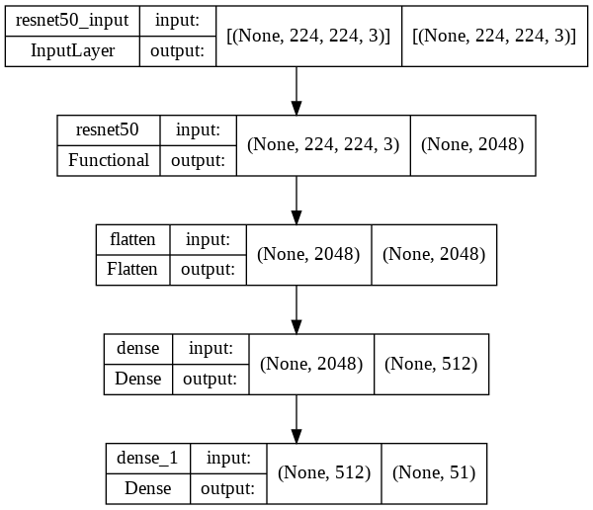
Second approach: Transfer Learning
Architecture
Finetuned CNN based of ResNet50
17 frames per video
Layers:
ResNet50 (not trainable, weights from ImageNet)
Flatten
Dense (activation: ReLu, SoftMax)

Slide 12
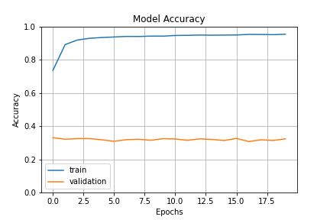
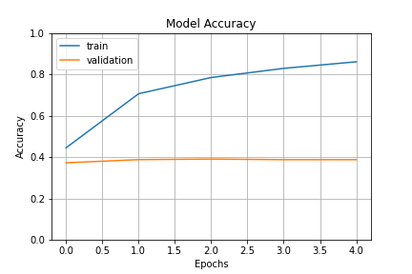
Second approach: Transfer Learning
First train:
Validation loss: 2.91
Top 1 accuracy: 31.9%
Top 5 accuracy: 59.1%
Best train:
Validation loss: 2.30
Top 1 accuracy: 39.0% -> 45.0% (integral video)
Top 5 accuracy: 71.6% -> 78.5% (integral video)
 | Optimizer | Epochs | L.R. | Batch | Train. P. | Data Aug. | Norm
First | Adam | 20 | 0.001 | 64 | 1,075,251 | Resize, Flip | [0,255]
Best | Adam | 5 | 0.0001 | 64 | 1,075,251 | Resize, Flip | Centered

Slide 13
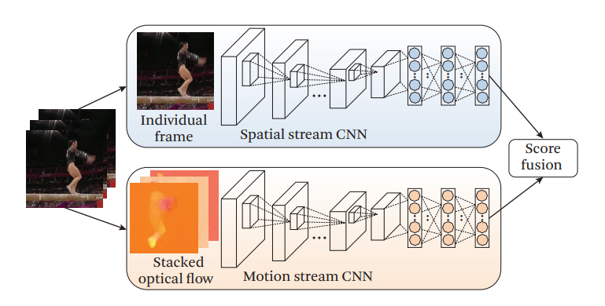
Third approach: two-stream CNN
Architecture:
Spatial CNN + Temporal CNN
Averaging SoftMax results
Spatial stream:
Finetuned ResNet
Motion stream:
Same architecture as “first approach CNN” with input size (224, 224, 20)
Semi-randomly selected batch of N stacked optical flow from N randomly selected videos
Each flow stack is composed of 10 x-channels and 10 y-channels consecutive optical flows

Slide 14
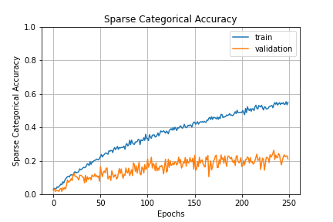
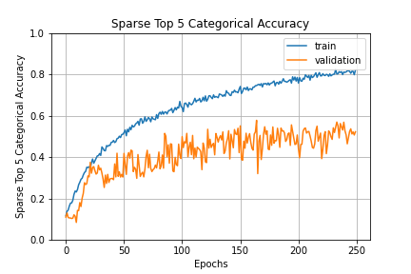
Third approach: two-stream CNN (motion stream)
First train:
Validation loss: 3.46
Top 1 accuracy: 15.0%
Top 5 accuracy: 42.4%
Best train:
Validation loss: 3.27
Top 1 accuracy: 25.8%
Top 5 accuracy: 54.3%
 | Optimizer | Epochs | L.R. | Batch | Train. P. | Data Aug. | Norm
First | SGD (mom. 0.9) | 100 | 0.01 | 64 | 117,789,043 | Resize | [0, 255]
Best | SGD (mom. 0.9) | 250 | 0.01 | 128 | 60,142,035 | Flip, Crop, Resize | Cent + Scal

Slide 15
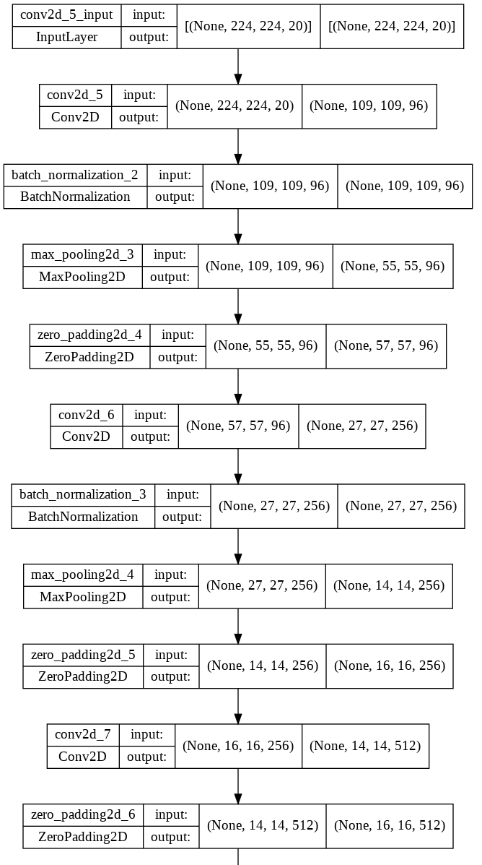
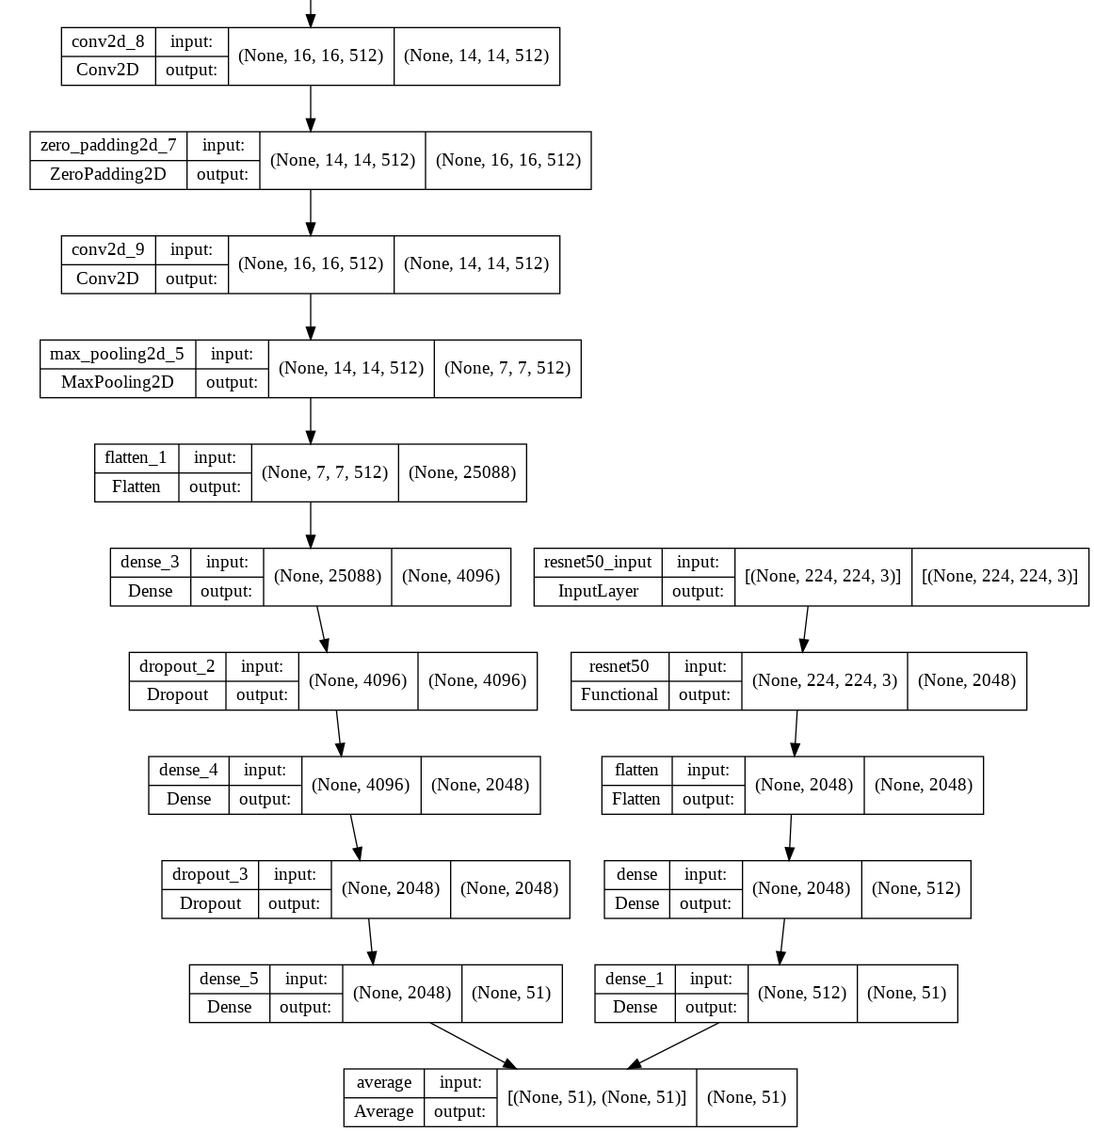
Third approach: two-stream CNN
Two-stream CNN:
Validation loss: 2,33
Top 1 accuracy: 38%
Top 5 accuracy: 70%

Slide 16
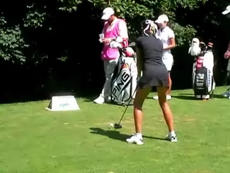
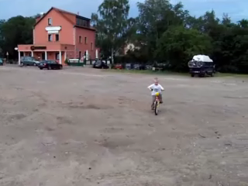
Models prediction on integral video (example)
Spatial net:
golf: 98,38 %
shoot_bow: 0,81%
catch: 0,40 %
kick_ball: 0,25 %
handstand: 0,03 %
Temporal net:
golf: 66,3 %
climb: 6,1 %
handstand: 5,0 %
walk: 2,0 %
pick: 2,0 %
Spatial net:
ride_bike: 75,6 %
push: 17,1 %
draw_sword: 1,1 %
ride_horse: 0,9 %
dive: 0,7 %
Temporal net:
catch: 19,2 %
cartwheel: 6,8 %
sommersault: 6,6 %
dide_horse: 5,3 %
climb: 5,3 %

Slide 17
Final evaluation
Best method:
ResNet (accuracy: 45,0% , top 5 accuracy: 78,5%)
Possibly the two-stream CNN in case of steady or stabilized videos
Possible causes of low accuracy:
Dataset:
Nuisances (camera motion, scenes cuts, low quality videos)
Limited number of individual videos (6849 clips extracted from 1407 videos)
Short action duration compared to video length (can be missed during the sampling phase)
Models:
Not optimal training parameters
Too many weights compared to data (first model)

Slide 18
Bibliography
Kuehne, Hildegard, et al. "HMDB: a large video database for human motion recognition." 2011 International conference on computer vision. IEEE, 2011.
Wang, Lei, and Piotr Koniusz. "Self-supervising action recognition by statistical moment and subspace descriptors." Proceedings of the 29th ACM International Conference on Multimedia (2021.)
Simonyan, Karen, and Andrew Zisserman. "Two-stream convolutional networks for action recognition in videos." Advances in neural information processing systems 27 (2014).
Wang, Limin, et al. "Temporal segment networks: Towards good practices for deep action recognition." European conference on computer vision. Springer, Cham, (2016).
Sargano, Allah Bux, Plamen Angelov, and Zulfiqar Habib. "A comprehensive review on handcrafted and learning-based action representation approaches for human activity recognition." applied sciences 7.1 (2017).
Laptev, Ivan, et al. "Learning realistic human actions from movies." 2008 IEEE Conference on Computer Vision and Pattern Recognition. IEEE, (2008).

Slide 19
Bibliography
Zach, Christopher, Thomas Pock, and Horst Bischof. "A duality based approach for realtime tv-l 1 optical flow." Joint pattern recognition symposium. Springer, Berlin, Heidelberg, (2007).
Karpathy, Andrej, et al. "Large-scale video classification with convolutional neural networks." Proceedings of the IEEE conference on Computer Vision and Pattern Recognition. (2014).

