Slide 1
Exploratory Data Analysis
Central Mediterranean route (IOM): monthly crossings time series + Missing Migrants incidents (2014–2025)
Each figure includes a ready-to-run R/ggplot2 snippet (full script: eda_plots.R)

Slide 2
Datasets used (already available)
1) IOM Missing Migrants Project (incident-level)
• File: iom_mmp_incidents_2014_2025_reg.csv
• Filter used in this EDA: Route == "Central Mediterranean"
• Key fields: Incident date, No. dead/missing, Cause of death (category), Latitude/Longitude
2) IOM monthly Mediterranean crossings time series (multivariate time series)
• File: med_crossings_monthlyTS.csv (one row per month)
• Central Med attempt proxy: arrivals (Italy+Malta) + interceptions (Libyan Coast Guard) + CMR deaths
• In this file, the LCG interceptions series starts in 2016 (earlier months are missing)
EDA goals for the slide deck
• Visualize trends in attempts and mortality (risk per attempt)
• Summarize incident composition (causes) and geography (pre/post key dates)
• Check consistency across the two datasets and surface definition mismatches
• Produce reusable R code blocks you can paste into a Quarto/analysis pipeline

Slide 3
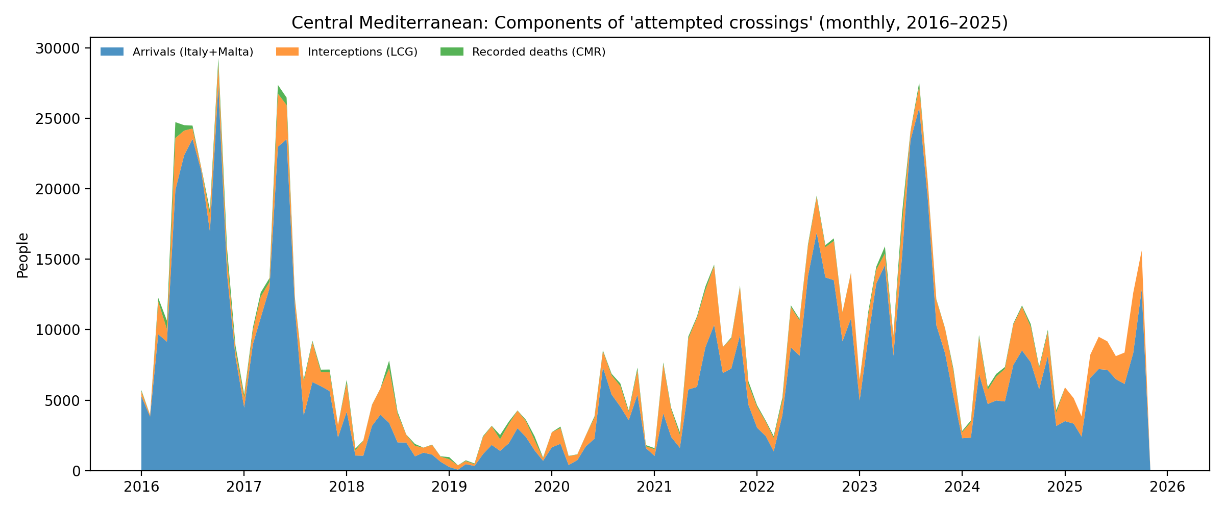
Time series: components of attempted crossings (CMR, 2016–2025)
R (ggplot2) snippet
1 library(tidyverse); library(lubridate) 2 ts <- read_csv("med_crossings_monthlyTS.csv") %>% 3 mutate(date=as.Date(date), 4 arrivals=coalesce(sea_arrivals_in_italy,0)+coalesce(sea_arrivals_in_malta,0), 5 interceptions=coalesce(interceptions_by_libyan_coast_guard,0), 6 deaths=coalesce(cmr,0)) 7 ts %>% filter(date>=as.Date("2016-01-01")) %>% 8 transmute(date, arrivals, interceptions, deaths) %>% 9 pivot_longer(-date) %>% 10 ggplot(aes(date, value, fill=name)) + geom_area(alpha=.8)
LCG interceptions start in 2016 in this file → plot window uses 2016–2025.

Slide 4
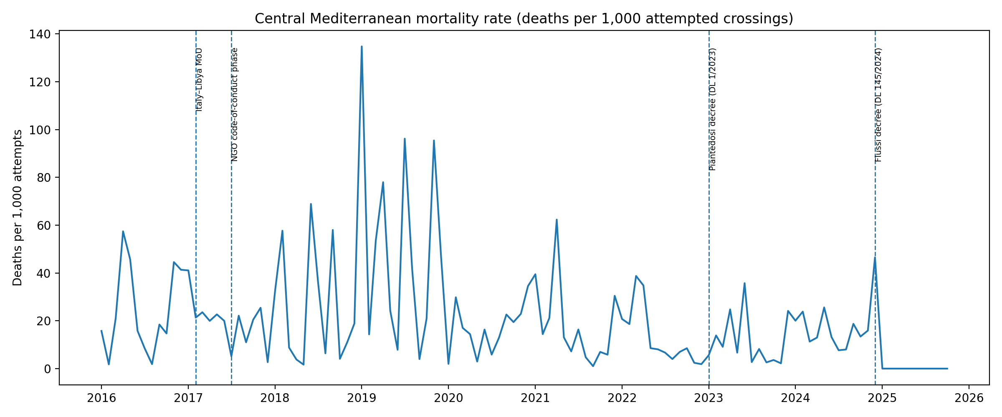
Time series: mortality per 1,000 attempts + policy markers
R (ggplot2) snippet
1 policy <- tibble::tribble( 2 ~label, ~d, 3 "MoU", as.Date("2017-02-02"), 4 "NGO CoC", as.Date("2017-07-01"), 5 "Piantedosi", as.Date("2023-01-02"), 6 "Flussi", as.Date("2024-12-01") 7 ) 8 ts %>% filter(date>=as.Date("2016-01-01")) %>% 9 mutate(attempts=arrivals+interceptions+deaths, 10 mort_1000=deaths/attempts*1000) %>% 11 ggplot(aes(date, mort_1000)) + geom_line() + 12 geom_vline(data=policy, aes(xintercept=d), linetype="dashed")
Descriptive EDA only: overlapping shocks and reporting changes mean these are not causal effects.

Slide 5
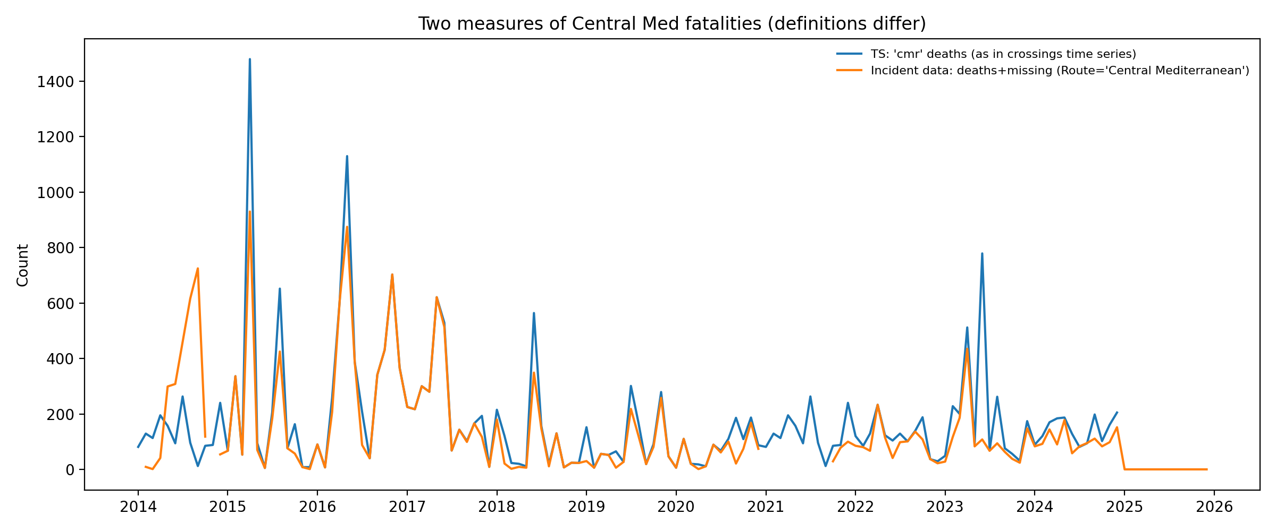
Definition check: fatalities in TS vs incident data
R (ggplot2) snippet
1 inc <- read_csv("iom_mmp_incidents_2014_2025_reg.csv") %>% 2 rename(incident_date = `Incident date`) %>% 3 mutate(incident_date=as.Date(incident_date)) %>% 4 filter(Route=="Central Mediterranean") 5 inc_m <- inc %>% 6 mutate(month=floor_date(incident_date,"month")) %>% 7 group_by(month) %>% 8 summarise(deaths_missing=sum(`No. dead/missing`, na.rm=TRUE)) 9 compare <- ts %>% select(date, deaths) %>% 10 left_join(inc_m, by=c("date"="month"))
These series can differ because definitions and route-classification rules differ (TS 'cmr' vs incident Route label; deaths vs deaths+missing).

Slide 6
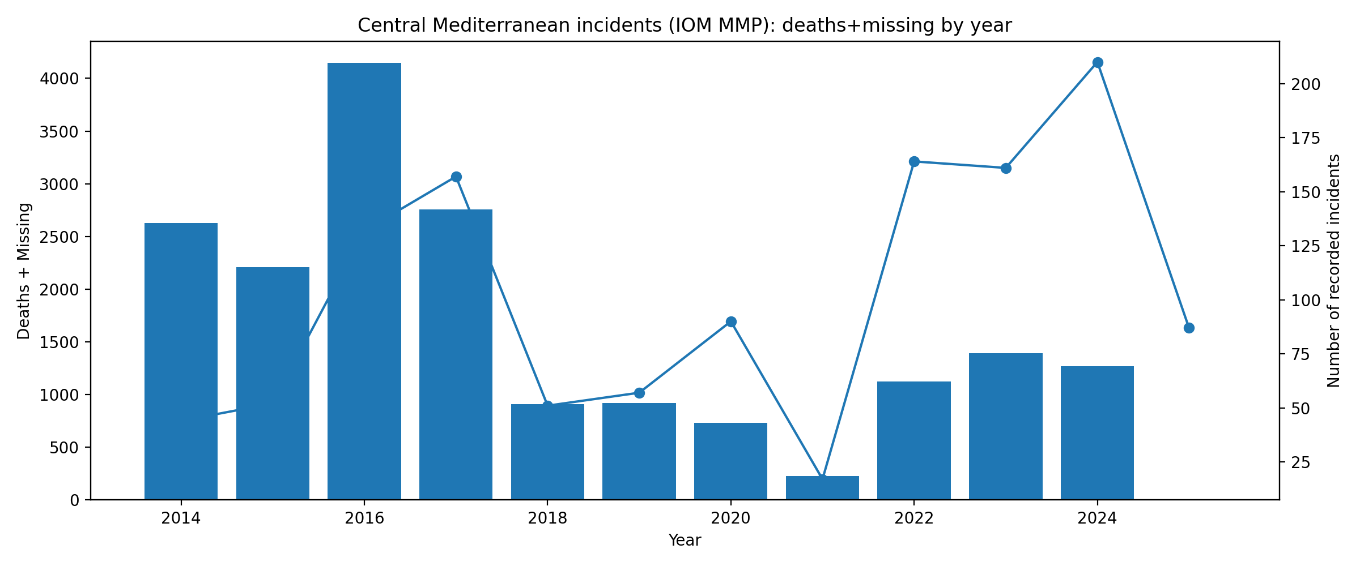
Incidents: deaths+missing by year (bars) and number of incidents (line)
R (ggplot2) snippet
1 inc_y <- inc %>% 2 mutate(year=year(incident_date)) %>% 3 group_by(year) %>% 4 summarise(deaths_missing=sum(`No. dead/missing`, na.rm=TRUE), 5 incidents=n()) 6 fac <- max(inc_y$deaths_missing)/max(inc_y$incidents) 7 ggplot(inc_y, aes(year)) + 8 geom_col(aes(y=deaths_missing)) + 9 geom_line(aes(y=incidents*fac)) + geom_point(aes(y=incidents*fac)) + 10 scale_y_continuous(sec.axis=sec_axis(~./fac, name="Incidents"))
Dual axis uses a scaling factor for readability; keep deaths+missing as the primary measure.

Slide 7
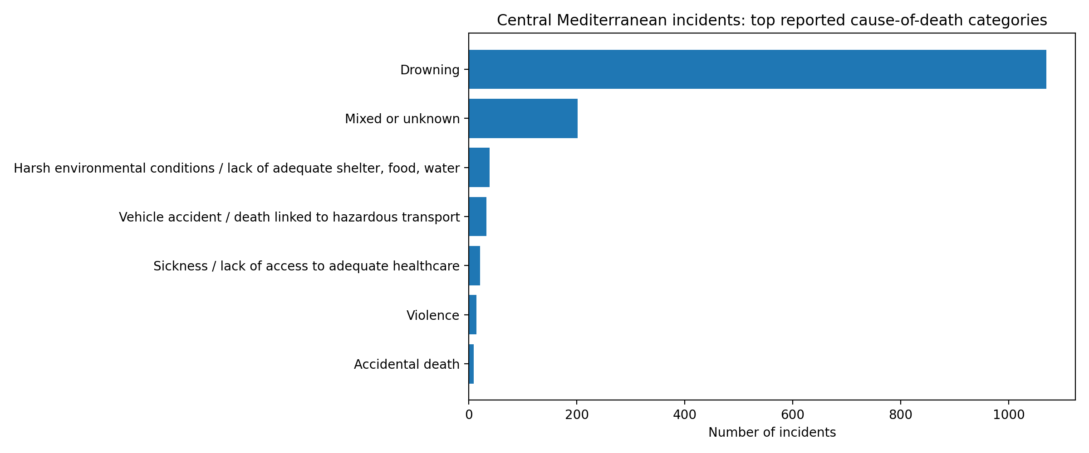
Incidents: top cause-of-death categories (Central Mediterranean)
R (ggplot2) snippet
1 inc %>% 2 mutate(cause=replace_na(`Cause of death (category)`, "Unknown")) %>% 3 count(cause, sort=TRUE) %>% 4 slice_head(n=10) %>% 5 ggplot(aes(reorder(cause, n), n)) + 6 geom_col() + coord_flip()
Typically, “Drowning” dominates. Useful as a check for coding changes over time (composition effects).

Slide 8
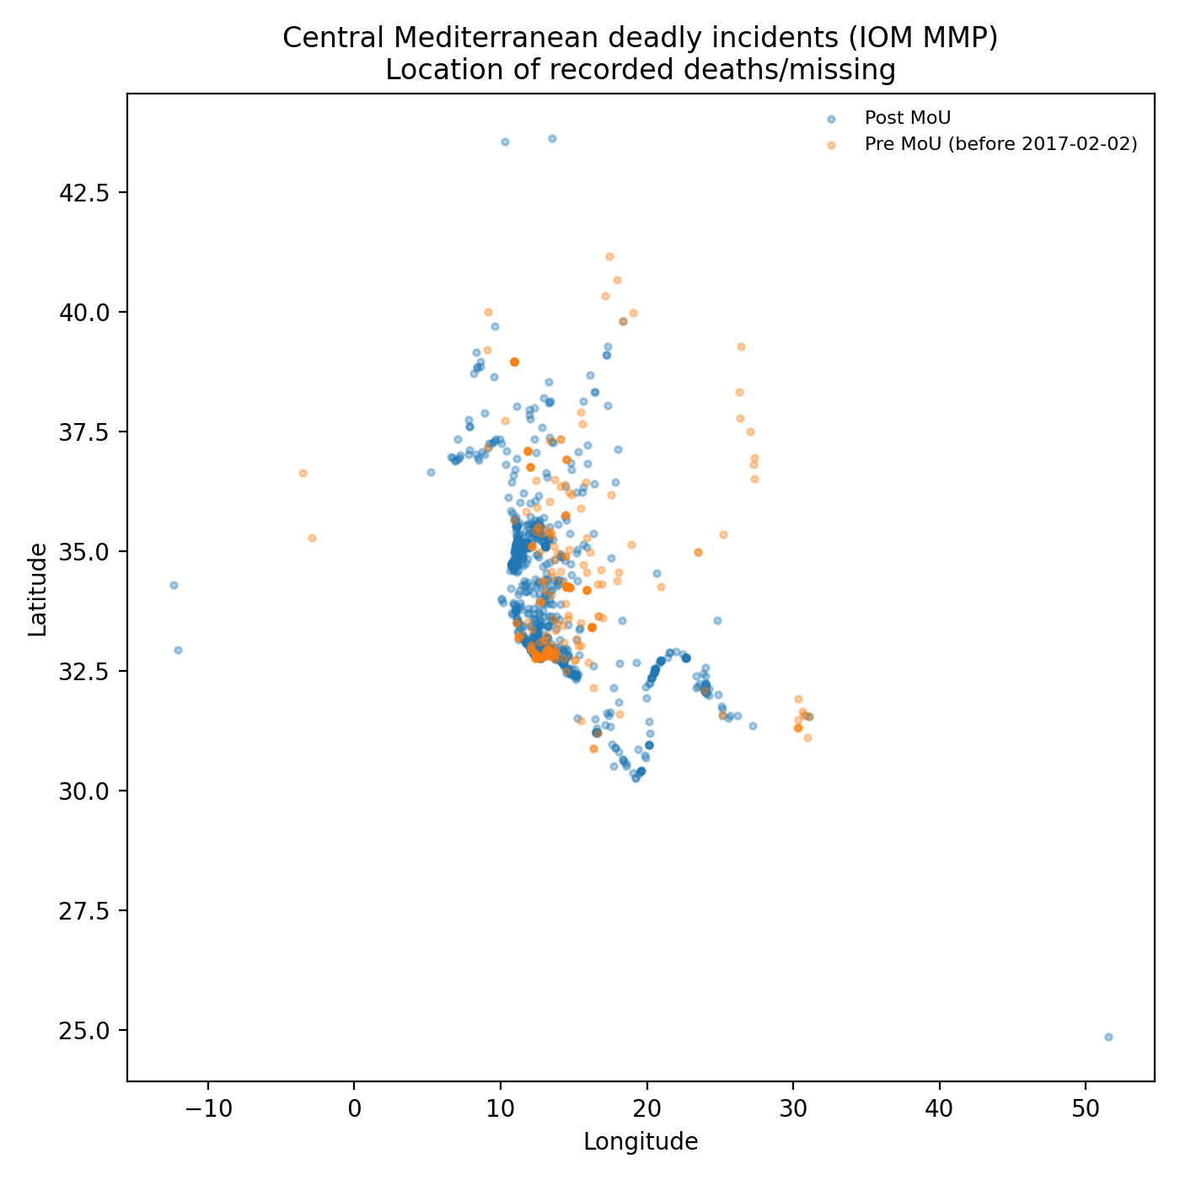
Incidents: spatial distribution of recorded locations (pre/post MoU)
R (ggplot2) snippet
1 inc %>% 2 filter(!is.na(Latitude), !is.na(Longitude)) %>% 3 mutate(period=if_else(incident_date < as.Date("2017-02-02"), 4 "Pre MoU", "Post MoU")) %>% 5 ggplot(aes(Longitude, Latitude, color=period)) + 6 geom_point(alpha=.35, size=1)
This visualizes *reported* incident coordinates, not exposure-adjusted risk by location (needs traffic/rescue presence data).

Slide 9
EDA takeaways and next steps
What these quick plots already show
• The attempt proxy is a constructed denominator (arrivals + LCG interceptions + deaths); the LCG series starts in 2016.
• Mortality (deaths per attempt) is volatile month-to-month; this makes it essential to model seasonality and uncertainty.
• Incident-level totals and TS route totals can diverge (classification + deaths vs deaths+missing).
• Drowning dominates reported causes → but check whether “Unknown/Mixed” share changes in policy periods.
• Spatial patterns are useful descriptively, but causal “where risk increases” needs exposure/rescue-presence proxies (AIS).
Suggested next EDA additions (easy wins)
• Add monthly weather controls (wind + wave height) and re-plot mortality vs sea state.
• Build a “SAR presence” proxy (NGO vessel-days or AIS-based presence) and overlay with mortality/incident geography.
• Harmonize route definitions (TS vs incident data) and document your final definition in an appendix.
• Once EDA is stable: move to a causal design (BSTS / event study) with clear intervention windows.
Full R script saved as: eda_plots.R

