Slide 1
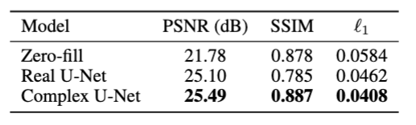
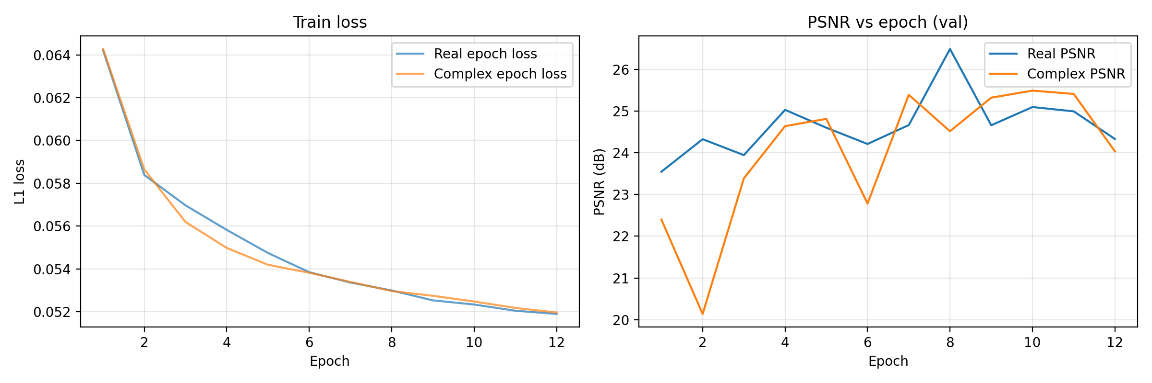
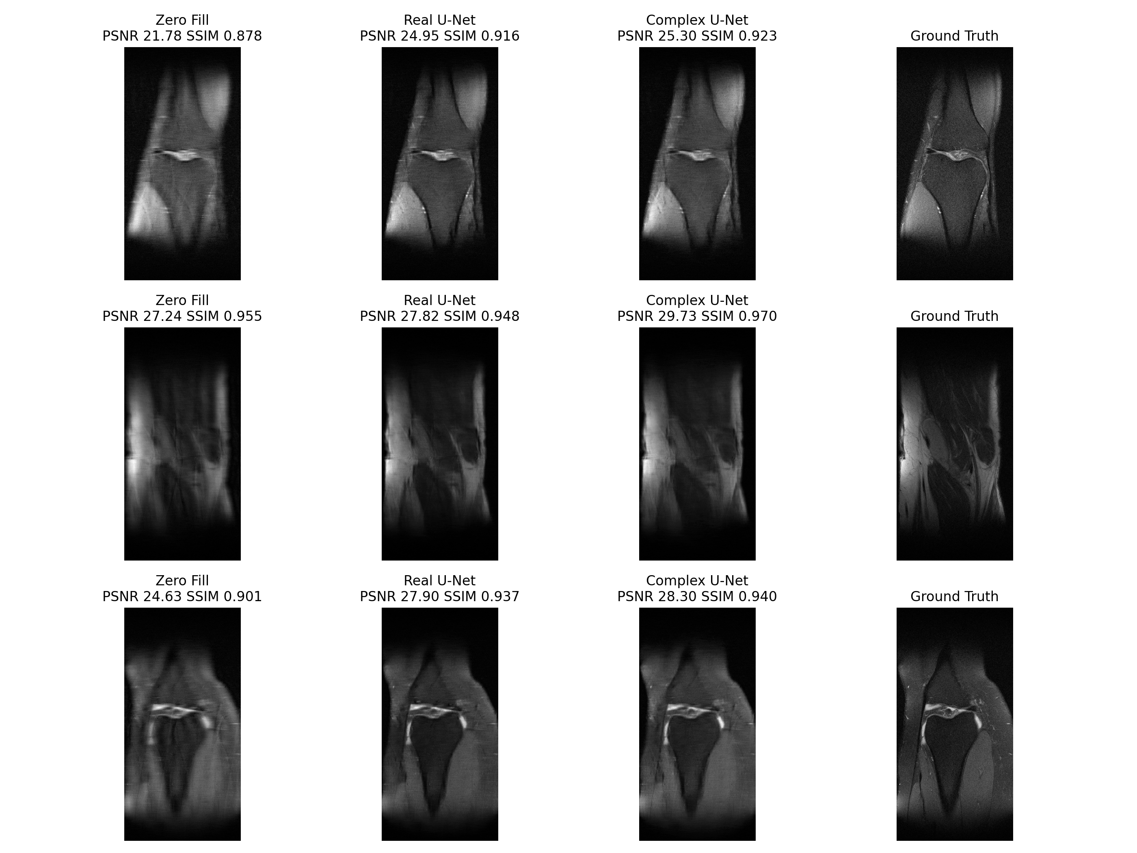
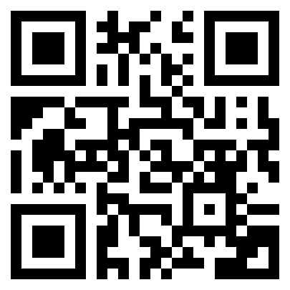
COMPLEX-VALUED CNNS FOR MRI RECONSTRUCTION
Giovanni De Geronimo
Intro
Undersampled MRI leaves zero-fill reconstructions blurry and ringing.
Cole et al. claim capacity-matched complex CNNs can beat real CNNs on MRI
Goal: tiny reproduction on fastMRI single-coil knees with matched real vs. complex U-Nets
Method
Data: fastMRI single-coil knees; equispaced mask with ACS=20 at R=6; slice-wise max-mag normalization
Models: real U-Net (width×1.42) vs. complex U-Net (widths [16,32,64,128,256]); both ~12.6M params
Training: Adam 1e-3, batch 2, 12 epochs (~50k steps), 8,192 train / 1,024 val slices, fixed seeds/masks
Result
Complex U-Net slightly outperforms real counterpart (see tables/figures)
Results directly compare lowest L1 loss checkpoint
Discussion
Complex U-Net delivers a modest but consistent lift at matched capacity.
Scope differs slightly from Cole et al.: single subsampled dataset, simpler mask, only U-Net architecture
Complex U-Net still significantly slower due to more involved operations
Extra Figures
& Tables
Complex-valued U-Nets slightly outperform real ones at matched capacity in MRI reconstruction.
Scan to
See GitHub repo (poster at report/betterposter)

