Slide 1
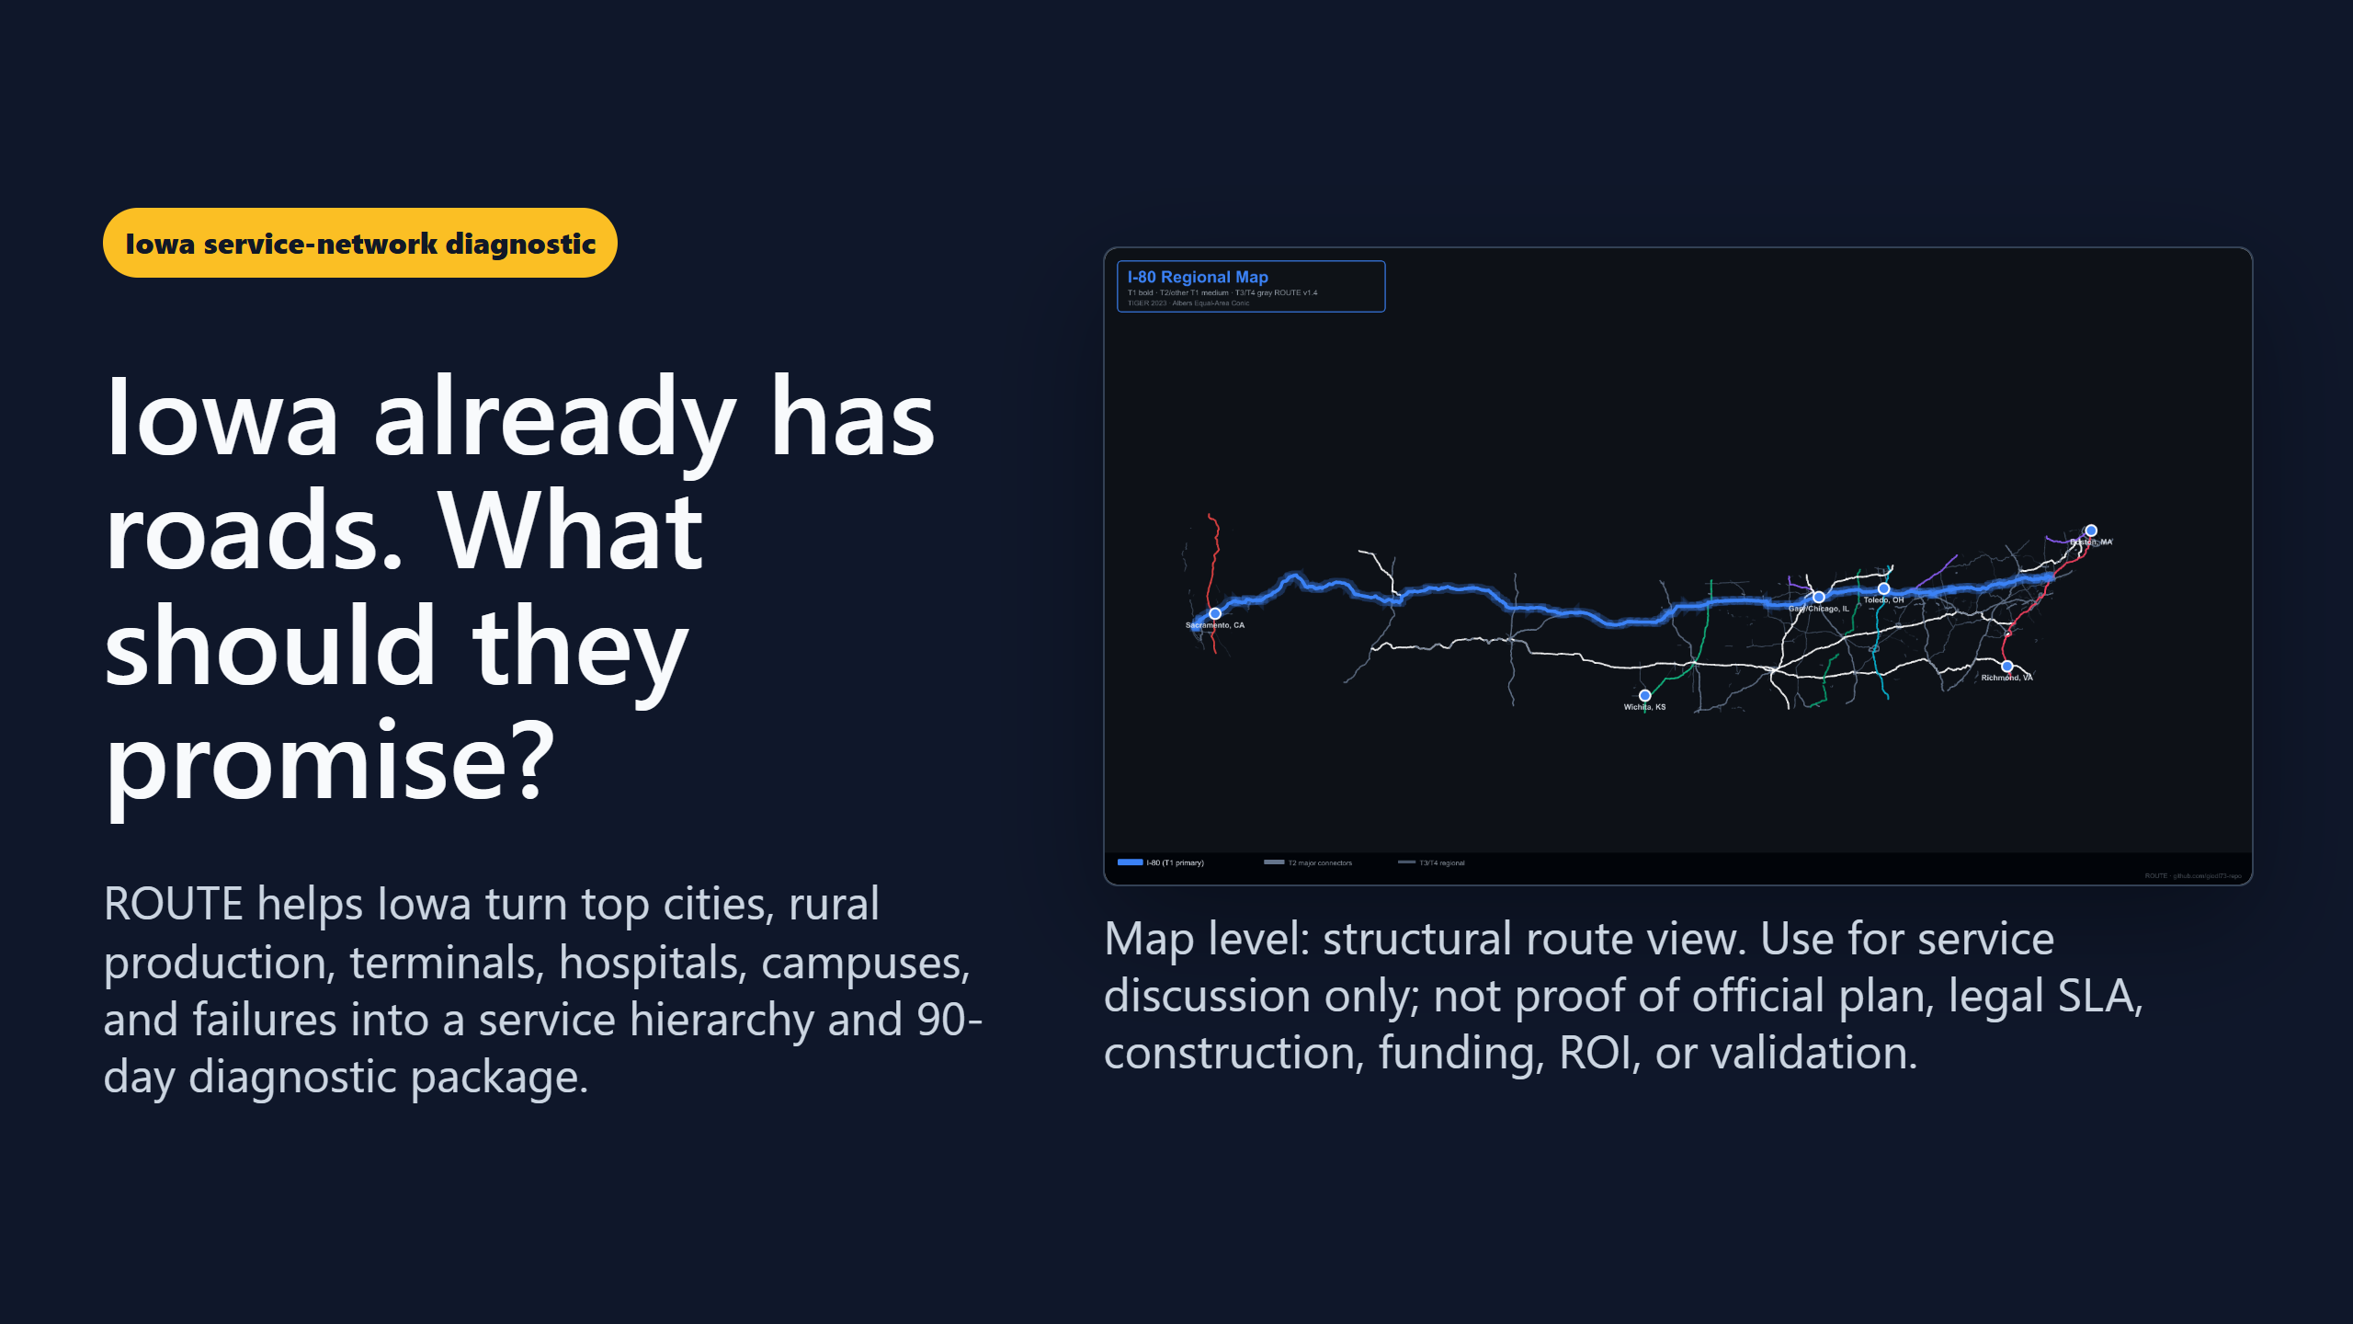
Notes:
Title: Iowa Service Network Pitch Slug: iowa-service-network-pitch Kind: deck Status: draft Truth label: concept / evidence-bounded. Client-facing state service-network pitch with official-plan, legal-SLA, construction, funding, ROI, clearance, validation, endorsement, and public-readiness claims held. Sources: - docs/briefs/iowa-state-service-network-goals.md - docs/briefs/iowa-state-service-network-offer.md - docs/briefs/iowa-service-network-discovery-workshop.md - docs/briefs/state-value-brief.md

Slide 2
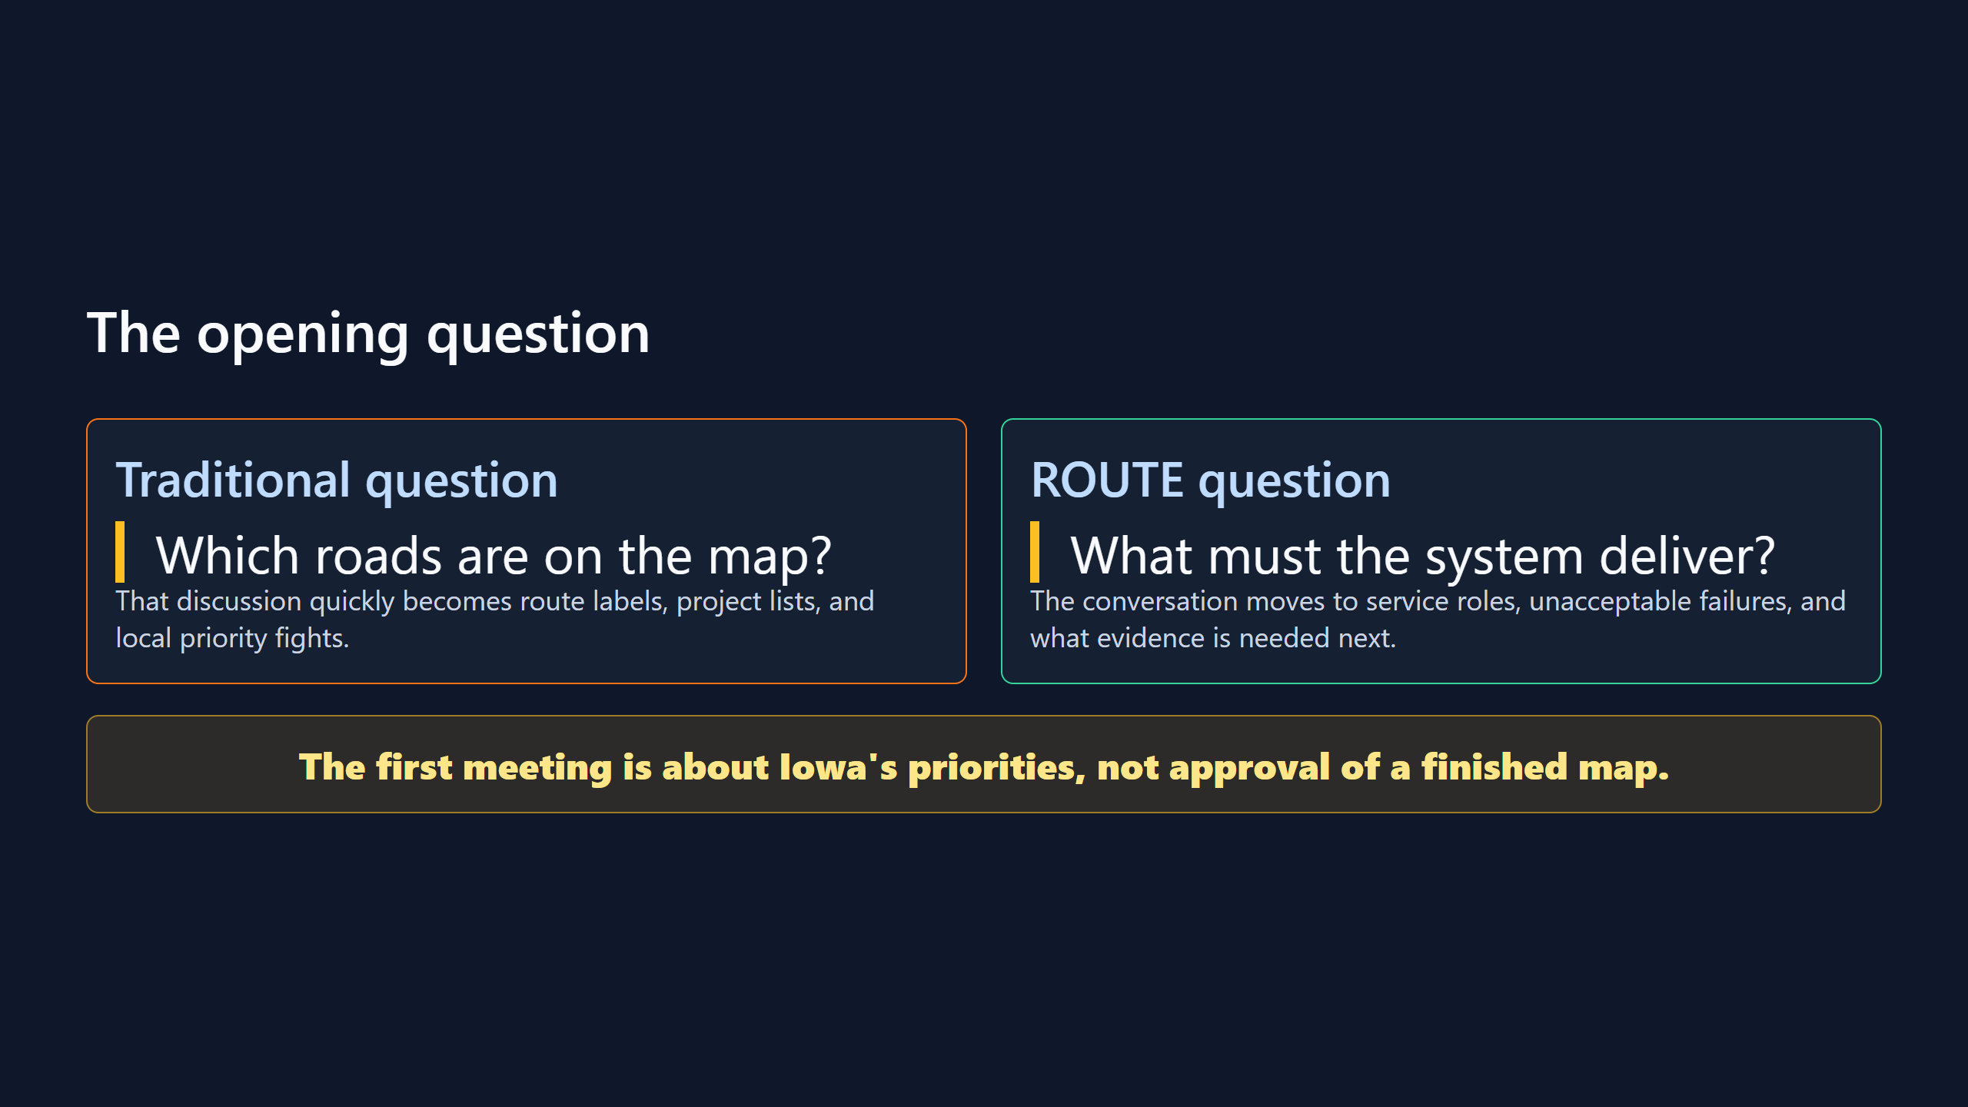

Slide 3
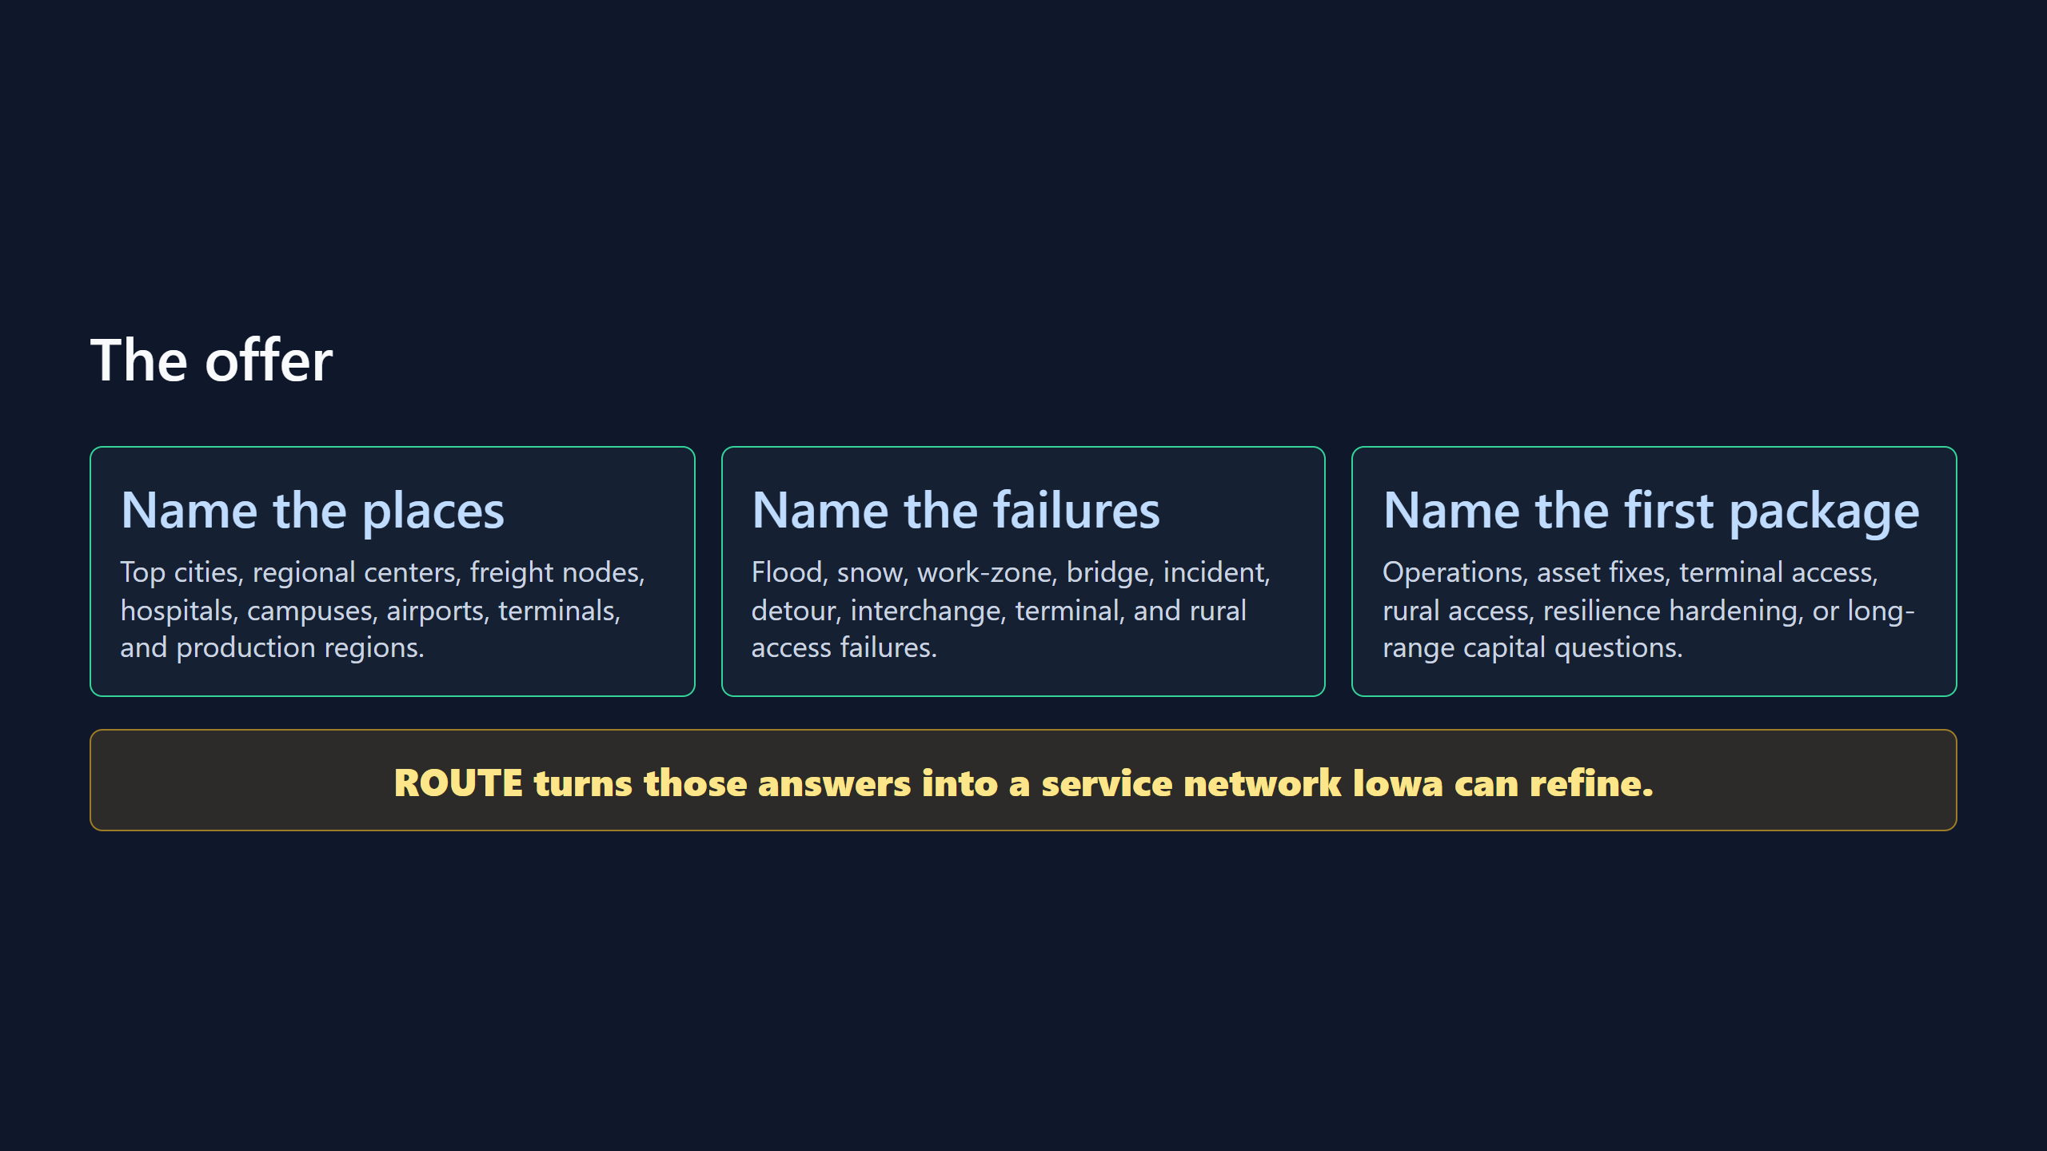

Slide 4
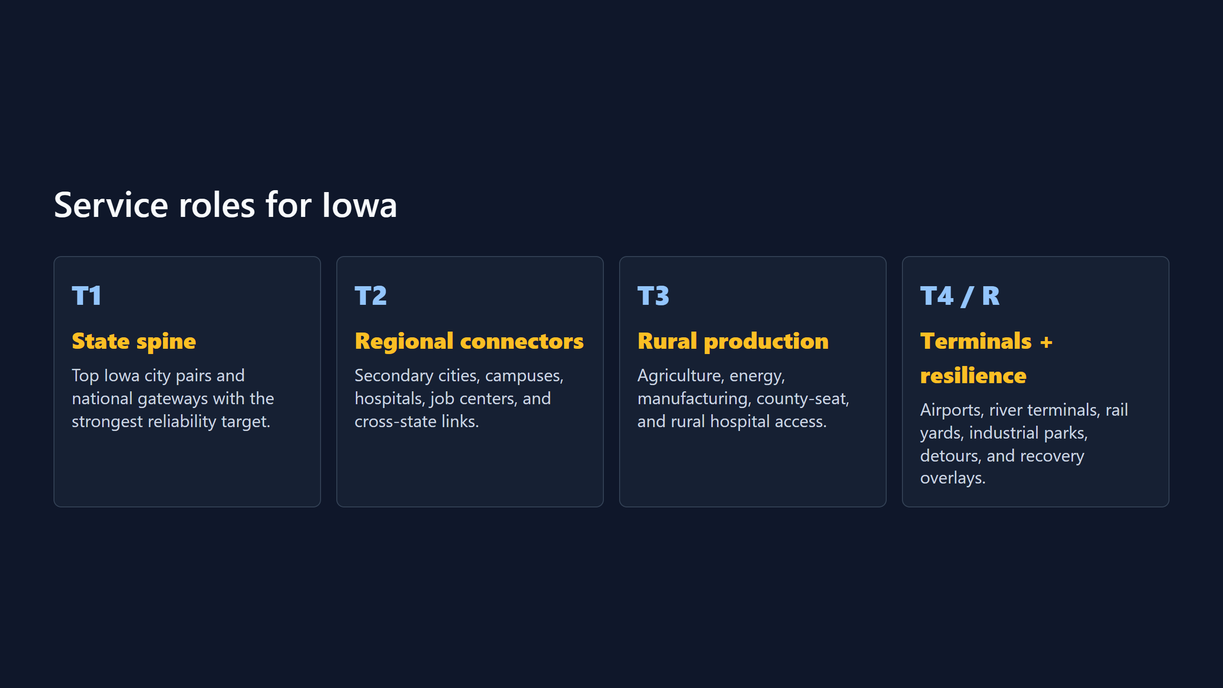

Slide 5
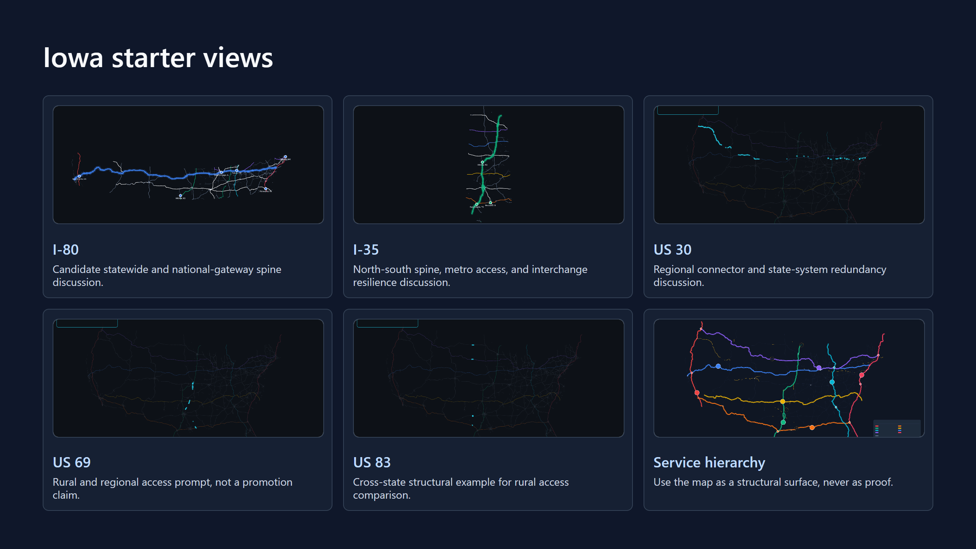

Slide 6
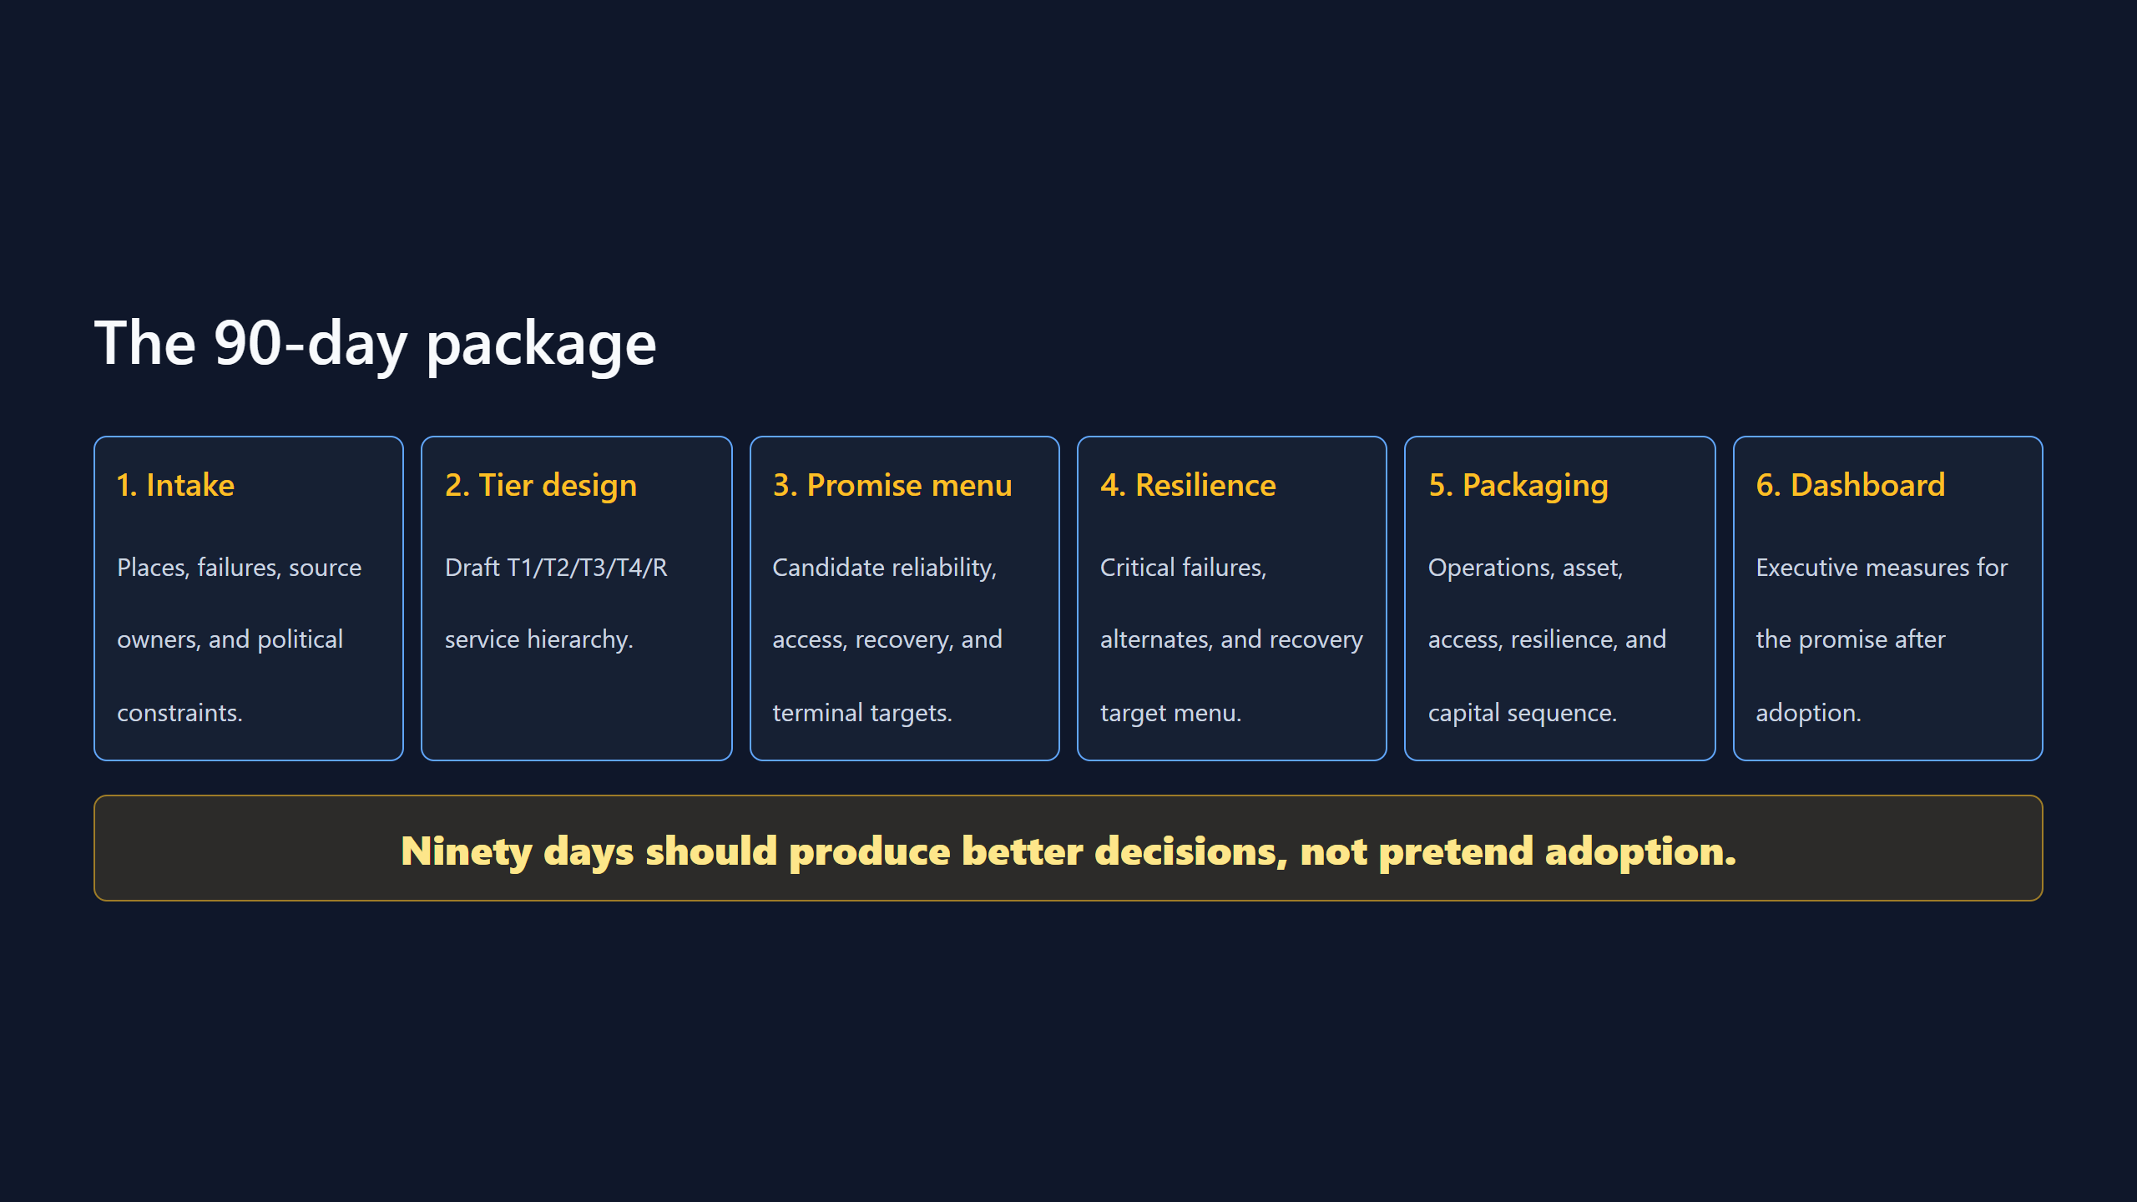

Slide 7
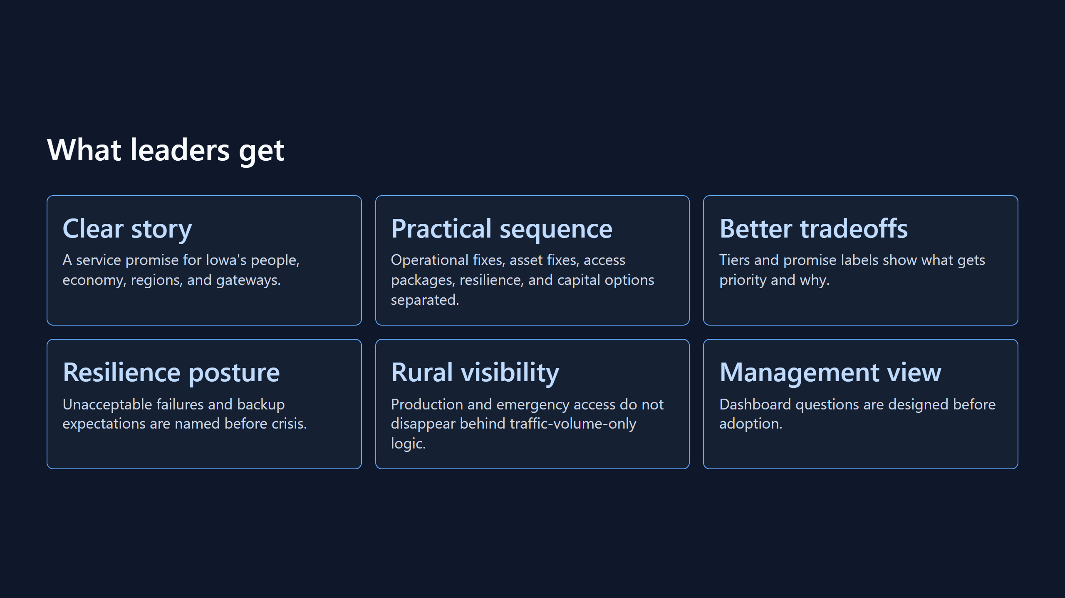

Slide 8
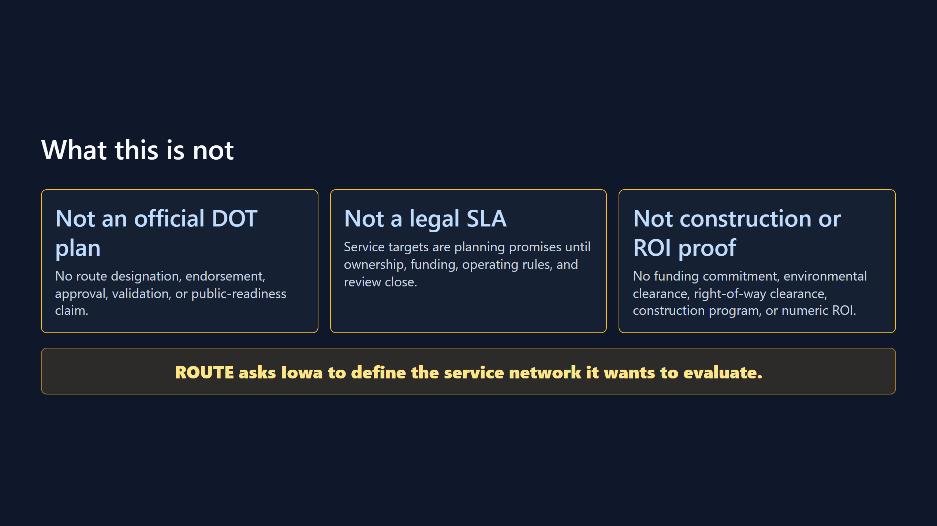

Slide 9
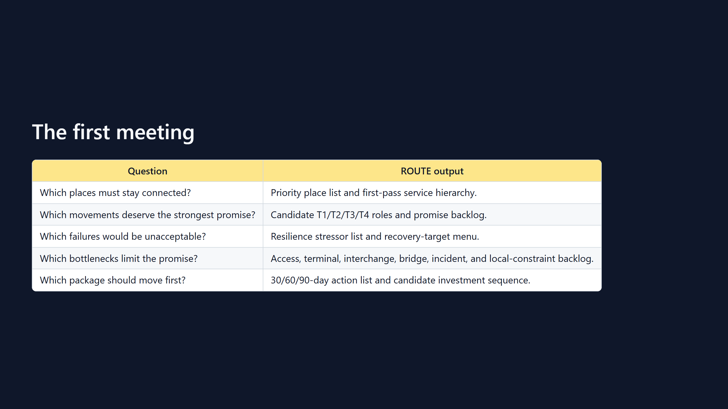

Slide 10
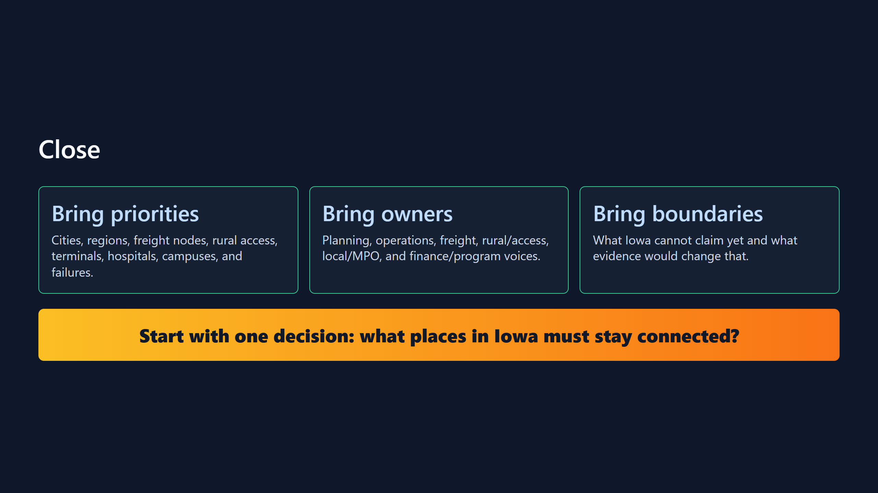

Slide 11
