Slide 1
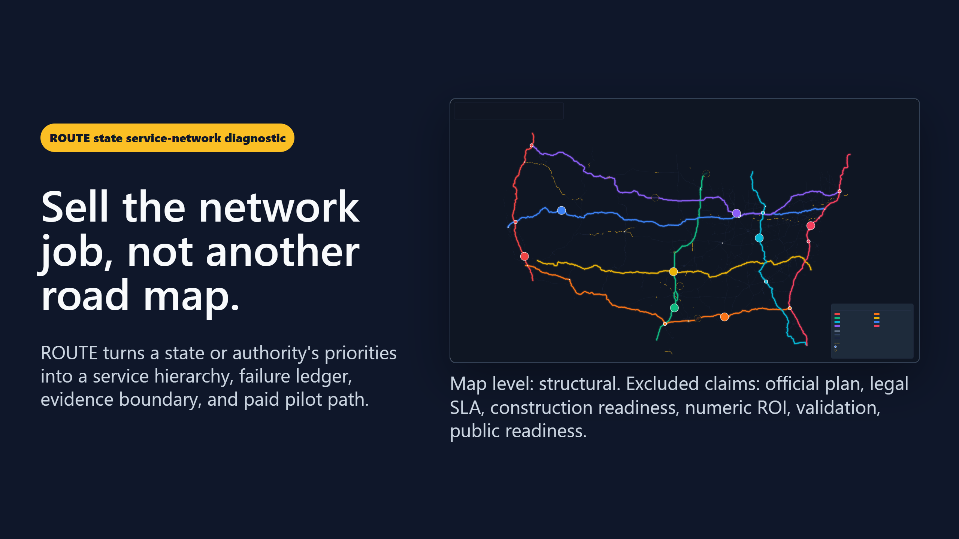
Notes:
Status: draft Kind: deck Owner: route-comms Truth label: sales-ready / evidence-bounded. This deck sells the ROUTE state service-network diagnostic and Texas paid-pilot pathway. It does not claim TxDOT endorsement, official-plan status, legal SLA readiness, construction readiness, numeric ROI, procurement readiness, validation, public readiness, or source-backed full inventory.

Slide 2
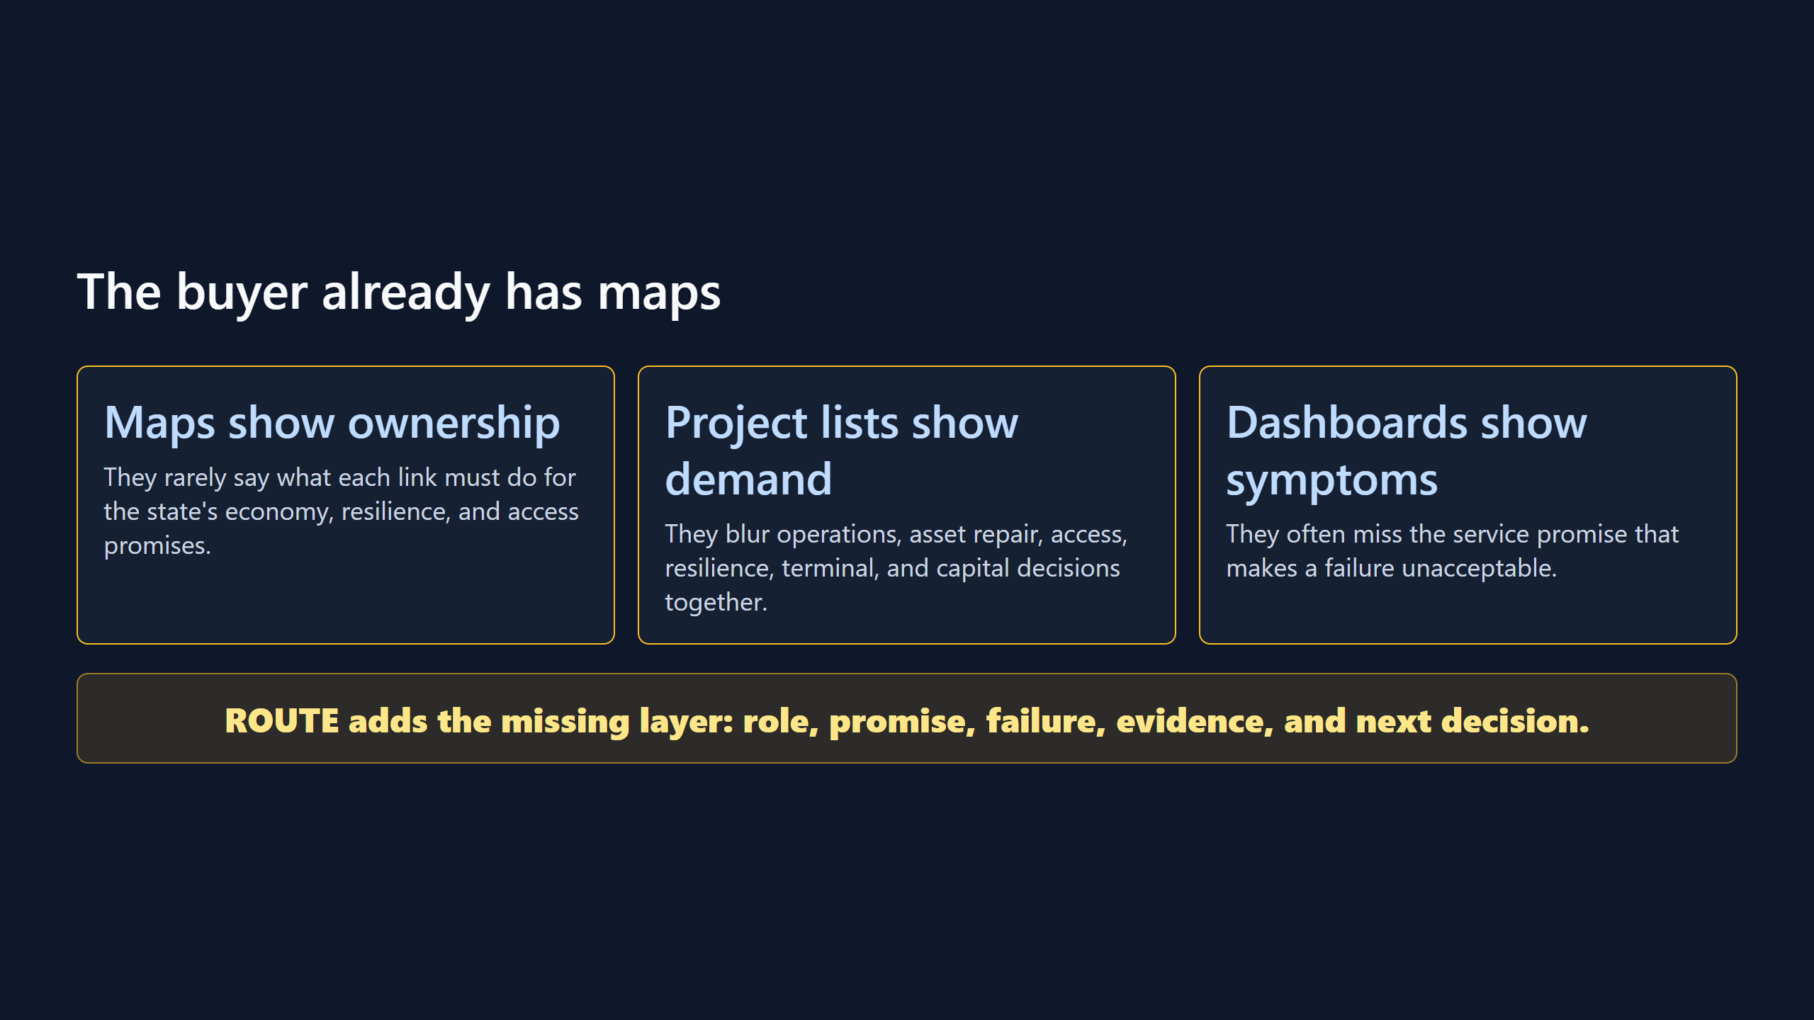

Slide 3
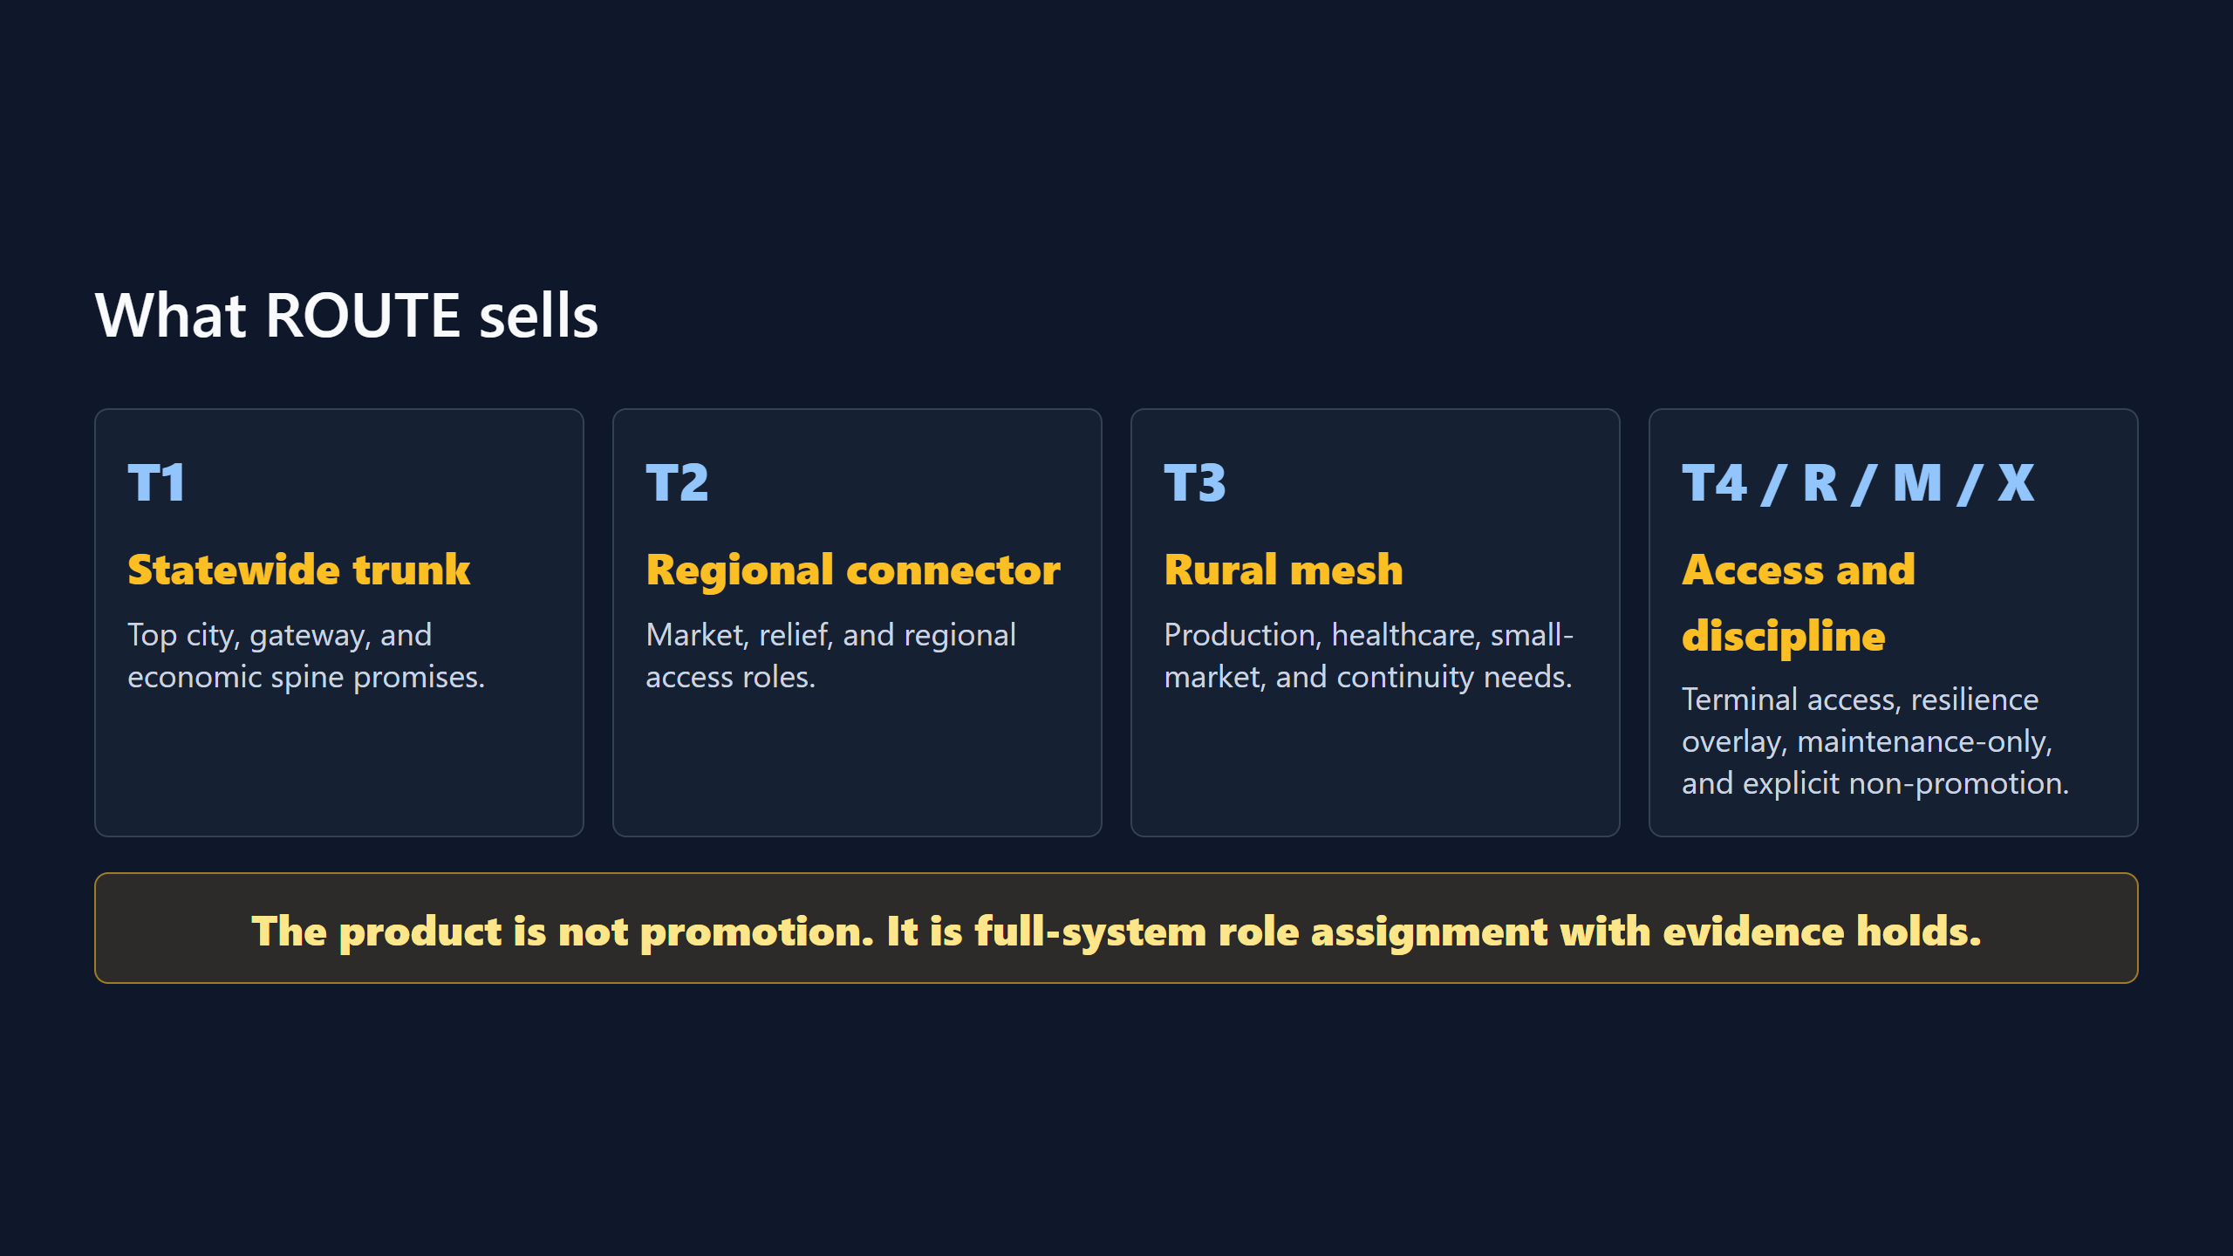

Slide 4
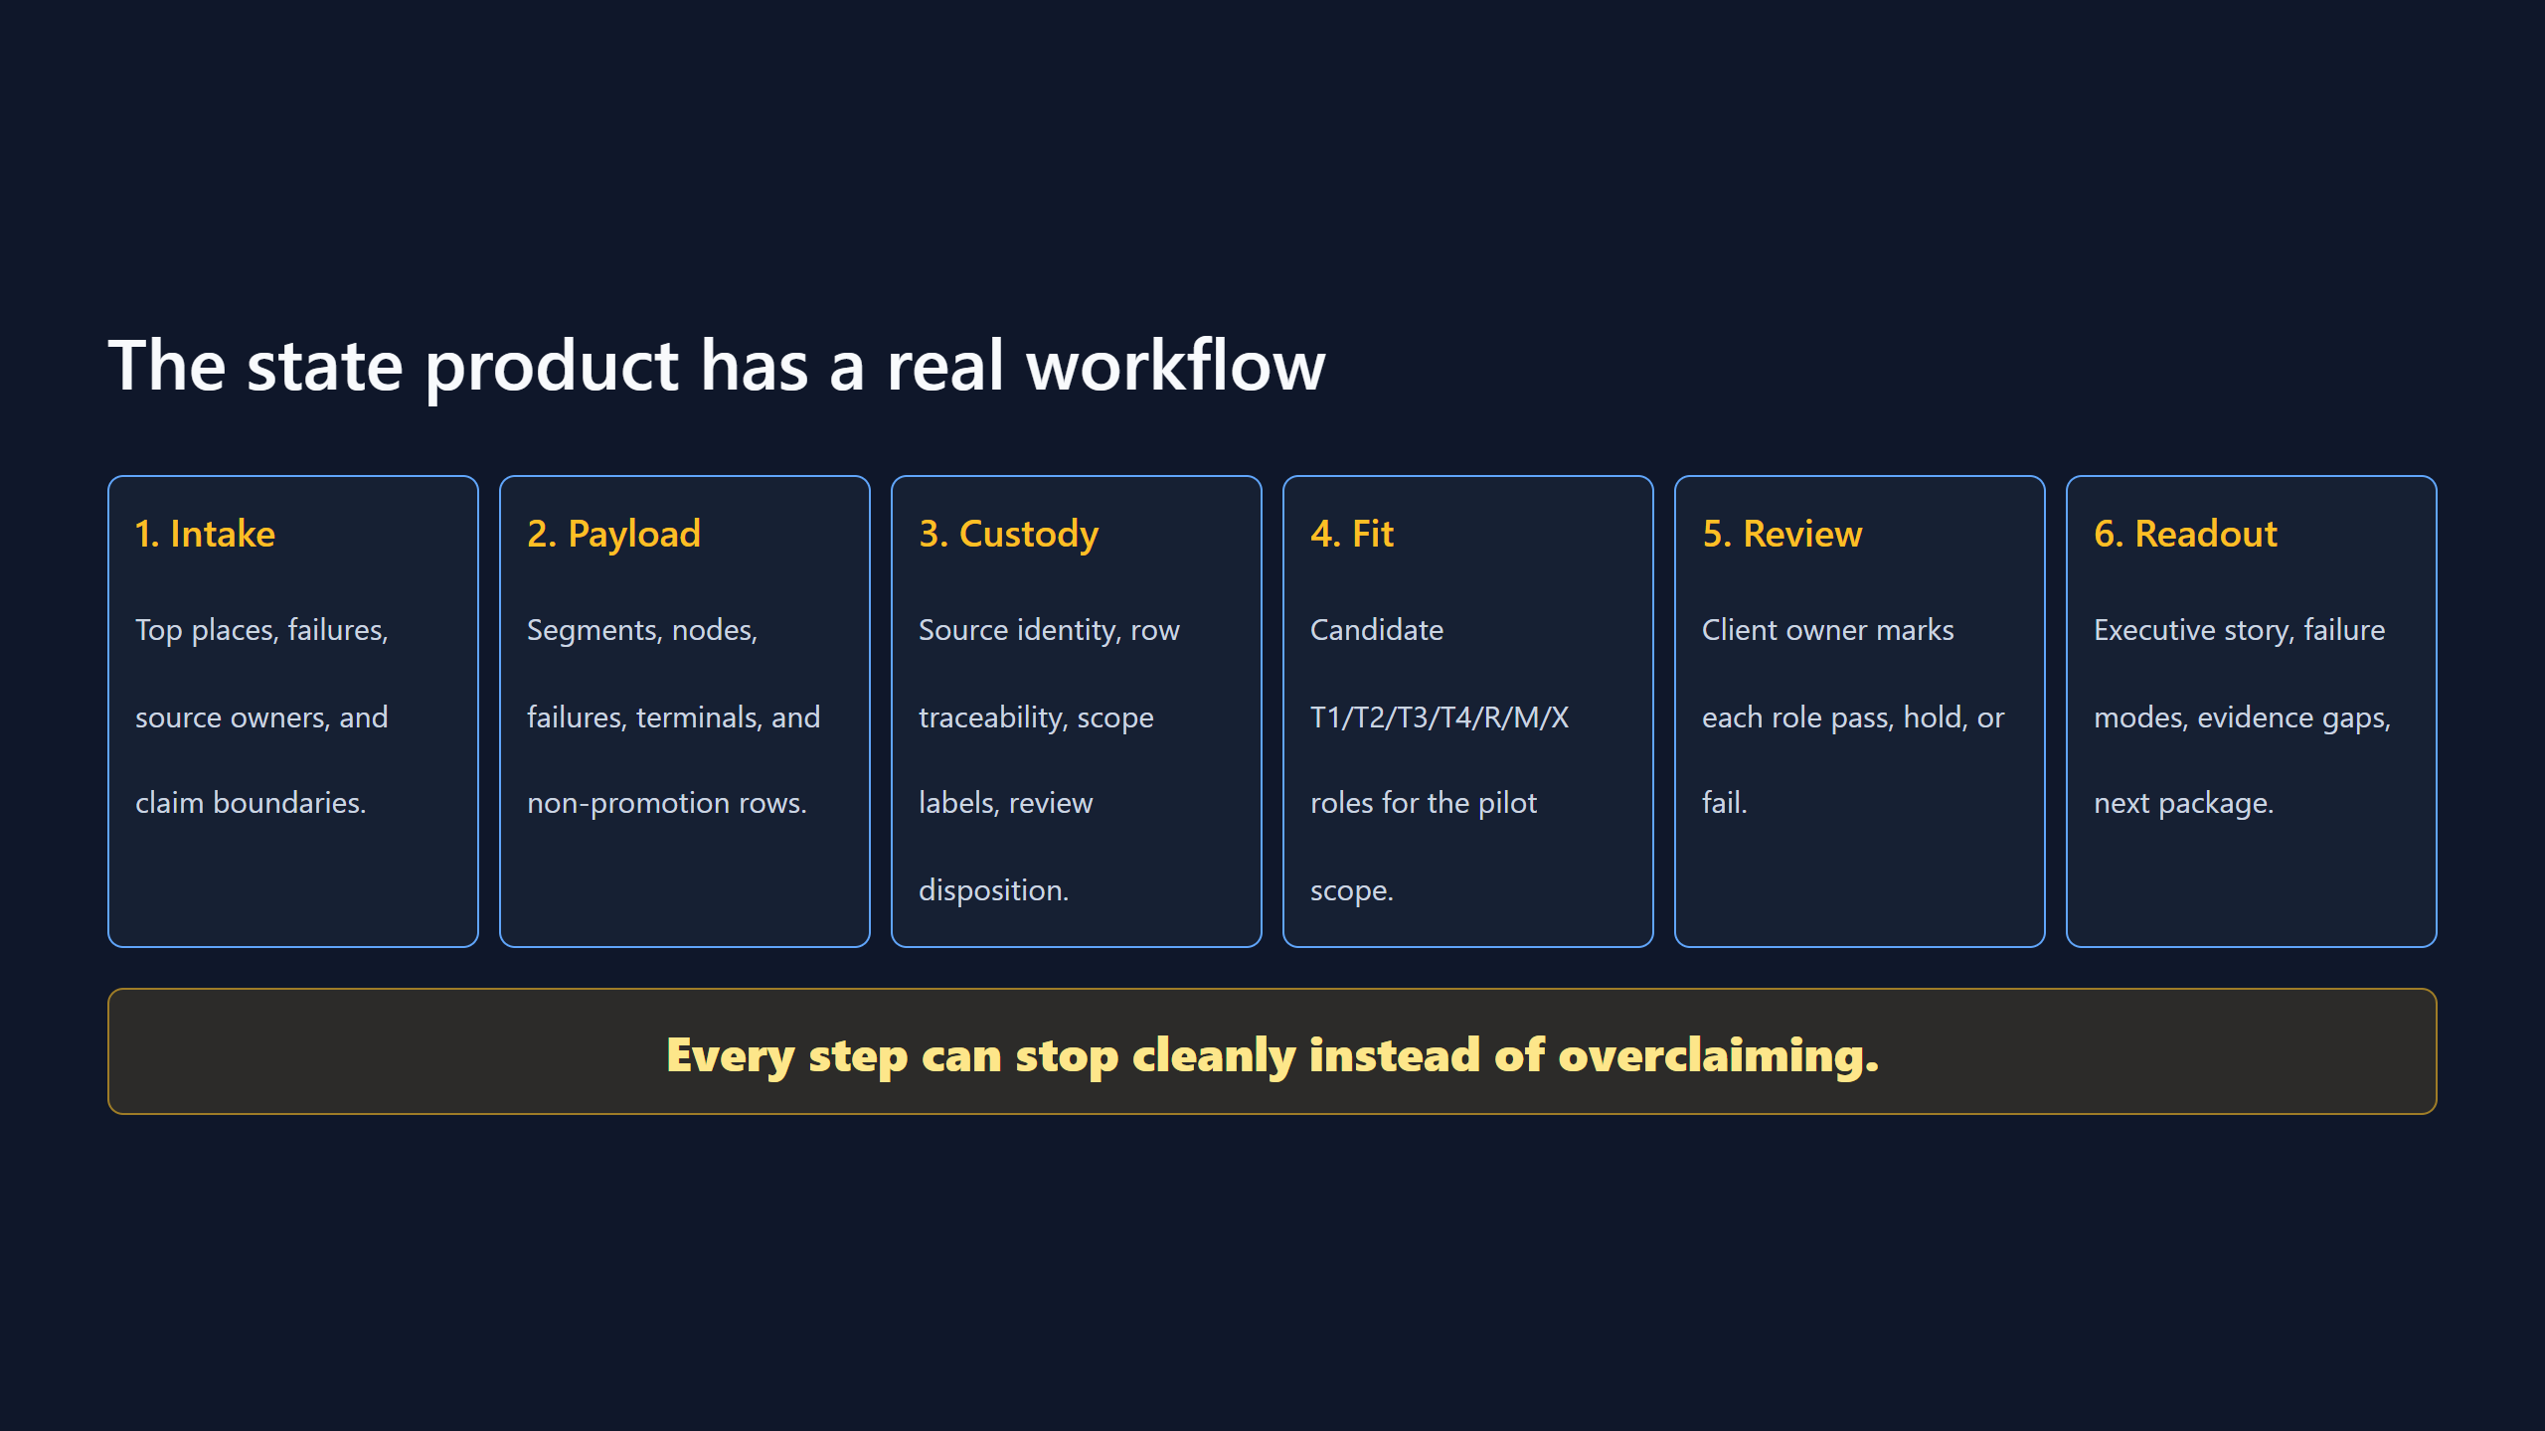

Slide 5
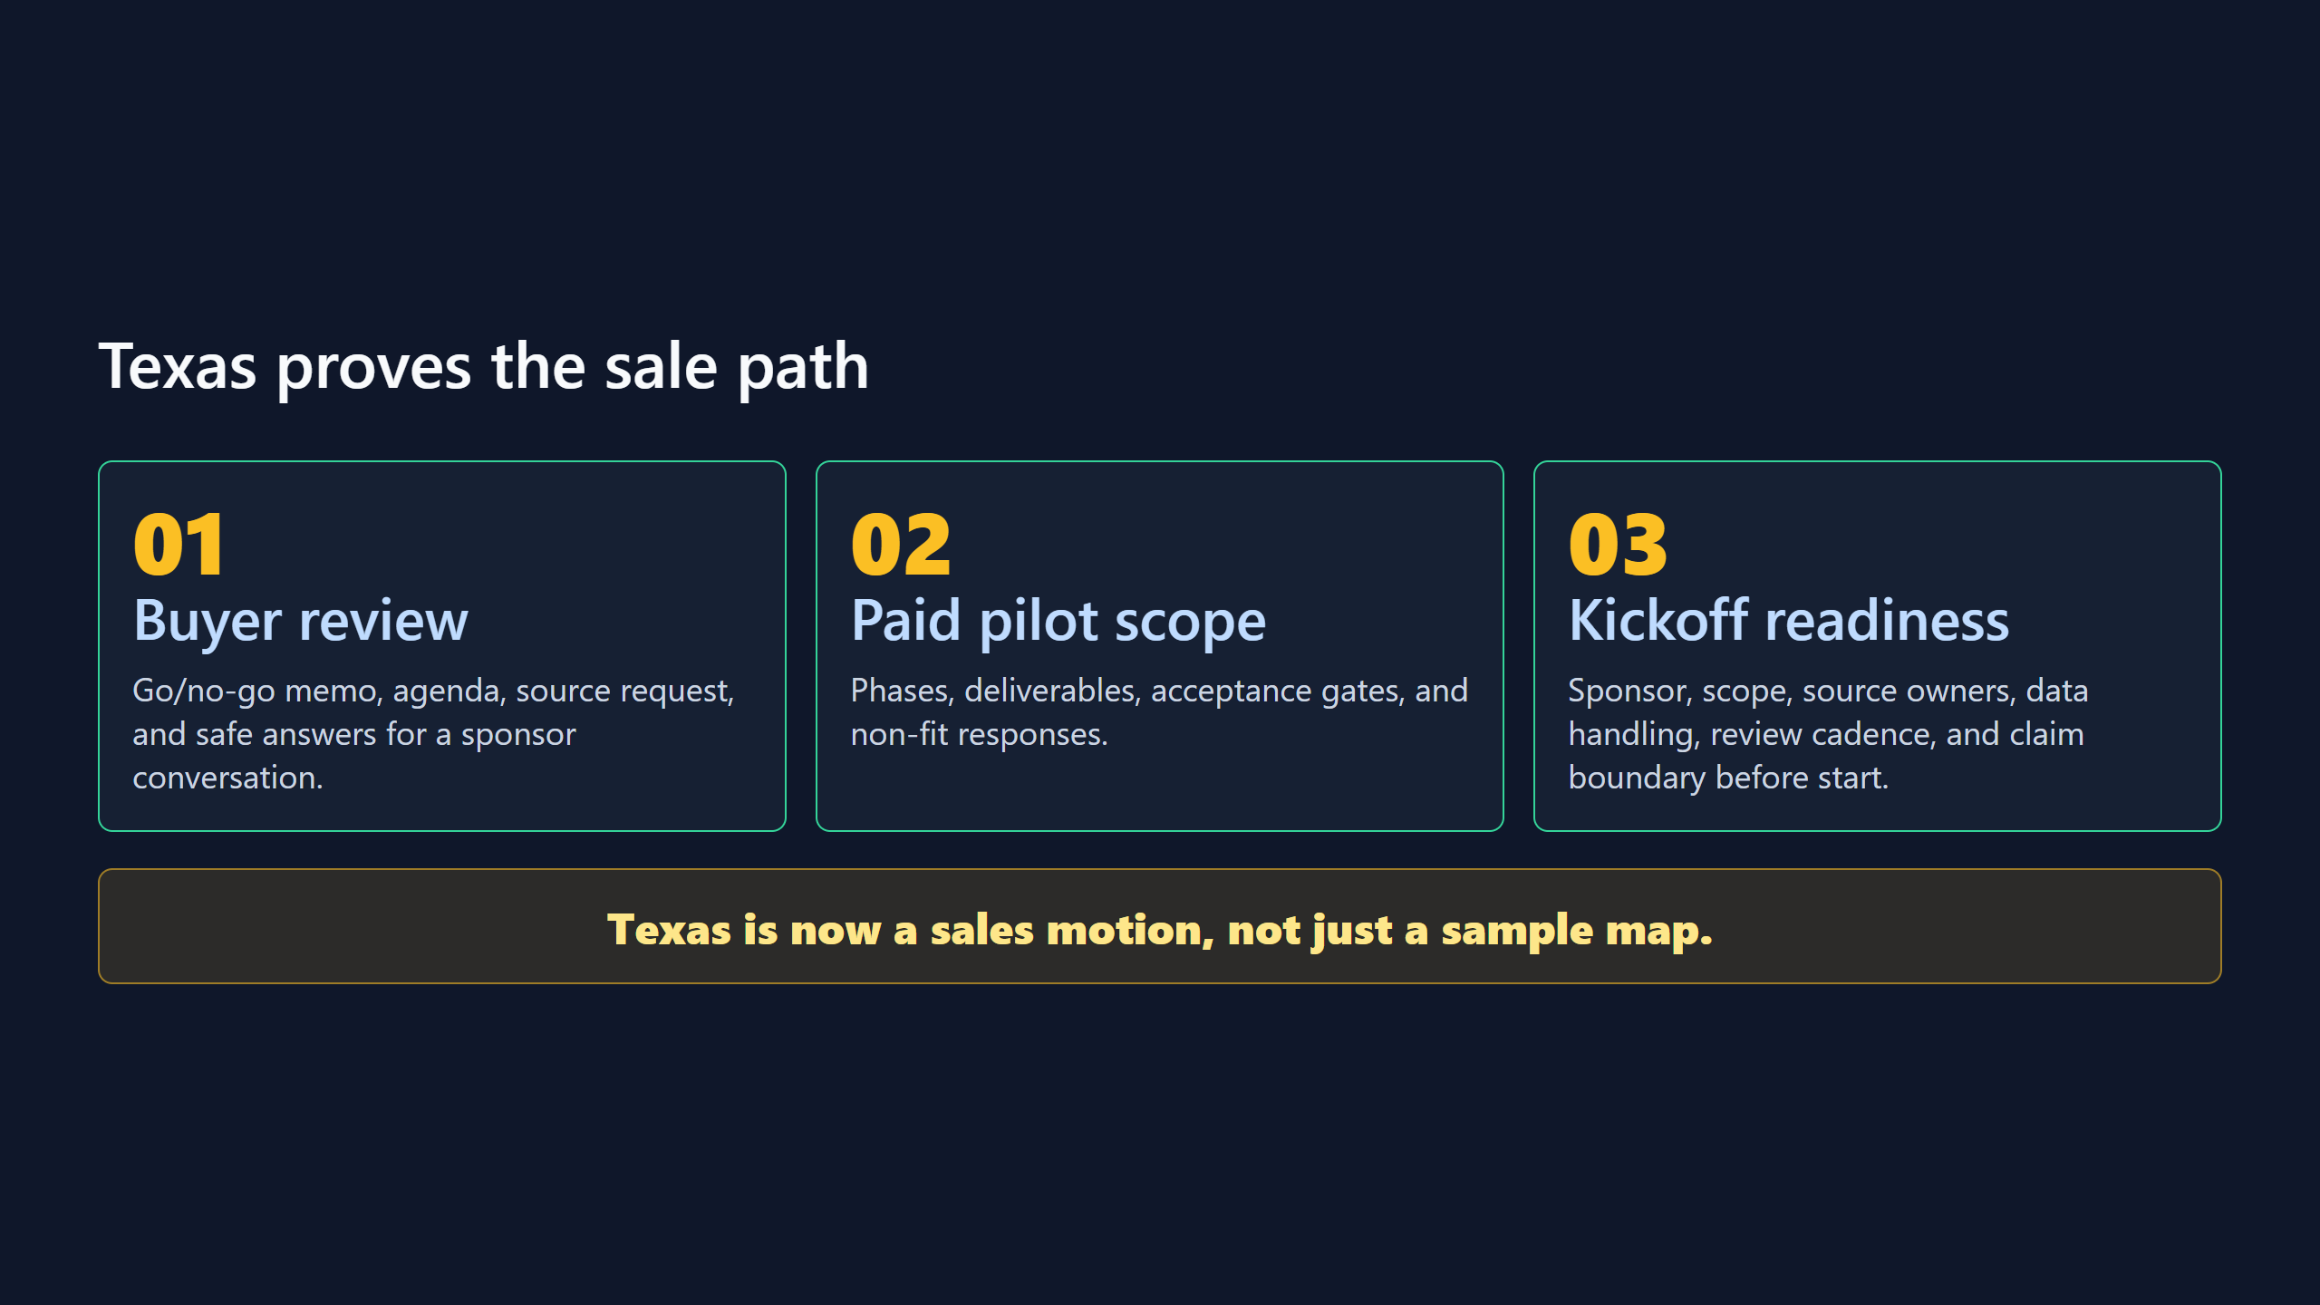

Slide 6
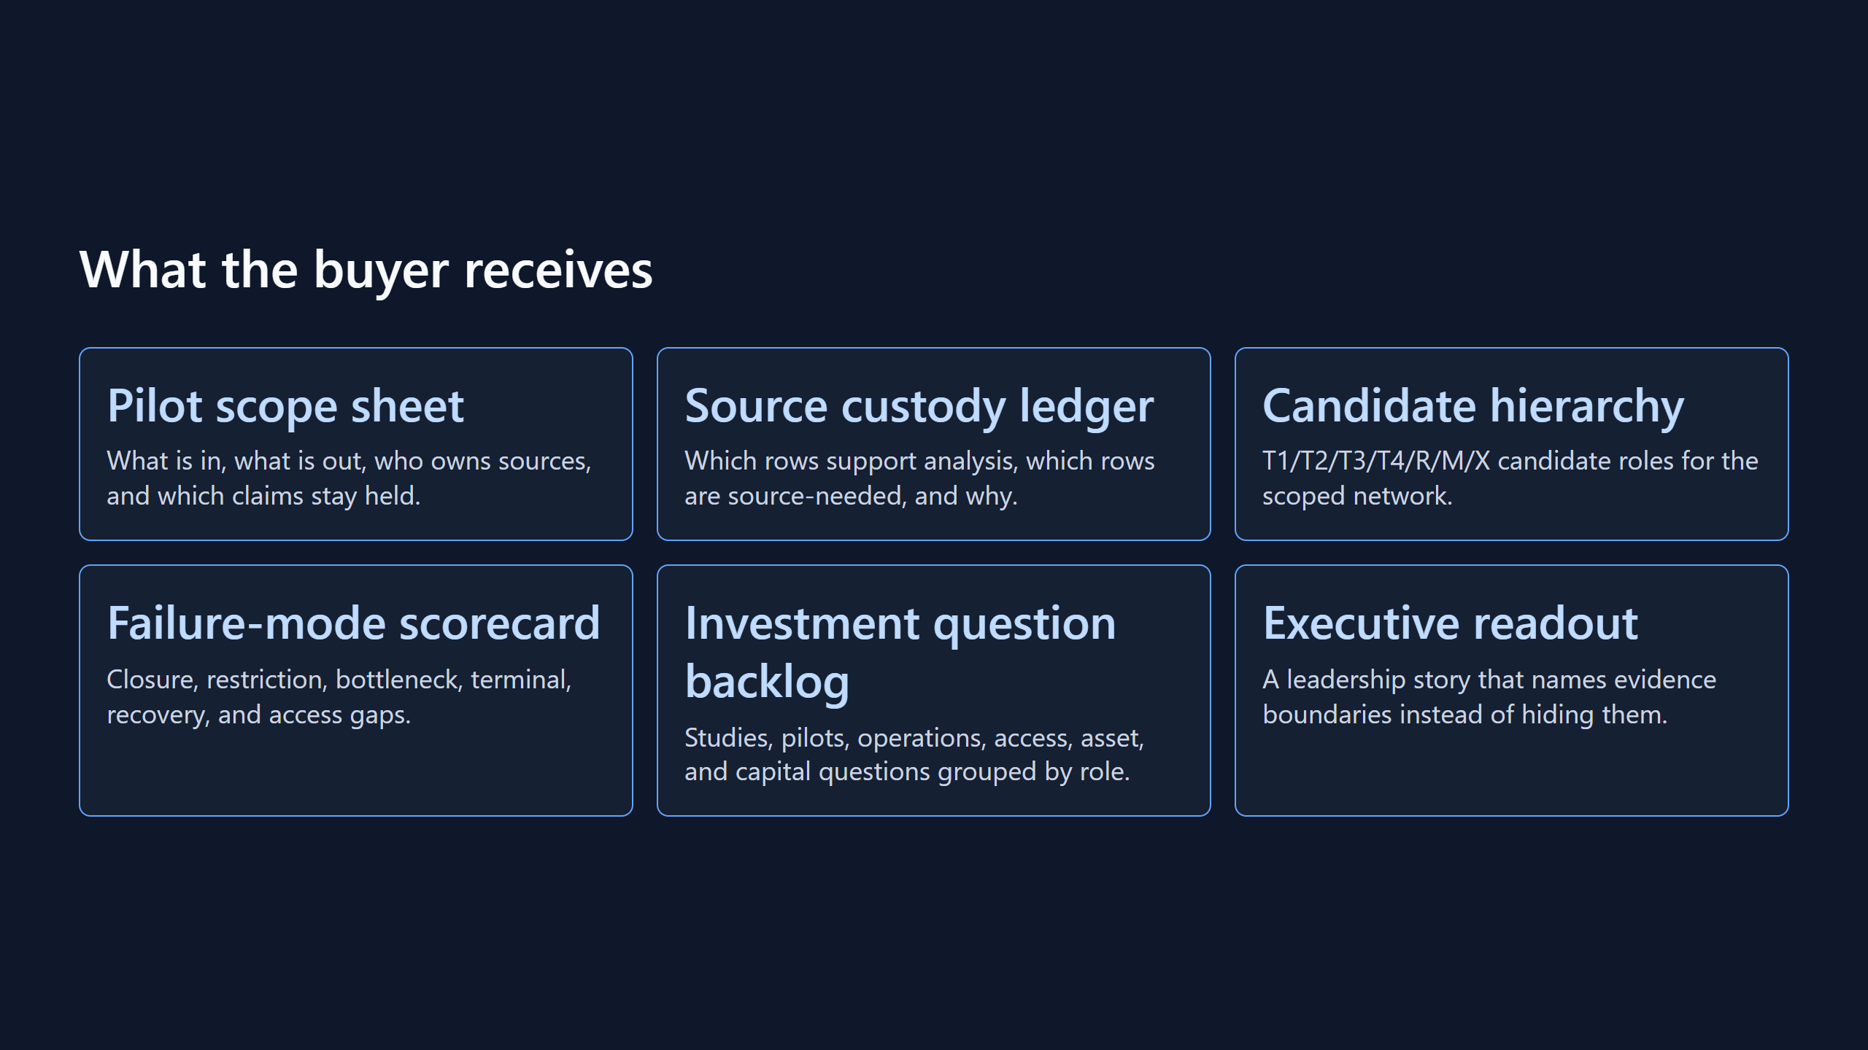

Slide 7
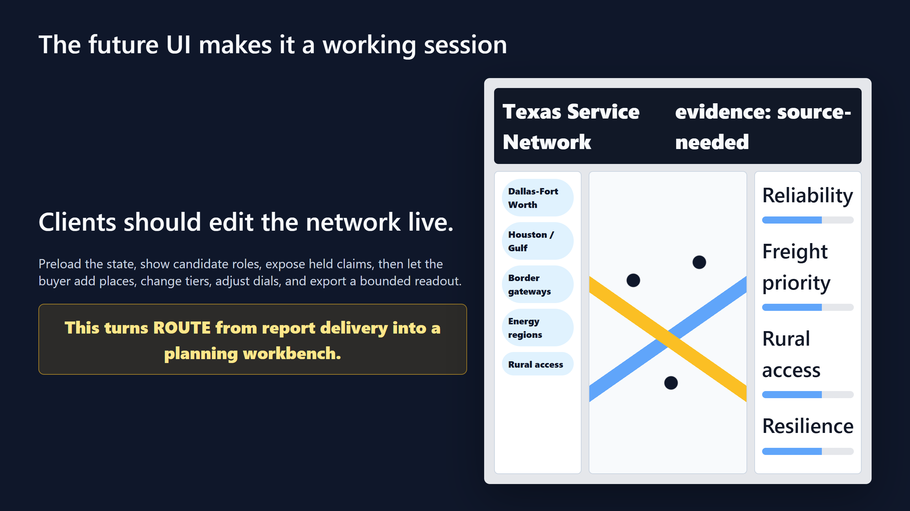

Slide 8
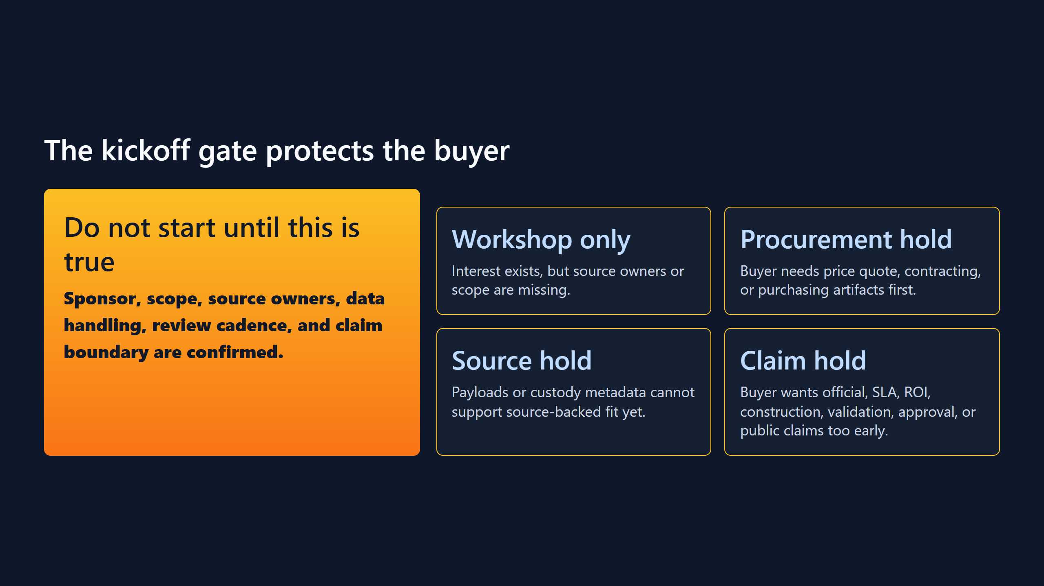

Slide 9
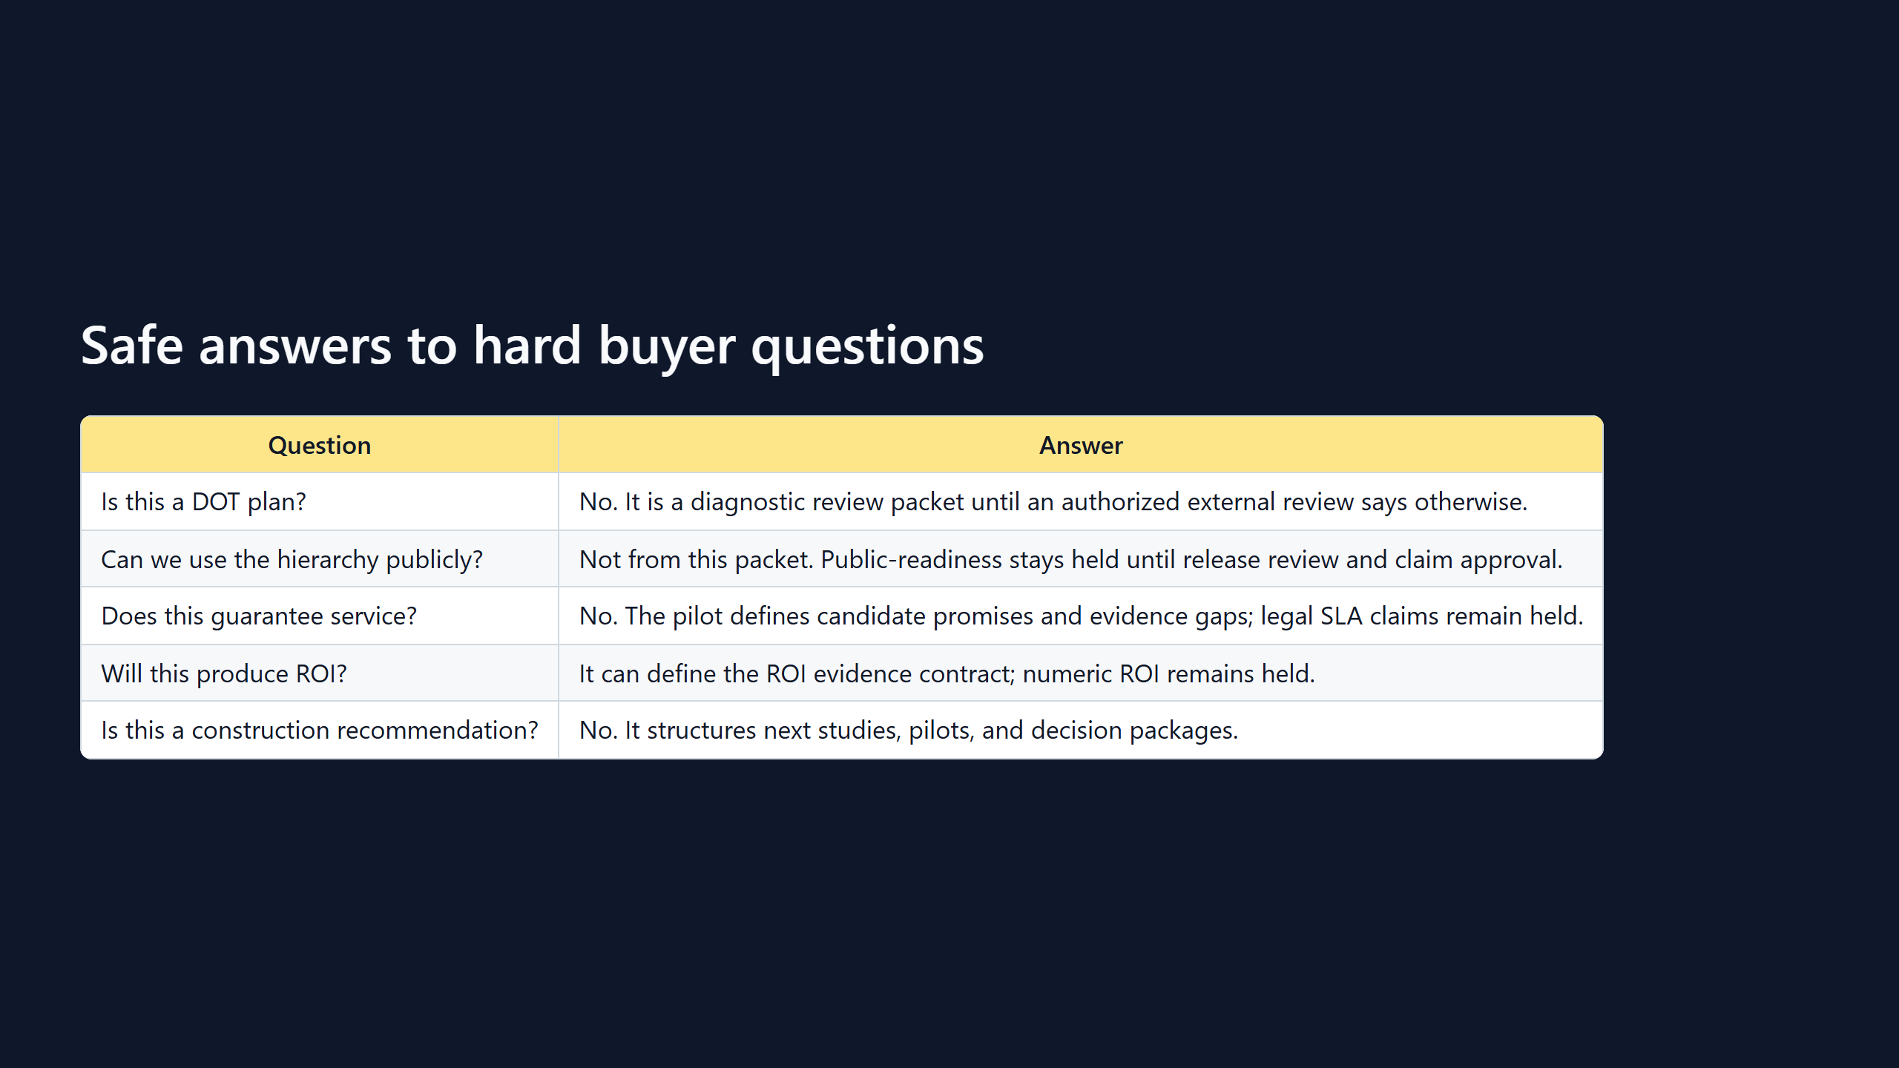

Slide 10
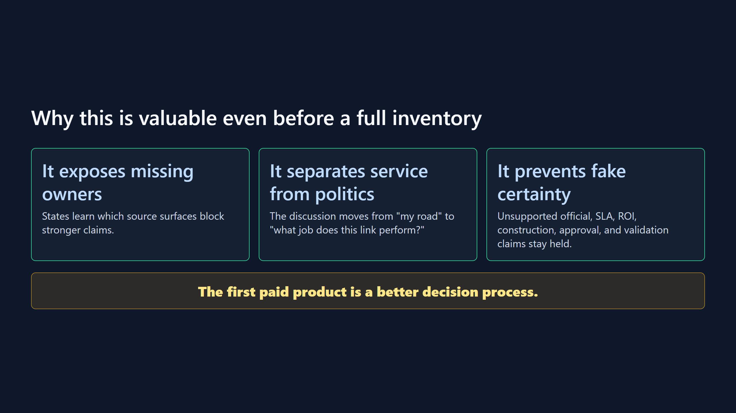

Slide 11
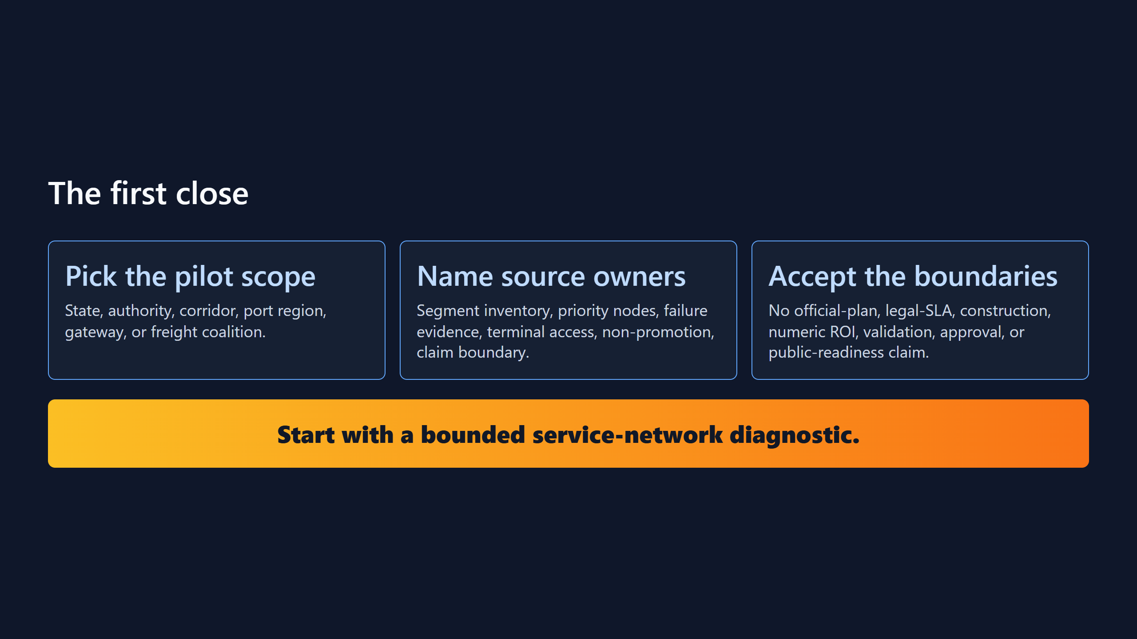

Slide 12
