Slide 1
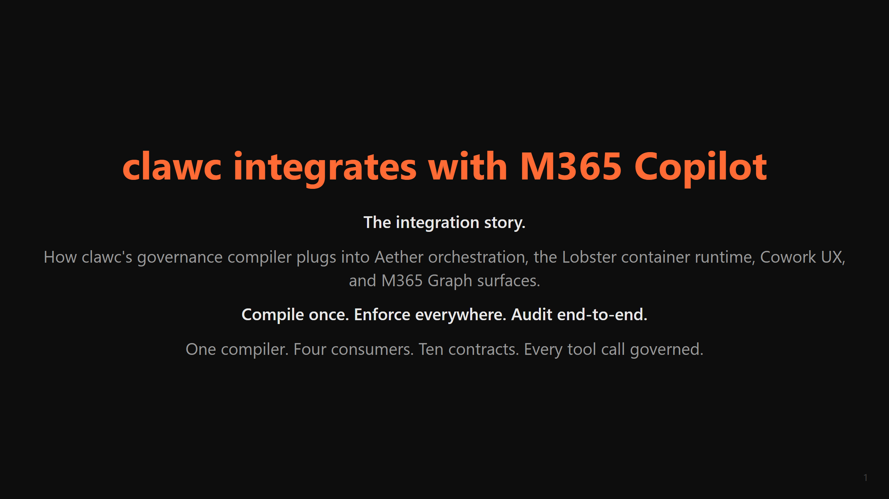

Slide 2
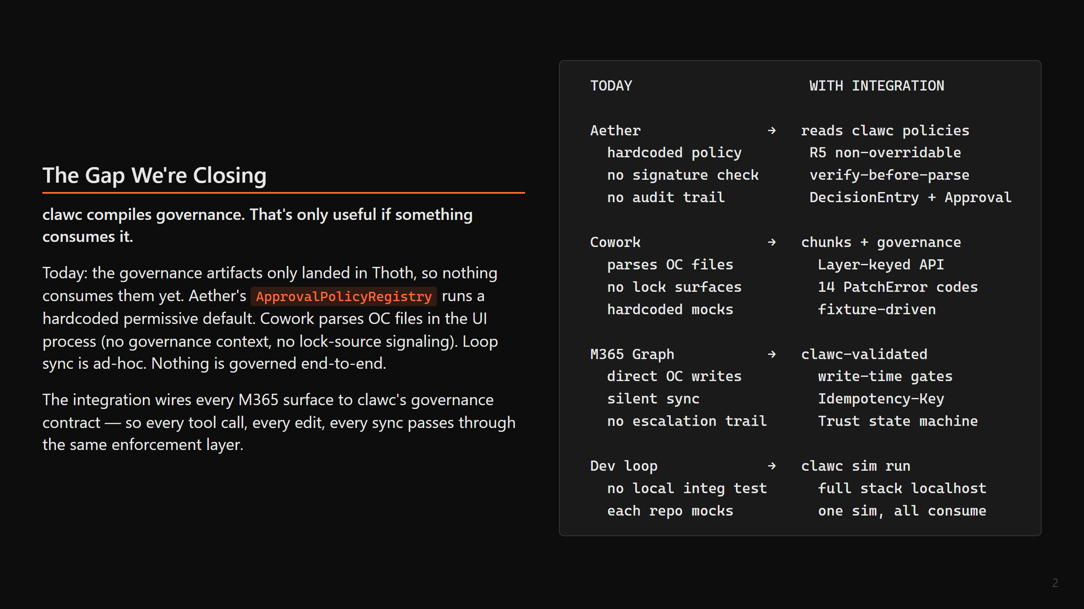

Slide 3
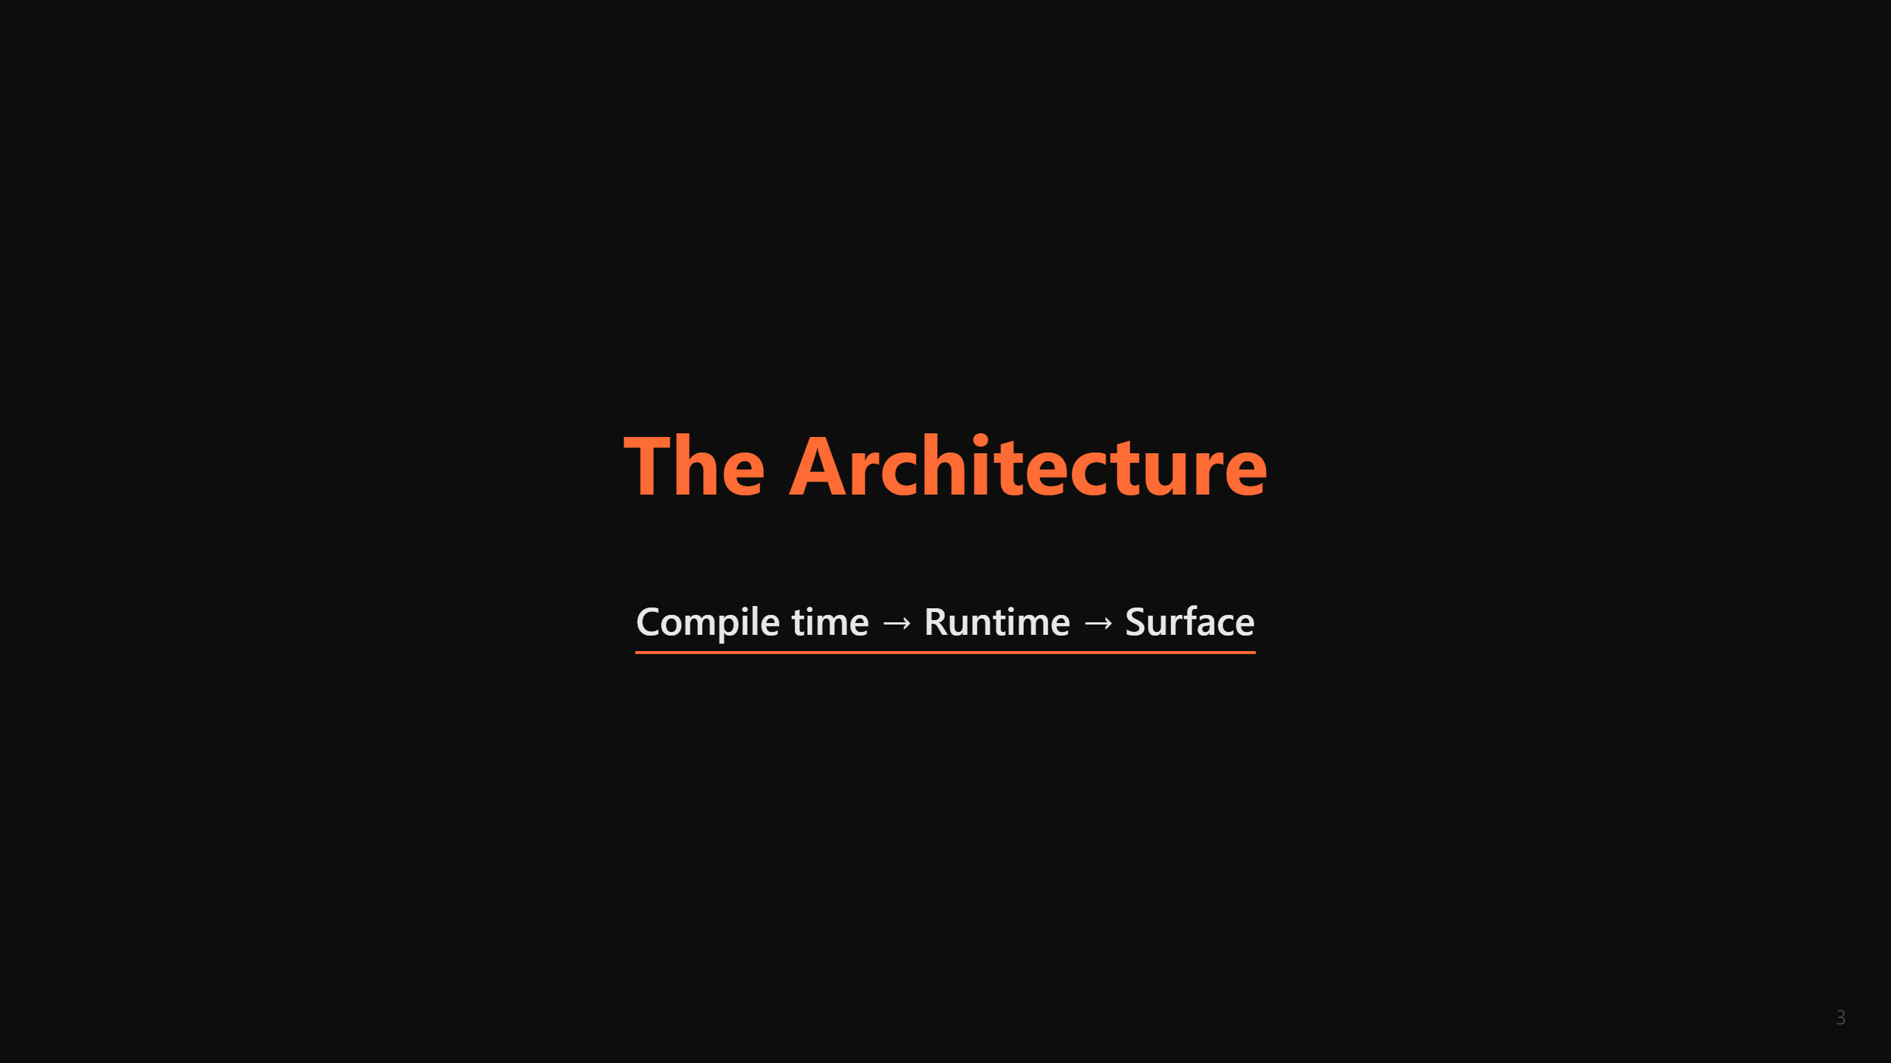

Slide 4
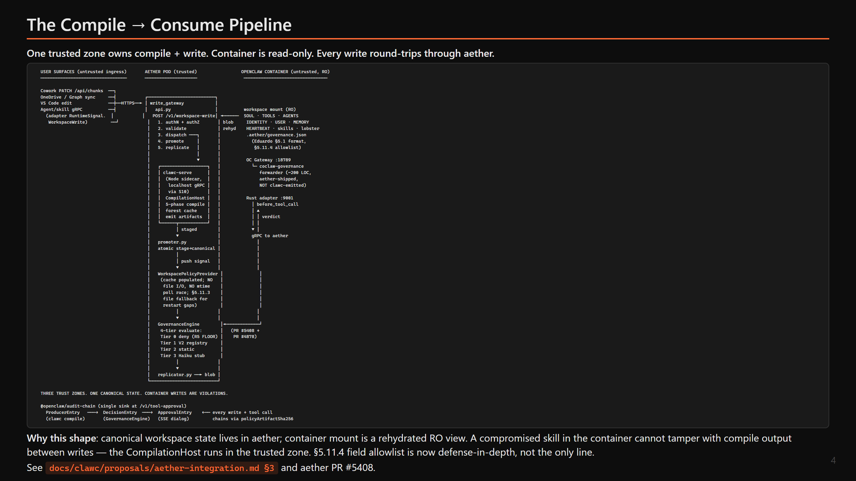

Slide 5
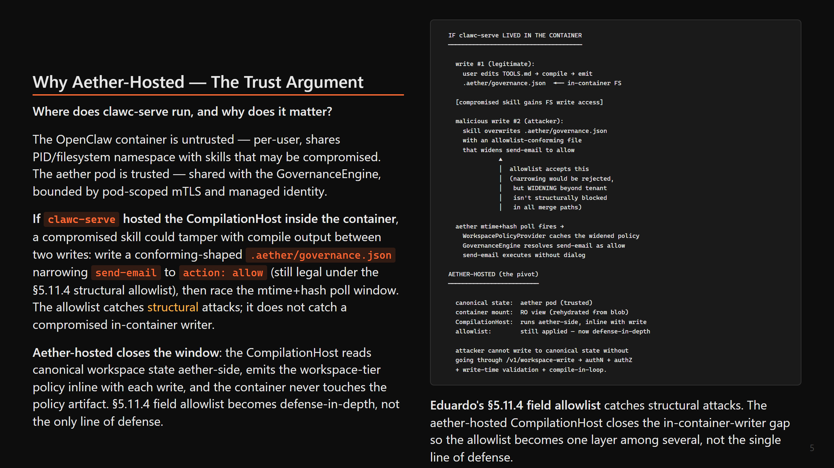

Slide 6
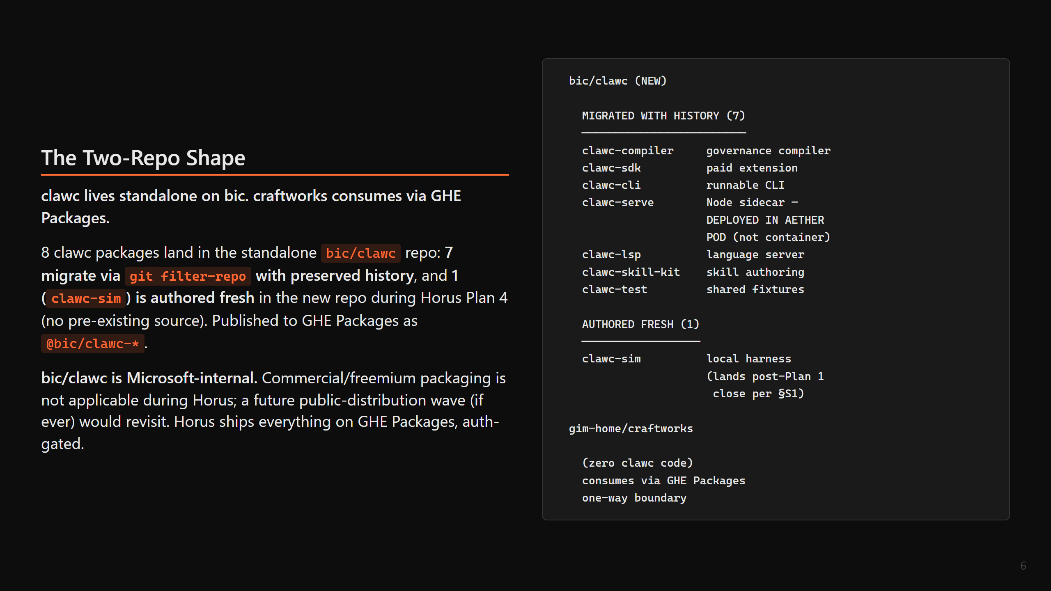

Slide 7
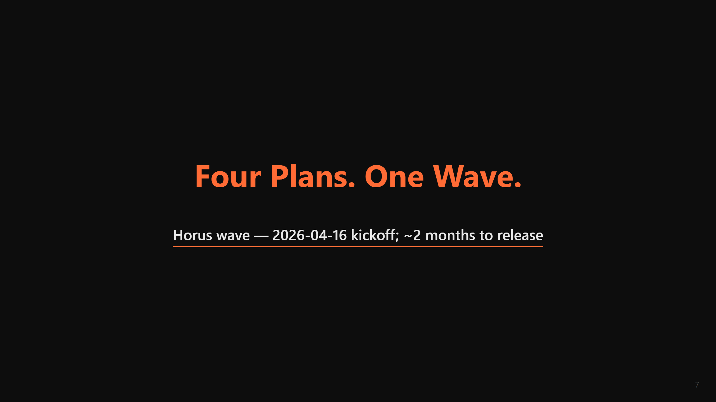

Slide 8
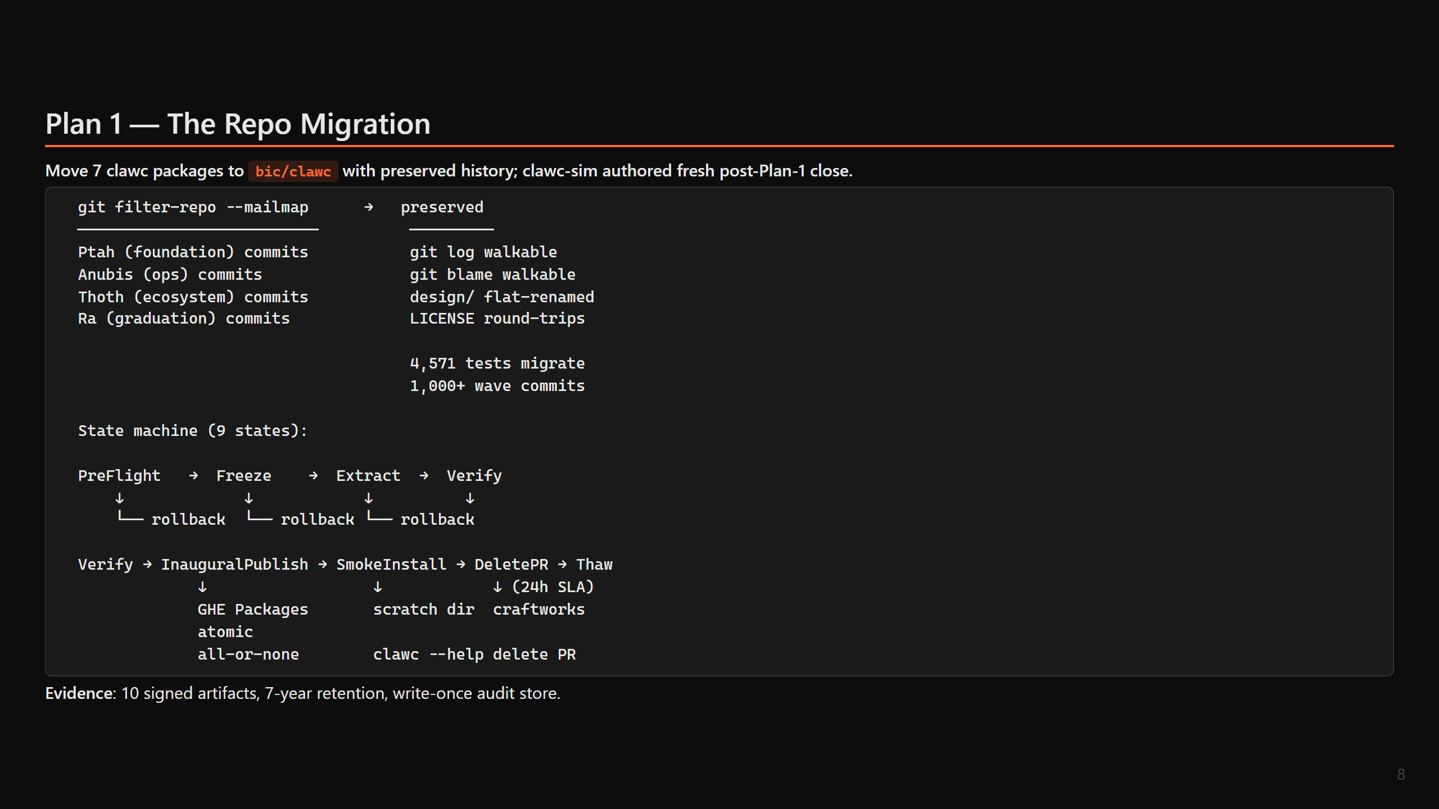

Slide 9
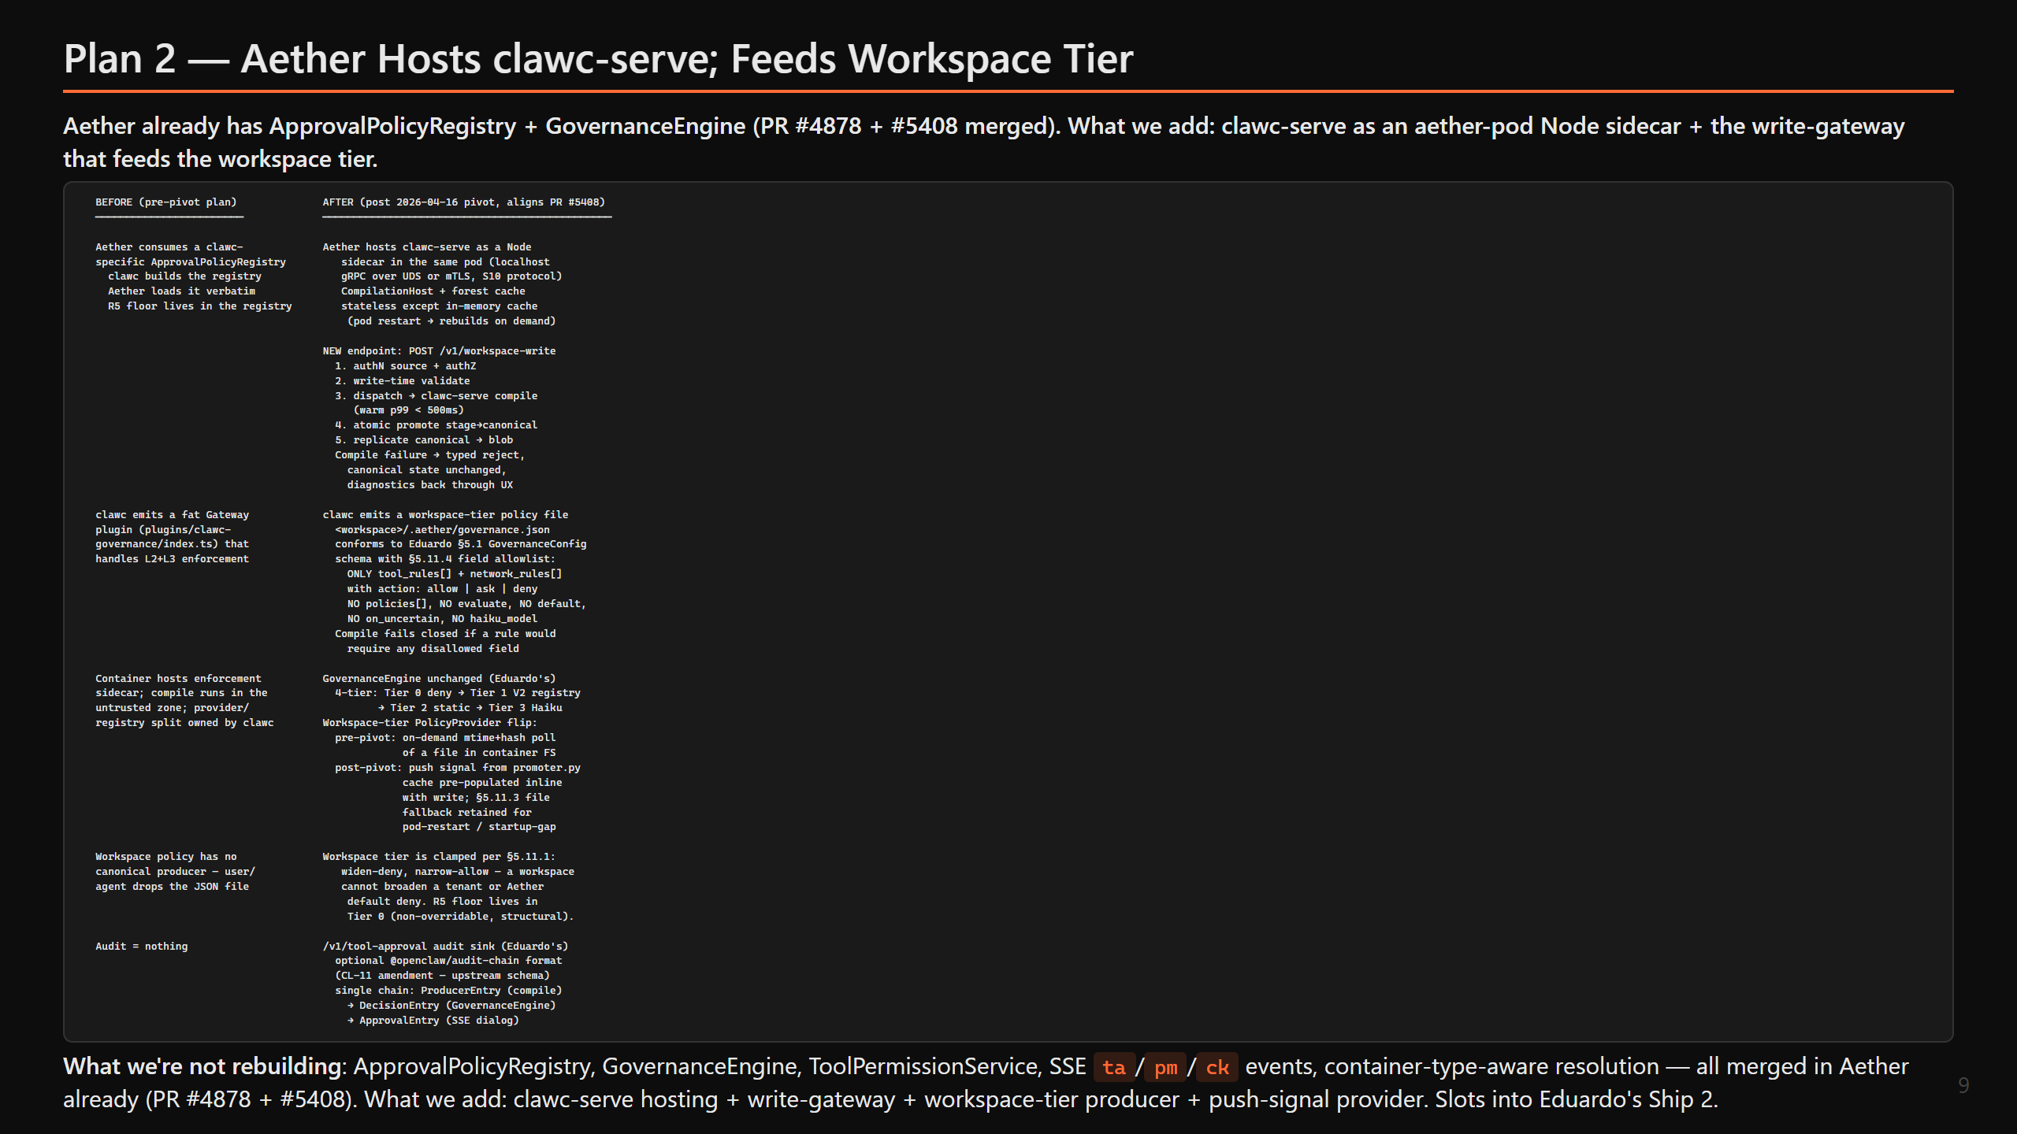

Slide 10
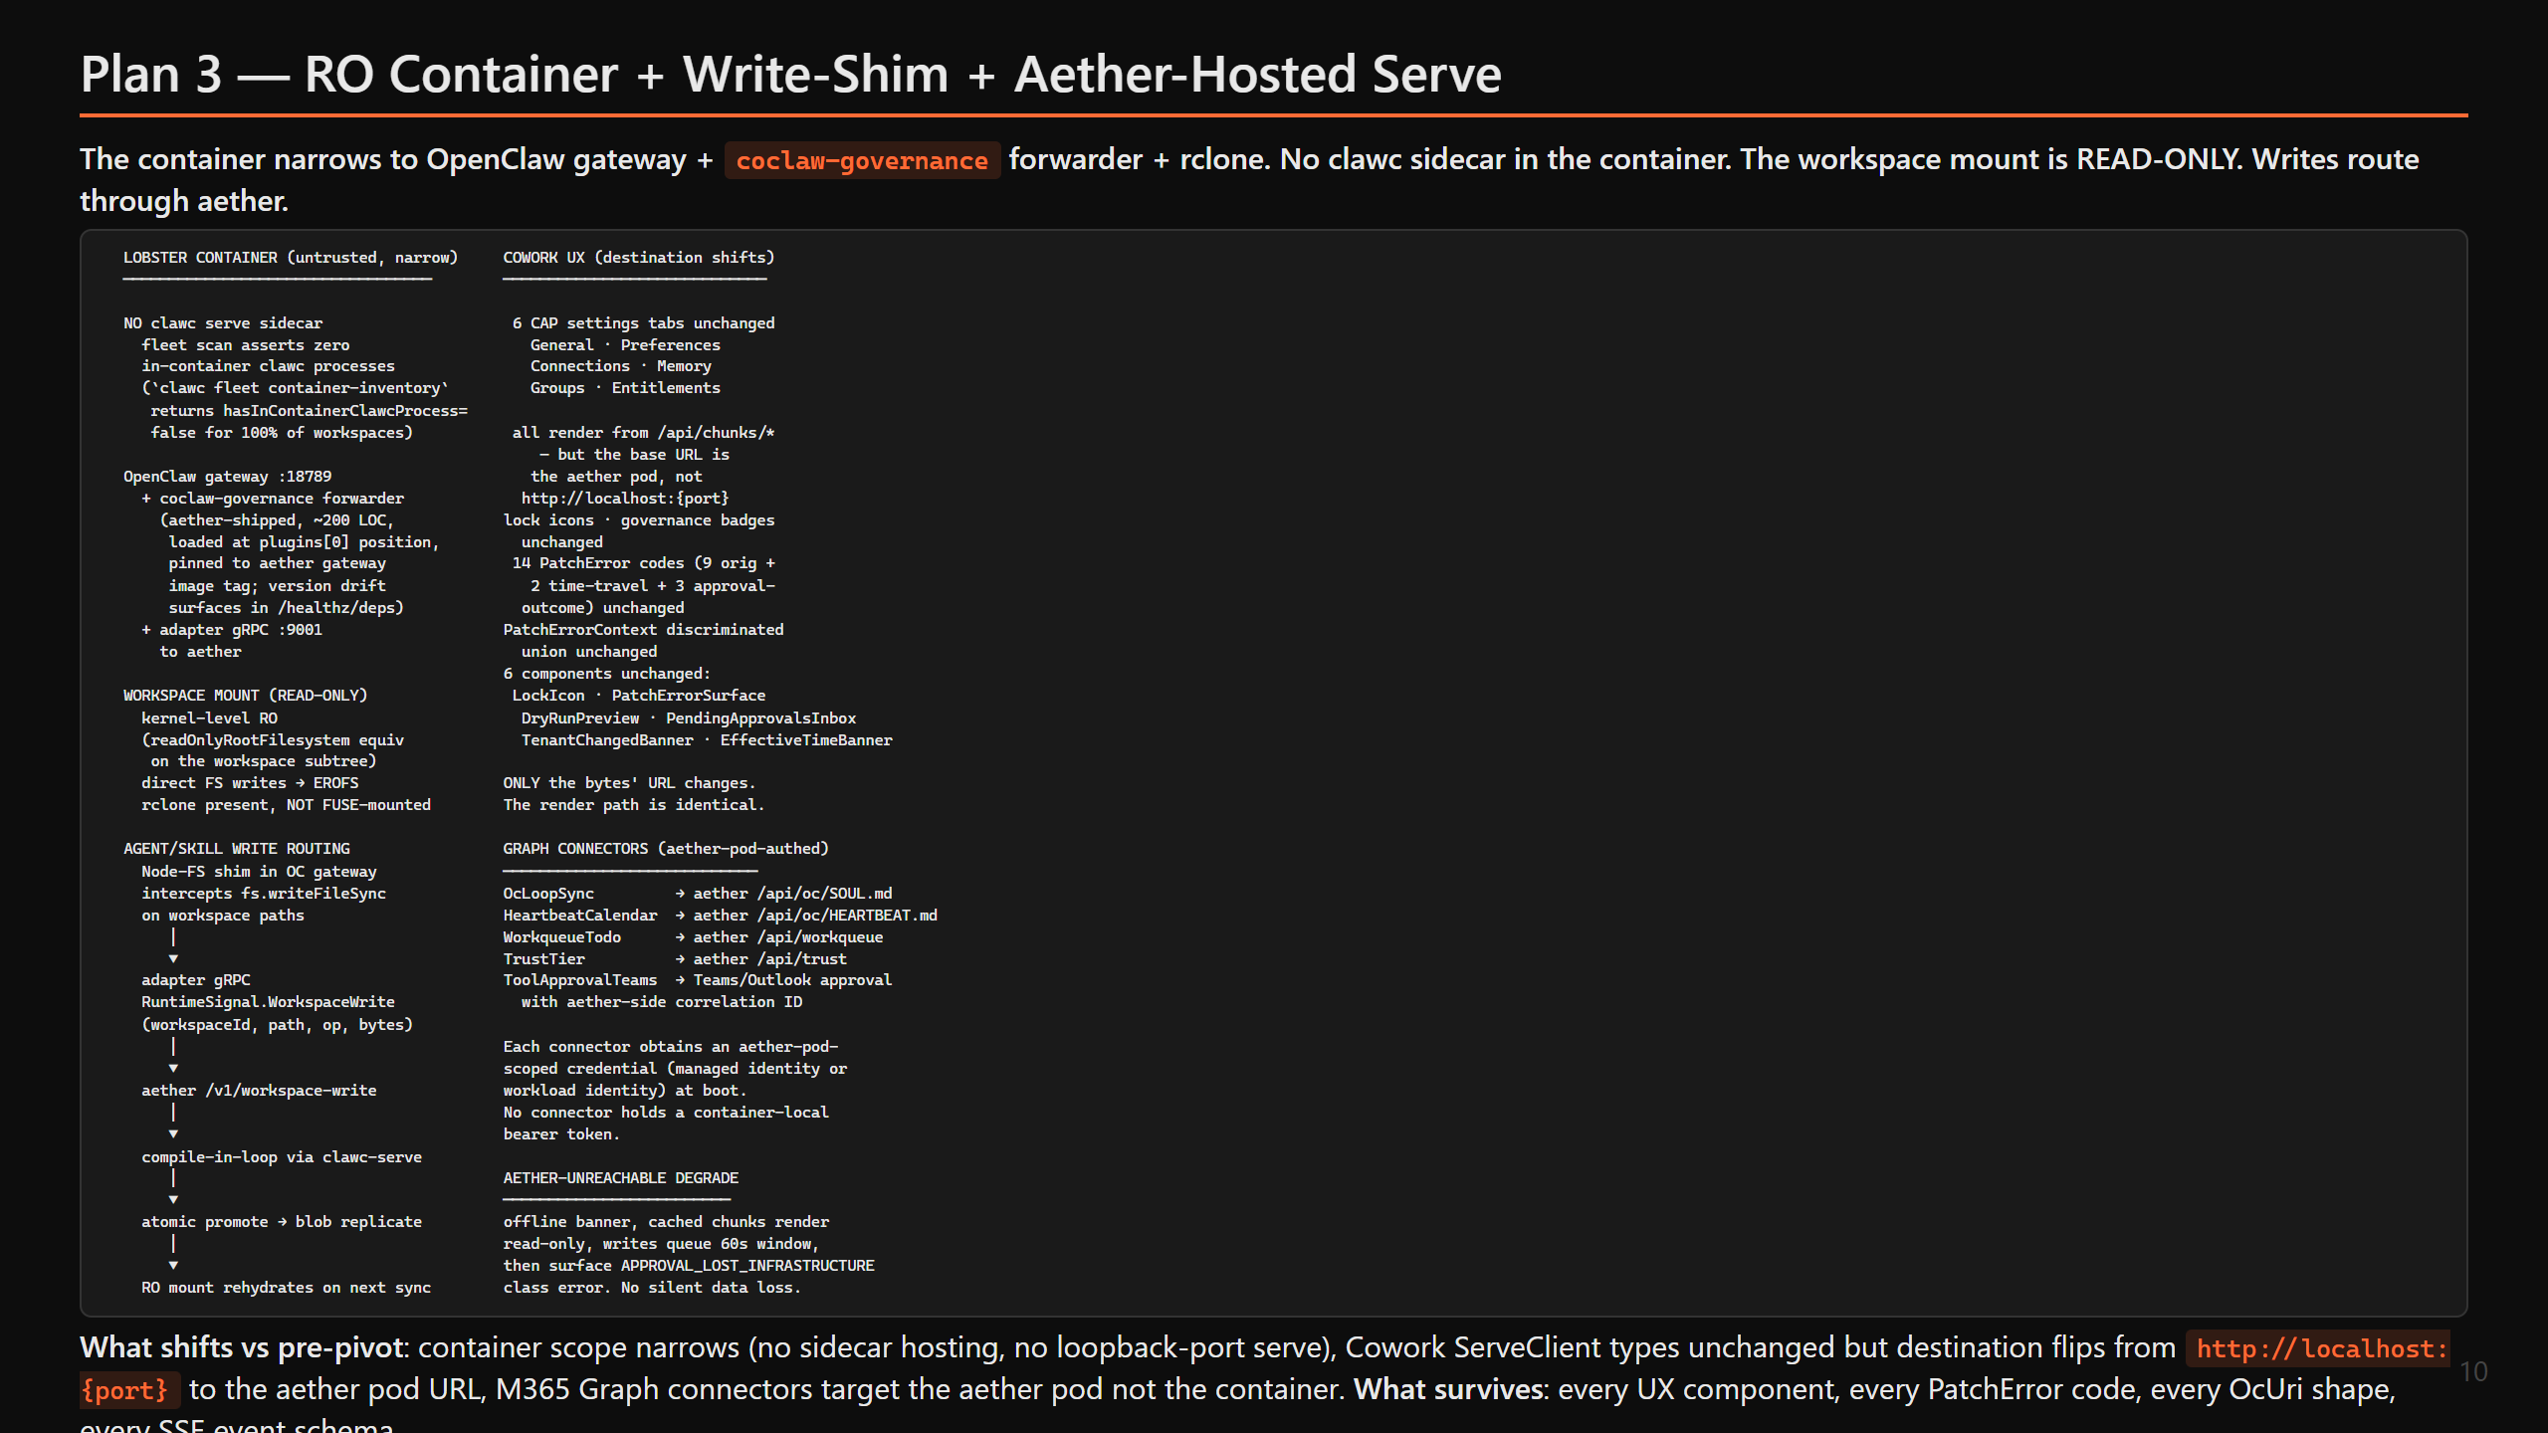

Slide 11
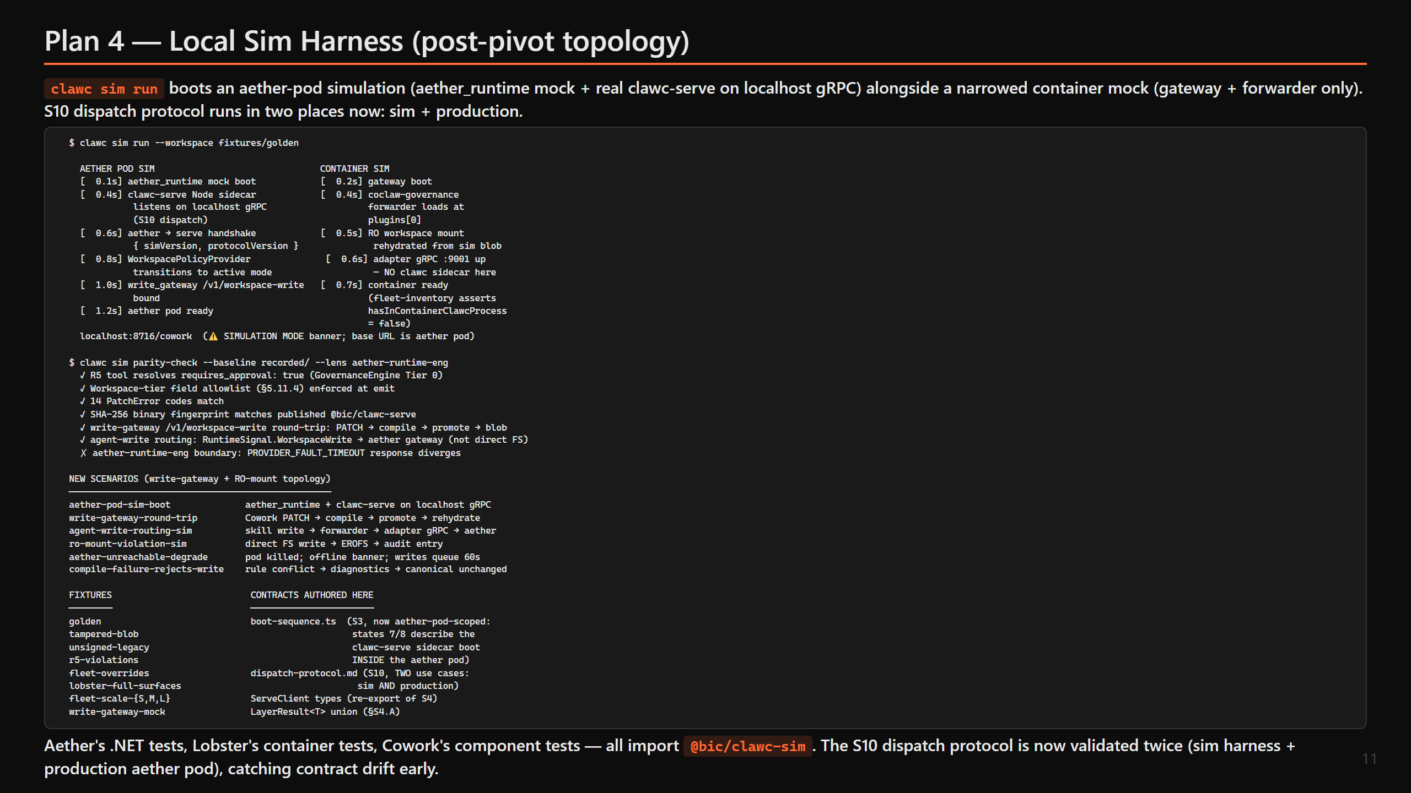

Slide 12
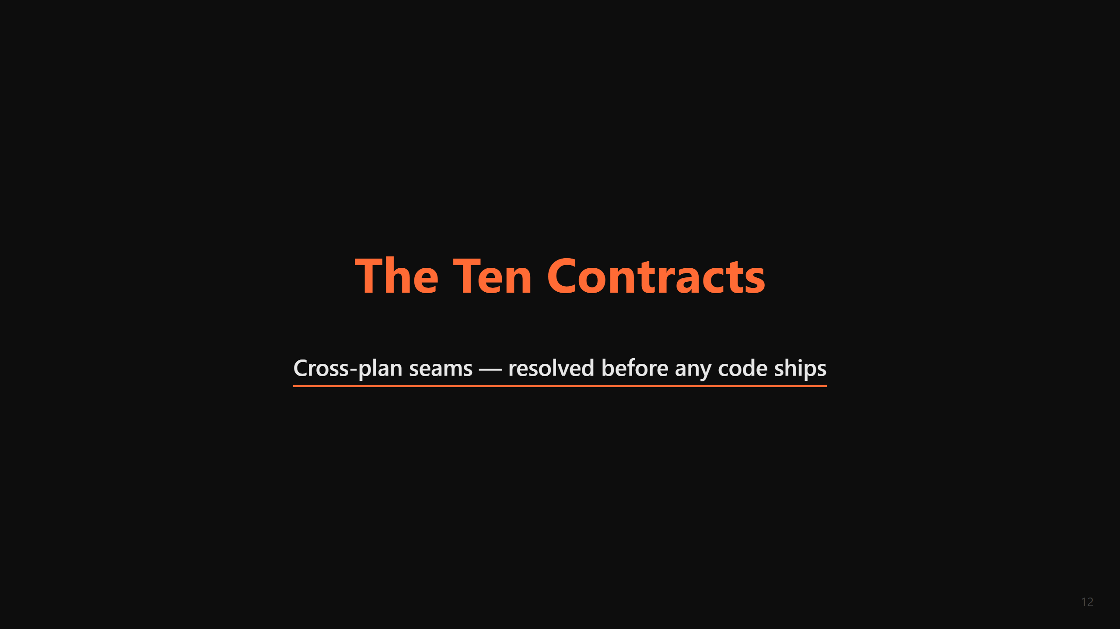

Slide 13
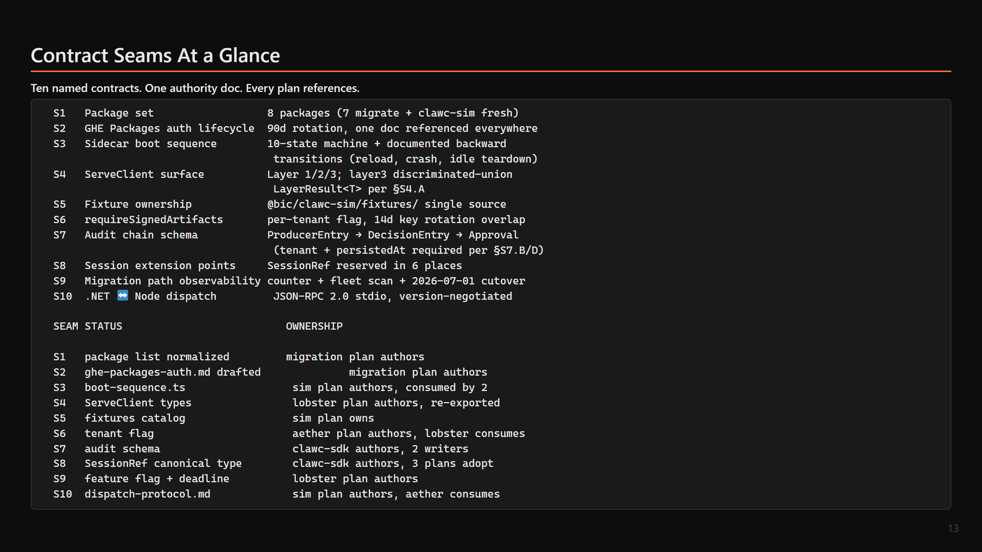

Slide 14
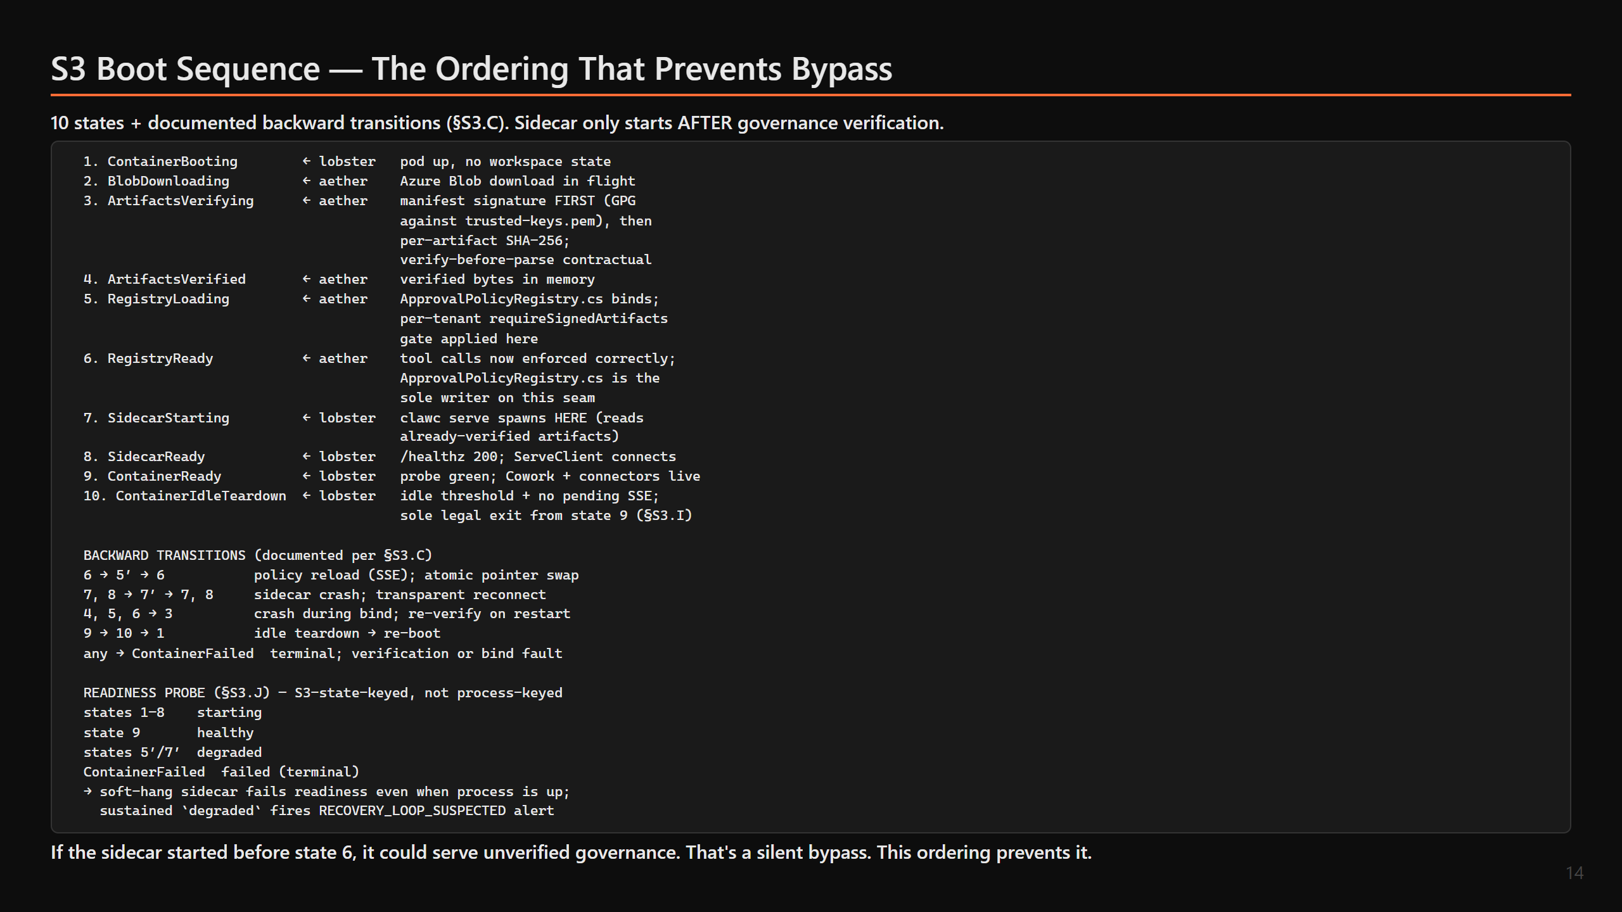

Slide 15
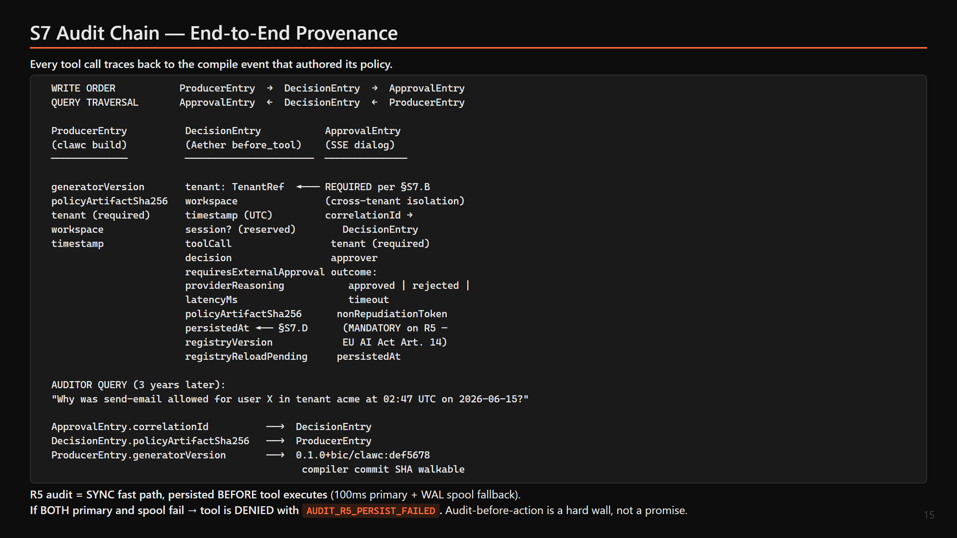

Slide 16
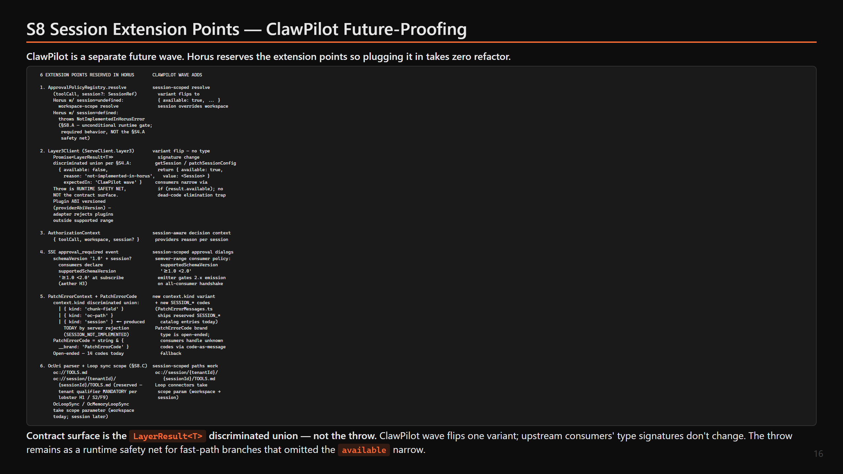

Slide 17
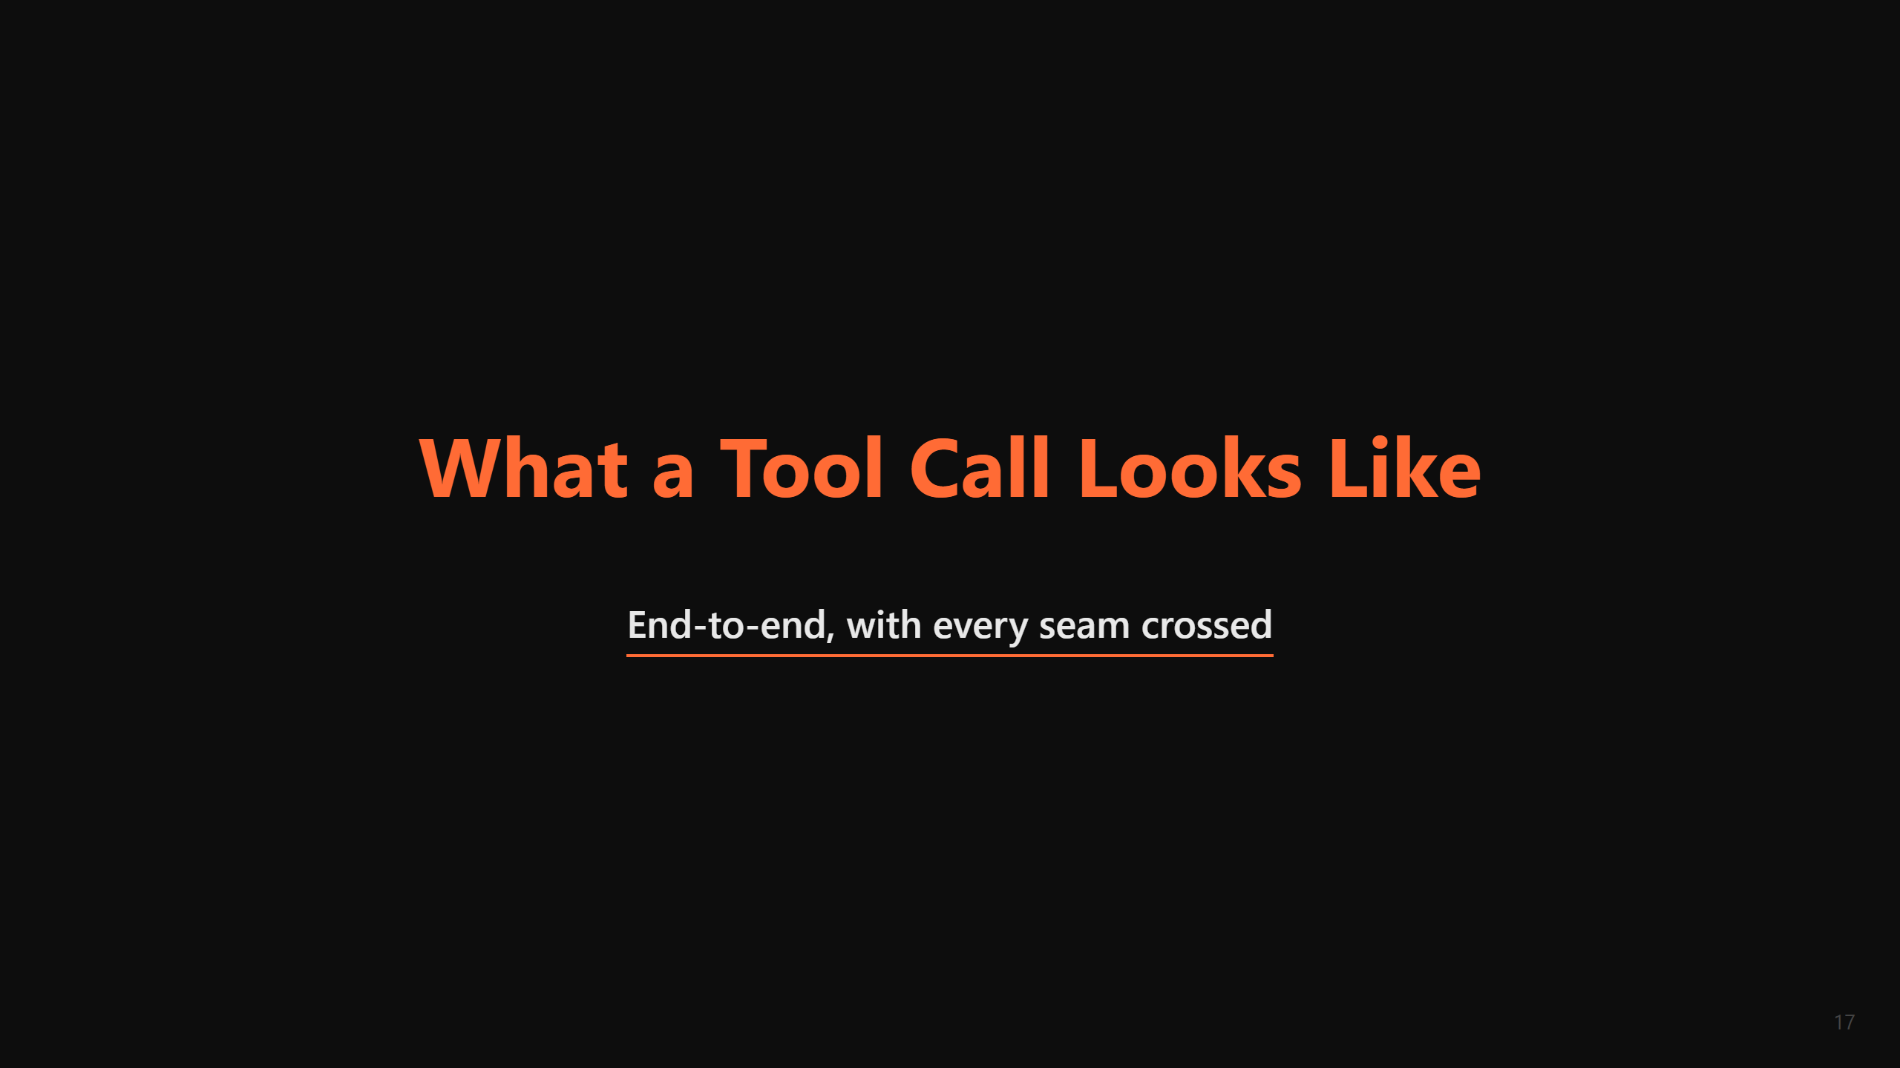

Slide 18
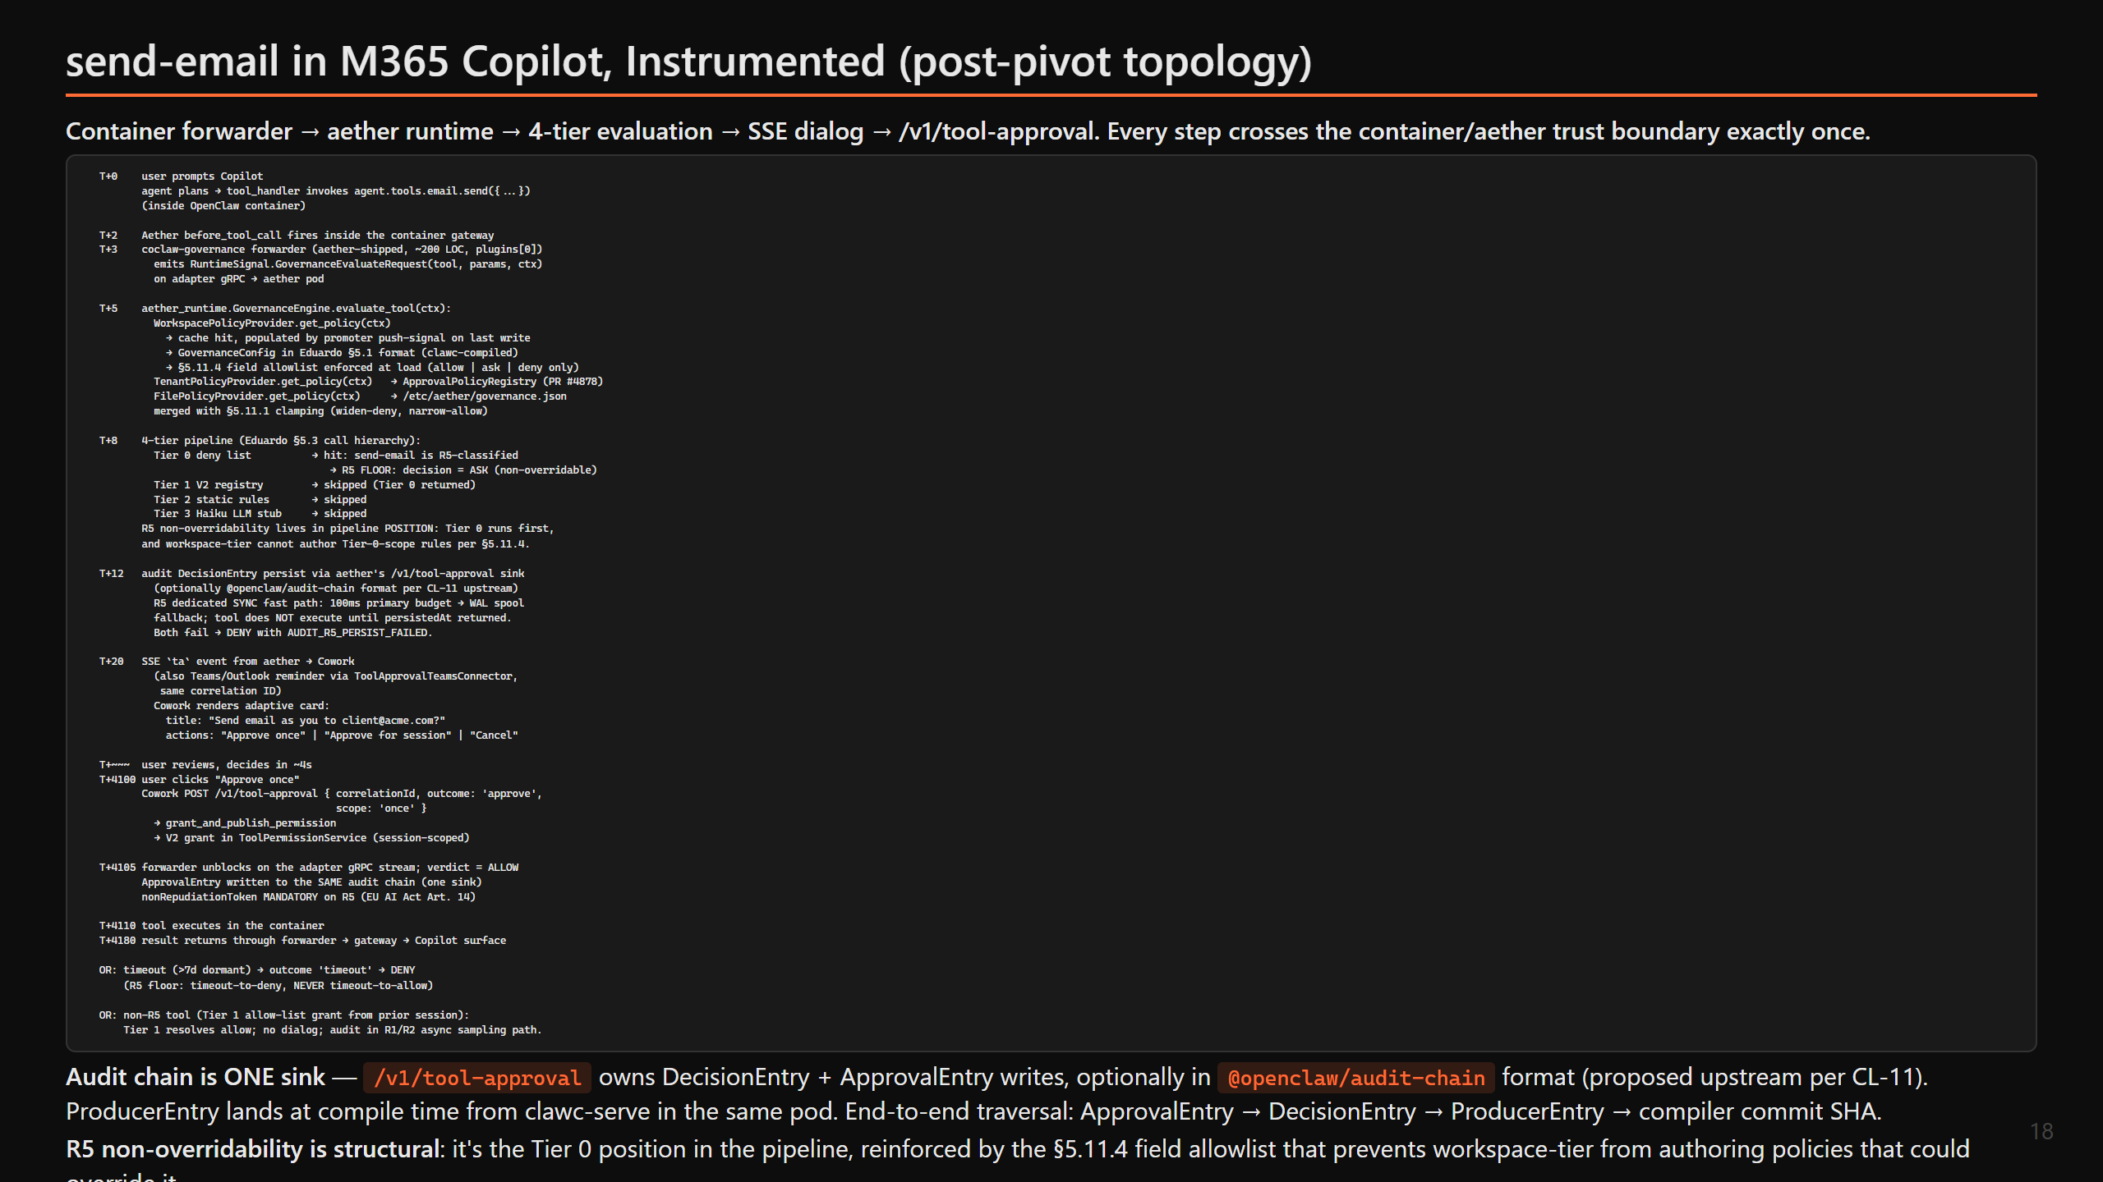

Slide 19
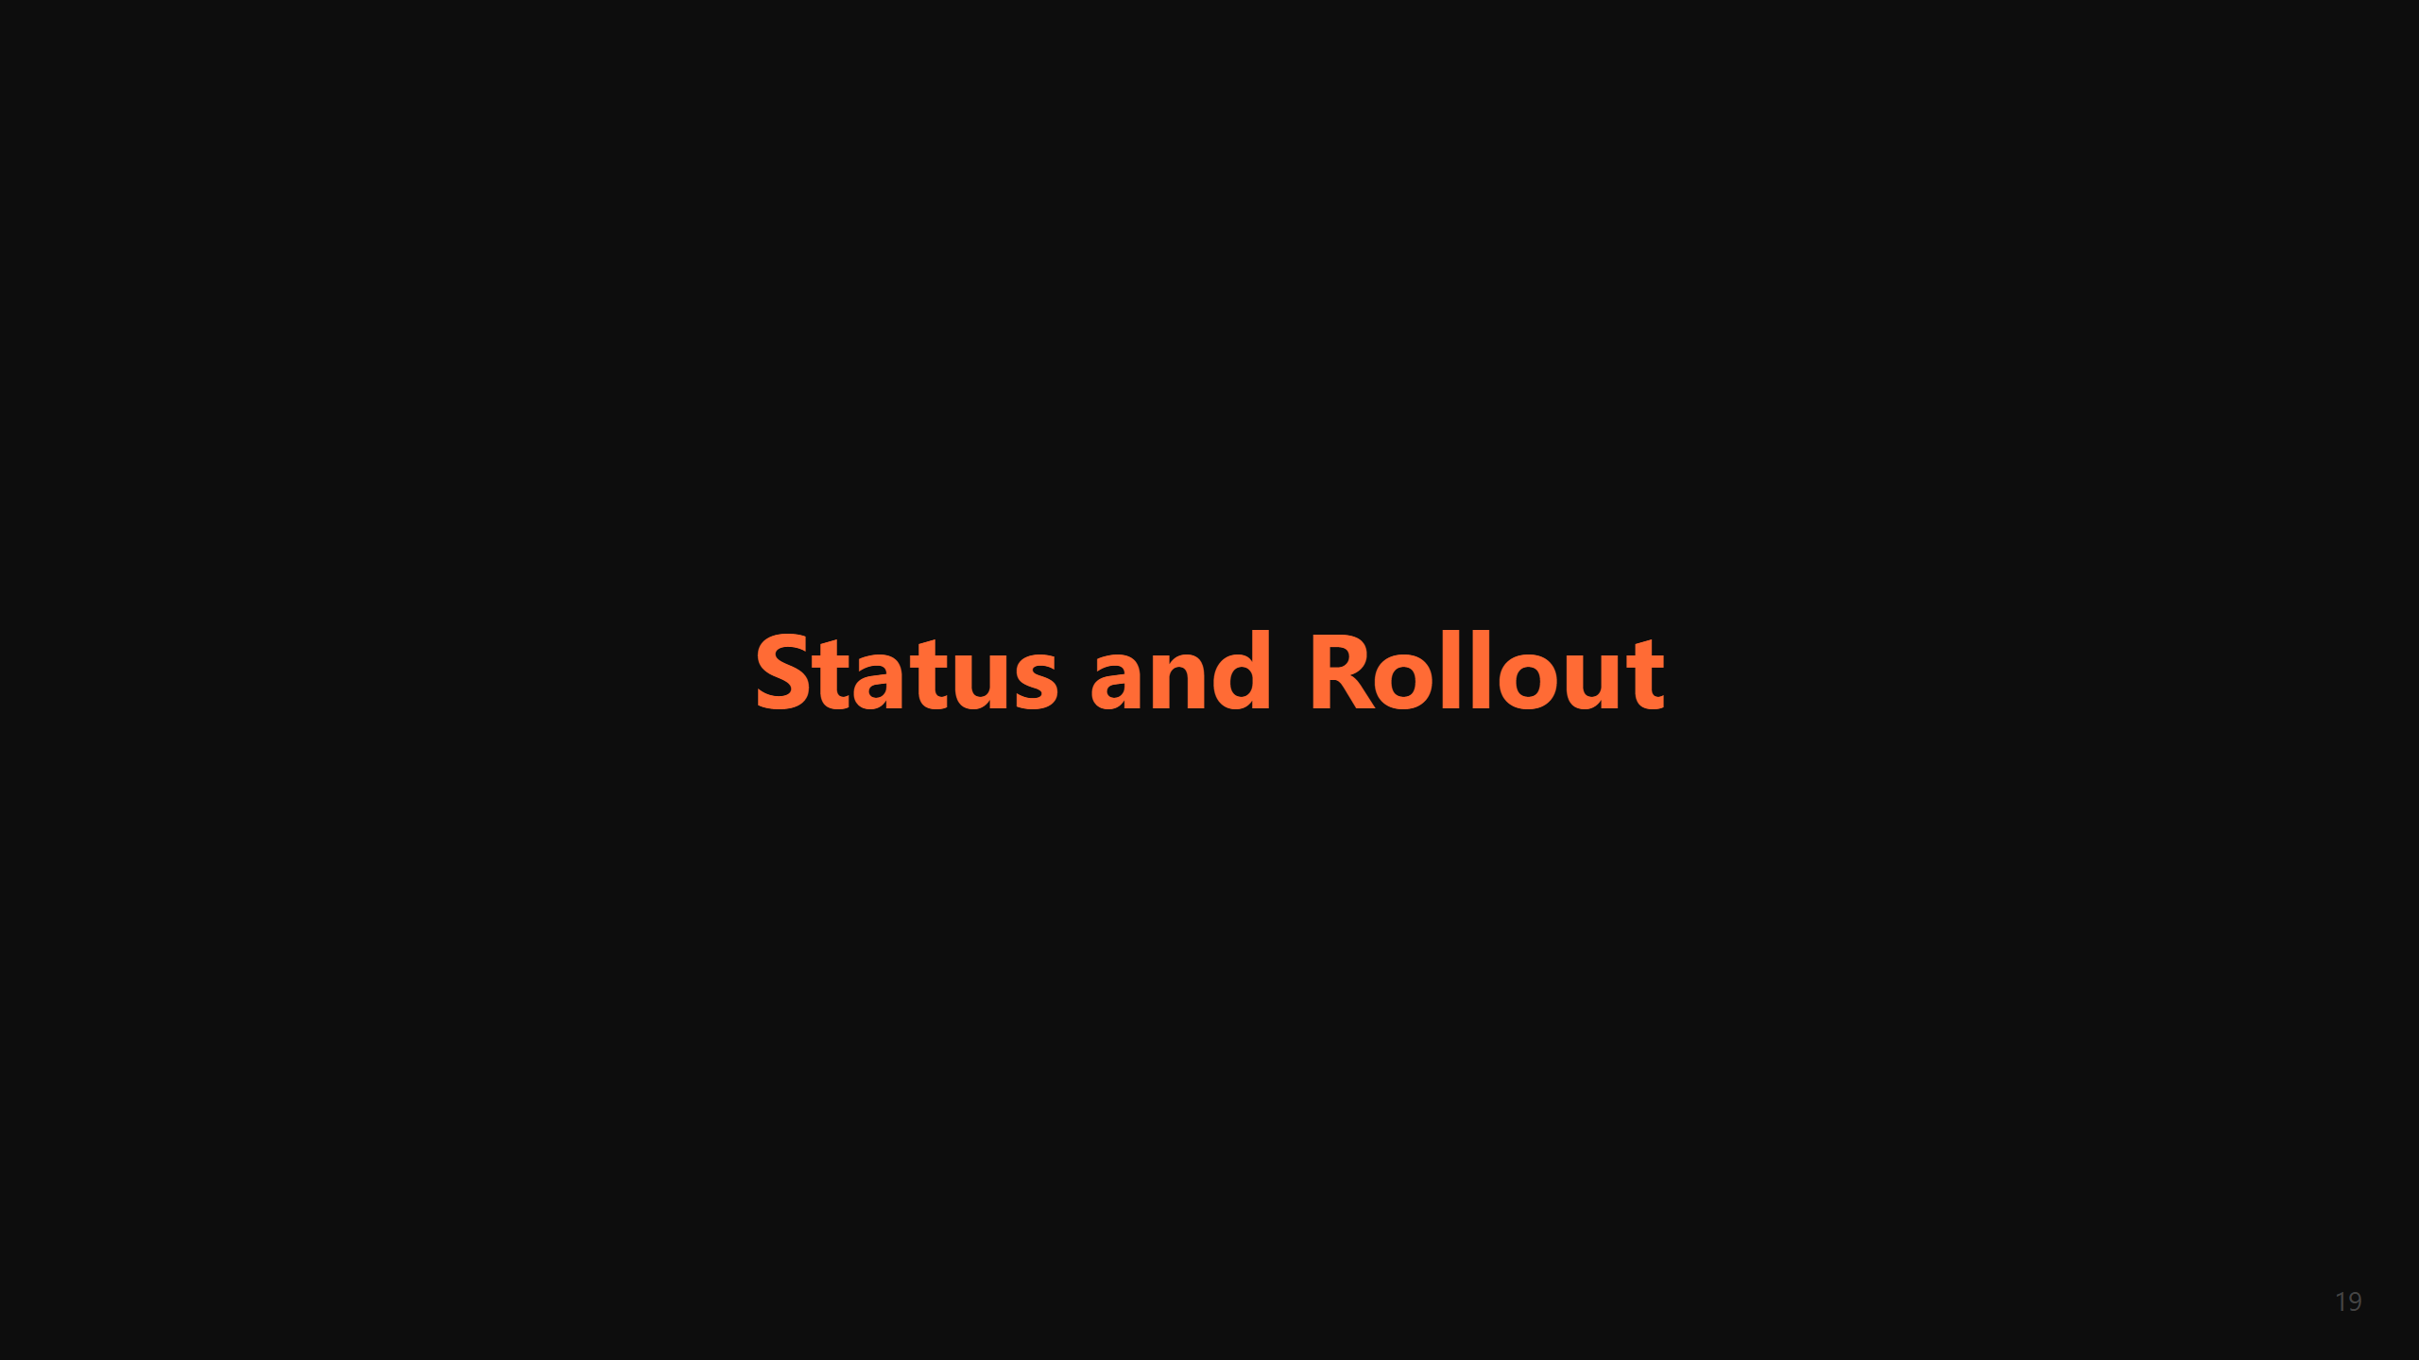

Slide 20
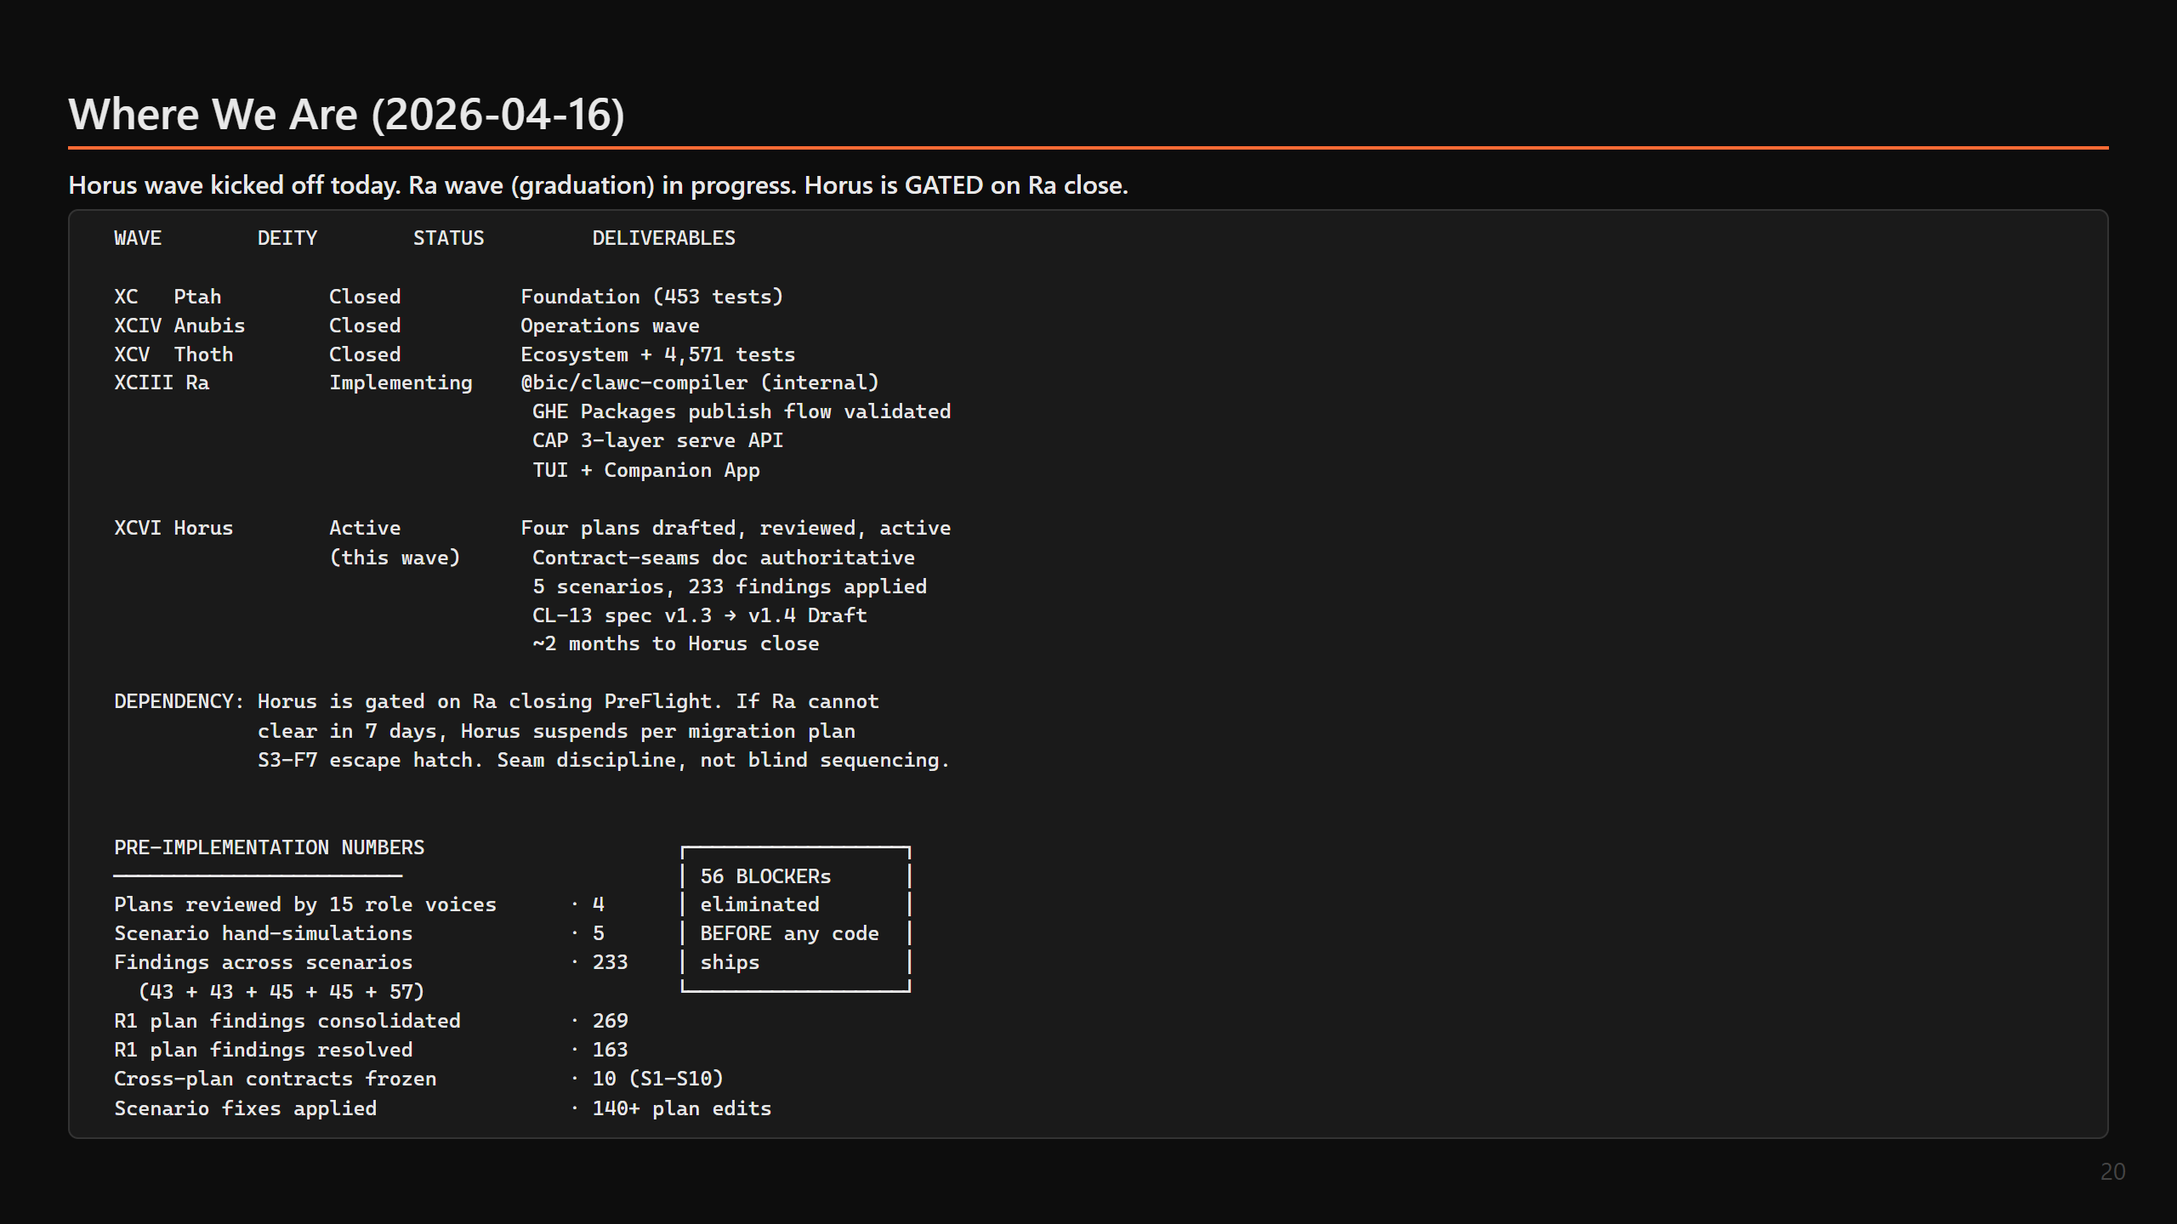

Slide 21
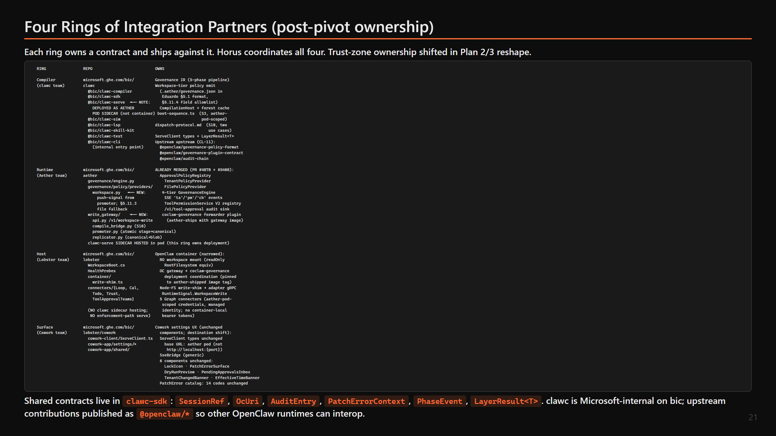

Slide 22
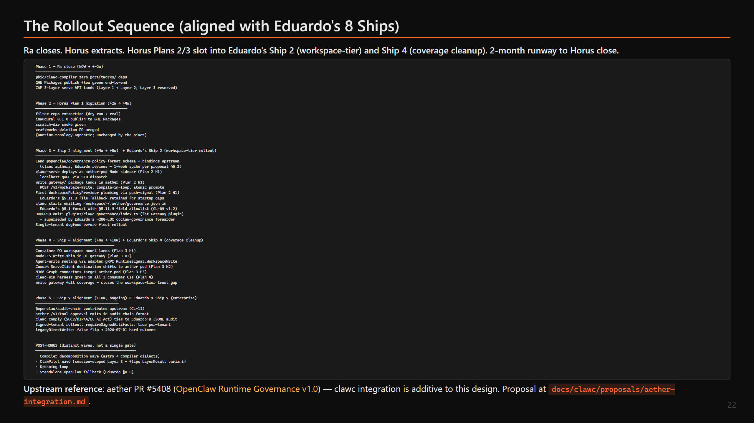

Slide 23
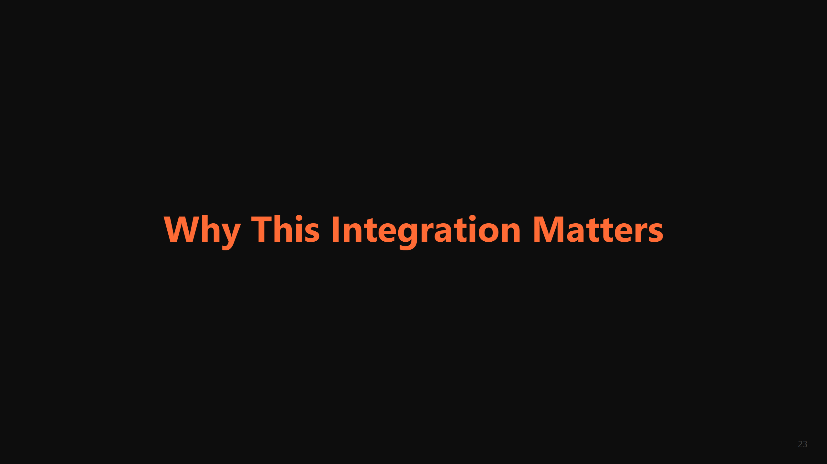

Slide 24
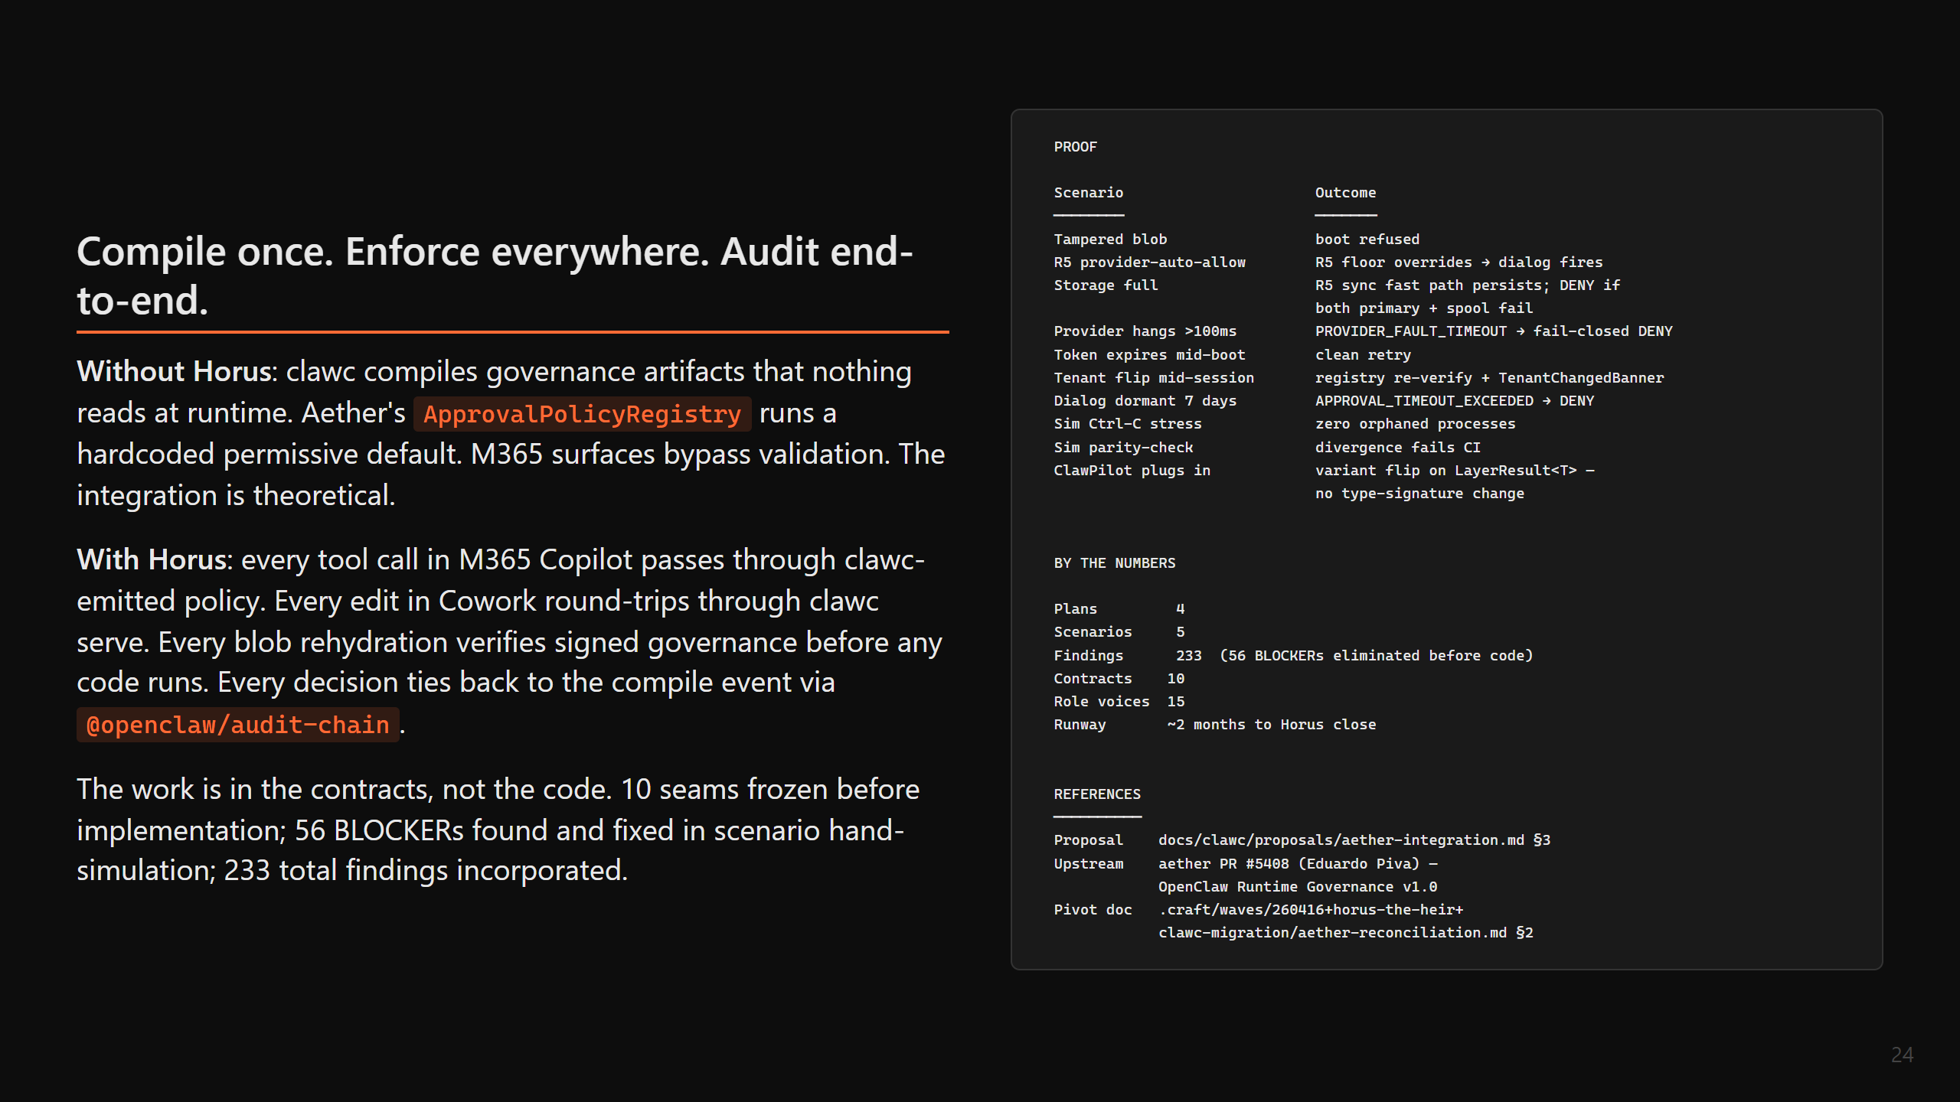

Slide 25
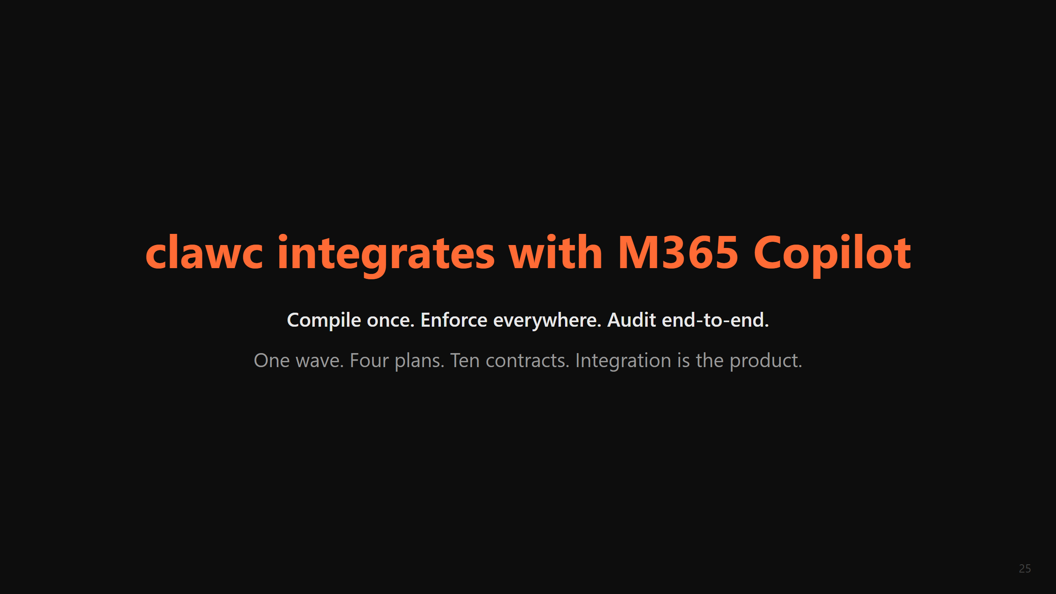

Slide 26

Notes:
## R2 Deferrals
The following R1 items were deliberately deferred to preserve deck accessibility and avoid slide inflation. They are stylistic, framing, or beyond the deck's audience scope:
- founder N2: Move "the work is in the contracts, not the code" framing earlier in the deck (slide 1 or 2). Deferred — the line still lands on slides 13 and 19.
- founder N4: Weave "Compile once. Enforce everywhere. Audit end-to-end." into section titles. Deferred — partial (title + closing reinforce it).
- ciso W4: Elevate R5 non-overridability to its own bullet on slide 4. Deferred — addressed inline on slides 4, 9, 12.
- ciso note about A2A / kill switch / SIEM mapping / OBO: Deferred — beyond integration-deck scope; belongs in a CISO-targeted compliance brief.
- clawpilot-product W5: Open-ended `LockOwnerKind` branded type note. Partially addressed via "lock owner kinds open-ended" line on slide 10.
- aether W5: Diagram-relocation of decision-matrix annotation between Bridge and Registry rows on slide 4. Deferred — matrix is now captioned "(see slide 9)" to indicate it's not bridge-enforced.
- lobster W3: Caption sim timeline as "illustrative on fixtures/golden". Deferred — sim slide already includes that fixture column and the parity-check output below clarifies the sampling nature.
- lobster W7 / N2: Sim divergence-report `--lens` footnote and `clawc fleet api-mode` measurement tool. Deferred — partial (fleet api-mode added on slide 10).
- founder W1: "M365-first" title critique. Addressed via retitling to "clawc integrates with M365 Copilot" (subject-verb-object).
- founder W3: "release" ambiguity. Addressed via "~2 months to Horus close".
- founder N3 / clawpilot-product N3: Typographic elevation (callout boxes, visual hierarchy). Deferred — textual callout box added on slide 15; full visual redesign is out of scope for R2.
All Major and share-blocking Warning items are applied in-deck.

