Slide 1
Using Natural Language Processing to to Communicate Ideas More Clearly in Writing
By: Giovanni Flores
Department of Computer Science

Slide 2
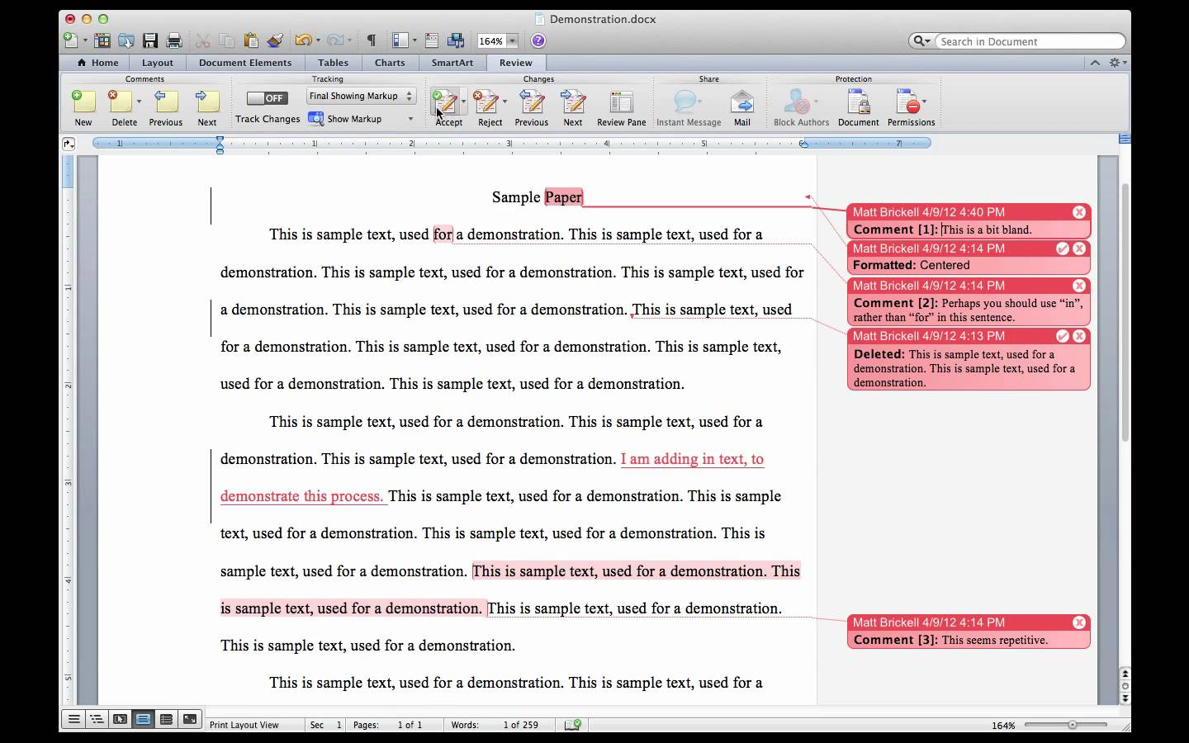
The problem
Rough drafts often include repetitive sentences.
Too much time spent editing,
not as much time spent writing
How can we fix this?

Slide 3
Background and Questions
Natural Language Processing (NLP): The study of the interaction between human languages and computers.
What counts as “fluff”? (i.e. unnecessary content)
How can NLP be used to eliminate said content?
How can this be optimized to eliminate as many words as possible?

Slide 4
Methodology
Week 1
Collect documents to use as sample corpora
Normalize the data
Week 2
Perform sentiment analysis (i.e. identifying opinions/attitude) on each sentence
If two sentences convey the same exact sentiment, eliminate one.

Slide 5
Methodology (cont.)
Week 3
Create a GUI that highlights the parts the algorithm suggests to delete.
Improves User Experience.
Week 4
Optimize algorithm to eliminate as much filler content as possible within one pass
Pass: How many times the algorithm runs
Graph performance
Week 5
Continue working on optimization/graphing.

