Slide 1
Using NLP to Communicate Ideas More Clearly in Writing
By: Giovanni Flores | Computer Science | Dr. Reinhart

Slide 2
Background
Natural Language Processing (NLP)
the study of the interaction between human languages and computers (HCI).
What’s it used for?
Spell check
Autocorrect and Predictive Text on Messaging apps.

Slide 3
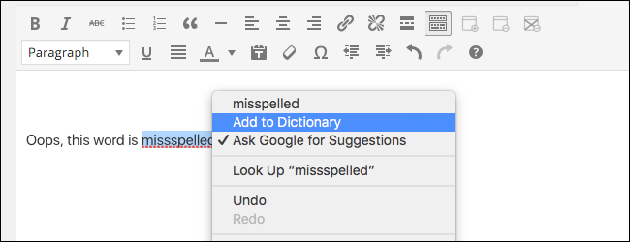
The Problem
Spell check limitations
Only checks for misspellings and contiguous duplicates.
Limited sense of grammar.
Doesn’t track redundant content.
Rough Drafts
More time spent on editing what you’ve already done.
Less time producing content

Slide 4
Questions and Significance
How can the time spent eliminating
redundancy from text be minimized?
How can we automate this task to allow
an algorithm to do this?
How can we optimize it to remove as many words
redundant words as possible?

Slide 5
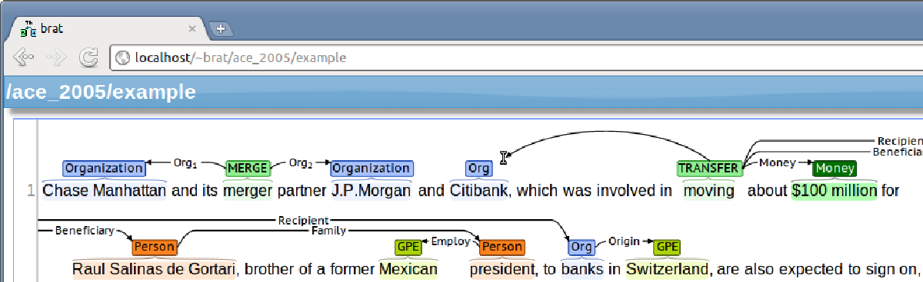
Relevant Work
Wagner, Foster and Genabith (2007) use Part-Of-Speech N-grams to check whether a sentence is grammatical or not
N-gram: sequence of n items in a piece of text.’
Stenetorp et al. (2012) created the BRAT annotation tool that annotates text by using Named Entity Recognition
Named-Entity Recognition (NER): Classification of text (named entities) into different categories

Slide 6
Methodology
Data Collection
Collected sample text from Project Gutenberg (www.Gutenberg.com) as endgoal.
Made smaller samples myself that contained redundancy
Average 3 sentence length.
Technical Tools
NLTK: Collection of python libraries used for natural language processing
Gensim: open-source library that incorporates text algorithms and models.

Slide 7
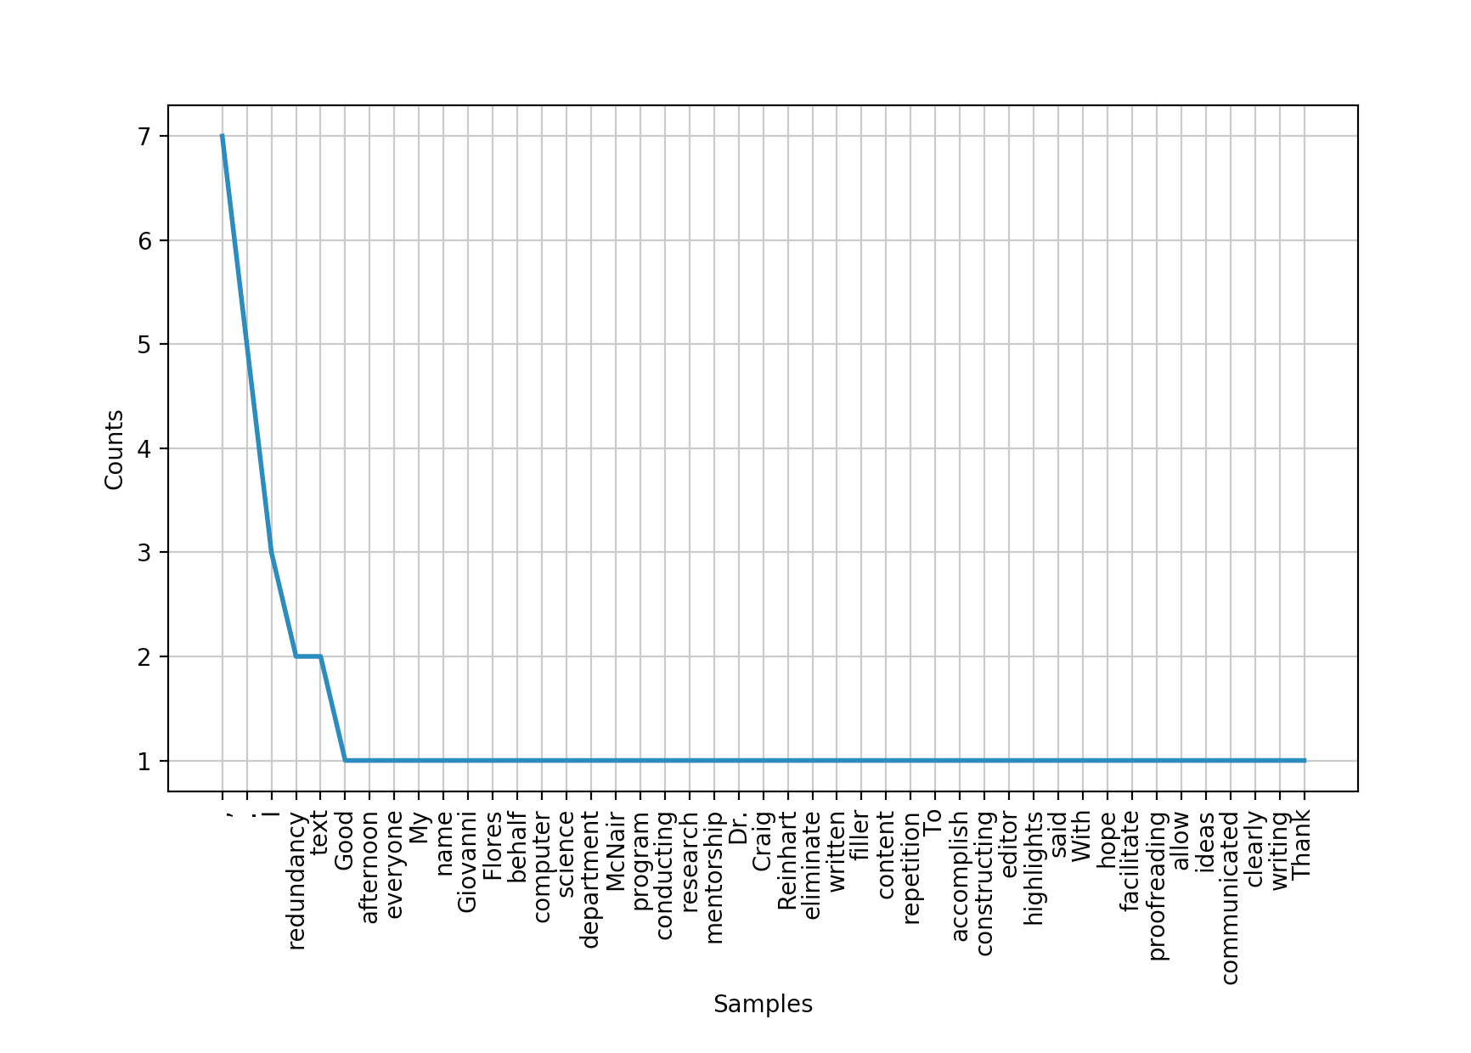
Methodology (cont.)
Fluff Cutter Algorithm
Tokenize the text by word and sentence
Filter all stopwords
Check for sentences that have the same sentiment
Count word occurrences and use frequency distribution to see which words are repeated in 2 sentence radius

Slide 8
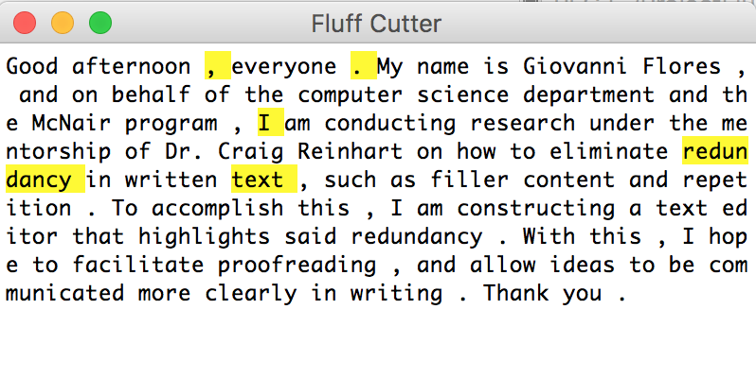
Methodology (cont.)
Constructed Text Editor to show
algorithm at work.
What’s highlighted is what the algorithm suggests to eliminate.

Slide 9
Findings
Faulty Algorithm
Word must occur more than once, and pass cosine similarity test.
Sentence must also have same sentiment.
(i.e. positive, negative, neutral)
Ambiguity of language
Words may not have anything in common.
sentence may still be redundant.
Hard to add eliminate functionality.

Slide 10
Next Steps
Fix algorithm
Build more tests to filter
Incorporate machine learning models.
Optimize algorithm
How many passes before all redundancy highlighted?
How long does it take?
How to store more words from larger samples?

